Slide 1
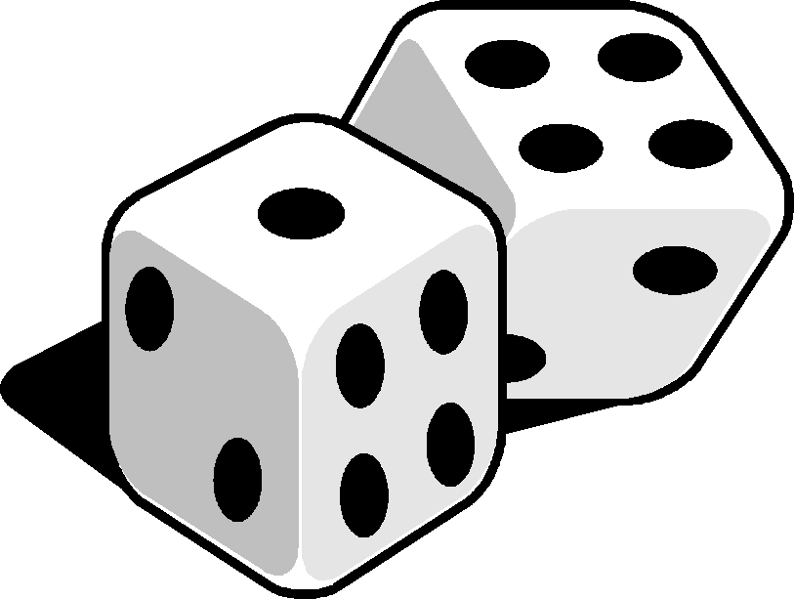
Multivariate Methods of
data analysis
Advanced Scientific Computing Workshop
ETH 2014
Helge Voss
MAX-PLANCK-INSTITUT FÜR KERNPHYSIK IN HEIDELBERG

Slide 2
Overview
Multivariate classification/regression algorithms (MVA)
what they are
how they work
Overview over some classifiers
Multidimensional Likelihood (kNN : k-Nearest Neighbour)
Projective Likelihood (naïve Bayes)
Linear Classifier
Non linear Classifiers
Neural Networks
Boosted Decision Trees
Support Vector Machines
General comments about:
Overtraining
Systematic errors

Slide 3
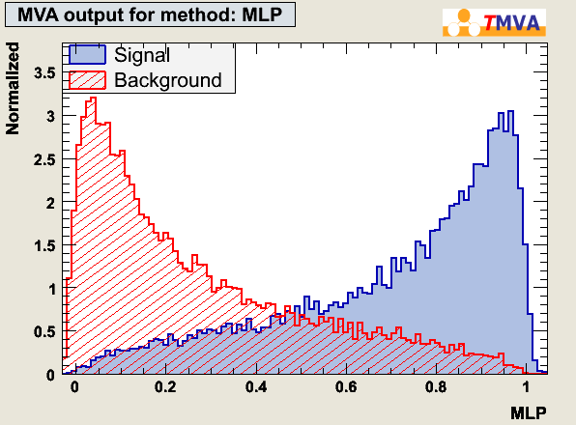
See some Classifiers at Work
kNN/Likelihood → PDF estimators → $y\left(x\right)=\frac{PDF(x|Signal)}{PDF(x|Bkg)}$
(non-)linear model $y\left(x\right)=∑w_{i}h(x)$ : $h(x)$ – basis function of model
Boosted Decision Trees: belong here: although the model $h(x)$ for $y\left(x\right)$ is a bit hard to identify…
So do SVM (linear model in transformed variable space → it’s just expressed not directly as “sum over basis functions)
→$y(x)$ for each event:
pose cut on $P(S|x)$
weigh event with $P\left(S | x\right)$
1.5
0.45
y(x)

Slide 4
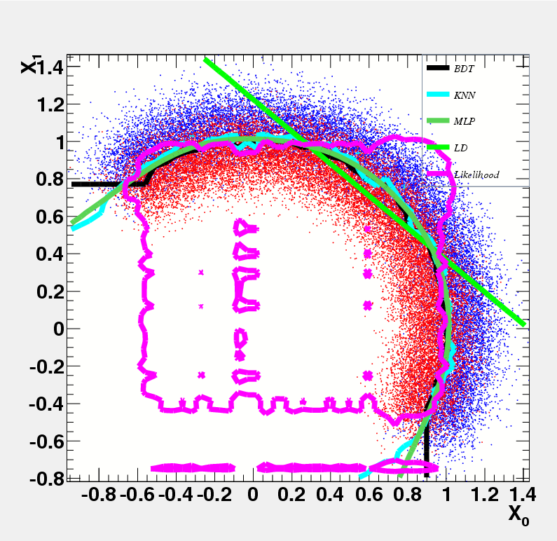
Decision Boundaries
BDT
kNN
MLP
LD
Likelihood

Slide 5
General Advice for (MVA) Analyses
There is no magic in MVA-Methods:
no need to be too afraid of “black boxes” → they are not sooo hard to understand
you typically still need to make careful tuning and do some “hard work”
no “artificial intelligence” … just “fitting decision boundaries” in a given model
The most important thing at the start is finding good observables
good separation power between S and B
little correlations amongst each other
no correlation with the parameters you try to measure in your signal sample!
Think also about possible combination of variables
this may allow you to eliminate correlations
rem.: you are MUCH more intelligent than what the algorithm
Apply pure preselection cuts and let the MVA only do the difficult part.
“Sharp features should be avoided” → numerical problems, loss of information when binning is applied
simple variable transformations (i.e. log(variable) ) can often smooth out these areas and allow signal and background differences to appear in a clearer way
Treat regions in the detector that have different features “independent”
can introduce correlations where otherwise the variables would be uncorrelated!

Slide 6
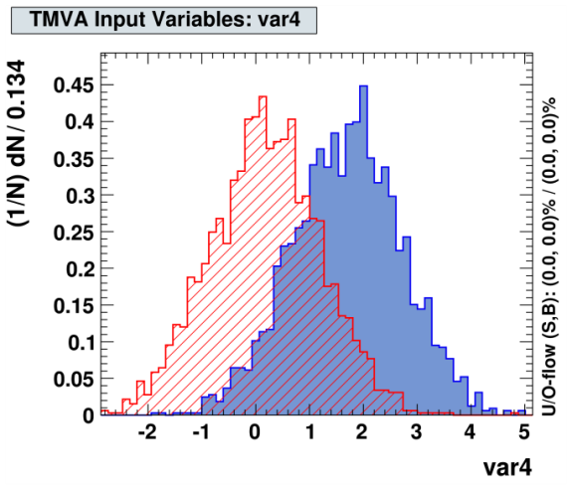
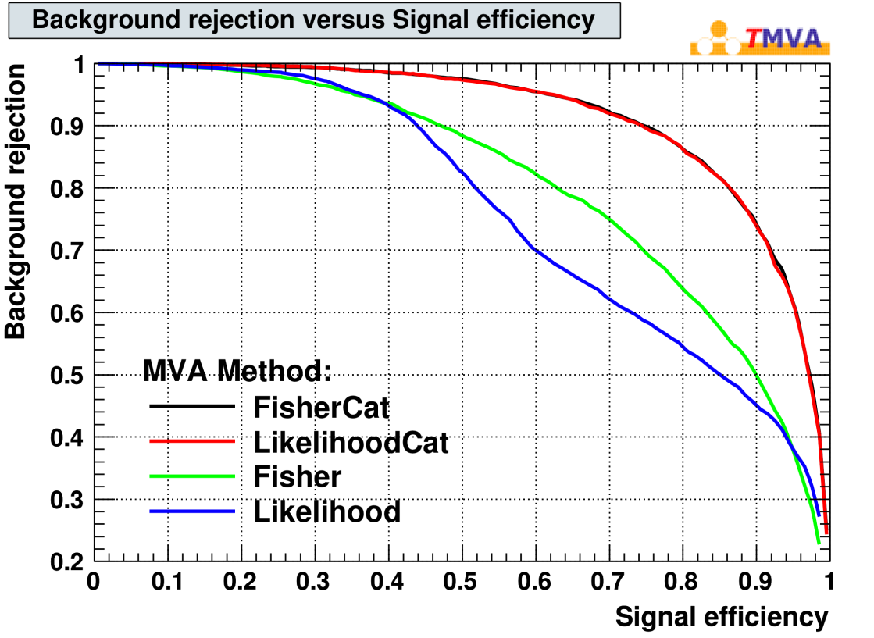
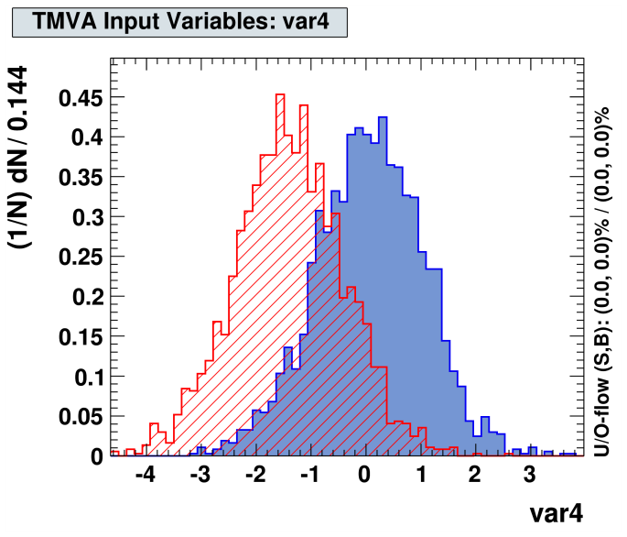
T MVA Categories
TMVA Categories: one classifier per ‘region’
‘regions’ in the detector (data) with different features treated independent
improves performance
avoids additional correlations where otherwise the variables would be uncorrelated!
Recover optimal performance after splitting into categories
|eta| > 1.3
Example: var4 depends on some variable “eta”
|eta| < 1.3

Slide 7
Overtraining
how to choose ‘meta’ parameters “α” that determine the classifier ‘flexibility’ e.g. Number of Nodes in Neural network, number of training cycles, “size of neighbourhood (k)” in nearest Neighbour algorithms etc…
it seems intuitive that this boundary will give better results in another statistically independent data set than that one
possible overtraining is concern for every “tunable parameter” α of classifiers: Smoothing parameter, n-nodes…
verify on independent “test” sample
x₂
S
B
Classifier is too flexible
→ overtraining
classificaion error
x₁
x₂
True eff (estimated from test sample)
S
training sample
training cycles
$$α_{optimal}$$
α
B
Bias if ‘efficiency/performance’ is estimated from the training sample
x₁

Slide 8
Cross Validation
classifiers have tuning parameters “α” → choose and control performance
#training cycles, #nodes, #layers, regularisation parameter (neural net)
smoothing parameter h (kernel density estimator)
….
more training data → better training results
division of data set into “training” and “test” and “validation” sample? ☹
Cross Validation: divide the data sample into say 5 sub-sets
Test
Test
Test
Test
Test
Train
Train
Train
Train
Train
Train
Train
Train
Train
Train
Train
Train
Train
Train
Train
Train
Train
Train
Train
Train
Train
Train
Train
train 5 classifiers: y_{i}(x,α) : i=1,..5,
classifier y_{i}(x,α) is trained without the i-th sub sample
calculate the test error:
choose tuning parameter α for which CV(α) is minimum and train the final classifier using all data

Slide 9
Kolmogorov Smirnov Test
Tests if two sample distributions are compatible with coming from the same parent distribution
Statistical test: if they are indeed random samples of the same parent distribution, then the KS-test gives an uniformly distributed value between 0 and 1 !!
Note: that means an average value of 0.5 !!
How does that look like for TMVA, where many people use the KS test to check for “overtraining”

Slide 10
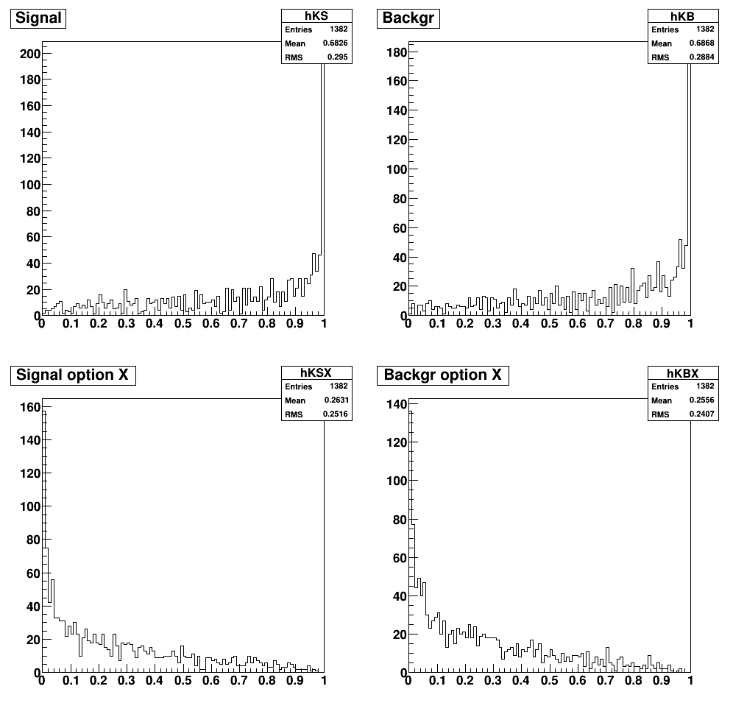
Kolmogorov Smirnov Test
Default (ROOT)
Setting option “X” (default in TMVA since 4.2)
→ Uses random sample generated from the two distributions that need to be compared
Distributions are not really “flat” → effect of using binned histograms (to be checked…)

Slide 11
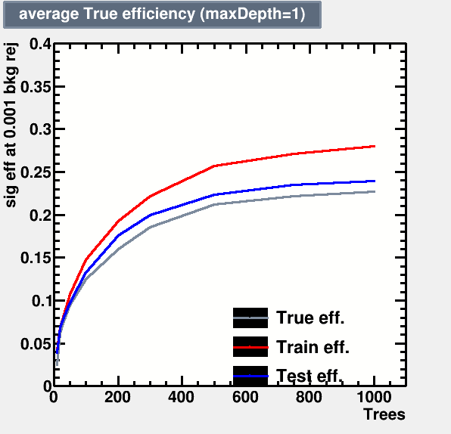
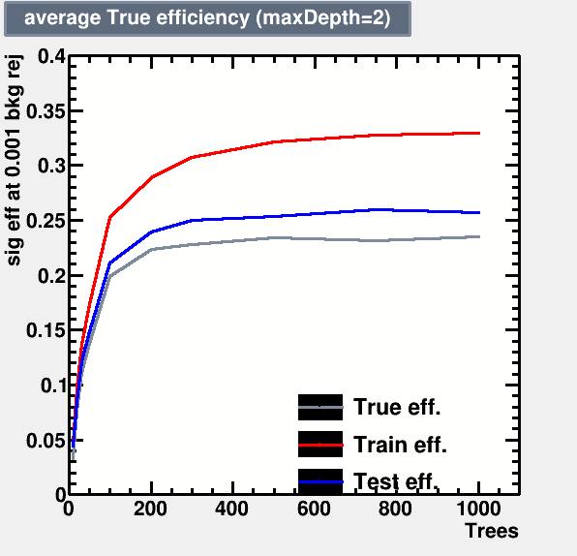
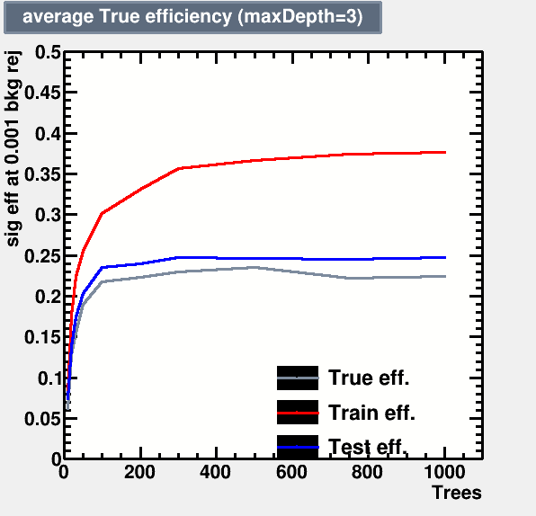
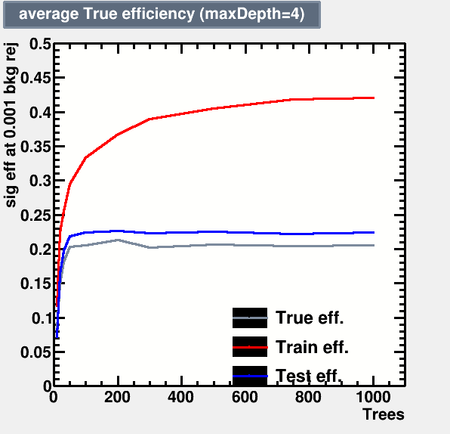
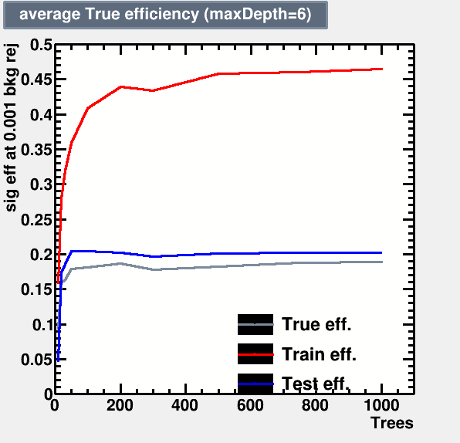
BDT performance vs #trees
For background rejection of 99.9% (bkg. Eff. 0.1%)
Notice: Best performance is at MaxDepth = 2 and Ntrees = 1000
→ That is NOT where the difference between true,test and training efficiency is minimal !!!

Slide 12
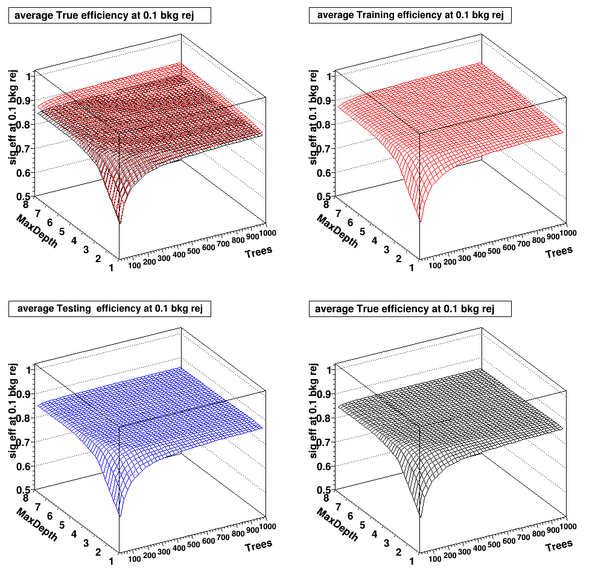
BDT:
Training Efficiency
Testing Efficiency
True Efficiency
for nominal background eff 10%

Slide 13
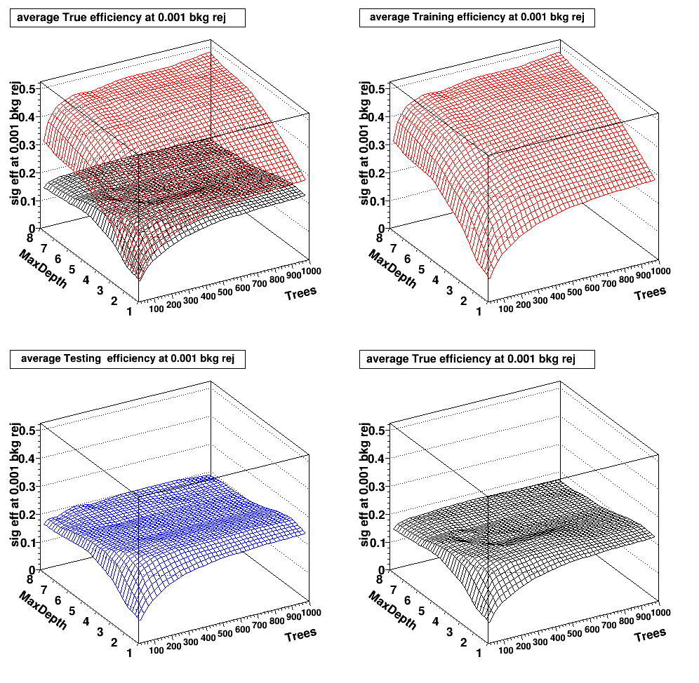
BDT:
Training Efficiency
Testing Efficiency
True Efficiency
for nominal background eff 0.1%

Slide 14
And for Cuts ?
Bias is fairly small, but for 0.1% bkg. Rejection still statistically significant:
Training: effS = 6.5%
Testing : = 4.2%
True: = 4.1
Difference: 2%+- 0.06%

Slide 15
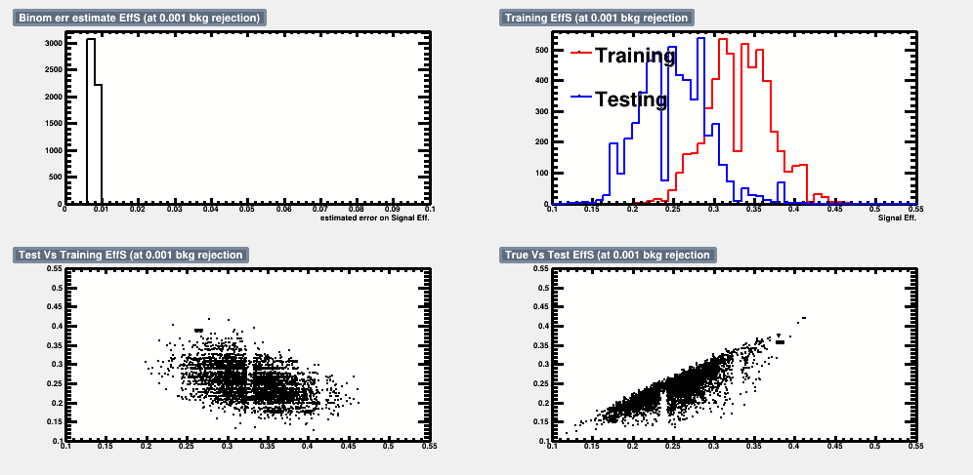
Example distributions
BDT:
MaxDepth = 2
Ntrees = 1000
Background Rejection 99.9%
0.1% bkg events of 6000 bkg total in test and training sample = 6 events only → train and test sample are highly “anti-correlated”
But what is this? True eff. Vs test eff.
Test eff. Is highly biased, too!
Again: “artefact” of the small event count.
True eff.
Test eff.

Slide 16
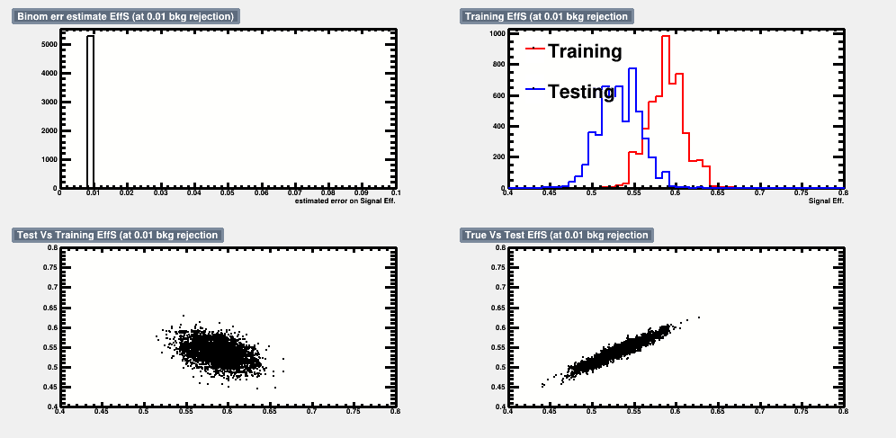
Example distributions
BDT:
MaxDepth = 2
Ntrees = 1000
Background Rejection 99%
The correlation between test and training efficiency is still there (1% bkg events of 6000 bkg total in test and training sample = 60 events !!)
Bias between true and test eff. disappeares with larger event counts, despite train-test correlation still visible
True eff.
Test eff.

Slide 17
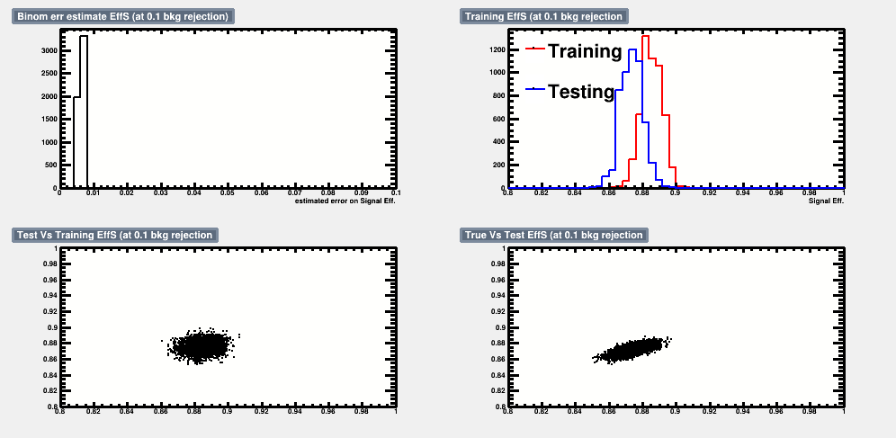
Example distributions
BDT:
MaxDepth = 2
Ntrees = 1000
Background Rejection 90%
The correlation between test efficiency and training efficiency is almost gone, as the samples left and cut away are both big enough
All correlations seem gone, we are only left with an ever smaller bias between between true (test) and training eff.
True eff.
Test eff.

Slide 18
Systematic Errors/Uncertainties

Slide 19
Some Words about Systematic Errors
Typical worries are:
What happens if the estimated “Probability Density” is wrong ?
Can the Classifier, i.e. the discrimination function y(x), introduce systematic uncertainties?
What happens if the training data do not match “reality”
Any wrong PDF leads to imperfect discrimination function
Imperfect (calling it “wrong” isn’t “right”) y(x) → loss of discrimination power
that’s all!
classical cuts face exactly the same problem, however:
in addition to cutting on features that are not correct, now you can also “exploit” correlations that are in fact not correct
Systematic error are only introduced once “Monte Carlo events” with imperfect modeling are used for
efficiency; purity
#expected events
same problem with classical “cut” analysis
use control samples to test MVA-output distribution (y(x))
Combined variable (MVA-output, y(x)) might “hide” problems in ONE individual variable more than if looked at alone → train classifier with few variables only and compare with data

Slide 20
MVA and Systematic Uncertainties
Multivariate Classifiers THEMSELVES don’t have systematic uncertainties → even if trained on a “phantasy Monte Carlo sample”
there are only “bad” and “good” performing classifiers !
OVERTRAINING is NOT a systematic uncertainty !!
difference between two classifiers resulting from two different training runs DO NOT CAUSE SYSTEMATIC ERRORS
same as with “well” and “badly” tuned classical cuts
MVA classifiers: → only select regions in observable space
Efficiency estimate (Monte Carlo) → statistical/systematic uncertainty
involves “estimating” (uncertainties in ) distribution of $PDF_{y_{S(B)}}$
statistical “fluctuations” → re-sampling (Bootstrap)
“smear/shift/change” input distributions and determine $PDF_{y_{S(B)}}$
estimate systematic error/uncertainty on efficiencies
Only involves “test” sample..
systematic uncertainties have nothing to do with the training !!

Slide 21
MVA and Systematic Uncertainties
Don’t be afraid of correlations!
typically “kinematically generated” → easily modeled correctly
“classical cuts” are also affected by “wrongly modeled correlations”
MVA method let’s you spot mis-modeled correlations!
“projections” of input variables
+ the combined MVA test statistic “y(x)” !

Slide 22
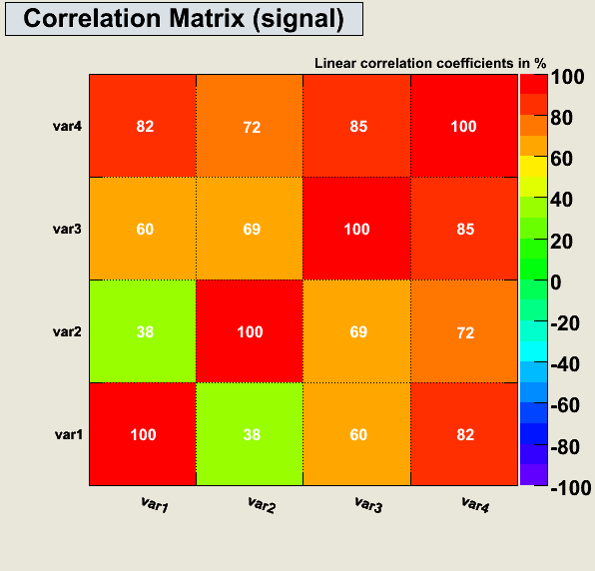
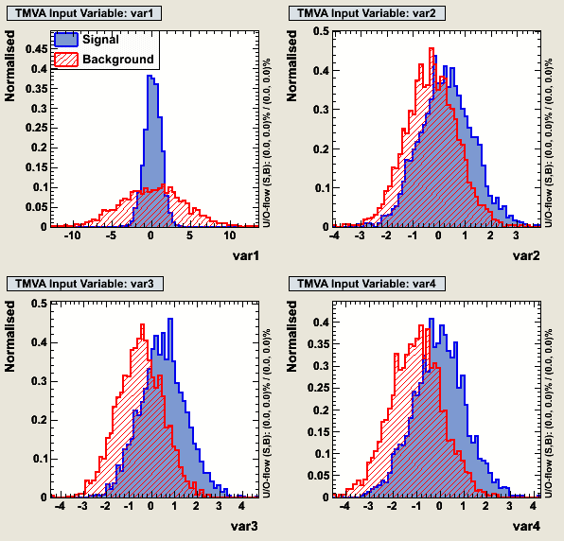
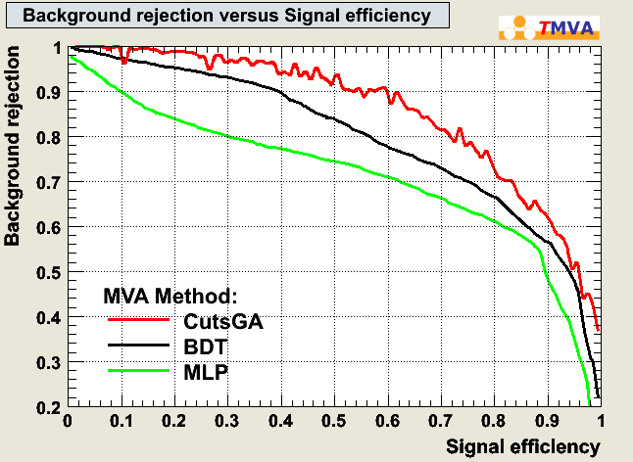
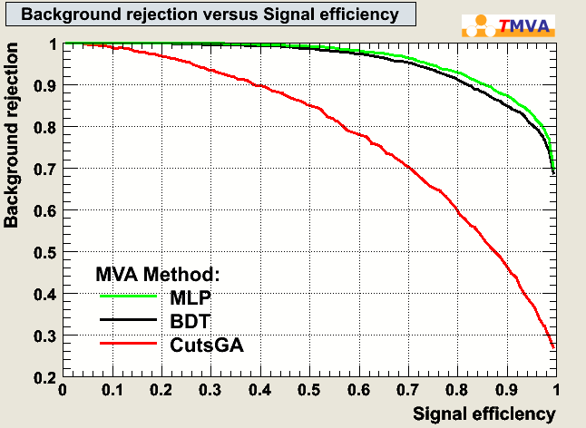
Systematic “Error” in Correlations
Use as training sample events that have correlatetions
optimize CUTs
train an propper MVA (e.g. Likelihood, BDT)
Assume in “real data” there are NO correlations → SEE what happens!!

Slide 23
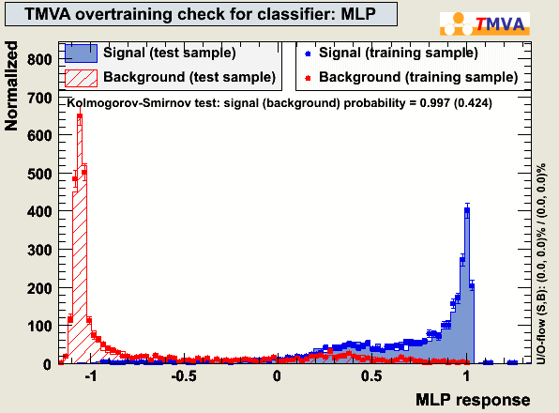
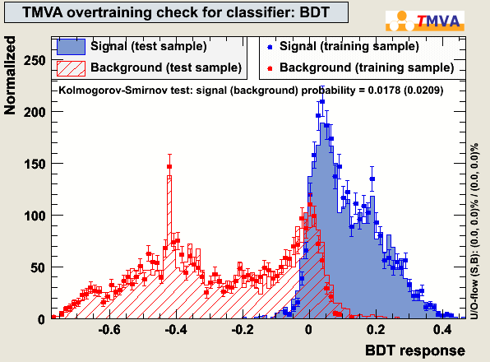
Systematic “Error” in Correlations
Compare “Data” (TestSample) and Monte-Carlo
(both taken from the same underlying distribution)

Slide 24
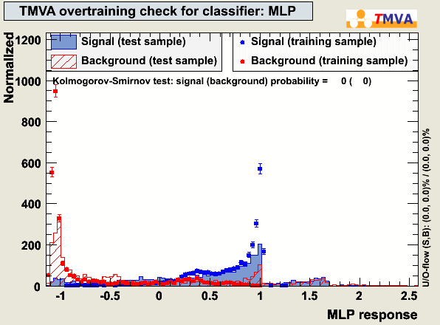
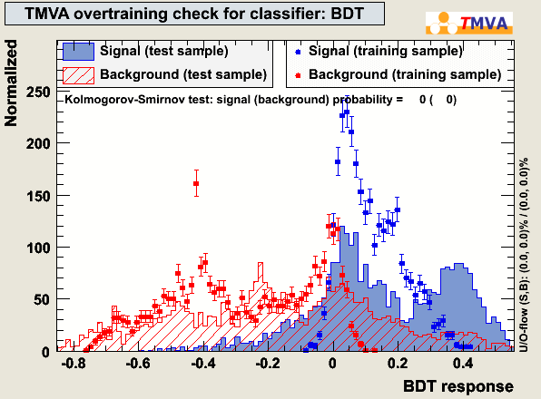
Systematic “Error” in Correlations
Compare “Data” (TestSample) and Monte-Carlo
(both taken from the same underlying distributions that differ by the correlation!!! )
Differences are ONLY visible in the MVA-output plots
(and if you’d look at cut sequences….)

Slide 25
(T )MVA and Systematic Uncertainties
minimize “systematic” uncertainties (robustness)
“classical cuts” : do not cut near steep edges, or in regions of large sys. uncertainty
hard to translate to MVAs:
artificially degrade discriminative power (shifting/smearing) of systematically “uncertain” observables IN THE TRAINING
remove/smooth the ‘edges’ → MVA does not try to exploit them
First attempts to automatize this are on the way
Signal
Background
Note: if I KNEW about the error, I’d correct for it. I’m talking about ‘unknown’ systematics

Slide 26
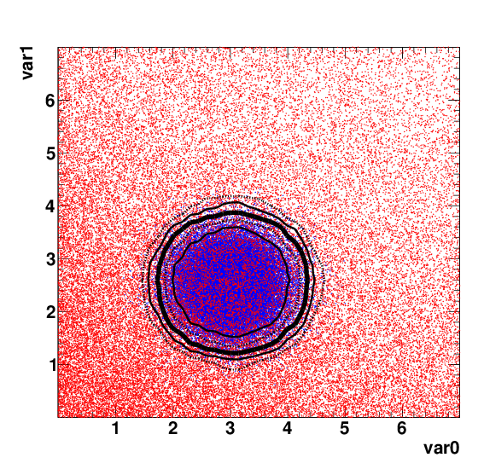
How does this look in 2D?
MVA-decision boundaries
Looser MVA-cut → wider boundaries in BOTH variables
What if you are sure about the peak’s position in var1, but less sure about var0 ?
You actually want a boundary like THIS
Tight boundaries in var1
Loose boundaries in var0

Slide 27
Reduce information content
Looking for a general tool to ‘force’ any MVA algorithm, not to rely too much on exact feature:
Similar: early stopping techniques in Neural networks to avoid overtraining
→ reduce difference between “signal” and “background”
→ or reduce information content in each, “signal” and “background”
Here: one would for example “shift” such that signal and backgr. are less separated
However, that’s not “universal”

Slide 28
Reduce information content
Looking for a general tool to ‘force’ any MVA algorithm, not to rely too much on exact feature:
Similar: early stopping techniques in Neural networks to avoid overtraining
→ reduce difference between “signal” and “background”
→ or reduce information content in each, “signal” and “background”
shift
smear
turn

Slide 29
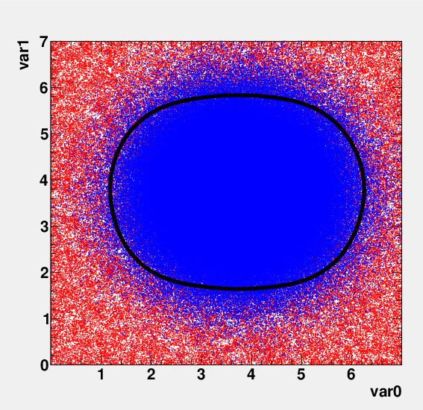
Reminder:
MVA-decision boundaries
Looser MVA-cut → wider boundaries in BOTH variables
You actually want a boundary like THIS
Tight boundaries in var1
Loose boundaries in var0
YES it works !

Slide 30
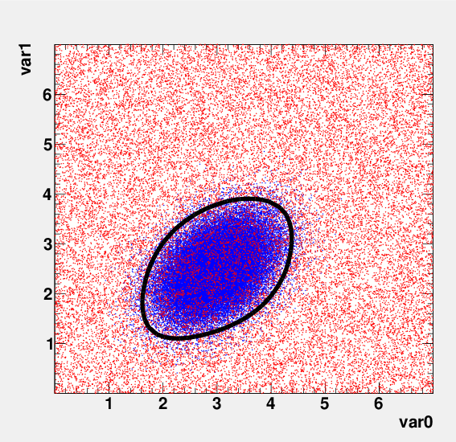
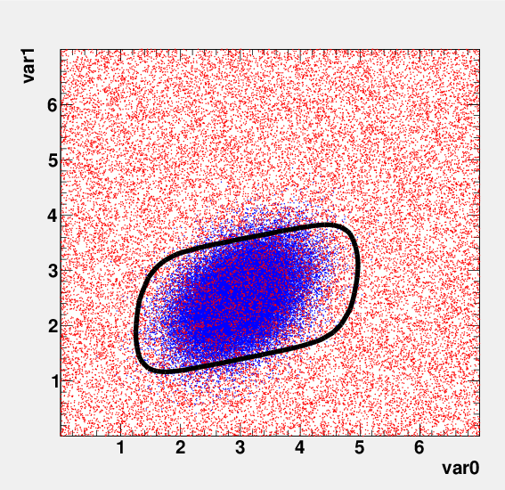
Another example..
Hmm… also here, I’d still say it does exactly what I want it to do
The difficulty is to ‘evaluate’ or ‘estimate’ the advantage (reduction in systematic ←→ loss in performance)

Slide 31
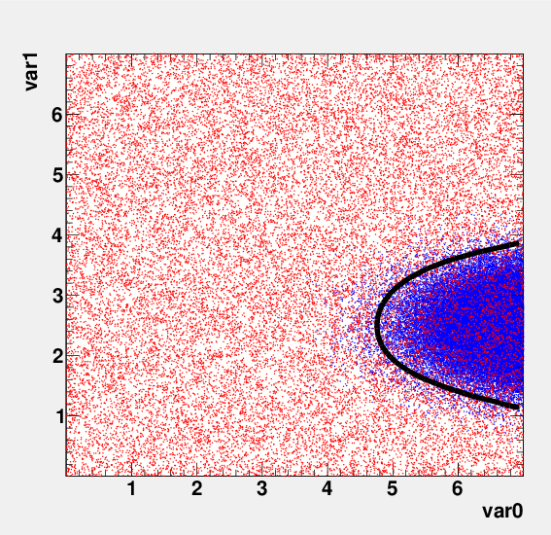
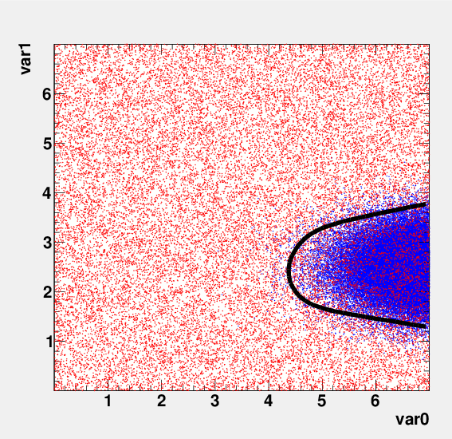
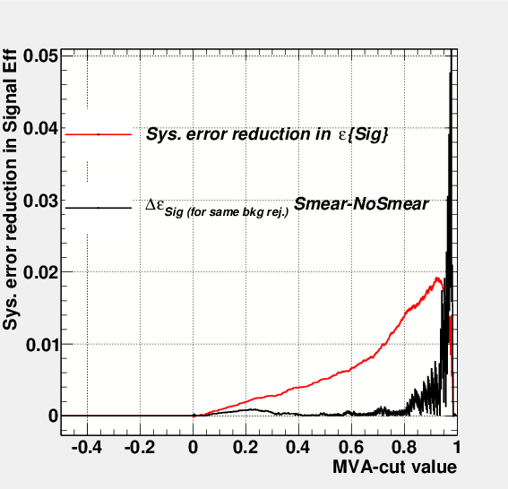
peak on the edge
AGAIN: assume uncertainty in position of peak in var0
bad
better
but by how much??

Slide 32
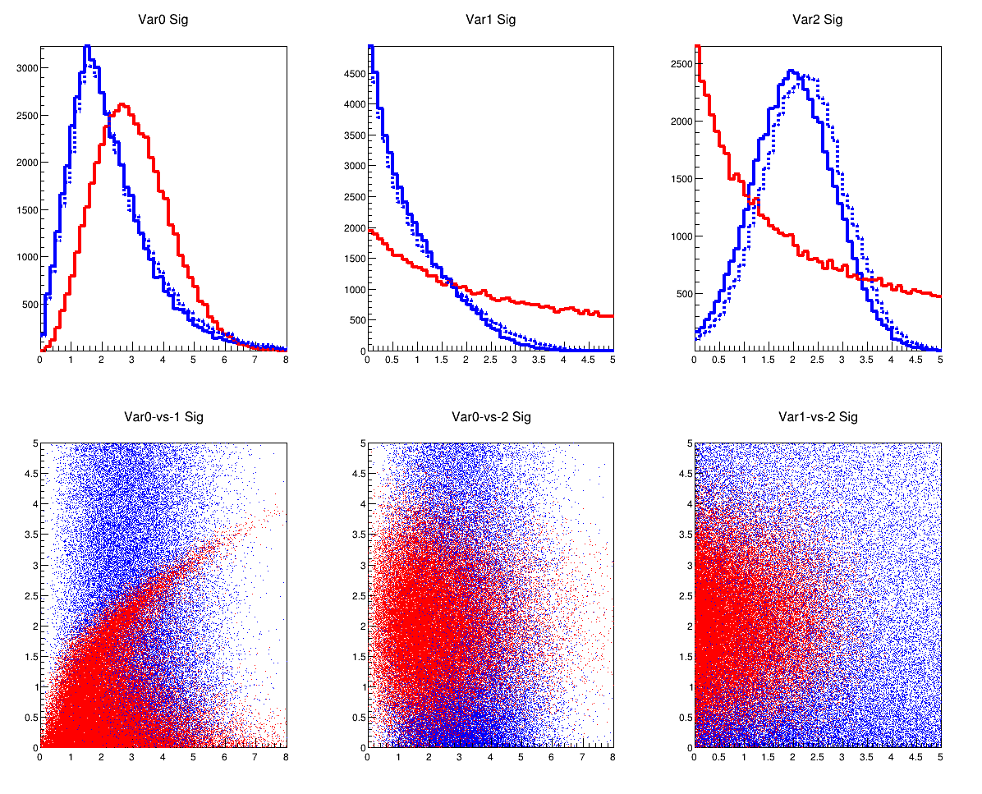
Back to my “complicated” 3D example

Slide 33
ROC Cuve - Zoom
compare: difference between red (what you think you have) and black (what your algorithm applied to nature might actually provide)
do this for solid (smeared) and dashed (unsmeared) classifiers
33

Slide 34
Summary
Multivariate Classifiers (Regressors) “MVAs”
→ (fit) decision boundary (target function)
direct exploitation of Neyman-Pearson’s Lemma: (best test statistic is the Likelihood ratio ) → direct pdf estimate in
multi-dimensional (and projective) Likelihood
classifiers that “fit” a decision boundary for given “model”
Linear: Linear Classifier (e.g. Fisher Discriminant)
Non-Linear: ANN, BDT, SVM
MVA should never be used as “black box”
they are just ‘functions’ of the observables and can be ‘studied’ even w/o knowing how the function is implemented → MVA output distributions
compare different MVAs !
find working point on ROC curve
MVAs are not magic … just fitting
systematic uncertainties don’t lie in the training !!
estimate them similar as you’d do in classical cuts

