Slide 1
Multivariate Methods of
data analysis
Advanced Scientific Computing Workshop
ETH 2014
Helge Voss
MAX-PLANCK-INSTITUT FÜR KERNPHYSIK IN HEIDELBERG

Slide 2
Overview
Multivariate classification/regression algorithms (MVA)
what they are
how they work
Overview over some classifiers
Multidimensional Likelihood (kNN : k-Nearest Neighbour)
Projective Likelihood (naïve Bayes)
Linear Classifier
Non linear Classifiers
Neural Networks
Boosted Decision Trees
Support Vector Machines
General comments about:
Overtraining
Systematic errors

Slide 3
Event Classification
Unfortunately, the true probability densities functions are typically unknown:
→ Neyman-Pearsons lemma doesn’t really help us directly
Monte Carlo simulation or in general cases: set of known (already classified) “events”
2 different ways: Use these “training” events to:
estimate the functional form of p(x|C): (e.g. the differential cross section folded with the detector influences) from which the likelihood ratio can be obtained
e.g. D-dimensional histogram, Kernel densitiy estimators, …
(generative algorithms)
find a “discrimination function” y(x) and corresponding decision boundary (i.e. hyperplane* in the “feature space”: y(x) = const) that optimially separates signal from background
e.g. Linear Discriminator, Neural Networks, …
(discriminative algorithms)
* hyperplane in the strict sense goes through the origin. Here I mean “affine set” to be precise

Slide 4
K- Nearest Neighbour
“events” distributed according to P(x)
estimate probability density P(x) in D-dimensional space:
The only thing at our disposal is our “training data”
x₂
h
Say we want to know P(x) at “this” point “x”
One expects to find in a volume V around point “x” N*∫P(x)dx events from a dataset with N events
V
“x”
count #training events in volume V(h)
→ K-events:
x₁
→ estimate of average P(x) in the volume V: ∫P(x)dx = K/N
V
→ Kernel Density estimator of the probability density
Classification: Determine
PDF_{S}(x) and PDF_{B}(x)
likelihood ratio as classifier!

Slide 5
K- Nearest Neighbour
estimate probability density P(x) in D-dimensional space:
The only thing at our disposal is our “training data”
“events” distributed according to P(x)
x₂
h
Say we want to know P(x) at “this” point “x”
One expects to find in a volume V around point “x” N*∫P(x)dx events from a dataset with N events
V
“x”
count #training events in volume V(h)
→ K-events:
x₁
→ estimate of average P(x) in the volume V: ∫P(x)dx = K/N
V
Regression: If each events with (x₁,x₂) carries a “function value” f(x₁,x₂) (e.g. energy of incident particle) →
i.e.: the average function value

Slide 6
K- Nearest Neighbour
“events” distributed according to P(x)
estimate probability density P(x) in D-dimensional space:
The only thing at our disposal is our “training data”
x₂
h
Say we want to know P(x) at “this” point “x”
One expects to find in a volume V around point “x” N*∫P(x)dx events from a dataset with N events
V
“x”
count #training events in volume V(h)
→ K-events:
x₁
determine K from the “training data” with signal and background mixed together
x₂
kNN : k-Nearest Neighbours
relative number events of the various classes amongst the k-nearest neighbours
Kernel Density Estimator: replace “window” by “smooth” kernel function → weight events by distance (e.g. via Gaussian)
x₁

Slide 7
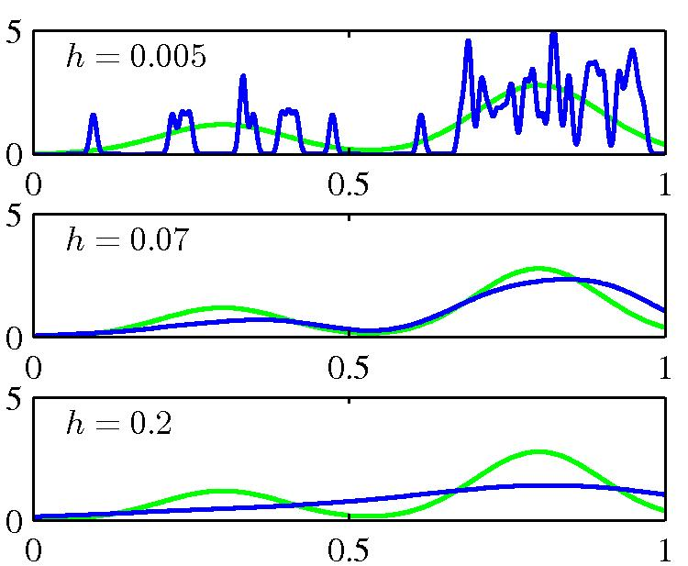
Kernel Density Estimator
: a general probability density estimator using kernel K
h: “size” of the Kernel → “smoothing parameter”
chosen size of the “smoothing-parameter” → more important than kernel function
h too small: overtraining
h too large: not sensitive to features in P(x)
which metric for the Kernel (window)?
normalise all variables to same range
include correlations ?
Mahalanobis Metric: x*x → xV⁻¹x
(Christopher M.Bishop)
a drawback of Kernel density estimators:
Evaluation for any test events involves ALL TRAINING DATA → typically very time consuming

Slide 8
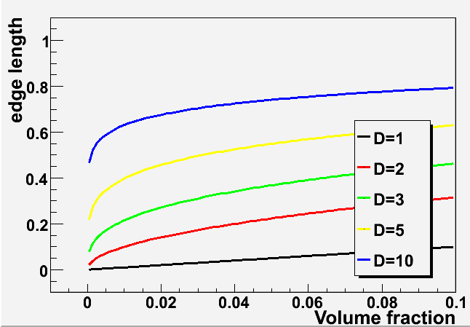
“Curse of Dimensionality”
Bellman, R. (1961), Adaptive Control Processes: A Guided Tour, Princeton University Press.
We all know:
Filling a D-dimensional histogram to get a mapping of the PDF is typically unfeasable due to lack of Monte Carlo events.
Shortcoming of nearest-neighbour strategies:
higher dimensional cases K-events often are not in a small “vicinity” of the space point anymore:
consider: total phase space volume V=1^{D}
for a cube of a particular fraction of the volume:
10 dimensions: capture 1% of the phase space
→ 63% of range in each variable necessary → that’s not “local” anymore..☹
develop all the alternative classification/regression techniques

Slide 9
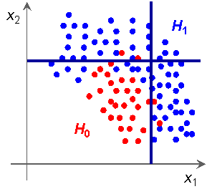
Naïve Bayesian Classifier (projective Likelihood Classifier)
Multivariate Likelihood (k-Nearest Neighbour)
→ estimate the full D-dimensional joint probability density
product of marginal PDFs
(1-dim “histograms”)
If correlations between variables are weak: →
PDFs
discriminating variables
Likelihood ratio for event event
Classes: signal, background types
One of the first and still very popular MVA-algorithm in HEP
No hard cuts on individual variables,
allow for some “fuzzyness”: one very signal like variable may counterweigh another less signal like variable
optimal method if correlations == 0 (Neyman Pearson Lemma)
try to “eliminate” correlations → e.g. linear de-correlation
PDE introduces fuzzy logic

Slide 10
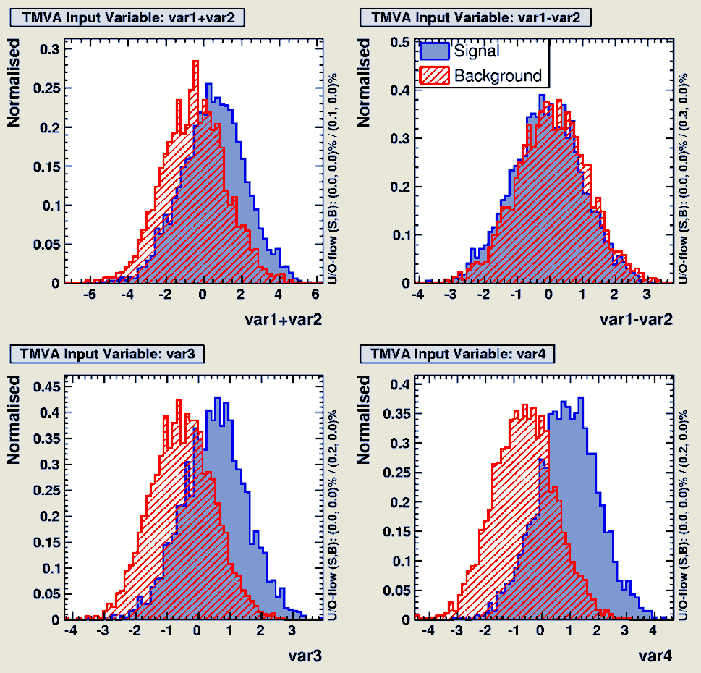
Naïve Bayesian Classifier (projective Likelihood Classifier)
Where to get the 1-D PDF’s ?
Simple histograms
Smoothing (e.g. spline or kernel function)

Slide 11
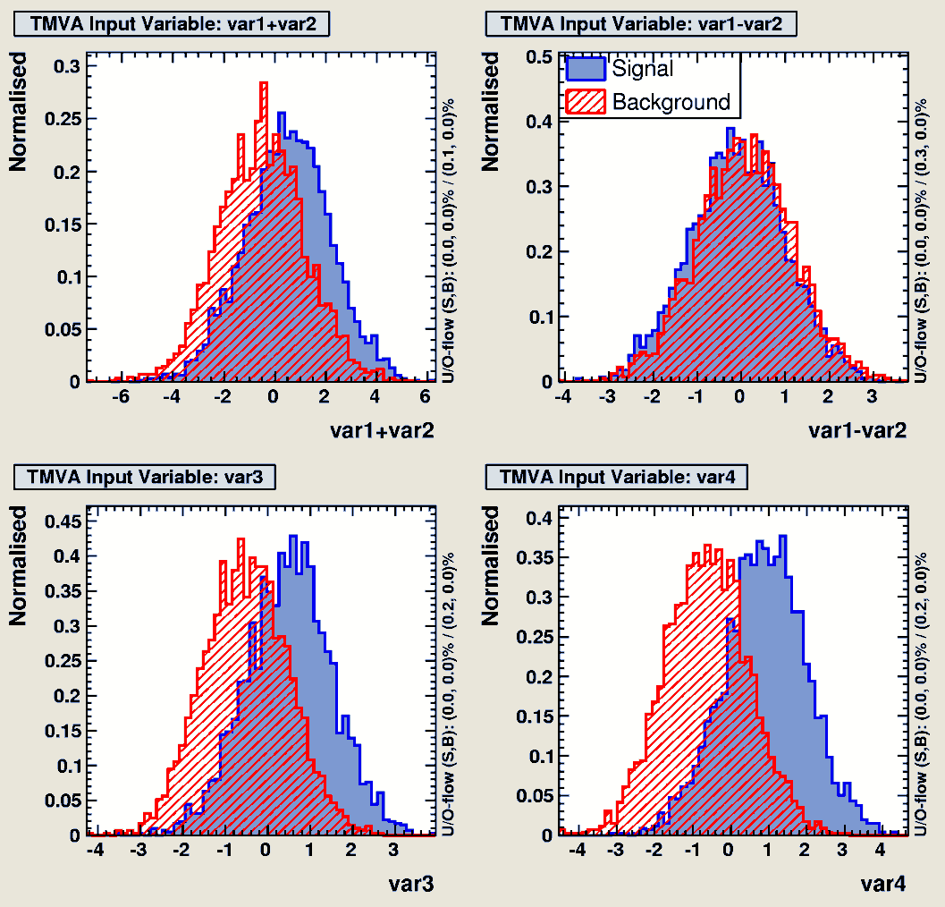
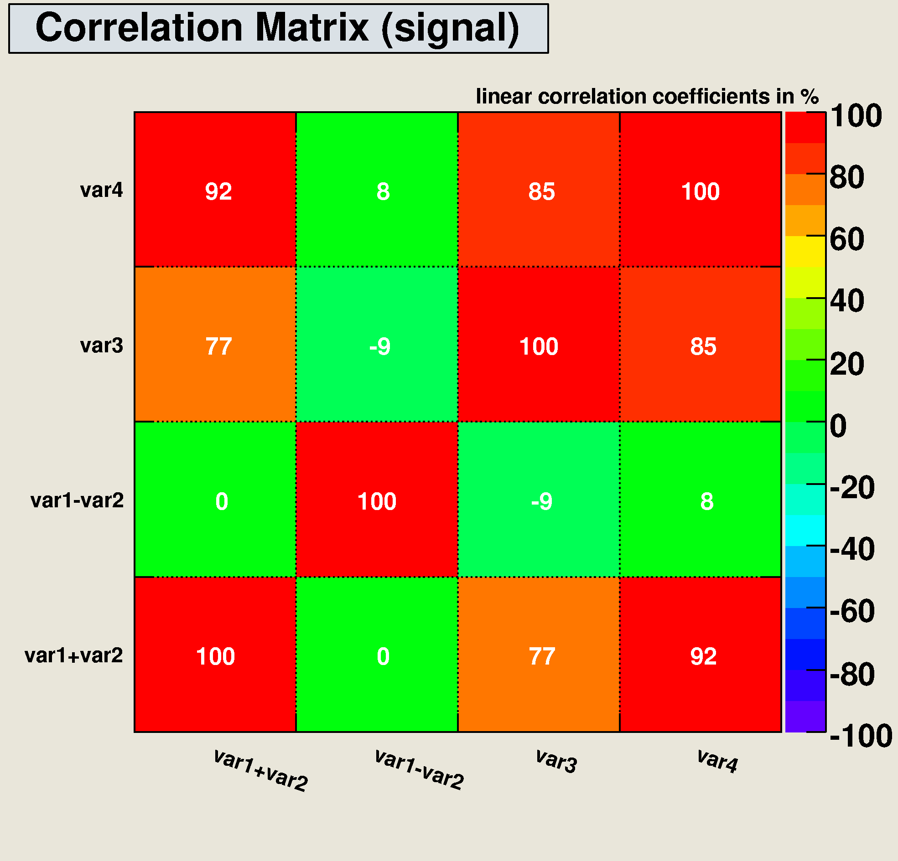
What if there are correlations?
Typically correlations are present: C_{ij}=cov[ x_{i} , x _{j} ]=E[ x_{i} x_{j} ]−E[ x_{i} ]E[ x_{j} ]≠0 (i≠j)
→ pre-processing: choose set of linear transformed input variables for which C_{ij} = 0 (i≠j)

Slide 12
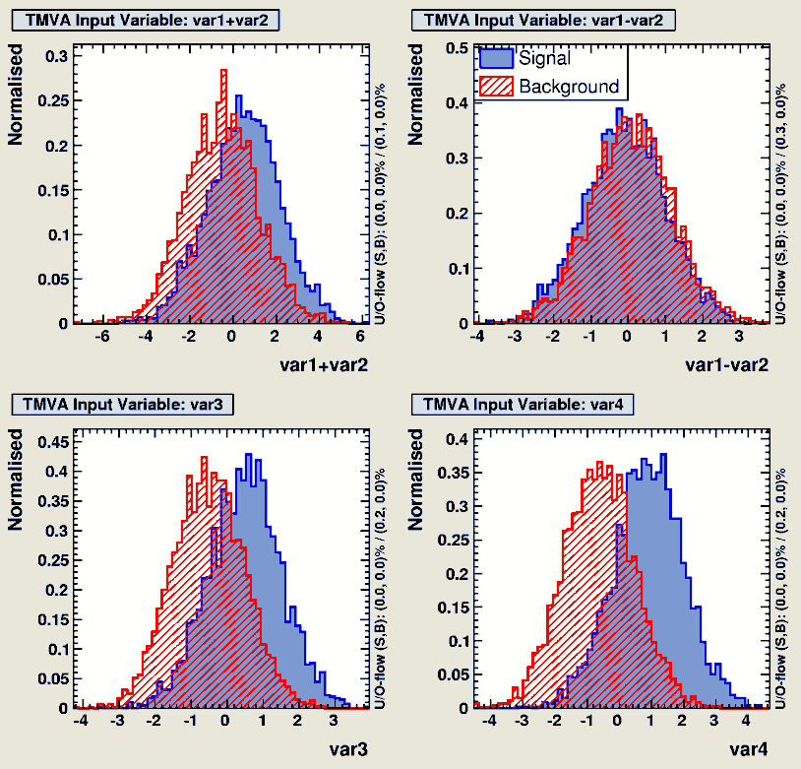
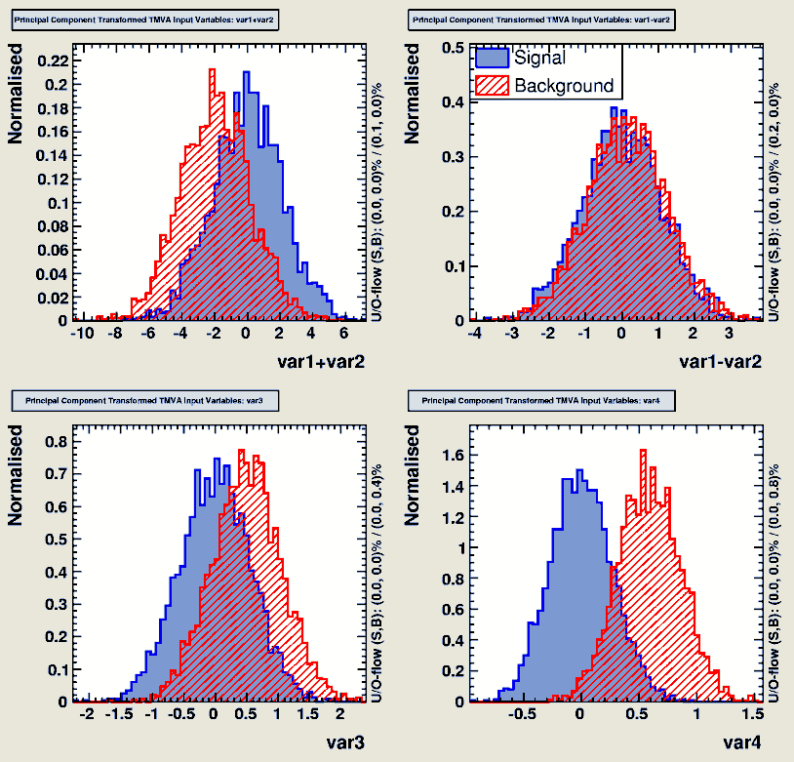
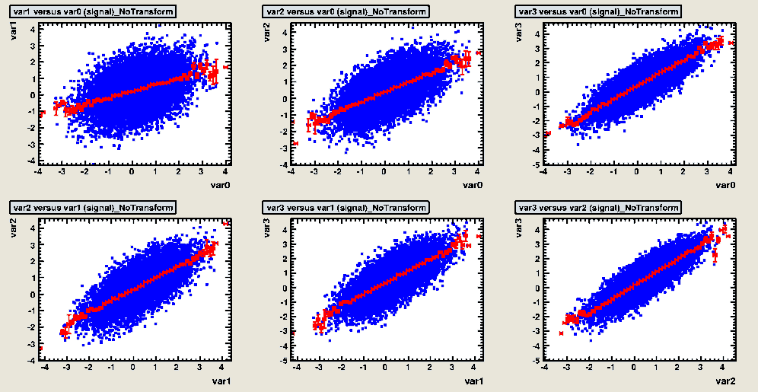
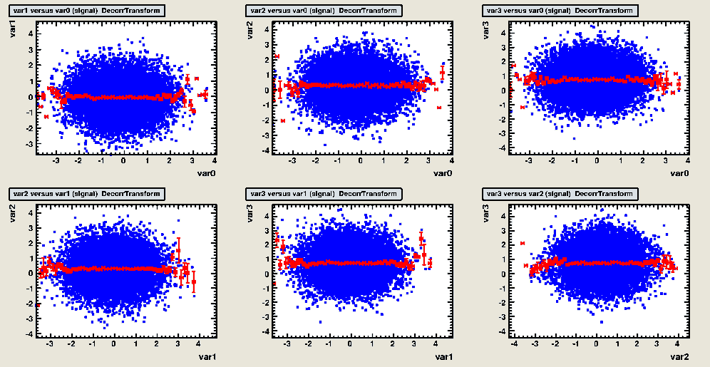
De-Correlation
Find variable transformation that diagonalises the covariance matrix
Determine square-root C ′ of correlation matrix C, i.e., C = C ′C ′
compute C ′ by diagonalising C:
transformation from original (x) in de-correlated variable space (x′) by: x′ = C ′−1x
Attention: eliminates only linear correlations!!

Slide 13
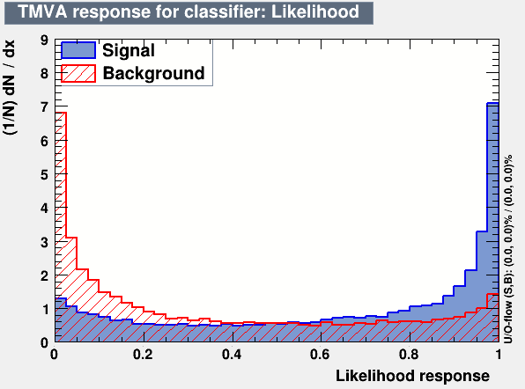
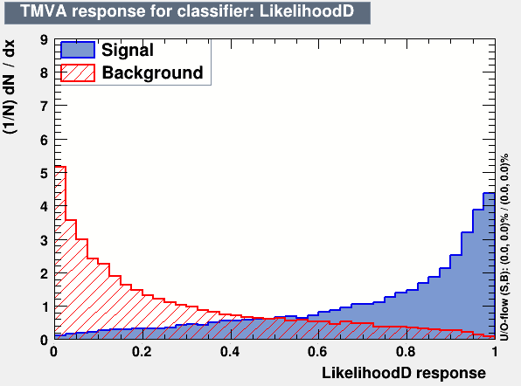
Decorrelation at Work
Example: linear correlated Gaussians → decorrelation works to 100%
1-D Likelihood on decorrelated sample give best possible performance
compare also the effect on the MVA-output variable!
correlated variables: after decorrelation
Watch out! Things might look very different for non-linear correlations!

Slide 14
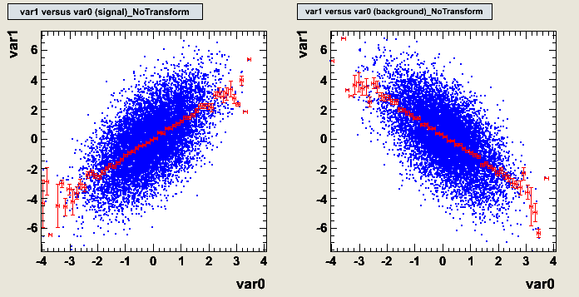
Limitations of the Decorrelation
in cases with non-Gaussian distributions and/or nonlinear correlations, the decorrelation needs to be treated with care
How does linear decorrelation affect cases where correlations between signal and background differ?
Original correlations
Signal
Background

Slide 15
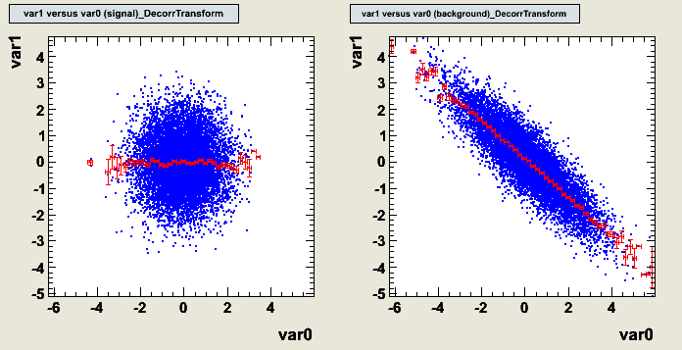
Limitations of the Decorrelation
in cases with non-Gaussian distributions and/or nonlinear correlations, the decorrelation needs to be treated with care
How does linear decorrelation affect cases where correlations between signal and background differ?
SQRT decorrelation
Signal
Background

Slide 16
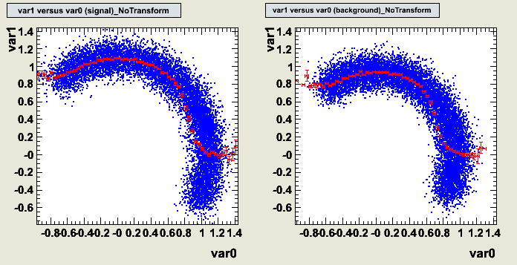
Limitations of the Decorrelation
in cases with non-Gaussian distributions and/or nonlinear correlations, the decorrelation needs to be treated with care
How does linear decorrelation affect strongly nonlinear cases ?
Original correlations
Signal
Background

Slide 17
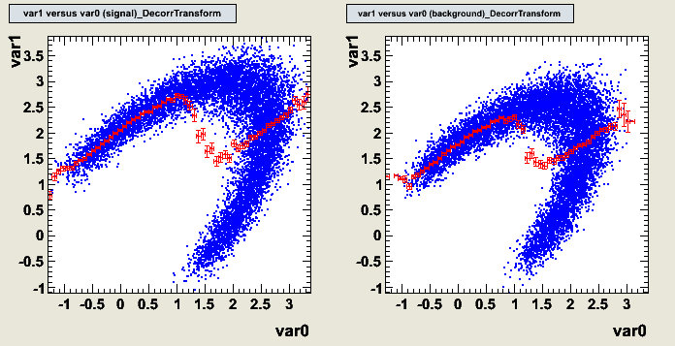
Limitations of the Decorrelation
in cases with non-Gaussian distributions and/or nonlinear correlations, the decorrelation needs to be treated with care
How does linear decorrelation affect strongly nonlinear cases ?
SQRT decorrelation
Signal
Background
Watch out before you used decorrelation “blindly”!!
Perhaps “decorrelate” only a subspace!

Slide 18
Summary
Hope you are all convinced that Multivariate Algorithem are nice and powerful classification techniques
Do not use hard selection criteria (cuts) on each individual observables
Look at all observables “together”
eg. combing them into 1 variable
Mulitdimensinal Likelihood → PDF in D-dimensions
Projective Likelihood (Naïve Bayesian) → PDF in D times 1 dimension
→ Be careful about correlations

