Slide 1
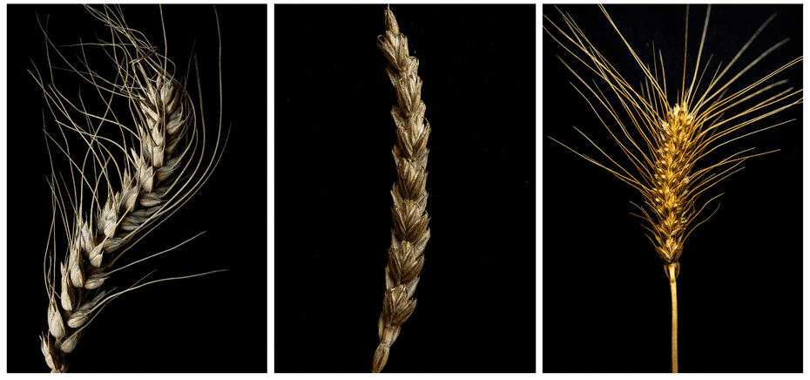
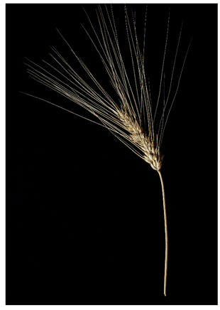
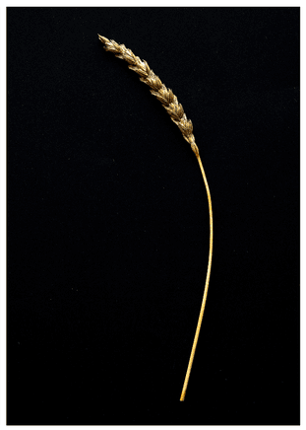
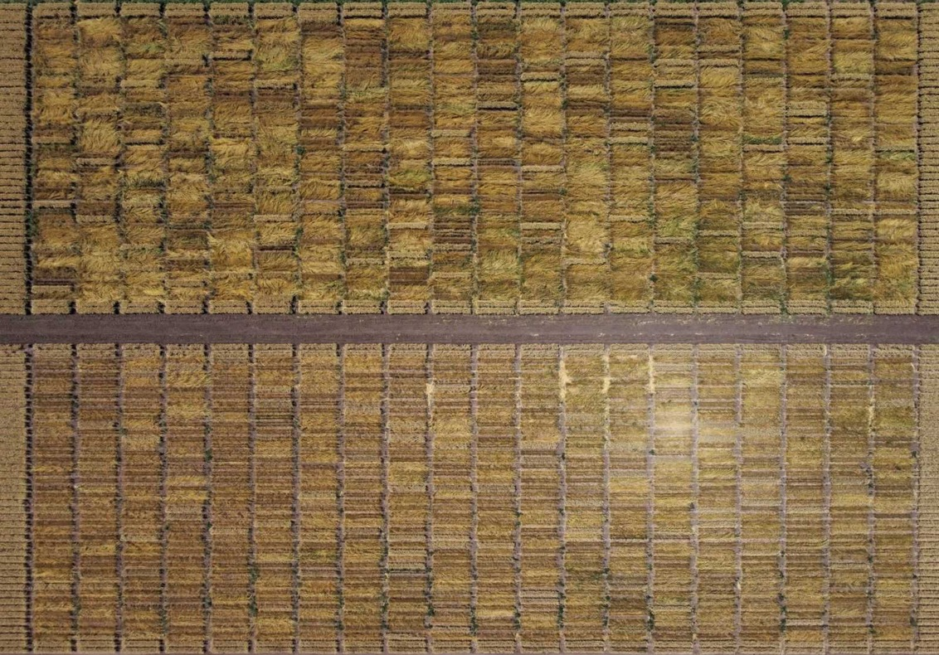
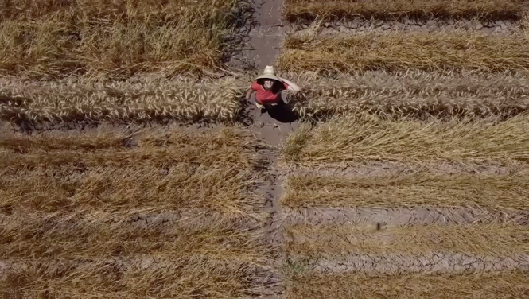
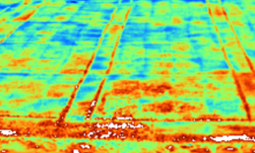
1

Slide 2
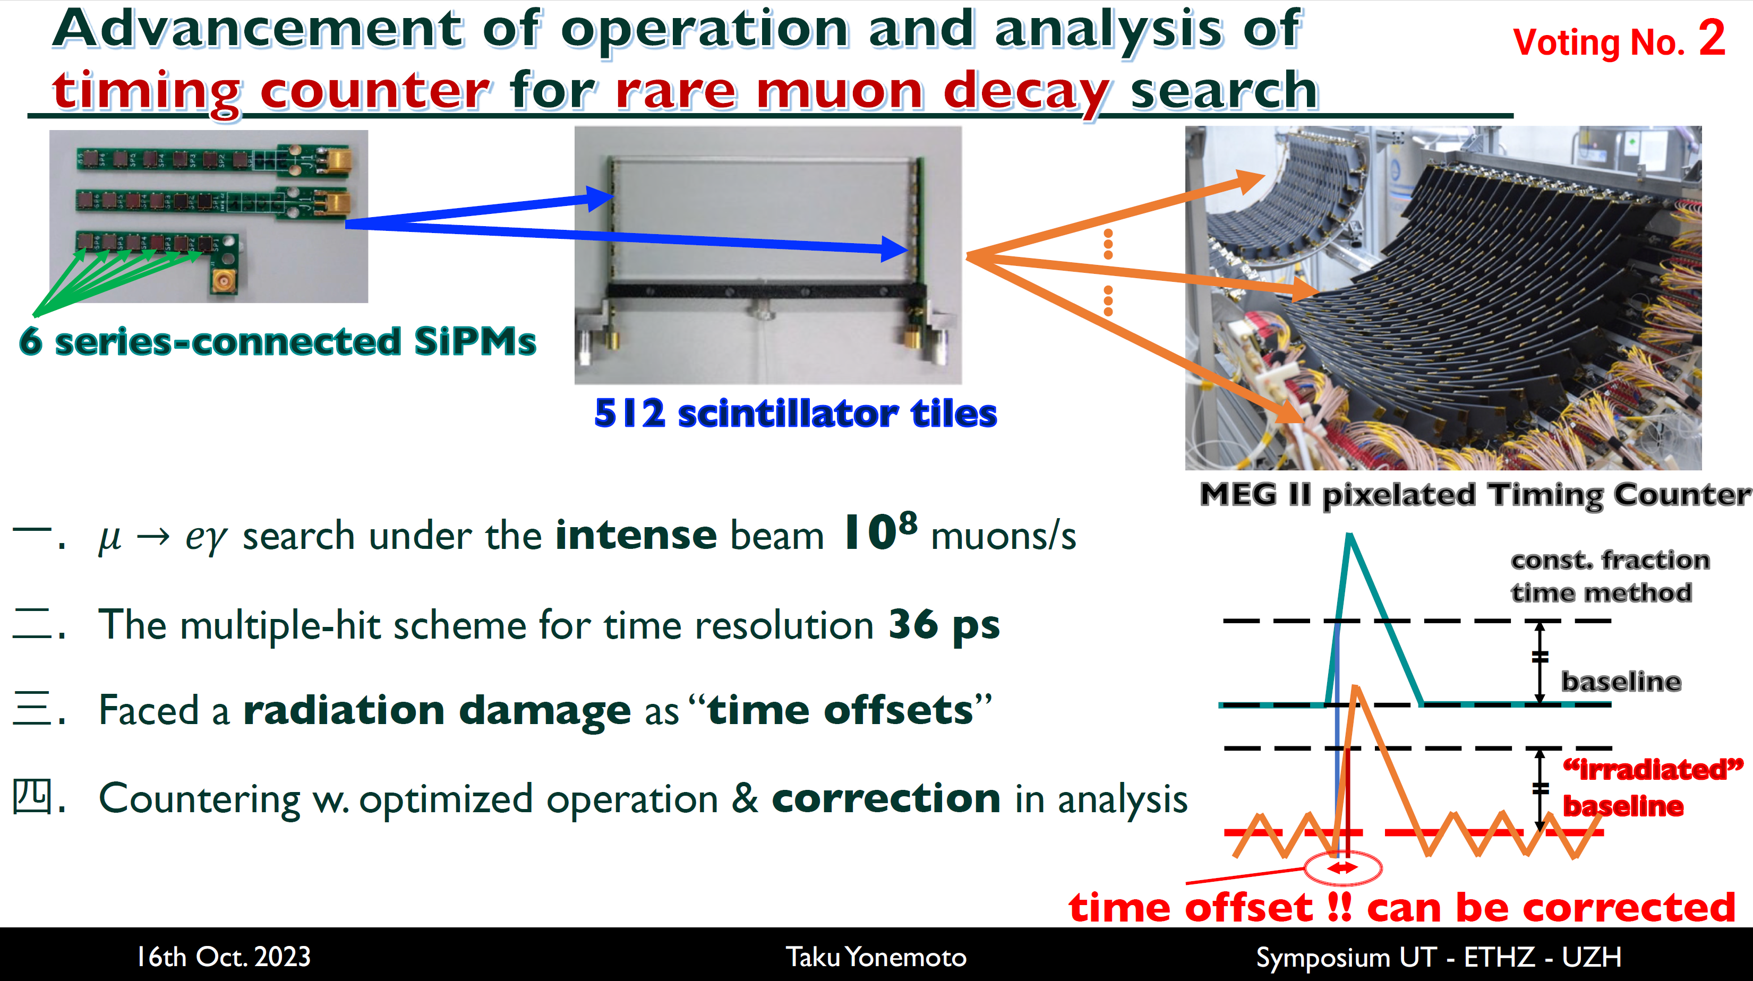

Slide 3
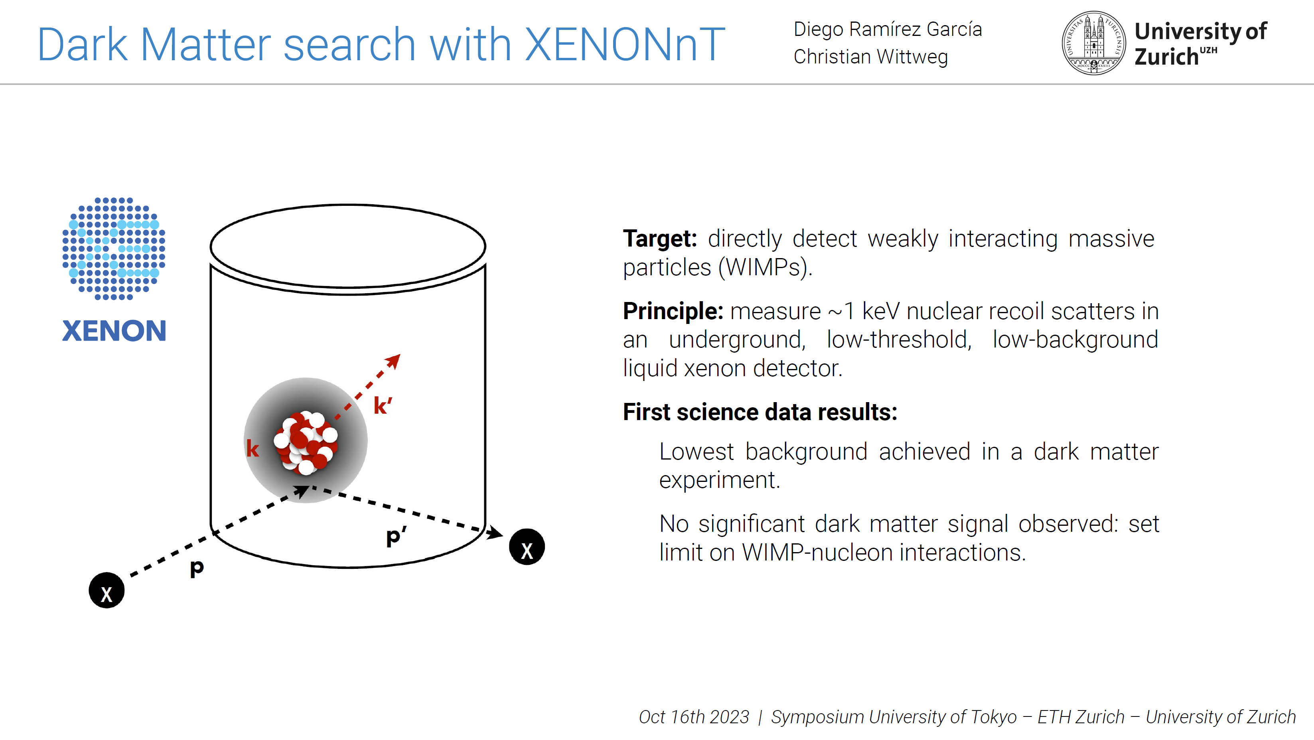
Poster No. 3

Slide 4


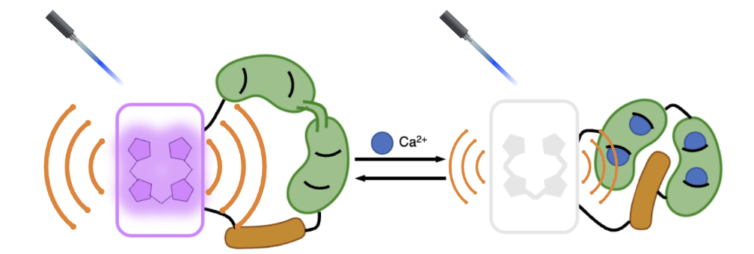
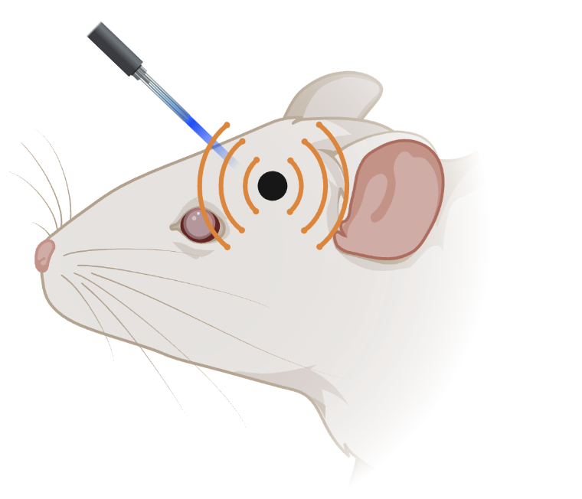
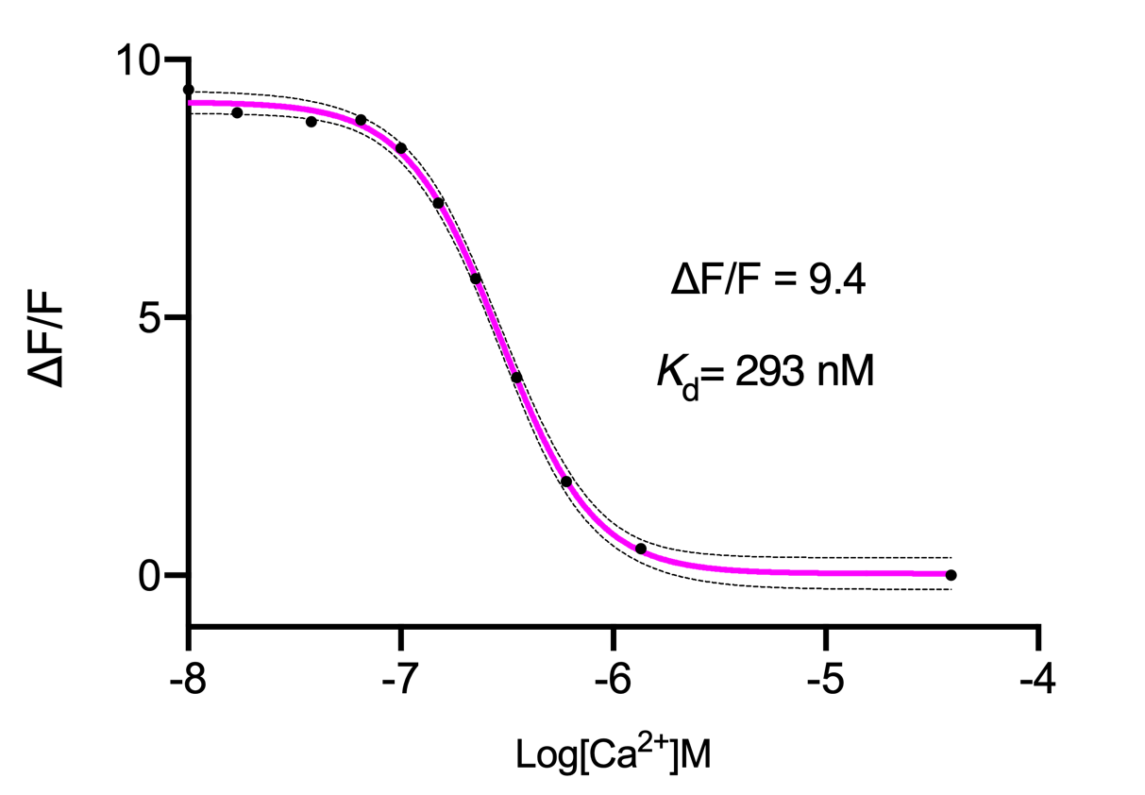
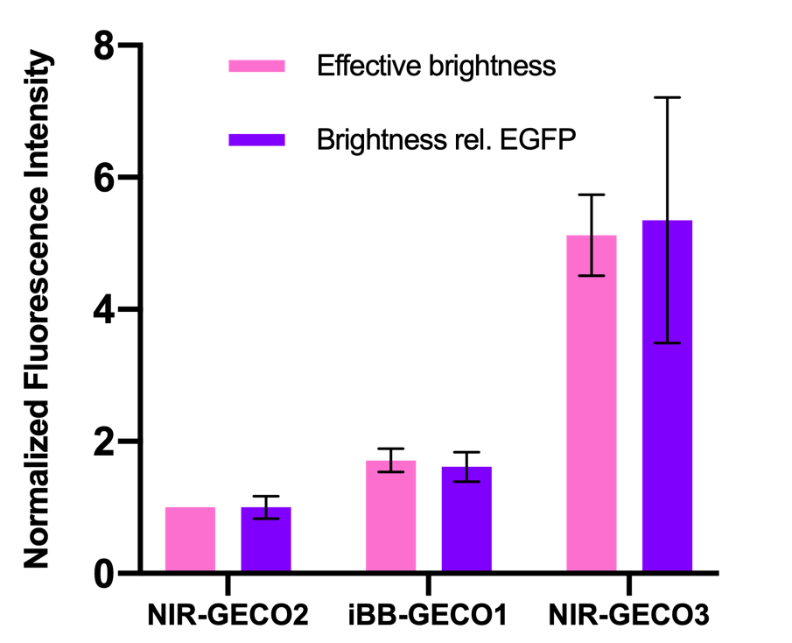



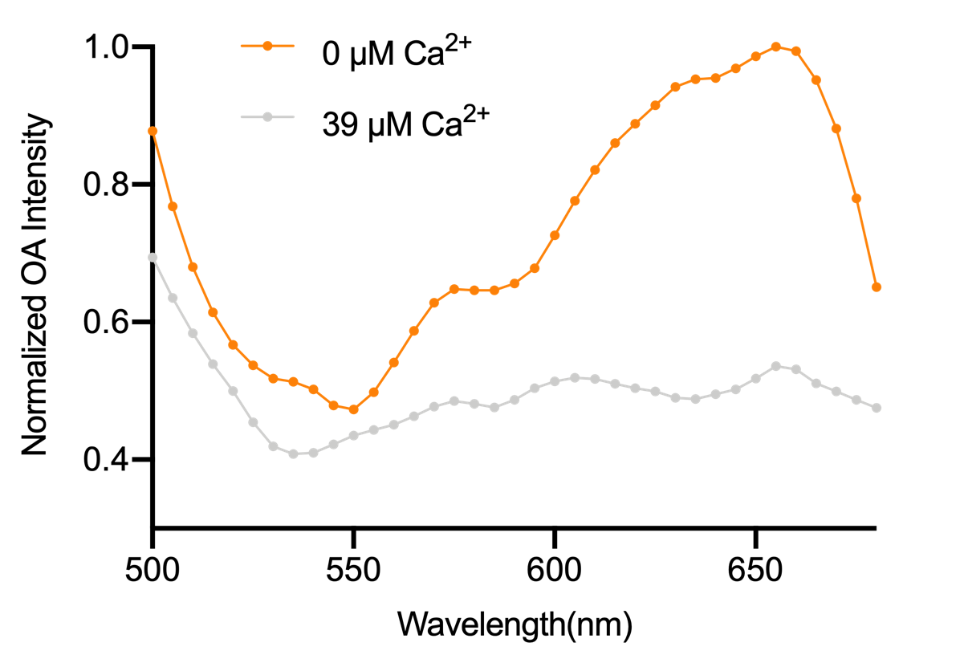
To engineer a new generation of near-infrared calcium ion indicators for fluorescence and optoacoustic imaging
Fu Chai¹, Xiang Liu^{1,2}, Yusuke Nasu¹, Takuya Terai¹, Robert E. Campbell¹
Fluorescence signal
Poster No. 4
Ca²⁺ sensing module
NIR FP
a
Optoacoustic signal
I will be sharing:
E. coli colonies
DNA library
Next round template
Protein extract
in vitro test
A random insertion technique !
A novel directed evolution method !
An exciting result !

Slide 5
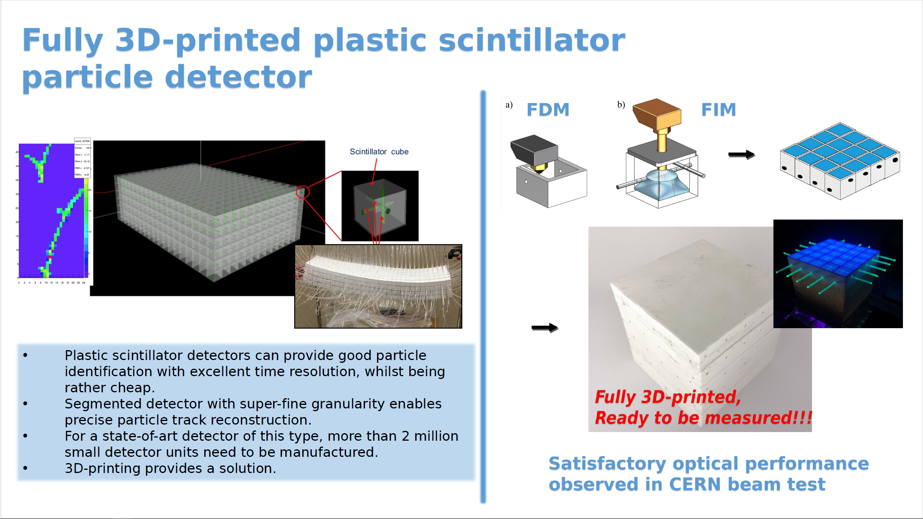
Poster No. 5

Slide 6
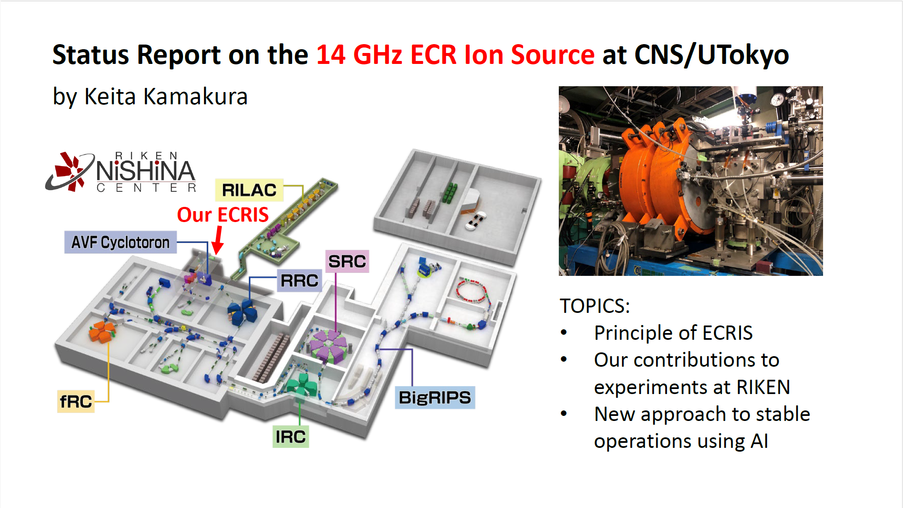
Poster No. 6

Slide 7



Crossing Strategy for Plant Breeding (Poster 8)
【Plant Breeding】
【Expected Progeny ability 】
Crossing
Crossing
Yield = 60
50
73
75
70
72
Progenies
Progeny distribution
…
Selection
35
70
72
73
75
Low
High
70
74
78
52
71
90
Improving the genetic ability
Not good...
Good!
Selection based on ...
Individual
vs
Potential of each cross
Traditional
New

Slide 8
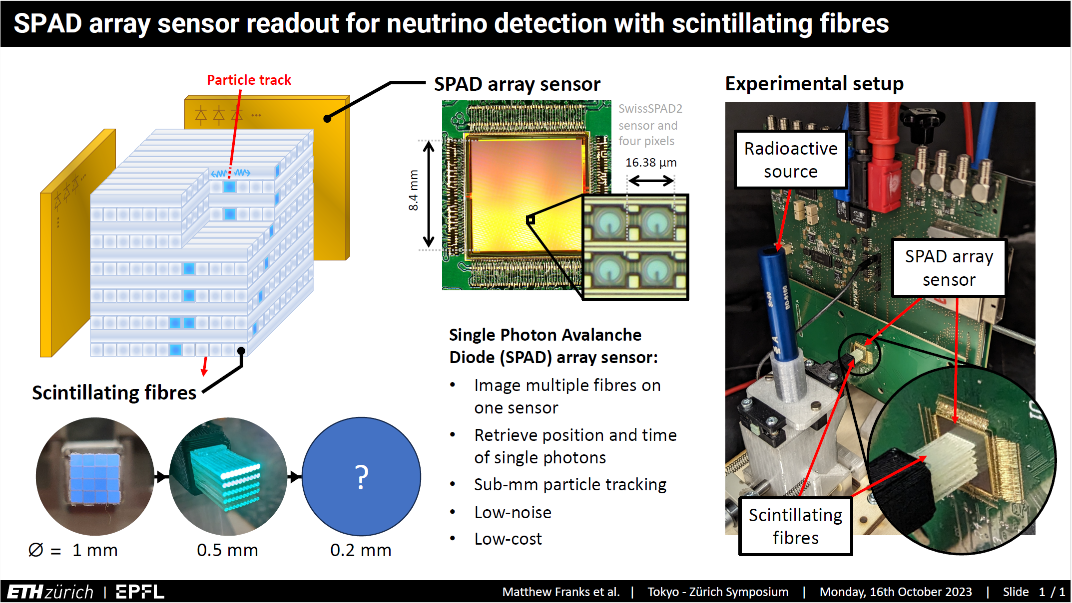
Poster No. 9

Slide 9
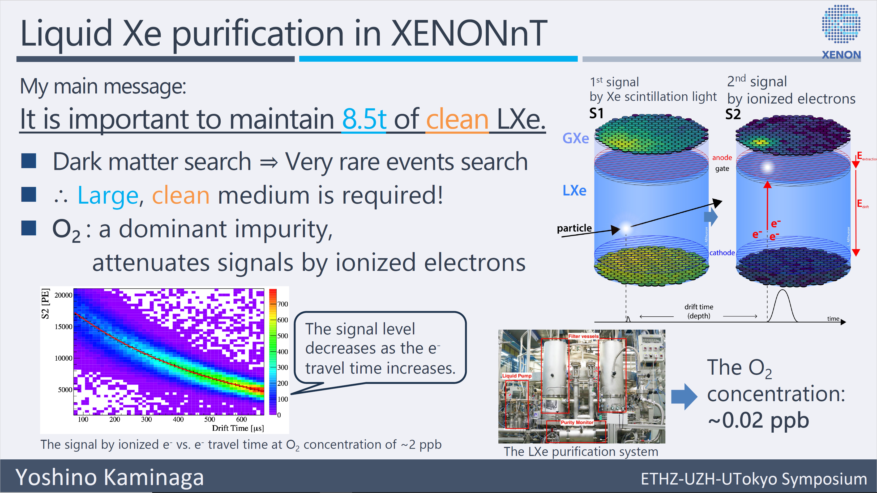
Poster No. 10

Slide 10

Poster No.11
muCool: Towards muon cooling at PSI
∆E = 10 keV
E < 100 eV
diameter < 20 mm
divergence < 2 mrad
E = 4 MeV
∆E = 800 keV
diameter = 70 mm
divergence = 200 mrad
E = 10 eV
diameter < 1 mm
Joanna Peszka
16/10/2023
Notes:
I would like to present you a muCool, so a novel technique for muon cooling at Paul Scherrer Institute. We use a technique of buffer gas cooling to achieve 3D compression and momentum reduction. The cooling of muons to eV energies is achieved by collissions with cryogenic helium and compression of the muon beam is obtained by varying the collissional frequency.

Slide 11

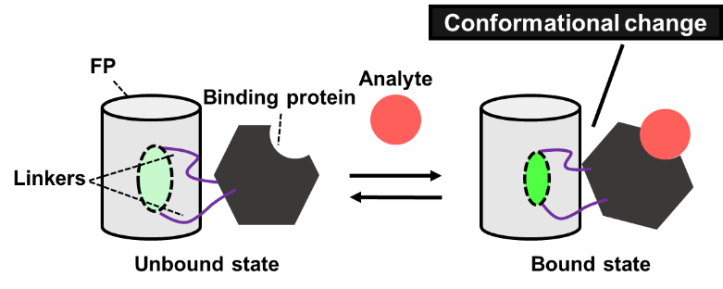
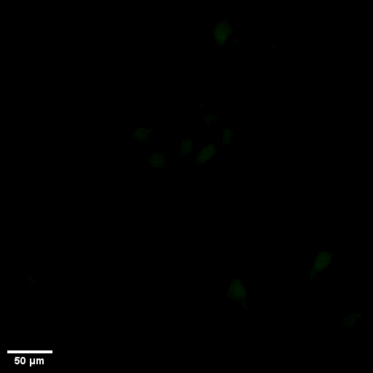
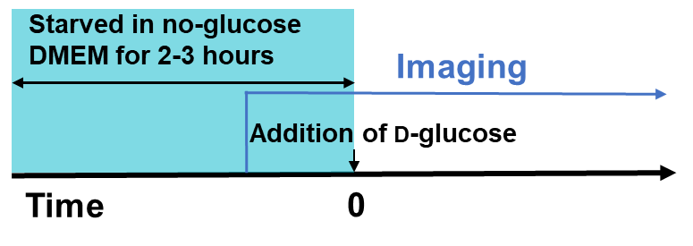
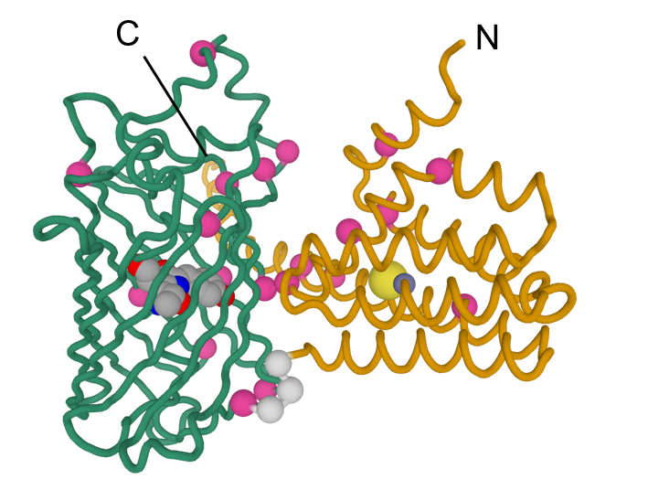
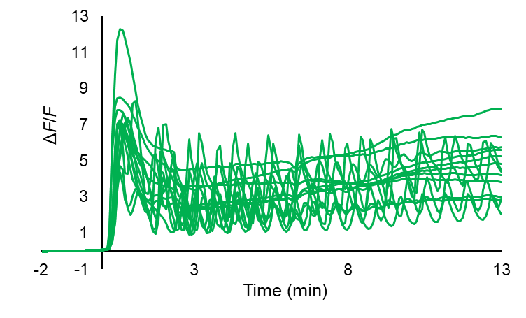
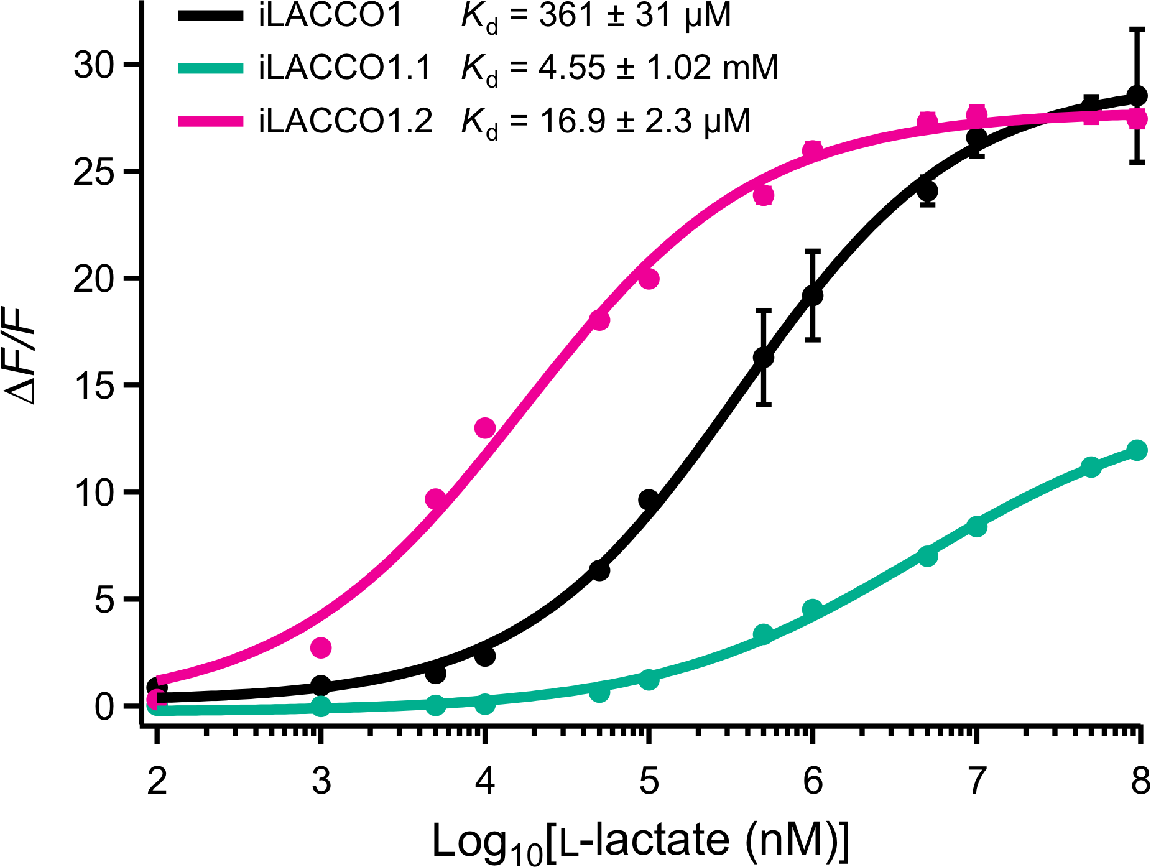
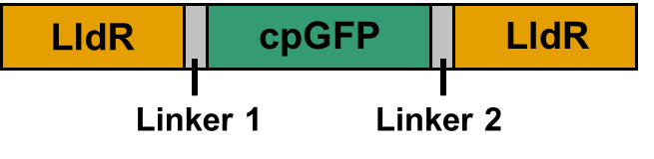
Development of GFP-based intracellular L-lactate biosensors and direct observation of L-lactate oscillation
Poster No.12
Saaya Hario, Giang N. T. Le, Kei Takahashi-Yamashiro, Takuya Terai, Yusuke Nasu, and Robert E. Campbell
Fluorescent protein (FP)-based biosensors
iLACCO series function well in mammalian cells and we observed L-lactate oscillations in starved cells.
D-glucose
pyruvate
Glycolysis
L-lactate
iLACCO series
GFP-based intracellular L-lactate biosensors

Slide 12
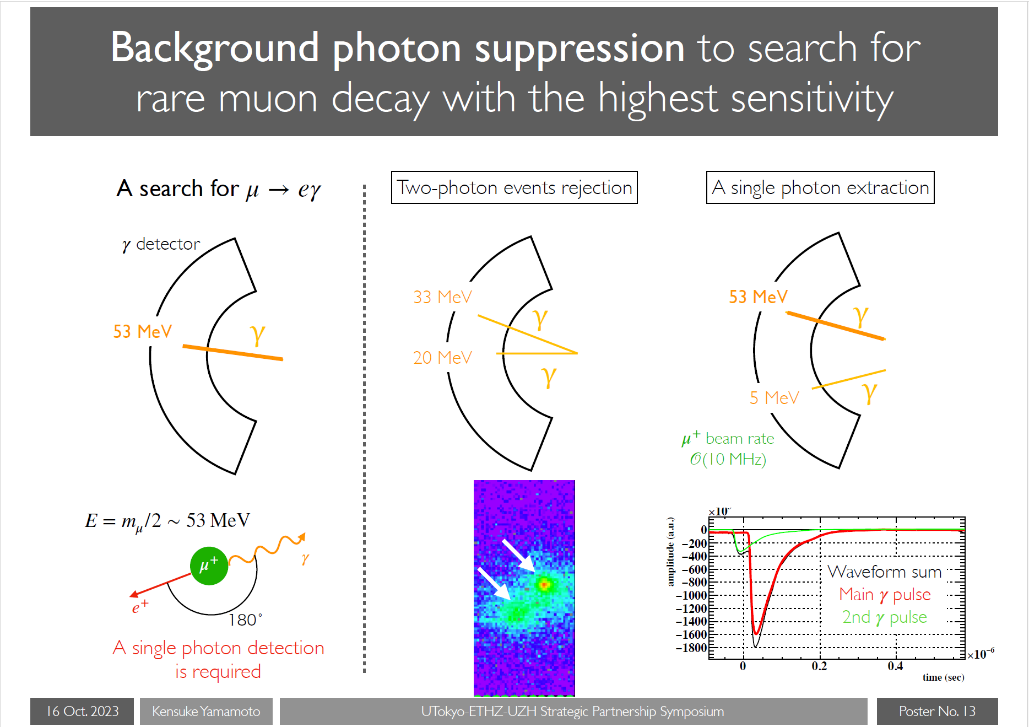

Slide 13
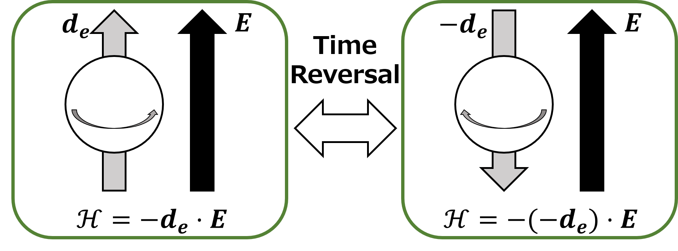
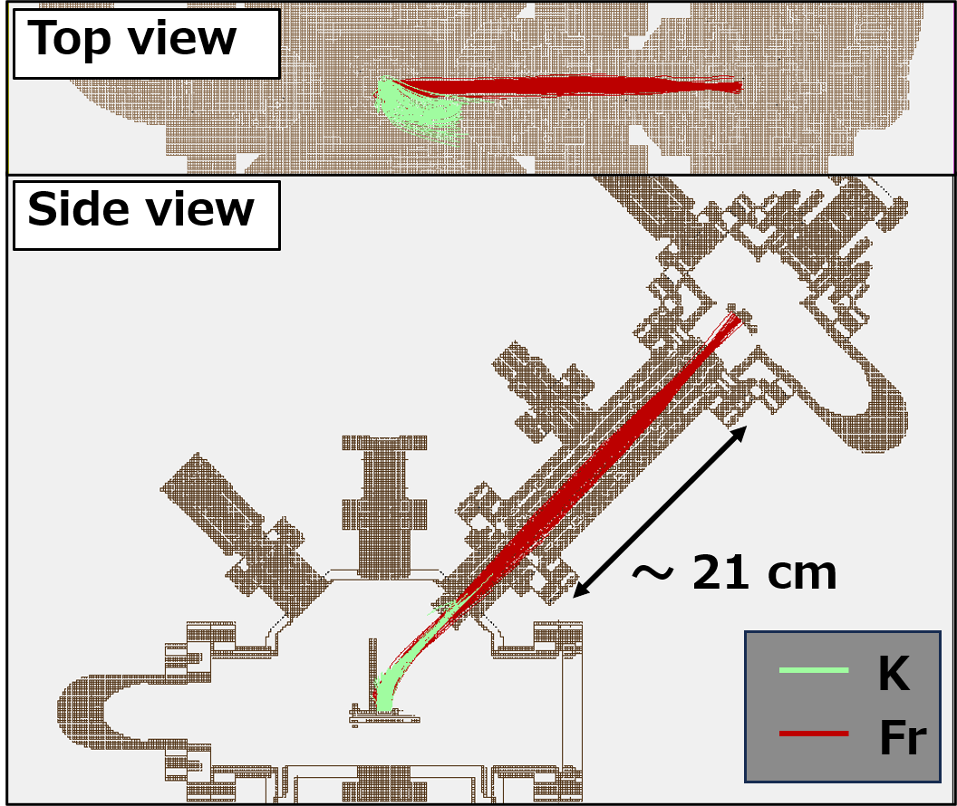
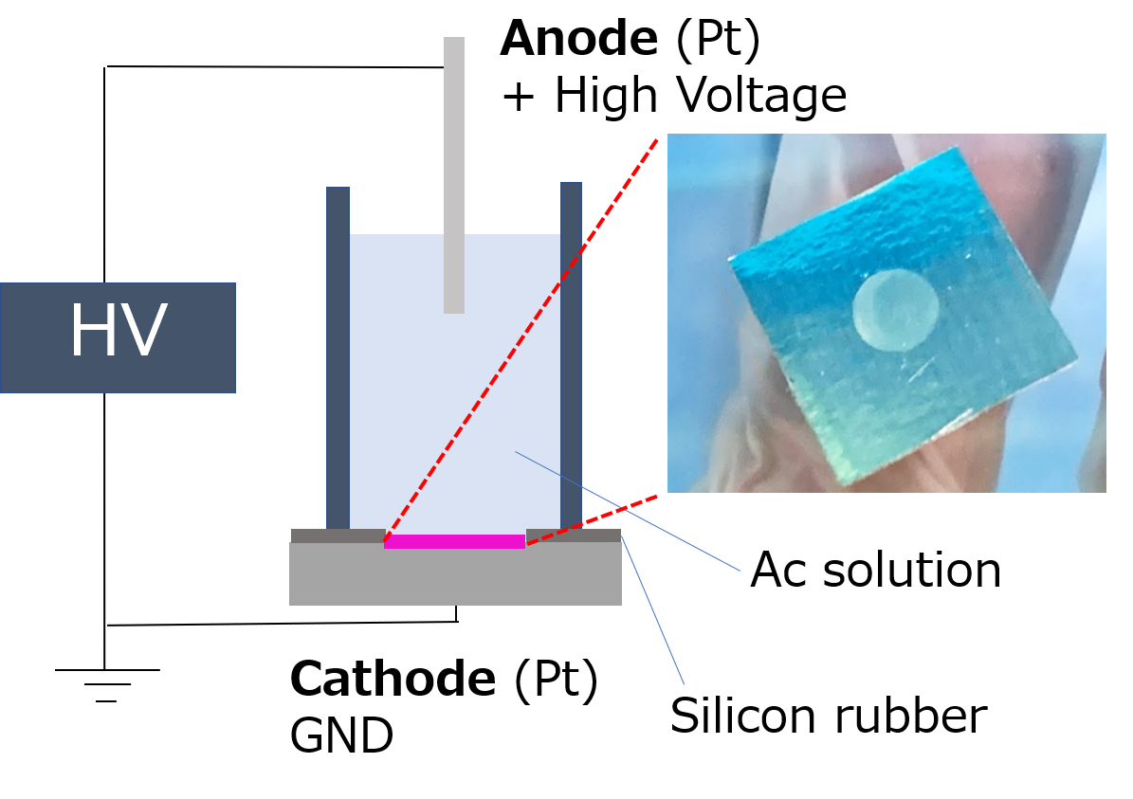
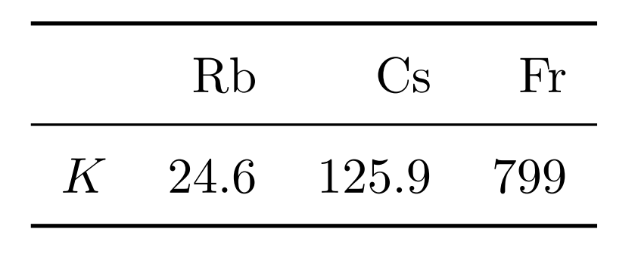
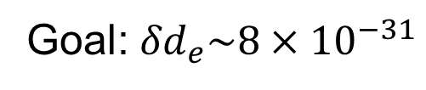
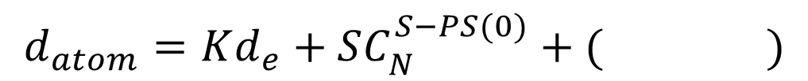

Present status of high intensity Fr source development to search for the EDM
M. Fukase et al.
Graduate School of Science, University of Tokyo
Poster No.14
Electric Dipole Moment
²¹⁰Fr: electron EDM
Fusion reaction
¹⁹⁷Au(¹⁸O, 5n)²¹⁰Fr
Improvement of beam purity
EDM of paramagnetic atom
Schiff
moment
²²¹Fr: Schiff moment (+electron EDM)
Alpha decay
²²⁵Ac ²²¹Fr
$$d_{atom}=Kd_{e}+SC_{N}^{S−PS(0)}+( )$$
$$K∝Z^{3}$$
[1,2]
nuclear octupole
deformation
Establishment of
electrodeposition treatment
Goal: ${δd}_{e}\sim {8×10}^{−31}$
[1] N. Shitara et al., J. High Energ. Phys. 2021, 124 (2021).
[2] H S Nataraj et al., J. Phys.: Conf. Ser. 80, 012050 (2007).

Slide 14
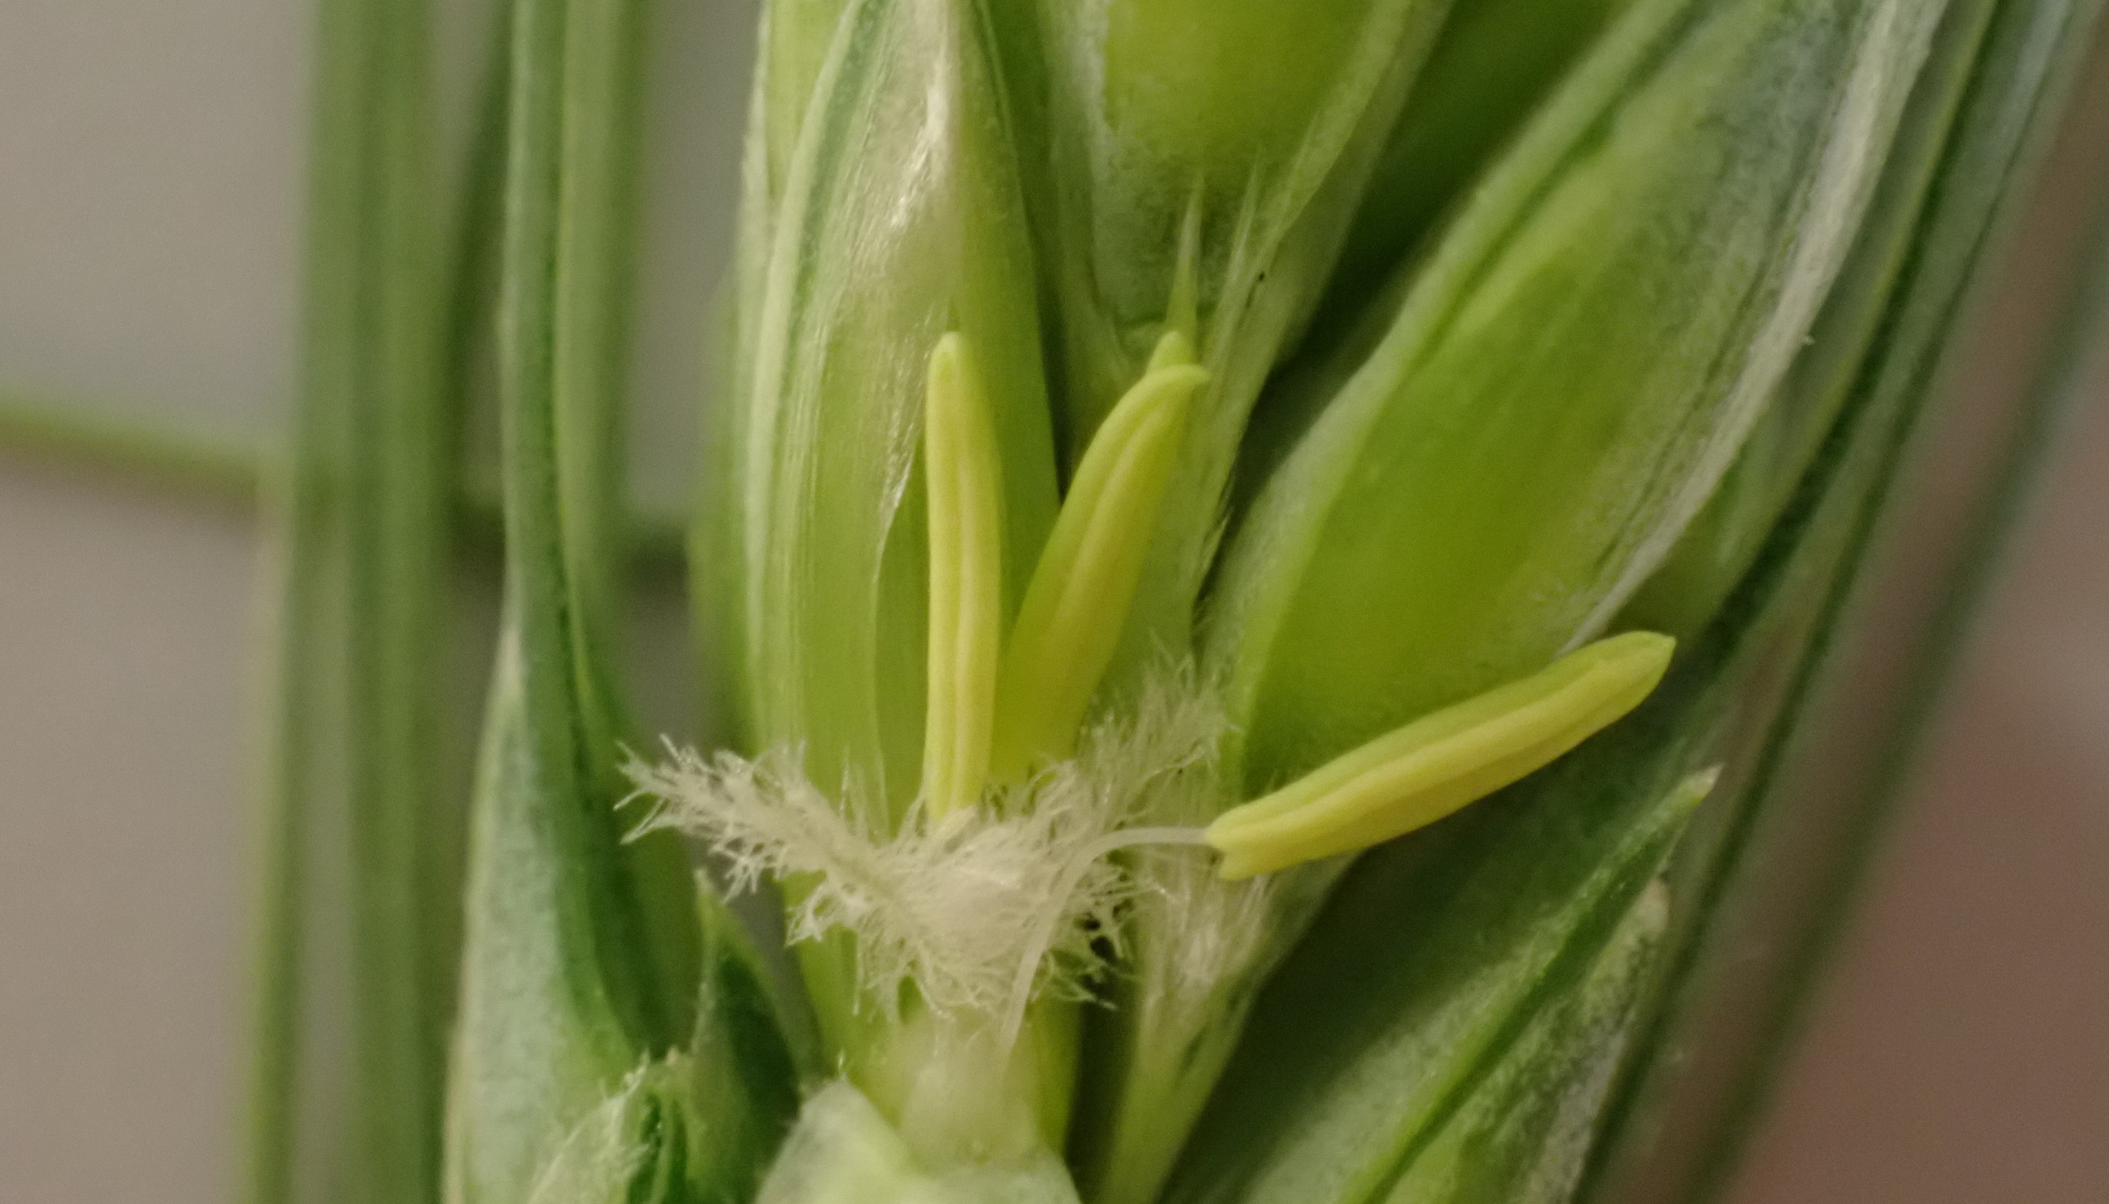
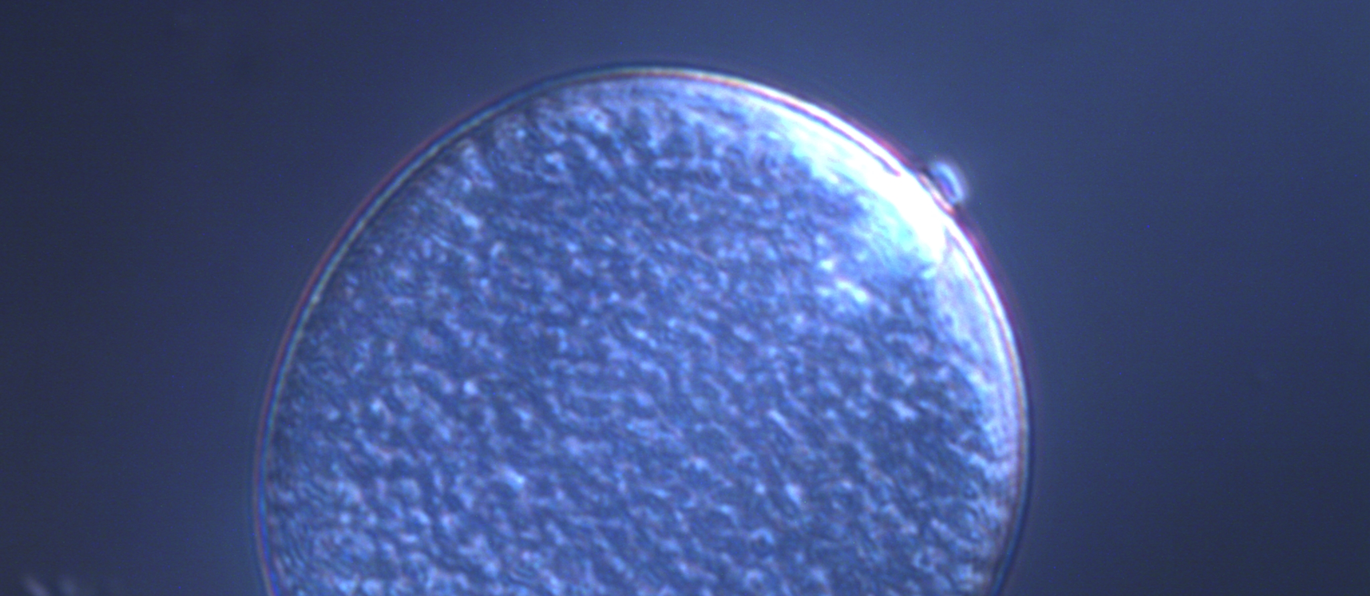
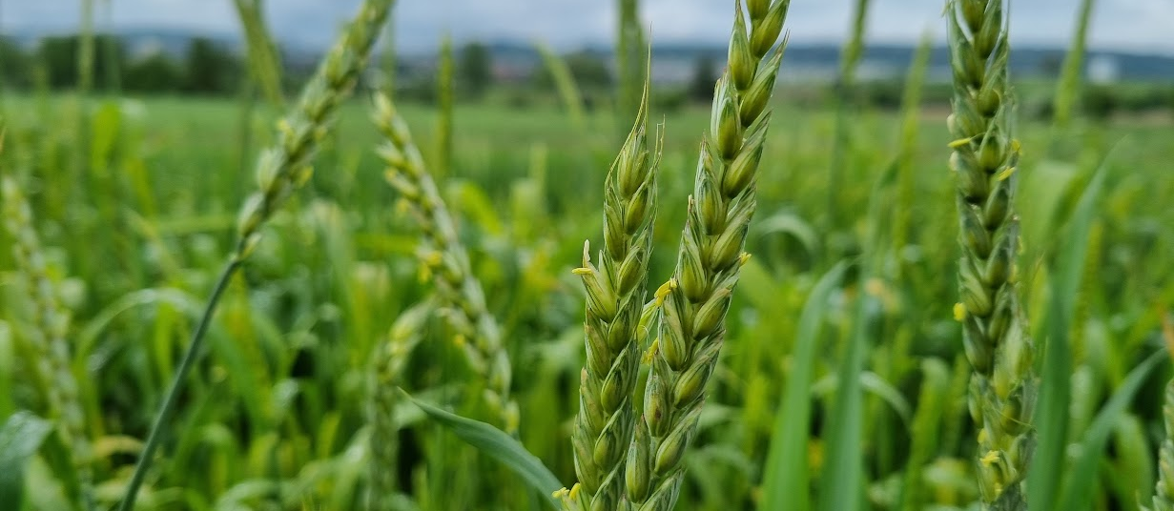
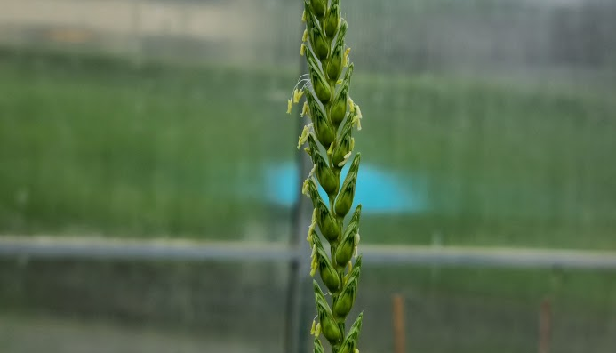
Poster No. 15
Naoto-Benjamin Hamaya (UZH)
Pollen number
Evolution in Action
Bread wheat

Slide 15
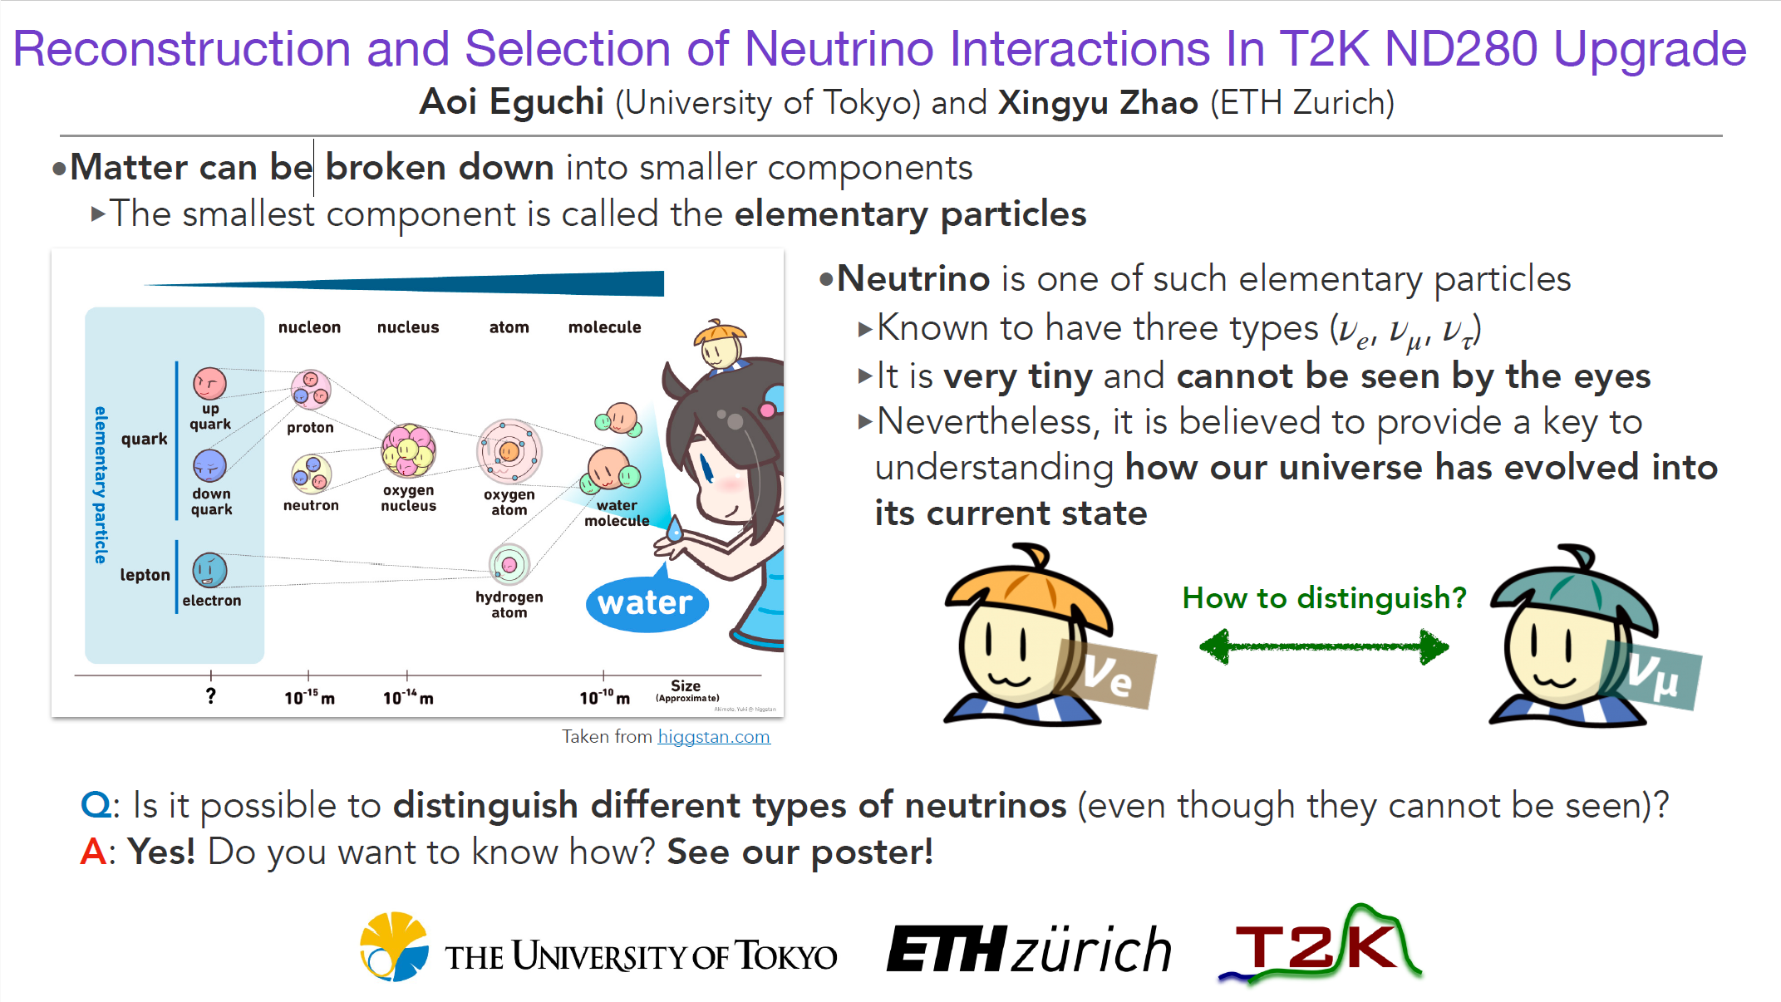
Poster No.16

Slide 16
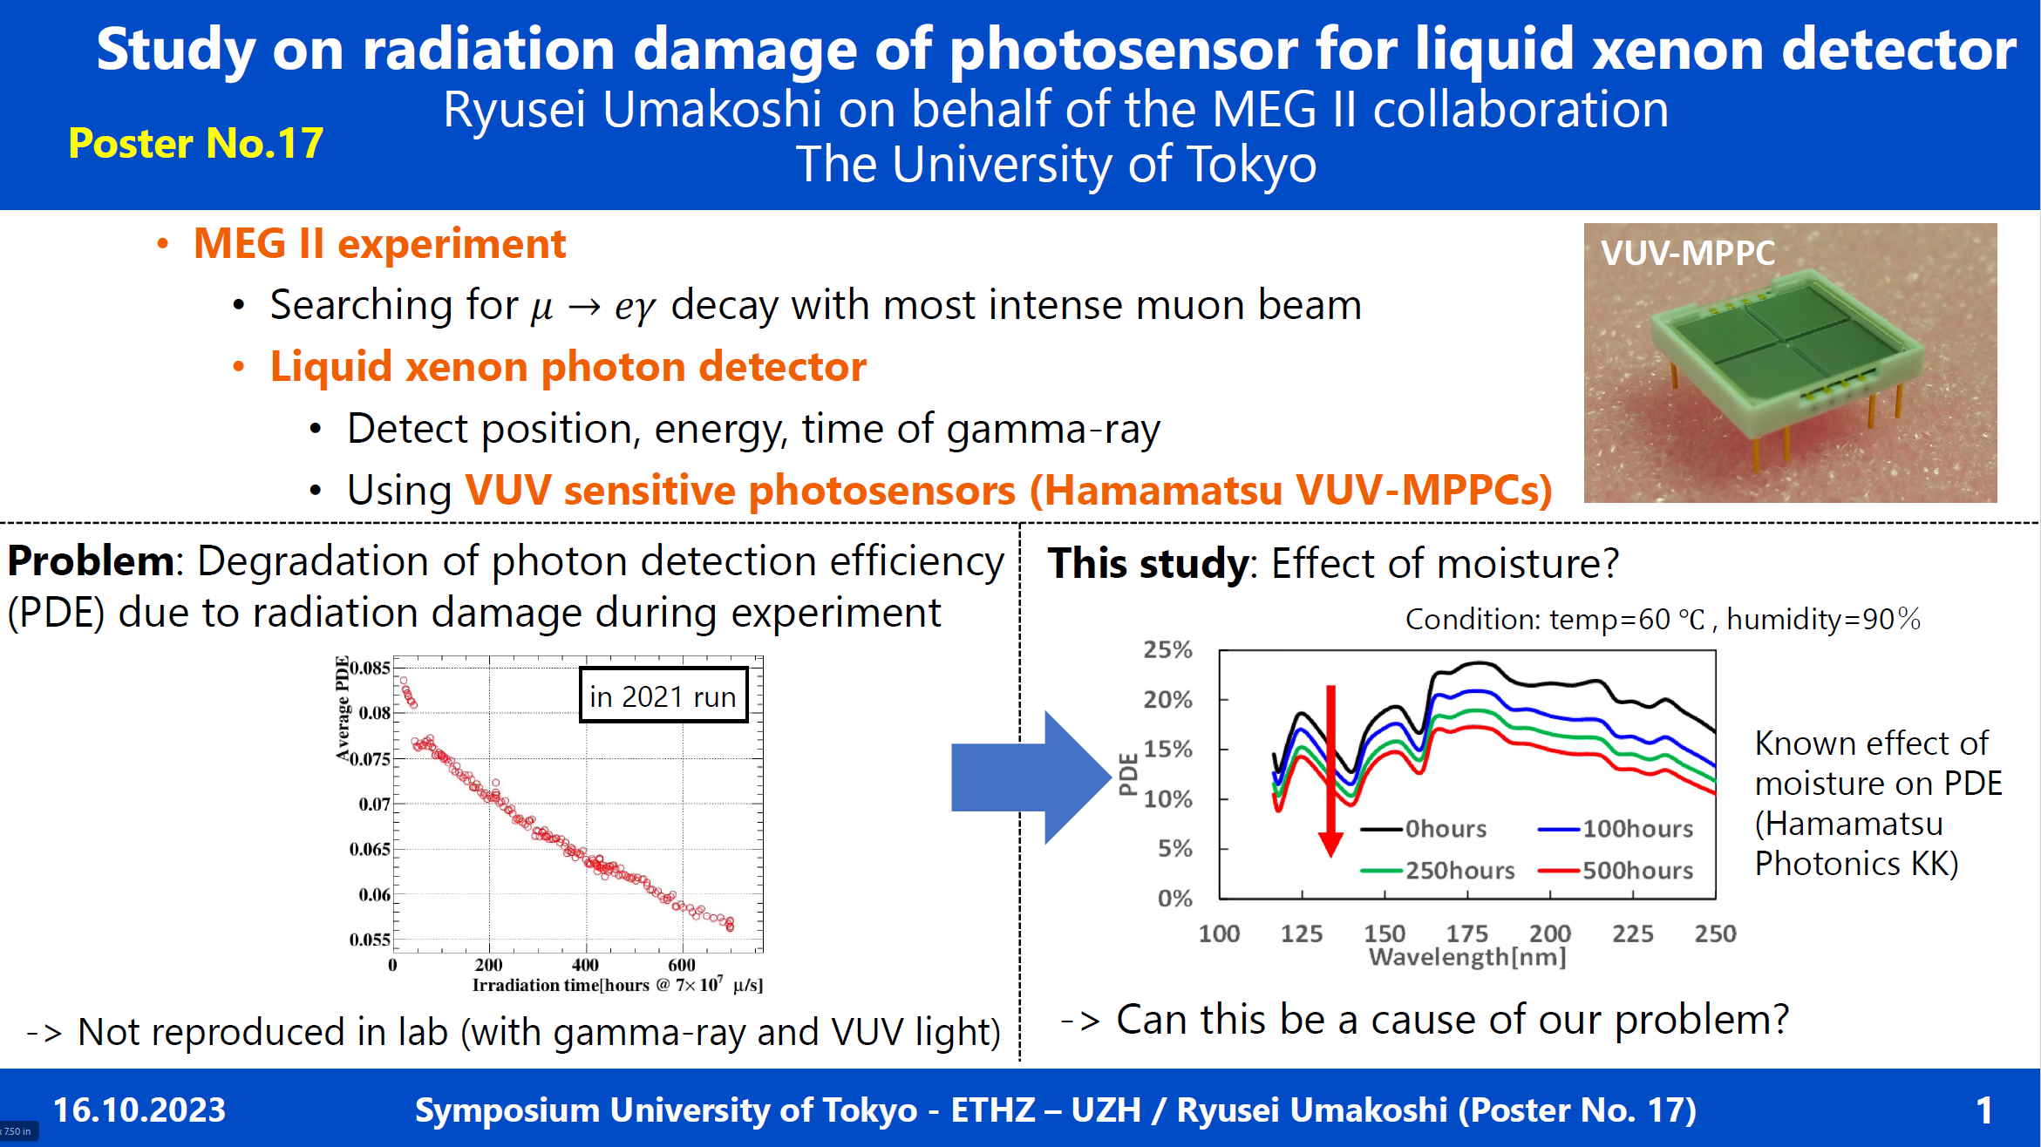

Slide 17


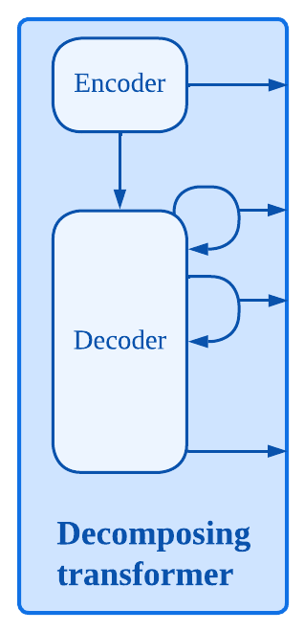
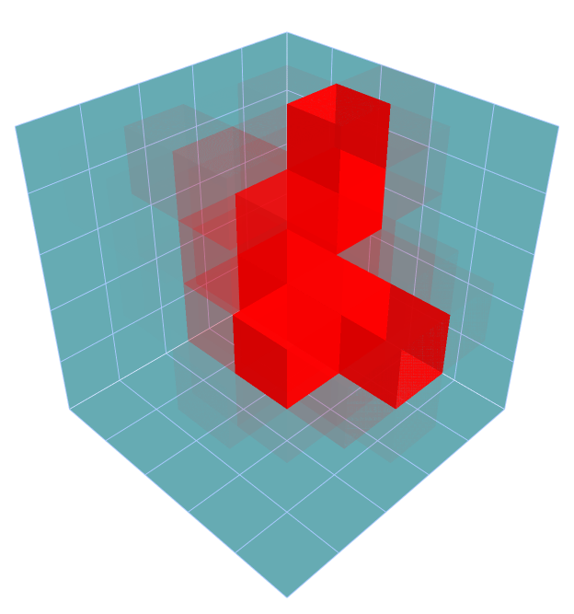
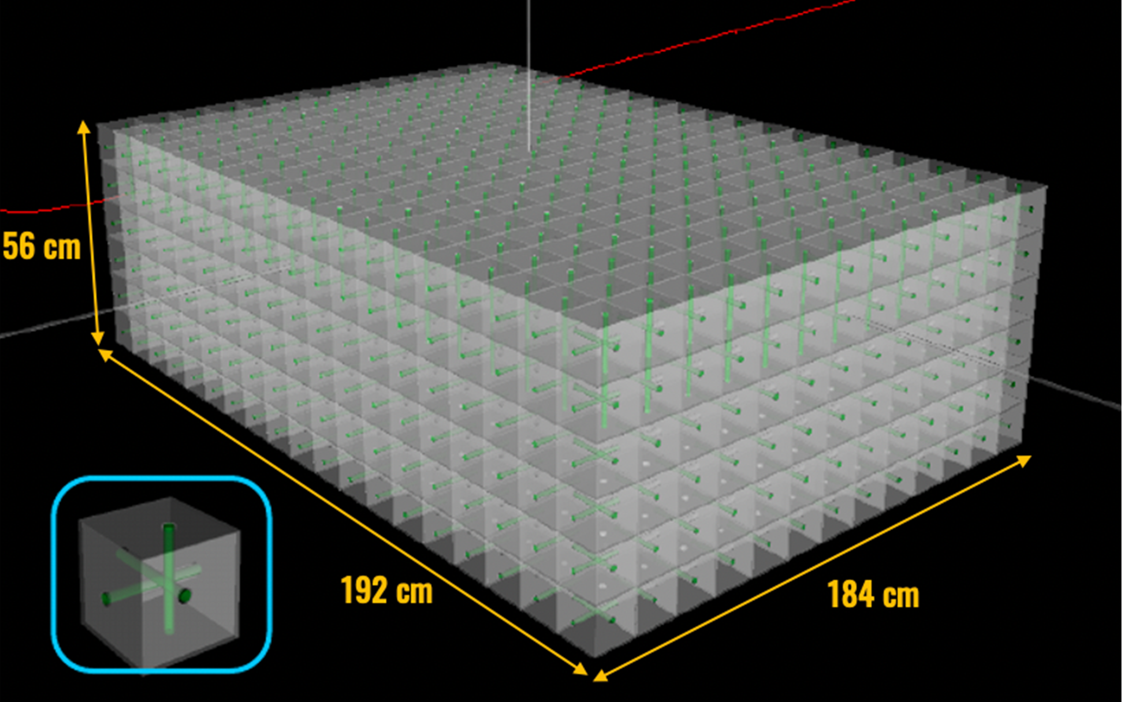

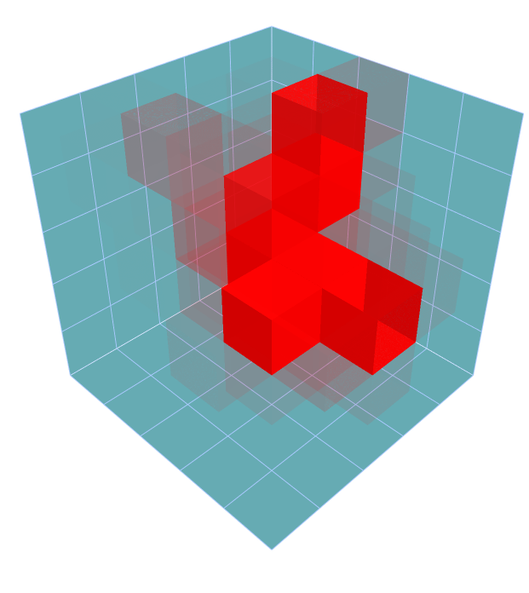
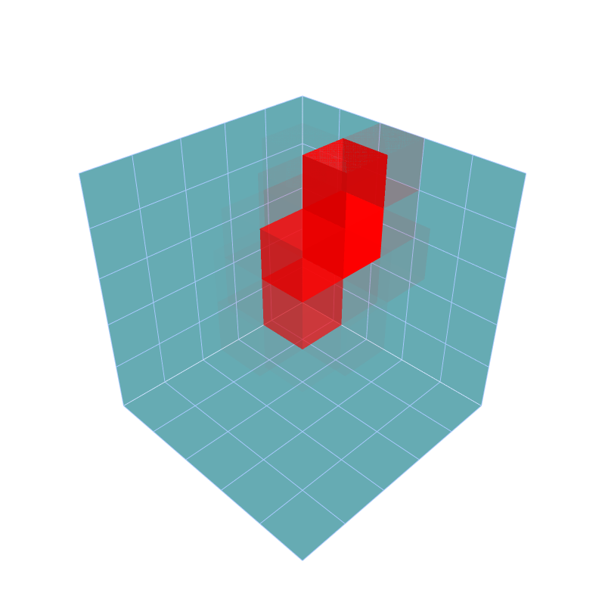
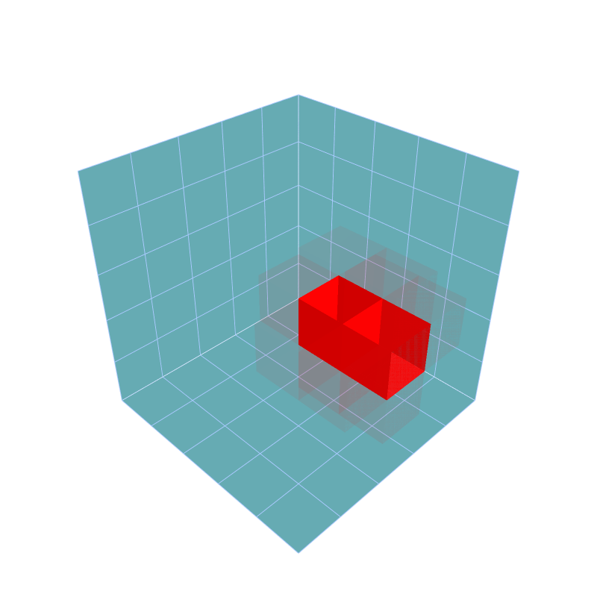
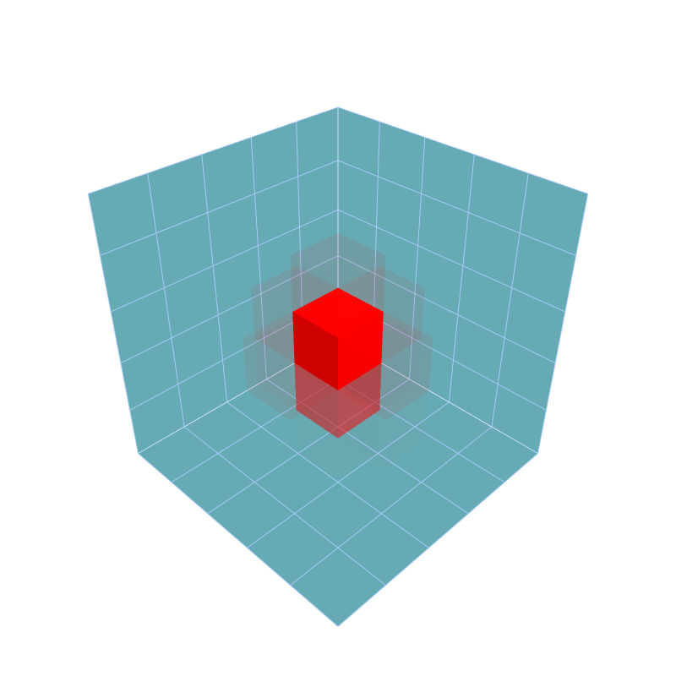
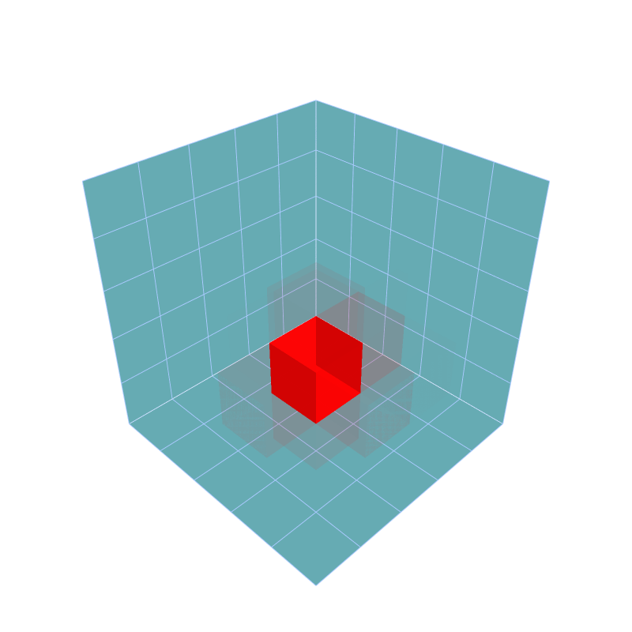
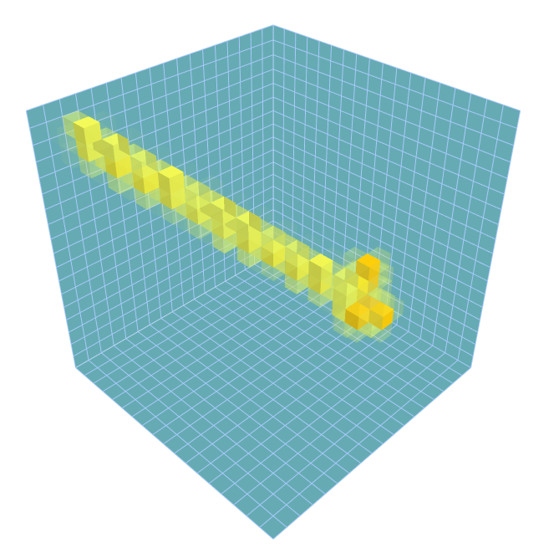
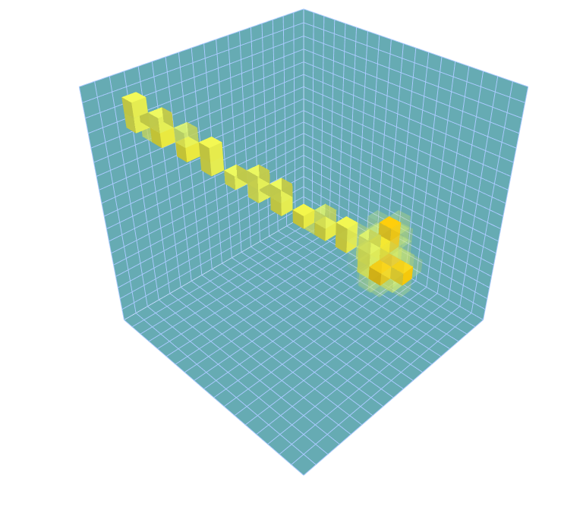
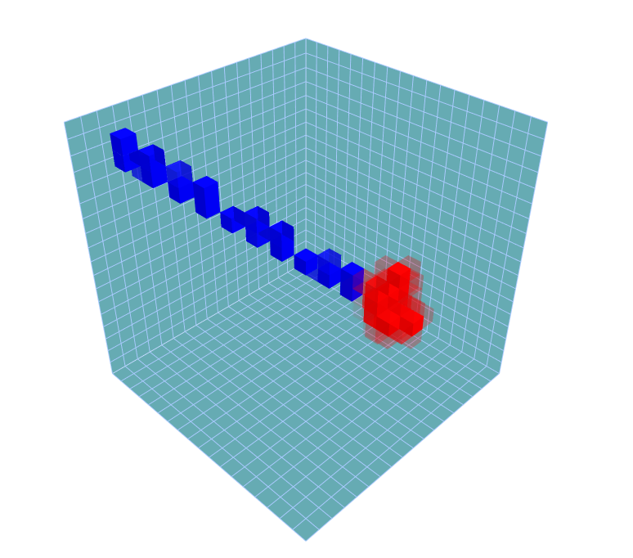
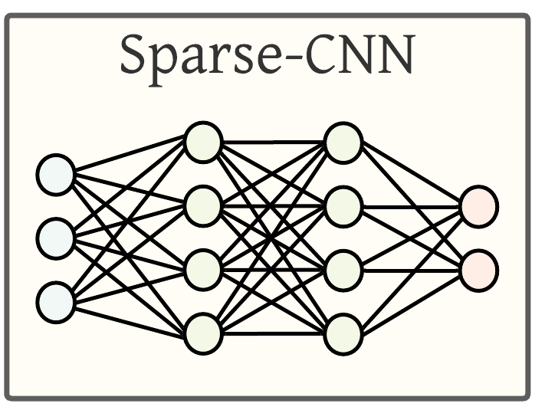
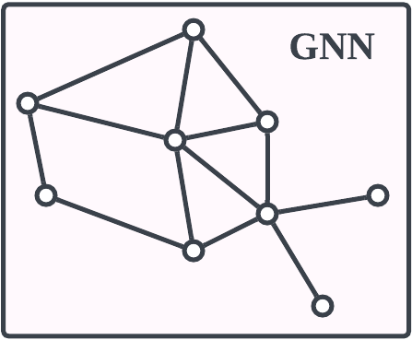


Poster #18: Deep learning in the T2K near detector
  Saúl Alonso-Monsalve
  Department of Physics, ETH Zurich
Neutrinos are the most mysterious particles in the universe, capable of passing through solid matter without leaving a trace.
Reconstructed kinematics of each single particle
Target event
Step 4: Transformer and generative models to identify and measure independent particles produced at the vertex of neutrino interactions.
SuperFGD neutrino detector:
Ultra-fine scintillator with 2M 1cm³ cubes
Part of the upgrade of the near detector of the T2K experiment in Japan.
Full deep-learning reconstruction and analysis chain!
Reconstructed event
Multi-particle
hits
Provides 3D images of neutrino interactions
Decomposed particles
Step 3: Transformer-encoder and recurrent-neural network (RNN) to fit the actual particle trajectory in the detector,
Clean event
Single-particle
hits
Voxels (hits) with their 3D position and energy.
Step 1: Graph neural network (GNN) to remove noise.
Step 2: Submanifold sparse convolutional network (Sparse-CNN) to discriminate hits.
Fitted particle trajectory

Slide 18








High-harmonic spectroscopy of salts solutions: probing anionic and cationic effects
Poster 19
How are high-harmonic generated?
Why salts solutions?
Salt solutions form their closest approximation to biological systems.
Salt solutions are equivalent doping in solids, thus a test case for studying dopant induced dynamics.
Generate XUV pulses of 43 as (${10}^{−18} s$) duration
“FOR EXPERIMENTAL METHODS THAT GENERATE ATTOSECOND PULSES OF LIGHT FOR THE STUDY OF ELECTRON DYNAMICS IN MATTER” -
The Nobel Committee for Physics
Optics Express. 25, 22, 27506 (2017)
ETH Zürich
Angana Mondal

Slide 19


Slide 20

Poster No.21

Slide 21













From LEGEND to Reality: Cracking the Code of Creation
Marta Babicz (Physik-Institut, University of Zurich)
Why did matter prevail over antimatter post-Big Bang despite their equal creation?
1.4 km thick layer of rock reduces cosmic muons by O(10⁶)
LEGEND’s ⁷⁶Ge detectors can both spark and spot a super-rare 0νββ decay.
Gran Sasso mountain
Neutrinos ($ν$), elusive particles that might be their own antiparticles ($\overline{ν}$) are linked to this imbalance.
?
⁷⁶Ge detectors
LEGEND’s goal:
Decode the origin of the universe by detecting neutrinoless double beta decay (0νββ) - a hypothetical nuclear decay which is only allowed if the neutrino is its own antiparticle
0νββ
⁷⁶Ge Detector Cross Section: Charge drift
Generated Signal
Water tank
$$e^{−}$$
$$e^{−}$$
Charge
Current
LAr cryostat
Poster No. 22

Slide 22



Quantum computation of a spin-boson model
23
Photosynthesis
Simulation by a quantum computer
Excitation energy transfer
Spin-boson model
N. Lambert et al. Nat. Phys. 9, 10-18 (2013)

Slide 23

Poster No.24

Slide 24



Poster No.25
Multiscale Functional and Molecular Imaging Lab
Platform for Optoacoustic screening of Genetically Encoded Calcium Indicators
E. coli.
Colonies
c, Optoacoustic image at 488 nm. Depth of 1–2 mm
d, Optoacoustic image at 650 nm. Depth of ~7 mm
^{Without Calcium}
^{With Calcium}
Figure 1: Non-invasive imaging of the GCaMP6f brain in vivo. [1]
Figure 2: Optoacoustic and Fluorescence images R-GECO1. [2]
[1] Gottschalk et al., Rapid volumetric optoacoustic imaging of neural dynamics across the mouse brain. Nat. Biomed. Eng. (2019)
[2] Hofmann et al., High-Throughput Platform for Optoacoustic Probing of Genetically Encoded Calcium Ion Indicators. iScience. (2019)
Contact: liuxian@ethz.ch

Slide 25







Poster No.26
UAV measurements of growth and phenology in larch and their genetic dissection
${\text{Haruka} \text{Sano}}^{1}$, ${\text{Yamato} \text{Unno}}^{2}$, ${\text{Sachiko} \text{Isobe}}^{3}$, ${\text{Wei} \text{Guo}}^{1}$, ${\text{Naoko} \text{Miura}}^{1}$, ${\text{Kazutaka} \text{Kusunoki}}^{2}$ and ${\text{Hiroyoshi} \text{Iwata}}^{1}$
1. Graduate School of Agricultural and Life Sciences, The University of Tokyo; 2. SUMITOMO FORESTRY CO., LTD; 3. Kazusa DNA Research Institute
A non-destructive and efficient system for measuring tree height and diameter was created by analyzing point cloud data acquired by UAV-mounted sensors.
We established a method to quantitatively measure tree phenology at the individual scale.
Heritability and genetic correlation were also calculated.
Phenology: Response of organisms to seasonal changes in the environment.
In recent years, the role of forests as carbon sink has received increasing attention in terms of climate change mitigation and adaptation.
Our goal is to develop a multidimensional method for measuring biomass growth in forests and to understand biomass growth with respect to environmental response and genetic factors.
Family
Growth period

Slide 26


Slide 27

Poster No.28

Slide 28




Short flashes of X-rays for show bio-molecules dance
Poster No.29
Optical-pump Soft X-ray probe spectroscopy
Experiment: 10 M urea solution
Theory: QM/MM+XAS
Photon energy, eV
Photon energy, eV

Slide 29














Poster No.30
UTokyo's Strategic Partnerships Project
Dr Kate Harris (UTokyo)
Maintain sustainable strategic partnerships
Establish sustainable relationships including industry and government
Establish partnerships
2014
2017
2021
2024
Phase 1
Phase 2
Phase 3
2022
Three presidents agree on the “Group of Zurich” principle
2023
Today’s symposium!
Strategic
Partnership
Strategic
Partnership
Strategic
Partnership
What do you want?

Slide 30

Poster No.31

