Slide 1

Interdisciplinary PhD teaching at UZH
Funding opportunities for Switzerland-Japan collaboration
- on behalf of UZH Global Affairs
Professor, Vice-Director of the Department of Evolutionary Biology and Environmental Studies
Co-Director of the University Research Priority Program of Evolution in Action
Kentaro Shimizu

Slide 2
Largest University in Switzerland
Faculty of Science
UZH_FactsFigures2022_en.pdf
Ever increasing number of students

Slide 3
Teaching Biology, Faculty of Science, Univ. Zurich
Bachelor | Master | PhD
3-4 years | 1.5-2 years | 4+ years
Annual Report, Division Biology 2022-2023
High number of PhD students

Slide 4
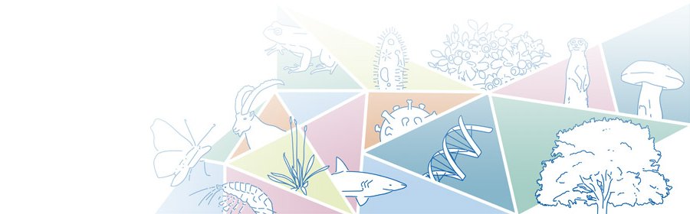
Bachelor: major differences from Japan
New in 2023:
Biological and environmental sciences and policy
Bachelor
- no entrance exam after “Matura” of Gymnasium (6-year high school)
- approximately half dropout in 2 years
Annual Report, Division Biology 2022-2023
https://www.biodiversitaet.uzh.ch/en.html
More and more lectures in English

Slide 5
Master in Biology: teaching in English
Courses, thesis (6-12 months)
79 MSc degrees finished in 2022
Annual Report, Division Biology 2022-2023
1.5-2 years

Slide 6
PhD in Biology
165 PhD degrees finished in 2022
Annual Report, Division Biology 2022-2023
Evolutionary Biology as an example

Slide 7


å
PhD Program in Evolutionary Biology
Director: Kentaro Shimizu, Coordinator: Tony Weingrill
https://www.evobio.uzh.ch/en.html
33 PIs (UZH, ETHZ)
PhD committee meeting every year by internal and external members
Courses including special lectures, Scientific Integrity, Teaching and presentation skills
BIO610 Next-Generation Sequencing and its Application using Machine Learning
(Sese, Shimizu, Shimizu-Inatsugi, Hatakeyama, Tanwar)
PhD Program in Evolutionary Biology

Slide 8
Guidelines on A.I. tools for lecturers and students
8 Sep. 2023, https://www.mnf.uzh.ch/en/studium/rund-ums-studium/Studium-und-KI.html
1. Lecturers and students are encouraged to experiment with, apply, and critically evaluate A.I. tools within the context of teaching and learning activities. The decision to use A.I. tools should be driven by their potential to enhance learning outcomes and should serve as a supplementary component to existing didactic strategies, rather than being adopted purely for their innovative appeal.
2. Lecturers and students are expected to critically evaluate the outputs generated by A.I. tools and determine the veracity and suitability of such results. The responsibility for the validity and authenticity of their work rests entirely with the user.
3. Lecturers and students should bear in mind that A.I. tools can amplify human biases, leading to potentially unfair or discriminatory outcomes.
4. The Faculty of Science strongly advocates for the development of students' critical and ethical thinking abilities, particularly in the context of using A.I. tools.
5. Lecturers grading remote learning and online examinations should take in account the accessibility of A.I. tools to students to ensure fairness and accuracy in evaluation.
6. In terms of academic work and publications, the focus should be directed towards the quality of data and their analyses. As A.I. tools become more widely used, grading of language quality should become less important.
7. Awareness of legal limitations related to the use of A.I. tools is crucial, especially concerning Data Protection laws in Switzerland and the General Data Protection Regulation (GDPR) in Europe. Any data uploaded to A.I. tools may be utilized for further A.I. training and could potentially be accessed by third-party applications, beyond the control of the users.

Slide 9
PhD Program in Evolutionary Biology
Director: Kentaro Shimizu, Coordinator: Tony Weingrill
https://www.evobio.uzh.ch/en.html
33 PIs (UZH, ETHZ)
PhD committee meeting every year by internal and external members
Courses including special lectures, Scientific Integrity, Teaching and presentation skills
77 students:
51% female, 49% male
26% Swiss, 74% International
PhD Program in Evolutionary Biology

Slide 10
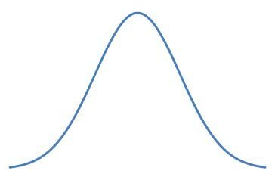
Attracting students and internationalization
Applications: both to programs and to PIs
Simple assumption: - normal distribution among students
- no average difference between countries
66 million
in France
More outgoing
Few incoming
- English lectures
- PhD salary
8 million
in Switzerland
(1 million for the
University of Zurich)
126 million
in Japan
- no big advantage
any more
Nikkei Newspaper
16 May 2023
Potential Challenge for Japan

Slide 11









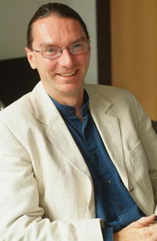
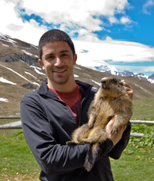
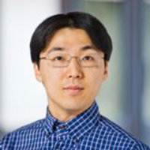
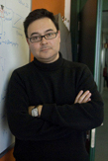
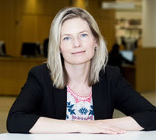

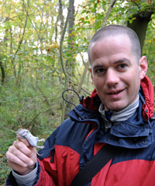

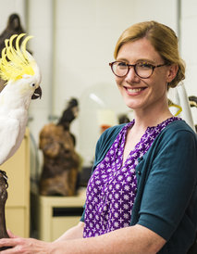

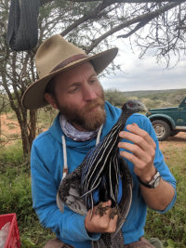
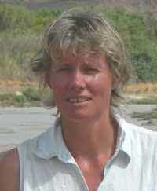
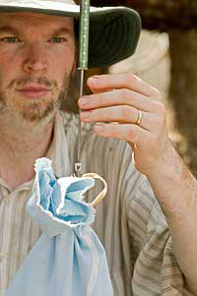
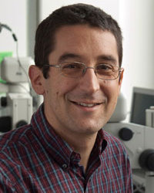
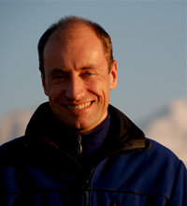
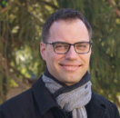
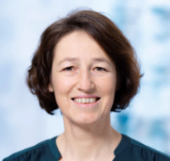
International research environment in Switzerland
Schiermeier, Nature 435:532 (2005)
Ursula Röthlisberger is in a minority at the Swiss Federal Institute of Technology in Lausanne (EPFL). That she is a woman and a young scientist leading her own independent group is not unusual. Rather, what makes her stand out is that she is Swiss.
Professors, Department of Evolutionary Biology and Environmental Studies, Univ. Zurich
Austria Turkey Japan Spain Finland Germany UK USA Australia
Wagner Ozgul Shimizu Bascompte Laine Blanckenhorn Petchey Hall Aplin
Australia/Switzerland
Farine
Switzerland
Manser Keller Altermatt Niklaus Lüpold Schaepman-Strub
www.ieu.uzh.ch
Faculty meeting in English

Slide 12
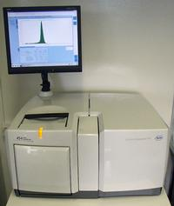


University Research Priority Program (URPP)
to support interdisciplinary education and research
12-year programs, between faculties and departments
Bottom-up proposals
Financial supports for young scientists (mostly PhD students)
URPP Systems Biology/
Functional Genomics
(2005-2016)
Biologists, mathematicians,
physicists, etc.
Coordinator: Cornelia Schauz
URPP Global Change
and Biodiversity (2013-)
URPP Evolution in Action
Grossniklaus & Shimizu
(2013-)
Often expanded to nation-wide programs (NCCR)

Slide 13
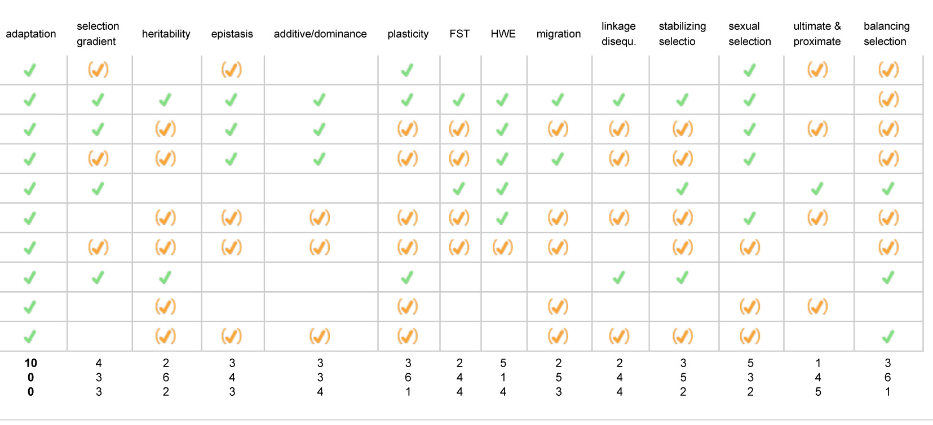
University Research Priority Program (URPP) Evolution in Action
Bottom-up proposals from PIs from different Departments/Faculties
Co-supervision of PhD students and postdocs
PhD program in Evolutionary Biology
-A crash course for common terminology (BIO395 Concepts in Evolutionary Biology)
to students in biology, medicine and linguistics
Additive/dominance
genetic variation
Linkage
disequi-
librium
Ultimate &
proximate
cause
Stabilizing
selection

Slide 14
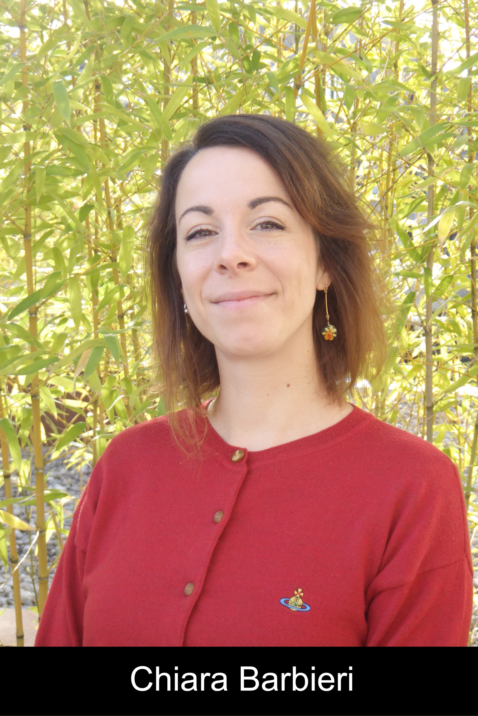
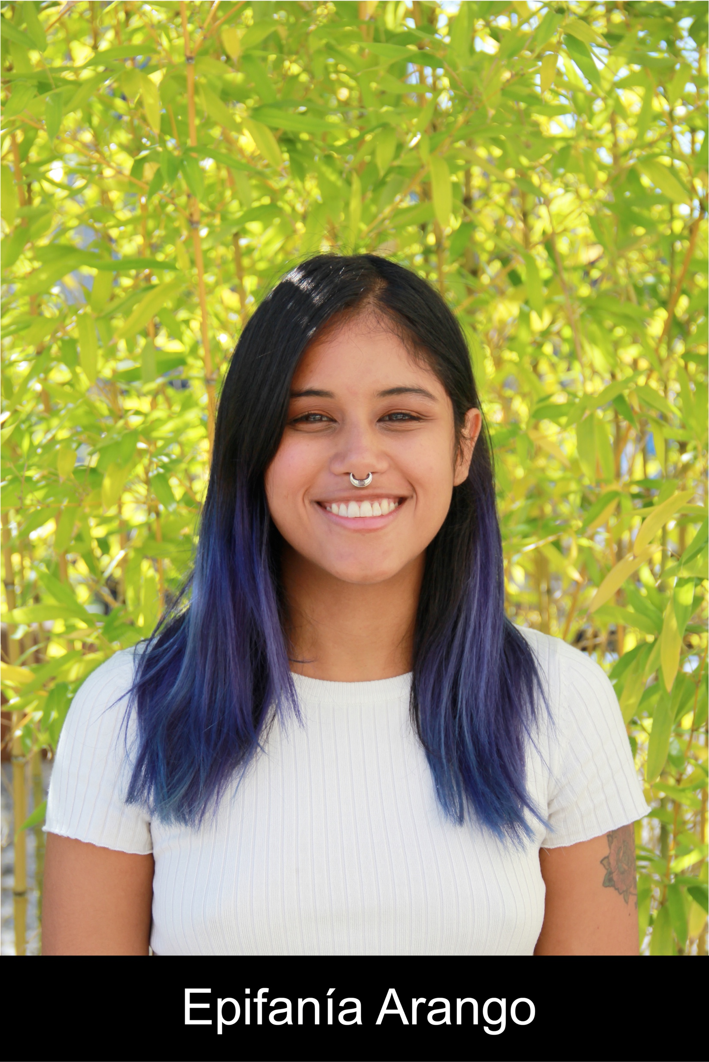
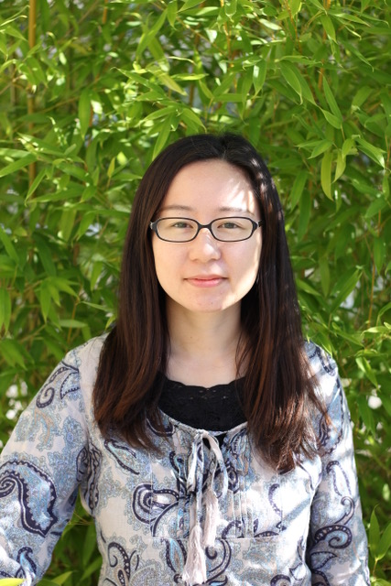
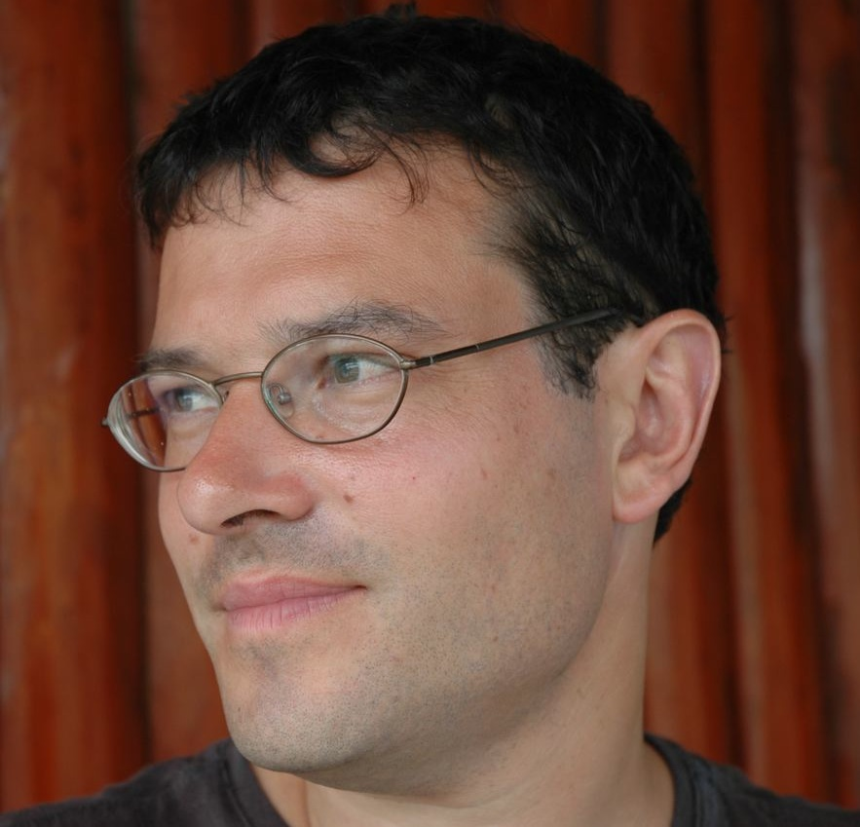
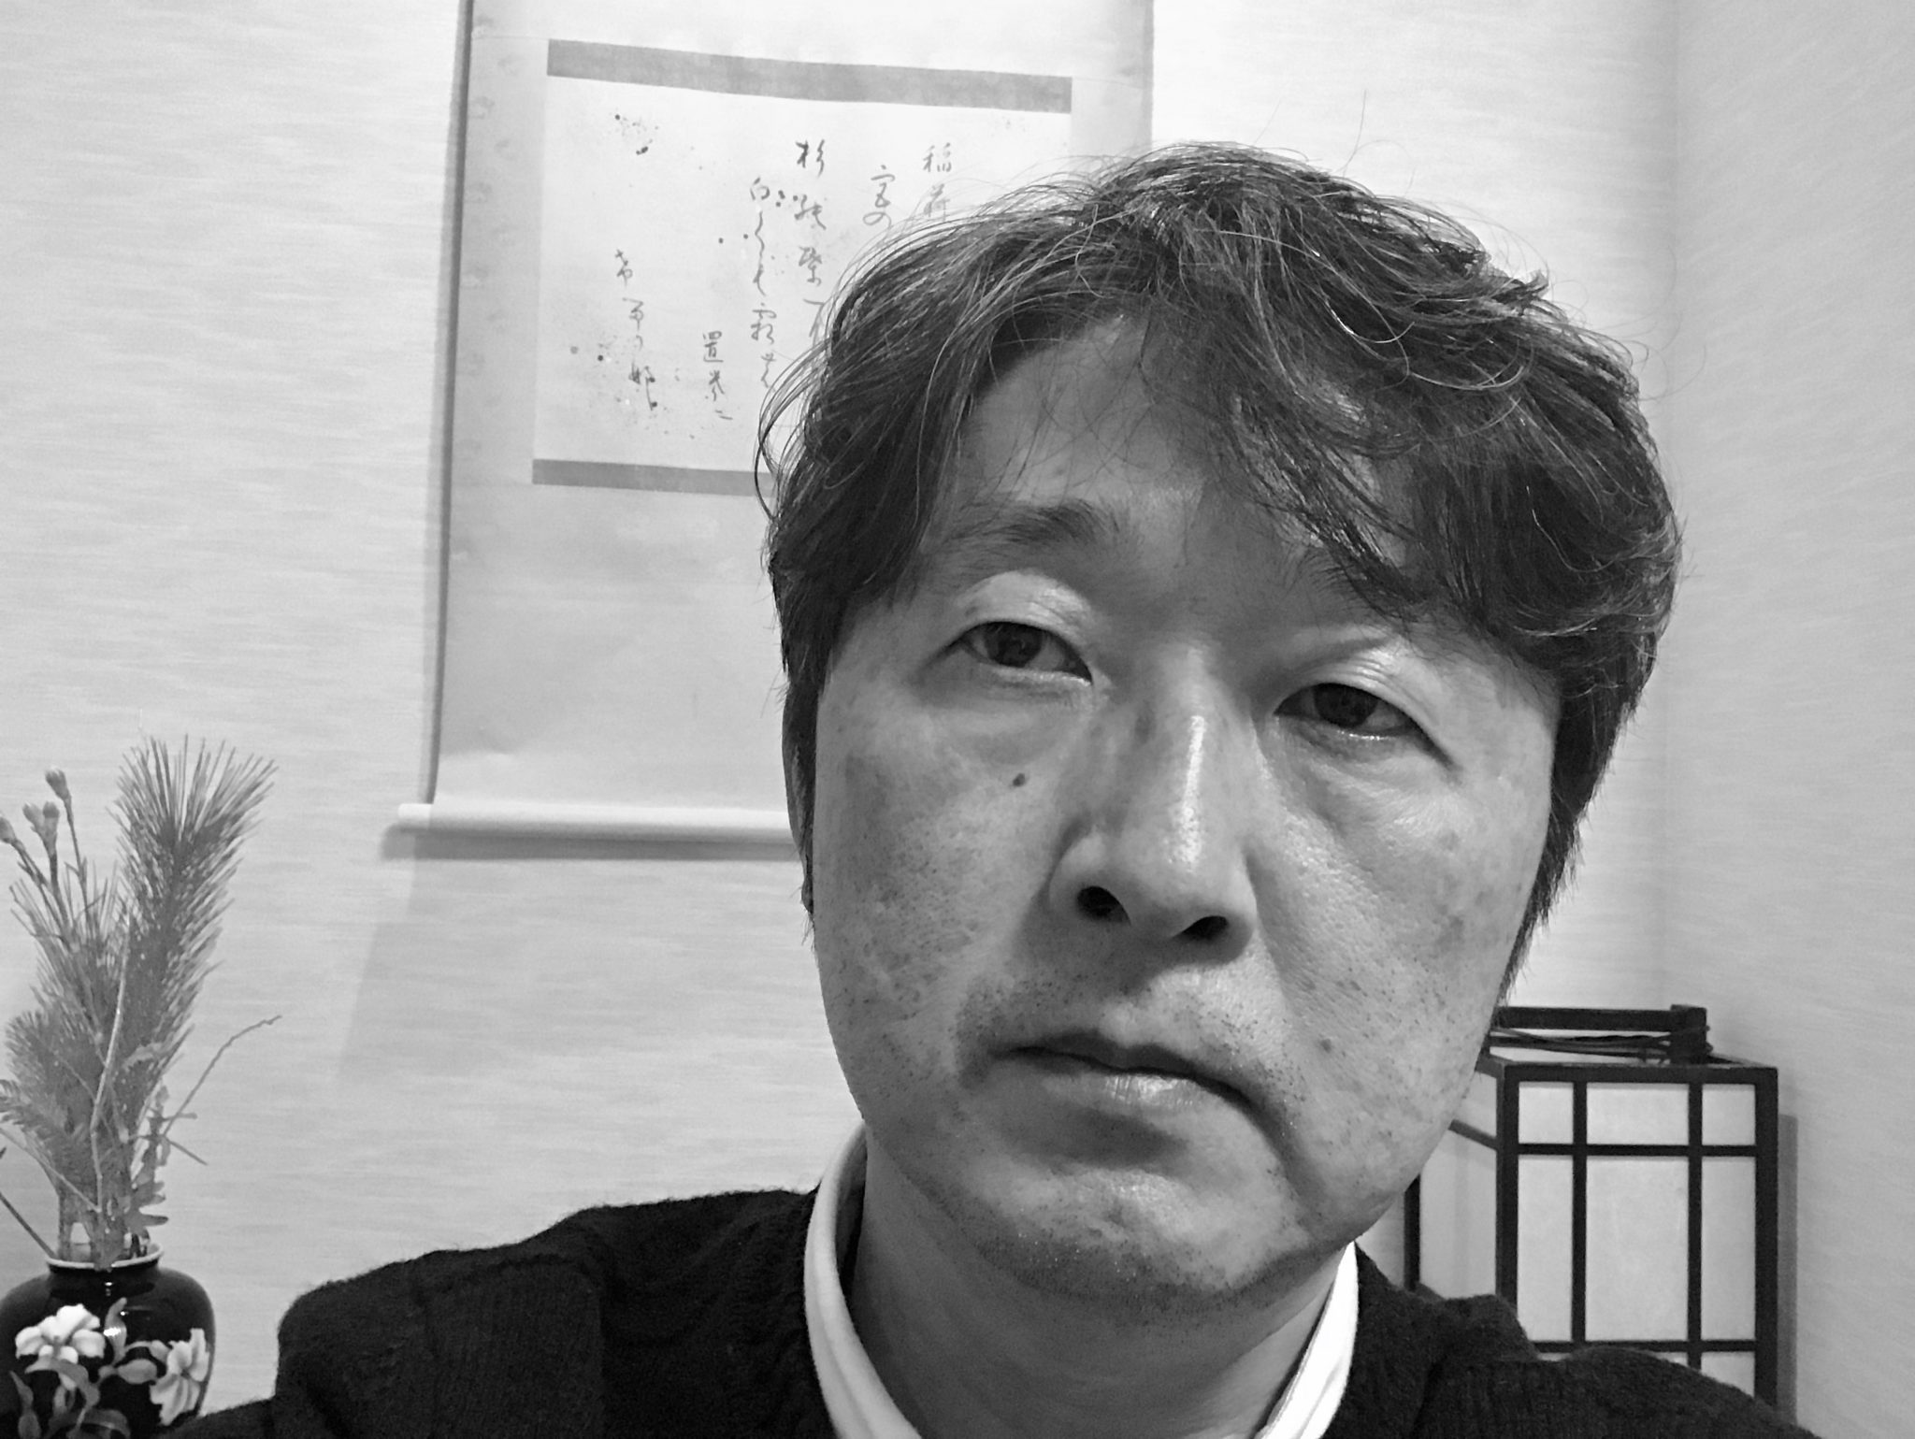
Interdisciplinary study by co-supervision
Example 1: language evolution
Young researchers supported by URPP Evolution in Action
Dr. Hiromi Matsumae
(now tenure-track,
Fac. Med., Tokai Univ.)
Dr. Chiara Barbieri
(now tenure-track,
Univ. Cagliari, Italy)
Epifania Arango-Isaza
(PhD student)
Linguistics
Anthropology
Prof. Balthasar Bickel, Univ. Zurich
Director of NCCR Evolving Language
Prof. Hiroki Oota, Grad. Sci., U. Tokyo
Started from the chat with Balthasar

Slide 15
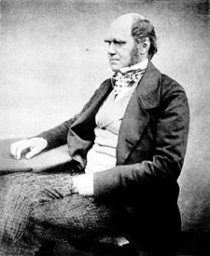
Genetic and linguistic evolution
1871
The formation of different languages and of distinct species, and the proofs that both have been developed through gradual process, are curiously parallel.
Charles Darwin
1859 Origin of Species
"a perfect pedigree of mankind … would afford the best classification of the various languages now spoken throughout the world
Match or mismatch of genetics and linguistics?

Slide 16
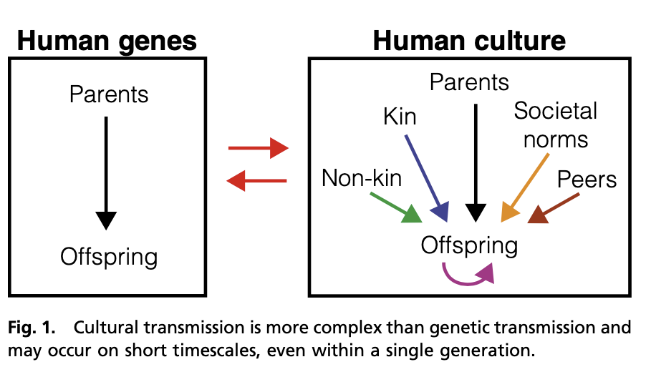
Similarity of biology and language:
transmission with modification
Creanza, Kolodny, Feldman PNAS 2017
DNA variation: (mostly) vertical
Spatio-temporary (relatively) stable
Useful to infer demography
Culture: vertical and horizontal
Similairty and difference

Slide 17
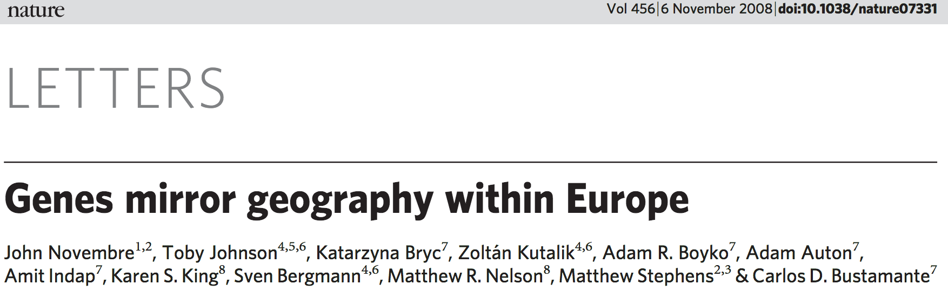
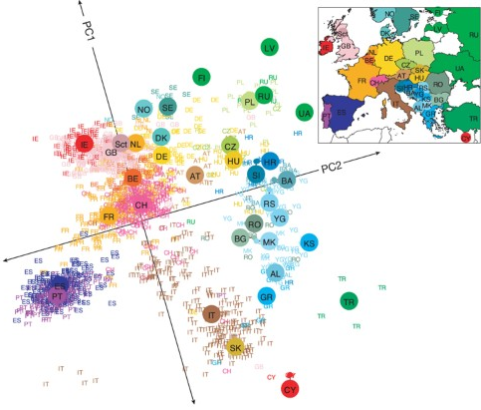
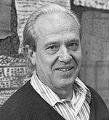
Previous studies using genetic data
General match but with an exception
“language shift”
Nature 456:98, 2008
Hungarian
Cavalli-Sforza et al.
PNAS 89, 5620, 1992
med.stanford.edu
Long dispute: match or mismatch?

Slide 18
A case study in North Asia
14 populations
11 language families/
isolates
Tungusic (2)
Chukuto-Kamchatkan (2)
Uralic (2)
Turkic
Mongolic
Eskimo-Aleut
Japonic
Yukagir
Korean
Nivkh
Ainu
Matsumae et al. Science Advances 18: eabd9223, 2021
Genetically and culturally diverse region

Slide 19
Linguistic data
14 populations
11 language families/
isolates
Lexicon data are not informative
21 grammatical traits
84 phonological traits
Japanese
Ainu
Japanese
Korean
Korean
Matsumae et al. Science Advances 18: eabd9223, 2021
AUTOTYP database at the UZH

Slide 20
Music data
14 populations
11 language families/
isolates
41 musical traits
Matsumae et al. Science Advances 18: eabd9223, 2021
Data by Patrick Savage

Slide 21
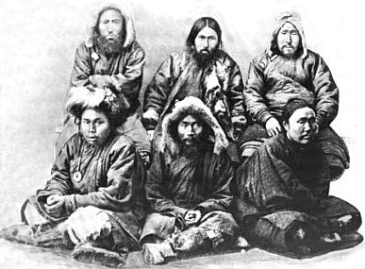
Genetic data: new data of hunter-gathers
14 populations
11 language families/
isolates
Nivkh
(new data)
Korean
Japanese
68,658 genome-wide polymorphisms in common
Ainu
www.wikipedia.org
22 Nivkh (Giliak) individuals (hunter-gatherers, language isolate):
DNA collection before 1980
Matsumae et al. Science Advances 18: eabd9223, 2021
F_{ST} as a genetic distance

Slide 22
Correlation between grammar and genetics
Redundancy analysis
phonology
music
grammar
genetics
genetics
grammar
music
phonology
Matsumae et al. Science Advances 18: eabd9223, 2021
Supporting long-term vertical transmission of grammar

Slide 23

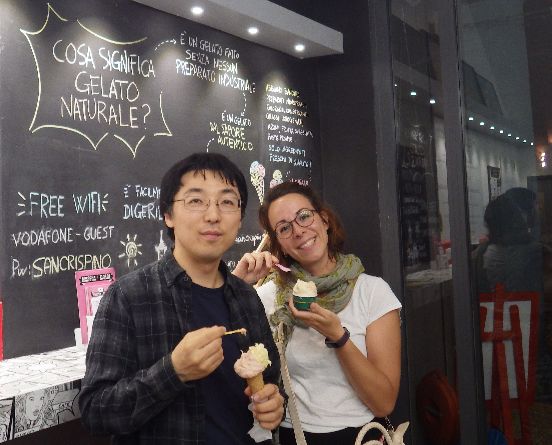
GeLaTo: world-wide database
Human Origins SNP chip
~600,000 SNPs
397 populations 4,030 individuals
295 languages
Dr. Chiara Barbieri
(now tenure-track,
Univ. Cagliari, Italy)
Epifania Arango-Isaza
(PhD student)
Barbieri et al. PNAS 119: e2122084119, 2022
Arango-Isaza et al. Curr Biol 33:2602, 2023
Both match and mismatch (~20%) are common

Slide 24
Summary of example 1: language evolution
Interdisciplinary collaboration: common terminology
Similarity and difference of evolution in action in Biology and Linguistics
In grammar, vertical transmission is common as Darwin proposed
Language shift is also common (~20%)
Indo-European language family was best studied but may not be representative
Nationwide NCCR Evolving Language

Slide 25
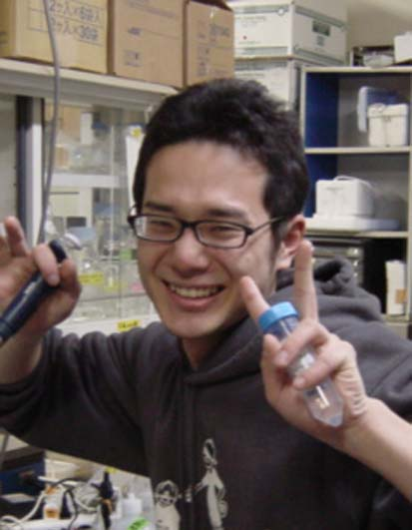
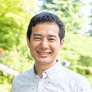
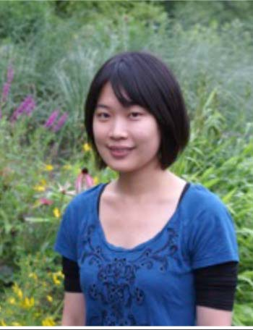
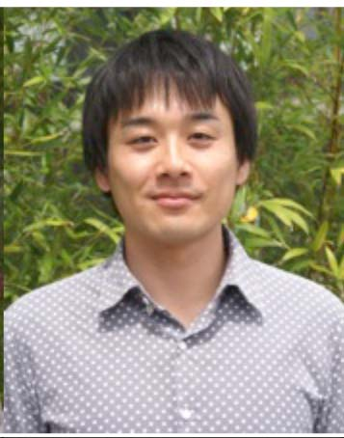
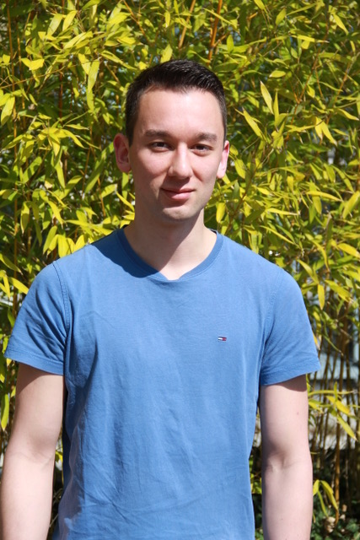
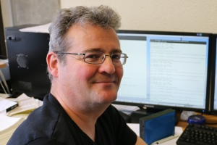
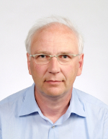
Interdisciplinary study by co-supervision
Example 2: self-fertilization and sperm/pollen number
Takashi Tsuchimatsu
Visiting PhD student from U Tokyo
(Now professor at U Tokyo)
Chowlih Yew
PhD student
Undergrad Singapore
Master Uni. Tokyo
Hiroyuki Kakui
Now U. Tokyo, Grad. Agr.
Assistant Prof
Naoto-Benjamin Hamaya
PhD student of
URPP Evolution in Action
u-tokyo.ac.jp
Thomas Wicker Beat Keller
Dept Plant and Microbial Biol, UZH
URPP Systems Biology / Functional Genomics
URPP Evolution in Action

Slide 26
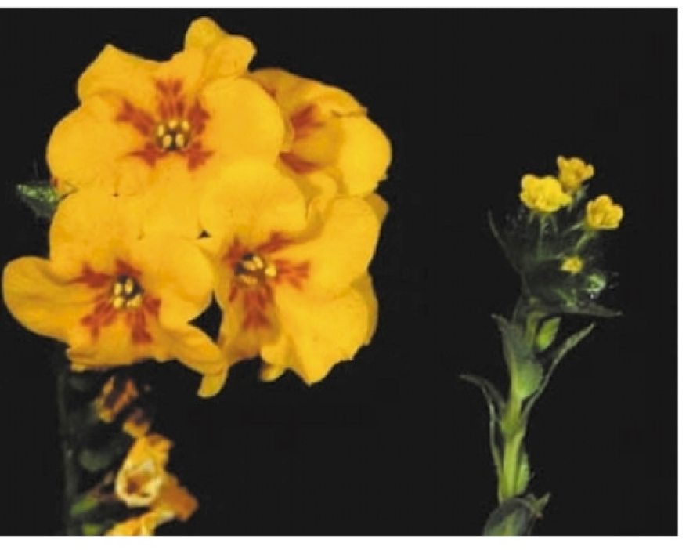
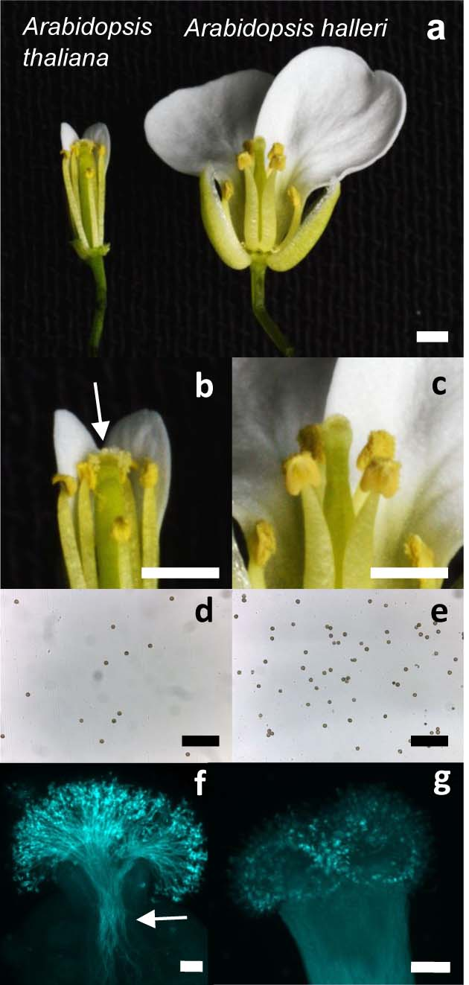
Outcrossing vs. selfing (self-fertilization)
Selfing syndrome
(reduced pollen number etc.)
Barrett 2002, Amsinkia
Loss of self-incompatibility
Tsuchimatsu et al. Nature 2010, Shimizu & Tsuchimatsu, Annu Rev Ecol Evol Syst 2015, Yew et al. accepted
A most frequent evolutionary transition in angiosperms

Slide 27
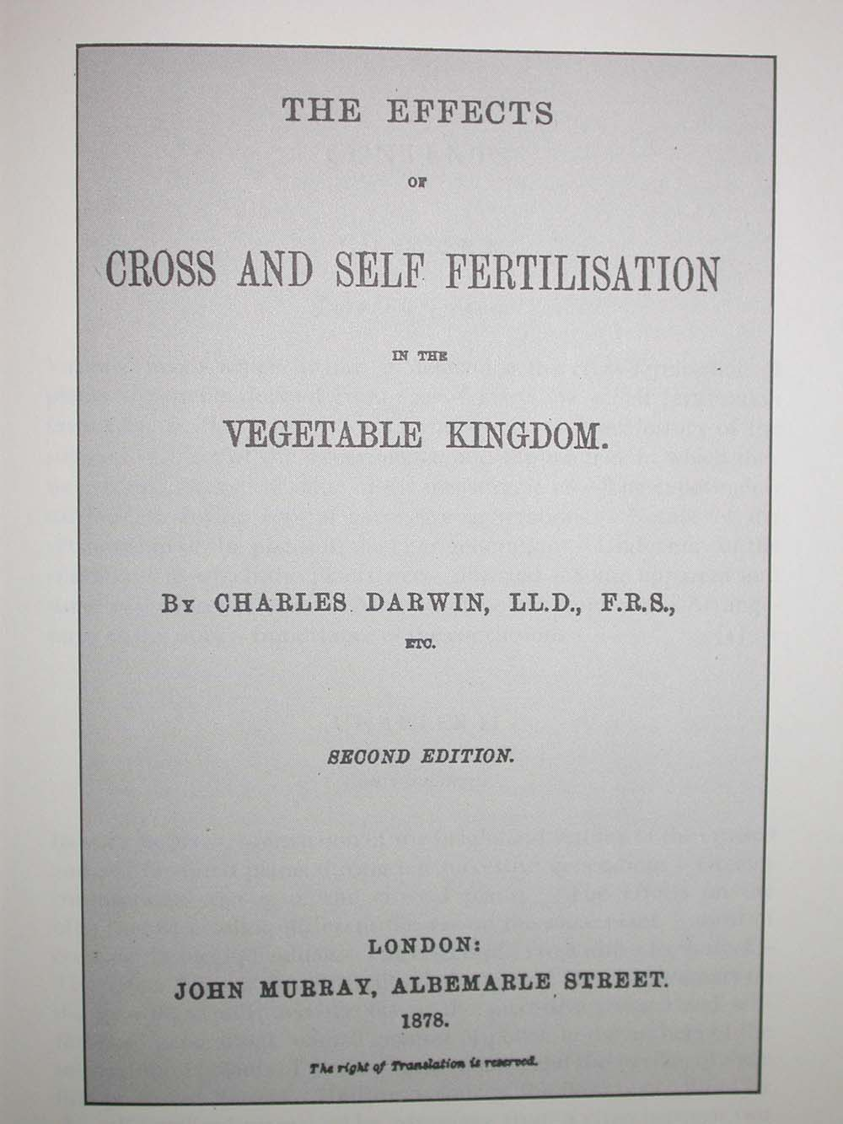
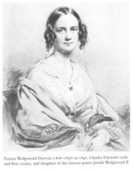
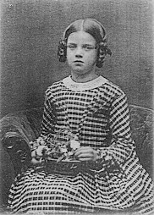
Selfing: maladaptation or adaptation?
en.wikipedia.org
Erasmus Darwin
Josiah Wedgwood
Robert
Susannah
Josiah II
Plants as models
(Darwin 1876)
Charles
Emma
Annie (tuberculosis?)
Adaptation for paucity of mates: molecular support?

Slide 28
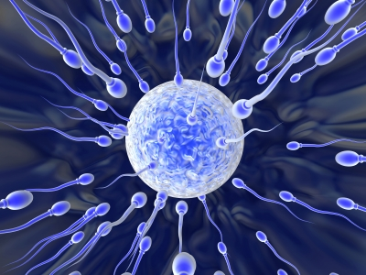
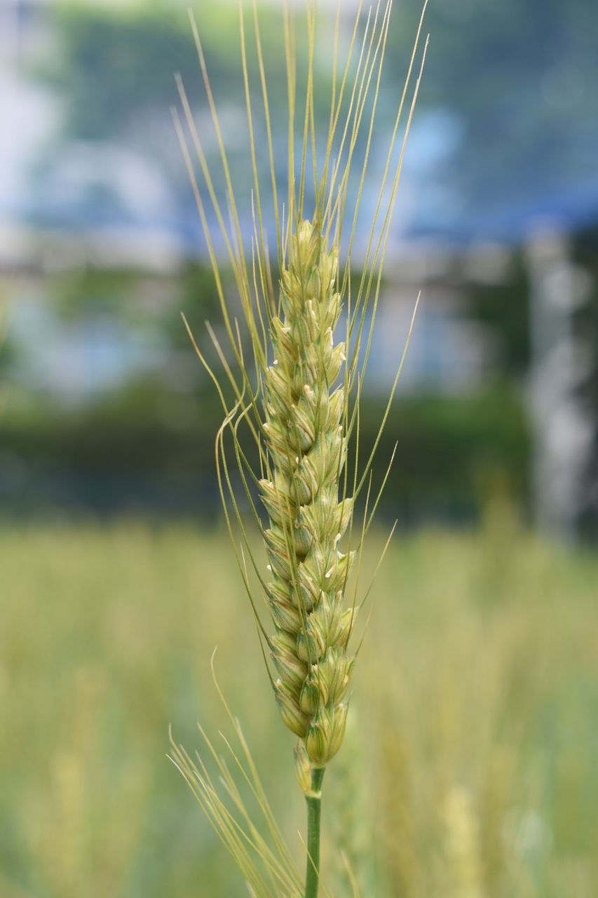
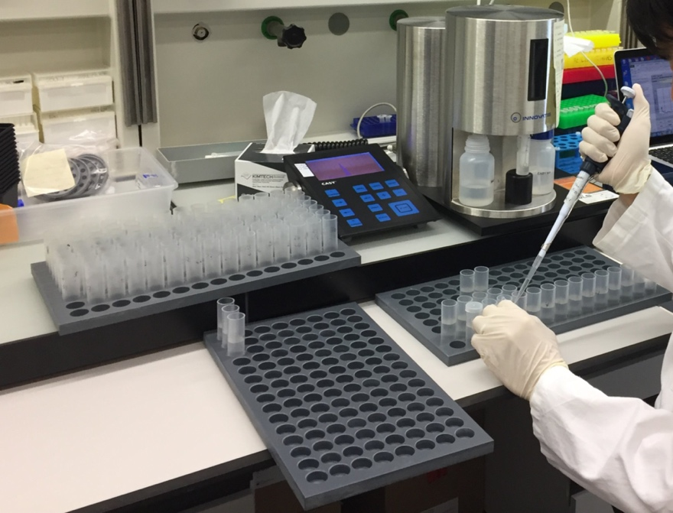
Reduced sperm/pollen number
Maladaptation or adaptation?
Maladaptation? Deleterious?
Selfing: inbreeding depression
http://biobunch.blogspot.jp/2013/09/
lets-talk-sexual-selection.html
Advantage of selfing syndrome? - resource allocation
Evolution in Action: human domestication in ~8,000 years of bread wheat
Pollen and pollen Tube Biology, 2020
Naoto-Benjamin Hamaya
PhD student of URPP Evolution in Action
Isolating relevant genes to test signature of selection

Slide 29
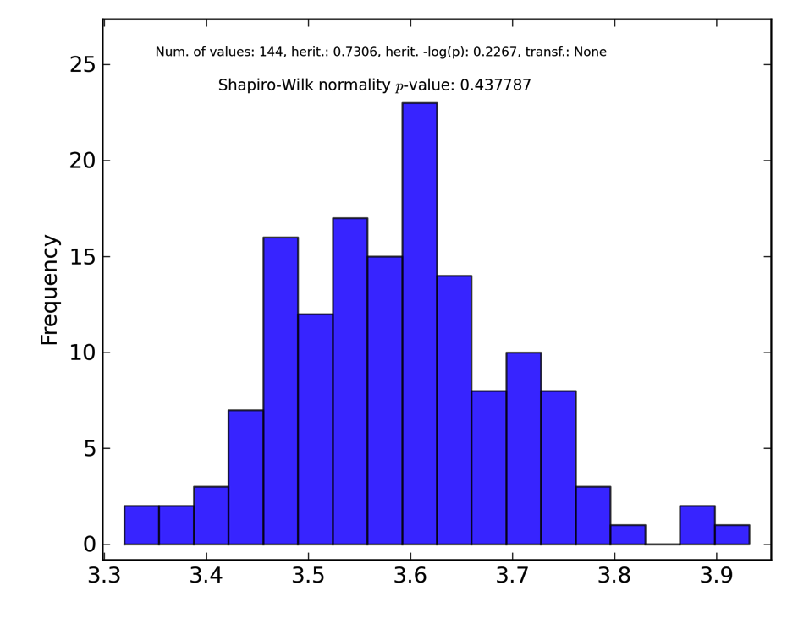
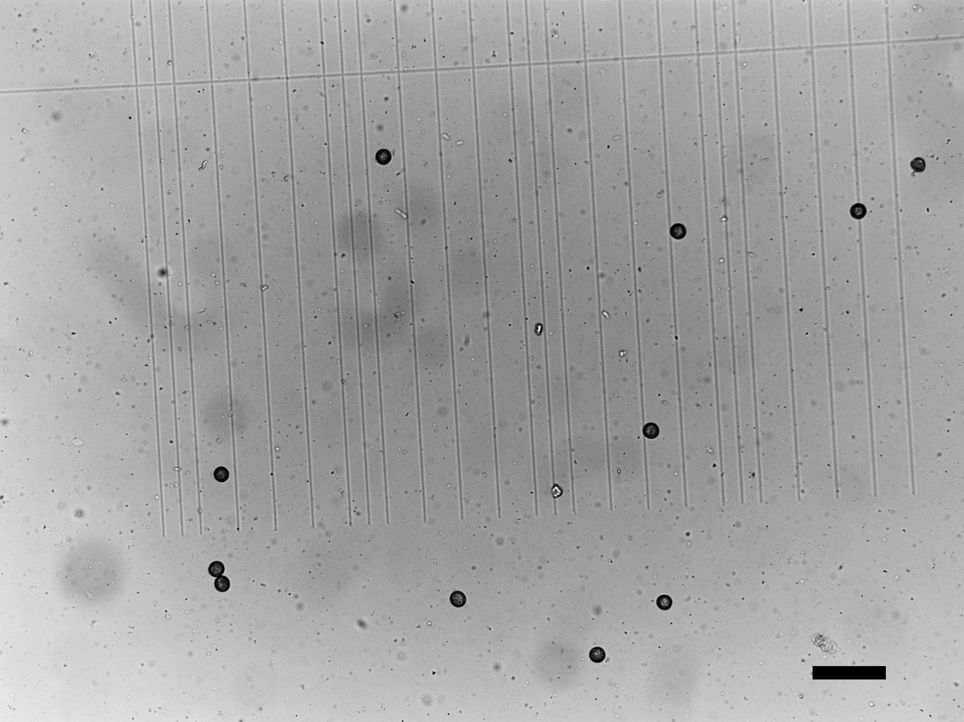
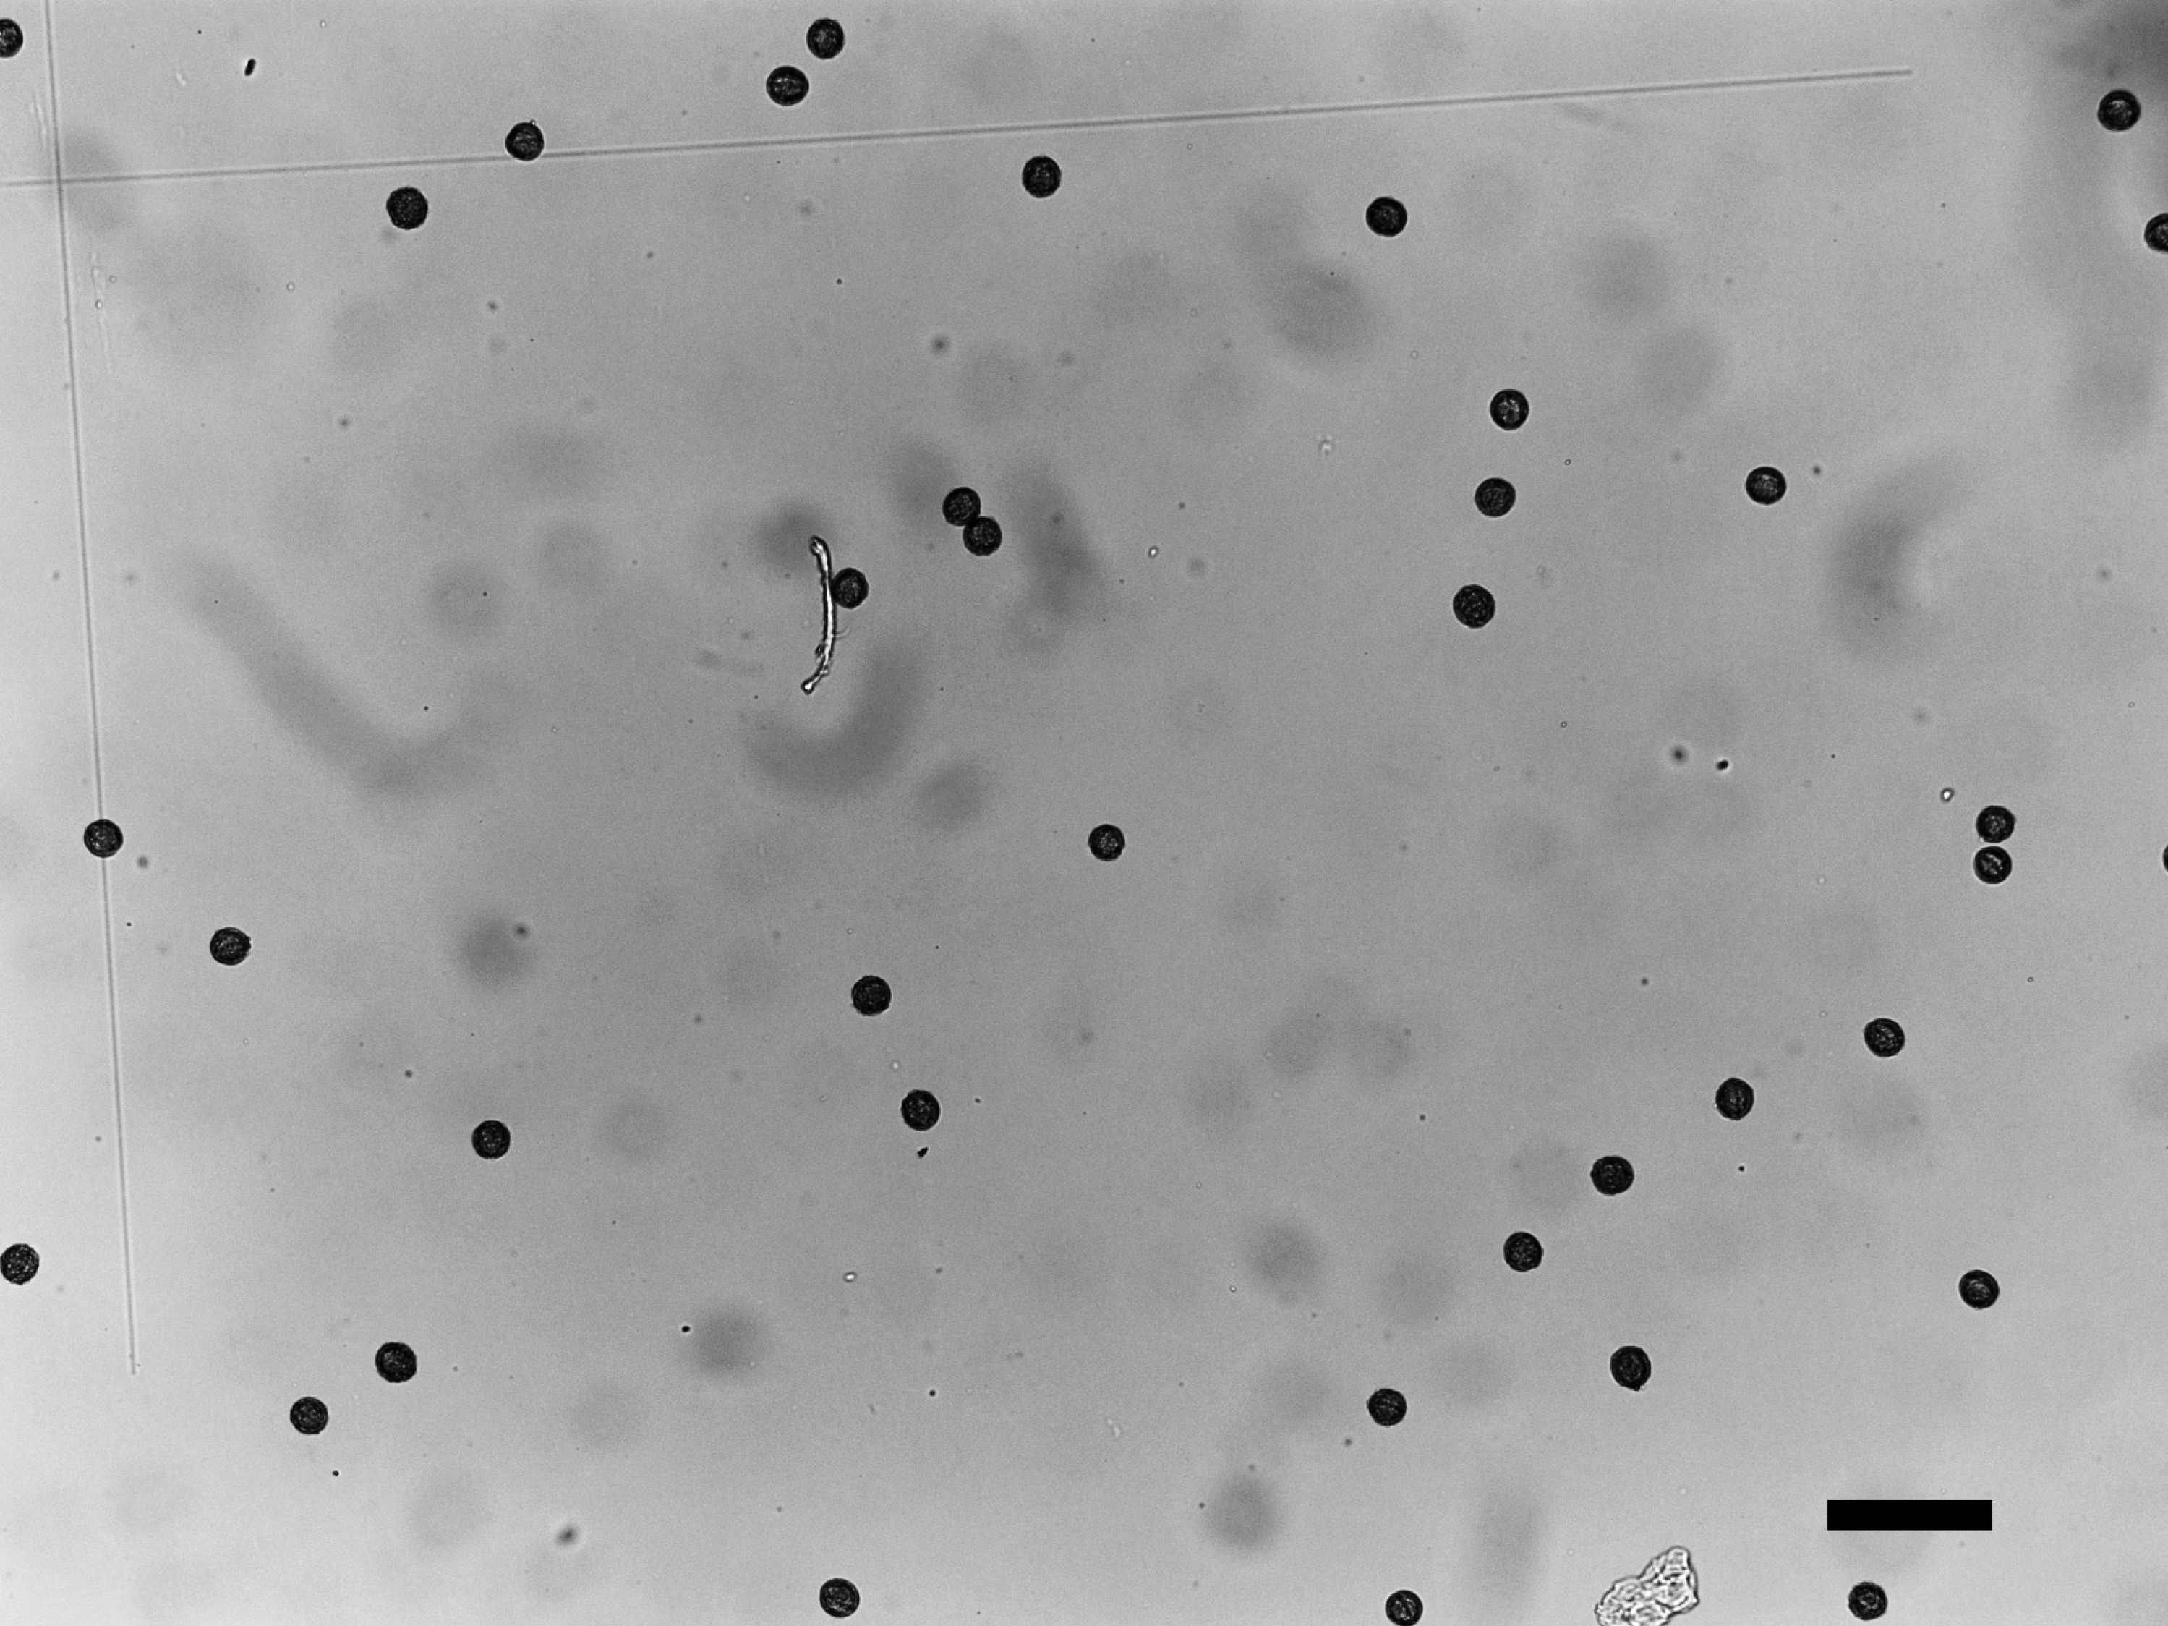

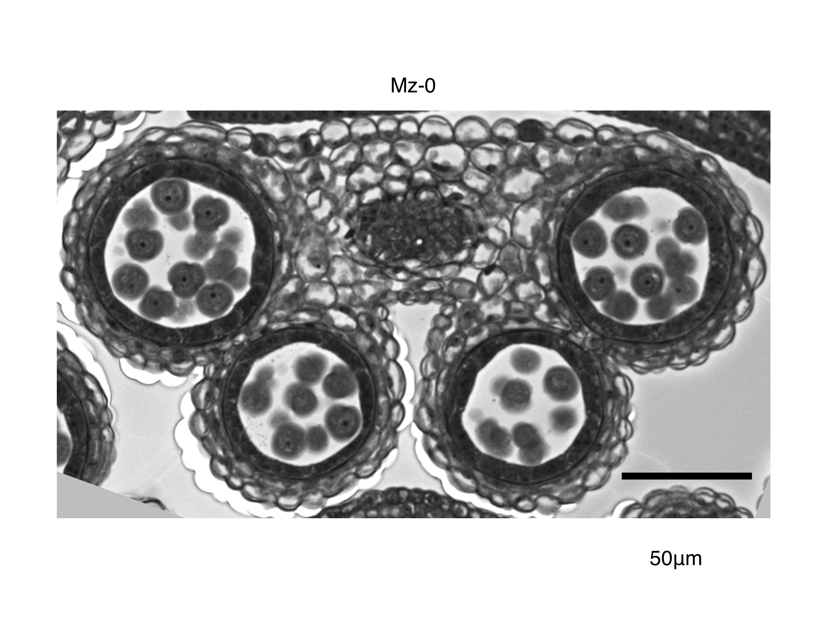
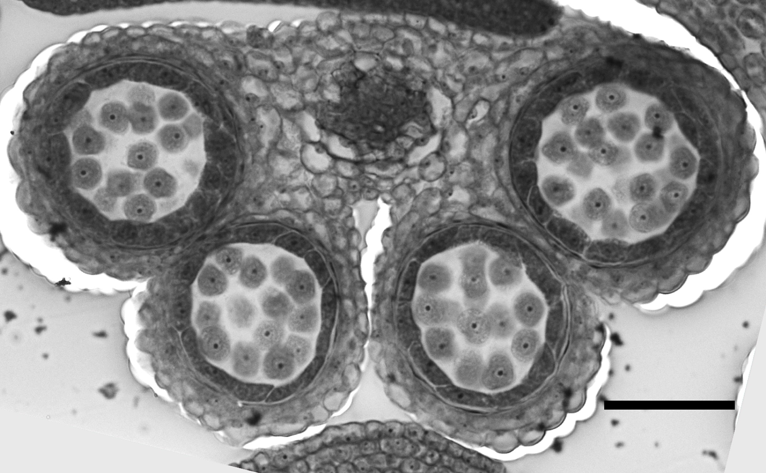

Pollen number variation within A. thaliana
157 accessions
A. lyrata
12,000-20,000
(Willi, 2012)
4.0
4.1
4.2
4.3
Log10 (Pollen number)
A. thaliana Mz-0
A. thaliana Bor-4
A.lyrata (MN47)
Tsuchimatsu, Kakui et al.
Nature Communications 11:2885, 2020
2,000-8,000 per flower

Slide 30

Genome-wide association studies
ACCACACC
TATAATTT
GGGTGGTT
AAAATTTT
GGGCGGCG
157
individuals
Individuals collected from wild populations
Phenotype (pollen number)
SNP1
SNP 250,000
SNP2
SNP3
SNP5 …
SNP4
RDP1 gene was isolated

Slide 31

The variants conferring reduced pollen number was advantageous
Pollen-reducing haplotype of RDP1
Human malaria resistance
Tsuchimatsu, Kakui et al.
Nature Communications 11:2885, 2020
Supported the advantage of selfing syndrome

Slide 32




PRIMA: rapid and cheap detection of 1-bp mutations
PCT/EP2020/072434, licence agreements in Europe, USA and Japan,
Kakui, Yamazaki, Shimizu. Sci. Rep. 11:20741, 2021
Electrophoresis using MultiNA
Misako Yamazaki
Hiroyuki Kakui
Assistant Prof.
Univ. Tokyo
40-bp single-strand DNA
Chinese Spring
Norin 61
5-bp deletion
Chinese Spring
Chinese Spring
20-bp
20-bp
Norin 61
Norin 61
1-bp indels and substitutions
for natural variation and the CRISPR genome editing

Slide 33
Summary of example 2: pollen number and selfing
Gamete number:
important for evolutionary biology, medicine and agriculture
Reduction of sperm/pollen can be advantageous
Evolutionary questions since Darwin can now be answered
by large-scale genomic data and genome-editing

Slide 34


Funding Opportunities Switzerland – Japan
Inputs from Carmen Richard and Katja Durkin, UZH Global Affairs

Slide 35
Researcher Exchange Program (JSPS / Leading House Asia ETH Zurich)
Bilateral program launched by the Leading House of Asia (ETH Zurich) and the Japan Society for the Promotion of Science (JSPS) for the exchange of early-career researchers.
The call on the Japanese side by JSPS has already been opened for 2024:
Link to the Call 2024 on the website of JSPS
The call on the Swiss side by the Leading House Asia at ETH Zurich will open in early 2024. Please subscribe to the Leading House Asia’s distribution list to receive the call when it’s announced.

Slide 36
Swiss Government Excellence Scholarship
Scholarship to promote international exchange and research cooperation between Switzerland and over 180 other countries, including Japan.
Open to: young researchers from outside of Switzerland, including Japan, who have completed a master’s degree or PhD
Costs covered: living costs; no financial support for field work or for conferences
Duration:
  PhD scholarship: 12 months, prolongable up to 36 months
  Research fellowships: 12 months
  Postdoctoral scholarship: 12 months
Grant sum: PhD and research fellowships: CHF 1,920 per month / Postdoc: CHF 3,500 per month
Submission deadline: 24 November 2023 (for academic year 2024/25)
→ Link to the scholarship

Slide 37

SNSF: Scientific Exchanges
For scientific conferences/workshops in Switzerland as well as research visits in Switzerland (incoming) or in another country (outgoing)
Open to: researchers employed in Switzerland. Research visits: applicants must hold a doctorate (or 3 years of research work as main source of income)
Scientific events: may also be submitted by doctoral students
Costs covered: Travel expenses (in case of scientific events also equipment for event)
Duration: 1 to 6 months (research visits); max. of 5 days (scientific events)
Grant sum: research stays: max. CHF 25,000
scientific events: max. CHF 2,500 per half-day
Submission deadline: Anytime; at least 4 months in advance
→ Link to the funding scheme

Slide 38

SNSF: Postdoc Mobility (Fellowship)
Open to: applicants from Swiss research institutions with a completed doctorate up to 3 years after doctoral exam
Costs covered: subsistence costs, travel expenses, contribution to research and conference costs
Duration: 24 months (fellowship); 3 to 12 months (return phase)
Annual rate for fellowship in Japan: CHF 54,000
Submission deadline: 1 February and 2 August
→ Link to the funding scheme

Slide 39

UZH Graduate Campus Travel Grants
Open to: UZH postdocs and doctoral students
Supported activities include: field study / data collection; research stay; summer and winter schools; research exchange with industry; academic meetings
Duration: 1 – 180 days
Grant sum: CHF 115 – 4,900
Submission deadlines: 15 November 2023 and 15 April 2024
→ Link to the funding instrument

Slide 40
UZH Global Strategy and Partnerships Funding Scheme
Launched by Global Affairs at the University of Zurich. The funding scheme is open to collaboration initiatives with specific partner universities of UZH
Open to: academic and professional staff with UZH employment
3 Levels of Funding:
  Level 1 – Travel Fund: to establish new contacts; only available for UZH outgoing staff; rolling call. Grant sum: max. CHF 1,200 (for travel and accommodation costs)
  Level 2 – Seed Fund: for exploring specific collaboration such as joint workshops, events, specific smaller projects. Grant sum: max. CHF 5,000. Co-funding by partner university is encouraged.
  Level 3 – Project Fund: for deepening existing collaborations with potential high impact/visibility. Grant sum: max. CHF 60,000. Co-funding by partner university is required.
  Next Calls:
    late November 2023 – late February 2024 (1st call 2024)
    early June – late August 2024 (2nd call 2024)
  → Link to the funding scheme

Slide 41
Workshop tomorrow:
UZH Global Strategy and Partnerships
Workshop on Plant biology
using remote sensing, modelling, genetics and genomics to apply our knowledge for the better future.
Wed. 18th October, 09:00-15:00
Irchel Campus, Y10-G-03/04 or online*
9:05 Hirosyoshi Iwata, Univ. Tokyo
13:45 Andreas Hund, ETH
And many young scientists
Main organizer
Misako Yamazaki

Slide 42
UZH Teaching Fund (ULF) – global_innovation
Launched by Educational Innovation at the University of Zurich. The funding line aims at supporting courses, modules, and structural collaboration in teaching with international partners of UZH that promote either internationalization@Home or (virtual) mobility experiences for UZH students.
Open to: all teaching staff employed at UZH
Grant sum: max. CHF 40,000
  Submission deadline: 27 October 2023 (call deadlines for 2024 tba)
  → Link to the funding scheme

Slide 43
Other Funding Opportunities (Lead Switzerland-based applicants)
The platform https://research.swiss/ offers an overview of funding opportunities for Switzerland-based applicants

Slide 44










Acknowledgment:
Some former lab members back to Japan
Yayoi Takeuchi
Nat’l Inst Env. Studies
Permanent
Ayako Izuno
Forestry (FFPRI)
Permanent
Masaki Kobayashi
Japan Int’l Res Cent Agr. Sci.
Permanent
Lab excursion Lichtenshtein
Dr. Reiko Akiyama
Dr. Cheng Choon Ang
Dr. Chiara Barbieri
Dr. Masaomi Hatakeyama
Dr. Rie Inatsugi
Dr. Stefan Milosavljevic
Dr. Ingrid Olivares
Dr. Yasuhiro Sato
Dr. Taro Takahashi
Dr. Misako Yamazaki
Aki Morishima
Epifania Arango-Isaza
Kazuki Fukushima
Katharina Jung
Naoto Benjamin-Hamaya
Kenji Yip Tong
Lukas Rohr
Moeko Okada
Univ. Niigata
Tenure-track
Eri Yamasaki
Inamori Foundation
Science Communication
Hiromi Matsumae
Tokai Univ. Fac. Med.
Tenure-track
Takashi
Tsuchimatsu
U. Tokyo,
Grad. Sci.
Professor
Hiroyuki Kakui
U. Tokyo
Grad. Agr.
Assistant Prof
Former Members from total 15 countries
Yuji Tokumoto
Univ Miyazaki, Fac. Agr.
Tenure-track
Nikkei Newspaper
16 May 2023
Further collaboration between Switzerland and Japan

