Slide 1
Interdisciplinary Strategic Partnership Tokyo – Zurich
Vice President for Research
Dr. Cornelia Schauz
Chief of Staff to the Vice President for Research
16 October 2023, Zürich

Slide 2
History and Future of ETH Zurich: Leading the way since 1855
Founded 1855
Today:
16 Departments
~ 25’000 students
~ 550 professors
Masterplan Hönggerberg 2040
HPQ – the physics building of the future
Construction 2022-2029
Quantum technologies
Notes:
Foundation Tokyo University: 1877
Established as an external location, today almost half of the ETH staff studies and works on the campus.

Slide 3
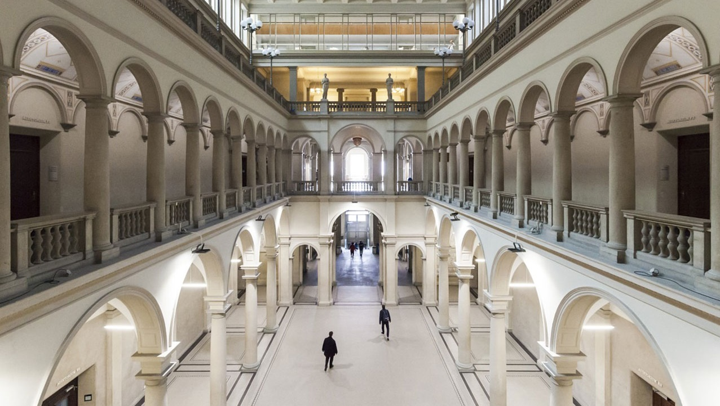
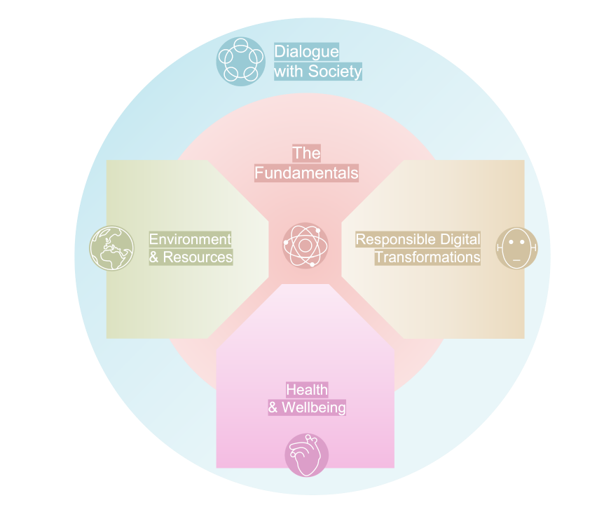
ETH Zurich in the Service of Society

Slide 4
Health and Wellbeing & Medicine@ETH
Health and Medicine
Bachelor course in medicine at ETH since fall 2017
Technologies are powerful drivers in medicine
ETH can contribute significantly to this development
1/3 of faculty already involved in medical research
Objectives
Train a new generation of healthcare experts
Foster interdisciplinary collaboration
Support digital transformation in medicine
Develop new solutions for prevention, diagnostics and rehabilitation

Slide 5
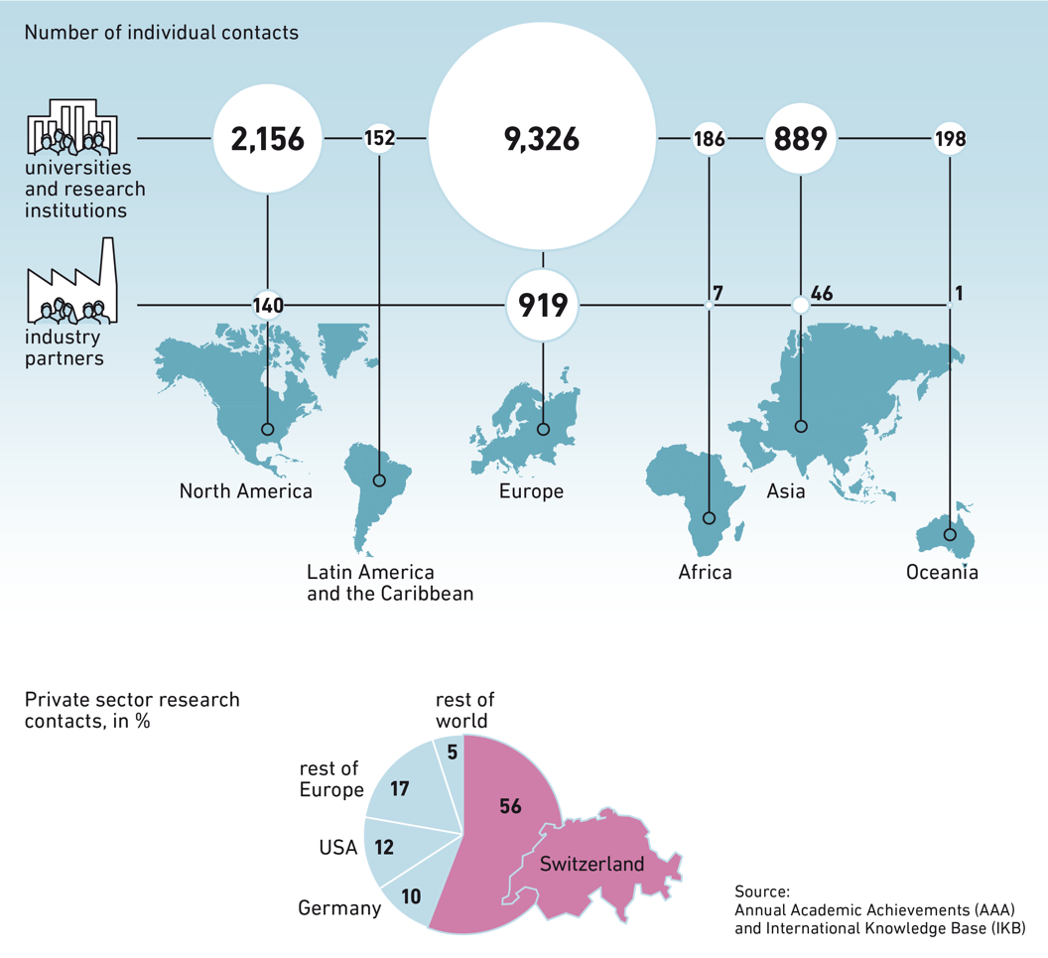
Connected to the world
IARU – International Alliance of Research Universities
Australian National University
National University of Singapore
Peking University
University of California, Berkeley
University of Cambridge
University of Cape Town
University of Copenhagen
University of Oxford
University of Tokyo
Yale University

Slide 6
ETH: Leading House Asia
Mandated by Switzerland's State Secretariat for Education, Research and Innovation (SERI)
ETH Zurich as Leading House Asia is responsible for the promotion of collaboration in science and technology with the East and Southeast Asia region for the funding period 2021–2024.
Funding Instruments
Mobility Grants
Research Grants
Innovation Grants
Opportunity Grants
Contact person: Anders Hagström, hagstroem@sl.ethz.ch

Slide 7
Excellence in Research – Education - Innovation
Research
Teaching
Innovation
Notes:
All three Universities are known for excellent Research
is the basis of best teaching and innovation.

Slide 8
Wolf Prize 2022 to Momoyo Kaijima & Yoshiharu Tsukamoto
“… an architect who appears to move effortlessly between research, education and practical design.”
ETH Zurich
Momoyo Kaijima
Chair of Architectural Behaviorology
since 2017
Notes:
Momoyo Katschima
the jury described her as
Architectural Behaviorology
Chair of Architectural Behaviorology.
During 1996-1997 she was a guest student with scholarship from Switzerland at Swiss Federal Institute of Technology, Zurich (ETHZ).

Slide 9
Dr. Cornelia Schauz
Chief of Staff to the Vice President for Research
cornelia.schauz@sl.ethz.ch
ETH Zürich
Rämistrasse 101
8098 Zürich
www.vpf.ethz.ch

