Slide 1
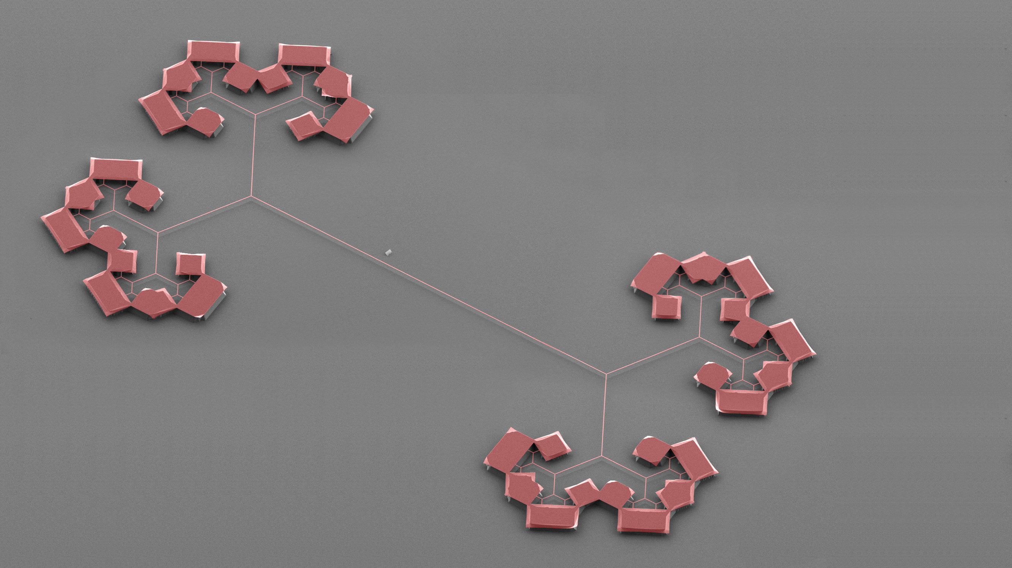
Ultralow dissipation mechanical resonators for sensing and optomechanics
Nils Johan Engelsen, EPFL

Slide 2
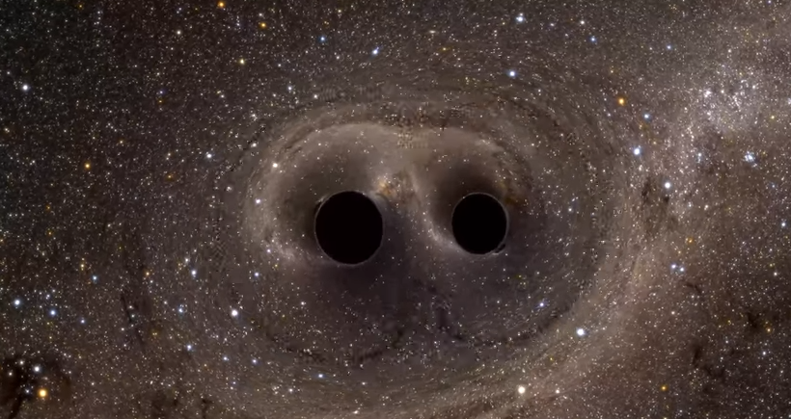
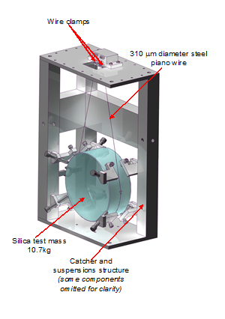
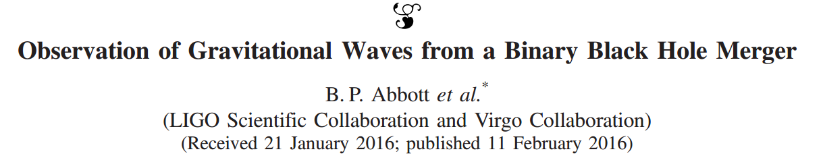
LIGO scientific collaboration
Science 256, 325 (1992)
Rep. Prog. Phys. 72, 076901 (2009)
Image: Simulating Extreme Spacetimes Project

Slide 3
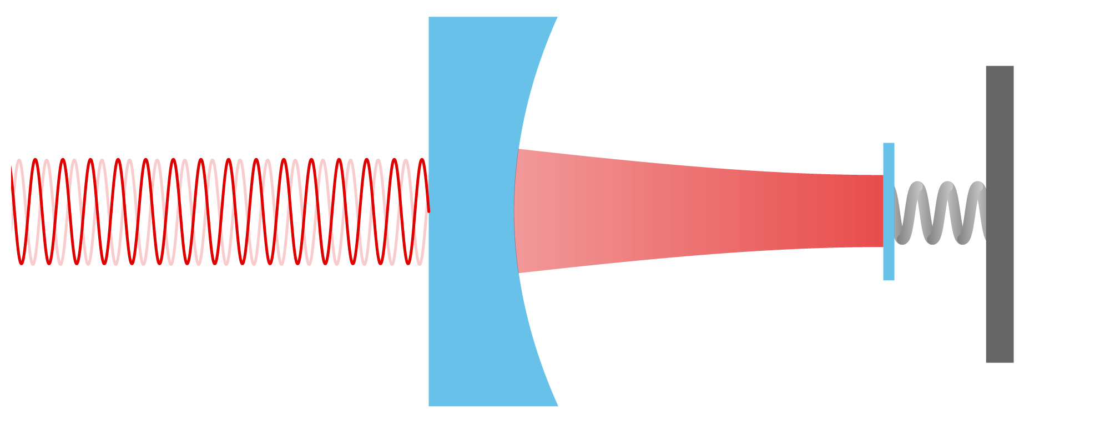
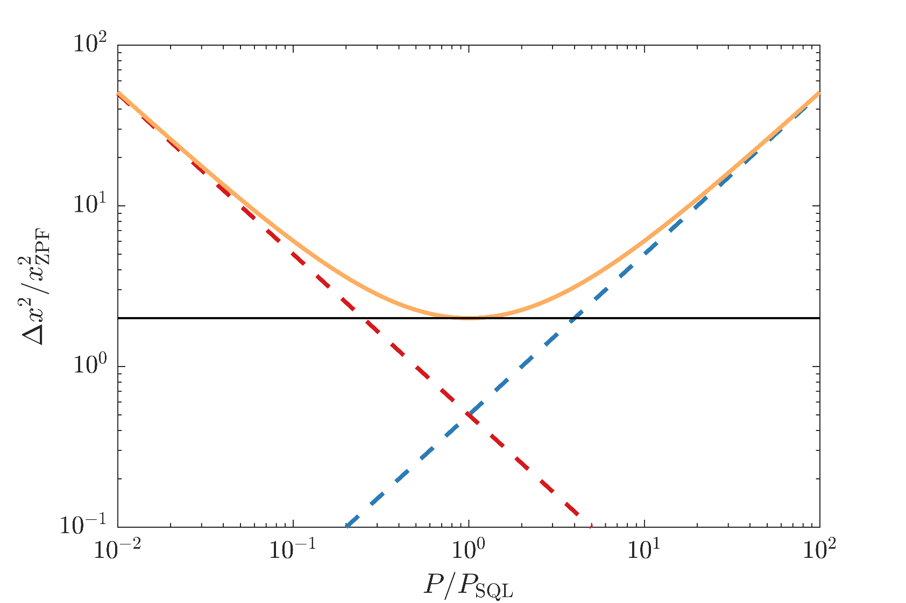
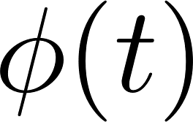
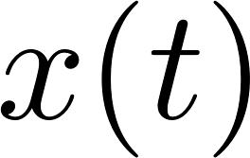
Standard quantum limit for position measurements
Photon shot noise
Radiation pressure backaction
Sum
Standard quantum limit
V. B. Braginsky, J. Exp. Theor. Phys. (1968)
C. M. Caves, Phys. Rev. Lett. (1980)
A. A. Clerk et al., Rev. Mod. Phys. (2008)
Notes:
We get half a zero-point motion each from shot noise and QBA and finally one zero-point motion contribution from the actual zpm of the resonator

Slide 4
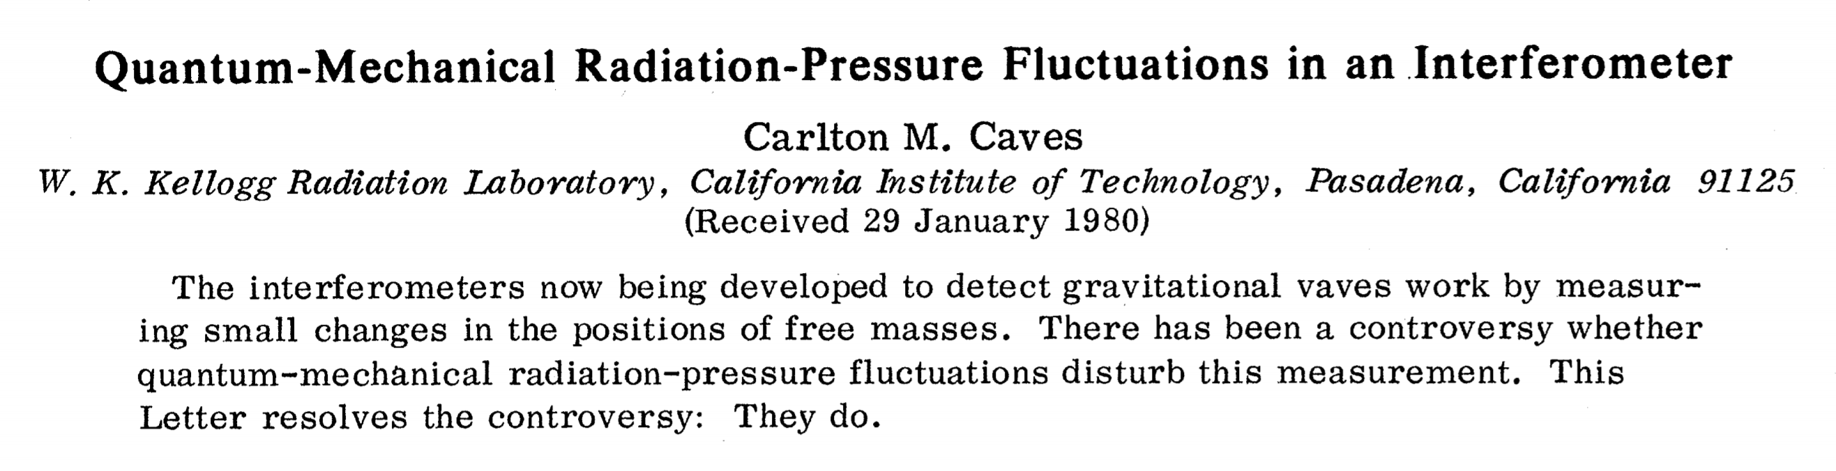
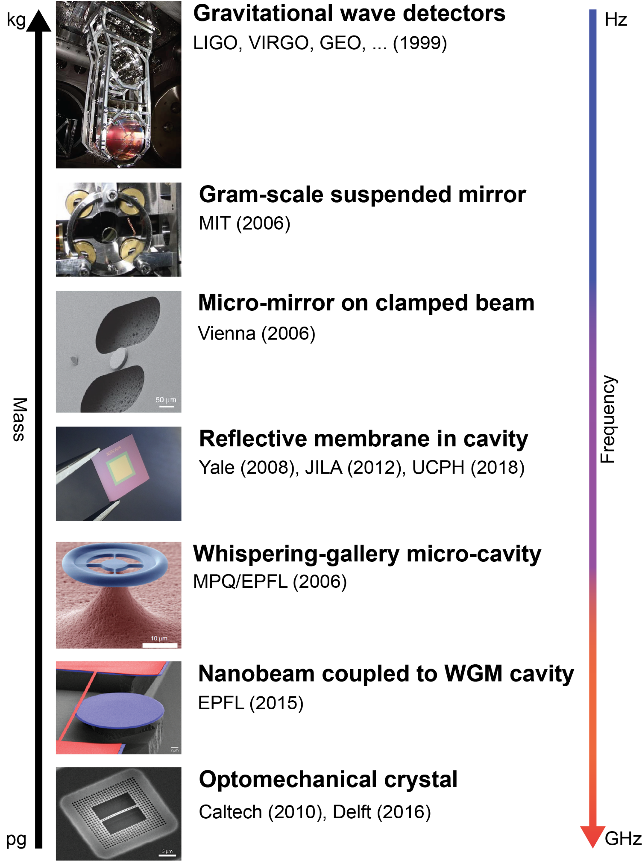

Quantum optomechanics

Slide 5
Nanomechanical resonators
Sensors
Transducers
Quantum technologies

Slide 6
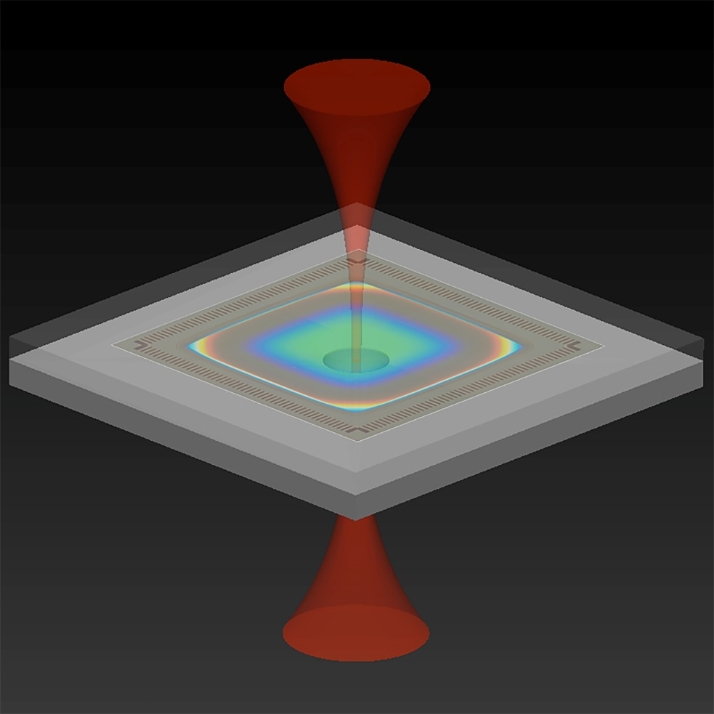
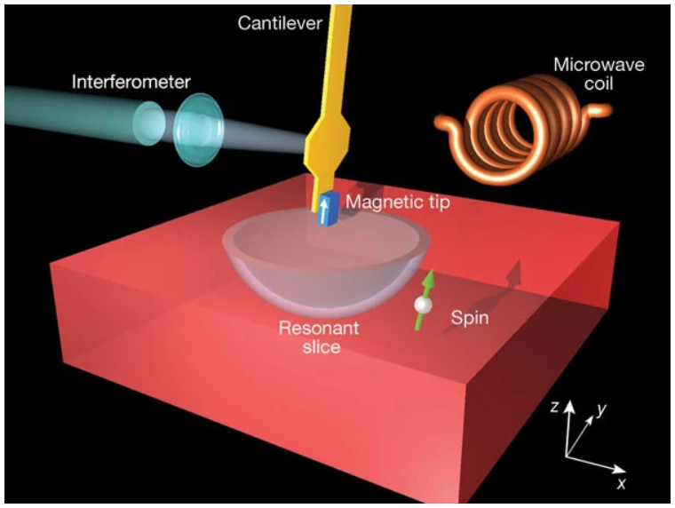
Mechanical sensors
Image: F. Zhou, NIST
Accelerometers
Krause et al., Nat. Photonics (2012)
Zhou et al., Optica (2021)
Magnetic resonance force microscopy
D. Rugar et al., Nature (2004)
M. Poggio and C. L. Degen, Nanotechnology (2010)
R. Fischer et al., New J. Phys. (2019)
U. Grob et al., Nano Lett. (2019)
Mass sensors
Yang et al., Nano Lett. (2006)
Chaste et al., Nat. Nanotechnol. (2012)
Dark matter searches
Manley et al., Phys. Rev. Lett. (2021)
Carney et al., Quantum Sci. Technol. (2021)
Notes:
Check if spin detection was published, maybe make images smaller and make more white space

Slide 7
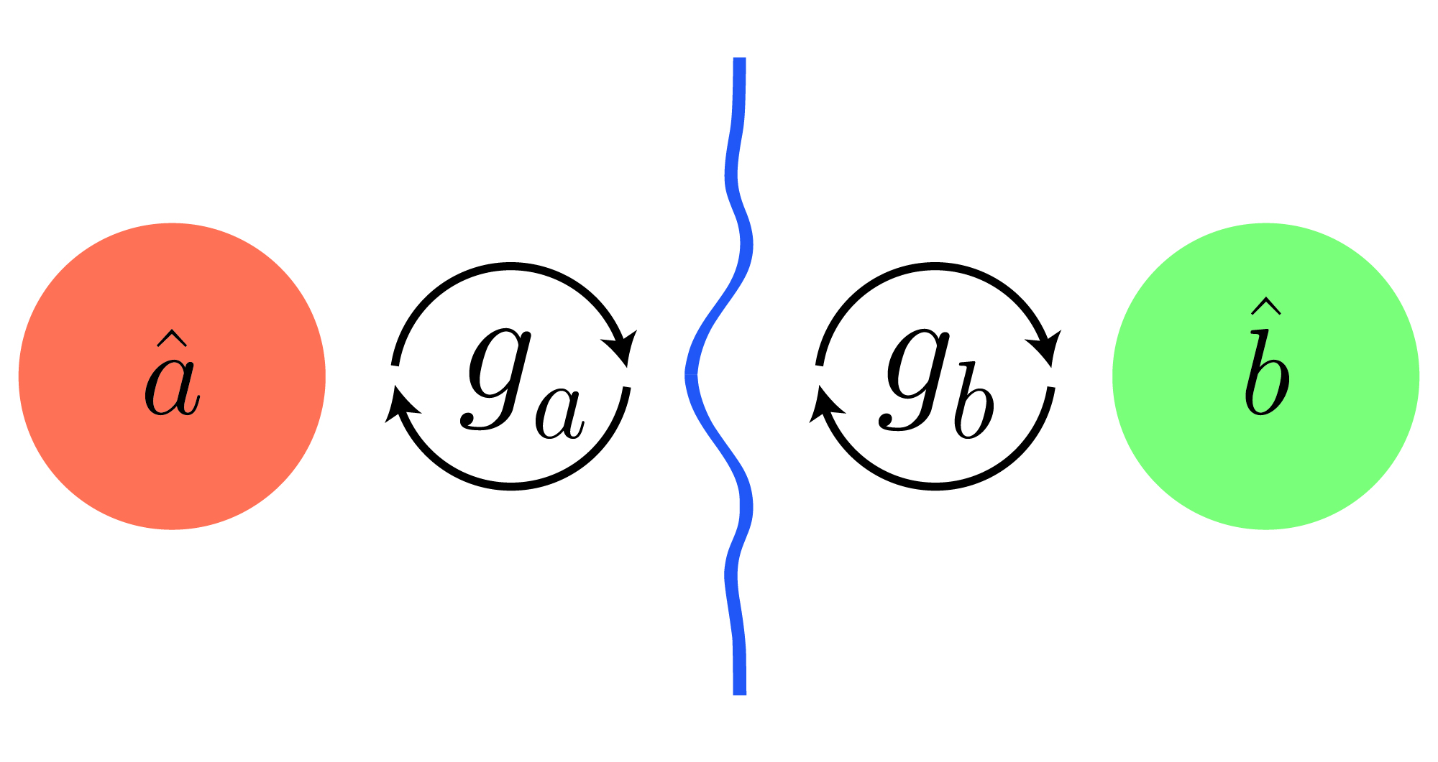
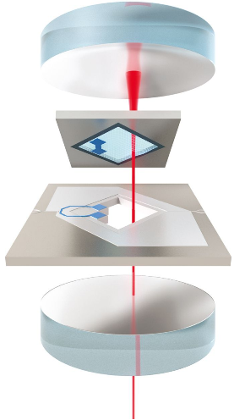
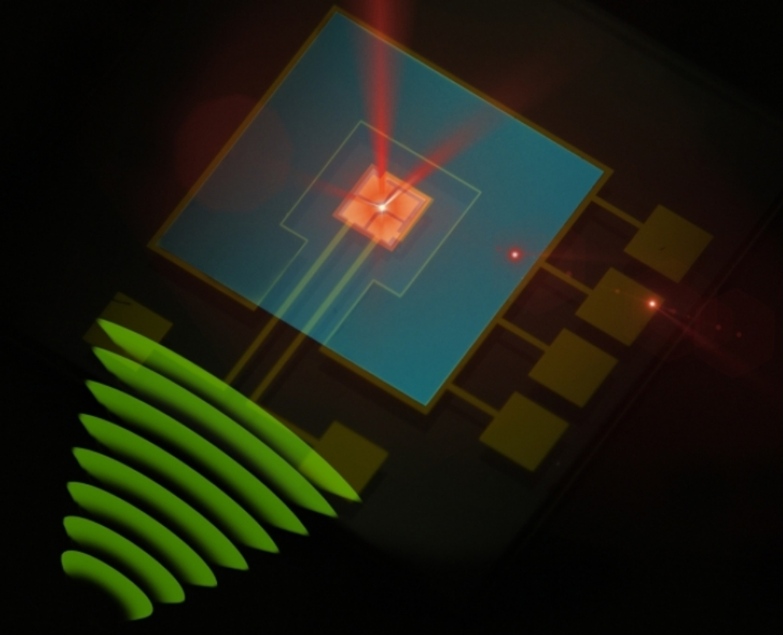
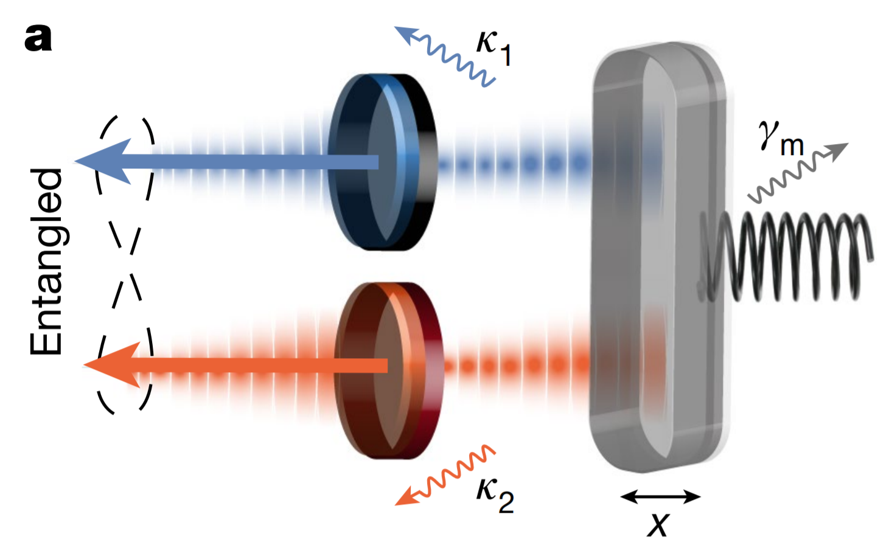
Mechanical transducers
Optical RF detection
Bagci et al., Nature (2014)
A. Simonsen et al., Opt. Express (2019)
Two-mode entanglement
Barzanjeh et al., Nature (2020)
Chen et al., Nat. Commun. (2020)
Microwave-to-optical conversion
Higginbotham et al., Nat. Phys. (2017)
Forsch et al., Nat. Phys. (2020)
Jiang et al., Nat. Commun. (2020)
Arnold et al., Nat. Commun. (2020)

Slide 8
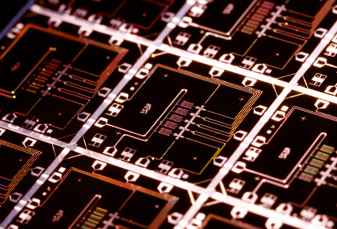
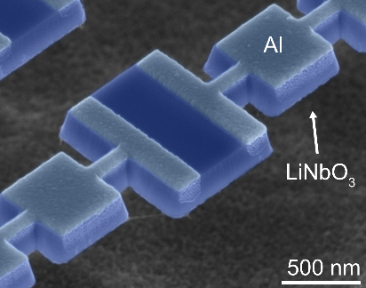
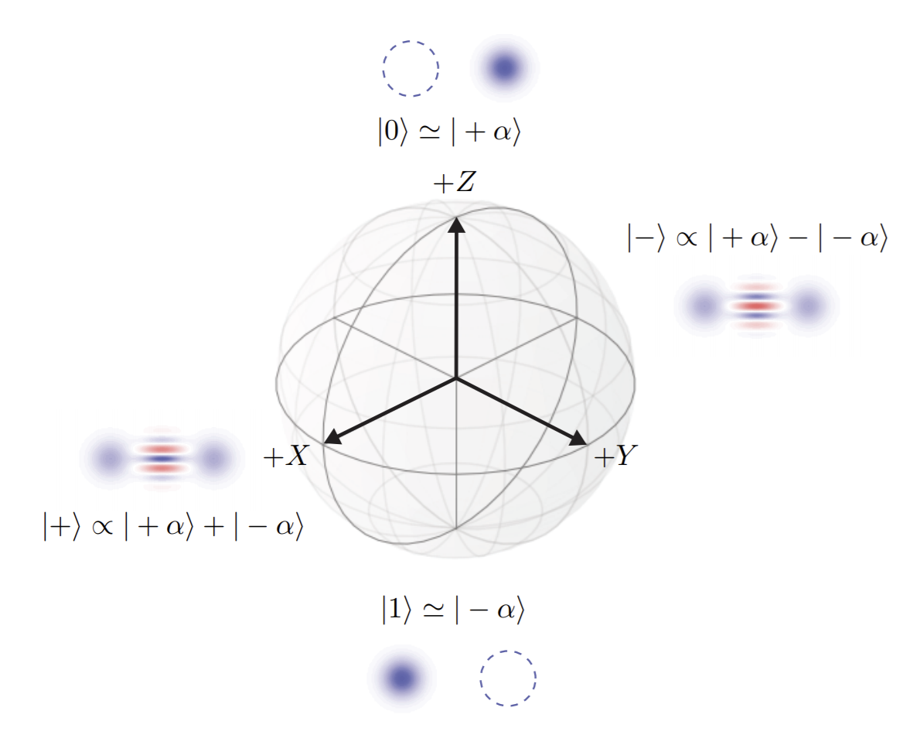
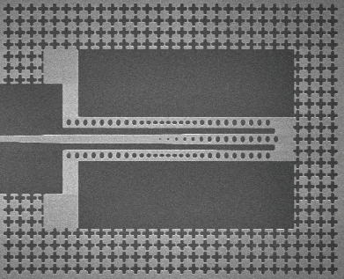
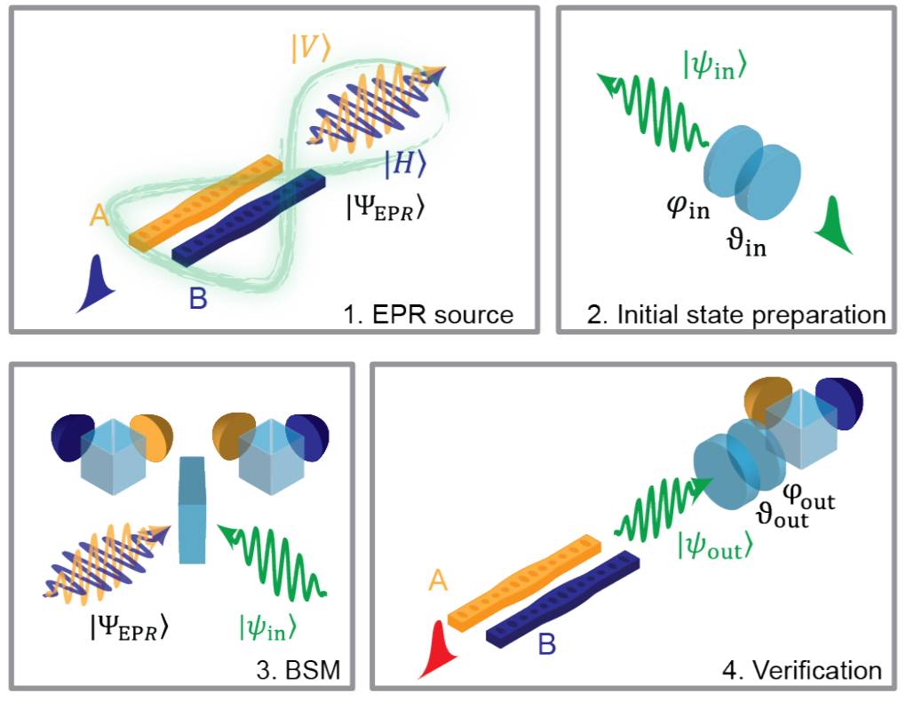
Mechanical resonators in quantum technologies
Coupling to superconducting qubits
Chu et al., Science (2017)
Chu et al., Nature (2018)
Arrangoiz-Arriola et al.,
Nature (2019)
Quantum memories
Teleportation
Chamberland et al., arXiv:2012.04108
Mechanical resonators are natural systems for encoding of cat state qubits
MacCabe et al., Science (2020)
Wallucks et al., Nat. Phys. (2020)
Fiaschi et al., Nat. Phot. (2021)
Notes:
Mirhosseini et al., Nature (2020)

Slide 9
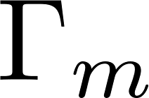
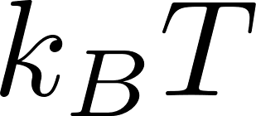
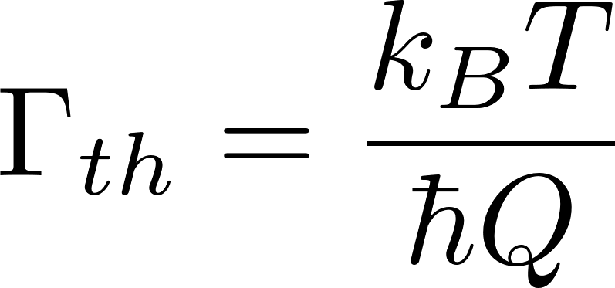
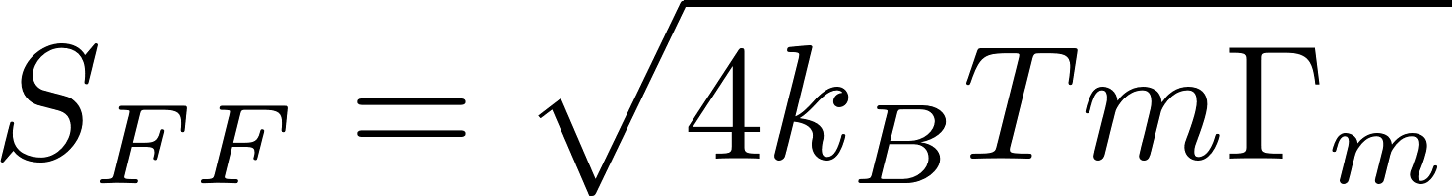
Figures of merit for mechanical resonators
Thermal-limited force sensitivity
Thermal decoherence rate

Slide 10
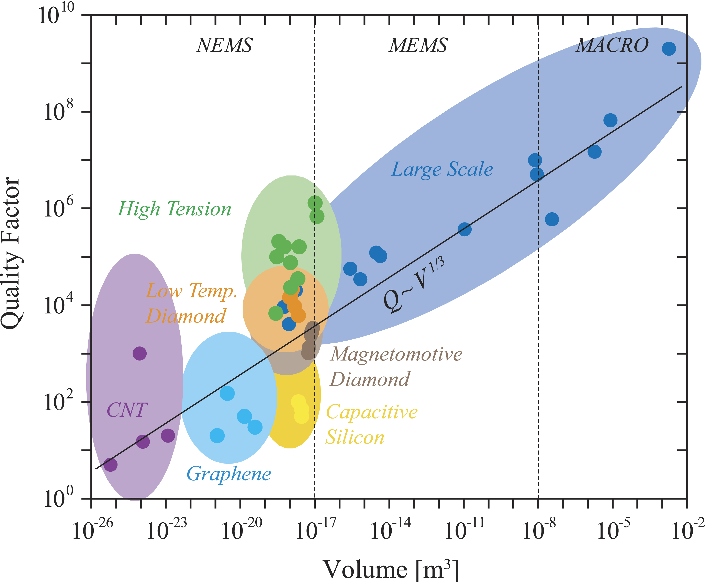
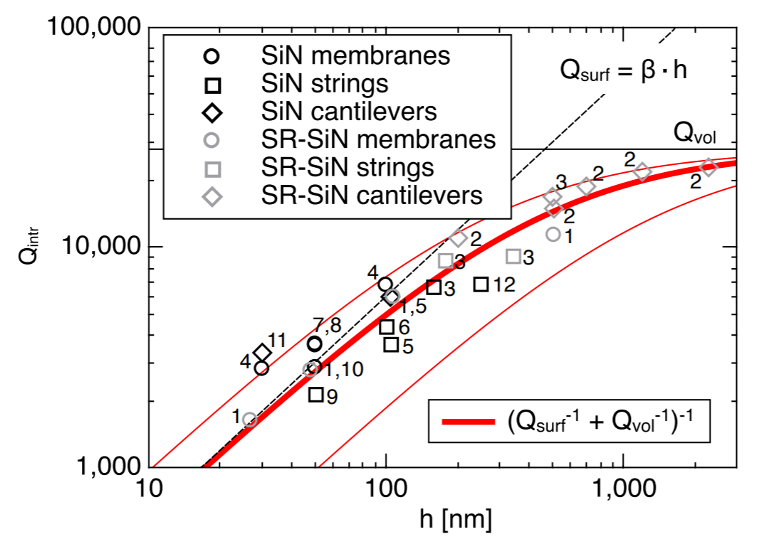
Smaller resonators limited by surface loss
Imboden et. al., Physics Reports (2014)
Villanueva and Schmid, Phys. Rev. Lett (2014)

Slide 11
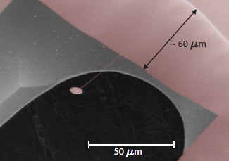
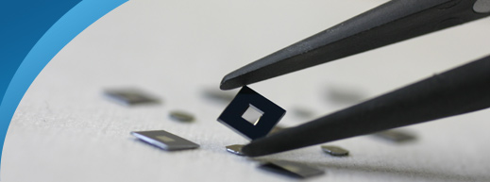
Dissipation dilution
Optical trapping
Gravitational potential
Nanomechanical resonators
Ni et al., Phys. Rev. Lett. (2012)
Cripe et al., Nature (2019)
González and Saulson,
J. Acoust. Soc. Am. (1994)
Unterreithmeier et. al. PRL (2010)
Yu et al., PRL (2012)

Slide 12
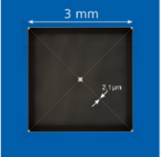
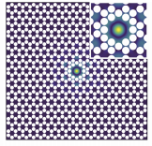
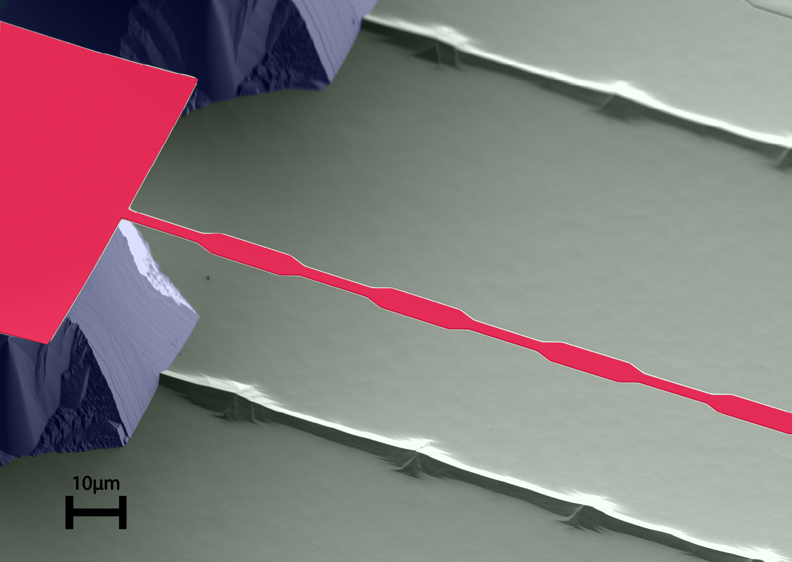
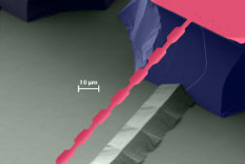
A timeline of strained nanomechanics
Millimeter-scale
membranes
Trampoline
membranes
Soft-clamping
Strain engineering
Thompson et al.,
Nature (2008)
Sankey et al.,
Phys. Rev. X (2016)
Y. Tsaturyan et. al.
Nat. Nano (2017)
Ghadimi et al.,
Science (2017)
Higher aspect ratios and engineered geometry has enabled 100-1000 times higher mechanical quality factor

Slide 13
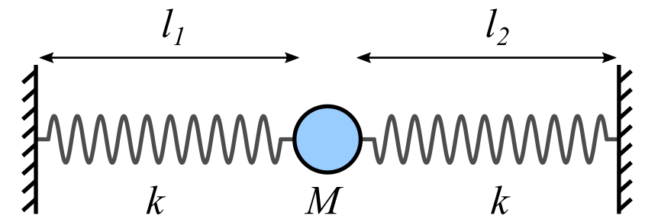
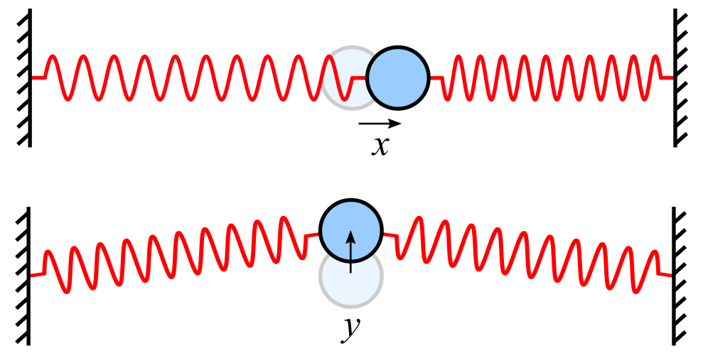
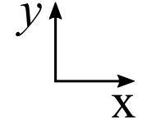
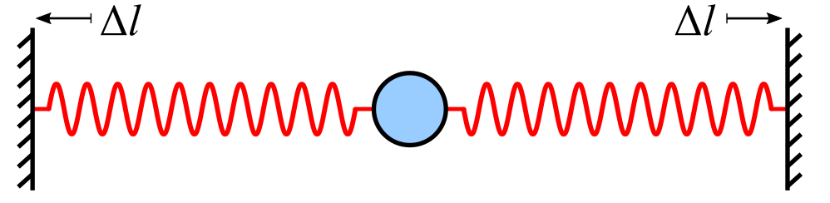
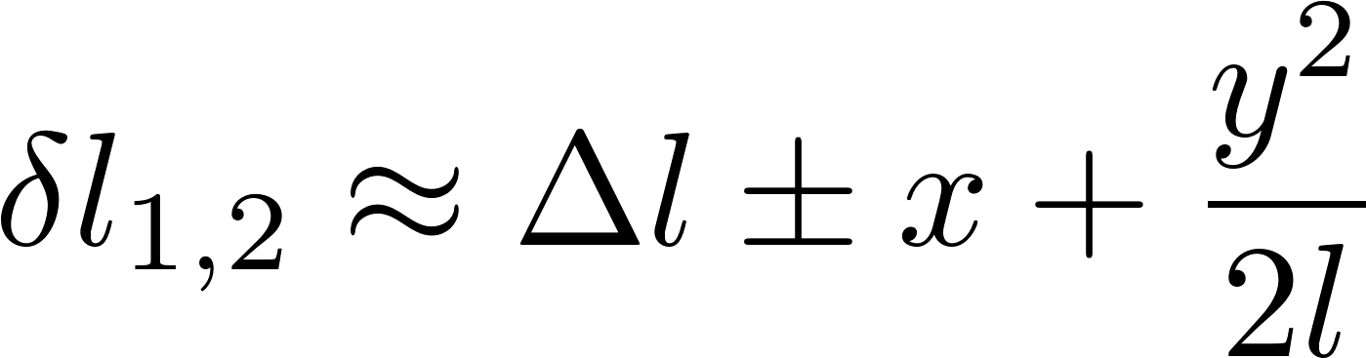
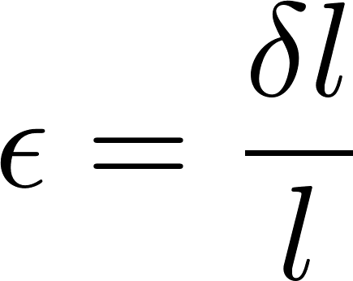
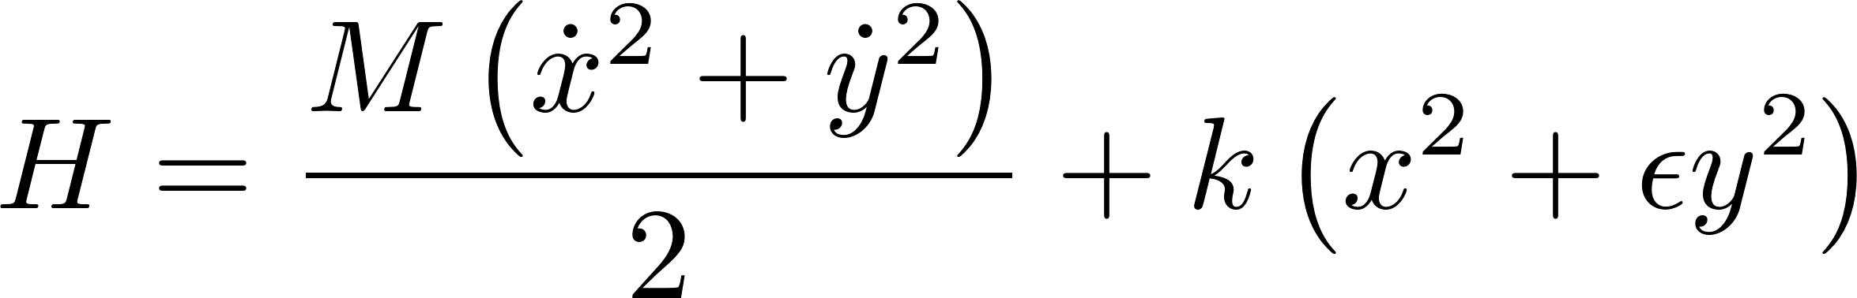
Dissipation dilution: a toy model
Tensioned spring system
Vibrational modes
Spring elongation
Hamiltonian
S. A. Fedorov, PhD Thesis (2021)

Slide 14
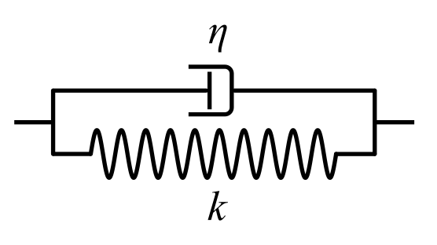
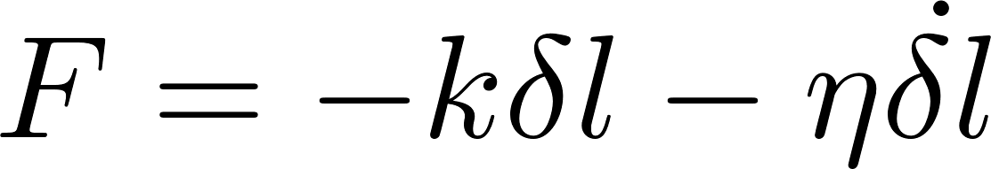
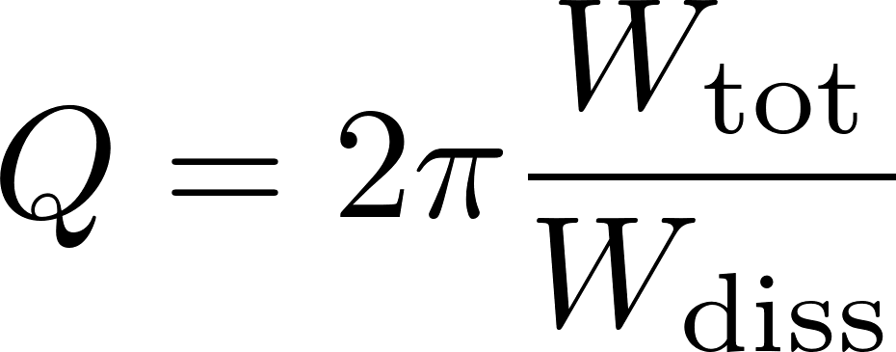
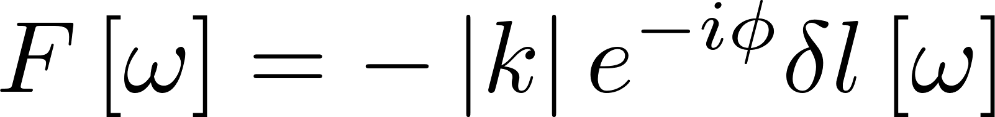
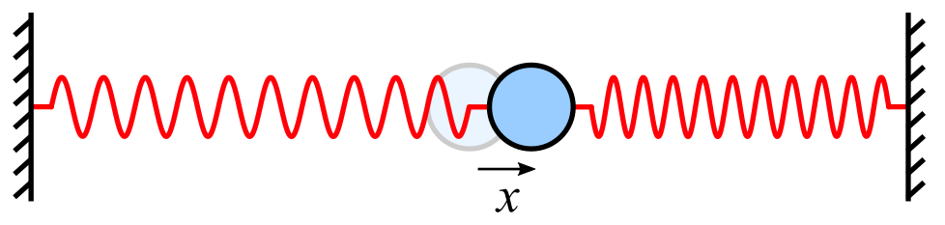
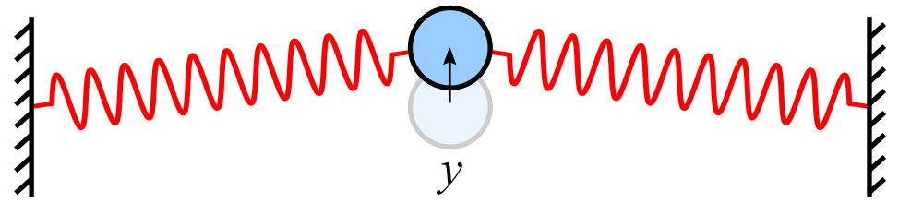
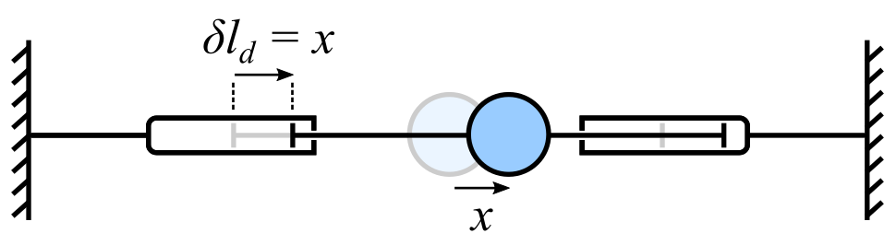
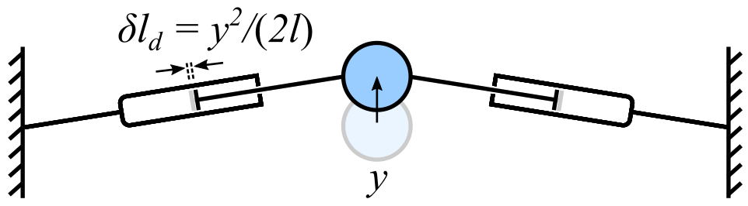
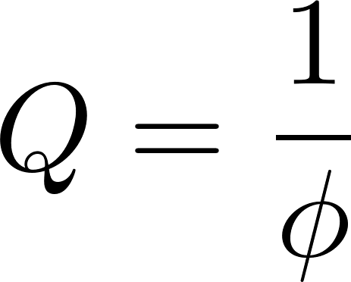
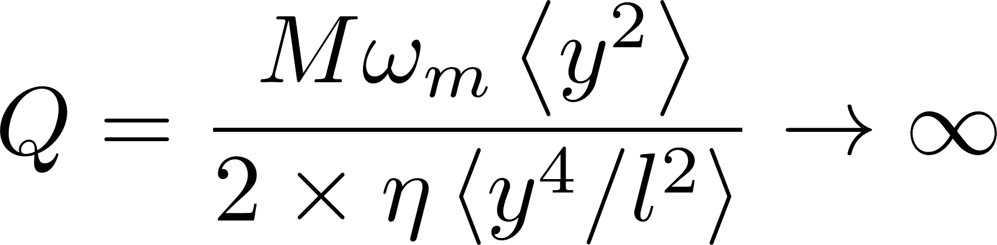
Dissipation dilution: introducing damping
Voigt damper
Force
Quality factor
A. S. Nowick and B. S. Berry, “Anelastic relaxation in crystalline solids” (1972)
V. B. Braginsky, V. P. Mitrofanov and V. I. Panov “Systems with Small Dissipation” (1985)
S. A. Fedorov, PhD Thesis (2021)

Slide 15



Dissipation dilution in realistic structures
Fedorov, Engelsen et al. Phys. Rev. B (2019)

Slide 16




Quality factor landscape
Material | Si₃N₄
Stress | 1.1 GPa
Thickness | 20 nm
Intrinsic Q | 2600

Slide 17


Strained silicon-on-insulator material platform
TEM cross section
Dark-field electron holography
Potentially much higher intrinsic quality factor at low temperature

Slide 18




Engineering dilution: soft clamping
arXiv:2107.02124
Help | Advanced Search
Beccari et al., arXiv:2107.02124 (2021)
Notes:
Label mode shape

Slide 19




Strained silicon nanobeams with Q~13 billion
Beccari et al., arXiv:2107.02124 (2021)

Slide 20

Soft-clamped perimeter modes by vertex-clamping
Mechanical quality factors limited by torsion in the supports
Bereyhi et al., arXiv:2108.03615 (2021)

Slide 21

Room temperature quality factor >3 billion
Bereyhi et al., arXiv:2108.03615 (2021)

Slide 22

Coupled perimeter modes
Bereyhi et al., arXiv:2108.03615 (2021)

Slide 23


Integrated optomechanical system
5 um
25 um
$$C_{0}=\frac{4g_{0}^{2}}{κΓ_{m}}=\frac{4×{\left(10 kHz\right)}^{2}}{4 GHz×0.1 mHz}={10}^{3}$$
Room temperature ground state cooling
Force/spin sensing

Slide 24



Devices with reflection pad

Slide 25






Force sensing with mechanical resonators
Very sensitive to frequency fluctuations and alignment drift

Slide 26


Feedback damping for broadened frequency response
Measurement
Damping rate
Spring constant
Increase damping by viscous feedback:
Flatter frequency response without added noise

Slide 27


Attonewton force sensitivity at room temperature

Slide 28

Applications in force microscopy
Tip+sample
Laser/optical cavity
Hälg et al., Phys. Rev. Appl. (2021)

Slide 29


Dark matter searches
Figure from Carney et al., Quantum Sci. Technol. (2021)
Particle-like dark matter: Search for impulses on detector
Ultralight dark matter: look for coherent force, mediated e.g. by B-L number
Figure from Manley et al., Phys. Rev. Lett. (2021)

Slide 30










G. Huang
S. Fedorov
D. Visani
M. Bereyhi
T. J. Kippenberg
A. Arabmoheghi
A. Beccari

Slide 31

Strained silicon
Strain engineering
Hierarchical structure
Vertex clamping
For more information:
Strain engineering: Ghadimi et al., Science 360 (2018)
Dissipation dilution: S. A. Fedorov et al., Phys. Rev. B 99 (2019)
Binary tree beams: S. A. Fedorov, et al., Phys. Rev. Lett. 124 (2020)
Hierarchical resonators: Beccari et al., arXiv:2103.09785 (2021)
Strained silicon: Beccari et al., arXiv:2107.02124 (2021)
Perimeter modes: Bereyhi et al., arXiv:2108.03615 (2021)

Slide 32
Backup slides

Slide 33






Feedback cooling
By applying a feedback force proportional to the velocity one can cool down the Brownian motion.
Measurement
Linear response (susceptibility)
Langevin Stochastic force
Damping rate
Spring constant
Detection noise limits the performance of feedback stabilization.

Slide 34



Soft clamping
Y. Tsaturyan et al., Nat. Nano. (2017)
Phononic crystal with defect localizes mechanical mode

Slide 35


Record room temperature $Q$ of 800 million at 1.3 MHz
Ghadimi et al., Science (2018)

Slide 36
Quality factor landscape
Material | Si₃N₄
Stress | 1.1 GPa
Thickness | 20 nm
Intrinsic Q | 2600

Slide 37



Soft clamping by hierarchical structure
Wave derivative transformation
Fedorov et al., Phys. Rev. Lett. (2020)

Slide 38






Quality factor survey
Beccari et al., arXiv:2103.09785(2021)

Slide 39






Quality factor of 800 million at 107 kHz
RT
6K
Force sensitivities surpassing the best AFM cantilevers
Beccari et al., arXiv:2103.09785(2021)

Slide 40



Fractional spectral dimension
Fractal-like structures can have fractional spectral dimension:
Beccari et al., arXiv:2103.09785(2021)

Slide 41



Hierarchical membranes
Trampoline resonators with $Q>2×{10}^{8}$ at $f∼100 kHz$
Beccari et al., arXiv:2103.09785 (2021)
Topology optimization: Høj et al., arXiv:2103.15601 (2021)
Trampoline membranes:
Reinhardt et al., Phys. Rev. X (2016) Pluchar et al., Applied Optics (2020)
Norte et al., Phys. Rev. Lett. (2016)

Slide 42



From toy model to realistic structures
For a deformation field, we have a strain tensor given by
Dissipation dilution requires:
Static strain
Geometric nonlinearity of strain
Especially strong for flexural (violin) modes
Fedorov, Engelsen et al. Phys. Rev. B (2019)

Slide 43




From toy model to realistic structures
Unterreithmeier et. al. PRL 2010
Elastic energy
Bending energy
Lossless
Lossy
Fedorov, Engelsen et al. Phys. Rev. B (2019)

Slide 44






Reduction of mode gradient over branches
Use divergence theorem combined with continuity of $u$ to obtain:
Balance of tension requires:
Giving:
Fedorov et al., Phys. Rev. Lett. (2020)

Slide 45


Binary tree beam design
Cascaded branching of a nanobeam reduces the mode curvature at the boundaries
Useful parameters:
$x_{n}$: Position on beam $n$
$N$: Total number of branches
$r_{l}$: Length contraction ratio ($l_{n+1}/l_{n}$), chosen to ensure the tree is not self-contacting
$r_{w}$: Width ratio ($w_{n+1}/w_{n}$)
$θ$: Angle between incoming and outgoing branch

Slide 46

What limits the quality factor? Torsional motion
Out-of-plane motion of one branch induces torque on the next branch
Results in trade-off: reduction of bending at the boundaries vs. increased torsional energy

Slide 47



Fractal beam design coefficients
Boundary curvature
Distributed curvature
Torsional energy
Using the calculated mode shape we can evaluate the boundary energy, distributed bending energy, torsional energy and tensile energy to calculate $α, β_{bend}$ and $β_{tors}$
Note: These are material independent
$$\frac{Q}{Q_{int}}=\frac{1}{αλ+βλ^{2}}$$

Slide 48





Si₃N₄ nanobeam process flow
Patterning
Gap definition
Undercut
Structures are patterned using
electron beam lithography
Upscaled version of the first lithography followed by deep reactive ion etching
Si undercut using KOH
FOX
FOX
FOX
SiN
SiN
SiN
Si
Si
Si

Slide 49

Mechanical characterization setup
Resolves Brownian motion of mechanical modes
Ringdown measurements conducted by driving with PZT element
Homodyne phase is locked by changing frequency of second AOM drive

Slide 50

Fabrication of sSi nanostrings
Patterning
Encapsulation
Undercut
Selective etch

Slide 51

Temperature dependence of dissipation
Beccari et al., arXiv:2107.02124 (2021)
Notes:
Observed some reversible degradation
Due to extra dissipation at clamping points, could be acoustic radiation or losses in the buried oxide layer at the pads

Slide 52



Mechanical sensors
Gravitational astronomy
Force microscopy
Mass difference:
Image: Simulating Extreme Spacetimes Project
LIGO scientific collaboration
Science 256, 325 (1992)
Rep. Prog. Phys. 72, 076901 (2009)
Tse et al., Phys. Rev. Lett. (2019)
Force-detected magnetic resonance
Nature 430 329 (2004)
Nanotechnology 21, 342001 (2010)

