Slide 1
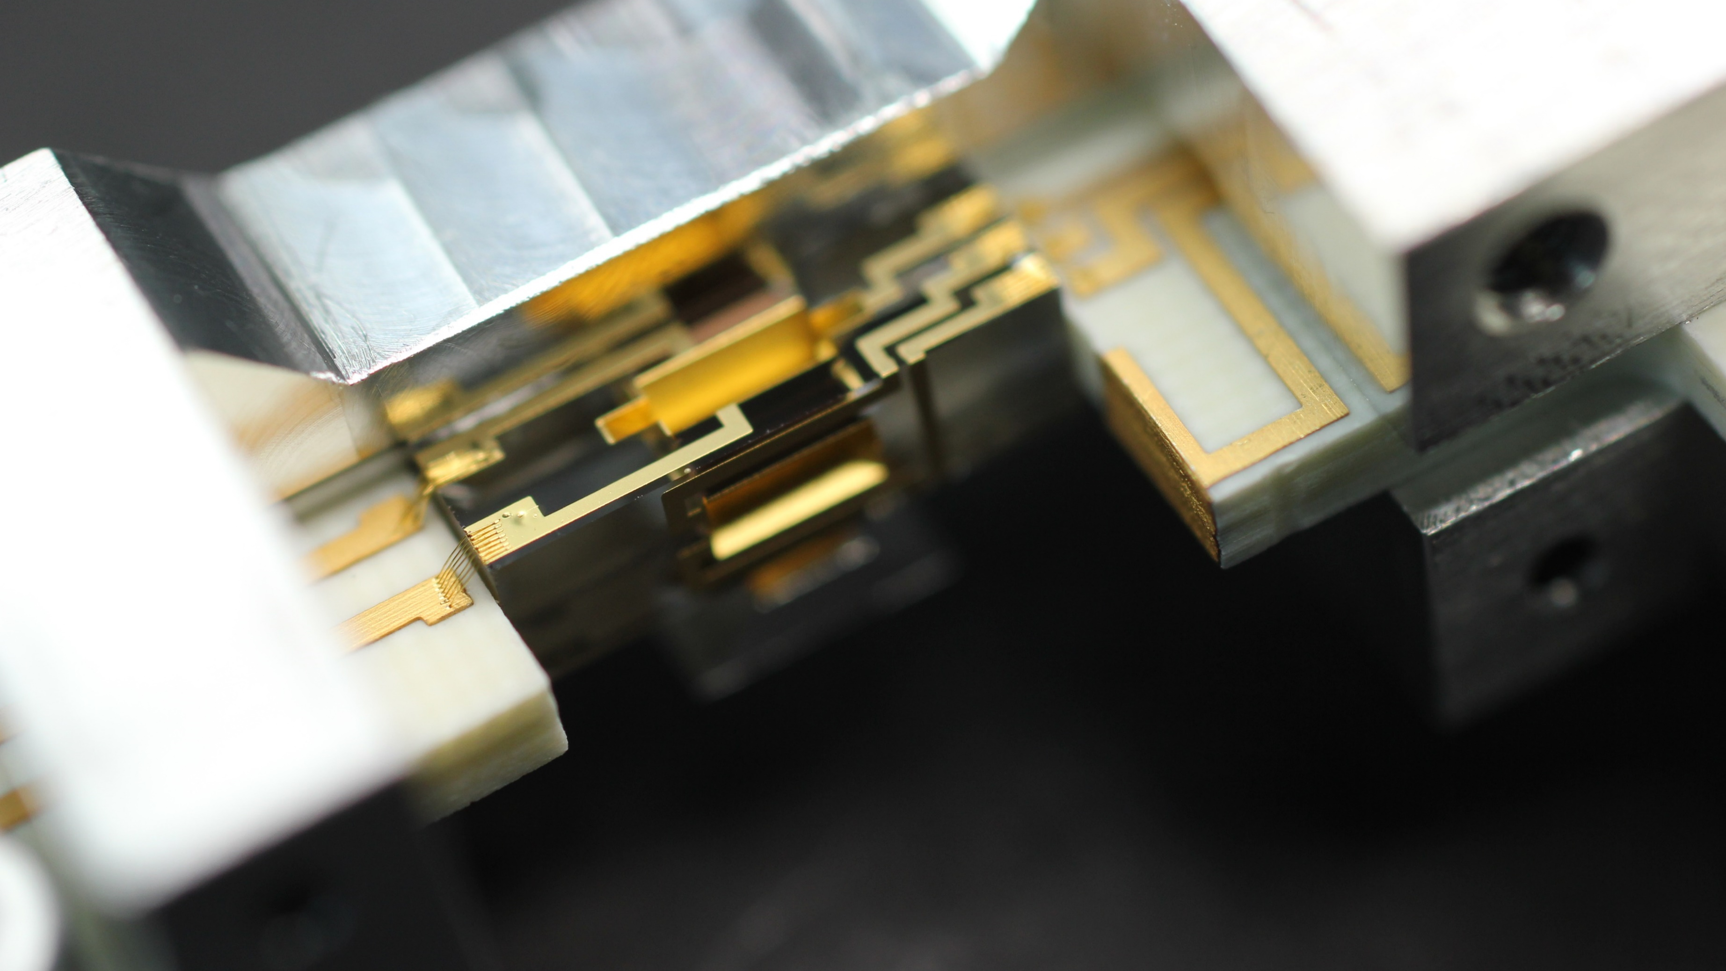
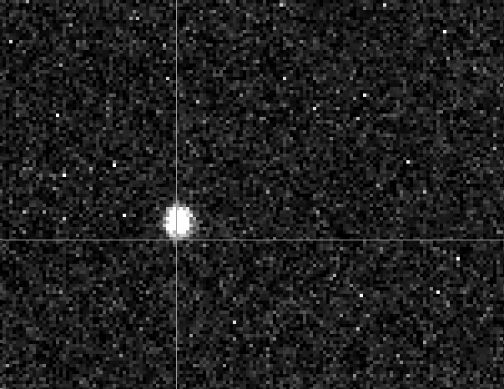
Towards quantum control and spectroscopy of a single hydrogen molecular ion
Be⁺
H₂⁺
N. Schwegler, D. Holzapfel, J. P. Home, D. Kienzler
Trapped Ion Quantum Information Group, ETH Zurich
21.01.2022
Searching for New Physics at the Quantum Technology Frontier

Slide 2
Be⁺
H₂⁺
Motivation
H₂⁺: simplest molecule
  Theory H2+, D2+, and HD+ (10⁻¹²) : V. I. Korobov et al. 2017 (10.1103/PhysRevLett.118.233001)
Rotation and vibration give access to fundamental constants …
  Proton-to-electron mass ratio (and its potential drift in time)
  HD⁺ ensemble:
      S. Patra et al. 2020 (10.1126/science.aba0453)
      I. V. Kortunov et al. 2021 (10.1038/s41567-020-01150-7)
  Proton charge radius
  Rydberg constant
… or theory test
  Probing QED, fifth force: e.g. M. Germann et al. 2021 (10.1103/PhysRevResearch.3.L022028)
Ion trap
  Measure in same setup with enough transitions
m_{p}/m_{e} (10⁻¹²)
J.-Ph. Karr et al. 2016 (10.1103/PhysRevA.94.050501)

Slide 3
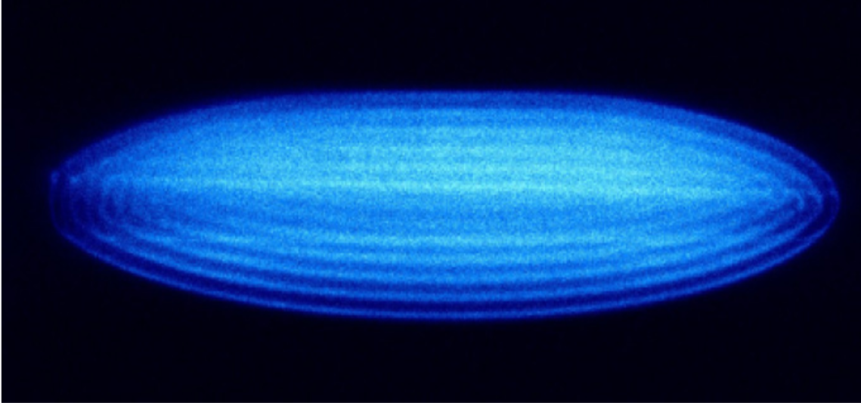
Why single trapped H2+?
  clean system
  lower temperatures suppress Doppler shift
  reduce negative effects from oscillating trapping potential
Be⁺
Be⁺
H₂⁺
H₂⁺
    H₂⁺ ensemble: J. Schmidt et al. 2020 (https://doi.org/10.1103/PhysRevApplied.14.024053)
    our setup
Single HD+: Ch. Wellers et al. 2021 (10.1080/00268976.2021.2001599)

Slide 4
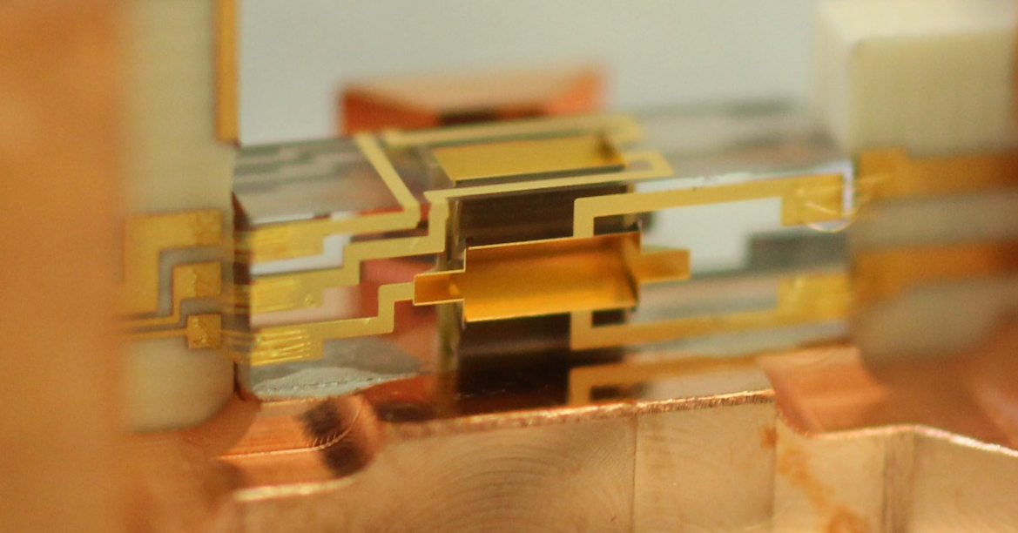
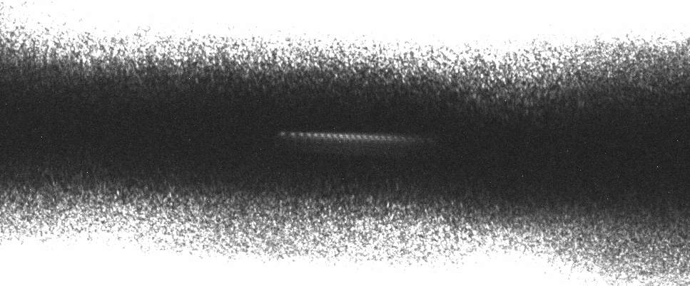
Ion trap
Linear Paul trap
High-precision micro-fabricated ion trap
Oscillating electric potential
+
-
+
+
static electric potential
+
-
+
2.5 mm
Independent harmonic oscillators with frequency O(1) MHz
200 um

Slide 5
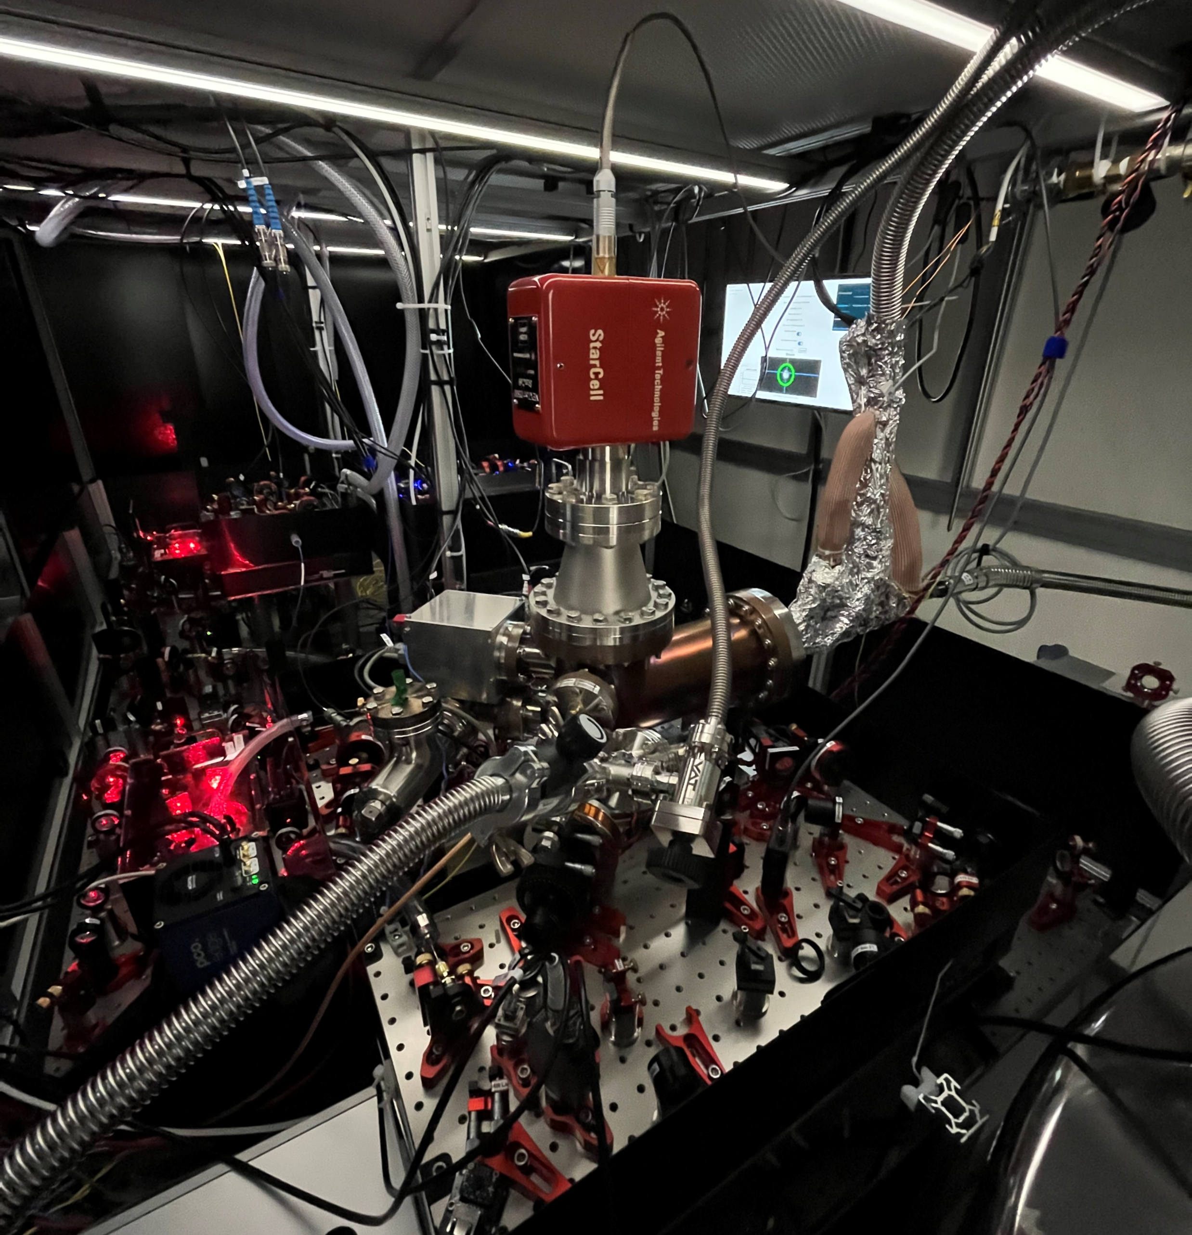
  “tabletop” experiment (~few m³)
  subgroup of Trapped Ion Quantum Information group:
    Benefit from knowhow
    (complex control system, trap fabrication, cryostat, shared lasers, …)
Challenge: Reactions with background gas limit lifetime:
  Ultra-High-Vacuum chamber
  trap cooled to ~10 K with liquid helium flow cryostat
H₂⁺ + H₂ → H₃⁺ + H

Slide 6
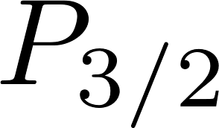


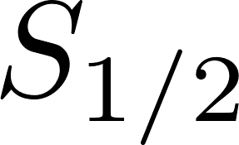




Quantum control
Be⁺
H₂⁺
closed, fast cycling transition
313 nm
  Challenge: H2+ has no such cycling transition
laser cool ion motion
electronic state preparation
state-dependent fluorescence readout
coherent control
laser cool ion motion
electronic state preparation
state-dependent fluorescence readout
coherent control
  Solution: Co-trap Be+ and H2+

Slide 7
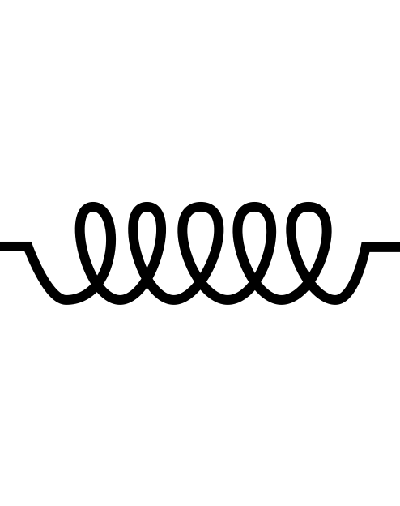
Quantum control
Two ion crystal
Model: Coupled harmonic oscillator
Be⁺
H₂⁺
lightest ion with high-level control
m₁
m₂
  1. sympathetic cooling of translational motion (groundstate)
  Coupling extends quantum control from Be+ to H2+

Slide 8
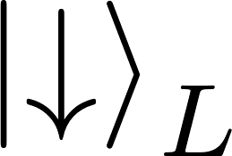
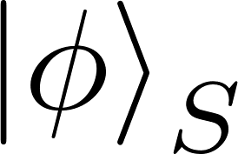
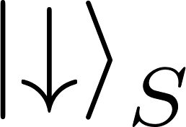
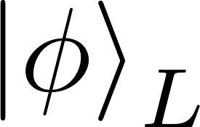
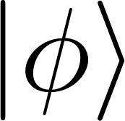

Readout and state preparation using “quantum logic spectroscopy”:
  non-destructive (keep H2+)
  Quantum Non-Demolition (QND) measurement.
    Al⁺: P. O. Schmidt et al. 2005 (DOI: 10.1126/science.1114375)
    MgH⁺: F. Wolf et al. 2016 (https://doi.org/10.1038/nature16513)
    CaH⁺: C.-W. Chou et al. 2017 (https://doi.org/10.1038/nature22338)
    N₂⁺: M. Sinhal et al. 2021 (10.2533/chimia.2021.291)
    3. enables preparation in pure quantum state
    2. state-dependent fluorescence readout
Need access to internal states of H2+ to extract spectroscopy information
Laser pulse maps internal state of H2+ onto shared motion
Laser pulse maps motional state onto internal state of Be+
Motional groundstate

Slide 9
Be⁺
H₂⁺
Proposed experiment sequence
He
  slow (O(10) minutes), do once
T = 10 K
proposed by S. Schiller et al. 2017 (https://doi.org/10.1103/PhysRevA.95.043411)
  Co-trap Be+ and H2+
  Helium buffer gas cools H2+ to rovibrational groundstate
  Prepare H2+ in pure quantum state (hyperfine level)
  Do spectroscopy experiments
“Quantum Logic Spectroscopy”
Fast, do many times to gather statistics:
1 shot = 1 bit = 1 probe time (e.g. for 10 ms for 100 Hz linewidth) + ~20 ms overhead
  convenient to have non-destructive readout and long lifetimes

Slide 10
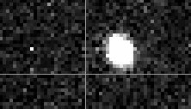
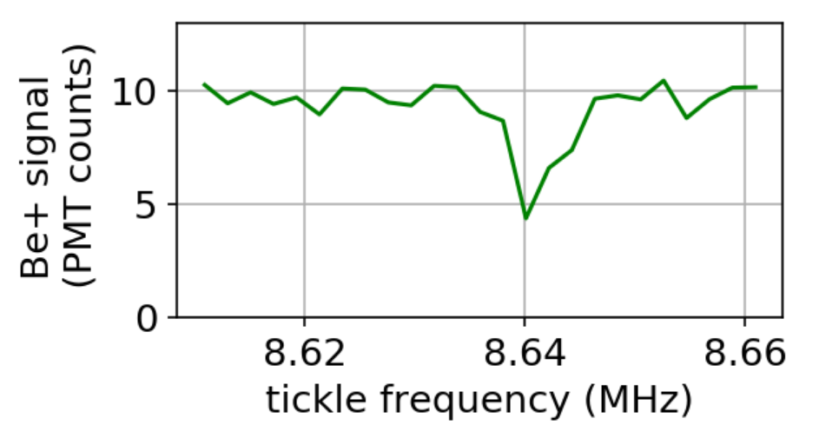
Current state
Load Be+ (photo-ionization laser) and Be+ control
Load H2+ (electron impact ionization)
Implementing control over H2+ (cool to motional groundstate, first steps towards quantum logic spectroscopy and buffer gas cooling)
First goal: microwave spectroscopy of the hyperfine sub-levels of H2+ prepared in rovibrational groundstate
H₂⁺ radial trap frequency
Be⁺
?
H₂⁺
lifetime ~8 hours
oscillating electric field

Slide 11
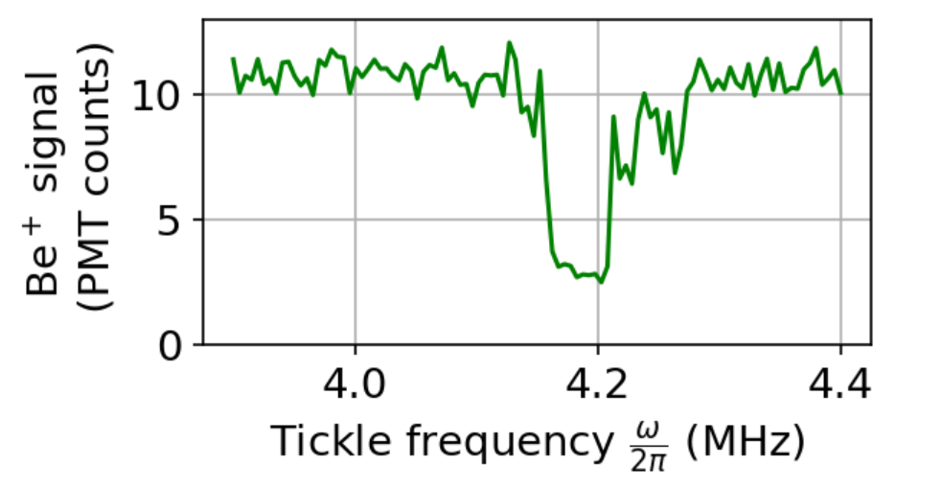
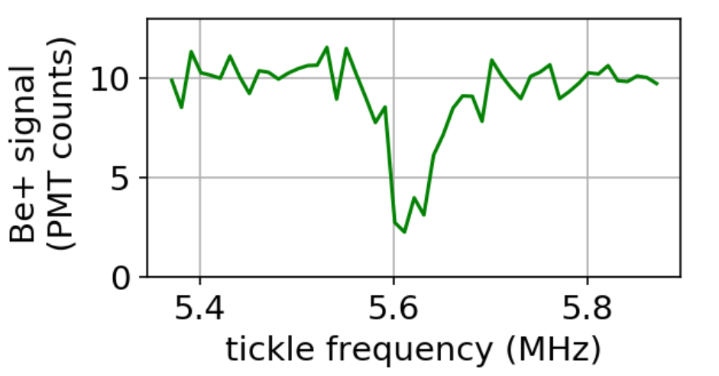
Future possibilities / dreams
Apparatus and techniques applicable to other light (molecular) ions.
Comparison matter vs. anti-matter:
quantum logic spectroscopy with anti-H2-
Be⁺
He⁺
Be⁺
H₃⁺
Be⁺
H₂⁻
  modifications to the trap required to co-trap positive and negative charges.

Slide 12
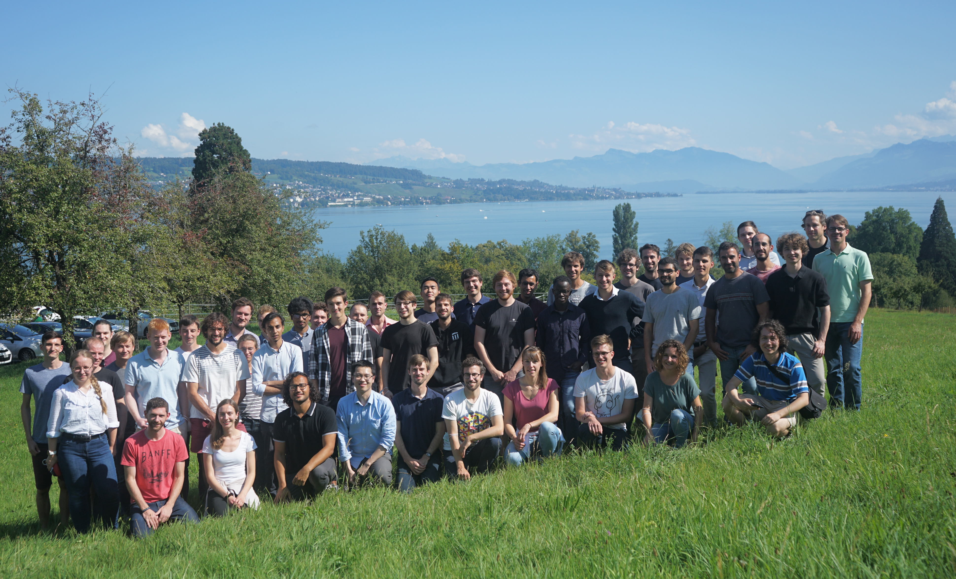

Team
Molecules “Sub-group”
PhD students
PI
Be⁺
Nick Schwegler
David Holzapfel
Daniel Kienzler
H₂⁺
J. P. Home
Martin Stadler:
Experiment computer control!
Seg trap team: laser light
Penning team: laser light
Trapped ion quantum information group, ETH Zürich

Slide 14
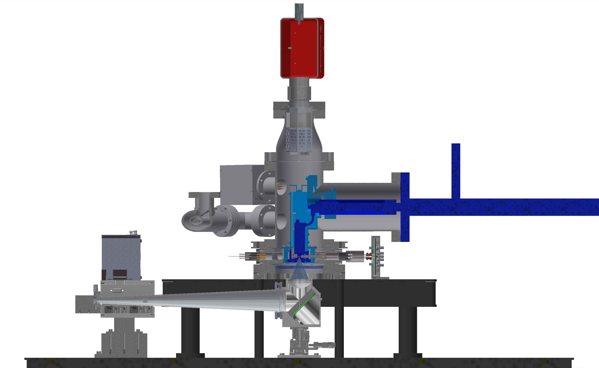
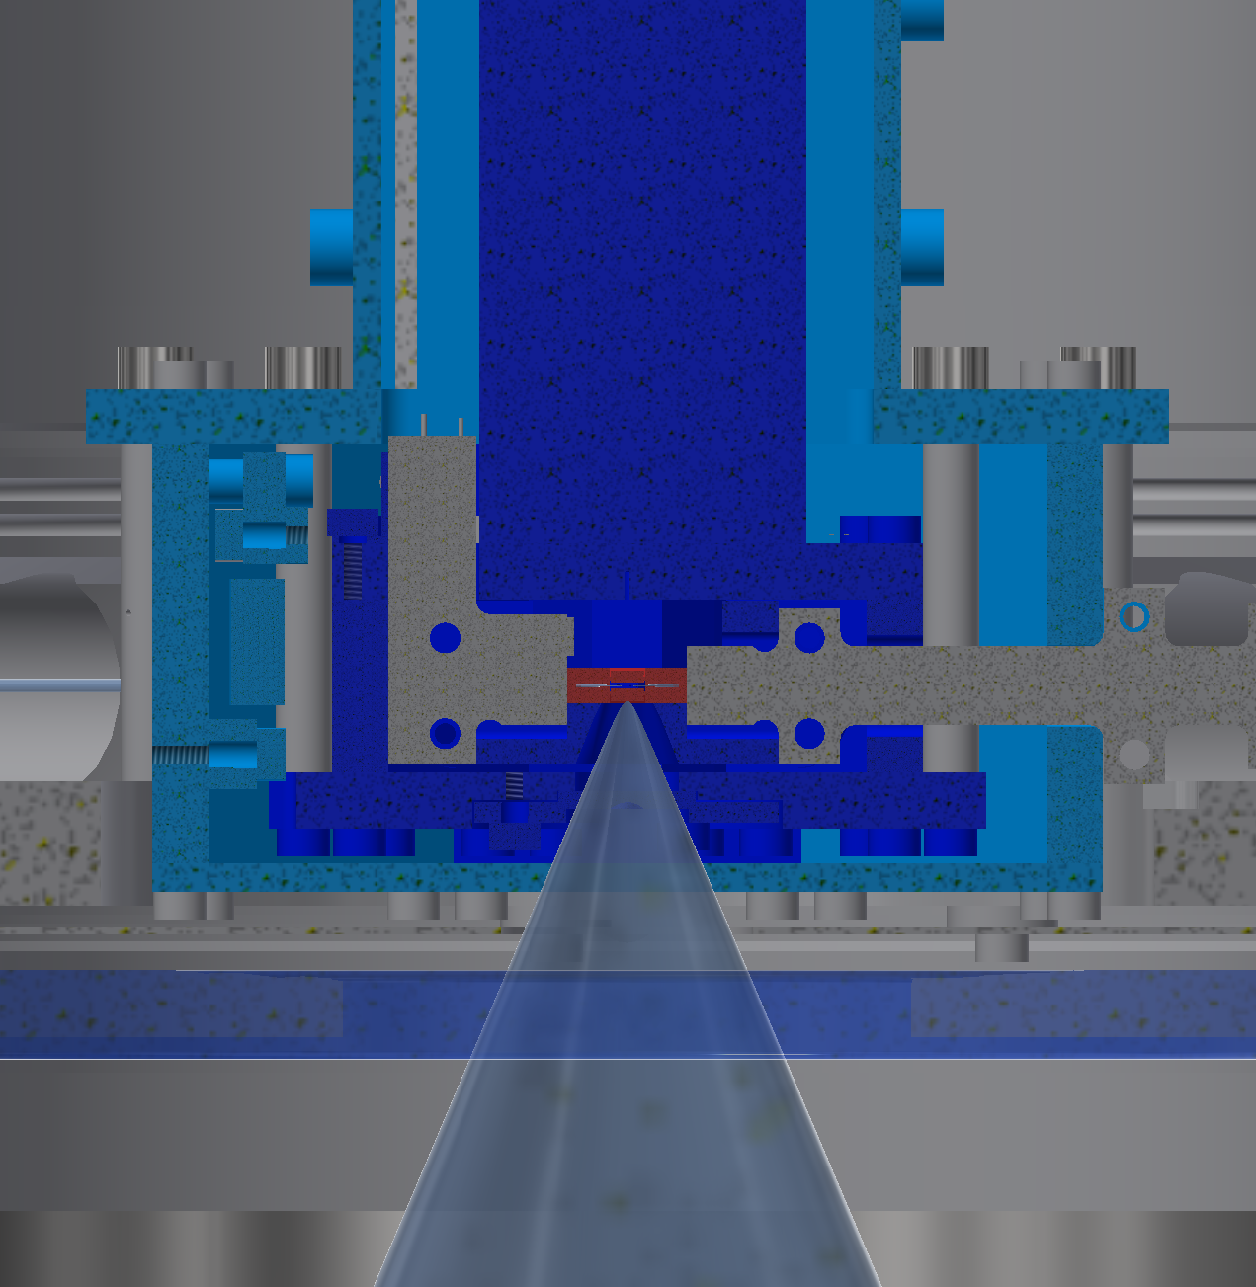
Trap chamber
Heatshield (80 K)
Ion pump and NEG
Ion trap
UHV chamber (300 K)
Coldhead (10 K)
50 mm
Liquid helium
flow cryostat (Janis)
Leak valve
CMOS
camera
RF resonator
PMT
Imaging system
600 mm

Slide 15

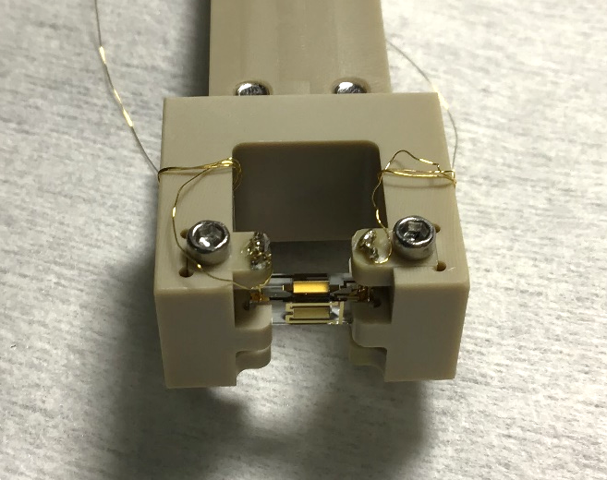
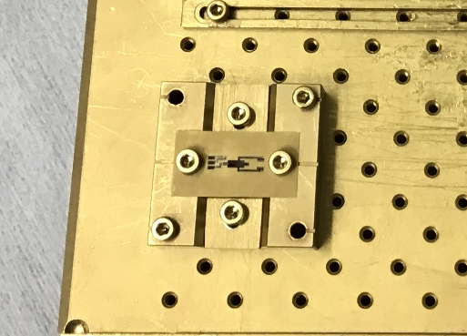
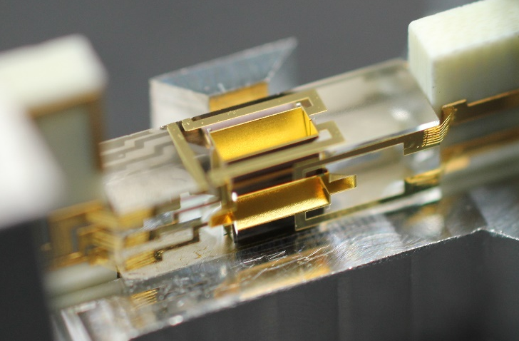
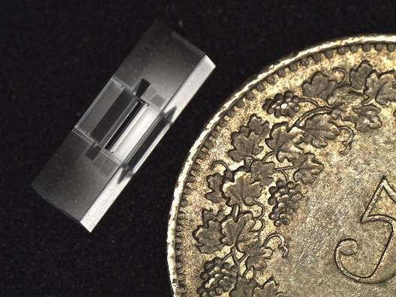
Trap Fabrication in 4 steps
3
2
Gold electroplating
(5 um)
Electron beam evaporation of gold (100 nm)
4
1
Femtoprint sample
Glue trap and wirebond

Slide 16
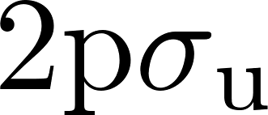

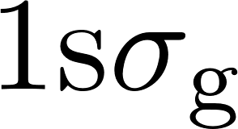






Level Diagram of H₂⁺
Rotation (L)
excited state
(unbound)
Vibration (v)
homonuclear molecule: no dipole moment (long lived rovibrational states)
p
p
e⁻
Dipole transition
> 1240 THz (< 241 nm)
Spin (I = 0,1; S = 1/2)
H₂⁺
…
…
Two species with different nuclear spin that don’t mix
Total angular momentum
J = I + S + L
Dipole forbidden
66 THz (4.5 um)
J = 3/2
Para-H₂⁺
(I = 0)
J = 5/2
…
Ortho-H₂⁺ (I = 1)
ground state
(bound)
symmetric
…
J = 1/2
Magnetic dipole transitions
1.5 GHz
Dipole forbidden
8 THz (37.5 um)
J = 1/2
anti-symmetric
J = 3/2
Electronic states
Ro-vibrational
states
Rotational states
Goal: Prepare a single hyperfine level

Slide 17

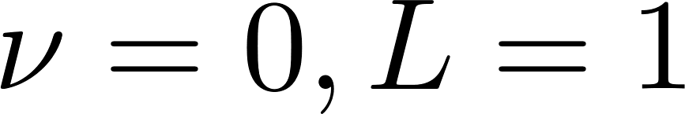
Initialization of single hyperfine level
mixed state after Buffer gas cooling
RSB π
Raman transition
285 THz (1050 nm, far detuned)
in QLS State preparation
(Sideband can couple to motion)
I + S = 1/2
J = 1/2
1.5 GHz
Microwave Carrier π pulse: transfer population to a fixed level (no coupling to motion possible)
J = 3/2
Buffer gas cooling + QLS
= prepare single hyperfine level, ready for spectroscopy experiments
Ortho-H₂⁺ (I = 1)
Repeat for all 18 hyperfine levels in L = 1

Slide 18
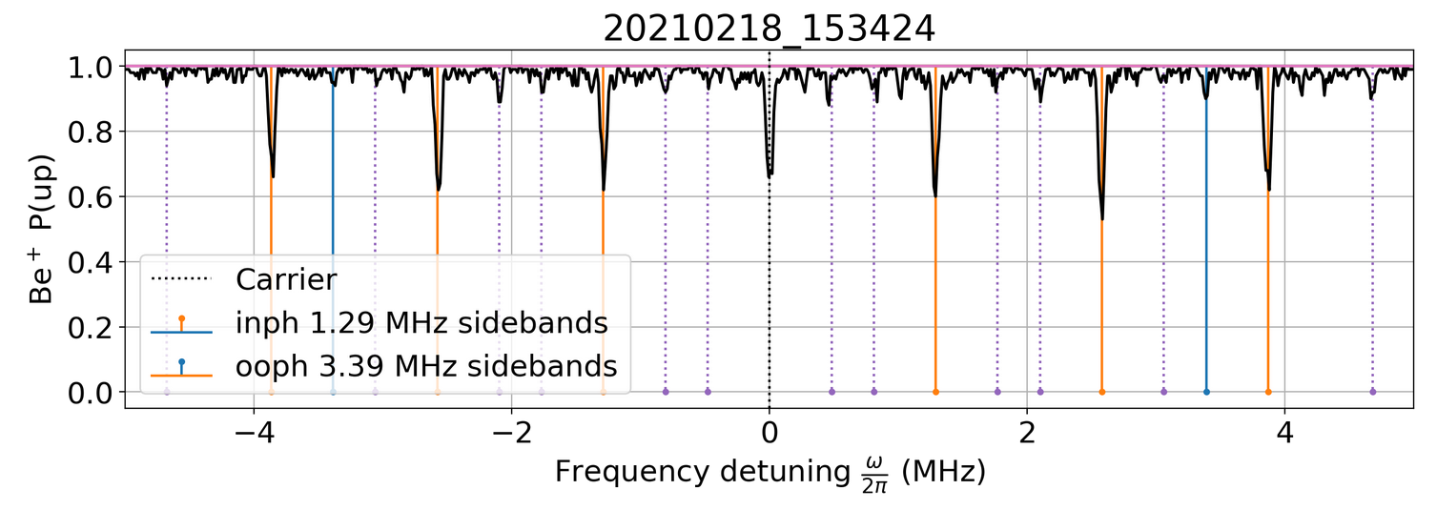
Be⁺
H₂⁺

