Slide 1
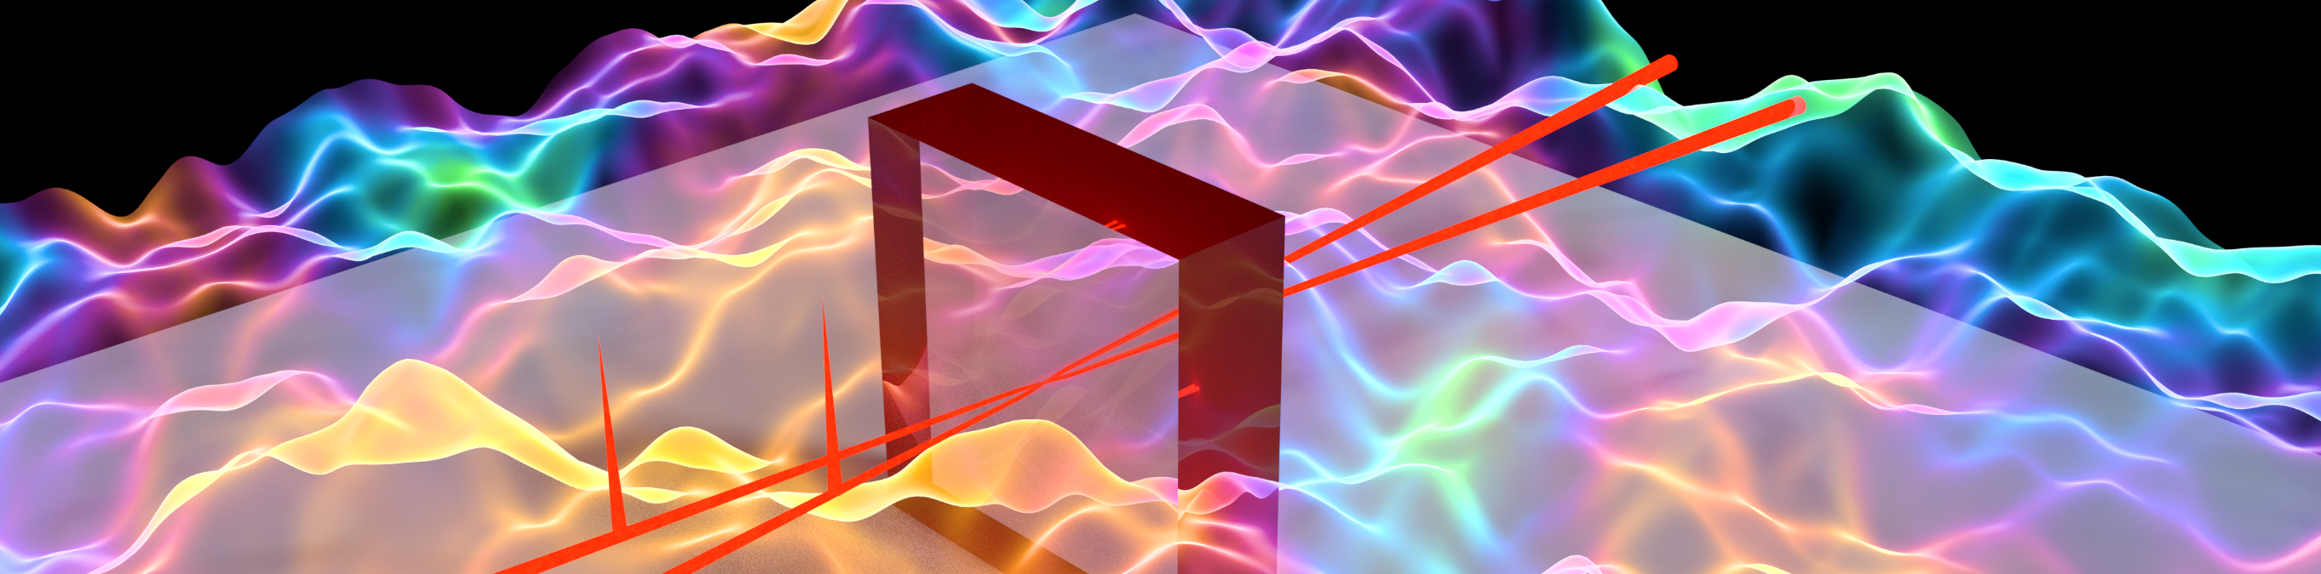
Exploring the structure of vacuum: measuring vacuum fluctuation correlations outside the light cone
Francesca Fabiana Settembrini¹, Frieder Lindel², Alexa Marina Herter¹, Stefan Buhman³, and Jérôme Faist¹
¹Institute of Quantum Electronics, ETH Hönggerberg, 8093 Zürich, Switzerland
² Physicalisches Institute, Albert-Ludwigs-Universität Freiburg, 79104 Freiburg, Germany
³ Institut für Physik, Universität Kassel, Heinrich-Plett-Strasse 40, 34132 Kassel, Germany

Slide 2
Presentation layout
Introduction
    Vacuum field fluctuation
    Quantum vacuum induced physics
Detection of quantum vacuum correlation outside the light cone
    Correlation harvesting via Unruh-deWitt detectors
    Unruh de-Witt detectors and electro-optic sampling
    Electro-optic sampling for correlation measurements on the quantum vacuum
    First results on vacuum correlation measurements at THz frequencies
    Electric field correlation on the electromagnetic groundstate from non-causally conneced space time points outside the light cone
Conclusions

Slide 3
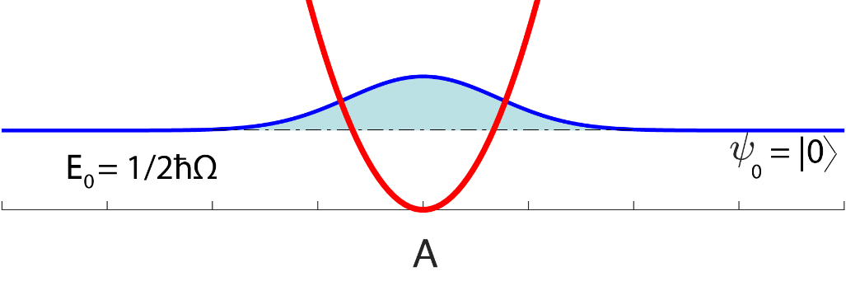
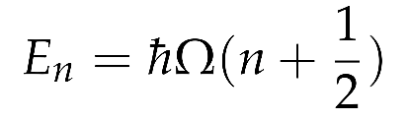
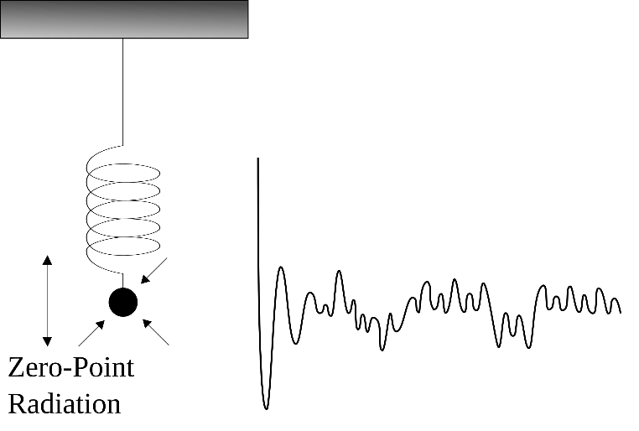

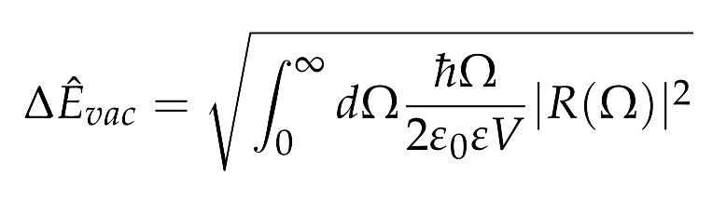
The vacuum field fluctuations
zero photons: n = 0
Non-vanishing electric field variance
Infinity of spectral components
2
x(t)
responsivity

Slide 4
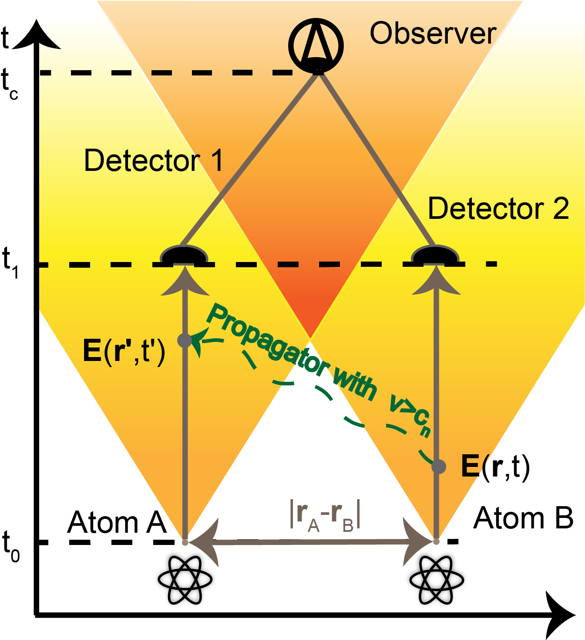

The vacuum field fluctuations
Electromagnetic vacuum is entangled and correlated
J.D. Franson Journal of Modern Optics, 55,13, 2117-2140 (2008)
B. Reznik Found.Phys. 33 (2003) 167-176
A. Valentini, Phys. Lett. A, 153 (67), (1991)

Slide 5

The vacuum field fluctuations
Electromagnetic vacuum is entangled and correlated
Electromagnetic vacuum is correlated also outside the light-cone, i.e. between space-time points without any causal connection
Two probe atoms A and B can be statistically correlated before influencing each other
J.D. Franson Journal of Modern Optics, 55,13, 2117-2140 (2008)
B. Reznik Found.Phys. 33 (2003) 167-176
A. Valentini, Phys. Lett. A, 153 (67), (1991)

Slide 6
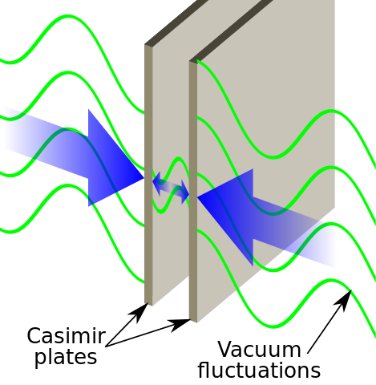
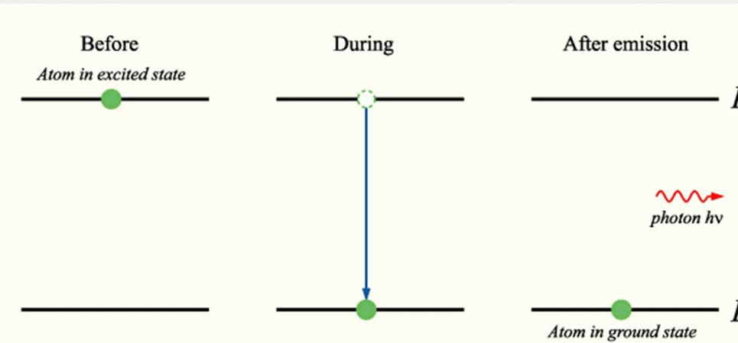
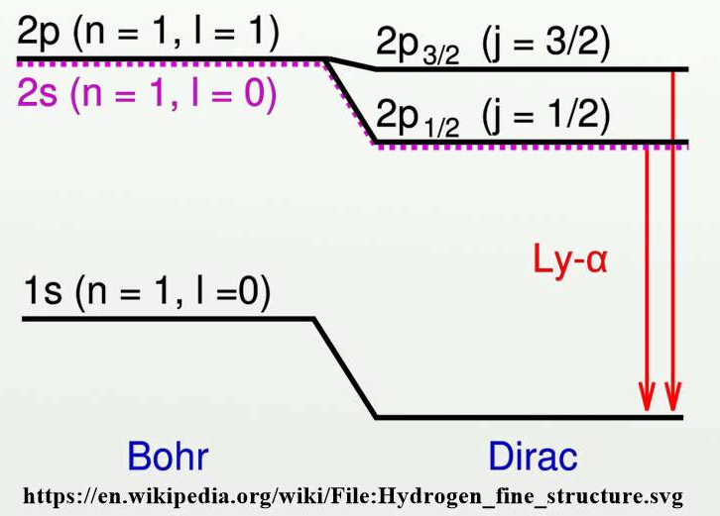
Vacuum field induced physics
Spontaneous emission
Lamb shift
Casimir force

Slide 7
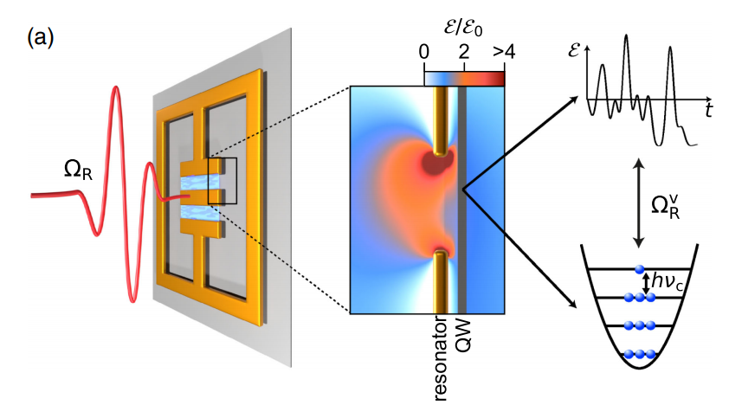
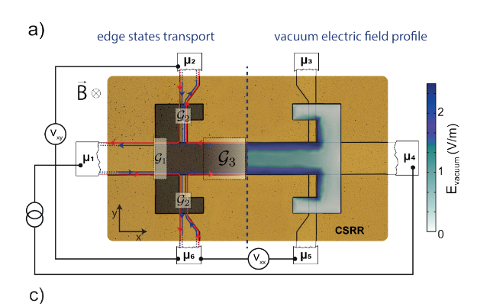
Vacuum field induced physics
Spontaneous emission
Lamb shift
Casimir force
Light matter coupling
Magnetotransport
J. Mornhinweg et al.,Phys. Rev. Lett. 126, 177404 (2019)
F. Appugliese et al., arXiv:2107.14145 (2021)

Slide 8
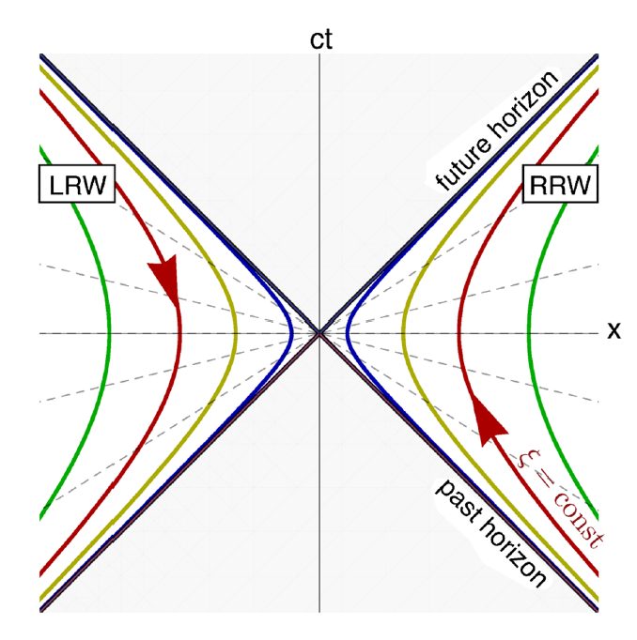
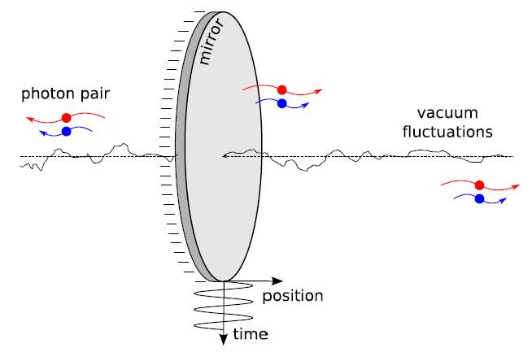
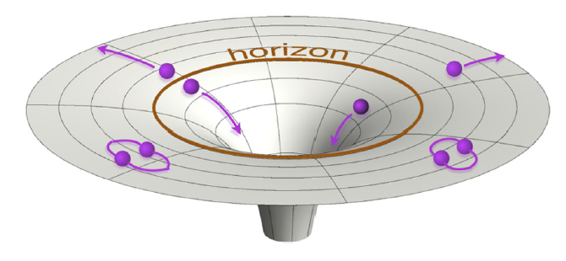
Vacuum field induced physics
Dynamical Casimir Force
Hawking radiation
Unruh effect
[1]
[1]
Direct characterization of the space-time correlations of the quantum vacuum has been missing up until now.
[1]
[1] Nation, P.D. et al. Rev. Mod. Phys. 84, 1 (2012)

Slide 9
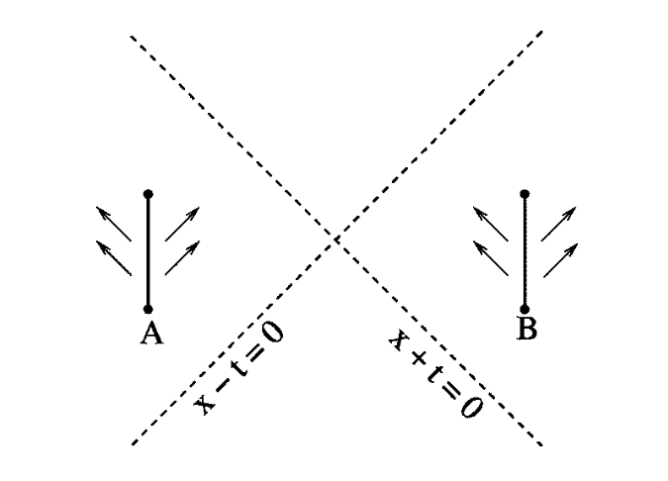
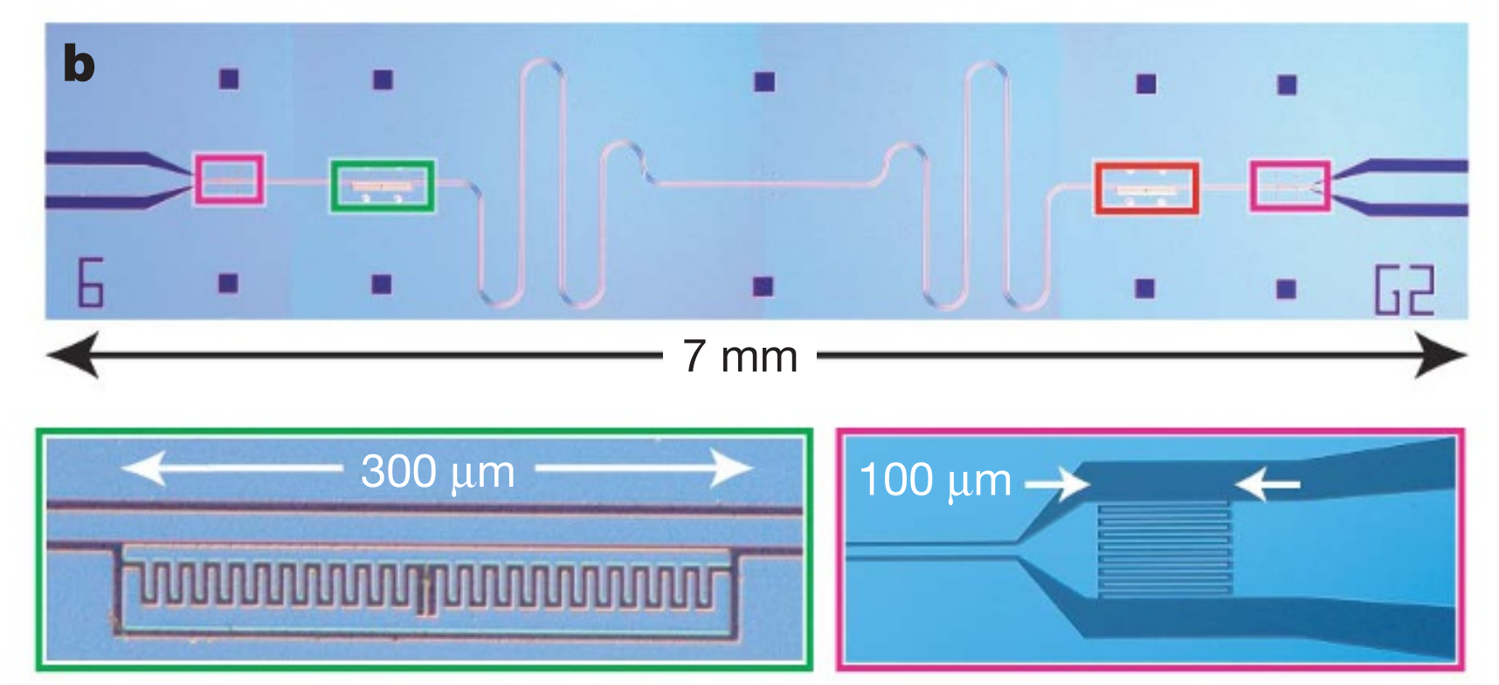
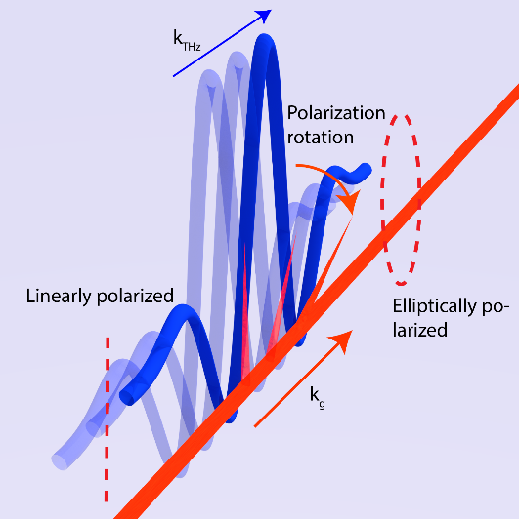
Measuring correlations of the quantum vacuum
Unruh de-Witt detector
Two level systems (particles, atoms, ...)
Point-like
Linear coupling with the local electric field Non-local correlations
Limited time of the interaction
[1]
Smooth temporal switching of the interaction and finite spatial extent of the detector harvest efficiently entangelment/correlation from the quantum vacuum [2]
[1]
Artificial atoms and superconductive circuits
χ⁽²⁾ nonlinear interaction
[3]
[1] B. Reznik, Phys. Rev. A, 71, 042104 (2005)
[2] Pozas-Kerstjens, Phys. Rev. D 92, 064042 (2015)
[3] J. Mayer, Nature 449, 443 (2007)

Slide 10
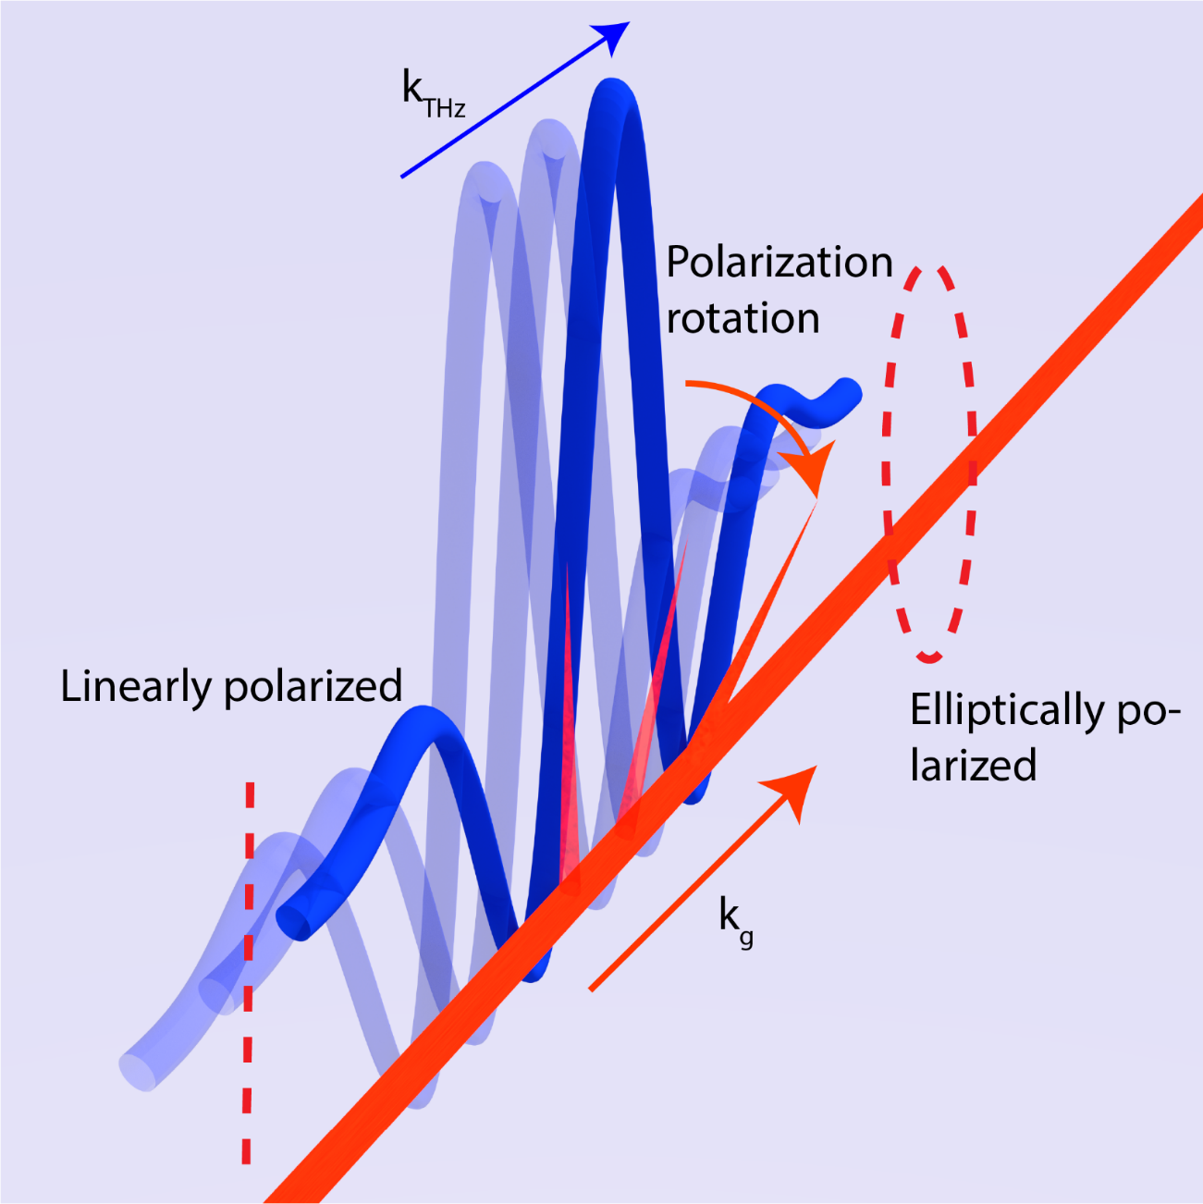
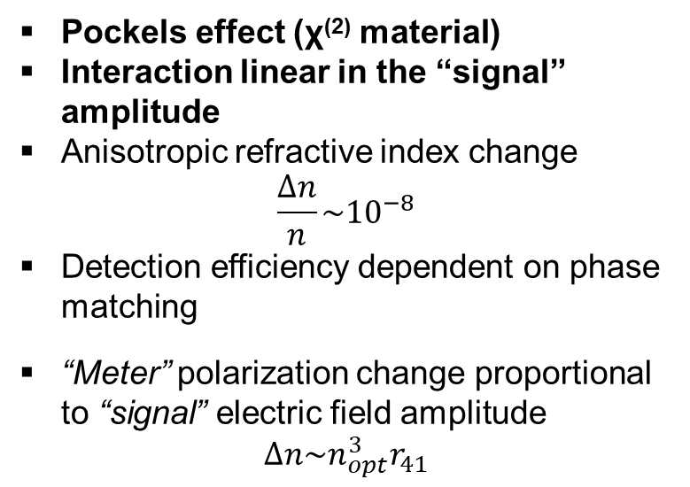
Electro optic sampling
Pockels effect (χ⁽²⁾ material)
Interaction linear in the “signal” amplitude
Anisotropic refractive index change
$$\frac{∆n}{n}\sim {10}^{−8}$$
Detection efficiency dependent on phase matching
“Meter” polarization change proportional to “signal” electric field amplitude
$$∆n\sim n_{opt}^{3}r_{41}$$
“signal”
“meter”

Slide 11

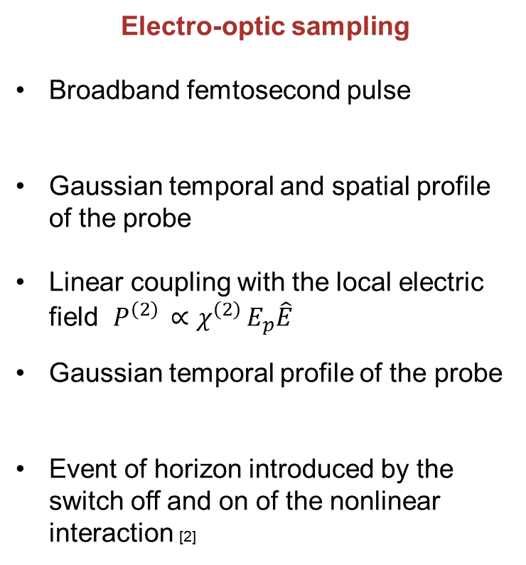
Unruh de Witt detectors and electro-optic sampling
Unruh de-Witt detector
Two level systems (particles, atoms, ...)
Point-like
Linear coupling with the local electric field
Smooth turn off and on of the interaction
Event of horizon due to accelerated reference frame
Electro-optic sampling
Broadband femtosecond pulse
Gaussian temporal and spatial profile of the probe
Linear coupling with the local electric field $P^{\left(2\right) }∝χ^{\left(2\right) }E_{p}\hat{E}$
Gaussian temporal profile of the probe
Event of horizon introduced by the switch off and on of the nonlinear interaction [2]
[1]M. Kiezman, Nature Physics 15, pages960–966 (2019)
[2] S. Onoe, arXiv:2103.14360v1

Slide 12
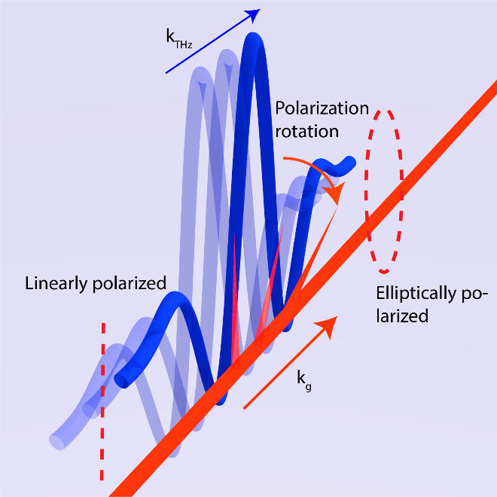
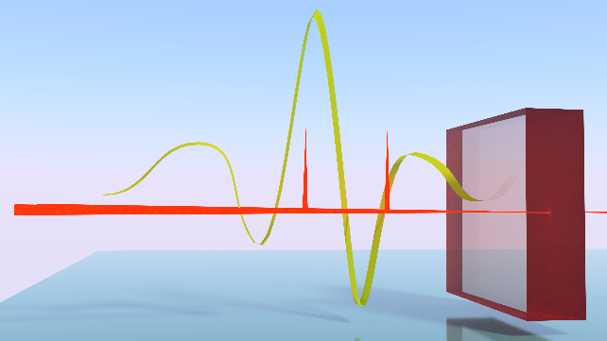
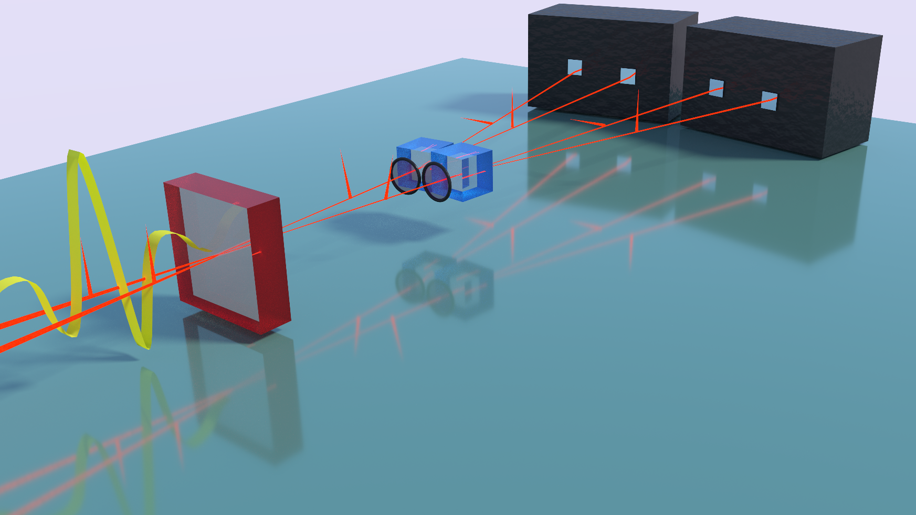

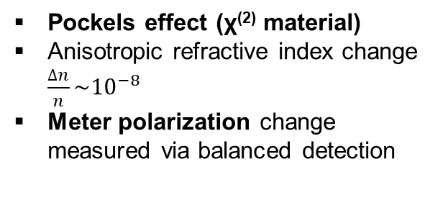
Electro optic sampling for correlations
THz wave
τ
NIR probe t+τ
τ
NIR probe t
“signal”
E(t+τ)
E(t)
Balanced photodetectors
Wollaston
prism
“meter”
λ/4
waveplate
Pockels effect (χ⁽²⁾ material)
Anisotropic refractive index change
$\frac{∆n}{n}\sim {10}^{−8}$
Meter polarization change measured via balanced detection
ZnTe crystal
Subcycle resolution
NIR pulse shot noise limited
Bandwidth of 2 THZ

Slide 13
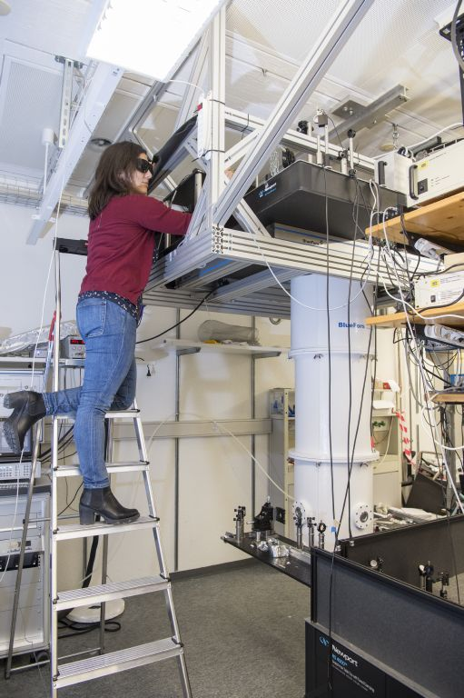
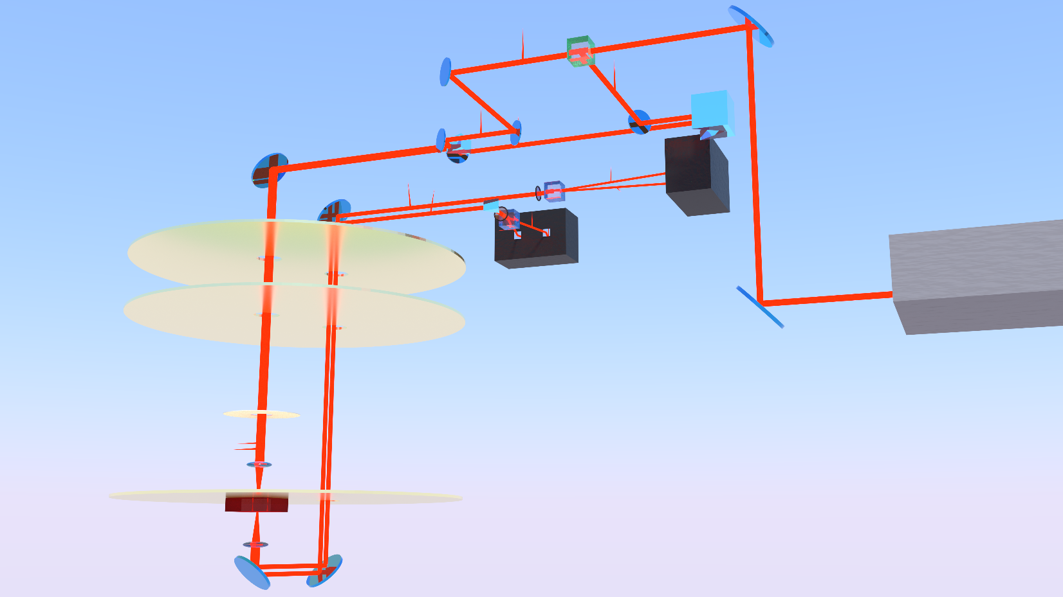
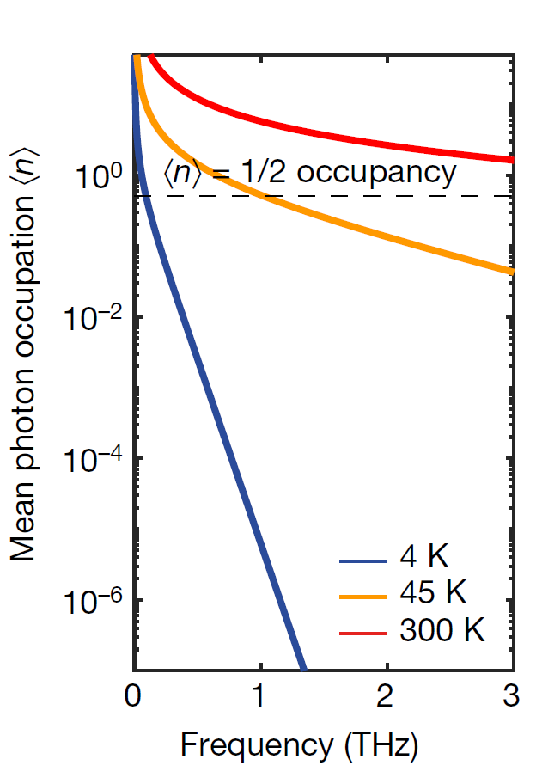
Experimental setup
Output mirror
BS
Delay stage
Input mirror
WP_{tau}
Detector_{tau}
60 K
WP_{t}
Detector_{t}
Thermal shield
4 K
ZnTe
crystal

Slide 14
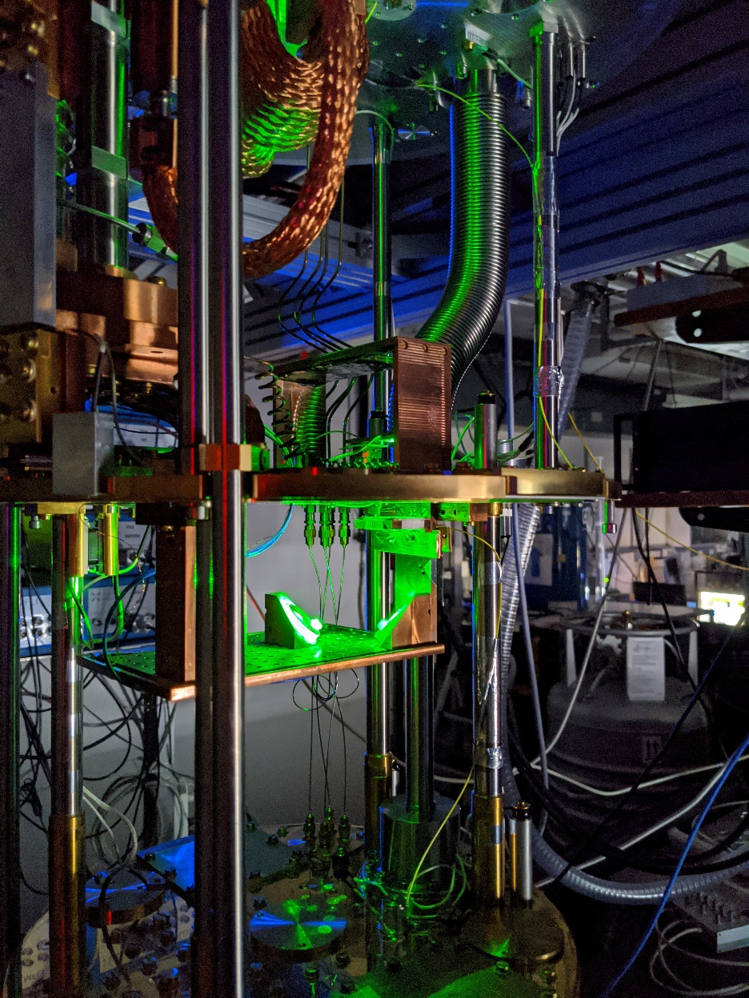
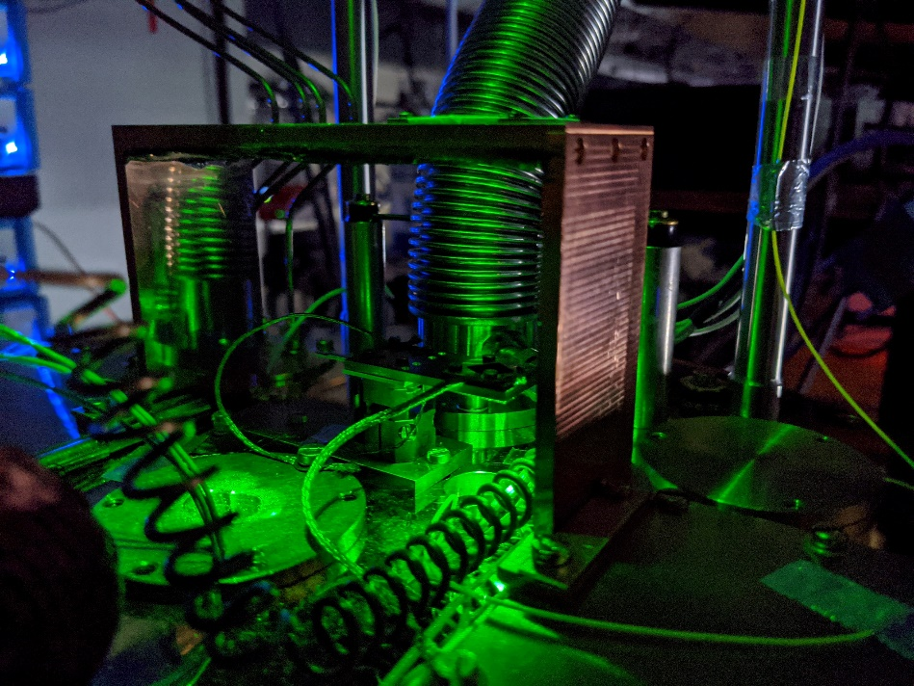
Experimental setup
Output mirror
BS
Delay stage
60 K
Input mirror
WP_{tau}
Lens
Detector_{tau}
60 K
WP_{t}
Detector_{t}
4 K
Thermal shield
4 K
ZnTe
crystal
ZnTe crystal

Slide 15
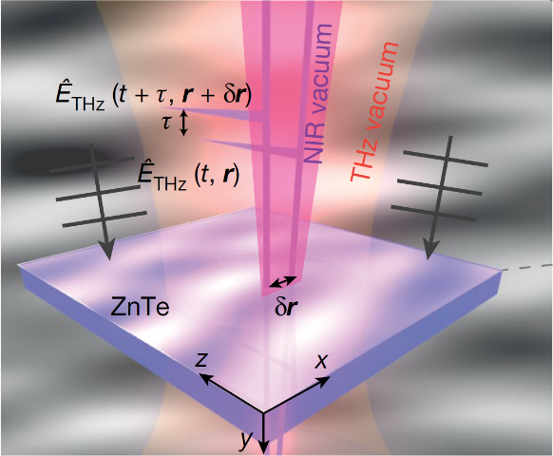
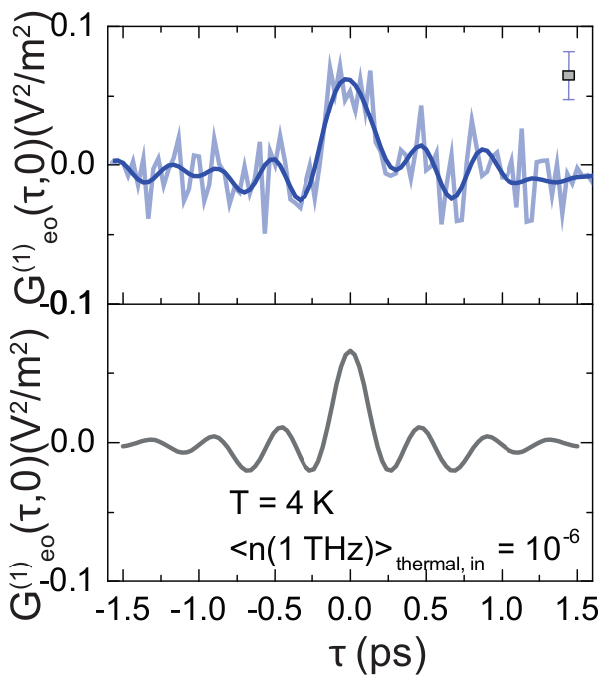
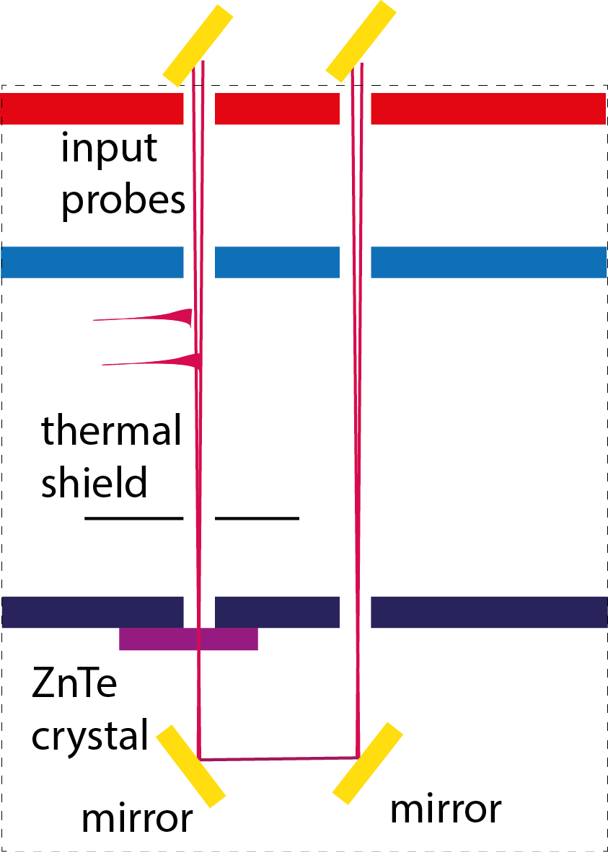
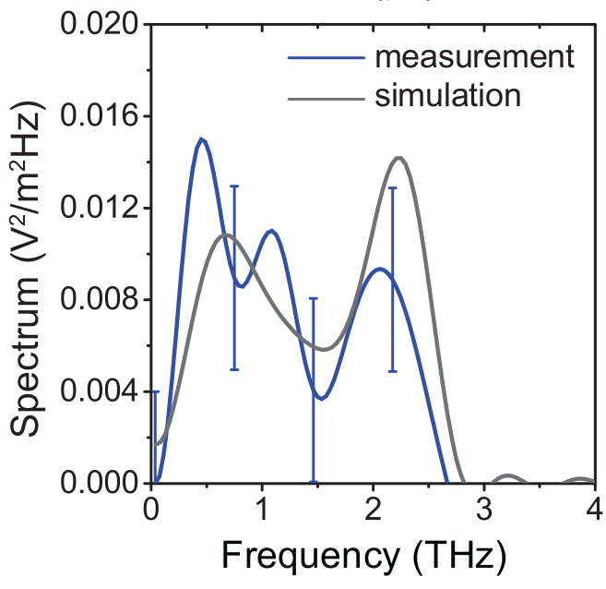
Field correlation on the quantum vacuum
T = 300 K
T = 45 K
T = 4 K
Integration time 1800 s per point !
Coherence window: 1.5–2.5 THz
Low frequency components
I-C Benea-Chelmus, F.F. Settembrini et al., Nature 568, 202–206 (2019)

Slide 16

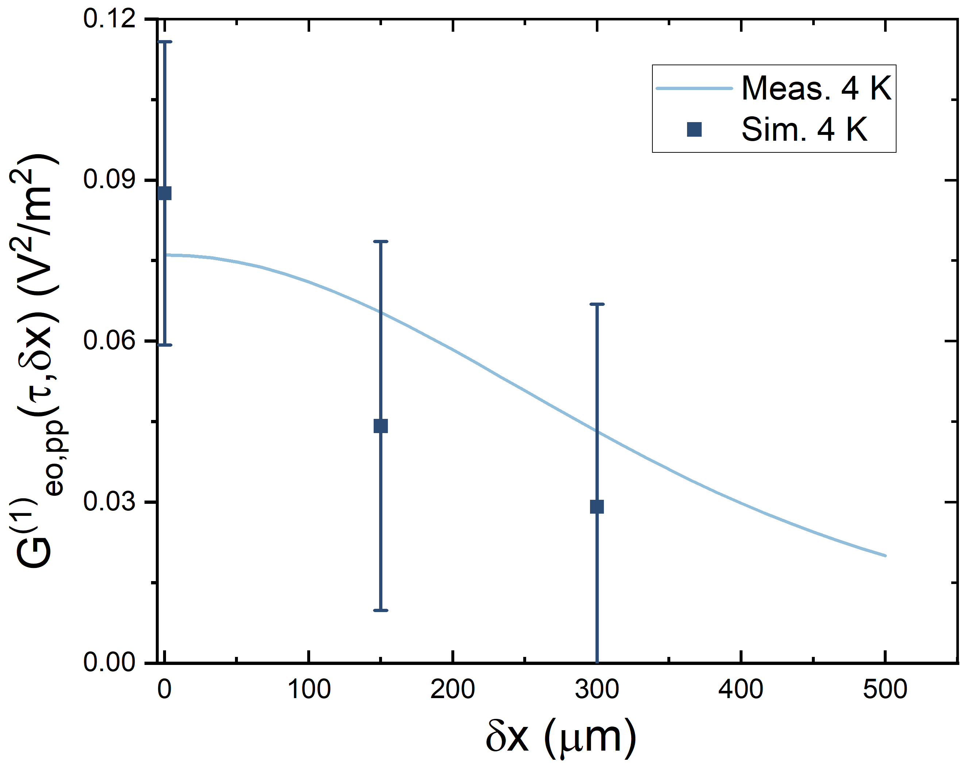
Spatial correlations
No information on the nature of the electric field correlations
I-C Benea-Chelmus, F.F. Settembrini et al., Nature 568, 202–206 (2019)

Slide 17
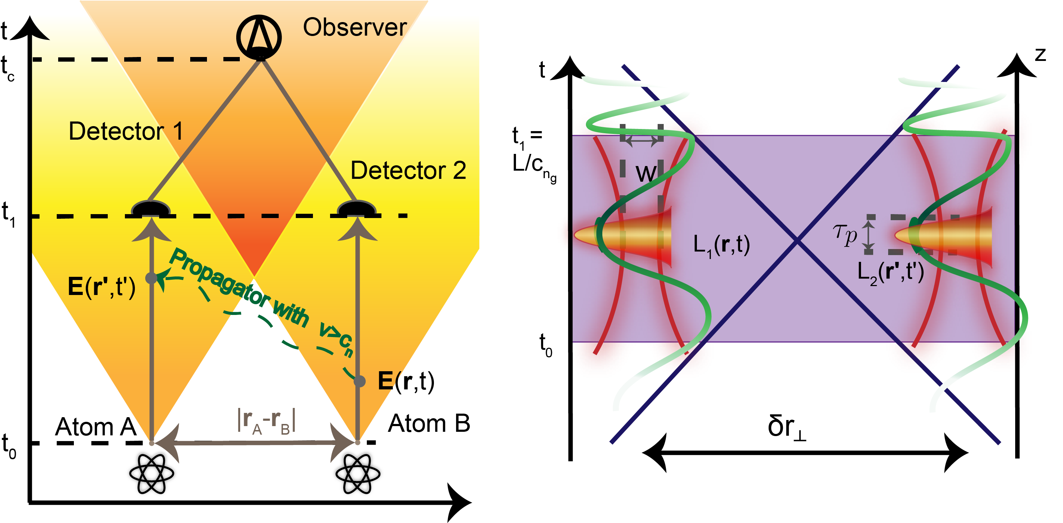

Quantum vacuum correlations outside the light cone
Distinction between causally and non-causally connected regions possible only in time domain.
L_{1r}(r,t) and L₂(r’,t’) are the space-time envelope of the gaussian probing pulses
F.F. Settembrini et al., arXiv:2111.02377 (2021)

Slide 18
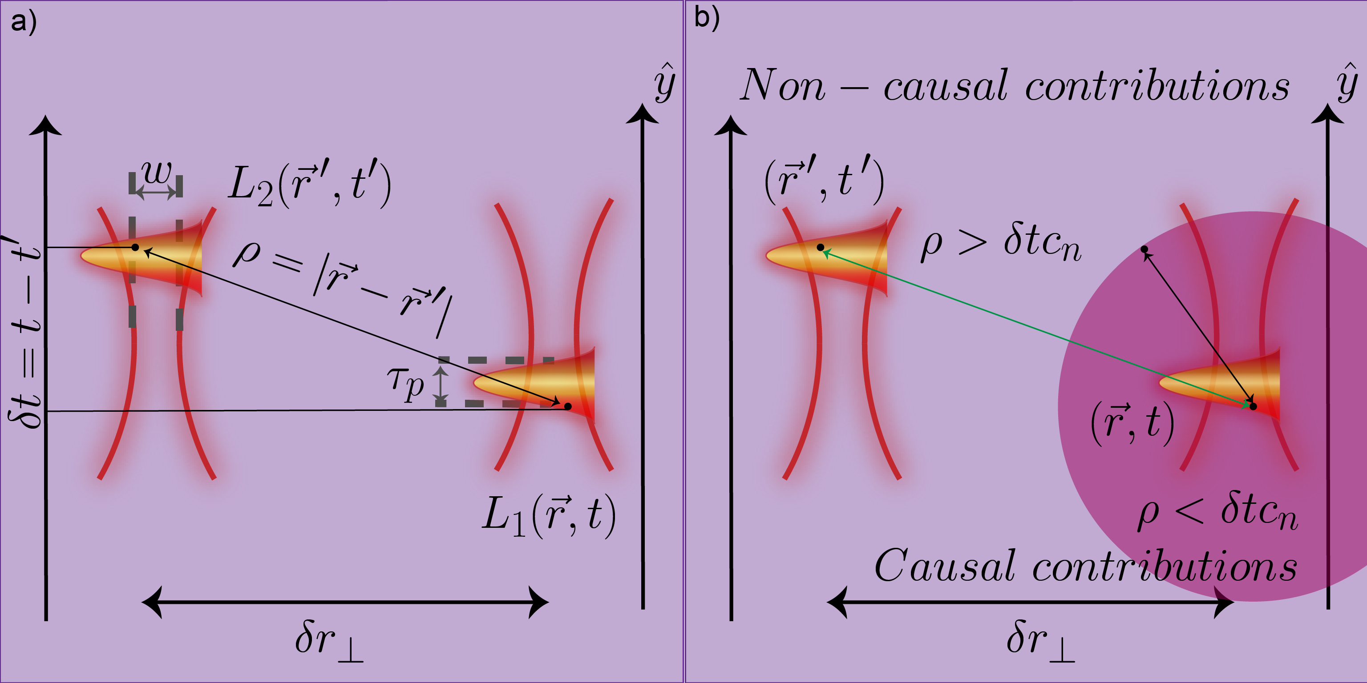
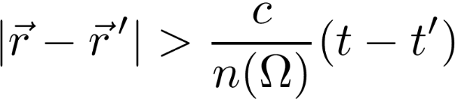
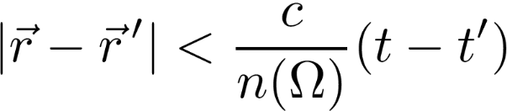
Quantum vacuum correlations outside the light cone
Non-causally connected (space-like) points
Causally connected
(time-like) points
F.F. Settembrini et al., arXiv:2111.02377 (2021)

Slide 19

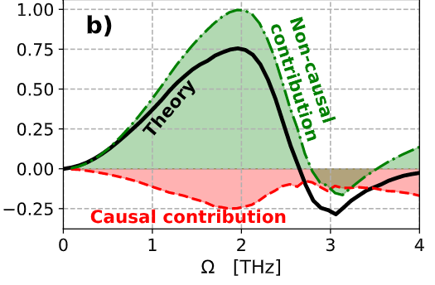
Quantum vacuum correlations outside the light cone
Non-causally connected (space-like) points
Causally connected
(time-like) points
F.F. Settembrini et al., arXiv:2111.02377 (2021)

Slide 20
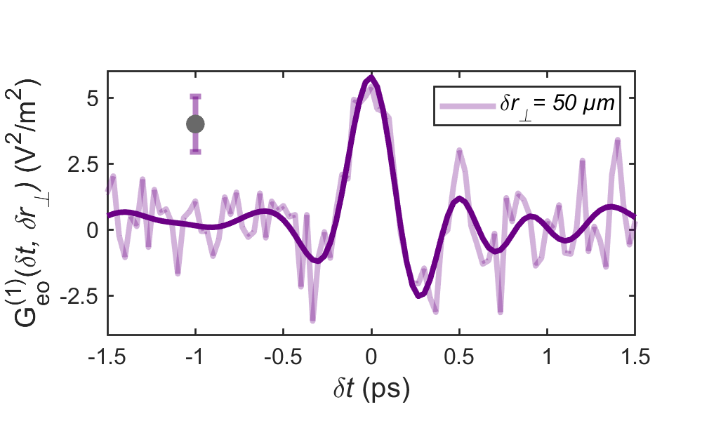
Quantum vacuum correlations outside the light cone
F.F. Settembrini et al., arXiv:2111.02377 (2021)

Slide 21
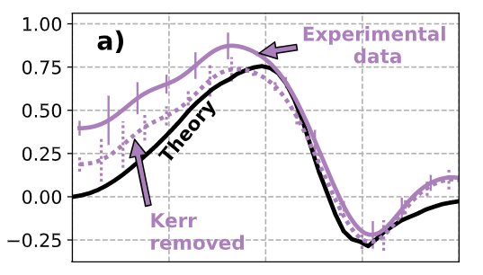

Quantum vacuum correlations outside the light cone
Residual low frequency noise due to third order nonlinearity
Good agreement between theory and measurement above 1 THz
F.F. Settembrini et al., arXiv:2111.02377 (2021)

Slide 22
Quantum vacuum correlations outside the light cone
Electromagnetic vacuum is correlated outside the forward light cone
Residual low frequency noise due to third order nonlinearity
Good agreement between theory and measurement above 1 THz
F.F. Settembrini et al., arXiv:2111.02377 (2021)

Slide 23
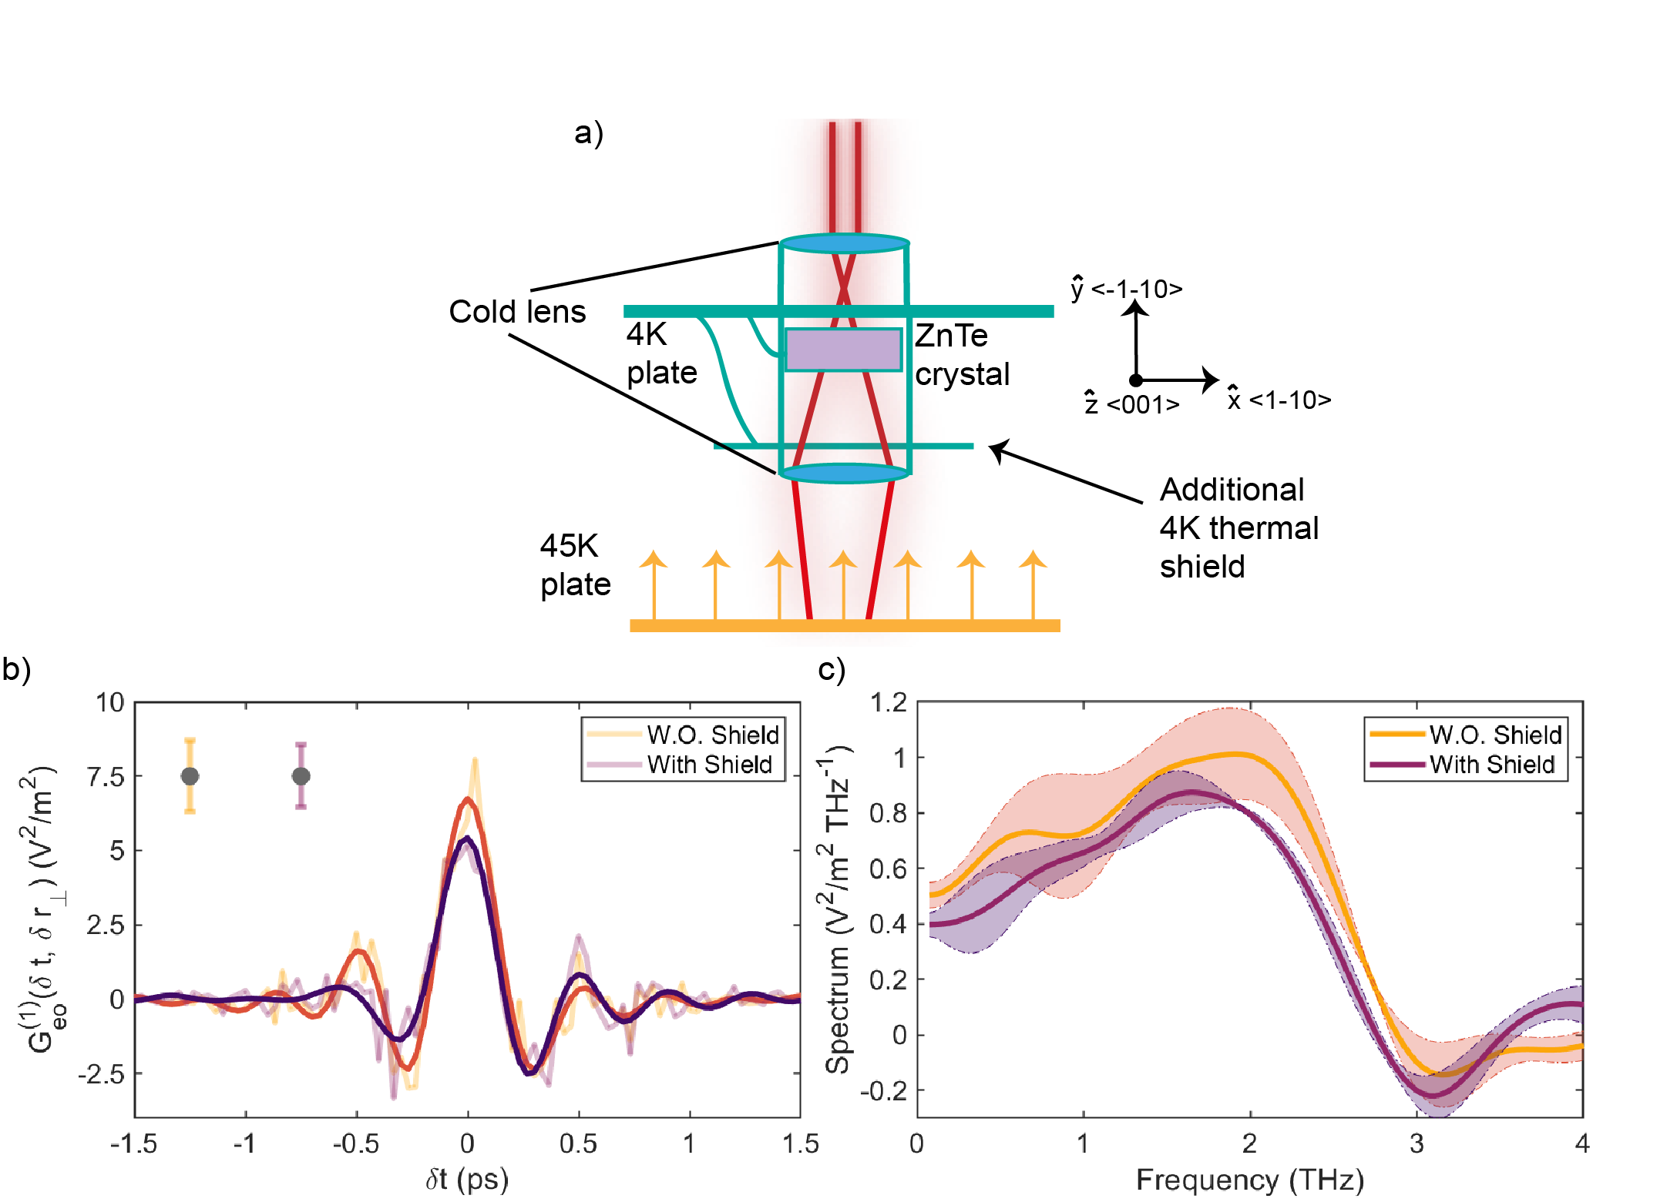
Quantum vacuum correlations outside the light cone
2w₀
Cold lenses opaque for thermal photons in THz regime
Check for possible thermal photon leakage by removing the additional 4 K shield
Reduction of electric-field amplitude
F.F. Settembrini et al., arXiv:2111.02377 (2021)

Slide 24
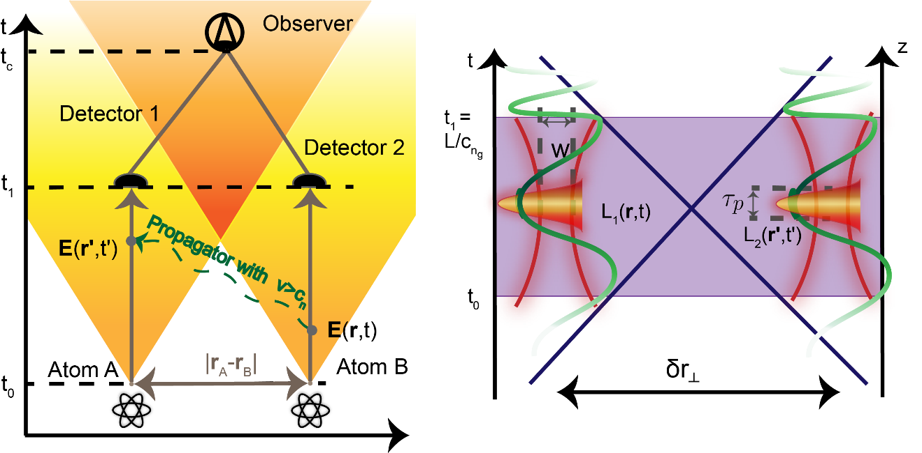
Conclusion
Via EOS we performed temporal and spatial correlation measurements on vacuum state
We implement a correlation measurement on the electromagnetic vacuum where the majority of the contributons come from non-causally connected space-time points
Electromagnetic vacuum is correlated outside the light cone

Slide 25
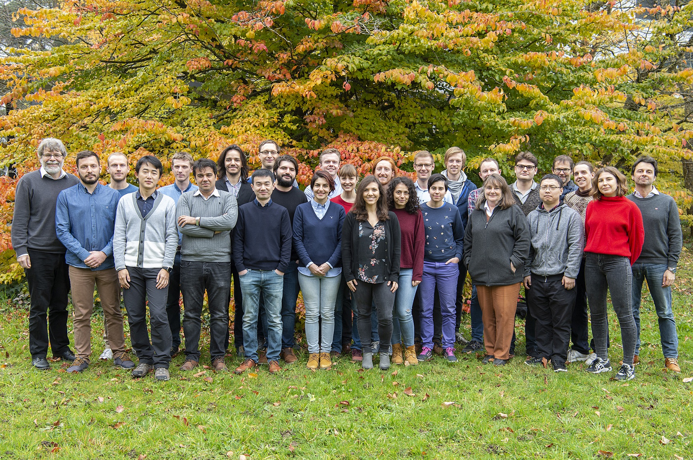



Thank you for your attention!
Special thanks to: J. Faist, S. Buhman, F. Lindel and A. Herter.

Slide 27
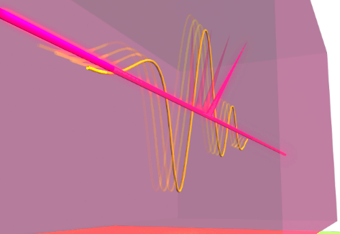
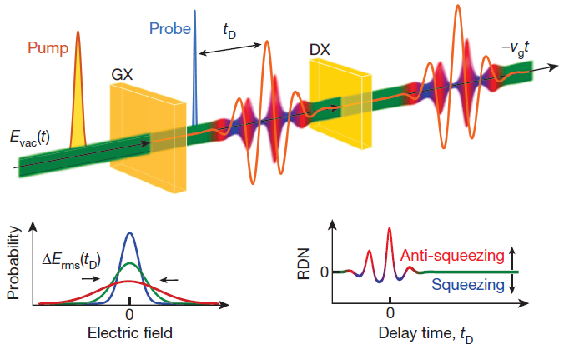
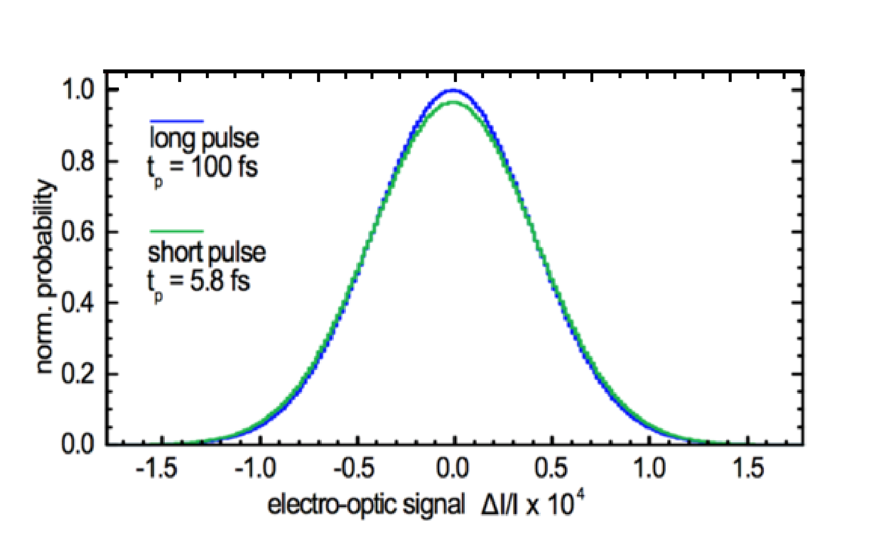
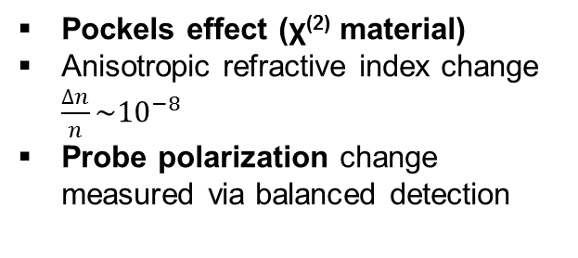
Electro optic sampling for correlations
Extreme sensitivity: measurement of the increase in noise due to the presence of bare and squeezed vacuum field.
Pockels effect (χ⁽²⁾ material)
Anisotropic refractive index change
$\frac{∆n}{n}\sim {10}^{−8}$
Probe polarization change measured via balanced detection
[1]
[2]
[1]
[1] C. Riek et al. Science 23, 420 (2015)
[2] C. Riek et al. Nature 541, 376 (2017)

Slide 28
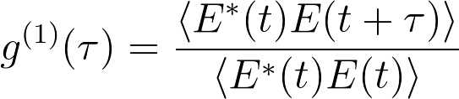
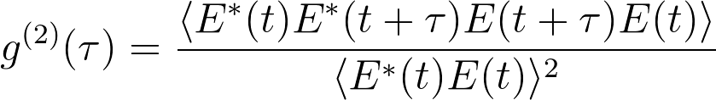


Correlation functions
g¹(t): Degree of first order coherence. Information of spectral composition, wave nature of light
g²(t): Degree of second order coherence. Information of energy, particle nature of
light
[1]
g¹(t) gives spectrum
-> In a Fourier Transform Infrared Spectrometer
g²(t) gives the photon statistics
-> used for quantum optics experiments
[1] I-C Benea-Chelmus et al, Phys. Rev. A 93, 043812 (2016)

Slide 29


Non-degenerate spontaneous parametric downconversion
NIR probe
NIR probe polarizarion
signal
ω
ω-Ω
$$χ^{(2)}$$
$$χ^{(2)}$$
pump
idler
THz vacuum
THz polarization
Ω
Ω
Classic parametric downconversion
Electro-optic sampling
$χ^{(2)}$ creates both the NIR probe polarization rotation (signal) and a THz idler. They can be described by coupled equations.

Slide 30

Non-degenerate spontaneous parametric downconversion
NIR probe
NIR probe polarizarion
signal
ω
ω-Ω
$$χ^{(2)}$$
$$χ^{(2)}$$
pump
idler
THz vacuum
THz polarization
Ω
Ω
Classic parametric downconversion
Electro-optic sampling
Generation of two modes squeezed states. Both THz and NIR vacuum are amplified
Signal
Back-action

Slide 31



Measurement interpretation
τ
Coherent state
Vacuum ground state
NIR probe t
In contrast to the coherent state, the vacuum state has no well-defined time dependence of the electric field
Comparison with measurement of an harmonic oscillator in the ground state
Classical value of the two-time correlation should be 0!
Correlation arises from the effect of the first measurement
NIR probe t+τ
measurement back-action
Electric field
Electric field

Slide 32


Terahertz frequency range
Lack of sources and detectors: THz gap
Low energy radiation (0.01*visible) ~ k_{B}T at T=300 K
Ultra-fast speed
Terahertz range
100 GHz – 10 THz
[2]
[1]
[3]
[1]
[1] K. Kawase et al.Opt. Express, 11 (2003)
[2] Appleby et al. IEEE Trans. Antennas Prop., 55 (2007)
[3] T. Cocker et al. Nature 539 (2016)

Slide 33



Electro optic sampling for correlations
Intensity detection
Electro-optic detection
NIR probe t
NIR probe t
Classical
NIR probe t+τ
Quantum mechanics
I-C Benea-Chelmus, F.F. Settembrini et al., Nature 568, 202–206 (2019)
A. Moskalenko et al. PRL 115 (2015)

Slide 34
Electro optic sampling for correlations
Intensity detection
Electro-optic detection
NIR probe t
NIR probe t
Classical
NIR probe t+τ
Quantum mechanics
Unruh-deWitt detectors with finite temporal and spatial extent can be used to harvest entangelment/correlation from the quantum vacuum
Broadband electro-optic detection (EOS) on the quantum vacuum is formally equivalent to the Unruh-deWitt detection on the quantum vacuum
Alejandro Pozas-Kerstjens et al., Phys. Rev. D 92, 064042 (2015)
Onoe S. Et al. arXiv:2103.14360 (2021)

Slide 35
Electro optic sampling for correlations
Intensity detection
Electro-optic detection
NIR probe t
NIR probe t
Classical
NIR probe t+τ
Quantum mechanics
Vacuum contribution
Thermal occupation contribution
I-C Benea-Chelmus, F.F. Settembrini et al., Nature 568, 202–206 (2019)
A. Moskalenko et al. PRL 115 (2015)

Slide 36


Noise properties
Shot noise limit
Beam stabilizing system
Fast data acquisition and fast computation
RF referencing
Possibility to measure background blackbody radiation and vacuum field fluctuations
Thermal background: integration time 100 s per point
Vacuum fluctuations: integration time 5000 s per point
I-C Benea-Chelmus, F.F. Settembrini et al., Nature 568, 202–206 (2019)

Slide 37

Experimental setup
Optics (stabilized)
Output mirror
BS
Delay stage
Input mirror
WP_{tau}
Det t+𝜏
Detector_{tau}
WP_{t}
Detector_{t}
Thermal shield
Det t
ZnTe
crystal

Slide 38


Correlation measurements: thermal vs. vacuum
T = 300 K
T = 300 K
T = 300 K
Dominant contribution: low frequencies
Few incoherent photons
I-C Benea-Chelmus, F.F. Settembrini et al., Nature 568, 202–206 (2019)

Slide 39


Intermediate check: 45 K
Crystal at 4 K
Radiation from 45 K plate
Notes:
Change the hamiltonians

Slide 40

Theoretical model
Macroscopic Cavity QED
Signal as a sum of contribution from all modes
,q
δr┴
I-C Benea-Chelmus, F.F. Settembrini et al., Nature 568, 202–206 (2019)
F. Lindel, F.F.Settembrini et al. arXiv:2107.02647 (2021)

Slide 41




Revisit field correlation function: G⁽¹⁾(τ)
NIR probe t
Intensity based detection
The result of the measurement on the electromagnetic vacuum state in an interferometer would give 0!
Solution: instead of photons measure directly the electric field!
A. Moskalenko and C. Ralph, Nature 568, 178-179 (2019)

Slide 42




Theoretical model
Macroscopic Cavity QED
Signal as a sum of contribution from all modes
System responsivity
  Phase matching
nT (Ω) average number of photons
Both spatial and temporal
correlation
,q
δr┴
2w₀
I-C Benea-Chelmus, F.F. Settembrini et al., Nature 568, 202–206 (2019)
F. Lindel, F.F.Settembrini et al. arXiv:2107.02647 (2021)
Francesca Fabiana Settembrini

Slide 43

Theoretical model
Macroscopic Cavity QED
Signal as a sum of contribution from all modes
System responsivity
  Phase matching
  Pulse width
nT (Ω) average number of photons
Both spatial and temporal
correlation
,q
δr┴
THz wave
τ
NIR probe t+τ
NIR probe t
NIR probe t
2w₀
E(t+τ)
E(t)
I-C Benea-Chelmus, F.F. Settembrini et al., Nature 568, 202–206 (2019)
F. Lindel, F.F.Settembrini et al. arXiv:2107.02647 (2021)

Slide 44


Theoretical model
Macroscopic Cavity QED
Signal as a sum of contribution from all modes
System responsivity
  Phase matching
  Pulse width
  Beam size
nT (Ω) average number of photons
Both spatial and temporal
correlation
,q
δr┴
I-C Benea-Chelmus, F.F. Settembrini et al., Nature 568, 202–206 (2019)
F. Lindel, F.F.Settembrini et al. arXiv:2107.02647 (2021)

