Slide 1
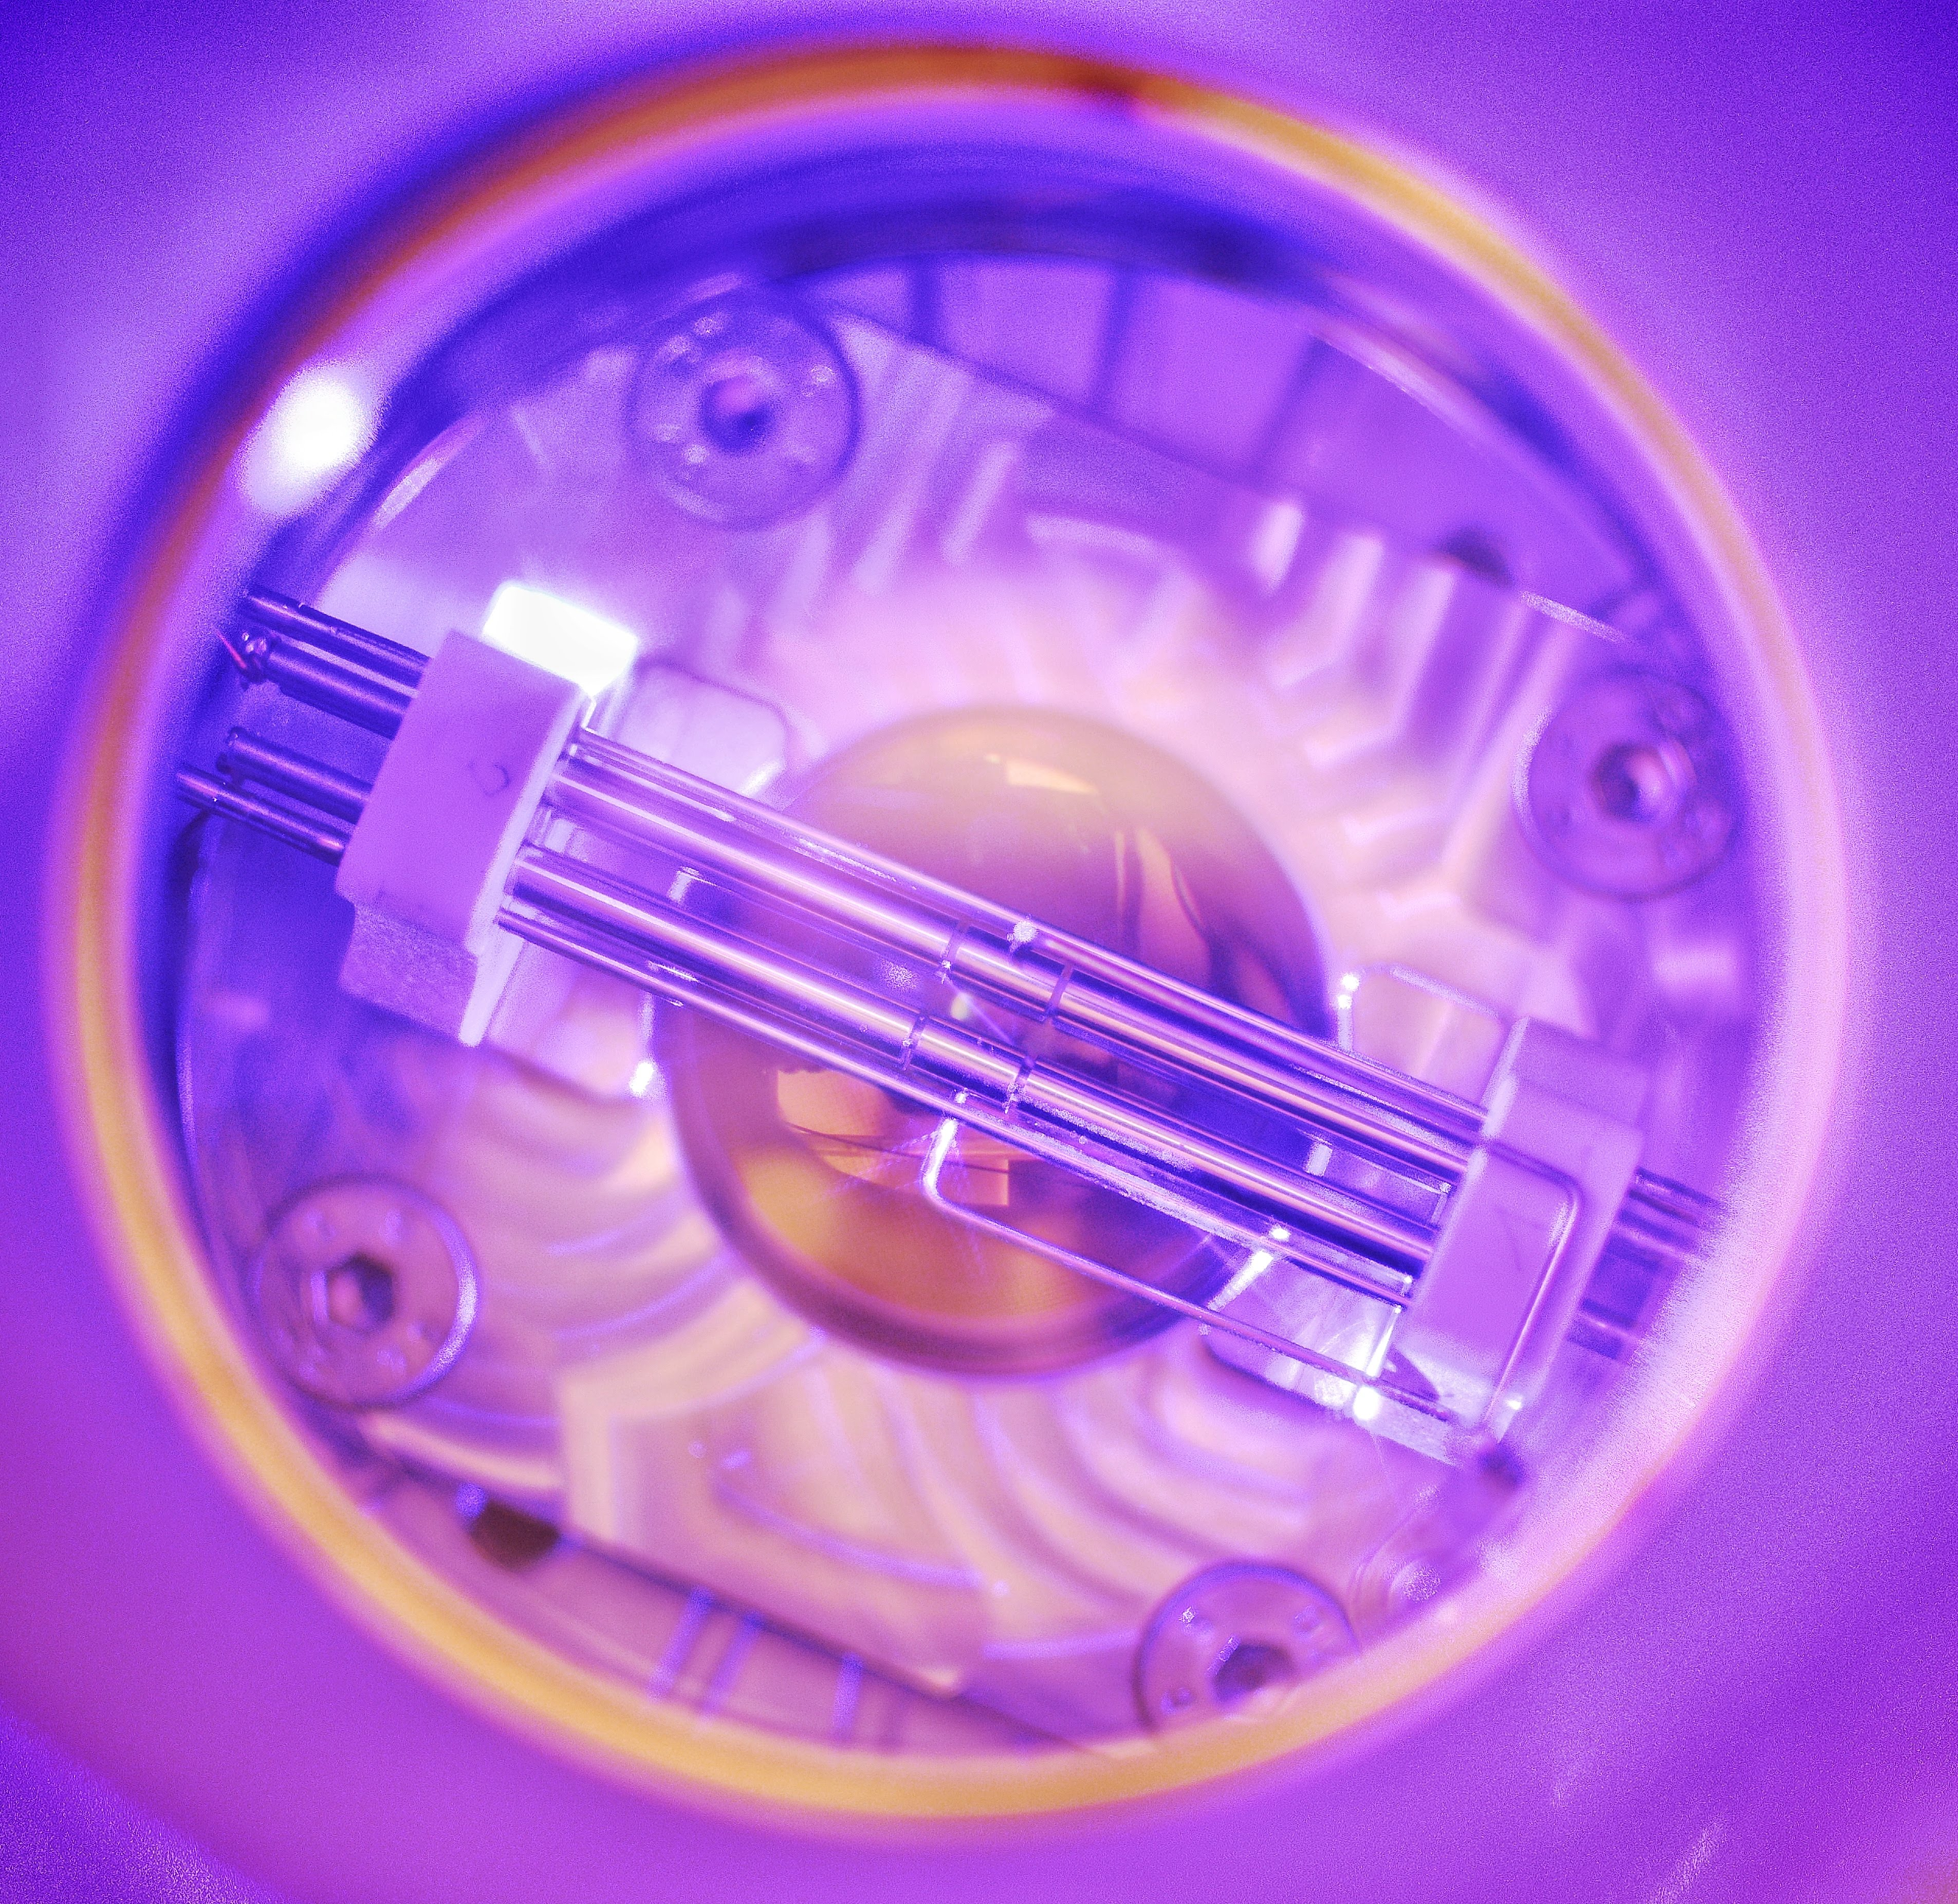
Molecular-ion quantum technologies for precision spectroscopy
Mudit Sinhal
Group Willitsch
University of Basel
Searching for New Physics at the Quantum Technology Frontier
20.01.2022

Slide 2
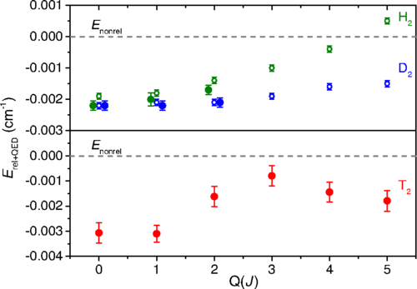
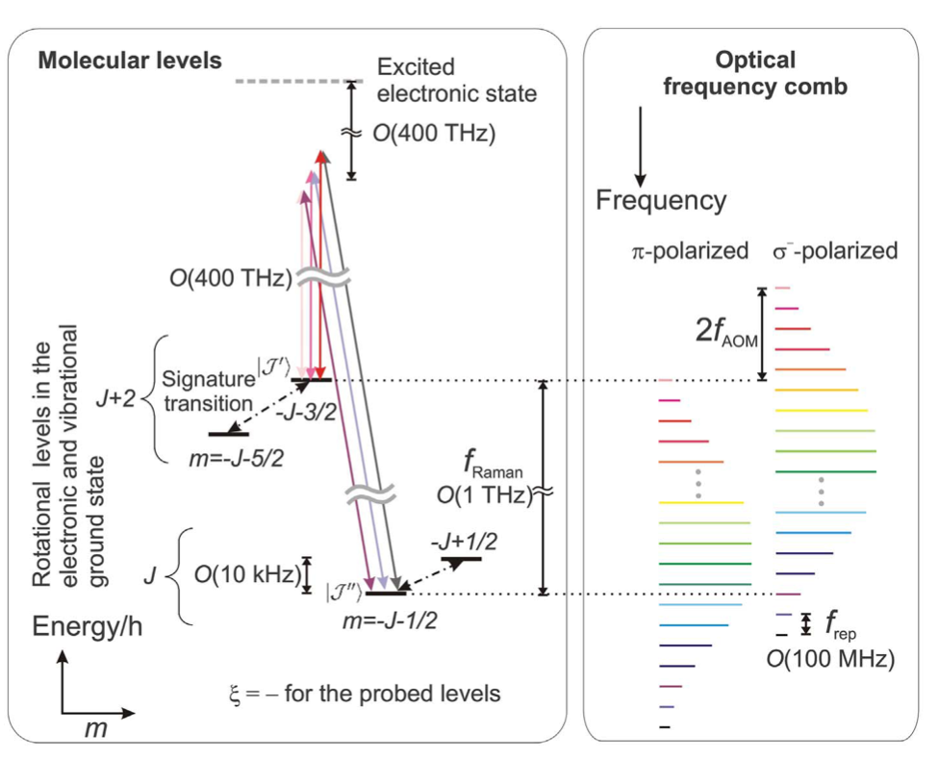
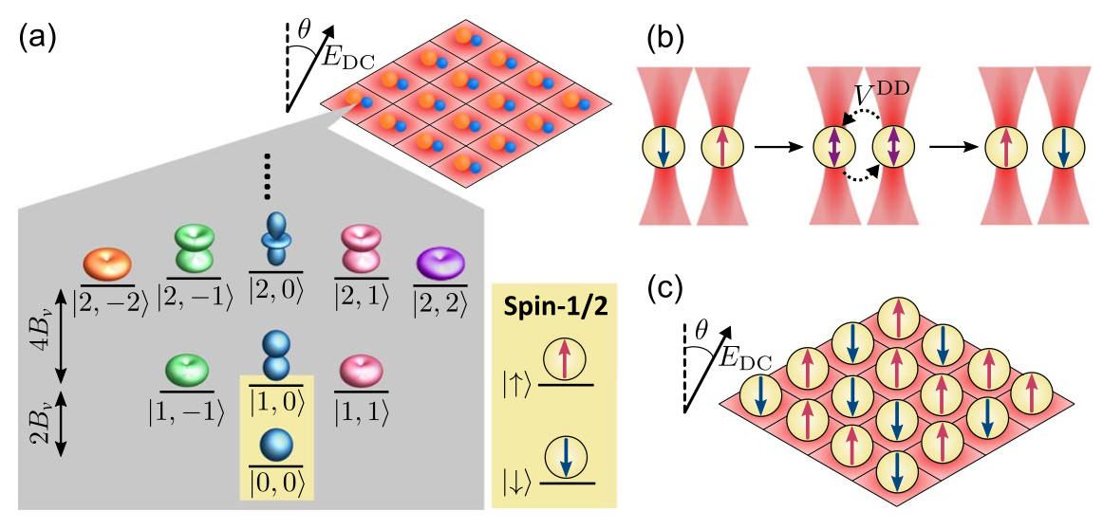
Tests of QED
Precision Spectroscopy
Ab-initio theory
Molecules for precision studies
Searches for new physics by precision measurements
  Possible variations in fundamental constants
  Measurement of the eEDM
  Parity-violation effects
Tests of QED
Verification of ab-initio molecular calculations
Development of molecular quantum simulators and computation applications
T. Madhu et al., Phys. Rev. Lett., 120, 163002 (2018)
C. W. Chou et al., Science, 367, 1458 (2020)
S. Alighanbari et al., Nat. Phys., 14(6), 555-559 (2018)
Search for new physics
Quantum simulation & computation
J. A. Blackmore et al., Quant. Sci. Tech. 4, 014040 (2019)
I. V. Kortunov et al., Nat. Phys., 17, 569-573 (2021)
Notes:
One is the search for new physics beyond the standard model which is traditionally studied in the context of high energy physics but today it is more and more studied in the context of precision spectroscopic measurements on atoms and molecules.
Like the search for the electron dipole moment - this can be achieved with molecules due to their intrinsic strong internal electric field. (used to couple to possible permanent dipole moment of the electron)
Or search for variations of fundamental constants - this is since the vibrational and rotational degree of freedom in the molecule involve the motion of the nucleus itself and for such it is sensitive to the proton to electron mass ratio while purely electronic transitions are less sensitive.
We can also use molecules to test modification to newtonian gravity at a short length scale of few angstrom where bounds for these fifth forces are very low.

Slide 3
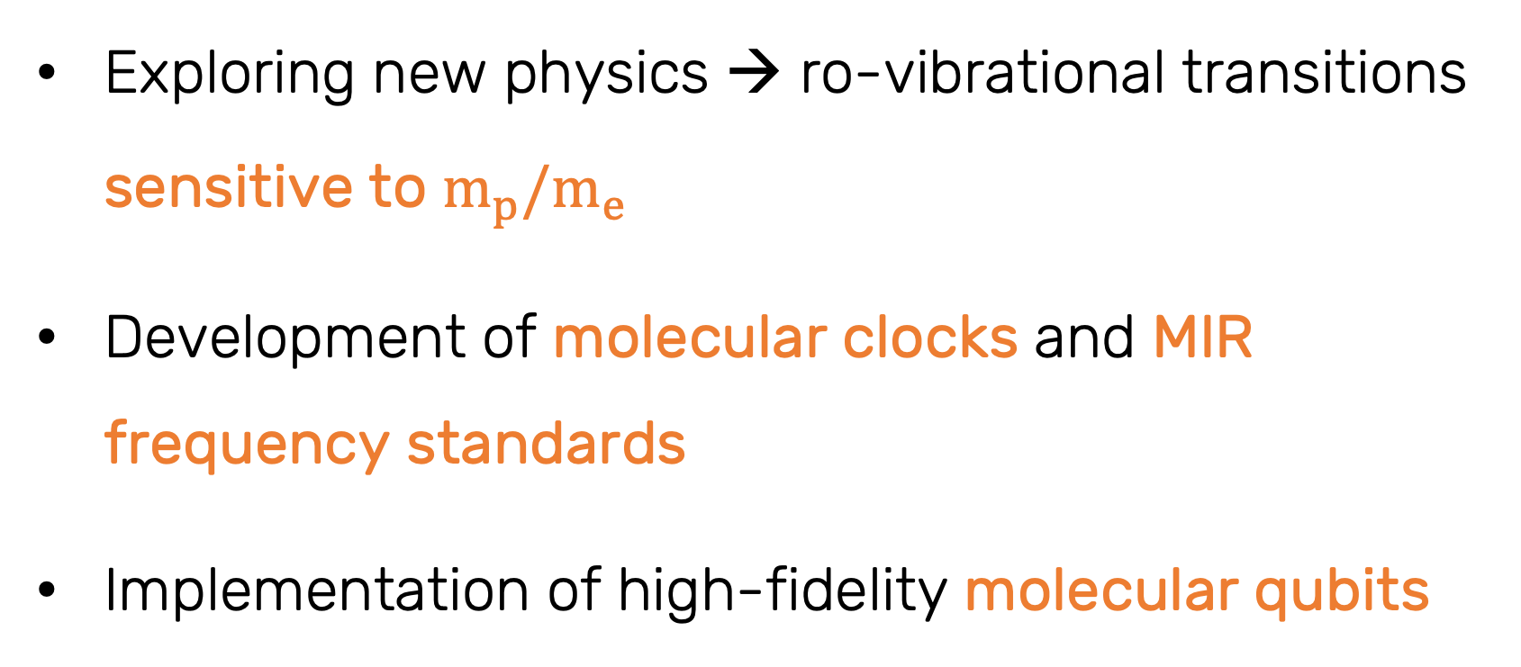
N2⁺ for precision studies
Exploring new physics → ro-vibrational transitions sensitive to $m_{p}/m_{e}$
Development of molecular clocks and MIR frequency standards
Implementation of high-fidelity molecular qubits
¹⁴N
¹⁴N
K. Najafian et al., Phys. Chem. Chem. Phys., 22, 23083-23098 (2020)
M. Kajita, Phys. Rev. A, 92, 043423 (2015)
M. Kajita et al., Phys. Rev. A, 89, 032509 (2014)

Slide 4
N2⁺ for precision studies
Homonuclear, diatomic molecule
No permanent dipole moment in the ground state
Ro-vibrational transitions in ground state are electric-dipole (E1) forbidden → allowed by electric quadrupole (E2) and magnetic dipole (M1) interactions
Long-lived ro-vibrational states (~year) with narrow transition linewidths (nHz)
Small coupling of ro-vibrational states to electric fields (small blackbody radiation, quadrupole, and Stark shifts)
Existence of many “magic” Zeeman transitions
¹⁴N
¹⁴N
K. Najafian et al., Phys. Chem. Chem. Phys., 22, 23083-23098 (2020)
M. Kajita, Phys. Rev. A, 92, 043423 (2015)
M. Kajita et al., Phys. Rev. A, 89, 032509 (2014)
Notes:
Lets look on the case of N2+ as a molecular clock
It is a homonuclear diatomic molecule - symmetric molecule.
For that, it doesn’t have a permanent dipole moment meaning that dipole transitions are forbidden in the electronic ground-state.
Hence they are narrow and long lived.
They can be driven by electric quadrupole and magnetic dipole.
Is this molecule ideal for clock?
They do have small coupling to electric fields, however, they are first order sensitive to magnetic fields.
Magnetic field fluctuations are dominant in introducing decoherence if you think on application of molecular qubits and also will reduce significantly the accuracy and precision of the spectroscopy.

Slide 5
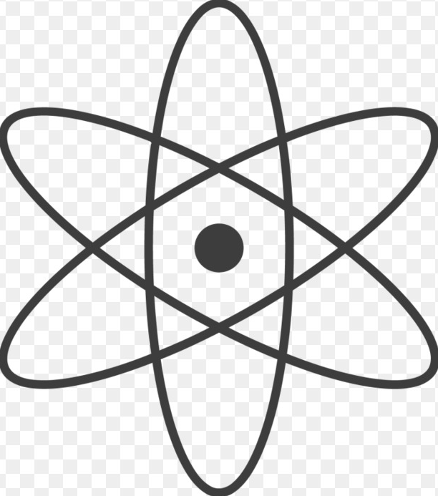




Oscillator or Laser
Frequency measurements
Counter
Preparation of internal quantum state of the ion
Cooling of the external motion of the ion to the ground state
Coherent manipulation of the ion
Detection of internal quantum state of the ion
M. Germann et al., Nat. Phys., 10:820, 2014

Slide 6
Oscillator or Laser
Challenges with molecules
Counter
Preparation of internal quantum state of the ion
Cooling of the external motion of the ion to the ground state
“logic”
ion
“spectroscopy”
ion
Coherent manipulation of the ion
Detection of internal quantum state of the ion
M. Germann et al., Nat. Phys., 10:820, 2014

Slide 7
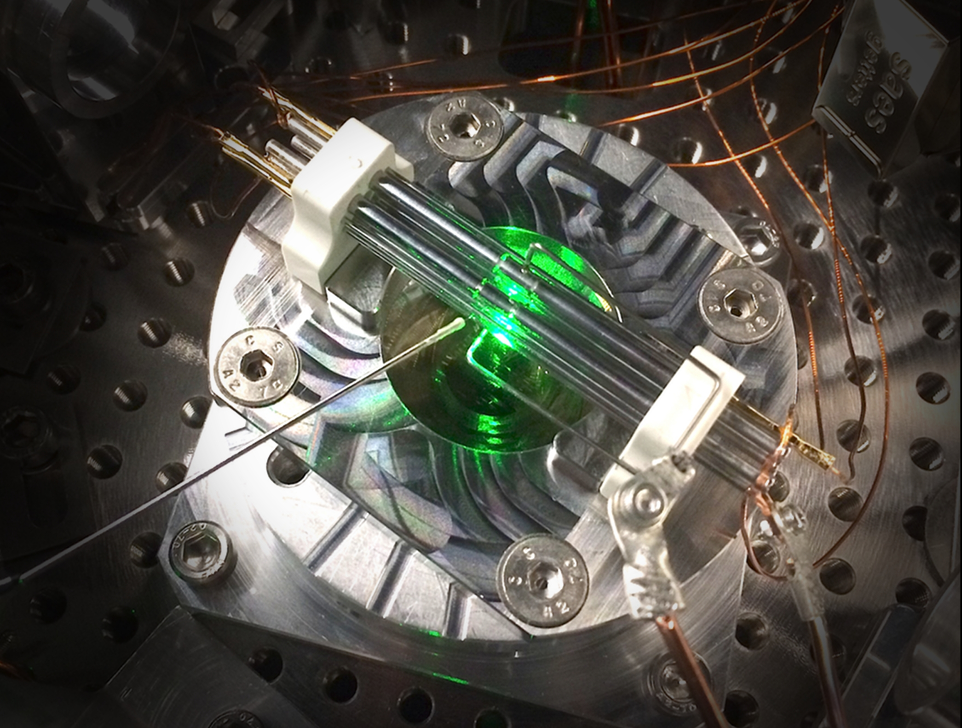


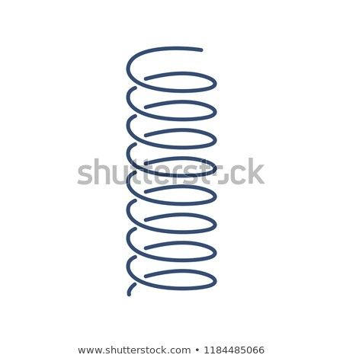
Challenges with molecules
Preparation of internal quantum state of the ion
Quantum logic of molecular ions in ion traps
⁴⁰Ca⁺
²⁸N2⁺
Cooling of the external motion of the ion to the ground state
+
+
Coherent manipulation of the ion
M. Sinhal et al., Science 367, 1213 (2020)
Detection of internal quantum state of the ion
P. O. Schmidt et al., Science, 309, 749 (2005)
D. Leibfried, New J. Phys., 14, 023029 (2012)
S. Ding and D. N. Matsukevich, New J. Phys., 14, 023028 (2012)

Slide 8
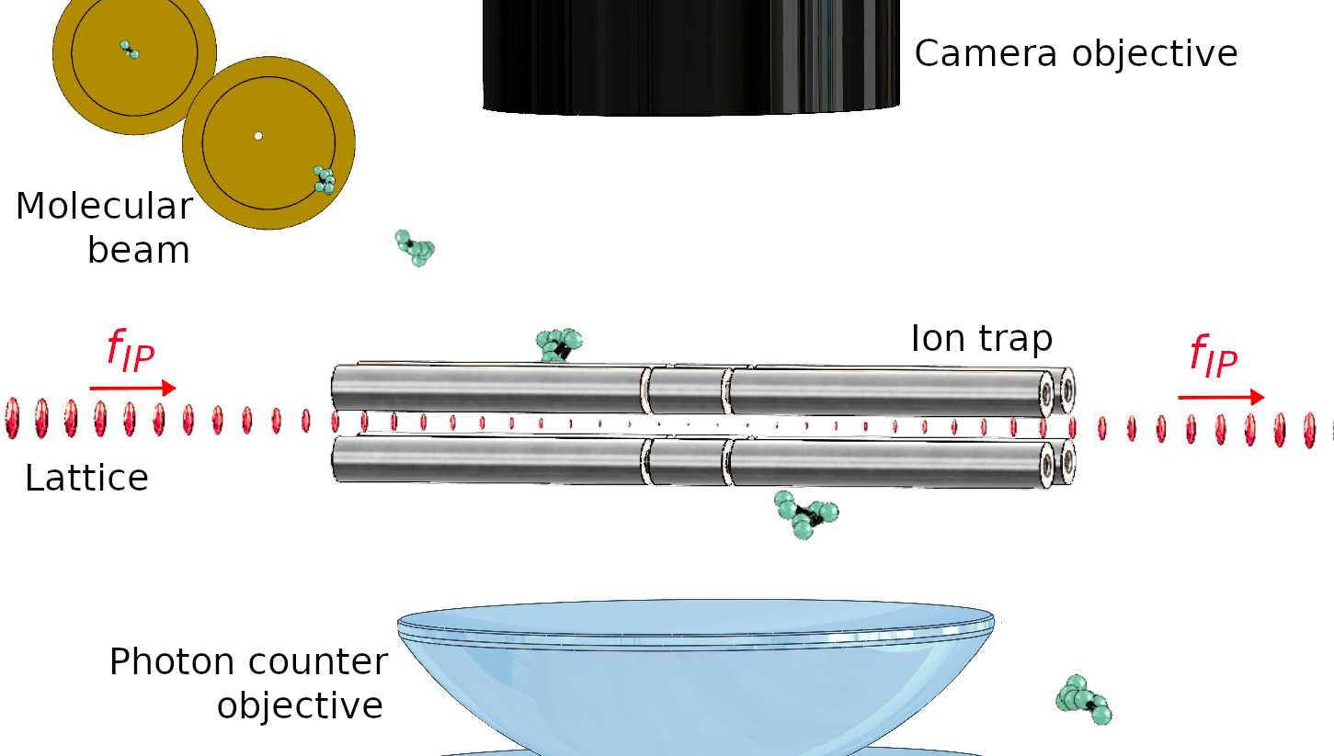

State preparation
Schematic of the experimental setup
Ca⁺
N2⁺
1’ photon
laser
Molecular beam machine to produce internally cold (~10K) neutral molecules
2+1’ ionization (REMPI) to ionize molecules in the ro-vibrational ground state
2 photon laser
M. Sinhal et al., Science 367, 1213 (2020)
K. Najafian et al., Phys. Chem. Chem. Phys., 22, 23083-23098 (2020)
Z. Meir et al., Faraday Discuss., 217, 561 (2019)
Notes:
So let me tell you a bit on our system.
It is a merge of two techniques from chemistry and physics disciplines.
On the chemistry side we use a molecular beam machine to produce packets of internally cold and neutral molecules. This is a very general and robust way of creating all type of molecules and it is used extensively in the chemistry world in molecular beam experiments. These molecules are neutral so they don’t see the electric field of the ion trap and they just fly through.
The ion trap is created by an oscillating electric fields which makes an effective harmonic potential for charged particles. We use two-colour three photon ionization scheme to ionise the molecules in the center of the trap. This scheme can be made rotational and vibrational state-selective.
The molecular ions are now trapped in the ion trapped where they are sympathetically cooled by an atomic ion, forming these two-ion crystal which are used for quantum logic.
And this ion trap is a quantum information ion trap - meaning that we have full control over the atomic ion for ground-state cooling and high fidelity detection and coherent manipulation.

Slide 9
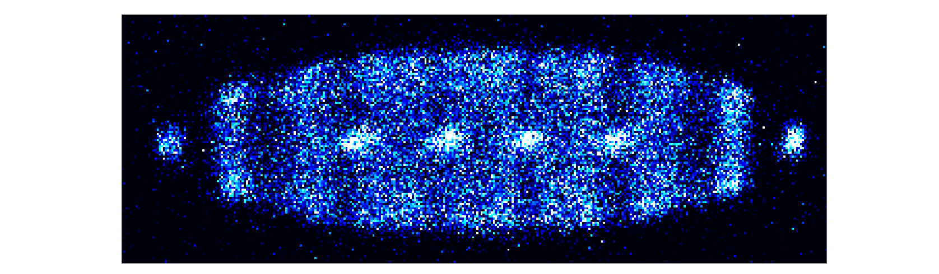
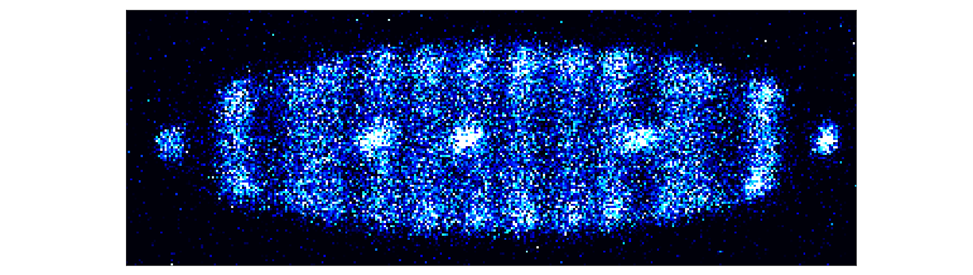
Loading and cooling of ions in the trap
Cooling the ion(s)
We start with a crystal of ~30 to speed up sympathetic cooling times
We load a single molecular ion from the molecular beam
+
+
Ca⁺
Cooling
Z. Meir et al., Faraday Discuss., 217, 561 (2019)

Slide 10
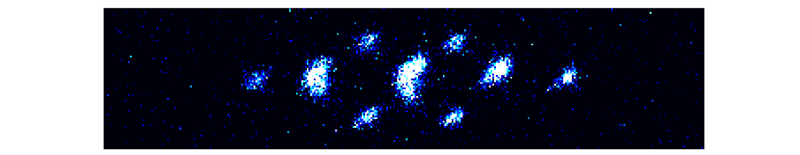

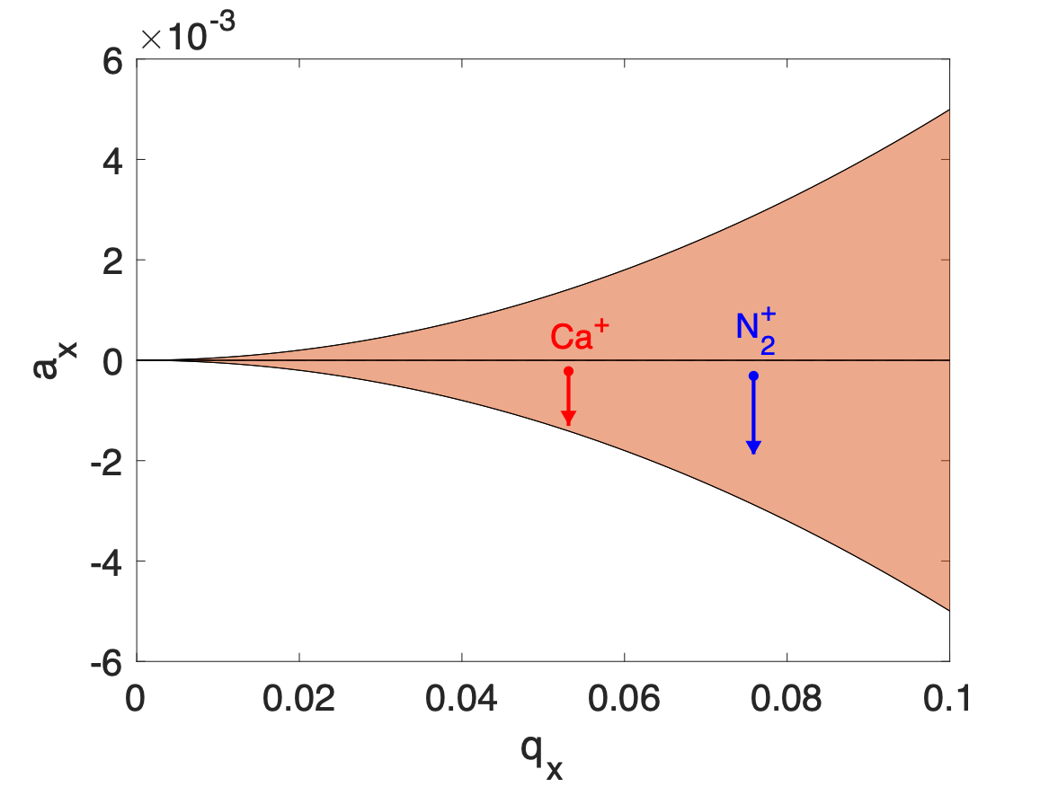
Loading and cooling of ions in the trap
Cooling the ion(s)
We start with a crystal of ~30 to speed up sympathetic cooling times
We load a single molecular ion from the molecular beam
By lowering the trap depth, the number of Ca ions is reduced
We repeat the reduction several times
Until we reach the desired amount of ions
Sympathetic Doppler cooling to ~0.5mK
Z. Meir et al., Faraday Discuss., 217, 561 (2019)
Notes:
Lamb-Dicke param = 0.113 (COM/IP) and 0.088 (STR/OP) mode
<n> = 16 (COM/IP), 10 (STR/OP)

Slide 11
Cooling the ion(s)
+
+
n = 15
n = 2
Frequency spectrum of the Ca⁺ ion
n = 1
n = 0
Carrier
Blue Sideband
Red Sideband
n = 3
+
n = 2
n = 1
D_{5/2}
n = 0
n = 3
n = 2
n = 1
n = 0
Sympathetic ground-state cooling
Z. Meir et al., Faraday Discuss., 217, 561 (2019)
S_{1/2}

Slide 12
Cooling the ion(s)
n = 15
n = 2
Frequency spectrum of the Ca⁺ ion
n = 1
+
+
n = 0
Carrier
Blue Sideband
Red Sideband
n = 3
+
n = 2
n = 1
D_{5/2}
n = 0
X
n = 3
n = 2
n = 1
n = 0
Sympathetic ground-state cooling
Z. Meir et al., Faraday Discuss., 217, 561 (2019)
S_{1/2}

Slide 13
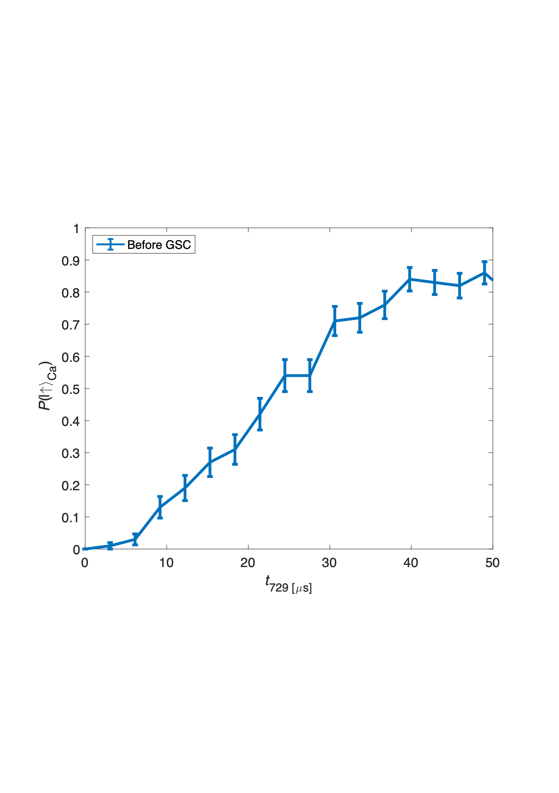
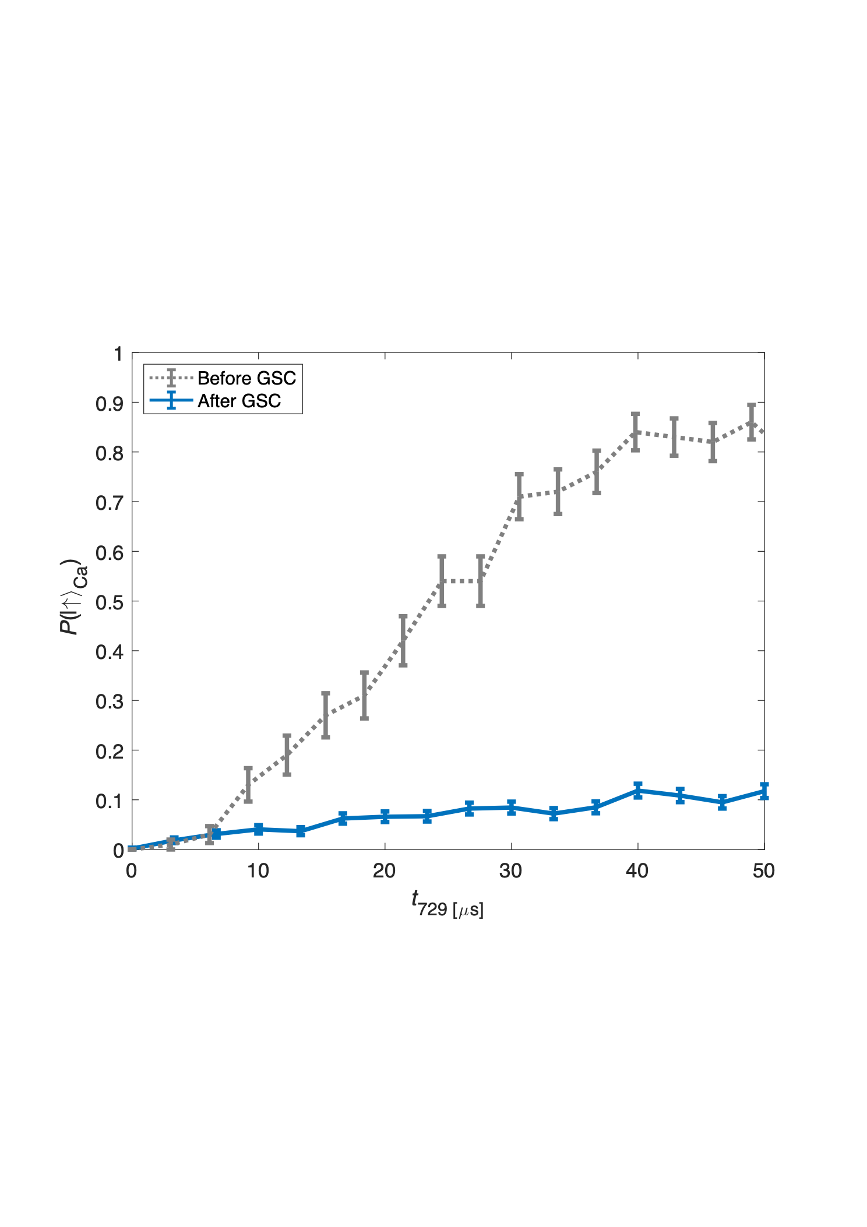
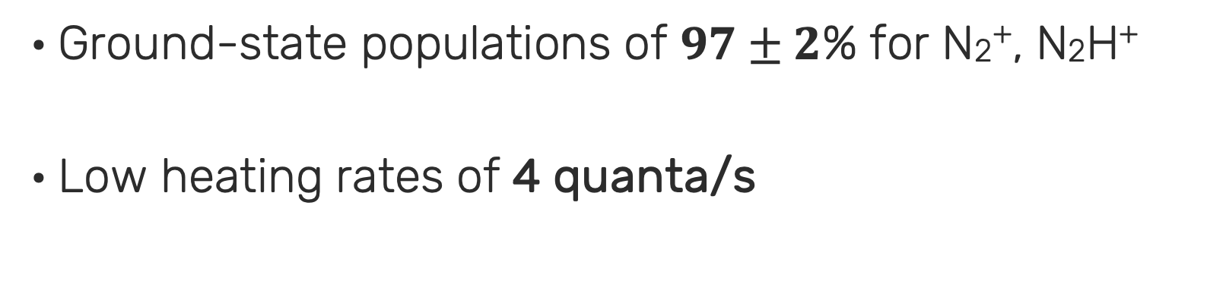
Cooling the ion(s)
Sideband Rabi Spectrum of the Ca⁺ ion
Sympathetic ground-state cooling of the two-ion string
Independent of the molecular structure
Ground-state populations of $97±2$% for N2⁺, N2H⁺
Low heating rates of 4 quanta/s
Excitation Probability
Z. Meir et al., Faraday Discuss., 217, 561 (2019)
Notes:
So I’m skipping many technical details and I will first show you how we cool the external motion of the molecule to the ground state.
The crystal has two modes - the in-phase mode and the out-of-phase mode.
We see here the Doppler cooled spectrum with the carrier transition and the sideband of the two modes due to modulation of the spectrum due to motion induced Doppler shifts.
We cool one of the modes by applying laser pulses that reduce single quanta of motion in each pulse. When we reach the ground-state level the coupling of this pulses vanish.
I think this is the most important thing to get from this slide. When the crystal is in the ground state there is no coupling on the motional sideband.
When optimised we get about 98% population in the ground state and our heating rates are quite low.
This cooling is independent of the energy states of the molecule so we can do it to any molecular ion in a reasonable mass range.

Slide 14
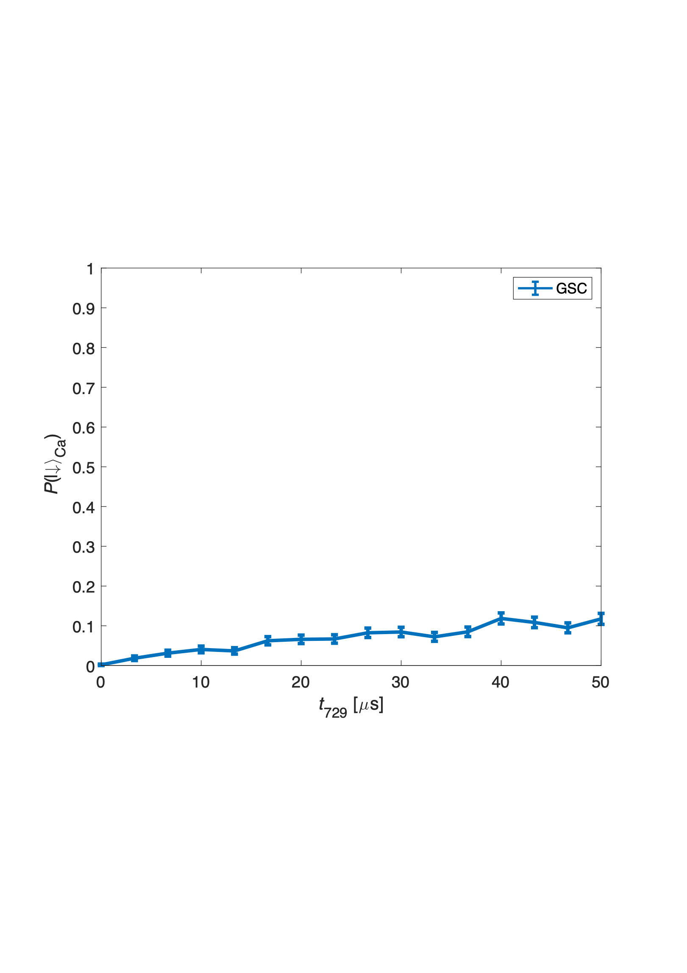
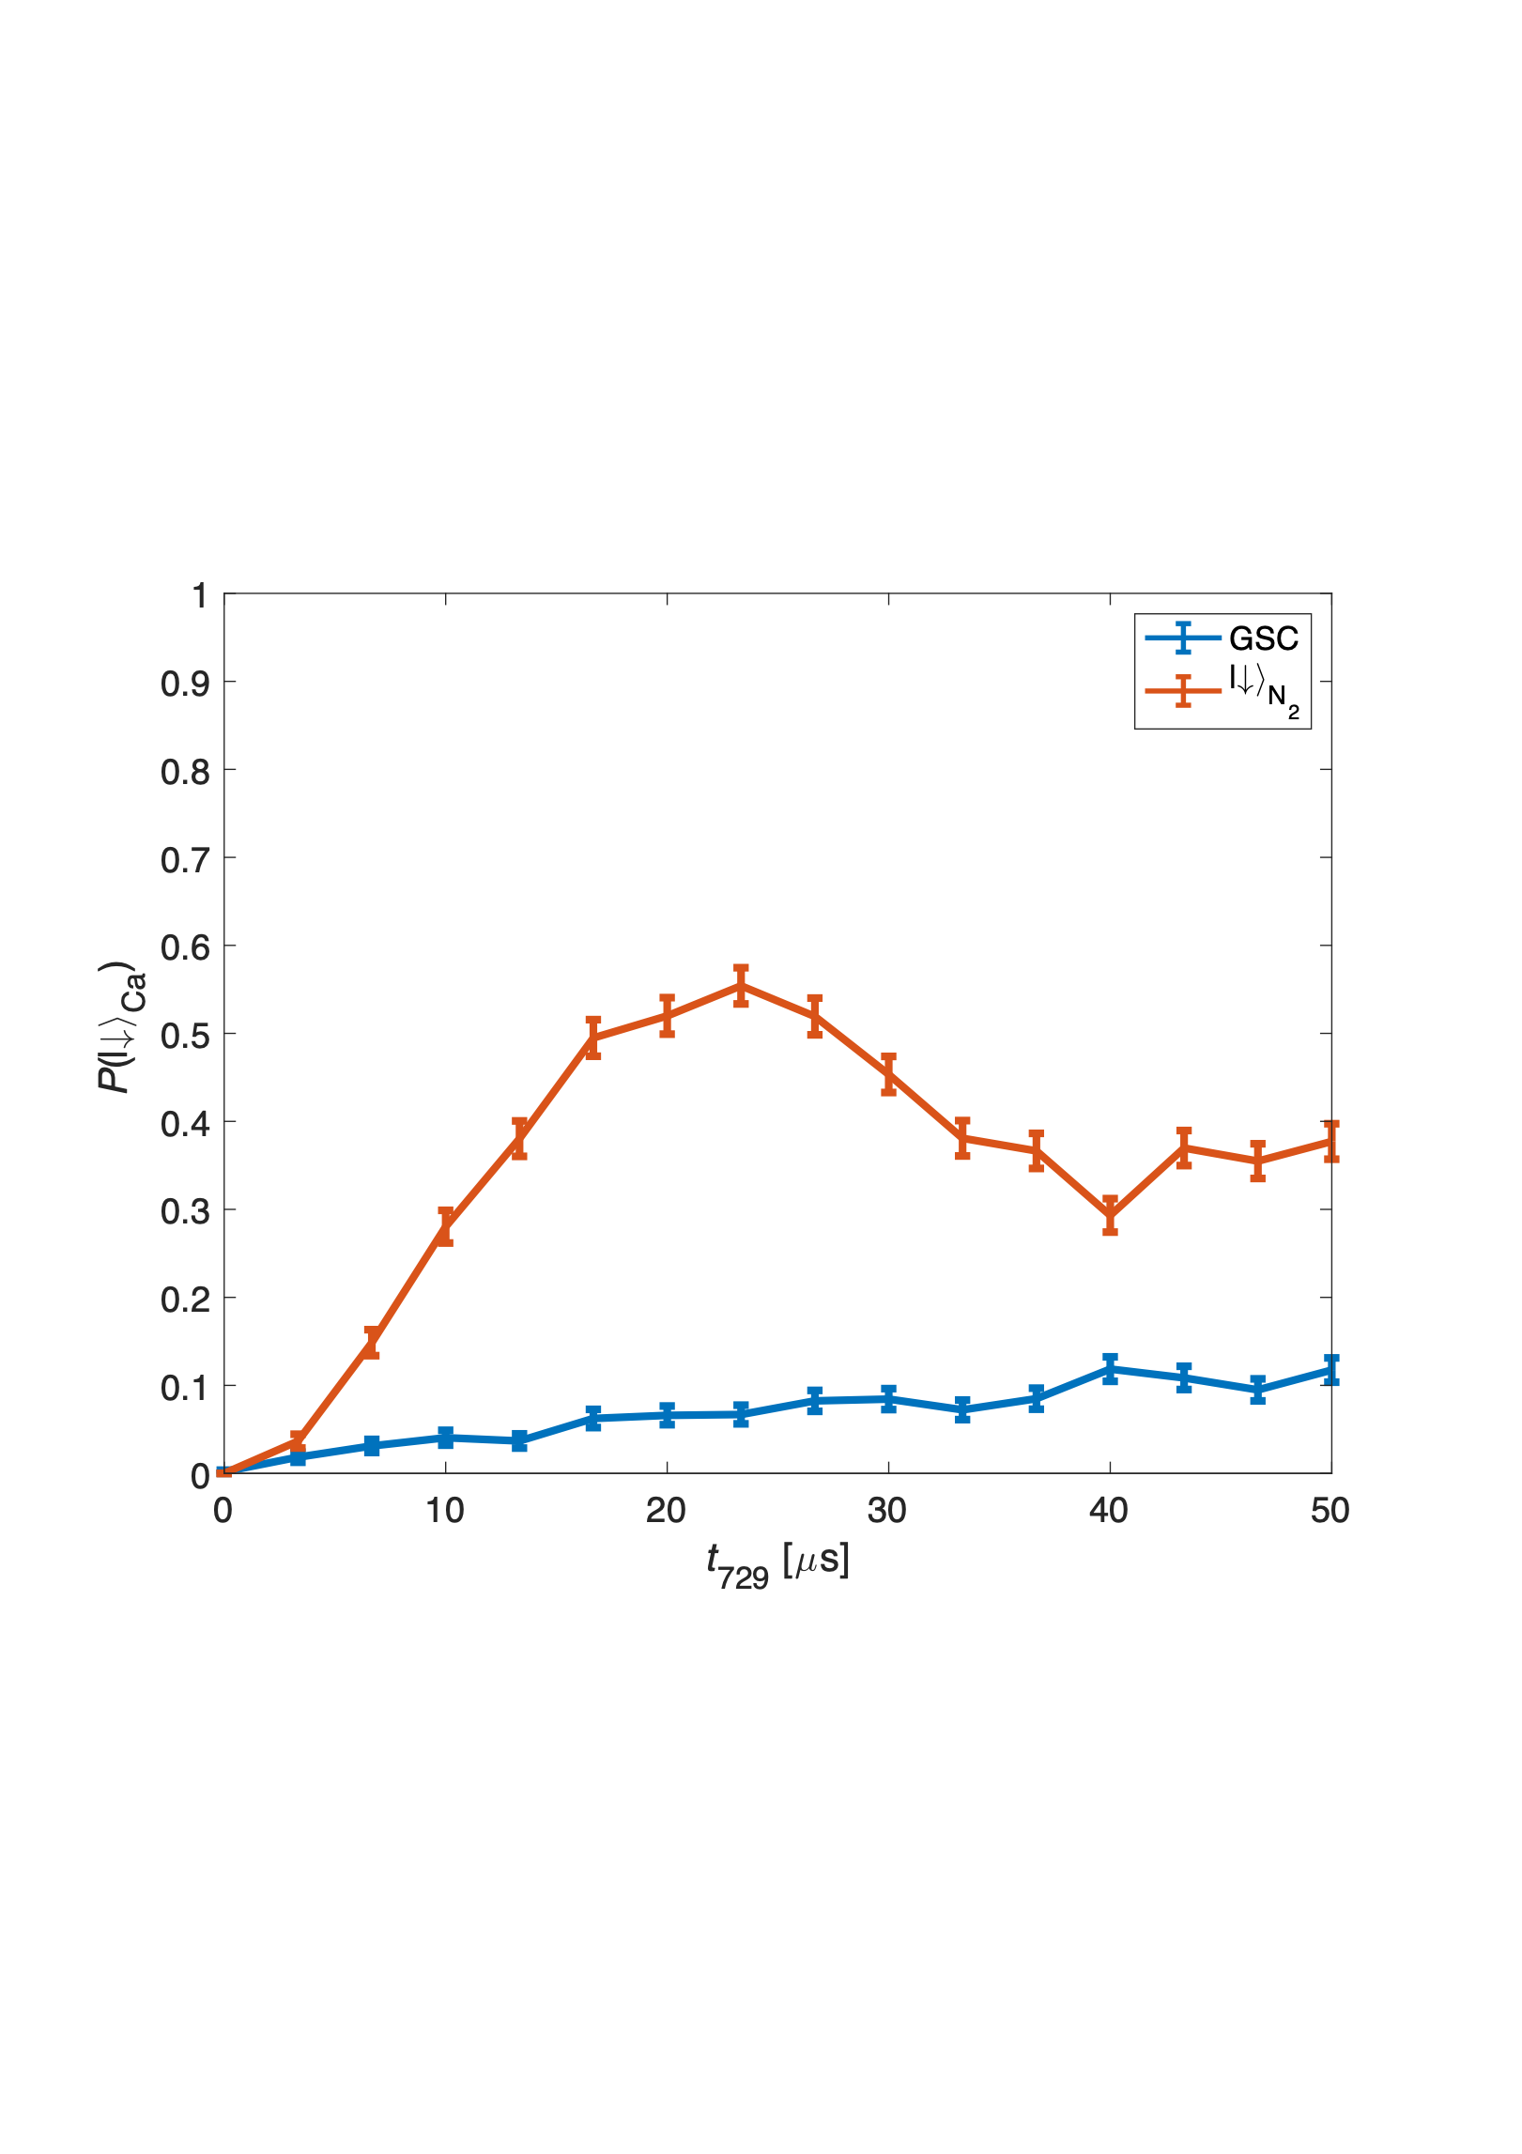
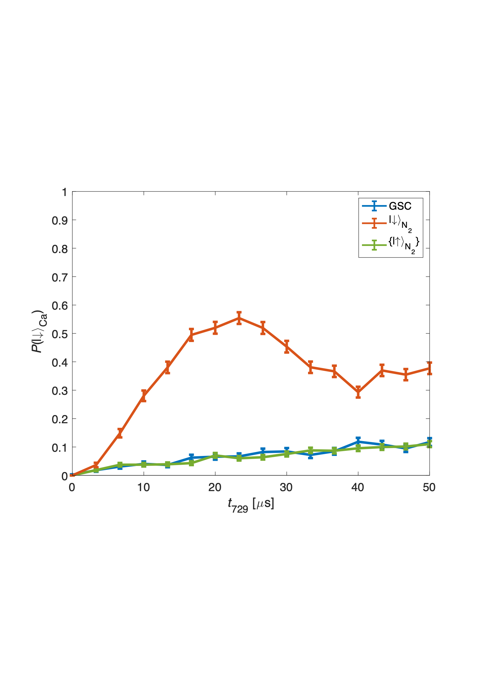
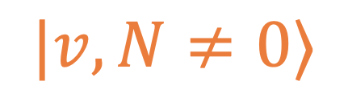

Quantum-logic
state detection
n = 15
+
+
n = 2
n = 1
+
+
n = 0
+
+
Sideband Rabi Spectrum of the Ca⁺ ion
~3,000 meas.
Excitation Probability
$$|v,N≠0⟩$$
Ground
electronic state
X²Σg⁺
~3,000 meas.
$$|v=0,N=0⟩$$
M. Sinhal et al., Science 367, 1213 (2020)
K. Najafian et al., Nat. Commun., 11, 1-10 (2020)
D. B. Hume et al., Phys. Rev. Lett. 107, 243902 (2011)
J. C. J. Koelemeij, B. Roth and S. Schiller, Phys. Rev. A 76, 023413 (2007)
Hume, Chou, Leibrandt, Thorpe, Wineland, Rosenband, PRL 107, 243902 (2011).
Koelemeij, Roth, Schiller, PRA 76, 023413 (2007).
Citation
Notes:
We wanted to improve on this method.
Our problems were few:
1) We wanted to separate the state detection from the spectroscopy part.
In our vision you don’t know a-priori in which state the molecule at to begin with
2) You also might don’t have the means to coherently control the molecule. Either you didn’t developed them yet or you don’t want to since you are interested, e.g, in studying state-changing interactions.
3) We wanted a simple method, which also relax the requirement for ground-state cooling which is crucial for QLS.
What we resort to is a state-dependent motional excitation. This was demonstrated as proof-of-principle on trapped atomic ions, and proposed for molecular ions. And we were the first to implement this method on actual molecules.
Suppose you can apply a state dependent force on your molecule.
Suppose that this force is also oscillating at the frequency of the mode of the crystal.
So we can excite the crystal resonantly this means that you can apply very weak forces (~10’s yN 1yocto=10^-24)
These forces correlate the motion of the crystal, here you see motional distribution with different amplitudes, with the molecule state.
Then we can read this motion on the ion using ion thermometry.

Slide 15

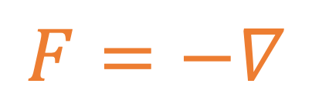


Quantum-logic
state detection
+
+
$$F=−∇$$
$$U_{\text{Stark}}$$
$$Δ$$
Sideband Rabi Spectrum of the Ca⁺ ion
$$δ$$
Electronically
excited state
A²Πu (v’=2)
Excitation Probability
$$|v,N≠0⟩$$
Ground
electronic state
X²Σg⁺
$$|v=0,N=0⟩$$
M. Sinhal et al., Science 367, 1213 (2020)
K. Najafian et al., Nat. Commun., 11, 1-10 (2020)
Hume, Chou, Leibrandt, Thorpe, Wineland, Rosenband, PRL 107, 243902 (2011).
Koelemeij, Roth, Schiller, PRA 76, 023413 (2007).
Citation
Notes:
1) We wanted to separate the state detection from the spectroscopy part. In our vision you don’t know a-priori in which state the molecule at to begin with
2) You also might don’t have the means to coherently control the molecule. Either you didn’t developed them yet or you don’t want to since you are interested, e.g, in studying state-changing interactions.
3) We wanted a simple method, which also relax the requirement for ground-state cooling which is crucial for QLS.
What we resort to is a state-dependent motional excitation. This was demonstrated as proof-of-principle on trapped atomic ions, and proposed for molecular ions. And we were the first to implement this method on actual molecules.
Suppose you can apply a state dependent force on your molecule.
Suppose that this force is also oscillating at the frequency of the mode of the crystal.
So we can excite the crystal resonantly this means that you can apply very weak forces (~10’s yN 1yocto=10^-24)
These forces correlate the motion of the crystal, here you see motional distribution with different amplitudes, with the molecule state.
Then we can read this motion on the ion using ion thermometry.

Slide 16
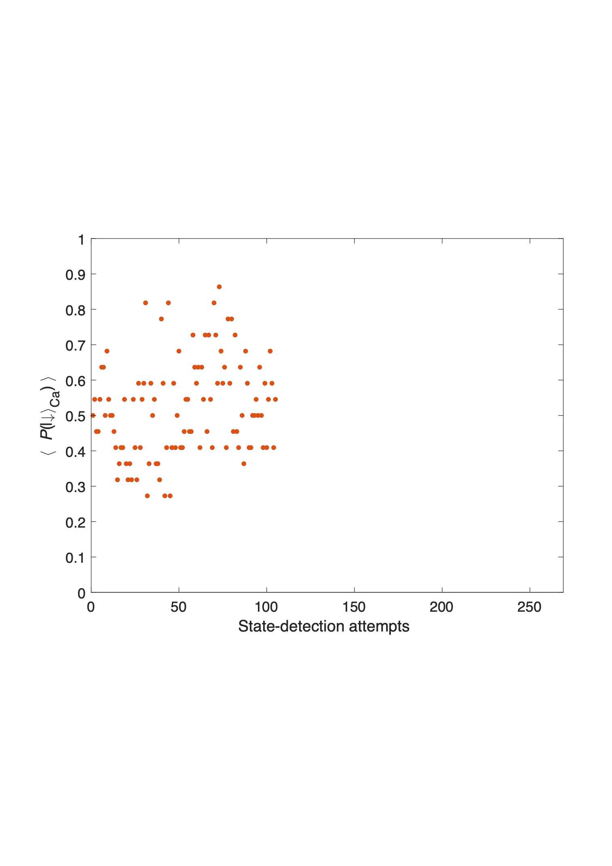
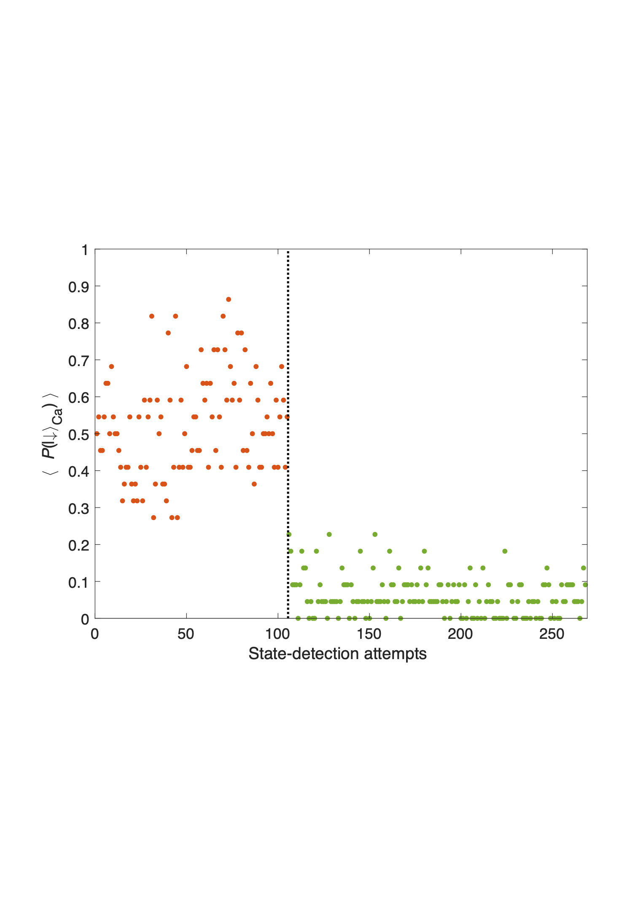
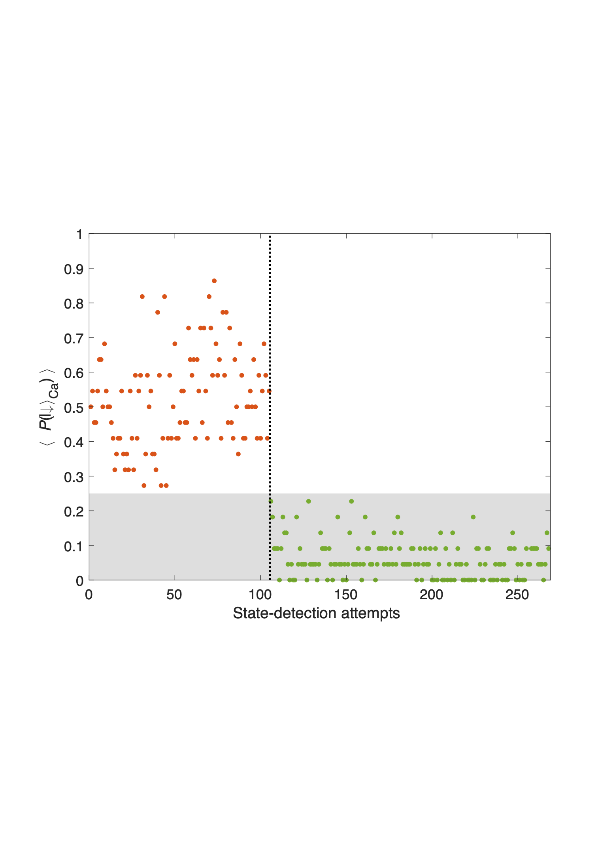
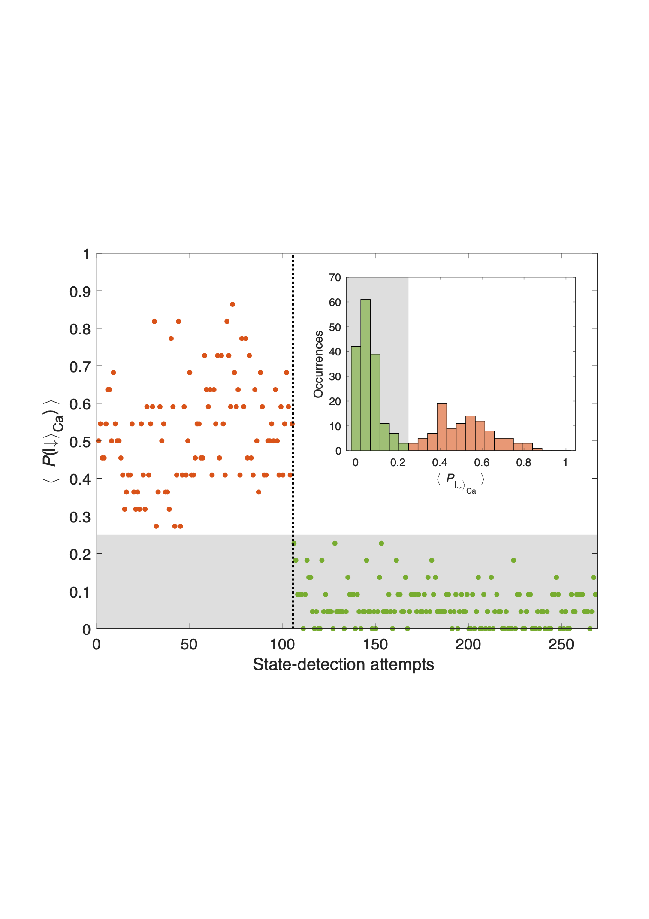
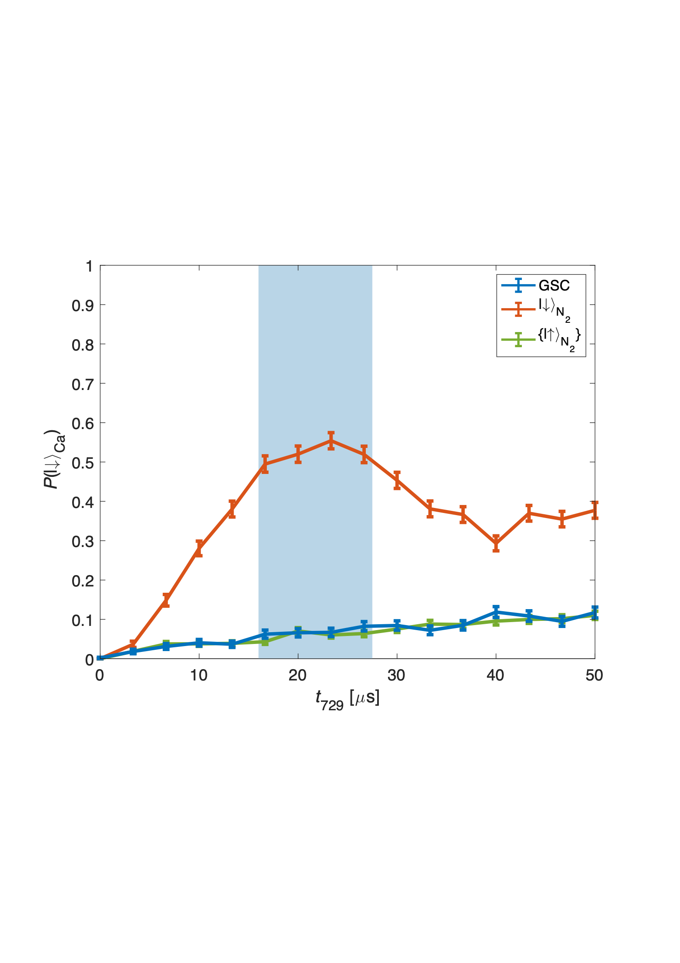
Quantum-logic
state detection
Sideband Rabi Spectrum of the Ca⁺ ion
Excitation Probability
Excitation Probability
Excitation Probability
Quantum
jump
Molecule in the ground state
Fidelity 99.1(9)%
Molecule in an excited state
Fidelity 99.4(6)%
M. Sinhal et al., Science 367, 1213 (2020)
Hume, Chou, Leibrandt, Thorpe, Wineland, Rosenband, PRL 107, 243902 (2011).
Koelemeij, Roth, Schiller, PRA 76, 023413 (2007).
Citation

Slide 17
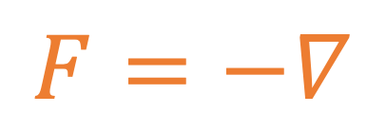

Quantum-logic
state detection
$$F=−∇$$
$$U_{\text{Stark}}$$
$$δ$$
Electronically
excited state
A²Πu (v’=2)
$$|v,N≠0⟩$$
Ground
electronic state
X²Σg⁺
$$|v=0,N=0⟩$$
M. Sinhal et al., Science 367, 1213 (2020)
Hume, Chou, Leibrandt, Thorpe, Wineland, Rosenband, PRL 107, 243902 (2011).
Koelemeij, Roth, Schiller, PRA 76, 023413 (2007).
Citation

Slide 18
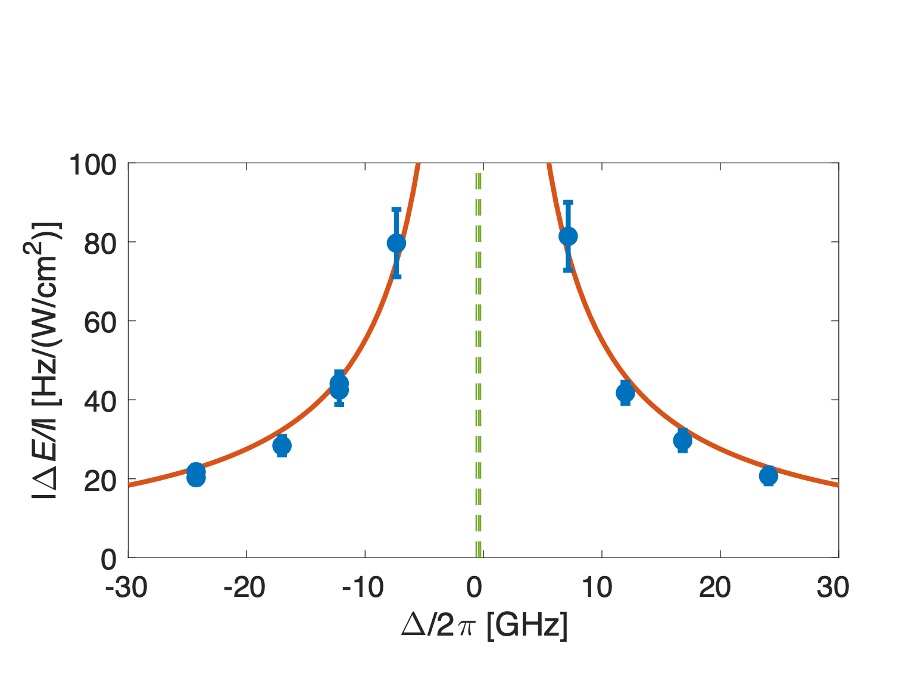
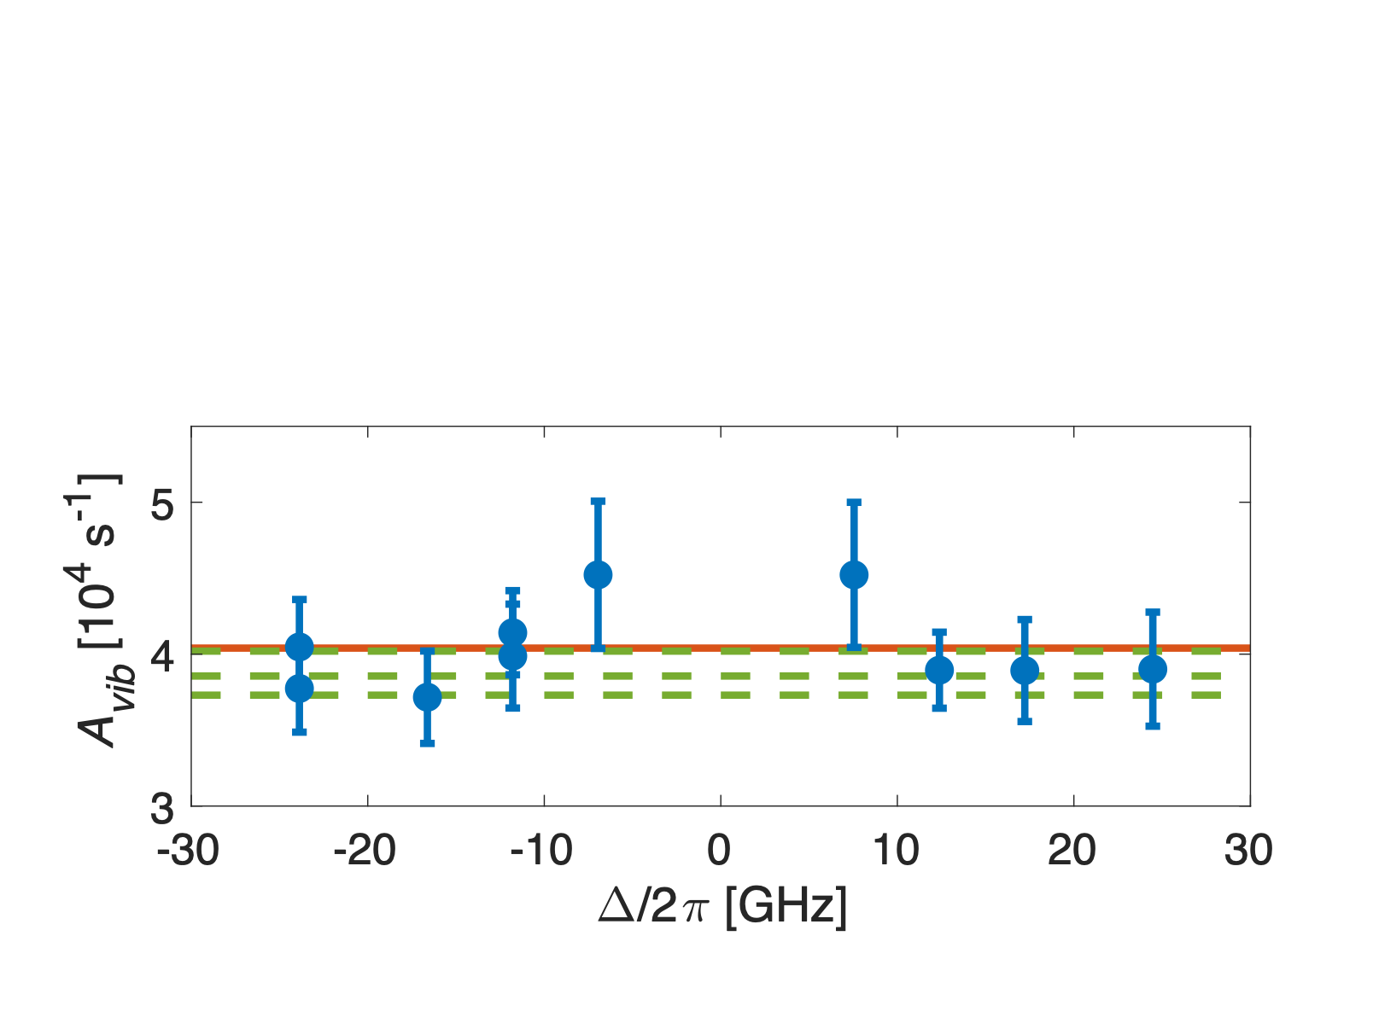
“Force” spectroscopy
Ro-vibronic Spectrum of the N₂⁺ ion
Measurement of electronic transition:
f = 380.7011(2) THz (our measurement)
f = 380.7007(3) THz (literature)
Absolute spectroscopy (line strength):
A = 4.03(11)x10⁴ s⁻¹ (our measurement)
A = 3.87(14)x10⁴ s⁻¹ (literature)
M. Sinhal et al., Science 367, 1213 (2020)

Slide 19
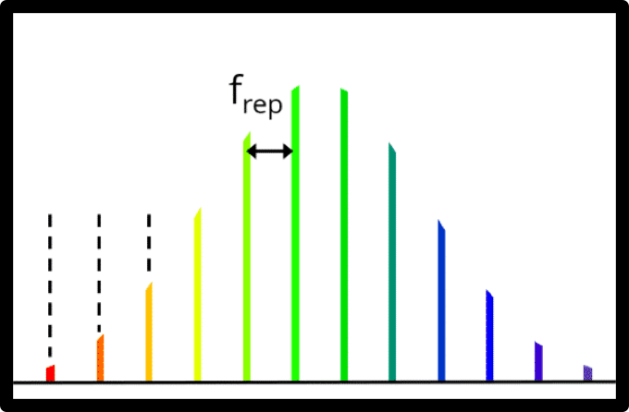
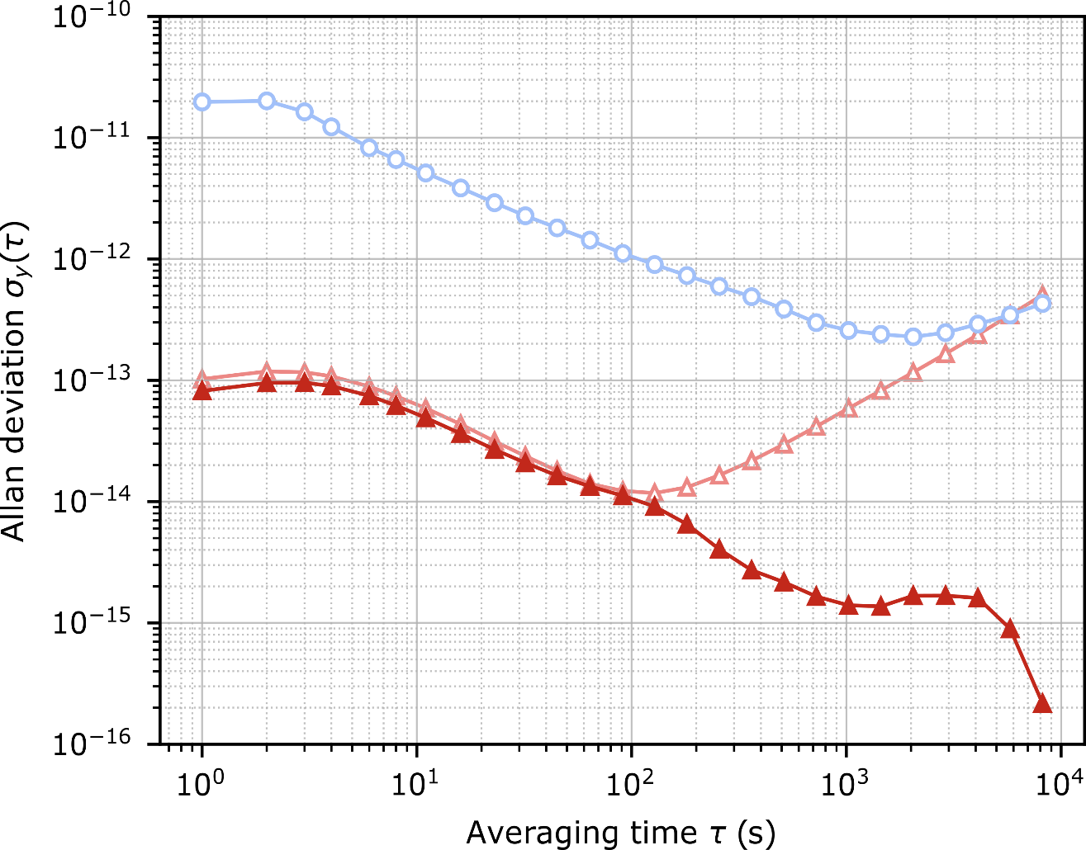
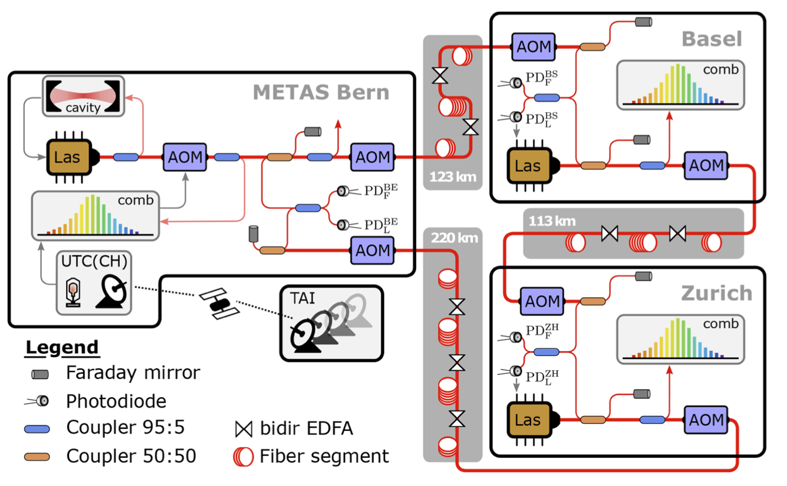
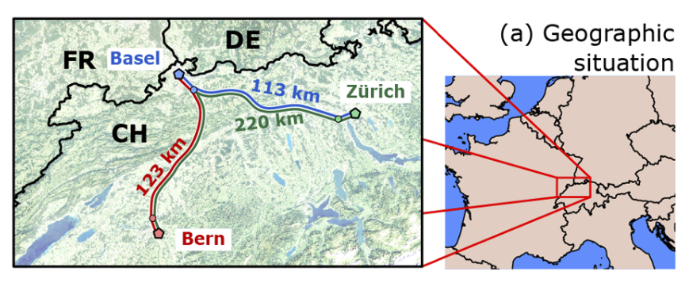
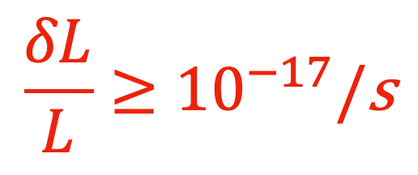
Precise and accurate laser systems
Ultrastable
Reference
Traceability of the 729 nm frequency
QCL
729
Using local oscillator
+
Using ultrastable reference
Establishing a metrology network to disseminate high accuracy optical frequencies through the Swiss academic fiber netwok.
Dominik Hussmann - 20.01.22 , 15:00
For N2⁺
For Ca⁺
$$\frac{δL}{L}≥{10}^{−17}/\text{s}$$
+
+
M. Sinhal, S. Willitsch In Preparation
D. Husmann, et al., Opt. Express, 29, 24592-24605 (2021)

Slide 20
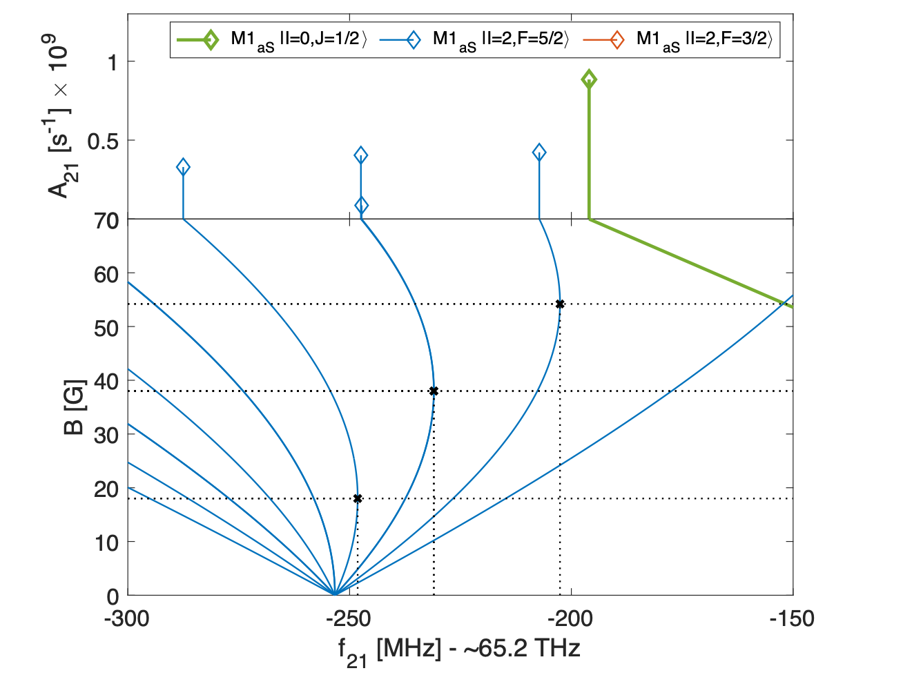
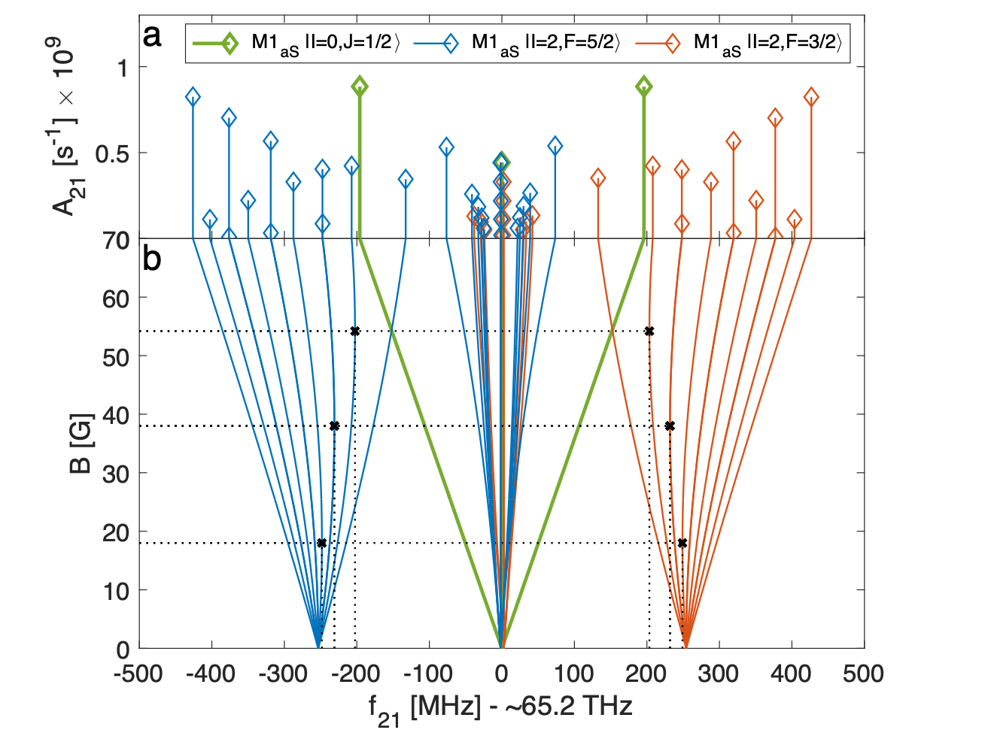
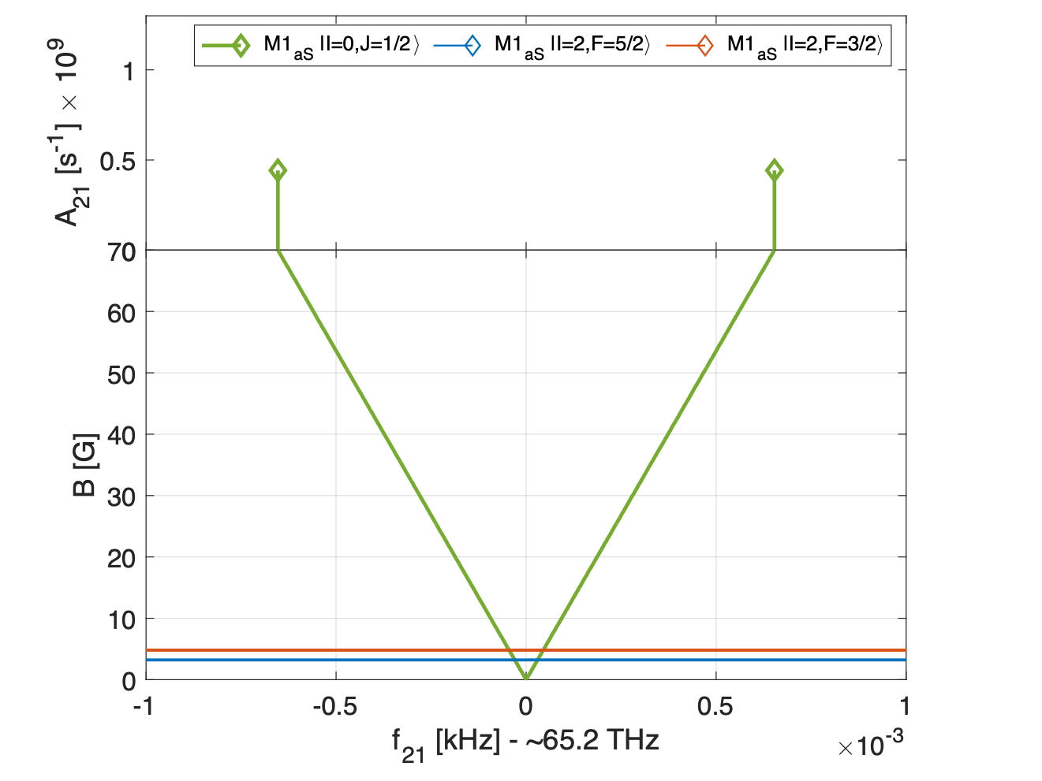
Magnetic insensitive transitions in N2⁺
Theoretical spectrum of the fundamental vibration transition (v=0->v’=1) with no rotation (Q(0))
Several “magic” rotational transitions at low magnetic field. Second-order sensitivity to magnetic fields < ~16 mHz/mG^2
“Stretched” transitions with low first order magnetic field senstivities ~10 mHz/mG
In comparison “regular” Zeeman transitions have sensitivities ~ kHz/mG -> 10⁵ higher dependance
K. Najafian et al., Nat. Commun., 11, 1-10 (2020)
Notes:
We went to find magnetic insensitive transitions in N2+ and because it is a molecule, we found plenty.
This is the spectrum of the fundamental vibration transition from v=0 to v=1 with no rotation. Q(0) transition.
I plot here the transition frequency for different Hyperfine Zeeman components as function of the magnetic field value.
Let’s zoom here - we see that the Zeeman shift is linear at low field but then it starts to bend - this is the intermediate Zeeman regime before going to the Paschen-Back regime.
Since the hyperfine splitting in molecules is low, order of few 100’s MHz. We get the transition to Pachen-Back at very low magnetic fields of few tens of Gauss.
We call these “magic” magnetic field transitions since we have zero first order Zeeman shift at these magnetic field values.
This will also happen in atoms, but at much larger magnetic field values due to the higher hyperfine splitting.
We can also focus on this part of the spectrum.
Here we find transition between “stretched” states. These are states where all the spin quantum numbers are pointing in the same direction. Since these transition are in the same electronic state, the magnetic Zeeman electronic spin cancels. These type of transitions will only happen in a molecules and they also have a very low Zeeman sensitivity.
Just as a comparison the regular Zeeman levels have 10^5 order of magnitude larger Zeeman sensitivity. This is why the lines here which are first order Zeeman sensitive look horizontal.
So molecules, provide magnetic insensitivity built in.

Slide 21
Ca⁺
N2⁺
Summary
¹⁴N
¹⁴N
+
+
State preparation, Trapping &
Cooling of single molecules
Excitation Probability
Ultrastable
Reference
Non-destructive state-detection of molecules
QCL
729
+
Excitation Probability
Excitation Probability
> 99% measurement
fidelity
Non-invasive dipole spectroscopy of molecules
System of SI referenced lasers
for precision spectroscopy

Slide 22




Acknowledgments
The Quantum Technologies team:
Prof. Dr. Stefan Willitsch
Aleksander Shlykov
Mikolaj Roguski
Dr. Ziv Meir
Kaveh Najafian
Gregor Hegi

Slide 23
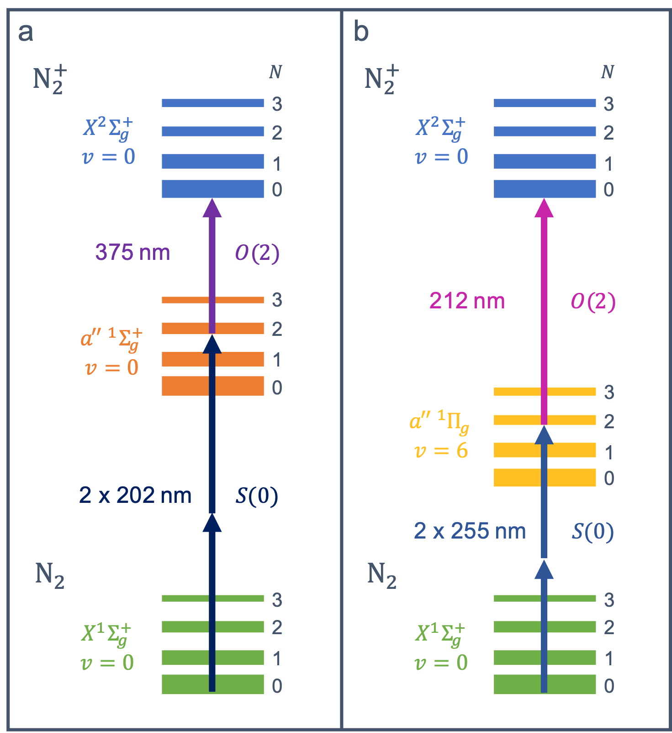
State preparation
Scheme I
Scheme II
Molecular beam machine:
internally cold (~10K) neutral molecules
2+1’ ionization (REMPI):
Create molecular ions in specific
rotational vibrational state
S. R. Mackenzie et al., Mol. Phys., 86, 1283 (1995)
X. Tong, A. H. Winney and S. Willitsch, Phys. Rev. Lett., 105, 143001 (2010)
A. Gardner, T. Softley and M. Keller, Sci. Rep., 9, 506 (2019)

Slide 24

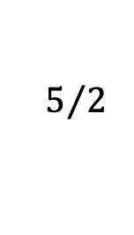
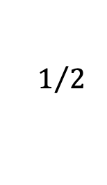


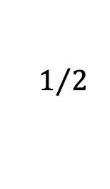

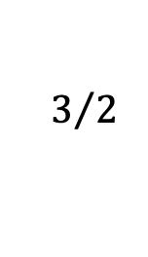


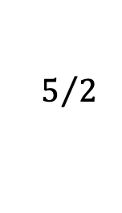
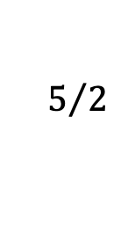


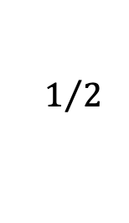



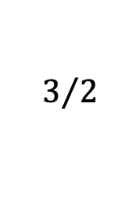
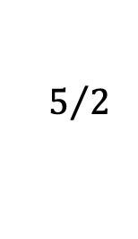


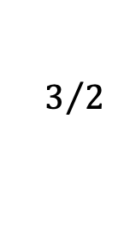



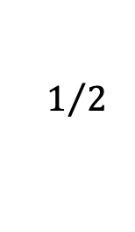



Energy levels of the N2⁺ ion
$$+5/2$$
$$5/2$$
$$5/2$$
Ground electronic state of N2⁺
Vibrational energies
Rotations
Fine structure
Hyperfine structure
Zeeman structure
$$N=2$$
$$−5/2$$
$$3/2$$
$$3/2$$
$$+3/2$$
$$1/2$$
$$1/2$$
$$−3/2$$
$$v=1$$
$$N=0$$
$$+1/2$$
$$−1/2$$
$$+5/2$$
$$5/2$$
$$5/2$$
$$N=2$$
$$−5/2$$
$$3/2$$
$$3/2$$
$$+3/2$$
$$1/2$$
$$−3/2$$
$$X^{2}Σ_{g}^{+}$$
$$v=0$$
$$N=0$$
$$1/2$$
$$+1/2$$
$$−1/2$$
$$J$$
$$F_{I=0}$$
$$M_{F}$$
K. Najafian, Z. Meir and S. Willitsch, Phys. Chem. Chem. Phys., 22, 23083-23098 (2020)
Z. Meir, G. Hegi, K. Najafian, M. Sinhal and S. Willitsch, Faraday Discuss., 217, 561 (2019)

Slide 25




















Energy levels of the N2⁺ ion
$$9/2$$
$$5/2$$
Ground electronic state of N2⁺
Vibrational energies
Rotations
Fine structure
Hyperfine structure - nuclear-spin isomers
Zeeman structure
$$N=2$$
$$3/2$$
$$1/2$$
$$v=1$$
$$N=0$$
$$1/2$$
$$5/2$$
$$3/2$$
$$9/2$$
$∼$ 65 THz
$$5/2$$
$$N=2$$
$$1/2$$
$$3/2$$
$$X^{2}Σ_{g}^{+}$$
$$v=0$$
$$N=0$$
$$1/2$$
$$5/2$$
$$3/2$$
$$J$$
$$F_{I=2}$$
$$M_{F}$$
K. Najafian, Z. Meir and S. Willitsch, Phys. Chem. Chem. Phys., 22, 23083-23098 (2020)
Z. Meir, G. Hegi, K. Najafian, M. Sinhal and S. Willitsch, Faraday Discuss., 217, 561 (2019)

Slide 26



“Complex” molecules
“Force” spectrum of rotationally excited states in N2⁺
Blue
Interferometric measurement
Red
+
+
+
-
(Same Phase)
$$F_{tot}^{SP}=F_{m}±F_{a}$$
Can we detect states in this dense spectrum?
Ambiguity in state determination.
+
+
(Opposite Phase)
$$F_{tot}^{OP}=F_{m}±F_{a}$$
+
-
Both amplitude and sign information
Najafian†, ZM†, Sinhal, Willitsch, arXiv:2004.05306 (2020).
(under referee evaluation Nat. Commun.)
Notes:
Now we wanted to see if we can work in a much more complicated regime of our molecule.
This is the absolute value of the polarizability / ac-Strak shift for a molecule in rotationally excited states for different Zeeman states.
Clearly it is much more dense than before.
Can we use our method to detect states in this spectrum?
But even if we can detect the strength very well, there is still an ambiguity in state determination, where states of different rotation give the same absolute value of force.
The reason for this ambiguity is because the ac-Stark shift has two signs. In one case the lattice is blue detuned from the resonance - positive energy shift while in the other the lattice is red detuned - negative energy shift.
In other words, if the molecule is in the N=6 state, blue detuned, than it will feel a force towards lower intensity of the lattice, if the molecule is in the N=4 state, than it will go to the maximum intensity of the lattice
But since these forces are equal and oscillating, we can’t tell what was the case.
So we need to build some sort of interferometric measurement. We do this by allowing a small force on the AI which is always pointing towards high intensity. We can control the two ion distance such that they see the same phase of the lattice intensity. In this case if the molecule is red then the forces add while if it was blue the force subtract. We call this the Same-phase configuration.
Now they sit on opposite slops of the lattice - the situation is opposite red gives lower signal than blue.
We can use these two measurements to extract both the amplitude and sign of the force.

Slide 27



Phase sensitive forces
Blue
Interferometric measurement
Red
+
+
+
-
(Same Phase)
$$F_{tot}^{SP}=F_{m}±F_{a}$$
$$F_{tot}^{OP}<F_{tot}^{SP}$$
$$F_{tot}^{OP}>F_{tot}^{SP}$$
+
+
N’’=4, J’’=7/2
N’’=6, J’’=11/2
(Opposite Phase)
$$F_{tot}^{OP}=F_{m}±F_{a}$$
+
-
Both amplitude and sign information
Najafian†, ZM†, Sinhal, Willitsch, arXiv:2004.05306 (2020).
(under referee evaluation Nat. Commun.)
Notes:
This is exemplified in these two Rabi oscillation signals.
In one the same phase configuration is stronger than the opposite phase - Red detuned lattice beam
In the other we have that the opposite phase is stronger than the same phase - Blue detuned lattice beam

Slide 28

Phase sensitive forces
“Force” spectrum of rotationally excited states in N2⁺
Blue
Interferometric measurement
Red
+
+
+
-
(Same Phase)
$$F_{tot}^{SP}=F_{m}±F_{a}$$
+
+
(Opposite Phase)
$$F_{tot}^{OP}=F_{m}±F_{a}$$
+
-
Both amplitude and sign information
Najafian†, ZM†, Sinhal, Willitsch, arXiv:2004.05306 (2020).
(under referee evaluation Nat. Commun.)
Notes:
We used that to identify states in this complex region of the molecular spectrum.
The colour and arrow direction indicates the sign and amplitude of the force acted on the molecule.

Slide 29

“Force” spectrum of rotationally excited states in N2⁺
Identified 6 (12) states out of 540 possible states - 99% (98%).
Demonstration of hyperfine-Zeeman state detection and preparation in a “complex” molecule
Najafian†, ZM†, Sinhal, Willitsch, arXiv:2004.05306 (2020).
(under referee evaluation Nat. Commun.)
Notes:
Overall we had 540 possible states, from which we could exclude almost all except of 6 states that agree within 1-sigma and 12 states that agree within 12 sigma to our measurement.
This is a state identification down to the hyperfine and Zeeman structure in the molecule.

Slide 30







State-to-state chemistry
Combination of quantum state detection and mass spectrometry to identify reactants and products in an ultracold and controlled chemical reaction
Identify the product state
Control over the neutral reactant state
N’’=4, J’’=7/2
$$N_{2}H^{+}$$
N’’=6, J’’=11/2
Sikorsky, ZM, et al., Nat. Commun. (2018)
Sikorsky, Morita, ZM, et al., PRL 17, 173402 (2018)
Ben-Shlomi, Vexiau, ZM, et al., arXiv:1907.06736 (2019)
$$N_{2}^{+}$$
Najafian†, ZM†, Sinhal, Willitsch, arXiv:2004.05306 (2020).
(under referee evaluation Nat. Commun.)
Notes:
*** make this slide shorter ***
We can also use our detection to track chemical reactions in our system.
In this case here we identified the molecule to be in the N=7 J=7/2 state. After reaction, the signal completely changes. Using mass spectrometry, we see that the mass of the molecular ion changed from 28 to 29. We don’t know the state of the product since the transitions are too highly detuned from our laser.
In the second case the molecule started in the N=6 J=11/2 state, now the mass remained 28 the mass of nitrogen so we conclude that this is a state changing collision.
We can’t identify in our setup the product state - for that we need to be able to scan the lattice laser to met closer to resonance conditions with the product.
We also can’t control the neutral reactant state - this can be done for example by implementing techniques done in Ozeri group for atom-ion reactions but now atom - molecular ion reactions.

Slide 31



Can we turn off hyperfine interactions?
Typically, molecules have distinct isomeric nuclear spins
For N2⁺, para-N2 -> I=1, ortho-N2 -> I=0,2
Excited state (v=1, N=2)
¹⁴N
¹⁴N
I1=1
I2=1
B [G]
I=I1+I2=0,1,2
Ground state (v=0, N=0)
Q(0) spectrum of I=0
Q(0) spectrum of I=2
?
Hyperfine on
Hyperfine off
Najafian, ZM, Willitsch, In Preparation (2020).
Notes:
Enough about clocks.
Can we turn off hyperfine interaction?
This seems like a weird question. With atoms either you have nuclear spin or you don’t and that what it is there is nothing you can do about it.
With molecules, this is a bit different. Molecules have different nuclear spin isomers.
For the nitrogen atom, 14N, we have nuclear spin of 1 such that the total nuclear spin of the molecule is zero, one or two.
The spin 1 is called the para-N2 and the spin 0 and spin 2 are the ortho-N2.
If we look on the Q(0) spectrum I showed you earlier, it is actually composed of two nuclear spin isomers. One for the spin zero with no hyper fine and one with I=2 with hyperfine this can be readily seen from the more complicated spectrum of the I=2 molecule. The nuclear spin isomers are regarded as different type of molecules. Can we coherently transmute the molecule from one type to the other?
According to our calculations we can, the spectrum of v=1, N=2 shows a Landau-Zenner type avoided crossing between two states of the molecule at low magnetic field value of 25 G.
The red energy eigenstate starts at low magnetic field as a I=0 molecule but ends as I=2 molecule at high magnetic fields.
To coherently change our molecule between the two isomeric states, we can start from state of definite nuclear isomer in the molecule ground state and drive them coherently in and out of the avoided crossing to transmute the molecule nuclear spin.
Thus by pushing a button we can change our molecule from one isomeric spin to the other and also create coherent superposition of both.

Slide 32



Trap Design
Electrode Radius ($r_{e}$): 1.5 mm
Ion-electrode distance ($r_{0}$): 1.75 mm
Extent of middle segment (2*$z_{0}$): 2*2.5 mm
Total trap length: 78 mm
K. Najafian, PhD Thesis, University of Basel

