Slide 1



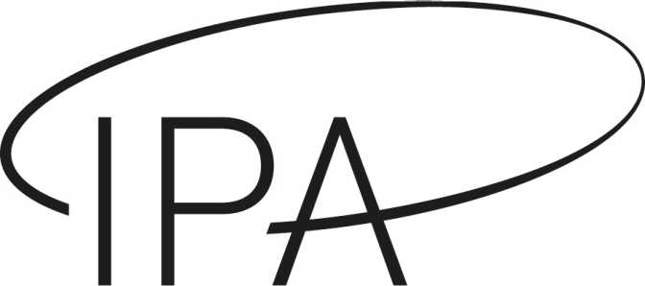
Robust cosmology through combined probes
Alexander Reeves
With Andrina Nicola, Alexandre Refregier,
Simone Ferraro, Martin White
Based on 2309.03258, 2502.01772

Slide 2
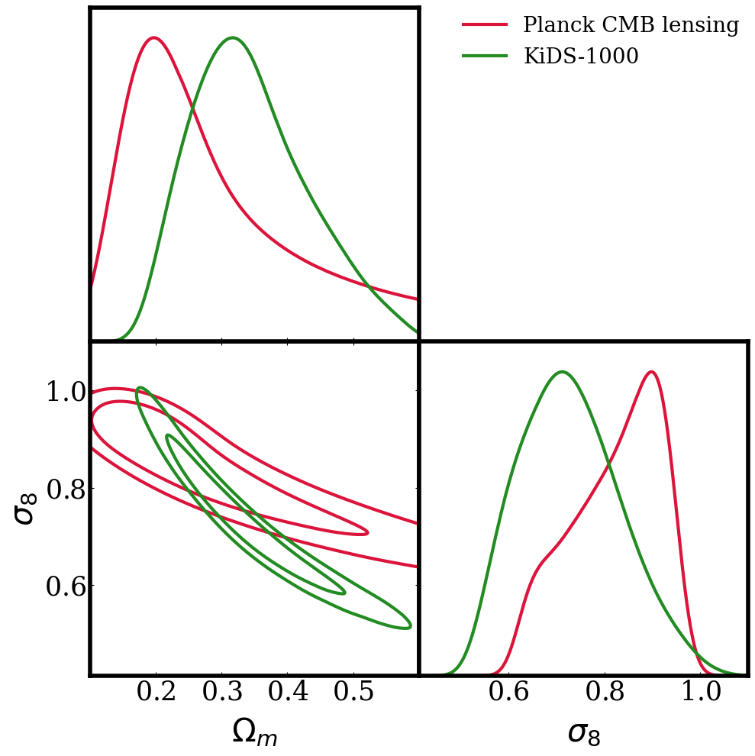
Combined probes: motivations
Combining data from independent experiments allows to identify and mitigate systematics
Test consistency between probes analysed in a consistent framework
Many different scales and redshifts: end-to-end test of cosmological models with strong constraints due to degeneracy breaking

Slide 3
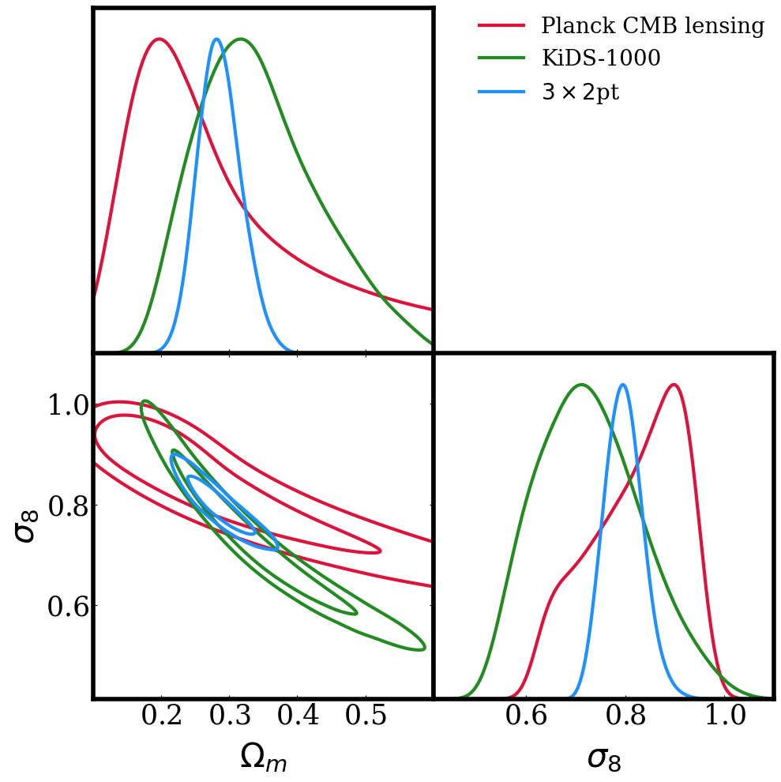
Combined probes: motivations
Combining data from independent experiments allows to identify and mitigate systematics
Test consistency between probes analysed in a consistent framework
Many different scales and redshifts: end-to-end test of cosmological models with strong constraints due to degeneracy breaking

Slide 4
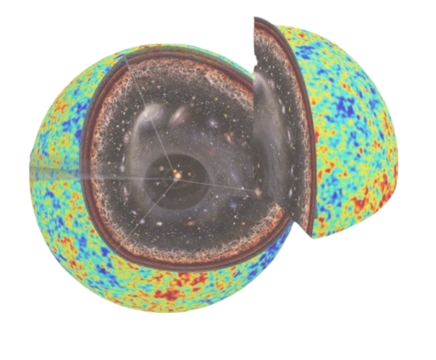

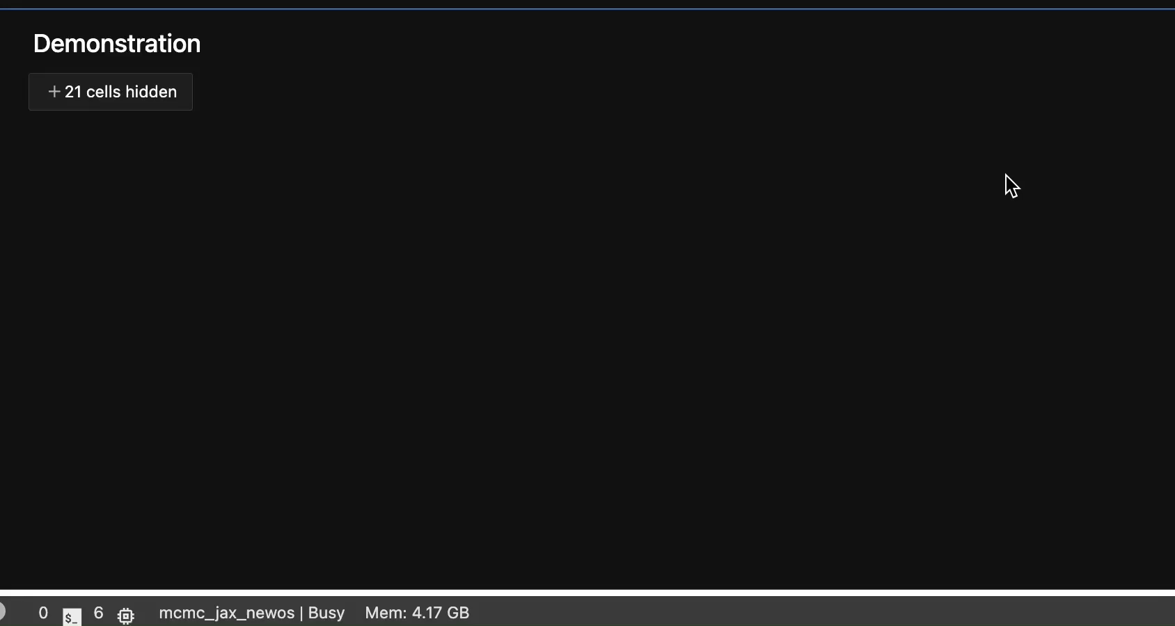
Combined probes: our approach
Build a consistent pipeline integrating several probes at the 2pt level
Restrict to scales (and summary statistics!) where simple modelling can be applied
Carefully quantify tensions between data before combining
Use emulators for theory predictions and implement all likelihoods in JAX for JIT + GPU acceleration when sampling

Slide 5
The combined probes pipeline
UFALCON2 code publicly available and can be interfaced with the cosmogrid

Slide 6
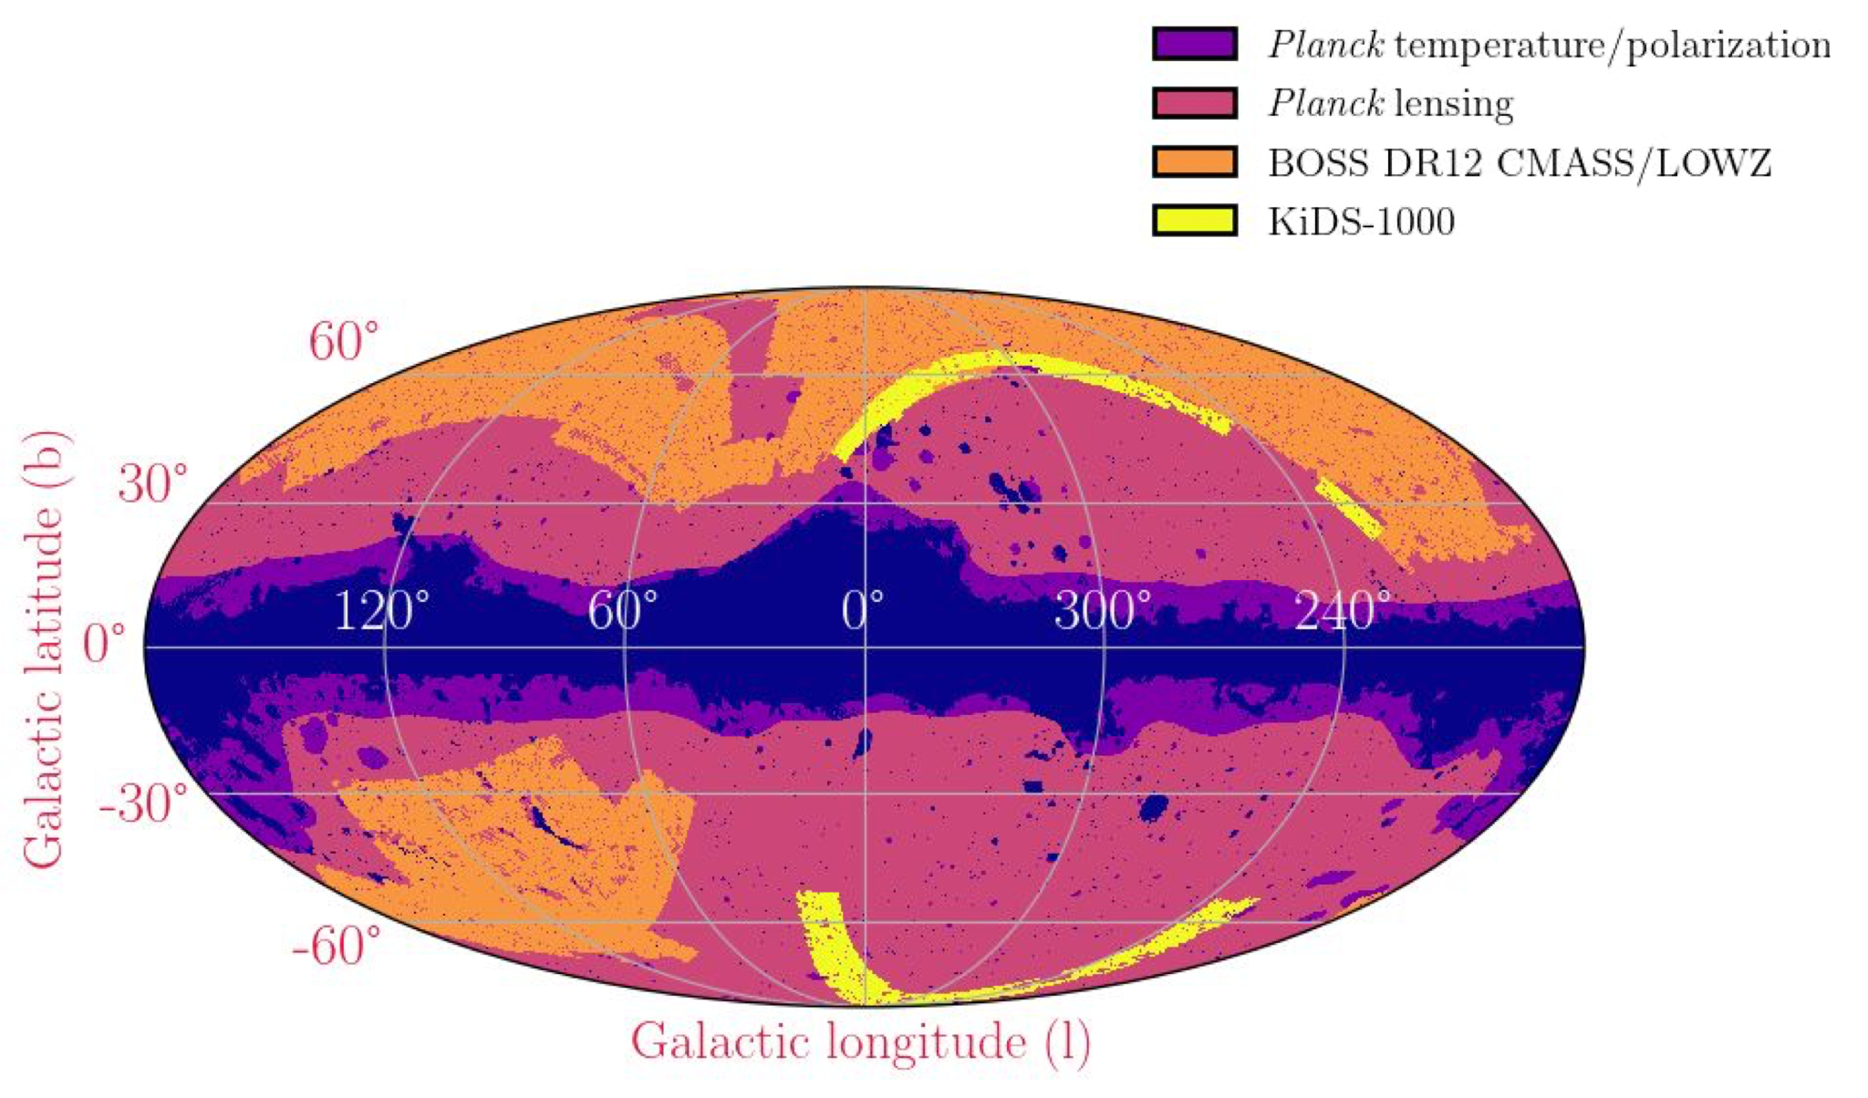
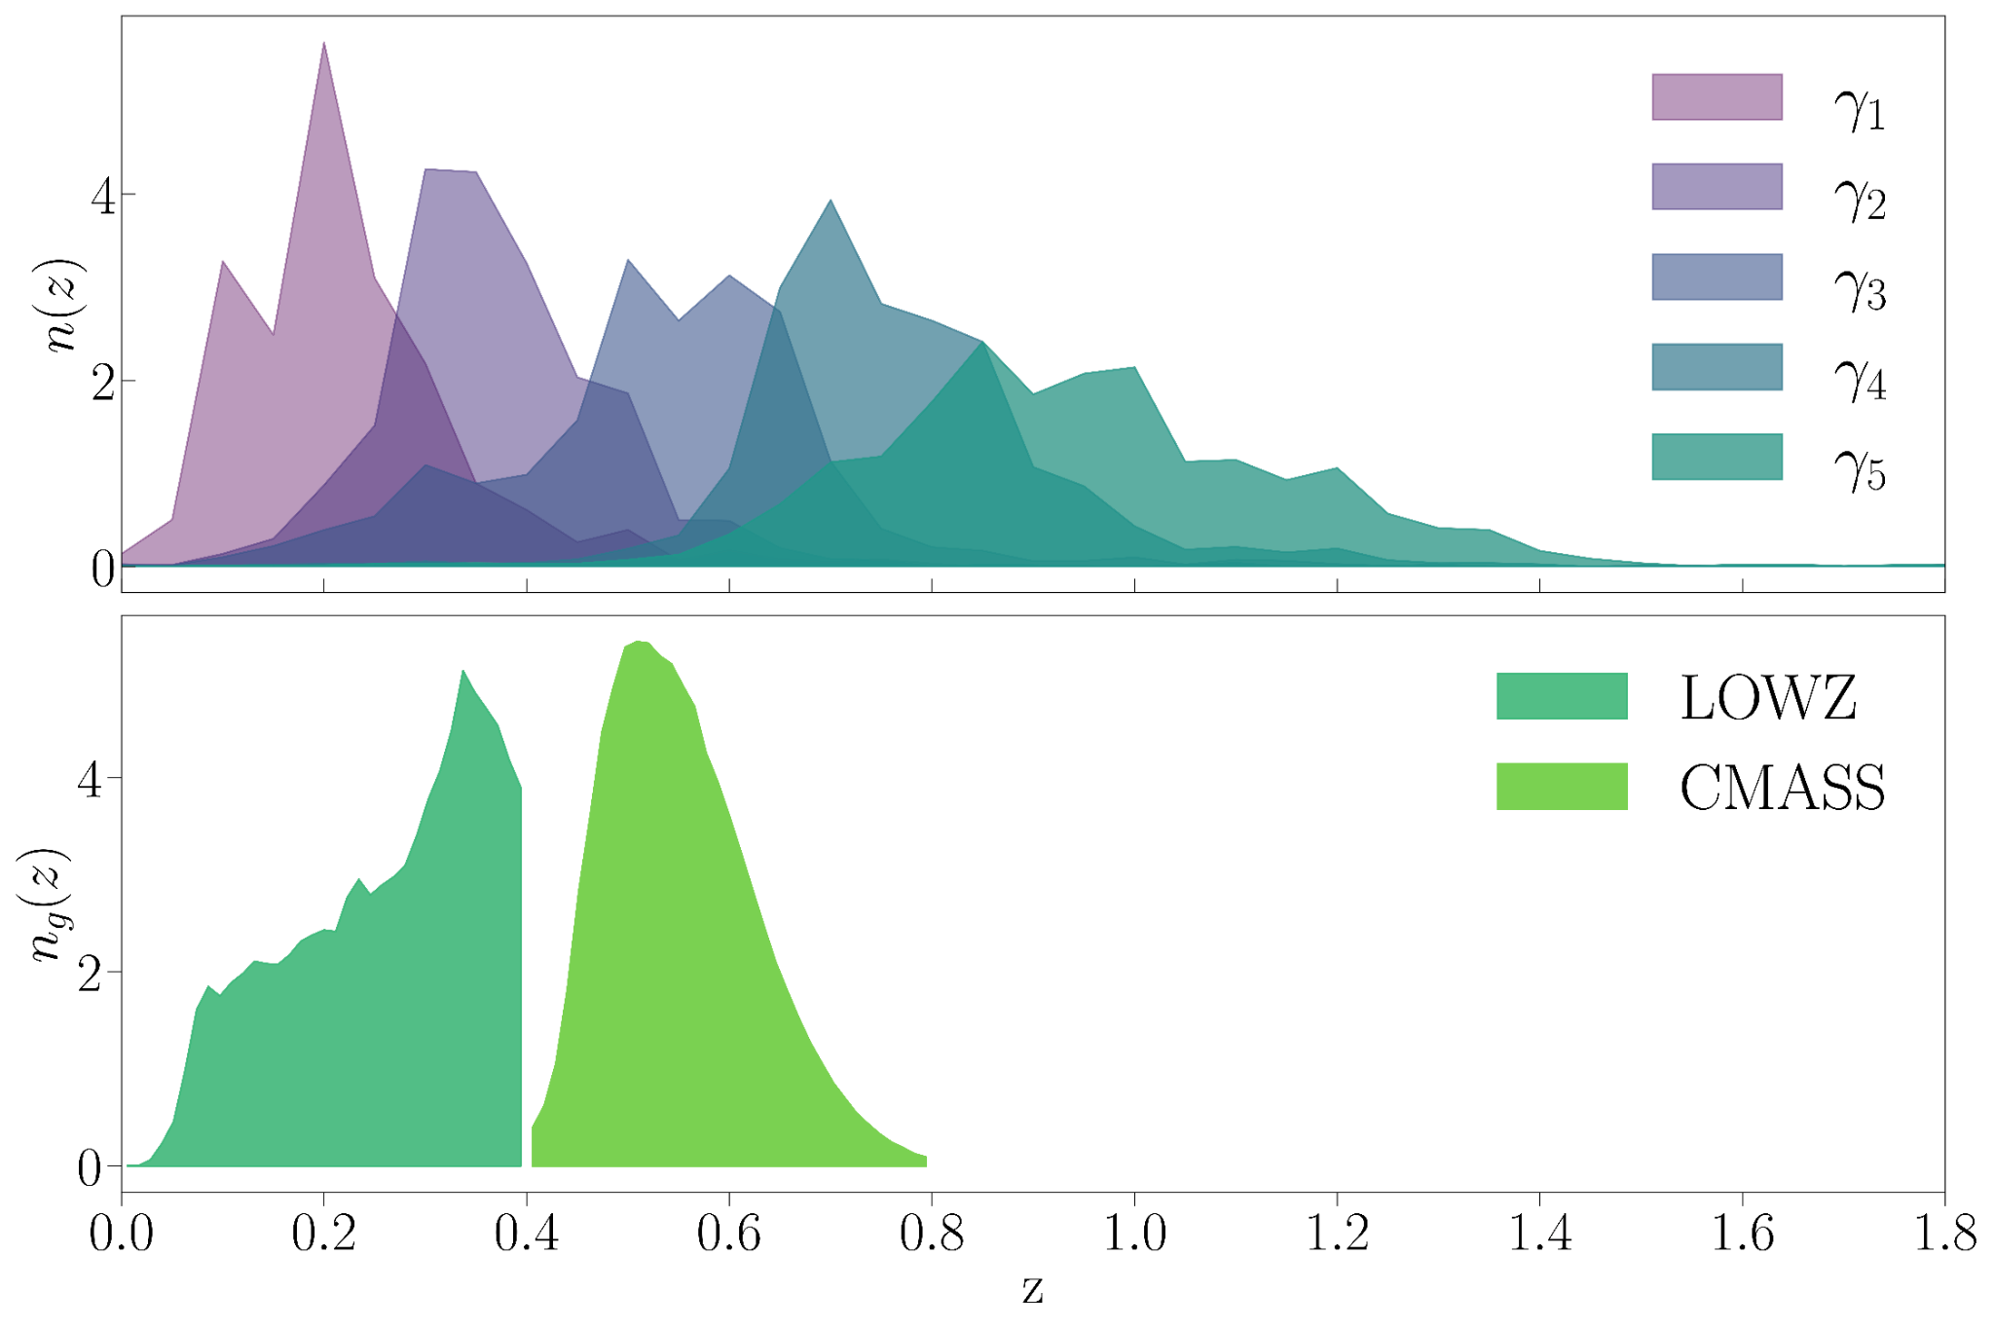
Apply framework to data
CMB: Planck PR3, Planck PR4 (Hillipop), ACT DR4+WMAP
BAO: DESI Y1
Low-z: CMB lensing + ISW (PR3) X KiDS-1000 X BOSS DR12 (9x2pt)
Tomographic - measure 43 separate 2-point functions for low-z data vector

Slide 7
Internal consistency
Amplitude parameter let free for each probe
Three deviations from expectations:
  Planck PR3: A-lens systematic detection
  KiDS z-bin 2: redshift systematic detection
  KiDS z-bins 4/5: S8 tension

Slide 8
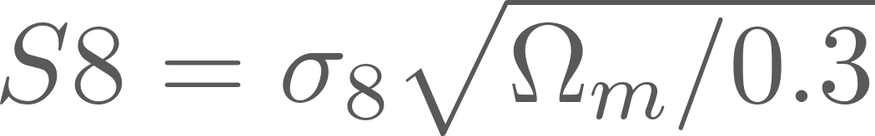
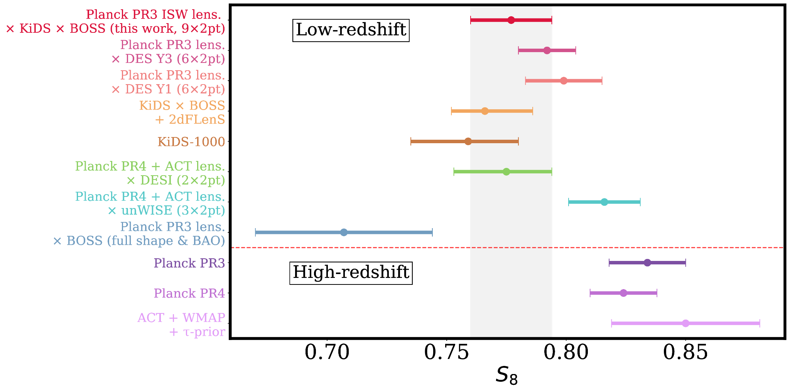
S8 measurement (ΛCDM)
Novel 9x2pt measurement from this data combination. Consistent with S8 found in other contemporary analyses
Tension with CMB likelihoods - “S8-tension” which is 2.2σ in for our baseline (Planck PR4)
In full parameter space reduced to 1.7σ and further still in extended models, and adding BAO (see later)
S8 measurements from (in order vertically):
DES collaboration, 2022, Xu et. al 2023, Heymans et. al 2020, Asgari et.al, 2020, Sailer et. al 2024, Farren et. al 2024, Chen et. al 2024.
Reeves et al. (2025)

Slide 9
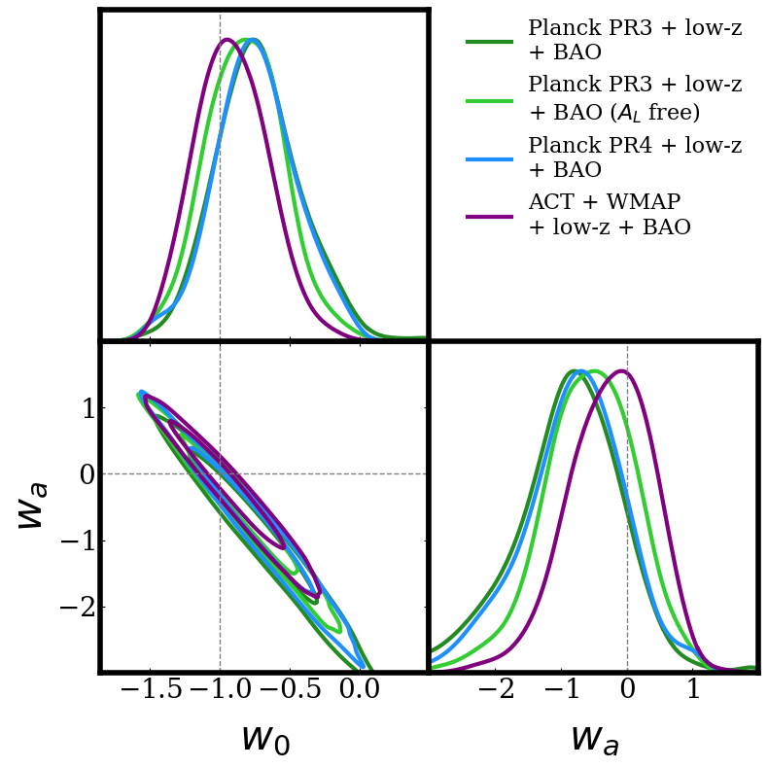
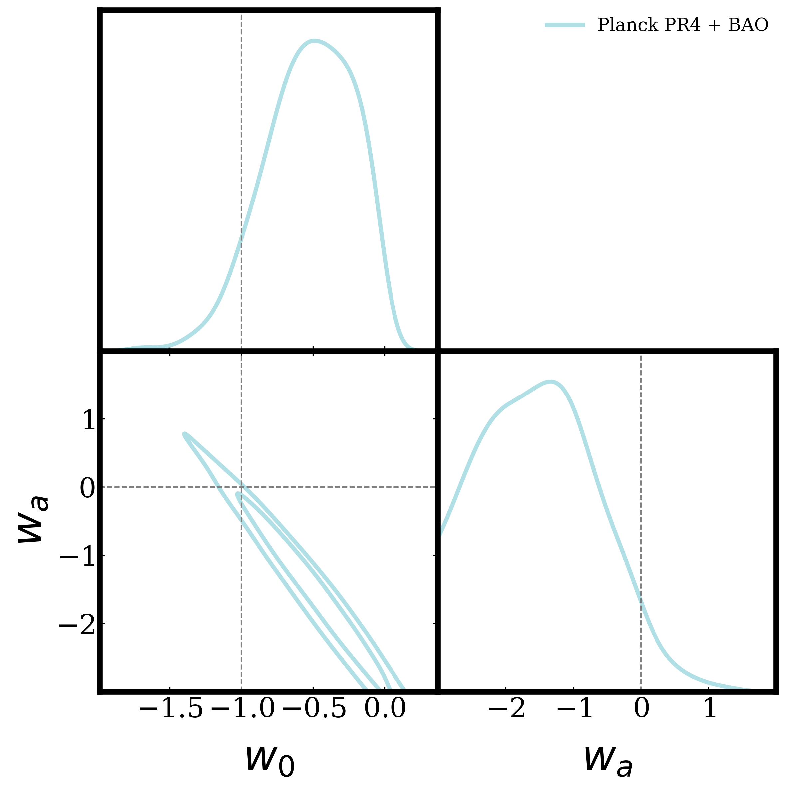
Dynamical dark energy: multiprobe constraints
Find models far from a CC worsen the S8 tension between CMB and low-z data (especially KiDS-1000)
This means that including KiDS-1000 in the analysis pushes constraints towards a CC
Caveat: based on DESI Y1 BAO and KiDS-1000 (both updated now!)
Reeves et al. (2025)

Slide 10
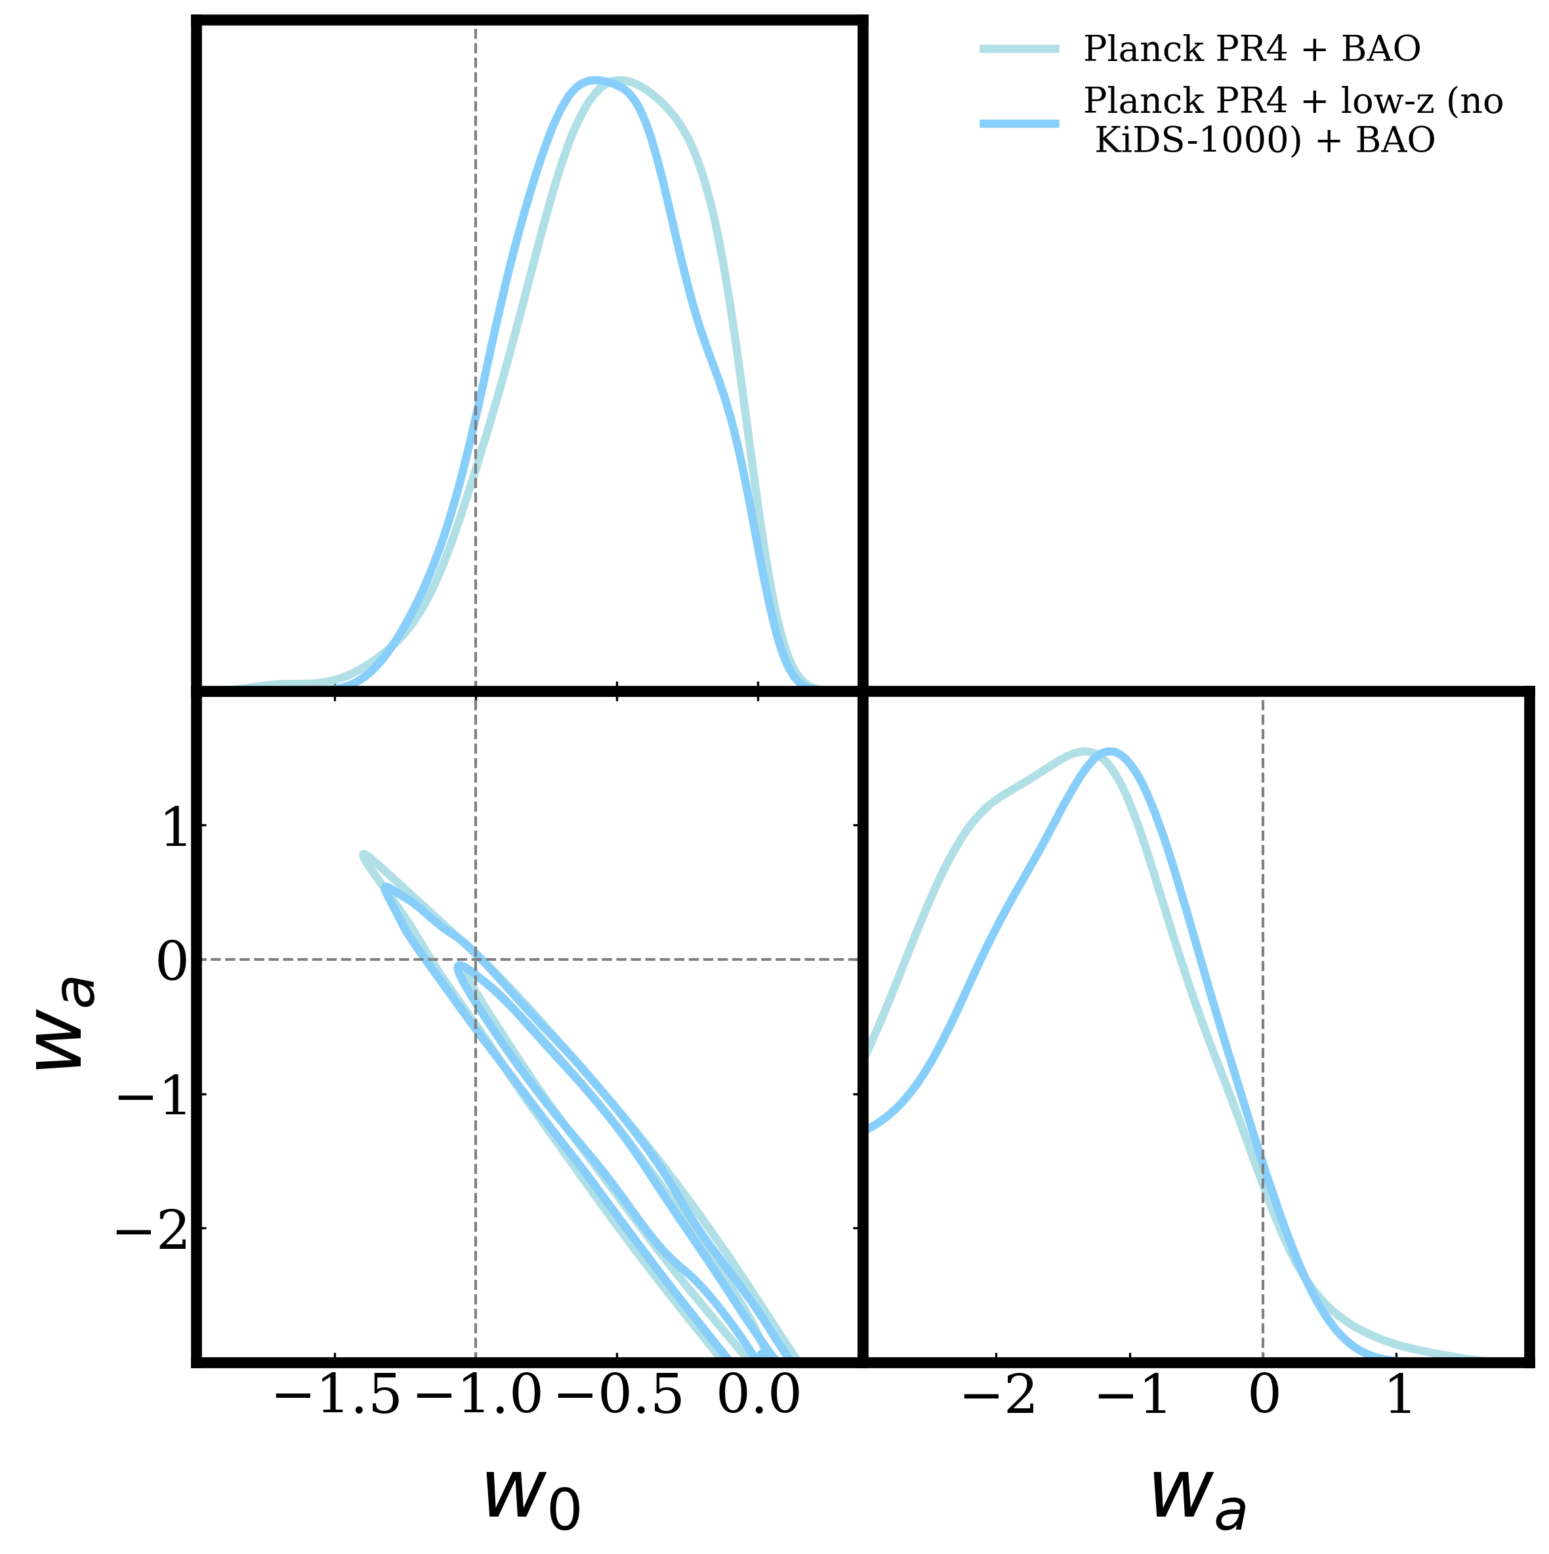
Dynamical dark energy: multiprobe constraints
Find models far from a CC worsen the S8 tension between CMB and low-z data (especially KiDS-1000)
This means that including KiDS-1000 in the analysis pushes constraints towards a CC
Caveat: based on DESI Y1 BAO and KiDS-1000 (both updated now!)
Reeves et al. (2025)

Slide 11
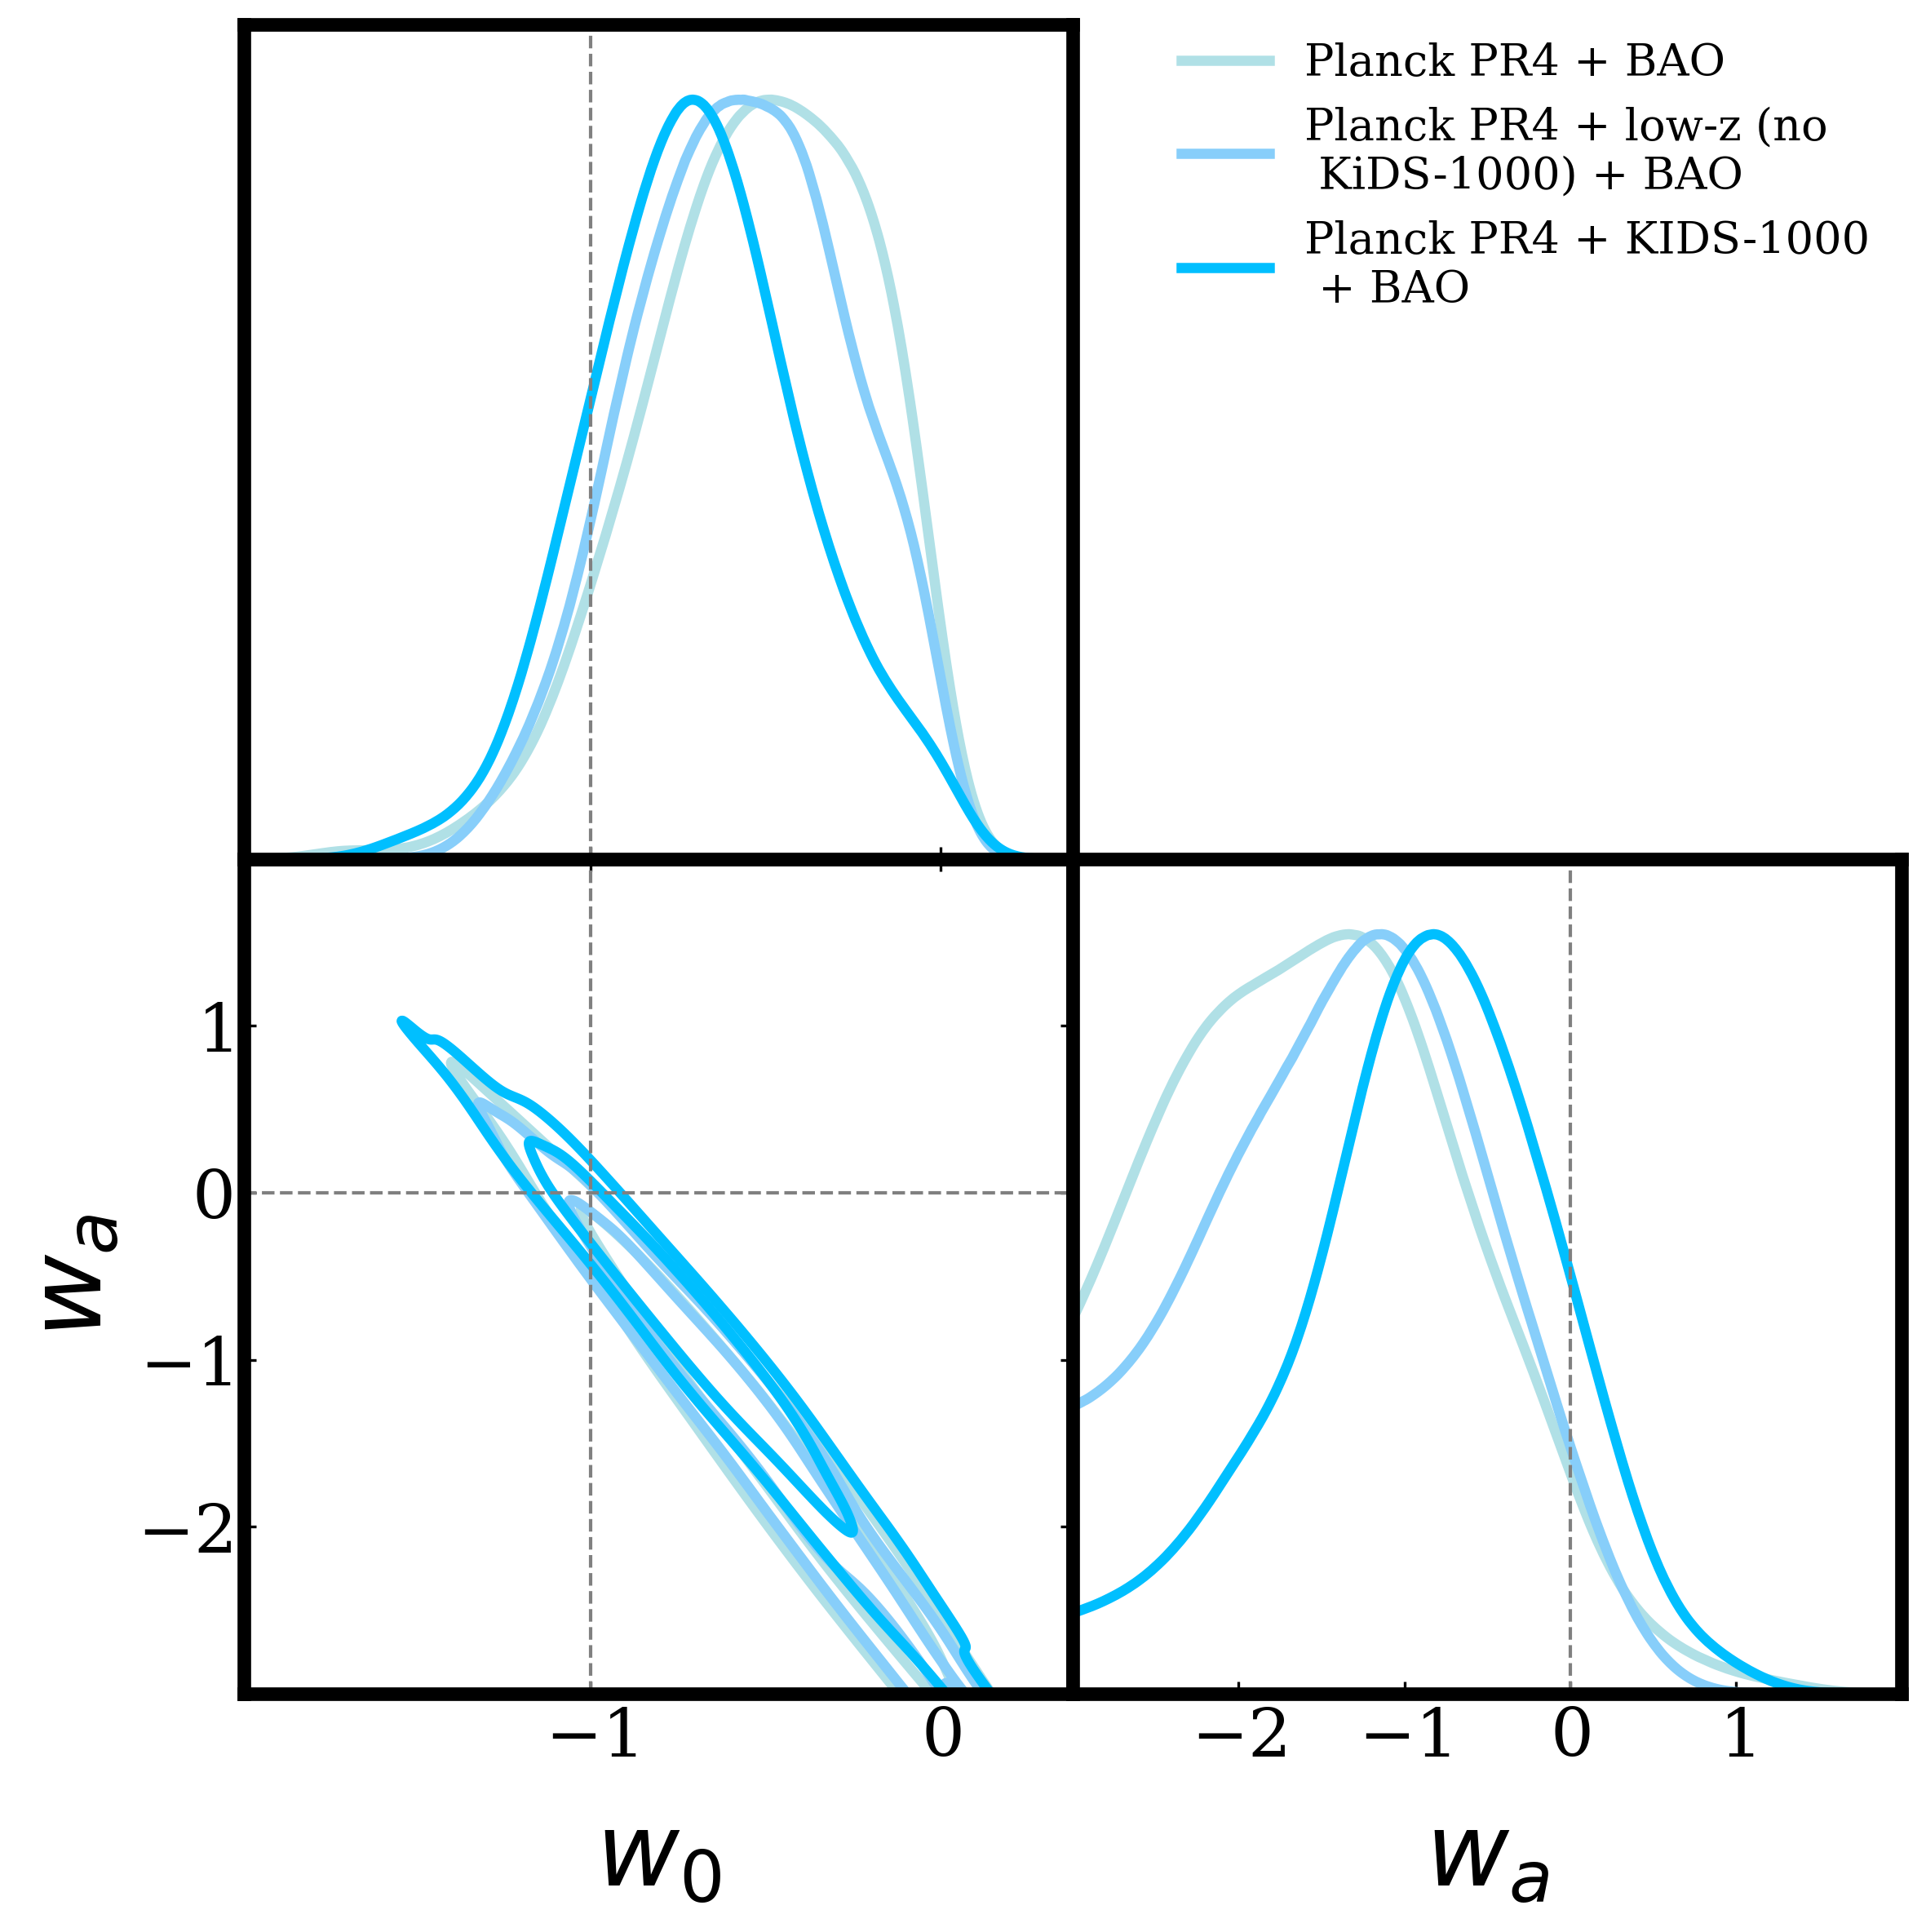
Dynamical dark energy: multiprobe constraints
Find models far from a CC worsen the S8 tension between CMB and low-z data (especially KiDS-1000)
This means that including KiDS-1000 in the analysis pushes constraints towards a CC
Caveat: based on DESI Y1 BAO and KiDS-1000 (both updated now!)
Reeves et al. (2025)

Slide 12
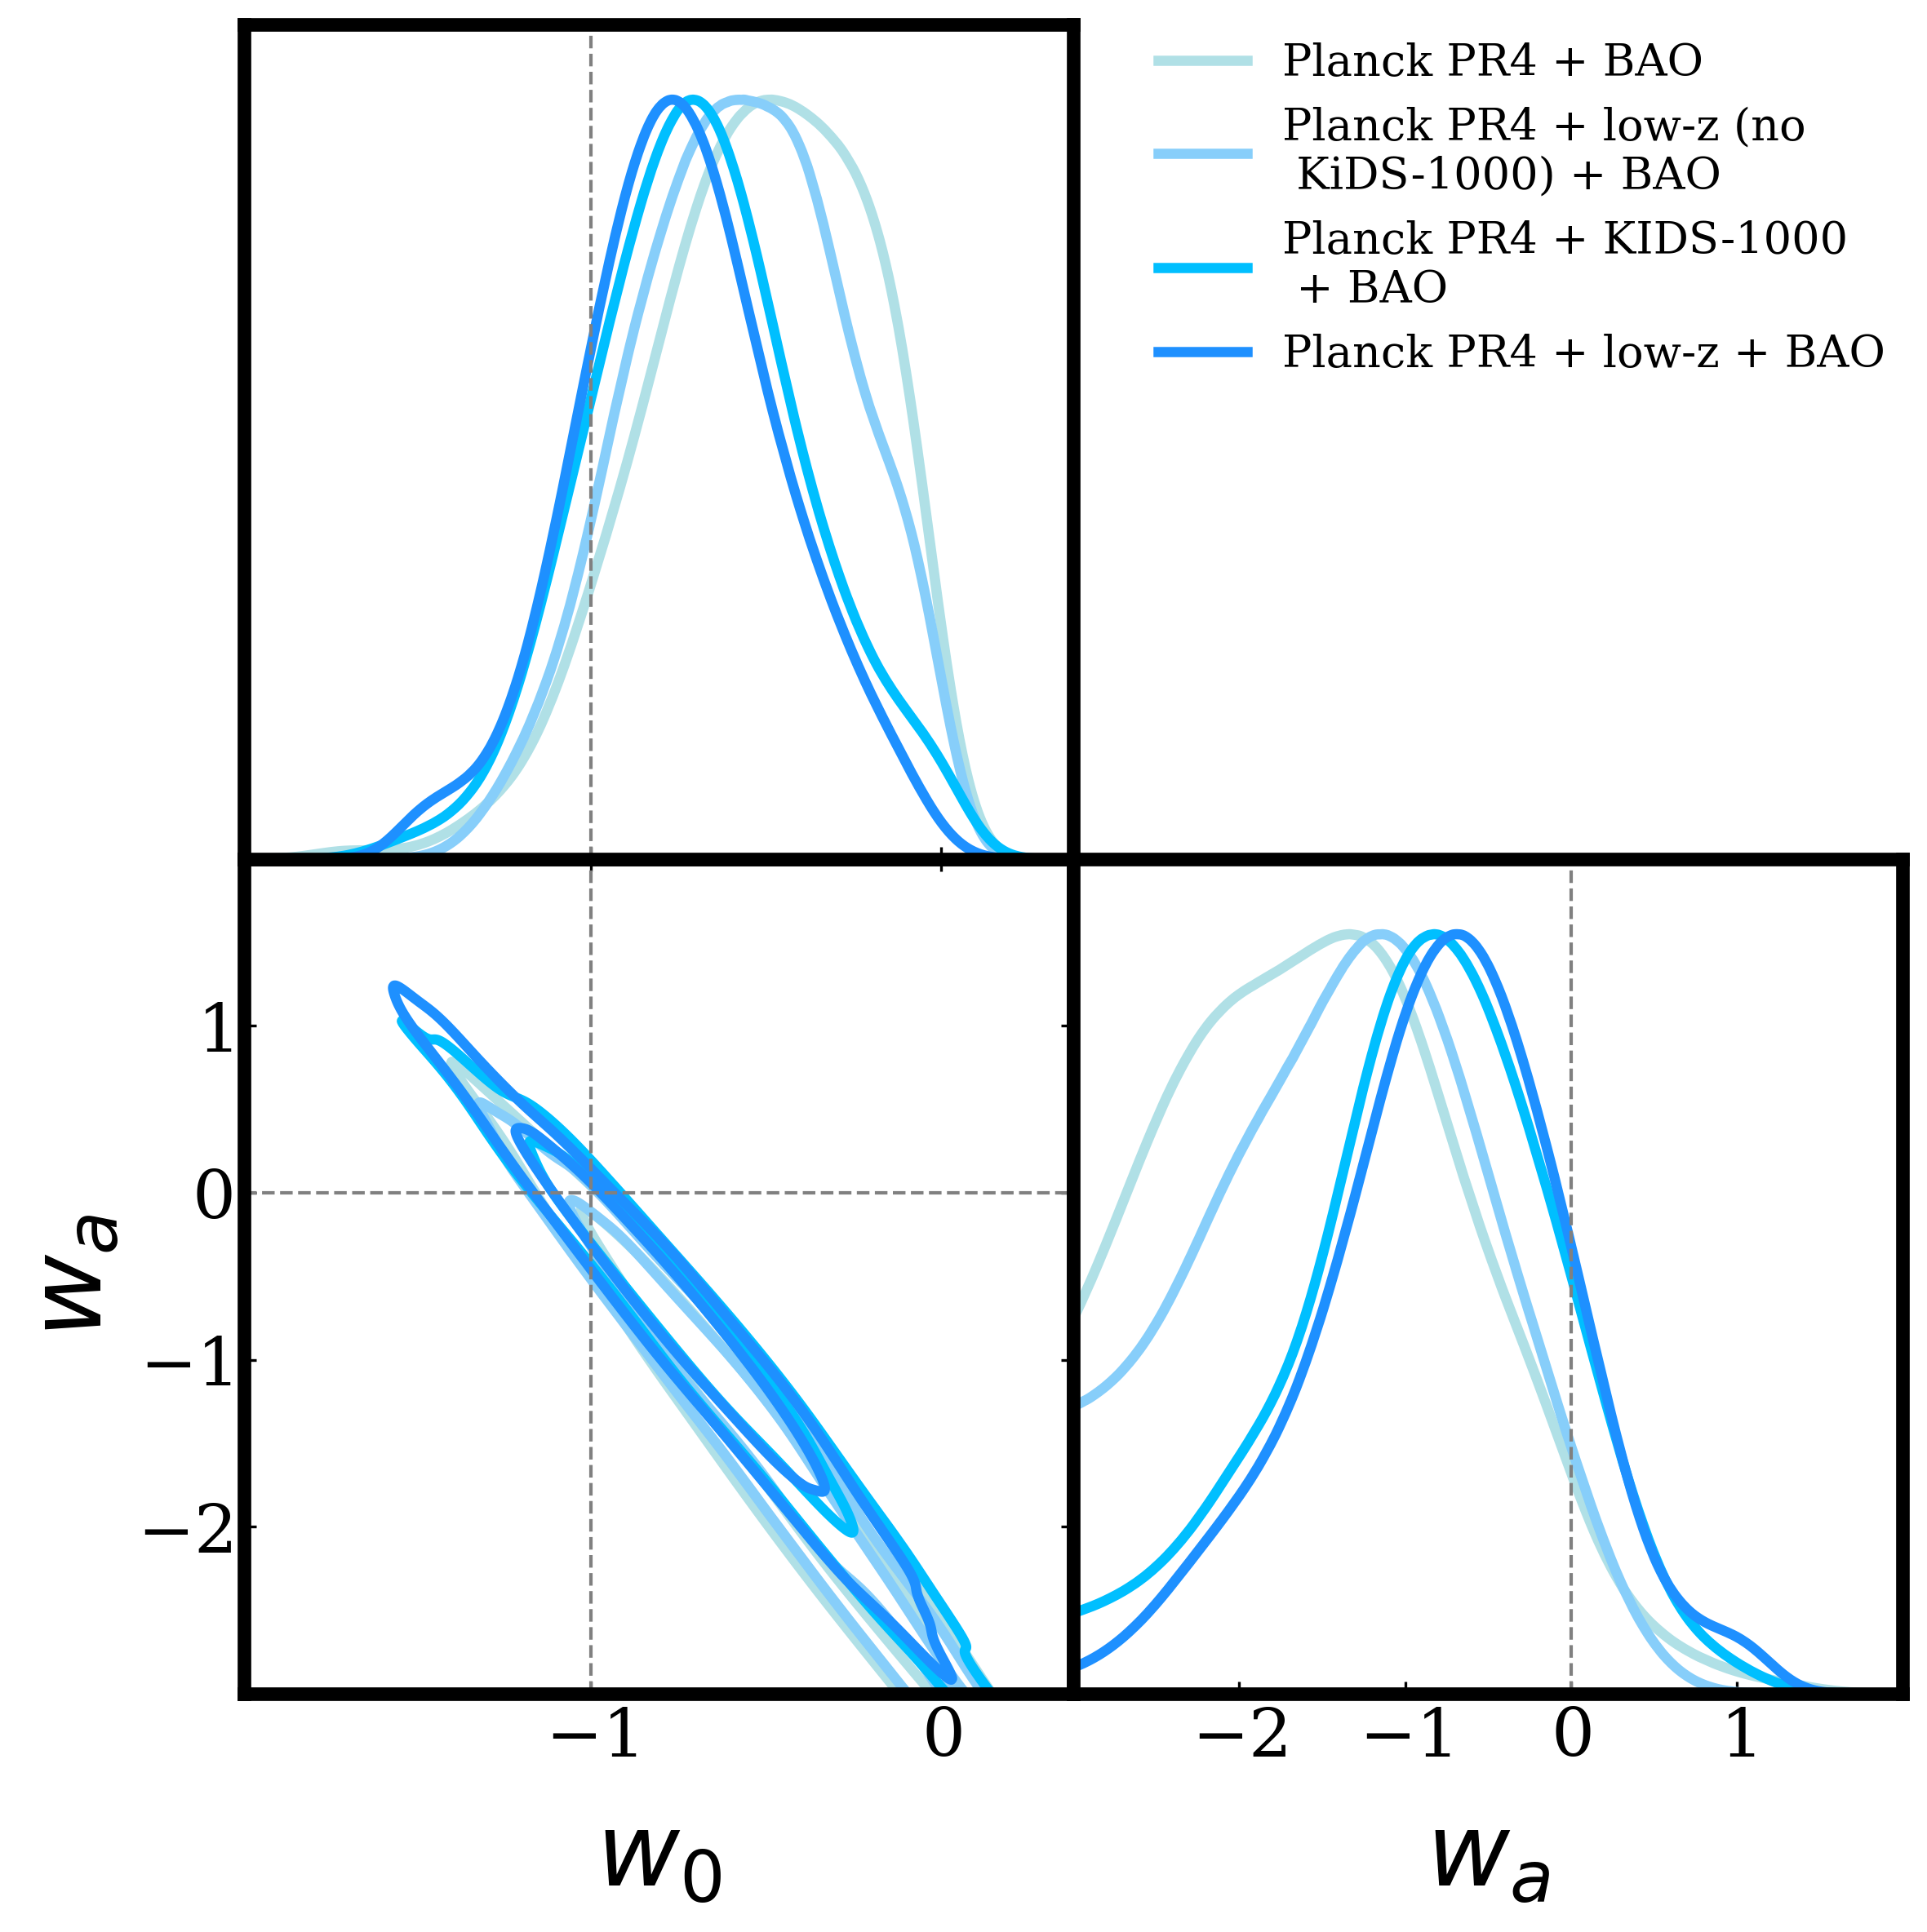
Dynamical dark energy: multiprobe constraints
Find models far from a CC worsen the S8 tension between CMB and low-z data (especially KiDS-1000)
This means that including KiDS-1000 in the analysis pushes constraints towards a CC
Caveat: based on DESI Y1 BAO and KiDS-1000 (both updated now!)
Reeves et al. (2025)

Slide 13
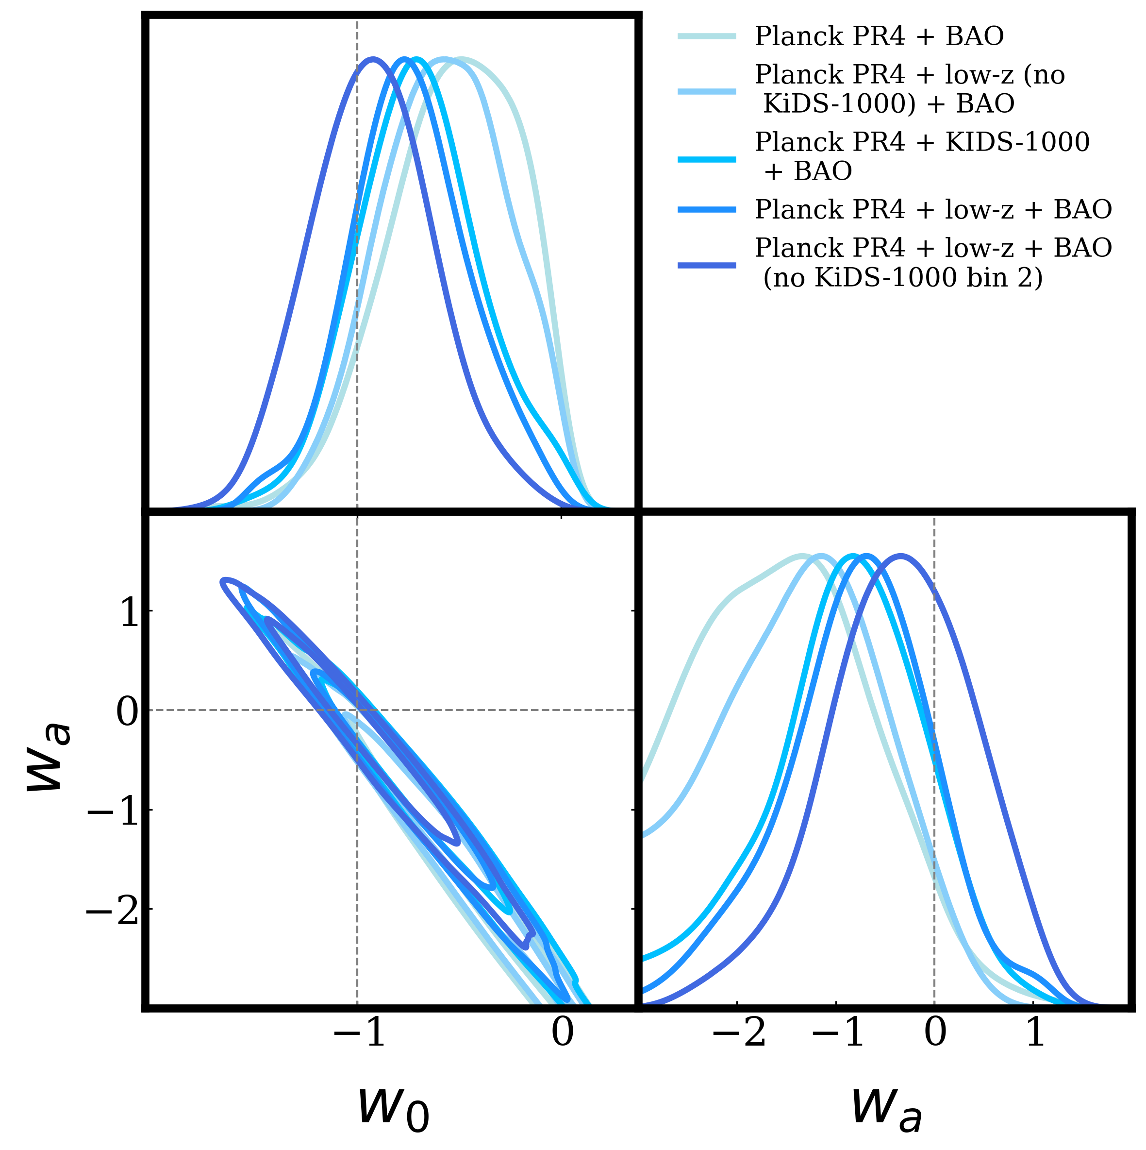
Dynamical dark energy: multiprobe constraints
Find models far from a CC worsen the S8 tension between CMB and low-z data (especially KiDS-1000)
This means that including KiDS-1000 in the analysis pushes constraints towards a CC
Caveat: based on DESI Y1 BAO and KiDS-1000 (both updated now!)
Reeves et al. (2025)

Slide 14

Neutrino masses
Fiducial neutrino mass measurement from combination:
Explored effect of “A-lens” parameter finding the combined probes approach makes upper limits robust to this systematic
Upper limit loosened when considering DDE background
Reeves et al. (2025)

Slide 15
Outlook and conclusions
Multiprobe analyses are powerful for:
  Identifying and mitigating systematics that do not correlate between datasets
  Exploring and understanding tensions between datasets
  Providing strong constraints on cosmological parameters via degeneracy breaking
Including KiDS-1000 data in a joint analysis pushes DDE constraints towards a CC
DDE models can loosen neutrino mass bounds, relieving tension with neutrino oscillation data
Several recent data releases- ACT DR6, DESI DR2 BAO, KiDS legacy. Currently working analysis with updated BAO, LSS and now SNe data, exploring early and late extensions – say tuned!
Preliminary
Plot inspired by Chaussidon et al. 2025

Slide 16
BACKUP

Slide 17
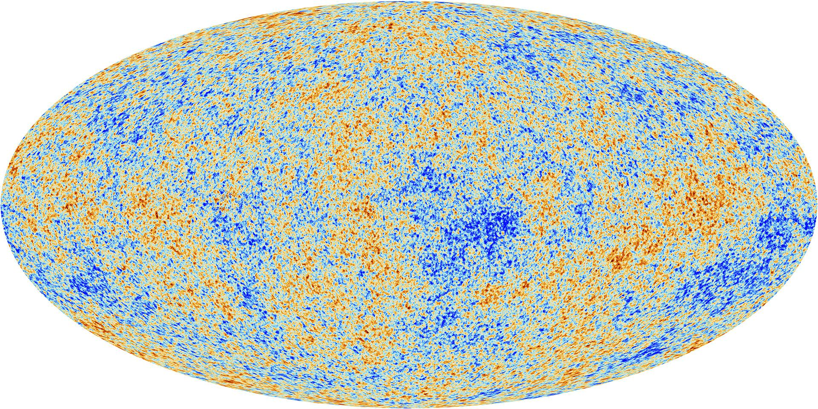
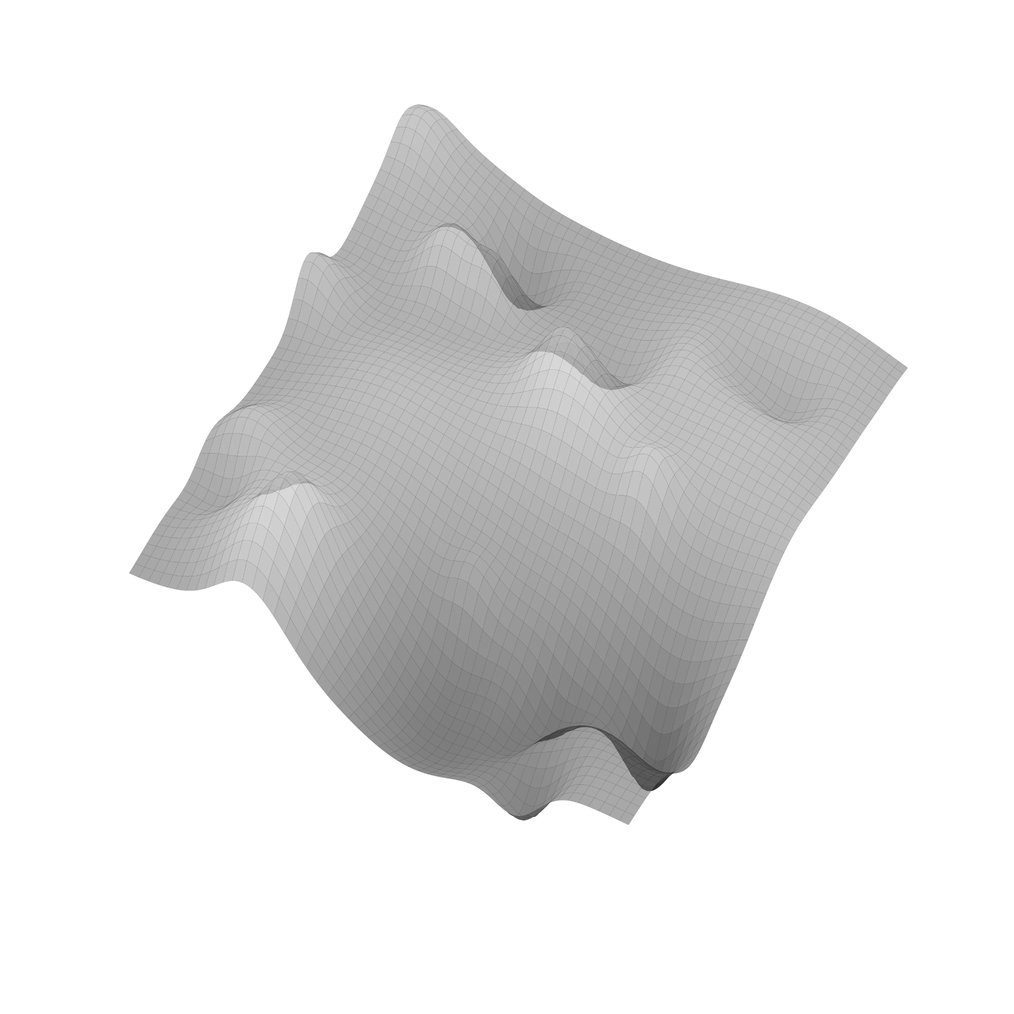



Multiprobe landscape
Image credits: Planck collaboration
Weak lensing unbiased probe of DM field between source galaxy and observer (we consider both CMB lensing and galaxy weak lensing)
𝛅
𝚽
CMB
(Gaussian) perturbations in early Universe
$$\dot{Φ}$$
BAO
Standard ruler tracer of background evolution
Clustering
biased tracer of DM field at source
(L)ISW probe of time evolution of potential

Slide 18
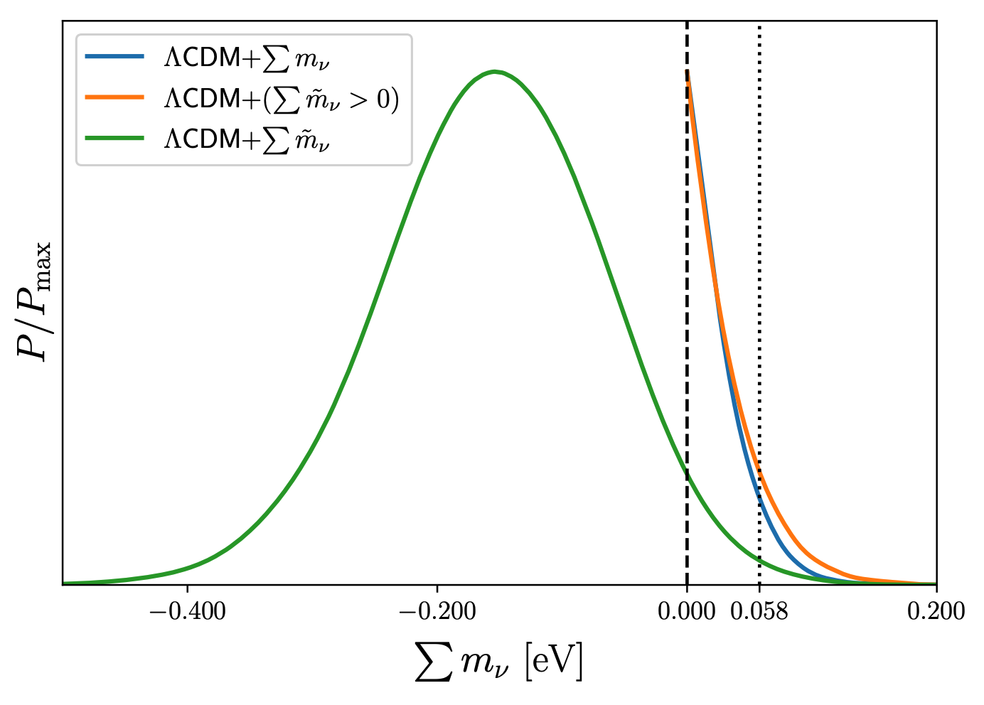
Preference for negative neutrino mass?
We know from neutrino oscillations that we must have the total neutrino mass greater than 0.058eV. Find a 2-3σ tension with this data
How do we interpret this?
  An issue with the assumed cosmological model?
  A hint of systematics in our data?
  Expected statistical fluctuation within the uncertainties of current data?
minimum neutrino mass in NO
Craig et al. 2024

Slide 19

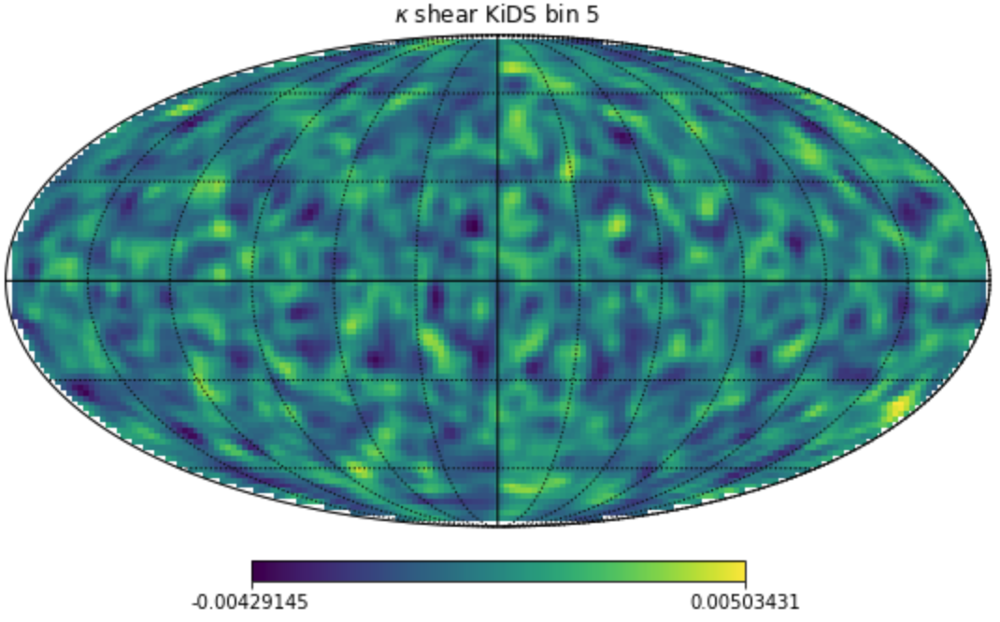
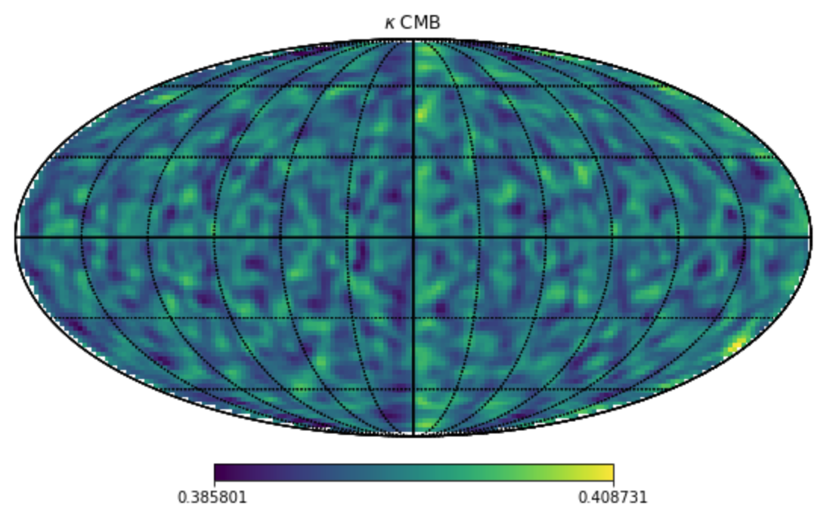
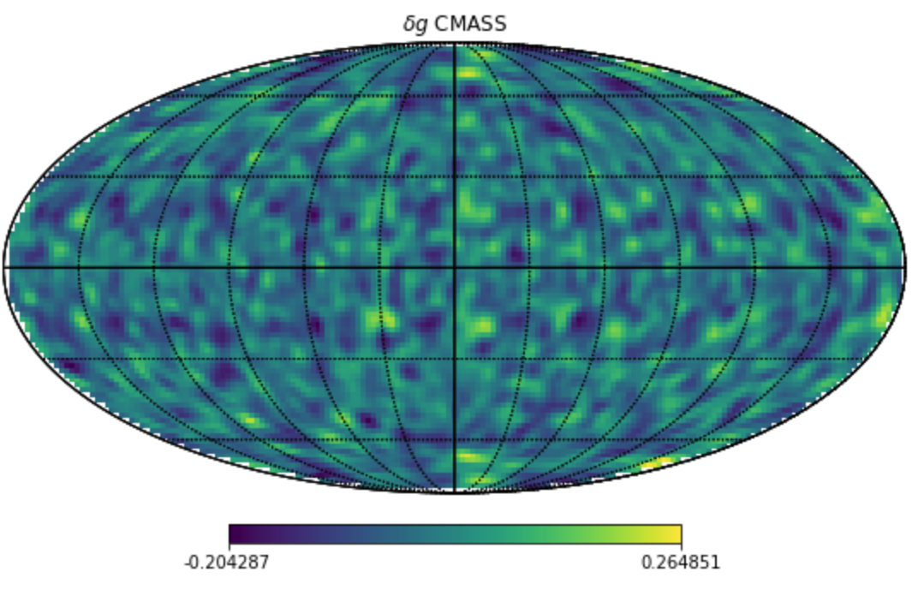
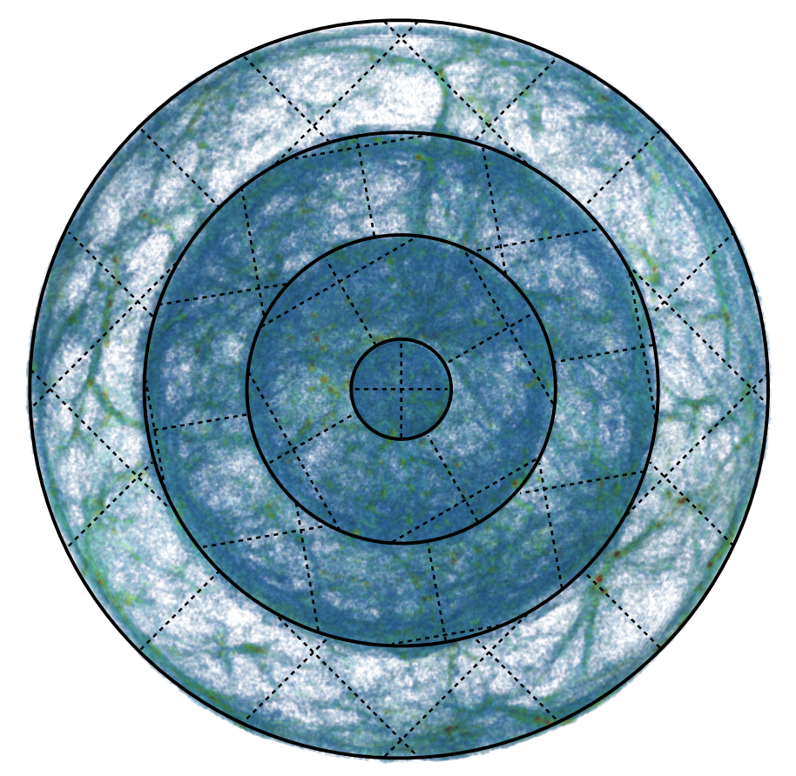
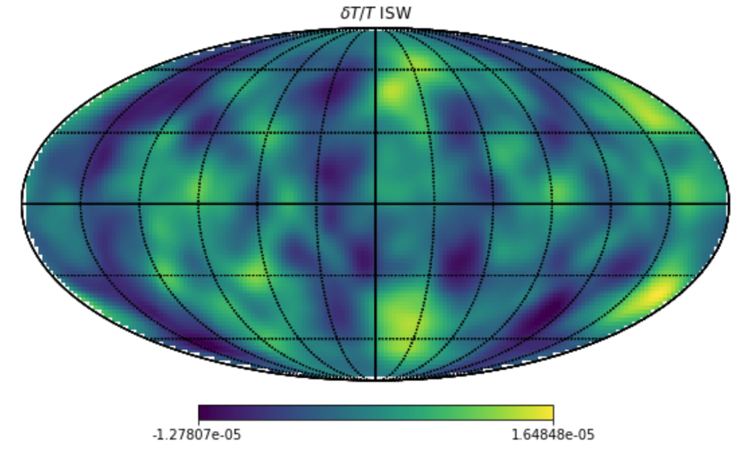
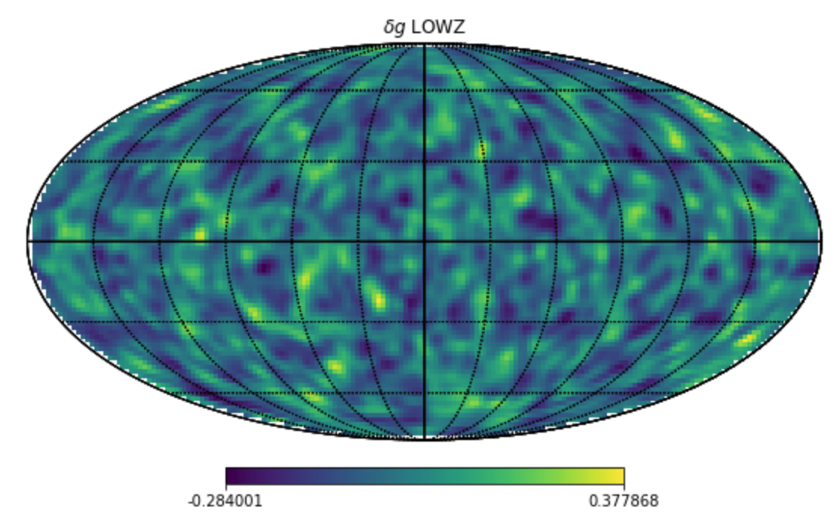
UFalcon2
ϰ_{weak lensing}
δg (CMASS)
ϰ_{CMB}
δT/T_{ISW}
δg (LOWZ)
Cosmogrid (PkDGraV N-body simulations)
Reeves et al. (2023)

Slide 20
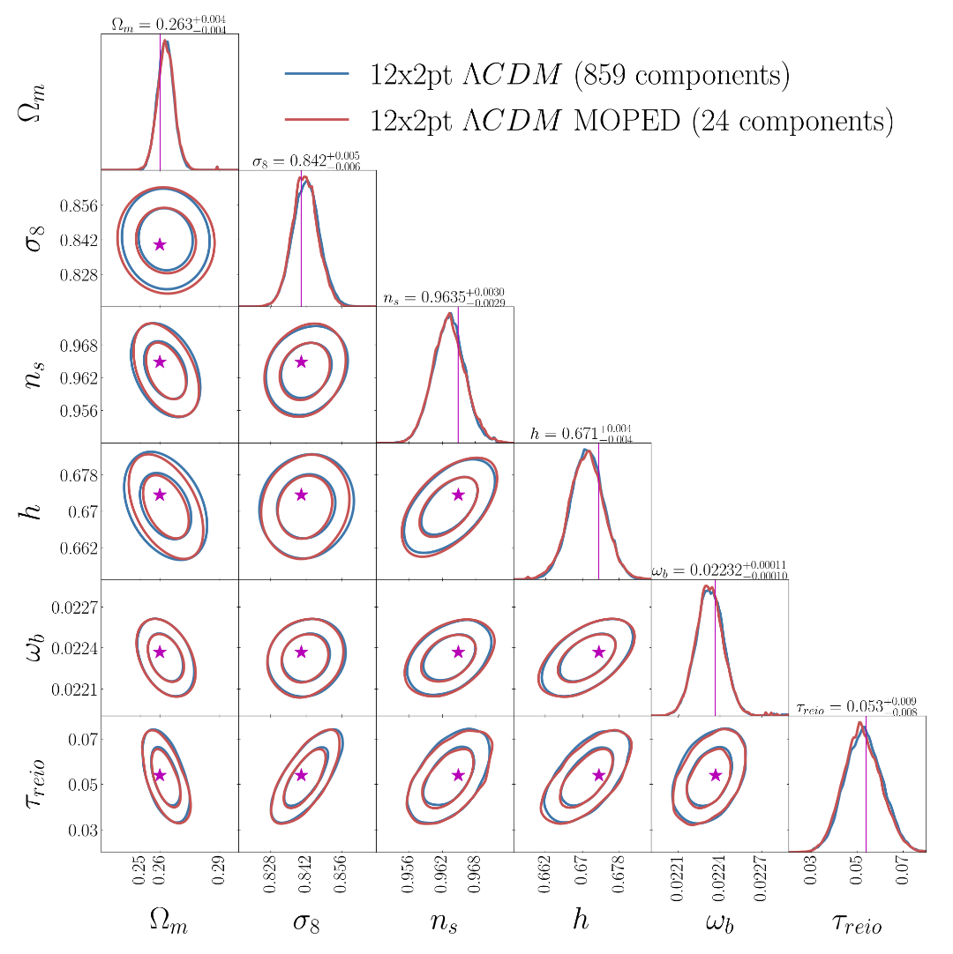
Validate pipeline with mock data
Mock analysis of CMB, LSS (galaxy clustering, weak lensing and CMB lensing/ISW)
Validate covariance matrix and inference side of pipeline
Checked the pipeline reproduces literature results with real data for individual likelihoods
Reeves et al. (2023)

Slide 21
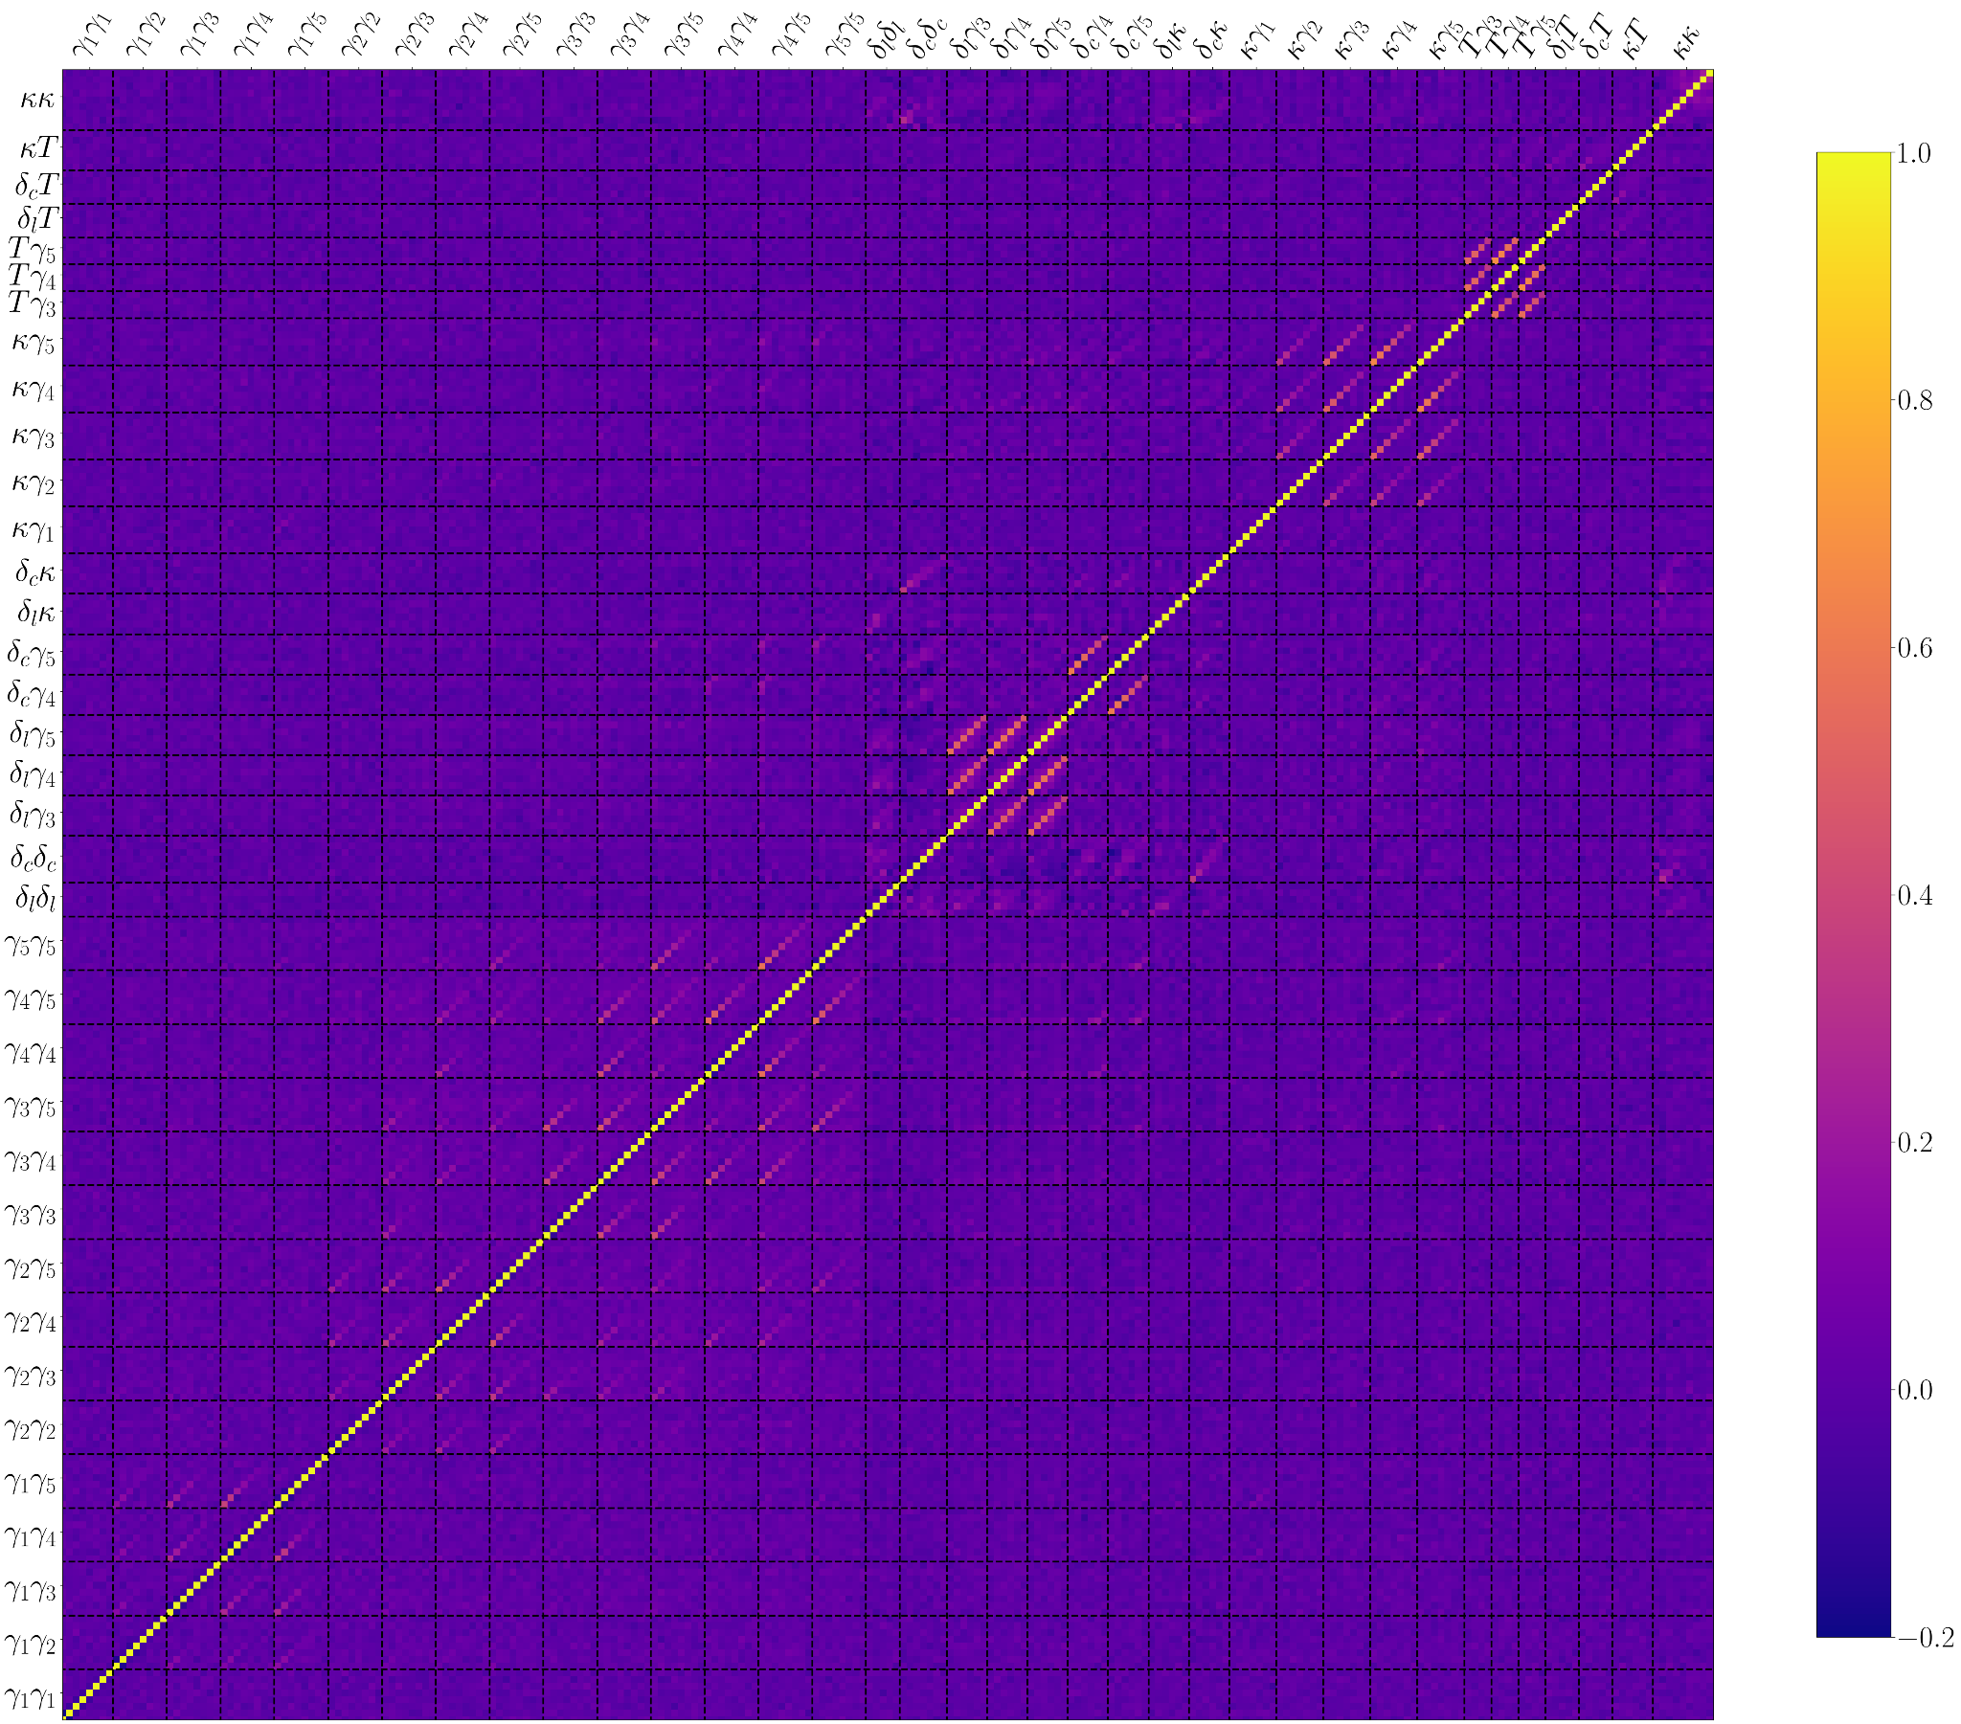
The multi-probe covariance matrix
Survey noise modelled on the map level
Using 2000 random cosmogrid fiducial simulations
Checked convergence
CMB primary and BAO treated separately
Reeves et al. (2023)

Slide 22
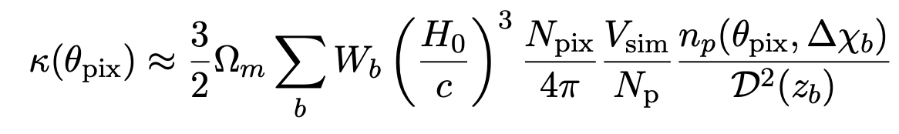
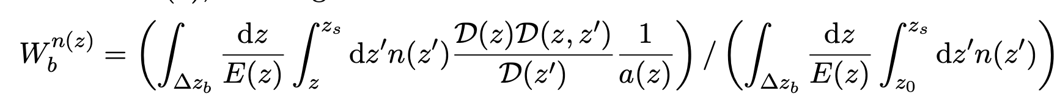
UFalcon2
ϰ_{weak lensing}
Sum over lightcone shells
Number of DM simulation particles at angle theta in given shell
Use Born approximation weak lensing kernel
Approximate integral over matter density as sum over lighcone shells
Input source n(z) distribution
Source redshift distribution
Cosmogrid (PkDGraV N-body simulations)

Slide 23
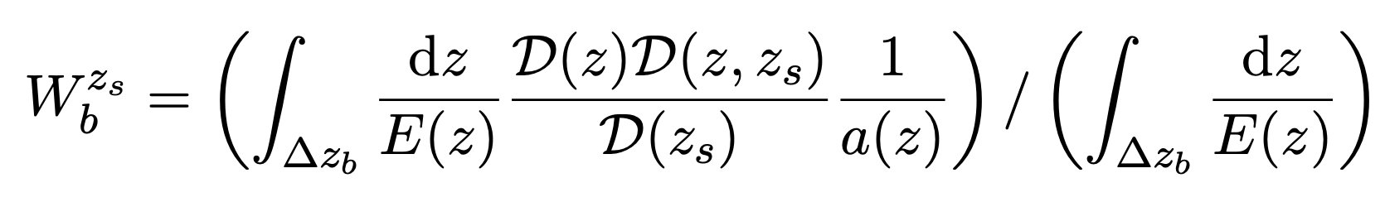
UFalcon2
ϰ_{CMB}
Identical to weak lensing shear case but with Dirac-function source at z_cmb
Cosmogrid (PkDGraV N-body simulations)

Slide 24
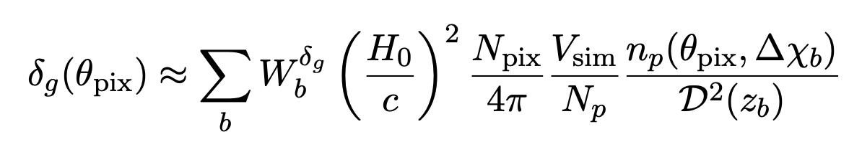
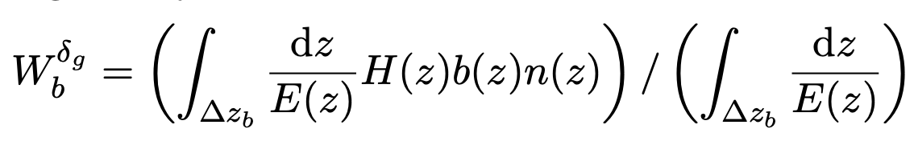
UFalcon2
δg CMASS
Linear bias model currently implemented
Ongoing work to introduce EFTofLSS forward model
δg LOWZ
Cosmogrid (PkDGraV N-body simulations)
Linear bias model
Source redshift distribution

Slide 25
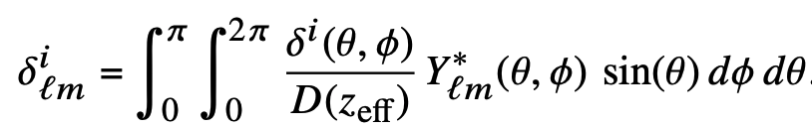
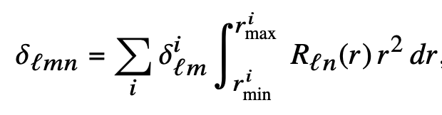
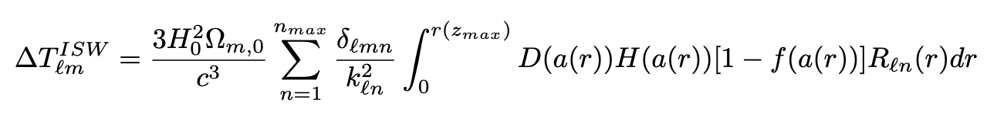
UFalcon2
New routine utilising the Spherical Bessel transform
Significant improvement over previous implementation requiring interpolation over snapshot to estimate potential
SBT transform of DM field
δT/T_{ISW}
Linear growth factor (from Astropy instance)
Cosmogrid (PkDGraV N-body simulations)

Slide 26
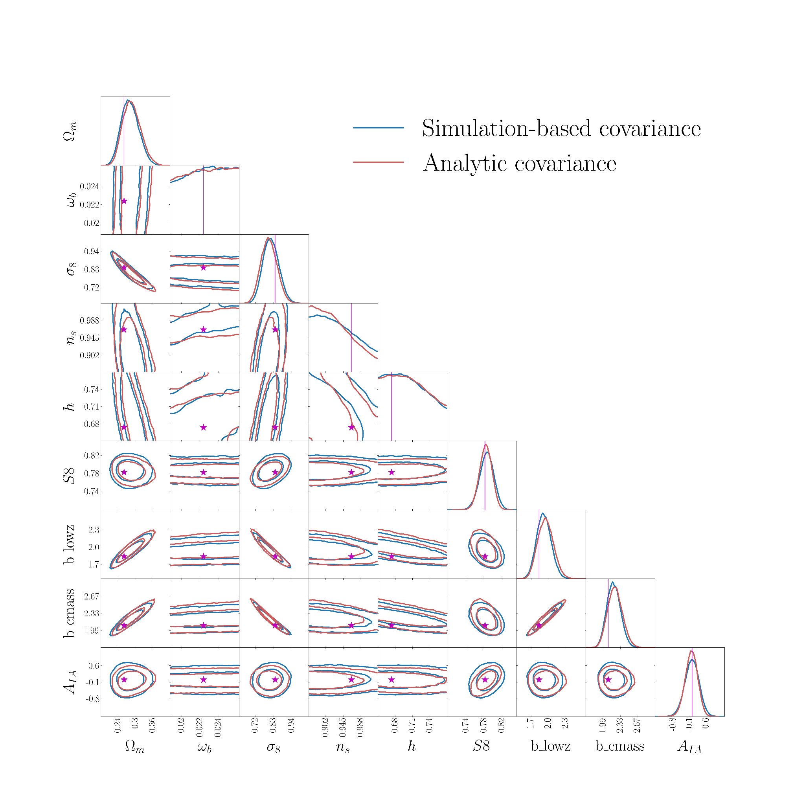
Covariance matrix validation

Slide 27
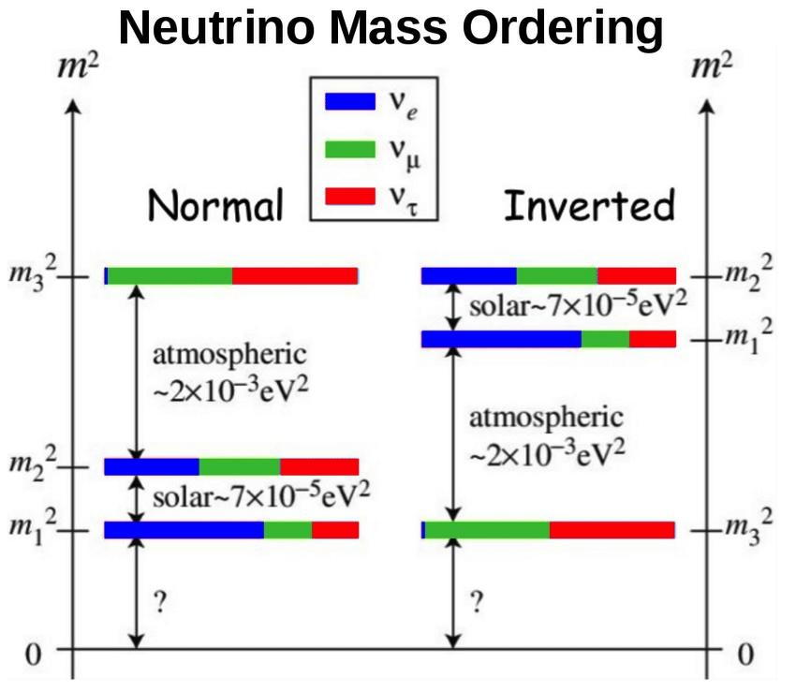
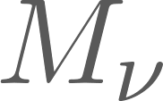

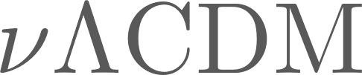
A cosmologists neutrino mass review
From oscillation experiments (e.g. Super-Kamiokande, SNO, KamLAND) there are two possible mass orderings: normal ordering (NO) and Inverted ordering (IO)
Lab based measurements: KATRIN upper limit of electron anti-neutrino mass of 0.8eV (doi: 10.1038/s41567-021-01463-1)
Cosmology sensitive to sum of neutrino mass eigenstates* ( )- current precision at least 10X stronger** than lab based measurements
Image credit: Pablo Fernandez
Planck + DESI Y1 BAO in
DESI collaboration, 2024
* Based on sensitivity of current data
** Model dependent

Slide 28
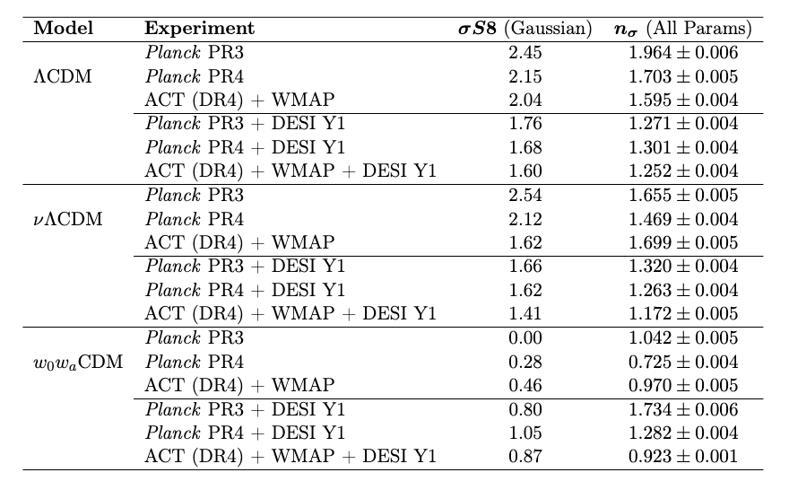
Internal consistency: measuring tensions
Parameter differences full parameter space tension

Slide 29
Internal consistency: measuring tensions
Largest value in Table
General decrease when adding BAO and in extended models

Slide 30
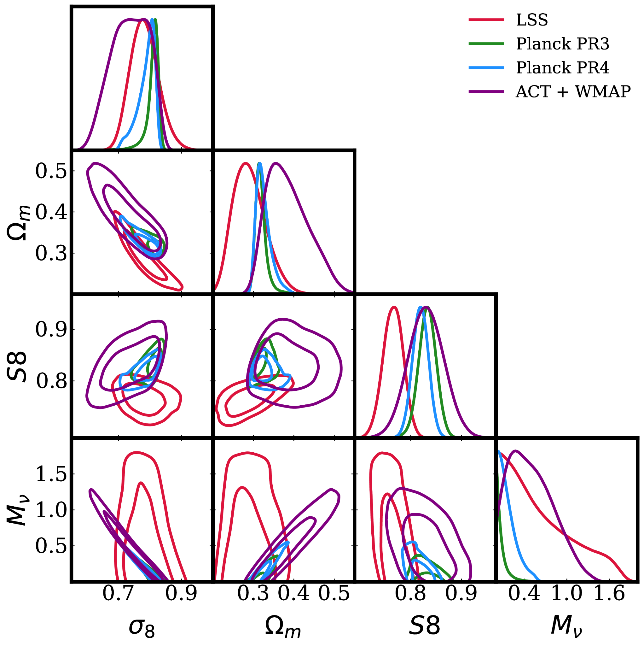
Single probe neutrino mass constraints (why does this not help S8?)

Slide 31
Baseline neutrino mass constraints tension with orderings
P(M_nu<0.06)=0.29 ~ 0.5sigma tension with NO minimal mass
P(M_nu<0.10)=0.078 ~ 1.7sigma tension with IO minimal mass
Note this is with a hard prior at M_nu=0 and so these tensions are lower than if we modelled the impact of an effective negative neutrino mass

Slide 32
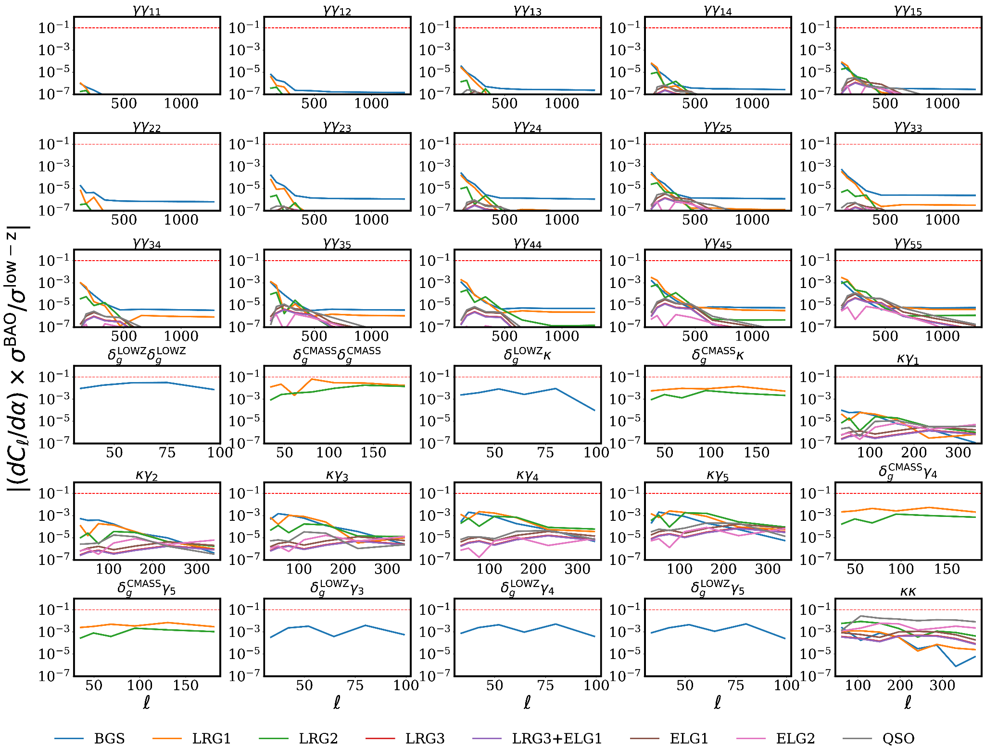
Constraining power from low-z data on DESI BAO bins

Slide 33
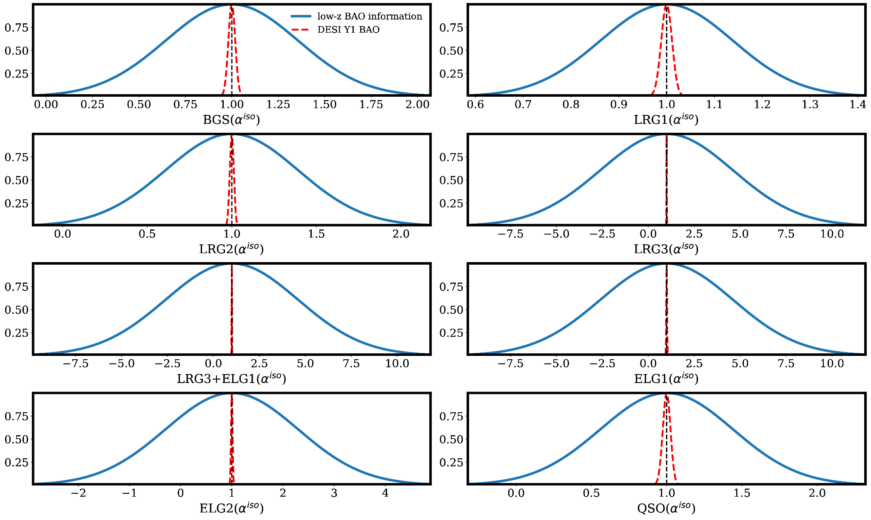
Fisher information for BAOs low-z vs DESI Y1

Slide 34
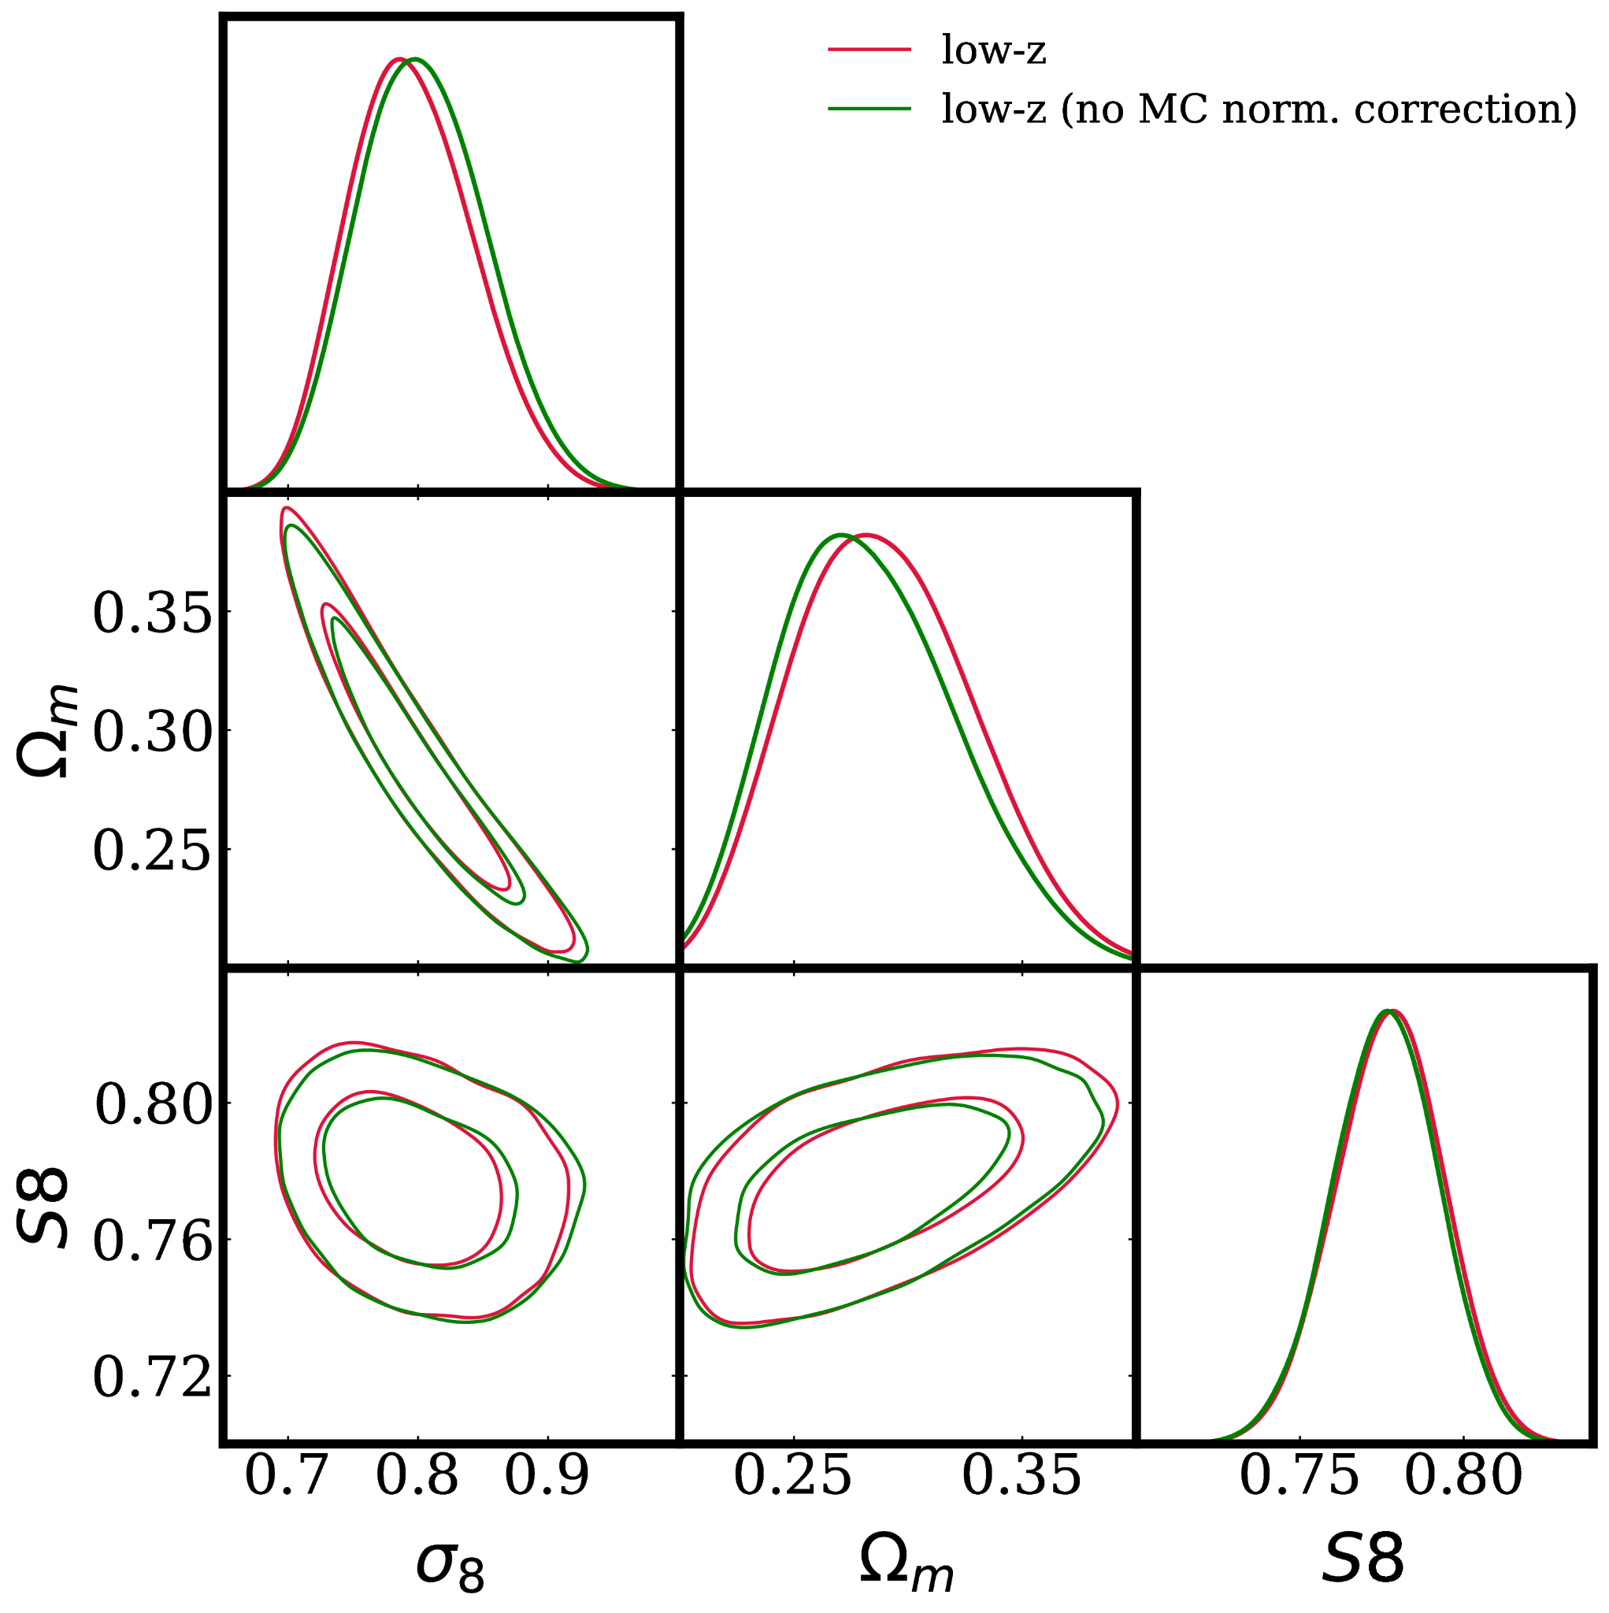
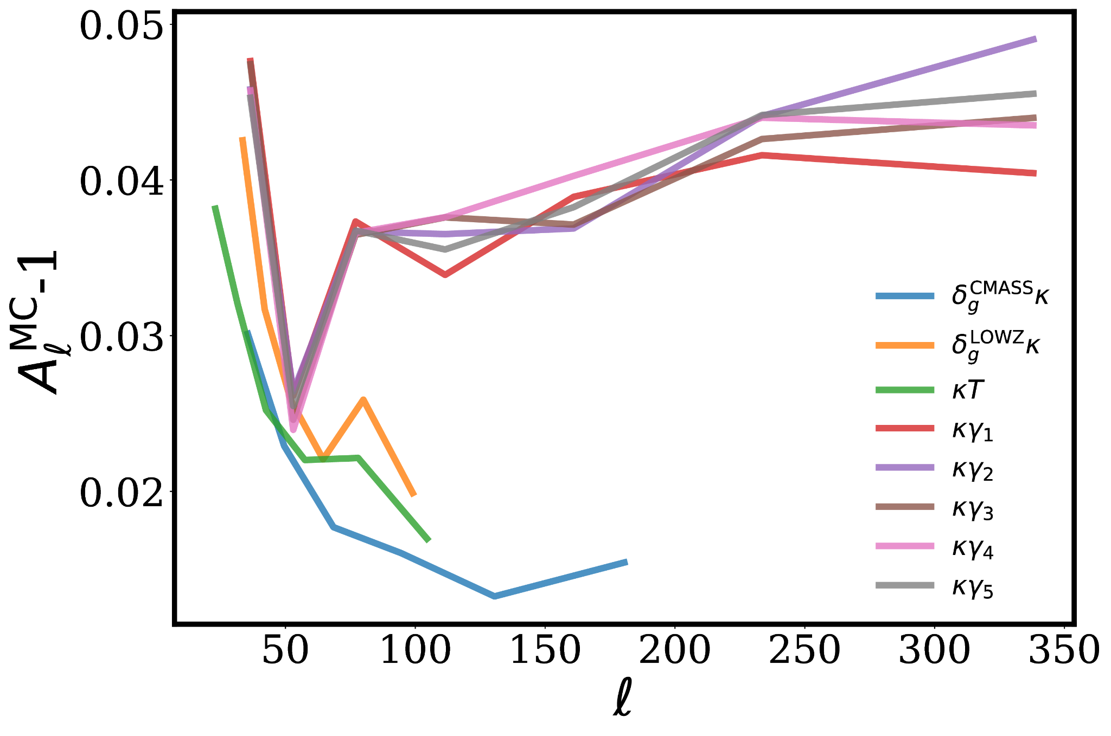
MC norm correction

Slide 35
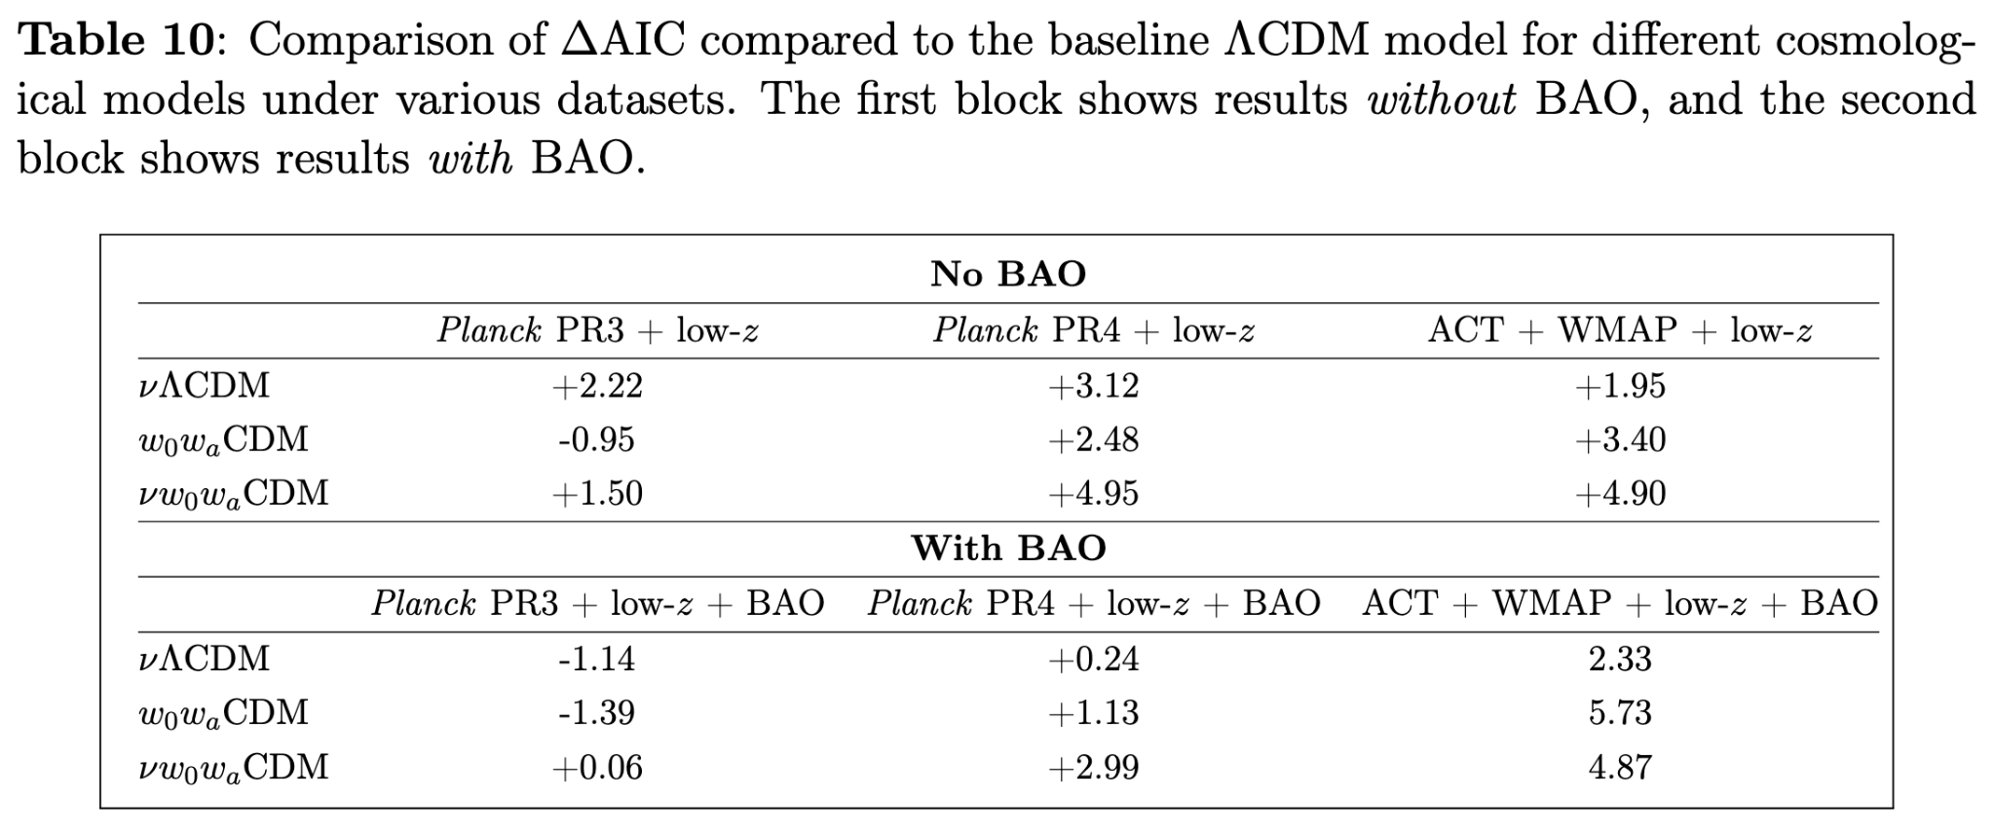
Model selection

Slide 36
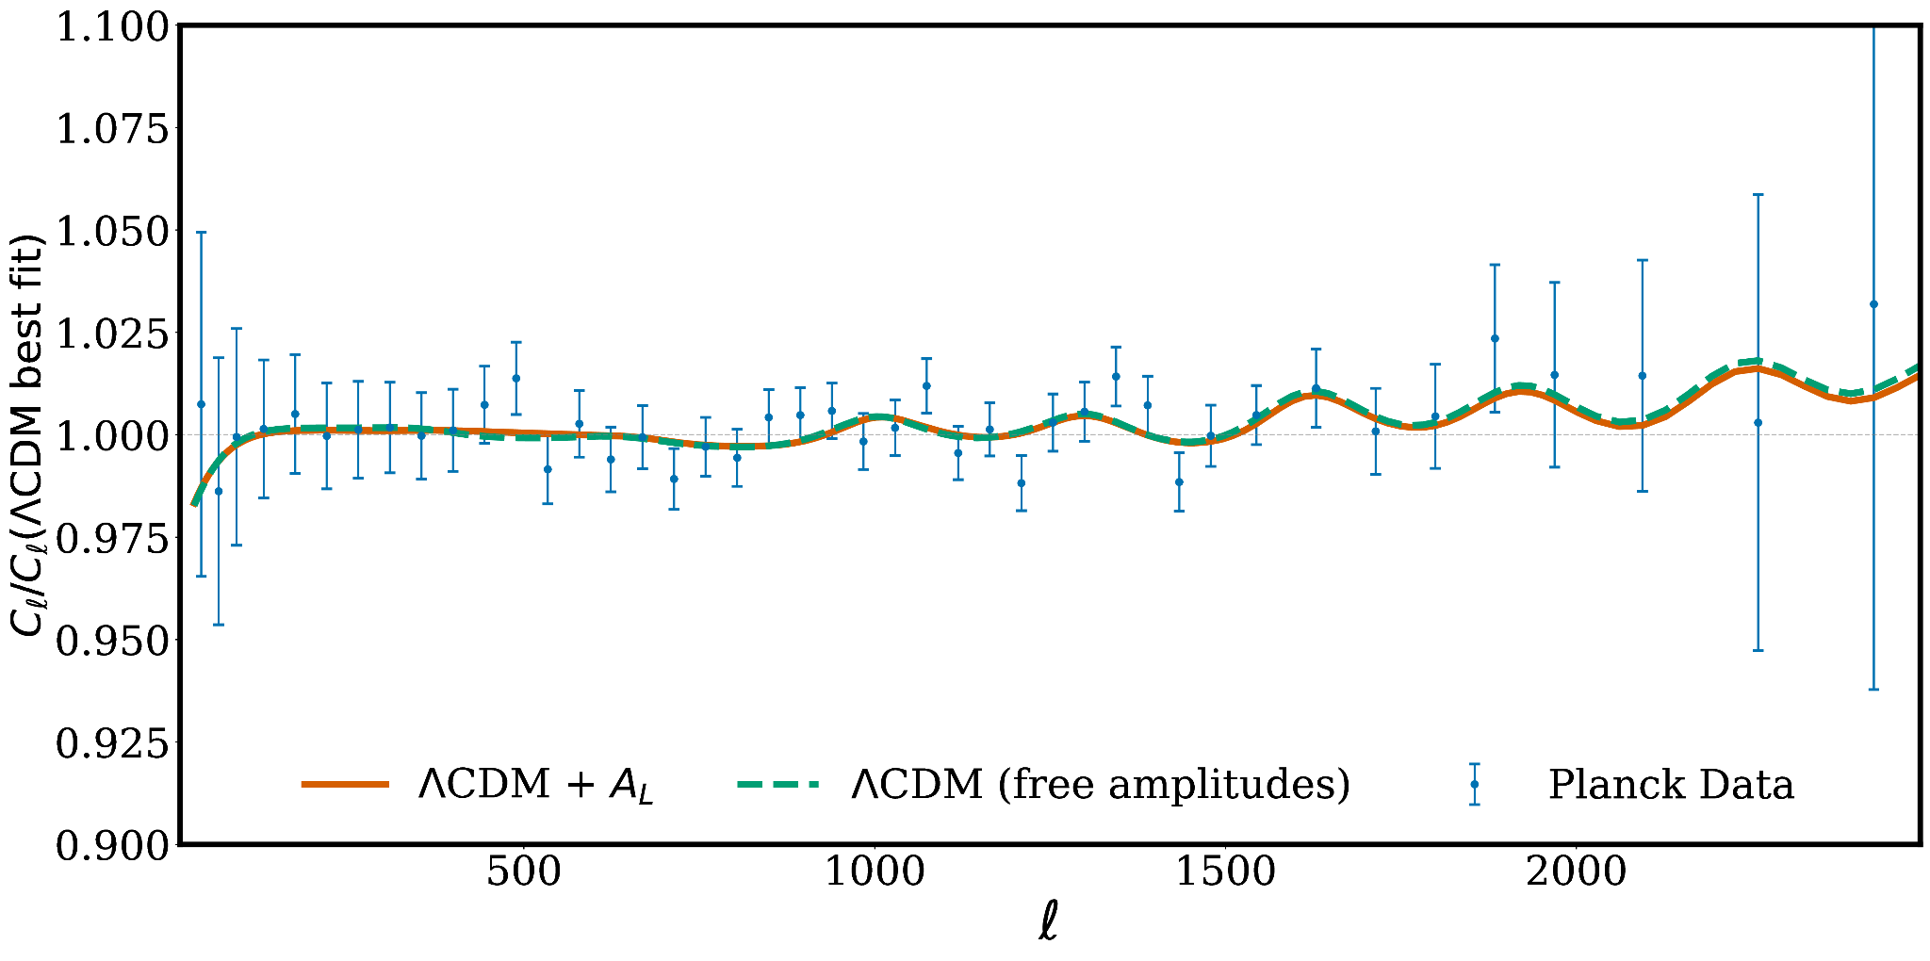
A-lens parameter
Having m_{i}<0 allows for a higher amplitude of clustering which fits the same “excess lensing” residual in PR3
Choose PR4 + low-z as baseline data combination
Reeves et al. (2025)

Slide 37
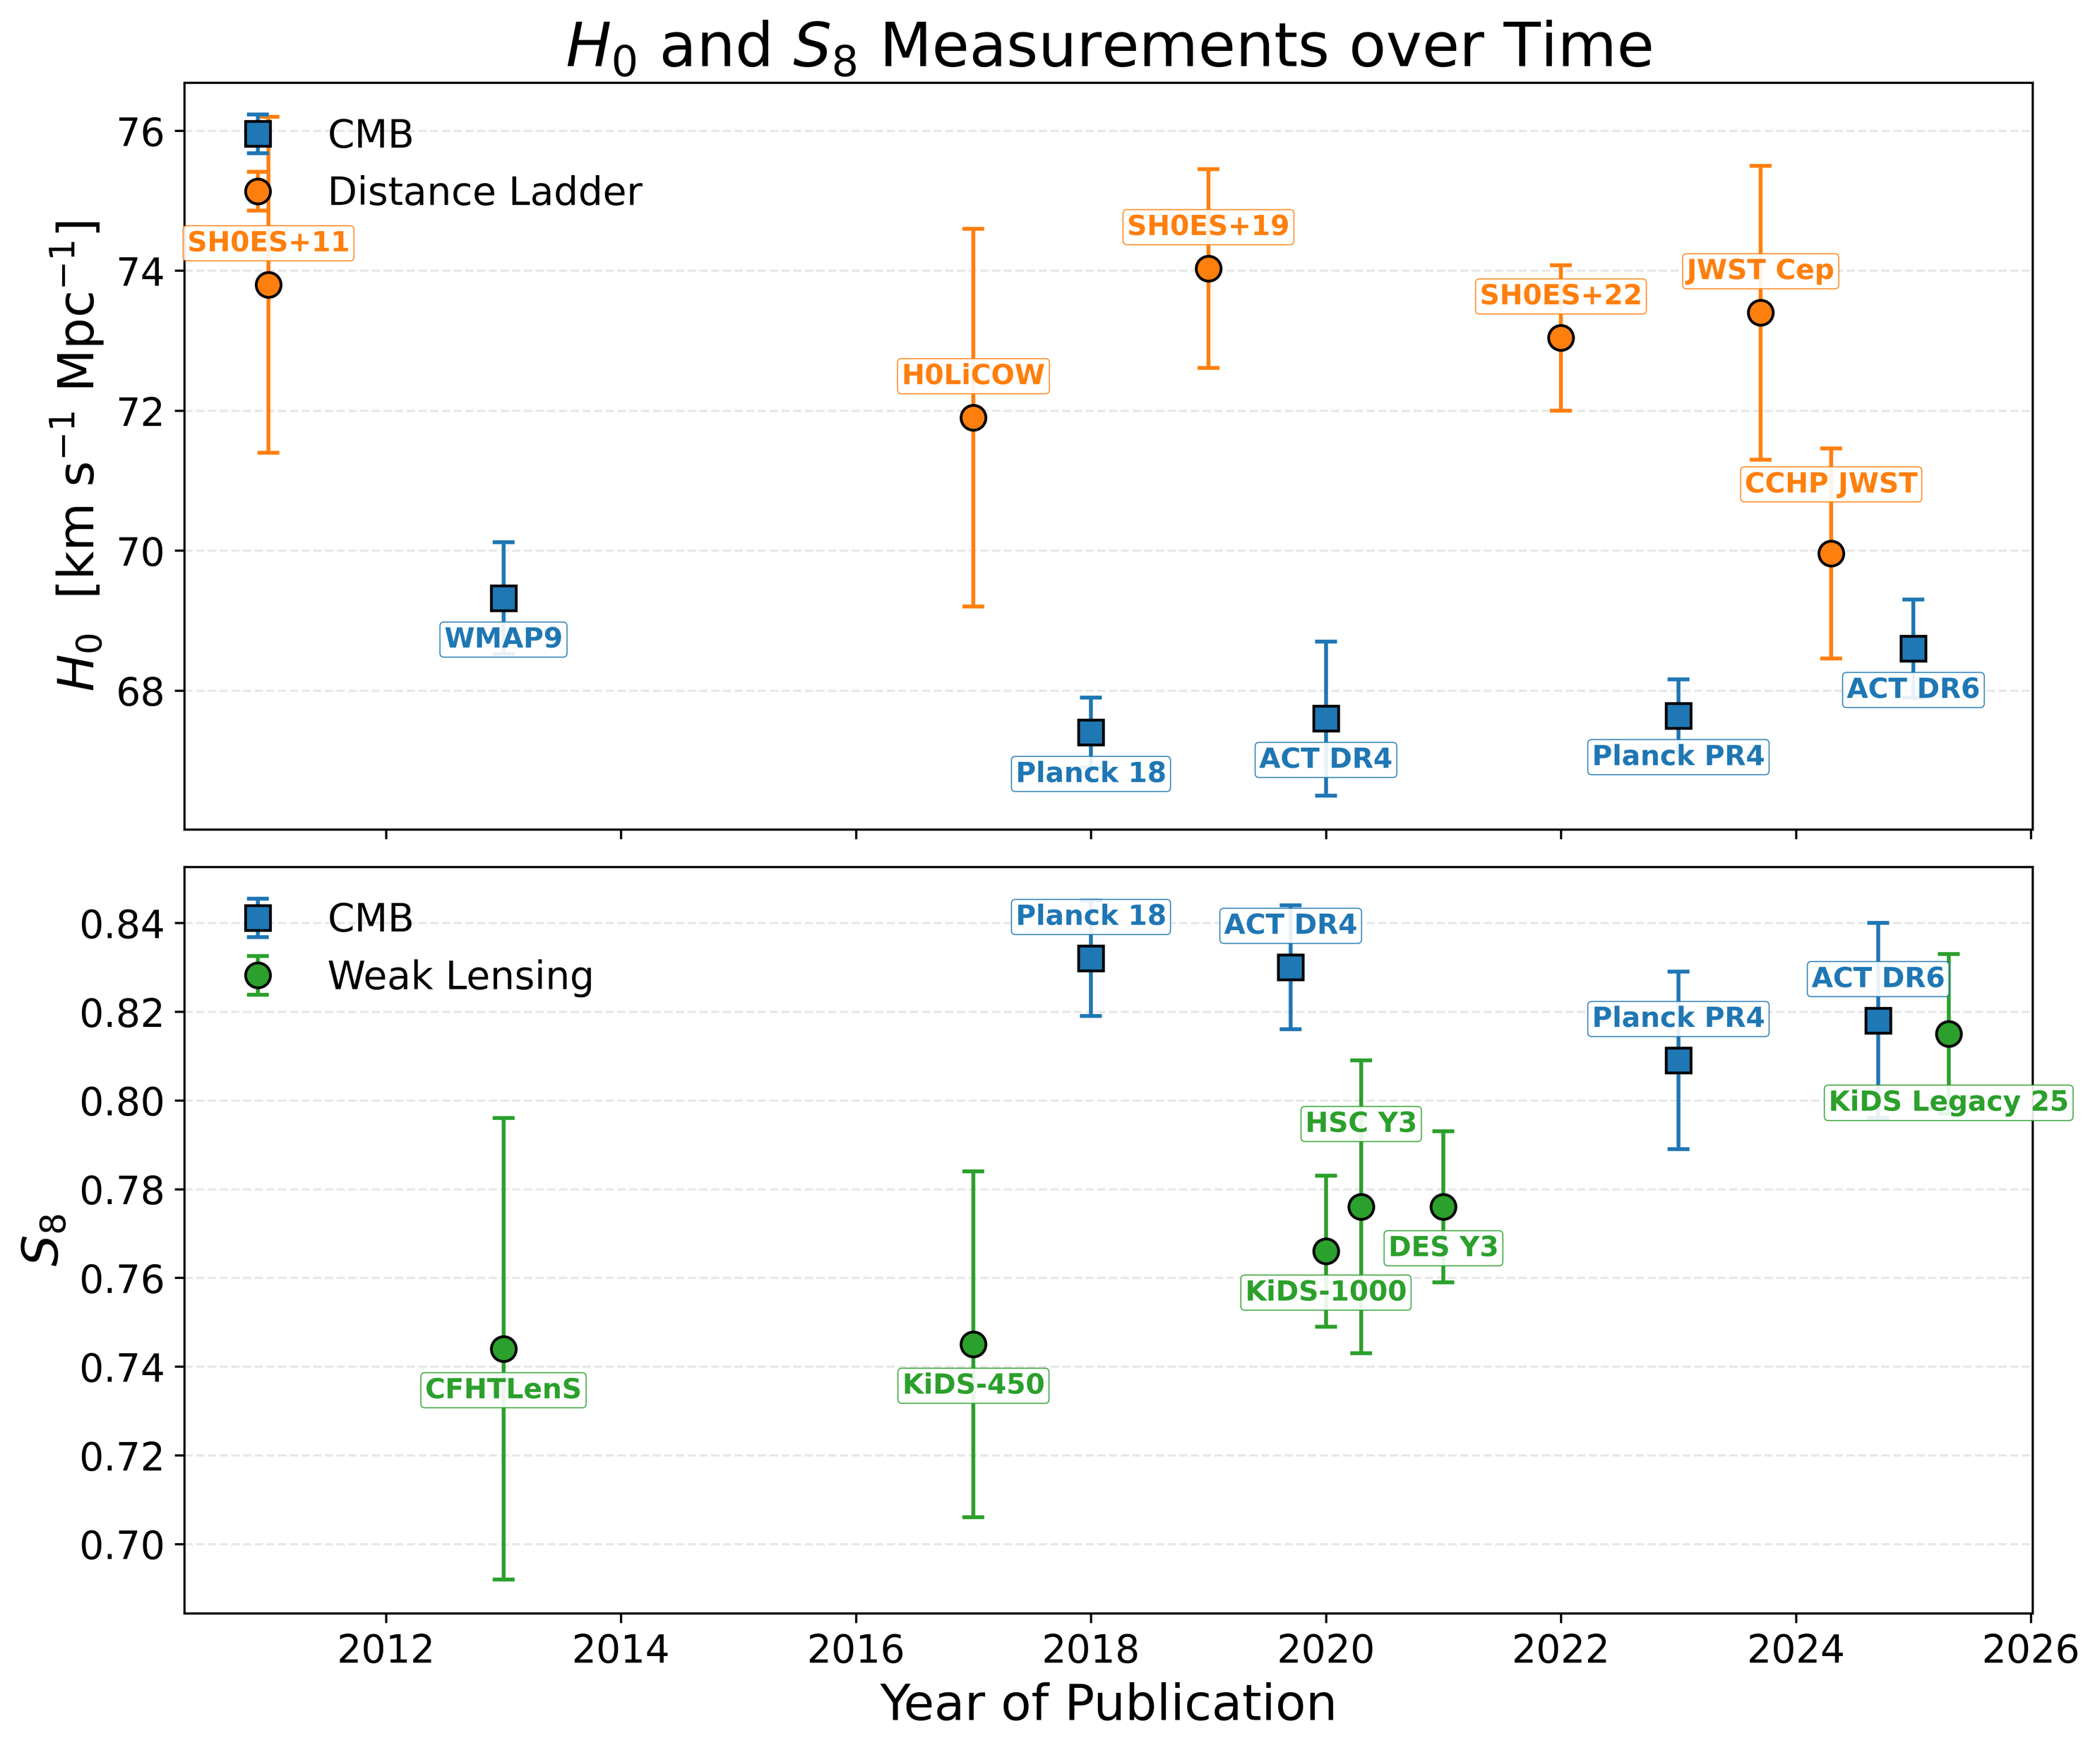
Combined probes: key challenges
Large data vectors/covariance matrix
Different systematics and noise modelling for each probe with many associated parameters
Tensions between datasets: how justified are we in combining data?

Slide 38
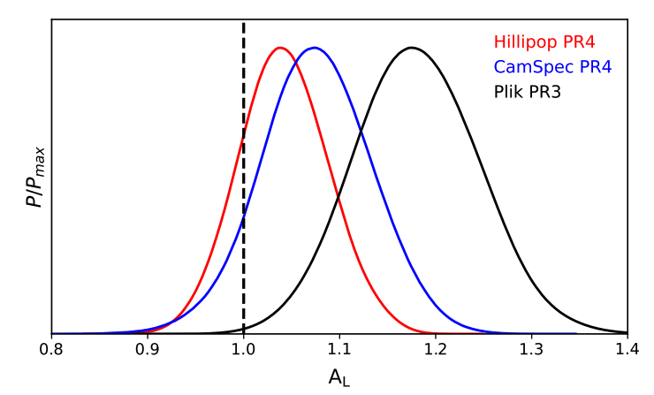
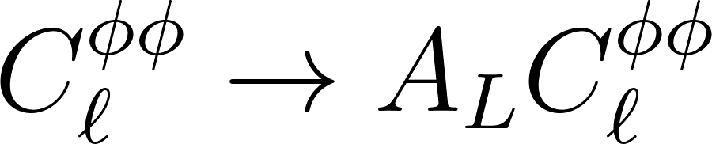
A-lens parameter
A_{L} is a phenomenological re-scaling parameter whereby (Calabrese et al. 2008):
(only for the impact of lensing on CMB primary!)
Measures consistency between CMB lensing information in the CMB primary and amplitude of CMB primary: expect A_{L}=1 in ΛCDM
CMB likelihoods:
  Planck PR3 gives A_{L}>1 at 3σ
  PR4 favours A_{L}>1 at 0.75σ
  ACT+WMAP has no preference for A_{L}>1
Tristram et al. 2023

