Slide 1
Investigating Self-Interacting Dark Matter using Interpretable Machine Learning
Swiss Cosmology Day
5/6/2025
Making machine learning trustworthy with interpretable outputs
Ethan Tregidga, David Harvey, Luca Biggio, Felix Vecchi

Slide 2
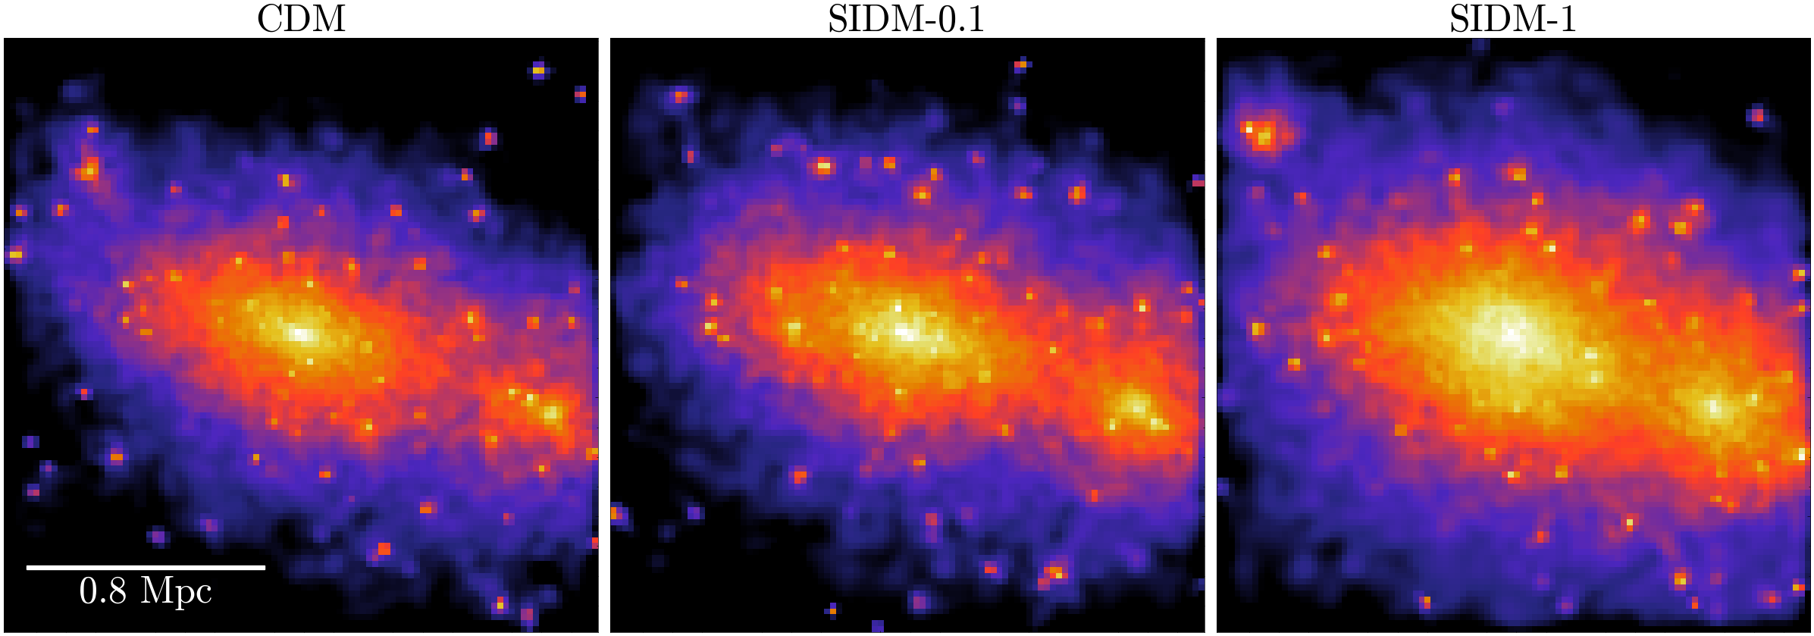
Effect of Self-Interacting Dark Matter

Slide 3
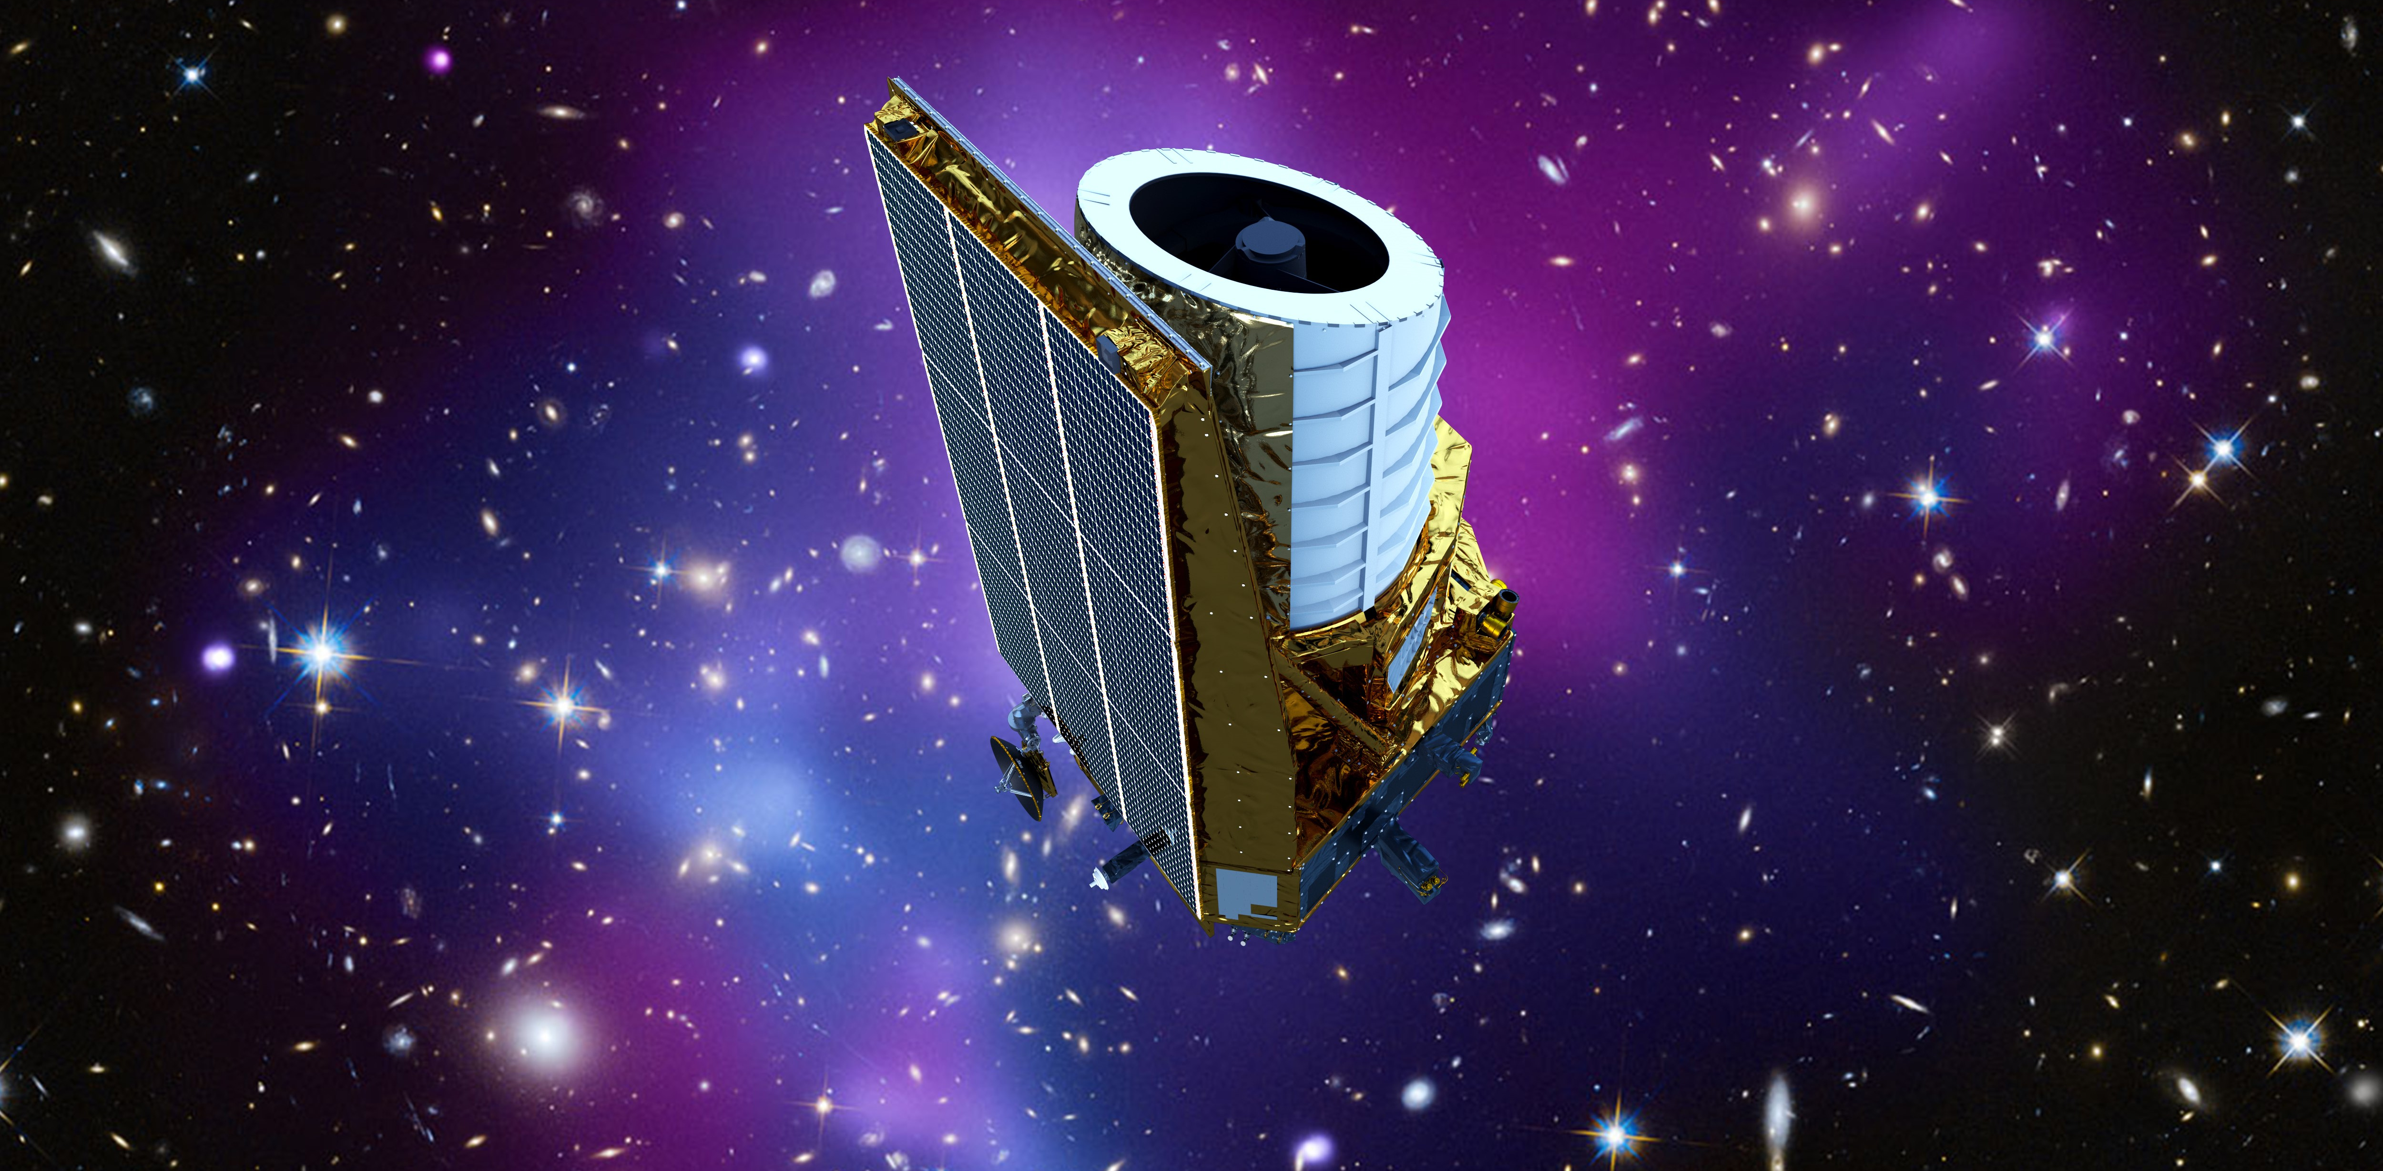
Era of Big Data
Keith Cooper, space.com

Slide 4
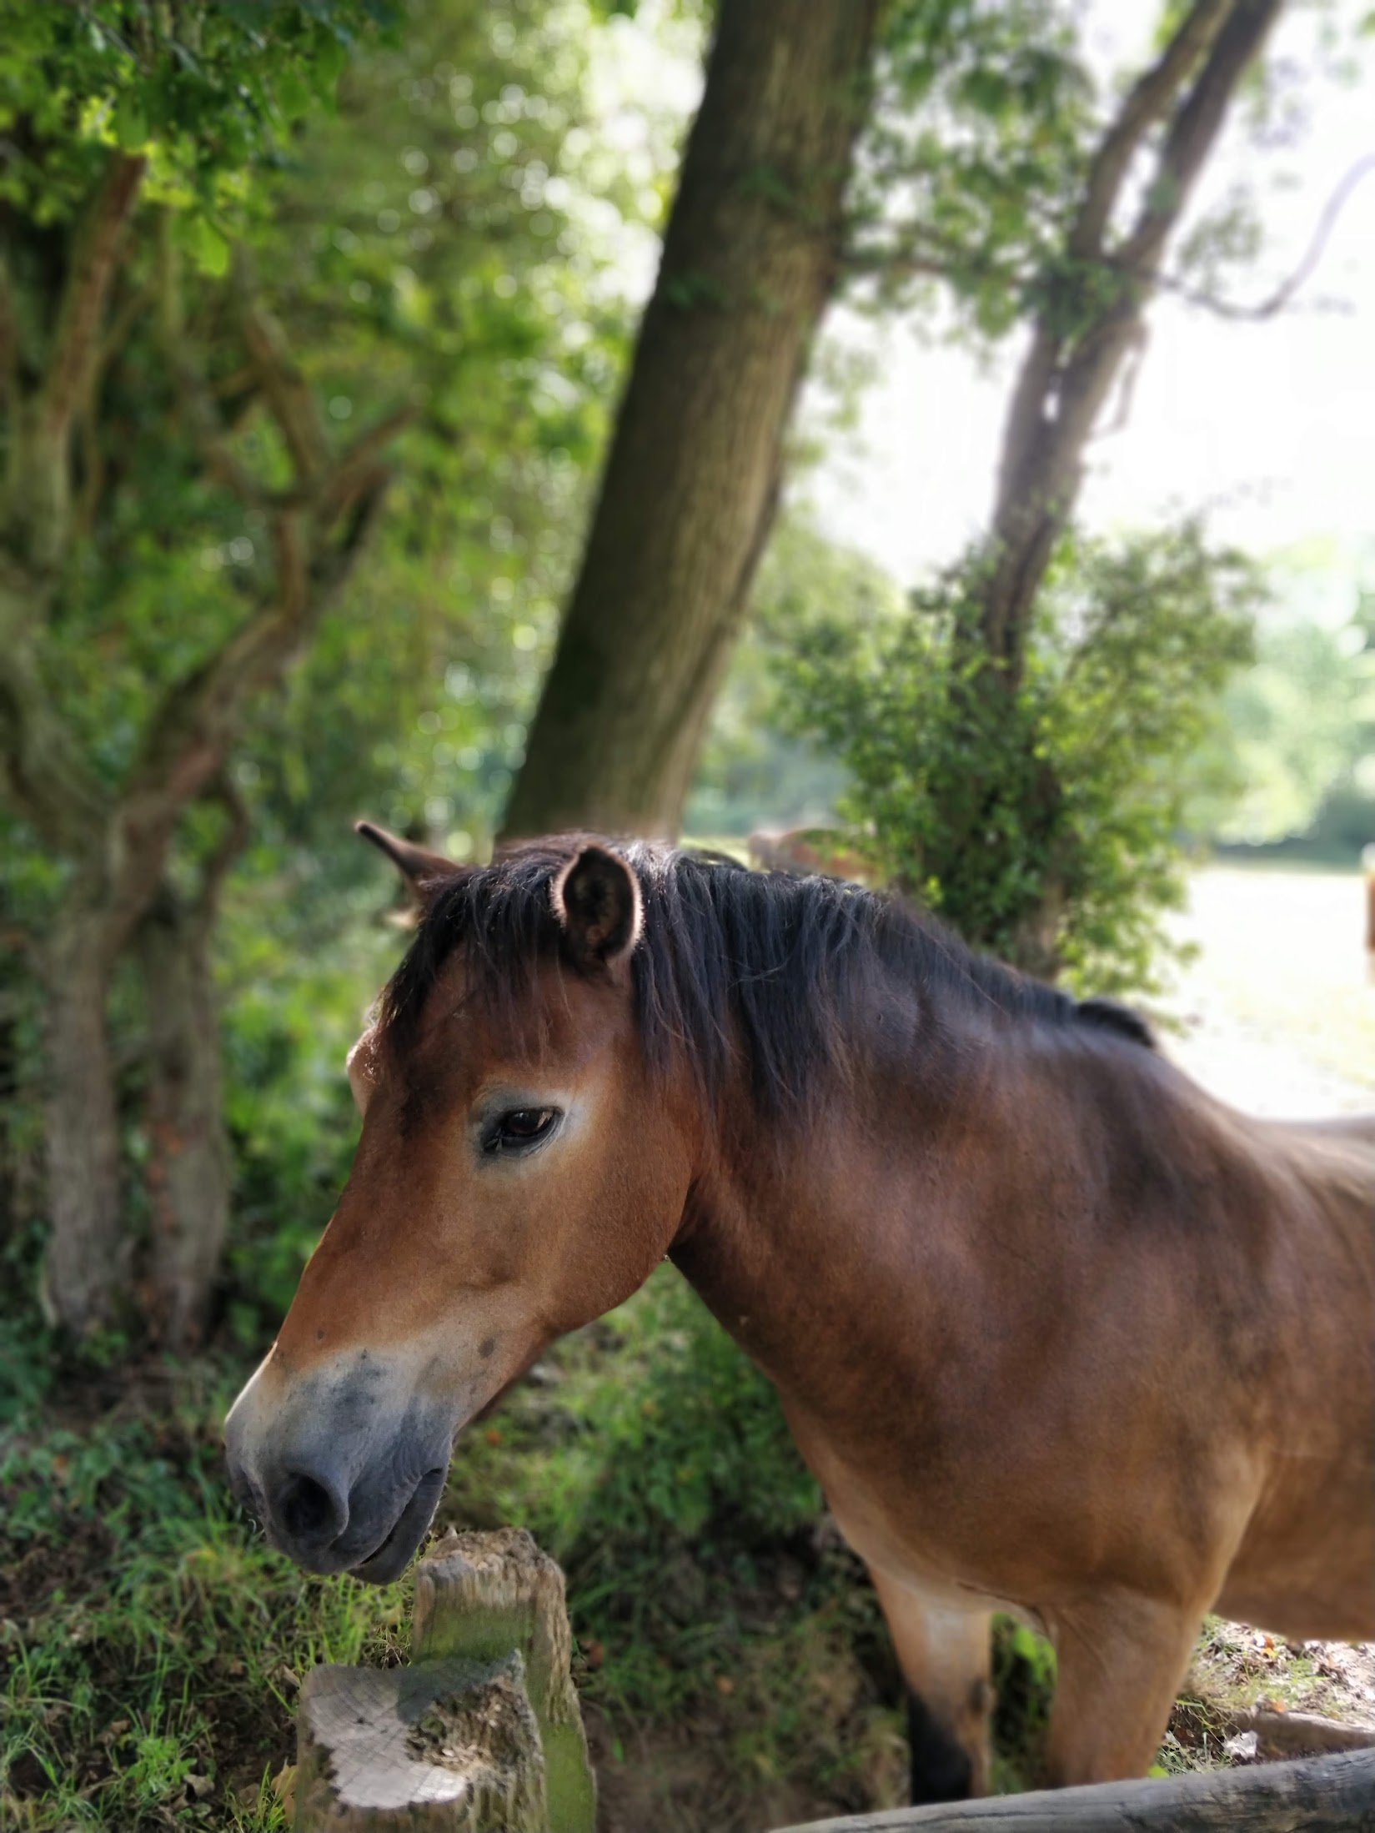
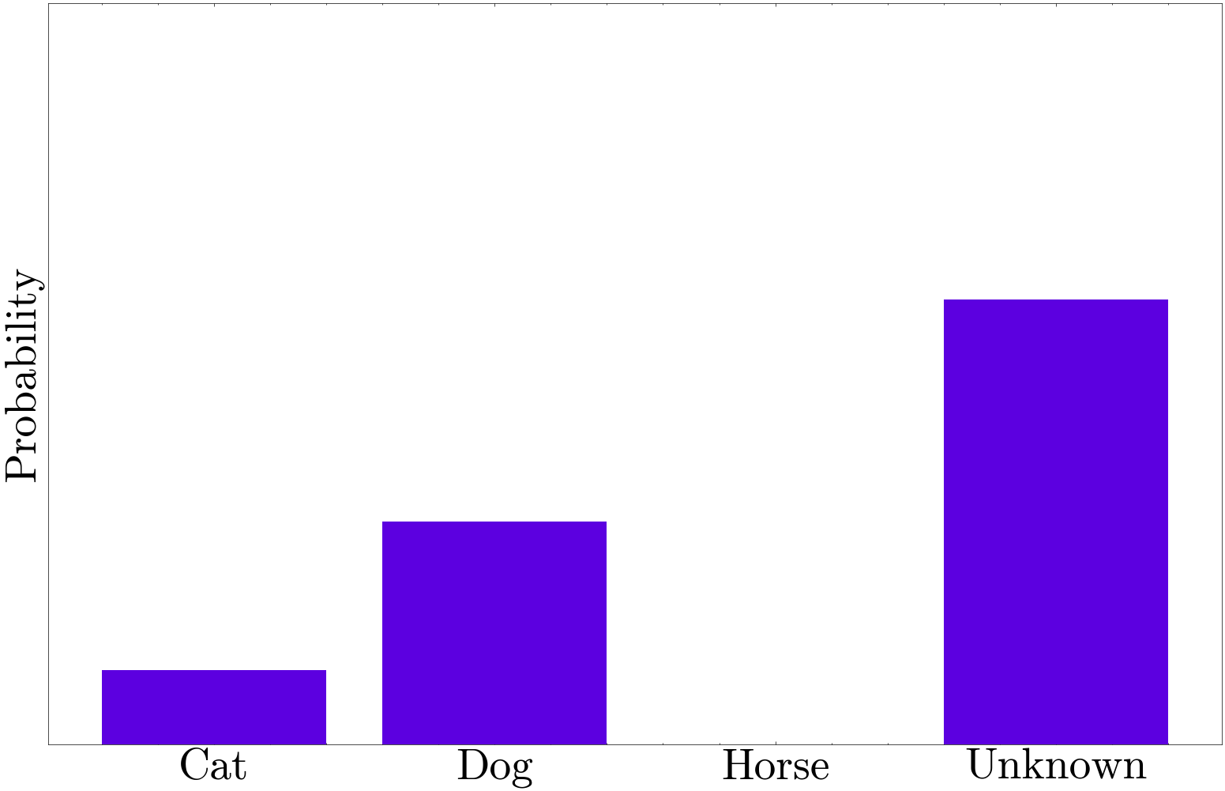
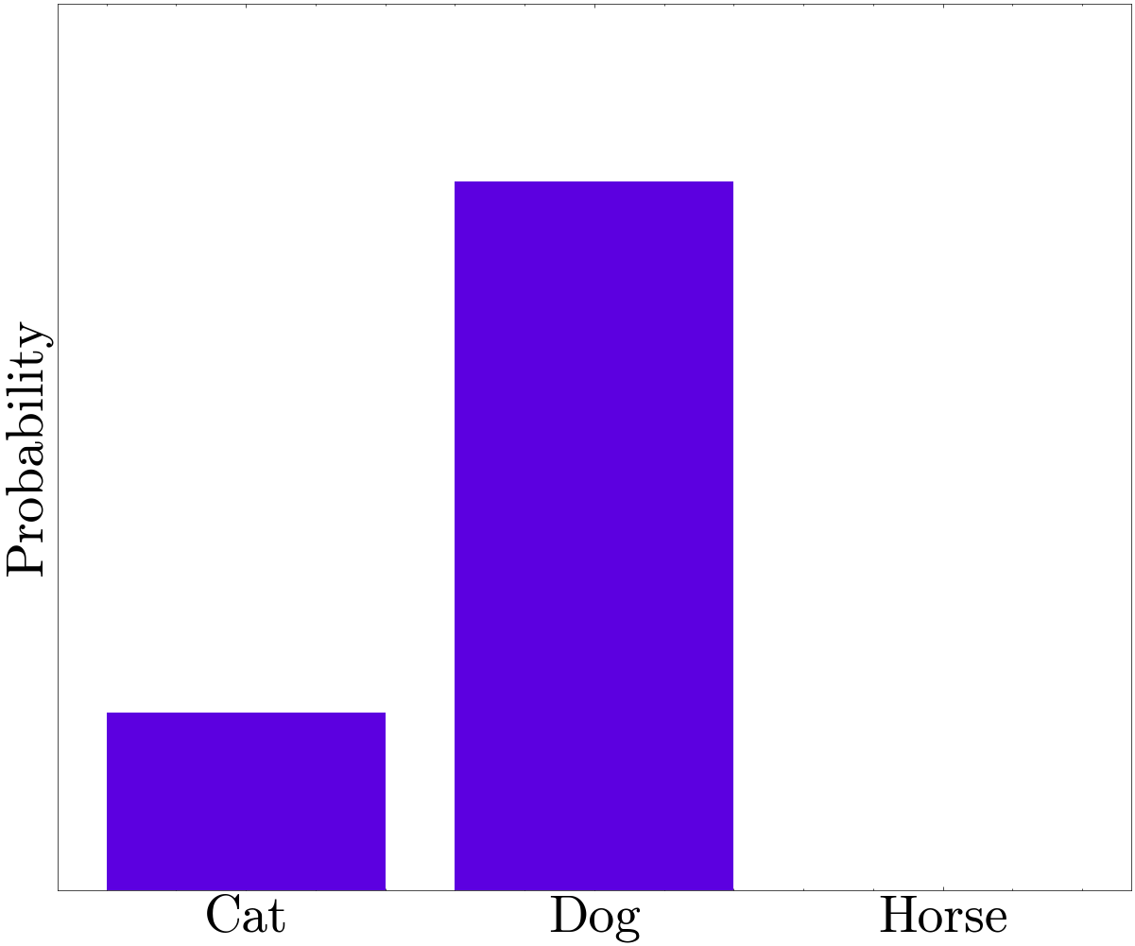
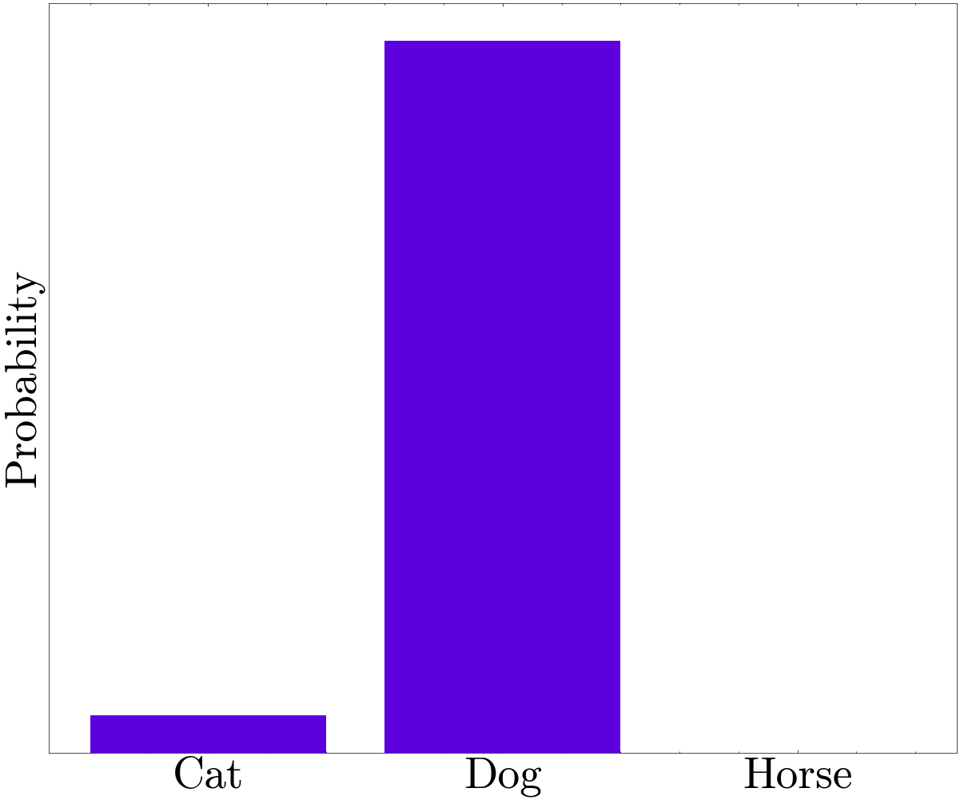
Confidently Wrong
I Don’t Know
Classifier

Slide 5
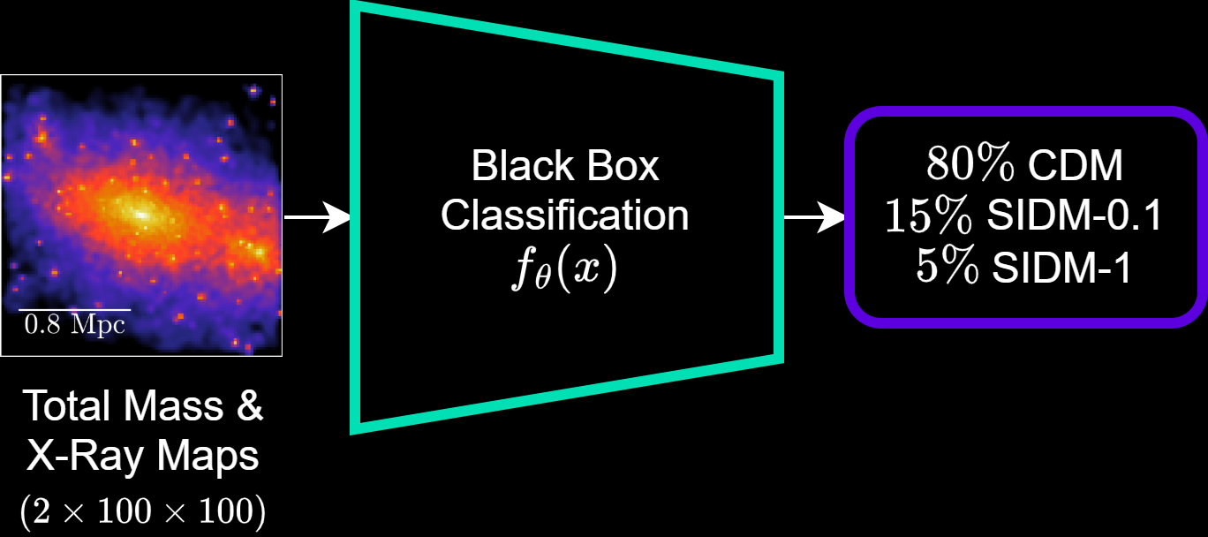
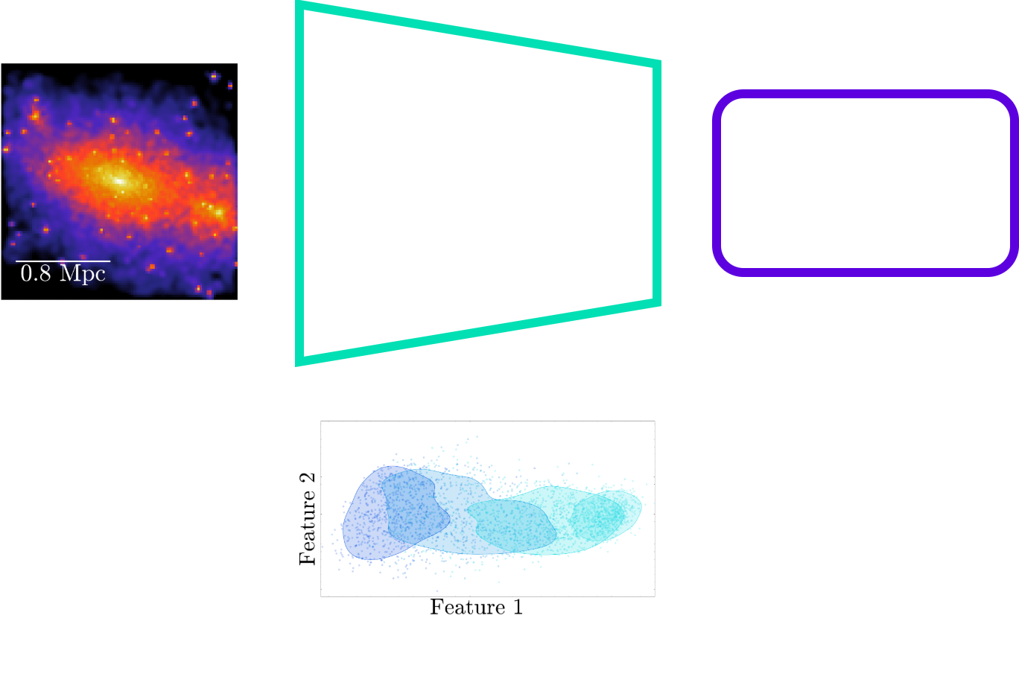
Creating an Interpretable Latent Space

Slide 6
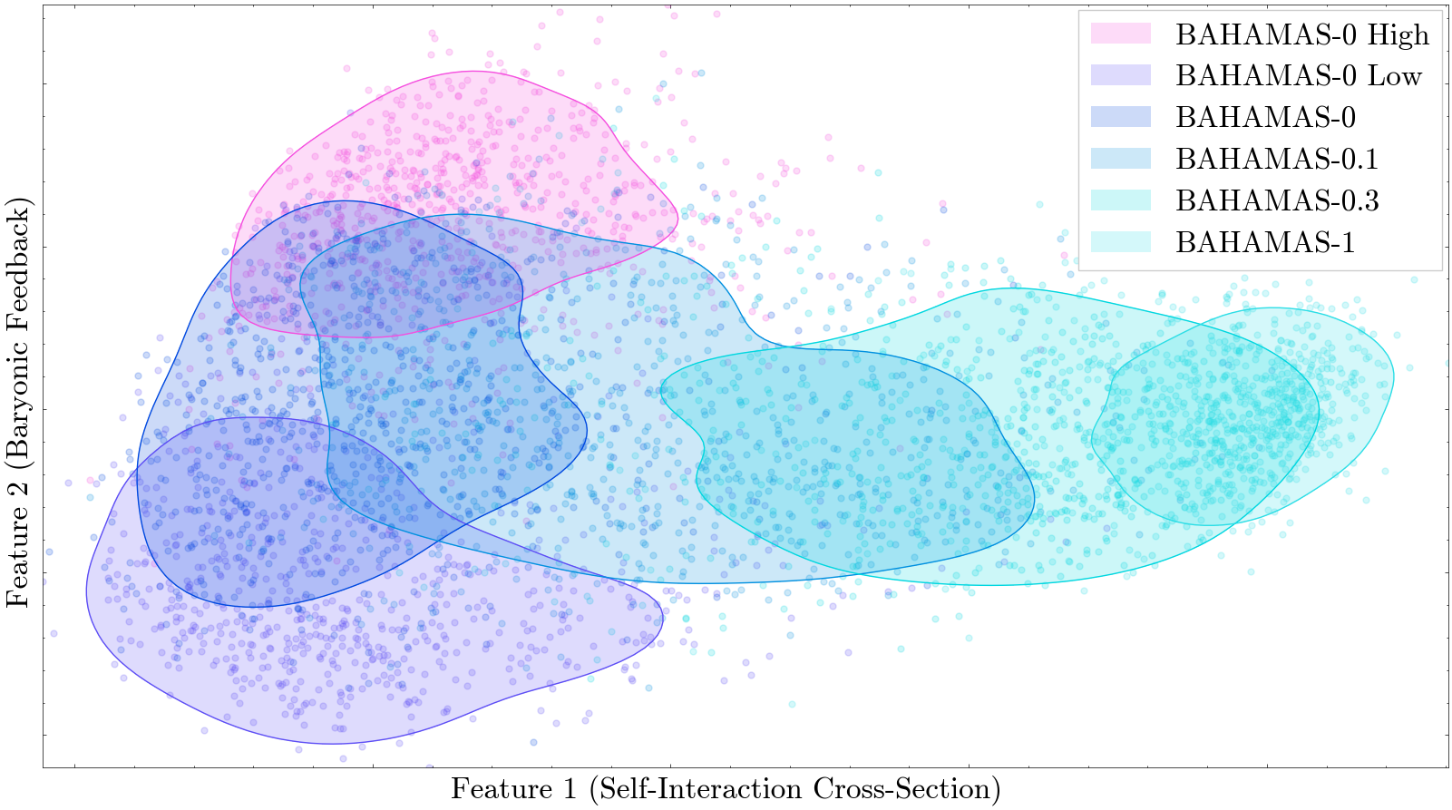
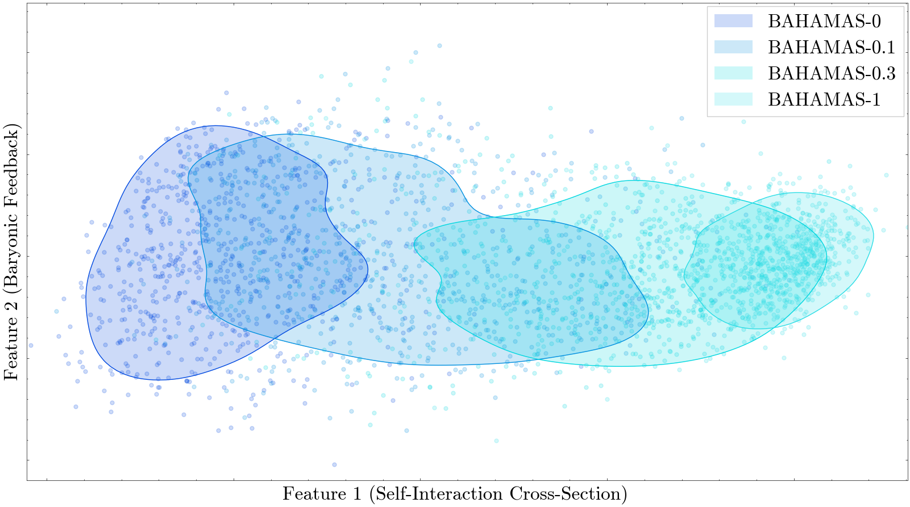
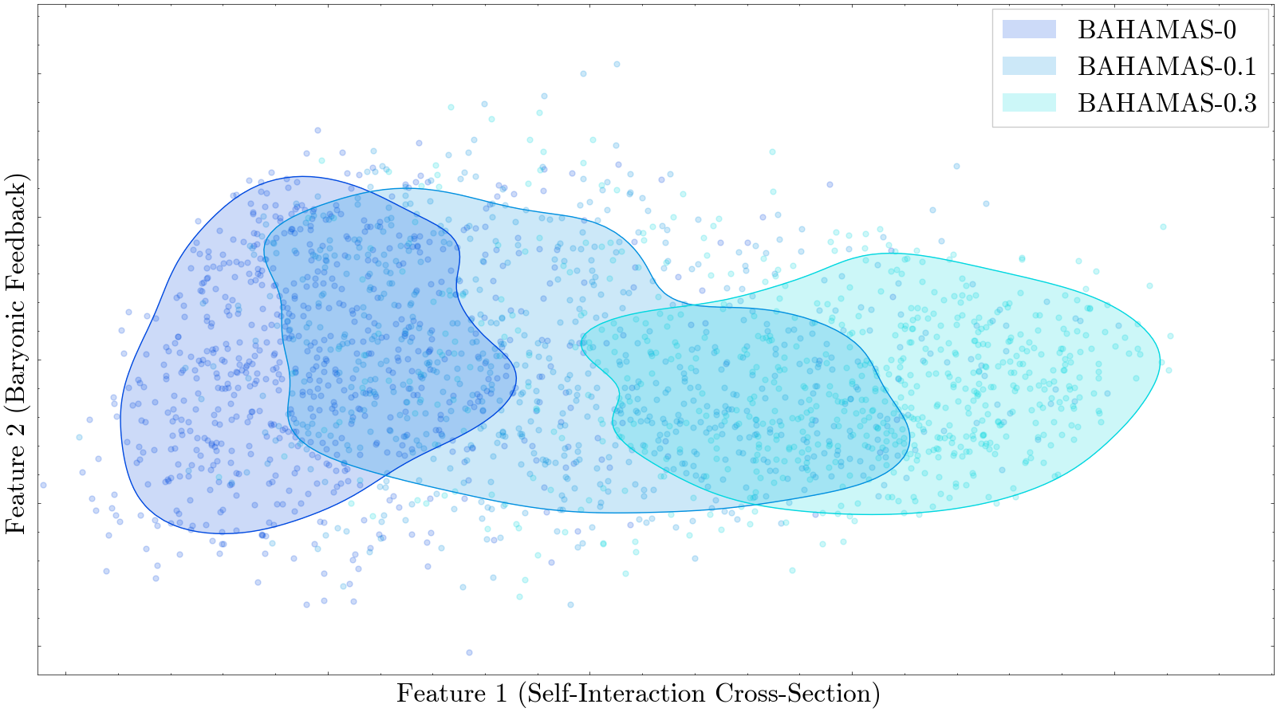
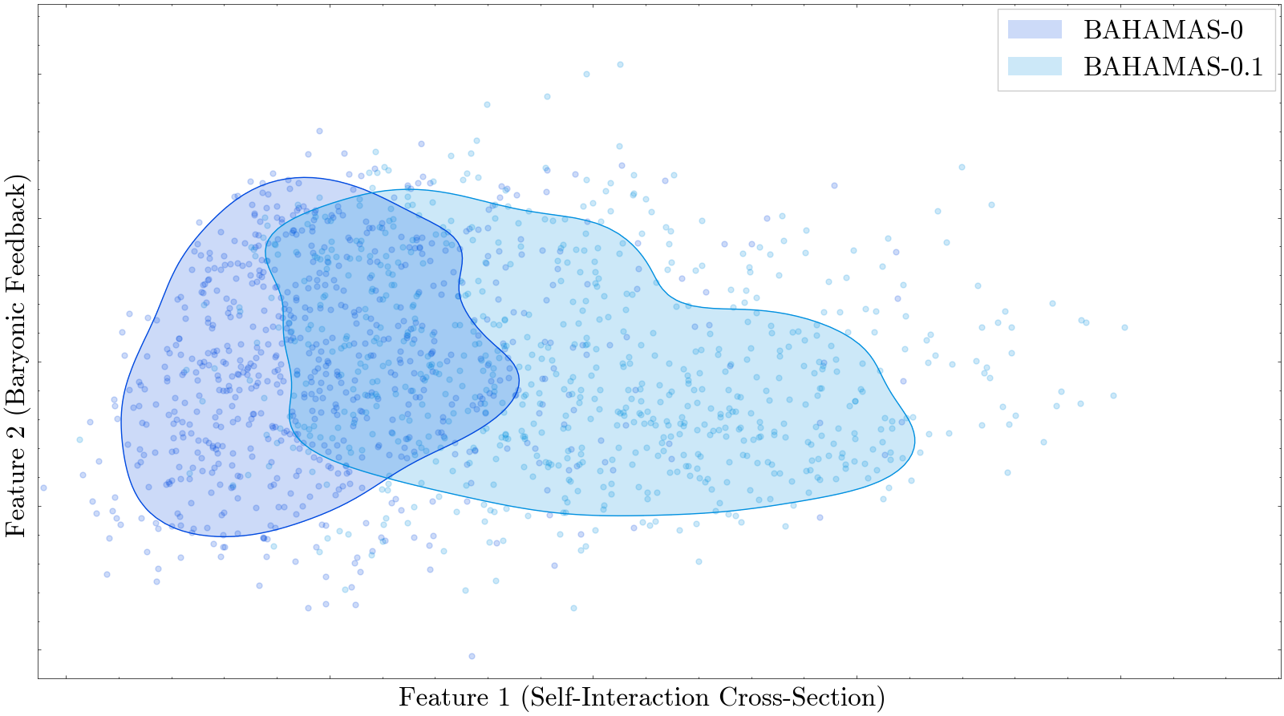
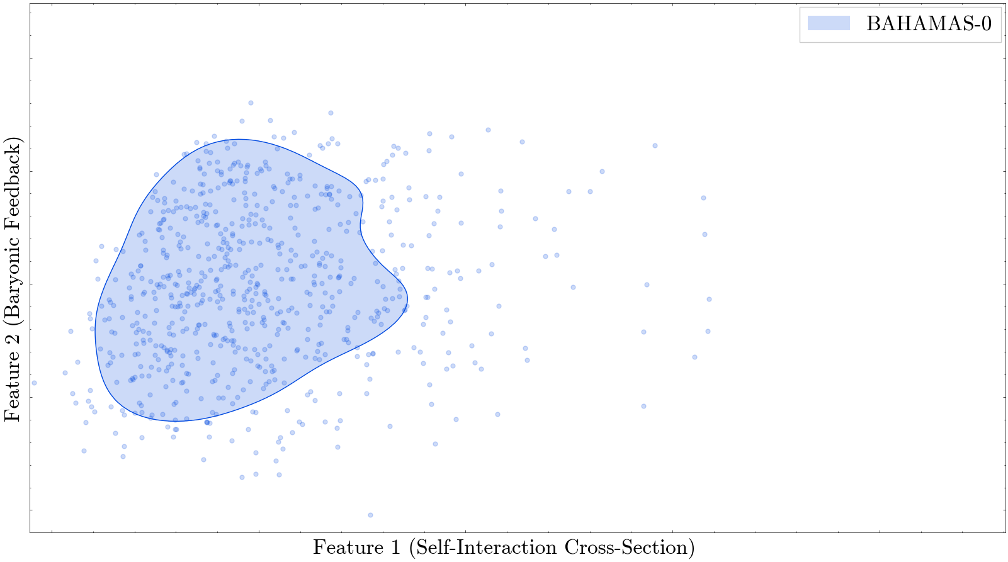
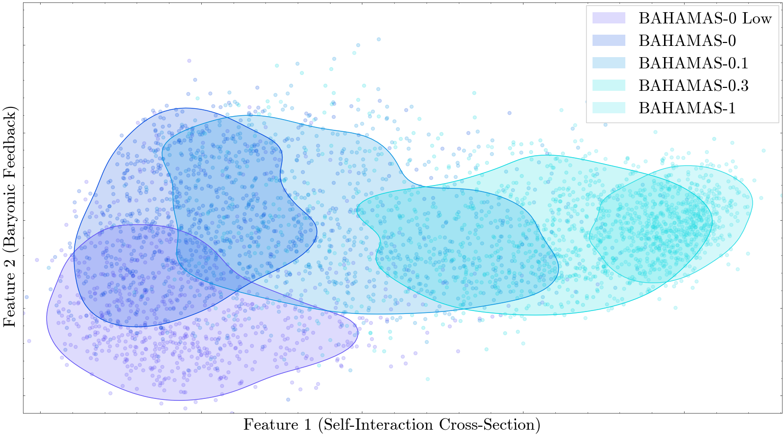
Identification of Unknown Physical Properties

Slide 7
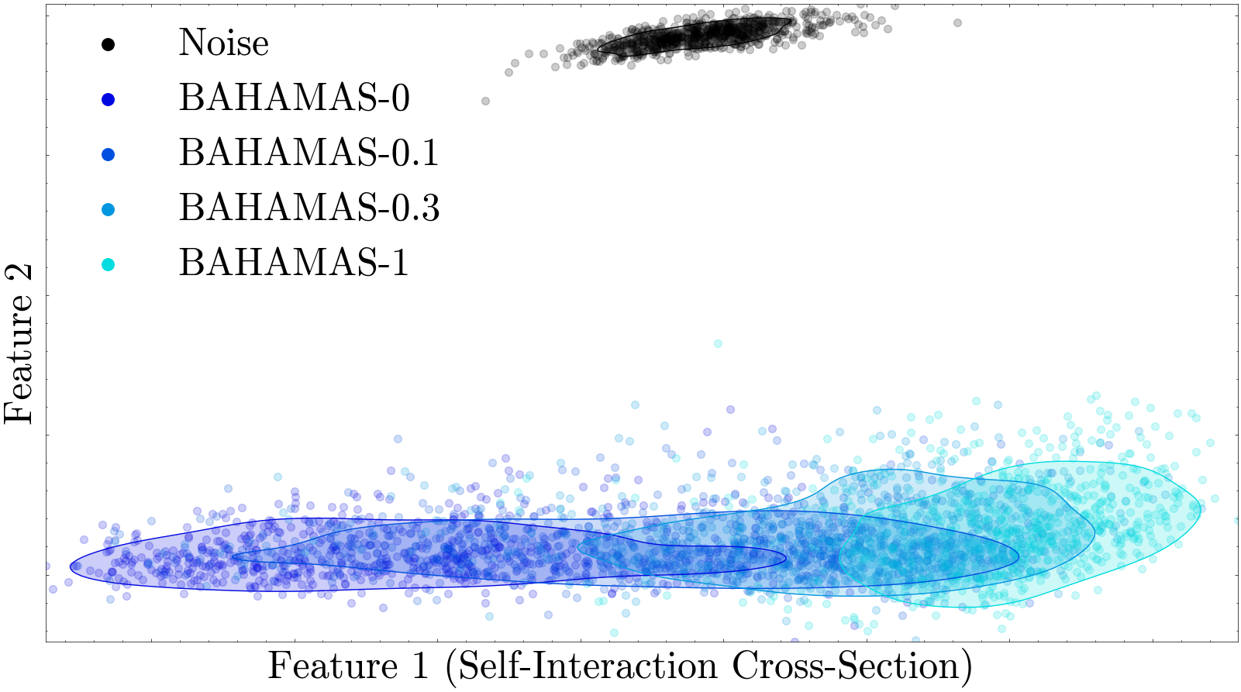
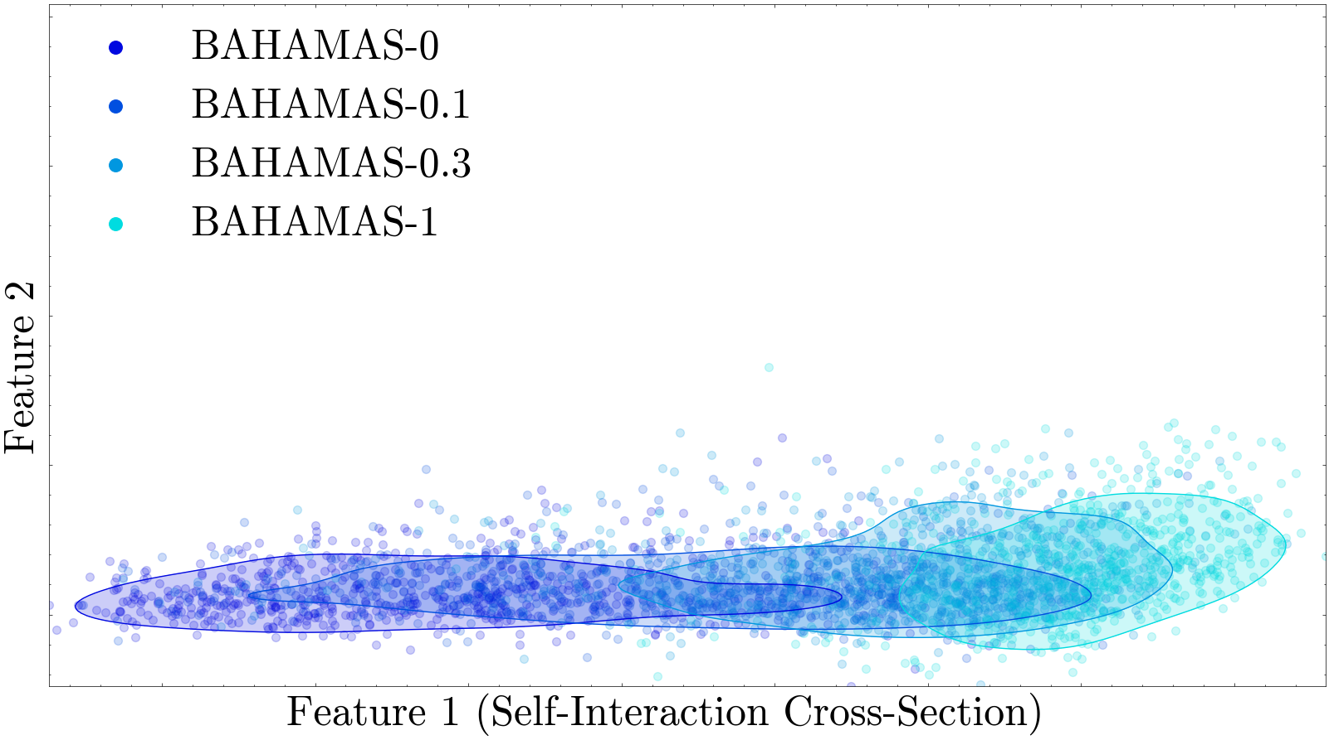
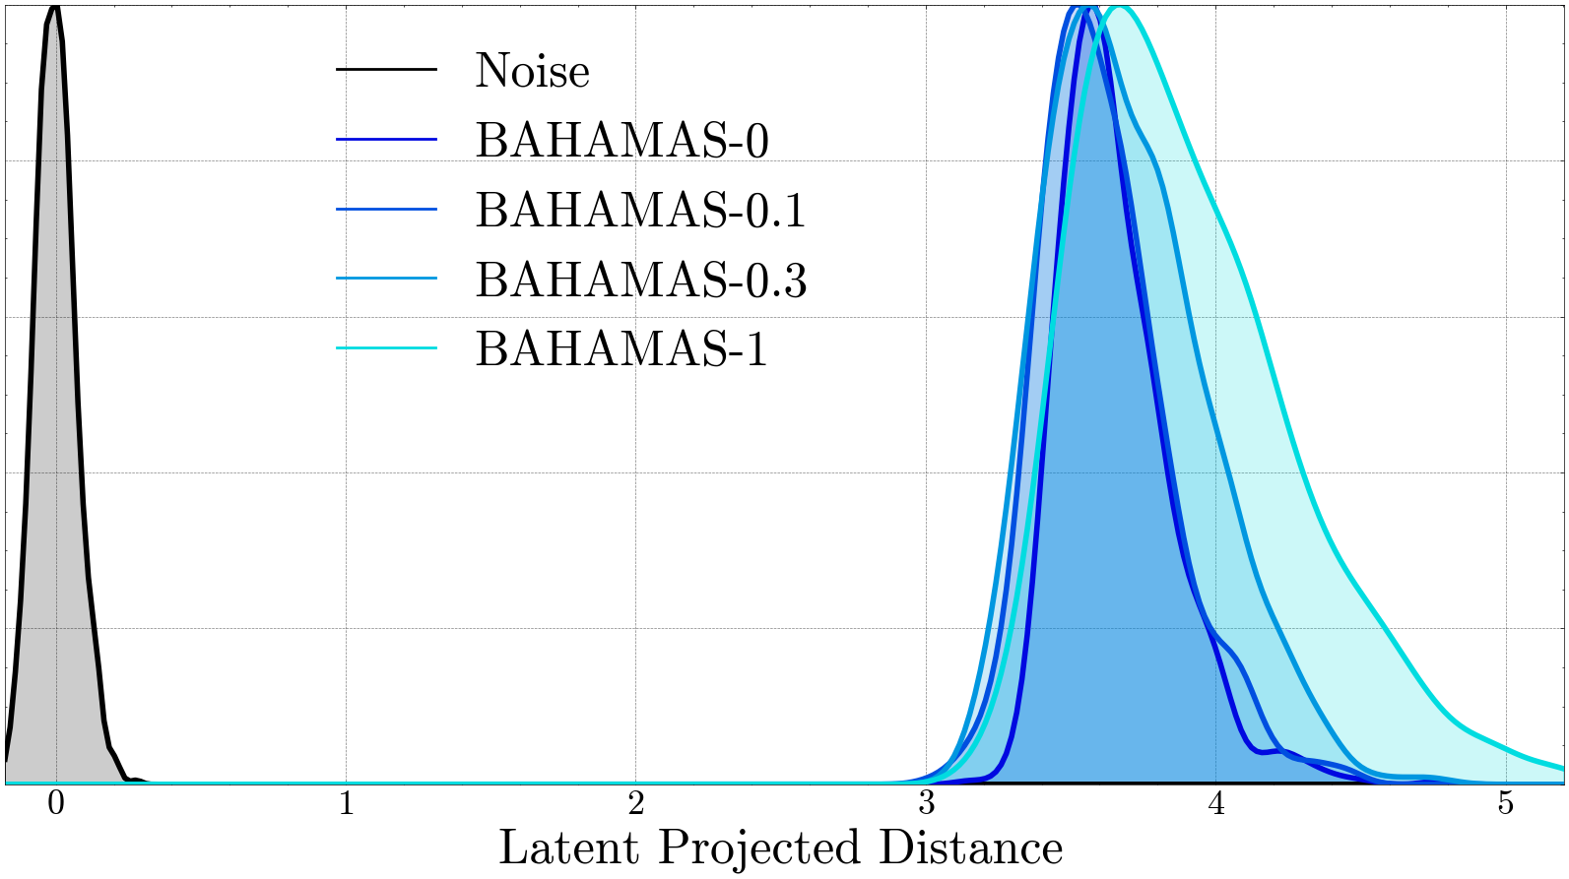
Identifying Unknowns
Foreign!

Slide 8
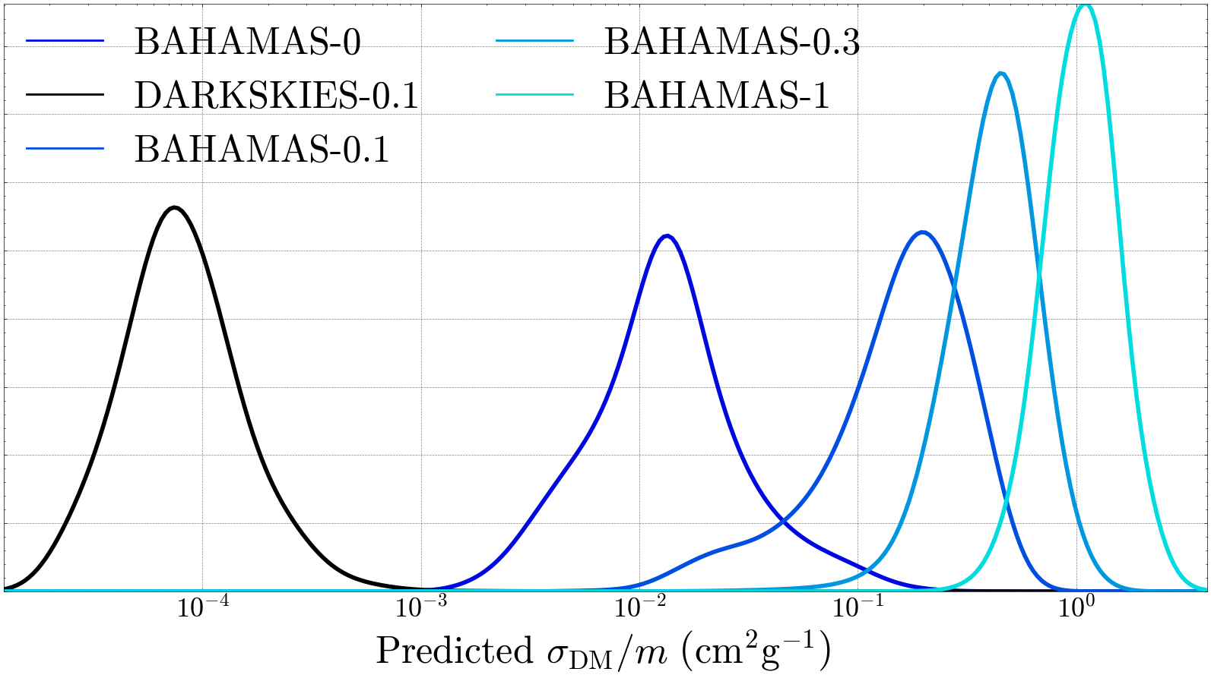
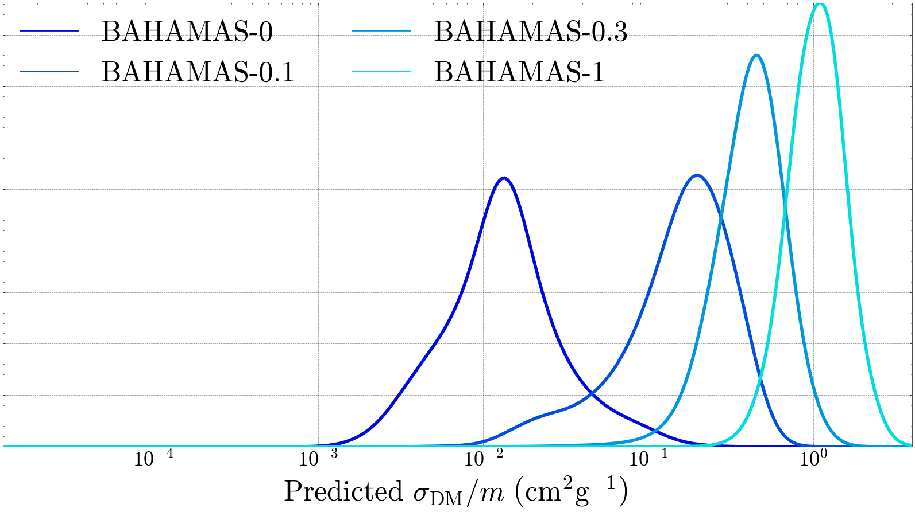
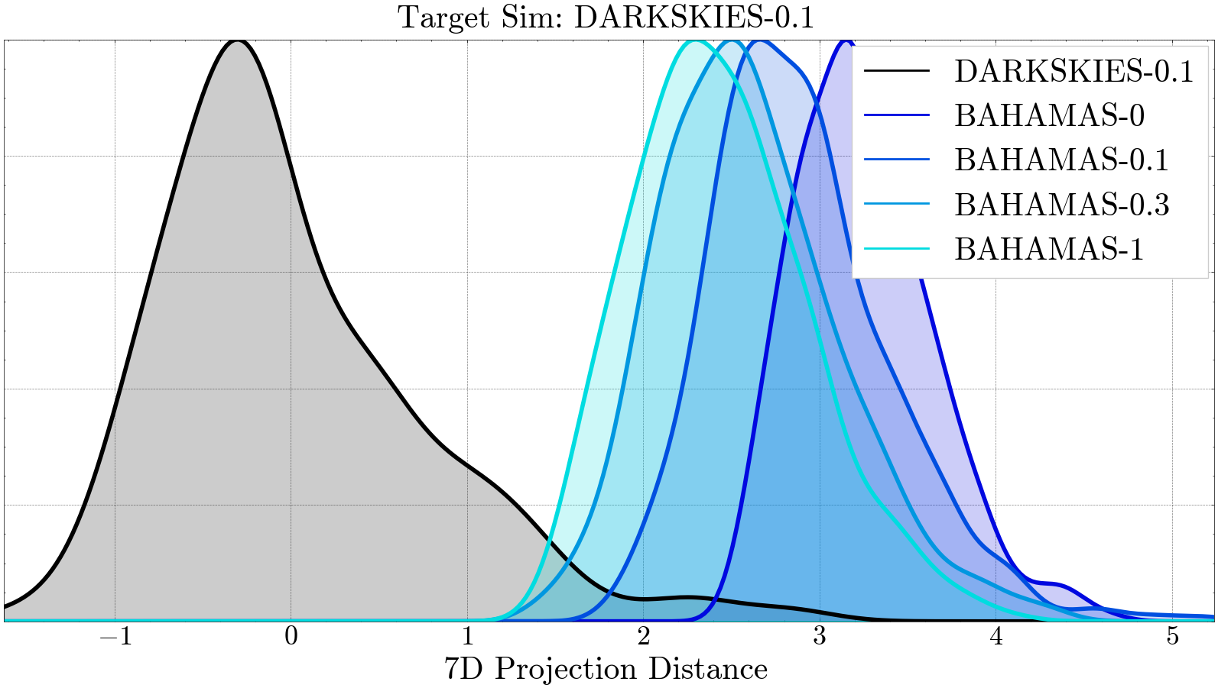
Improving Accuracy with Additional Data
Foreign!

Slide 9
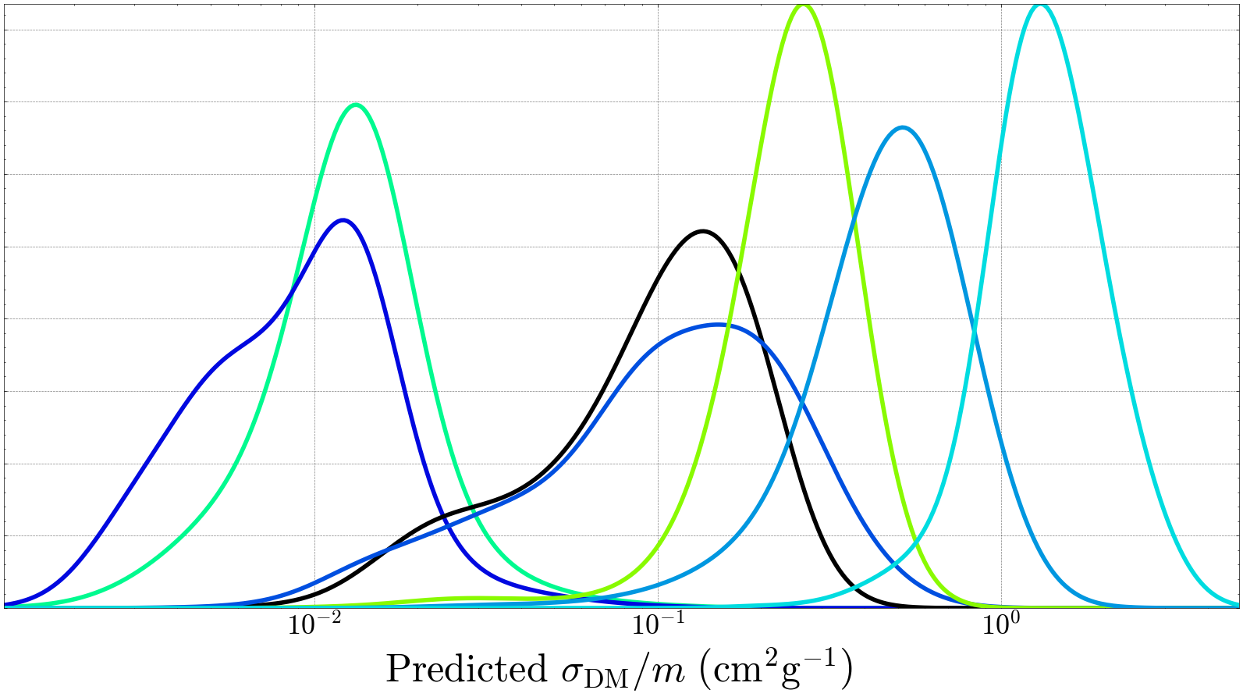
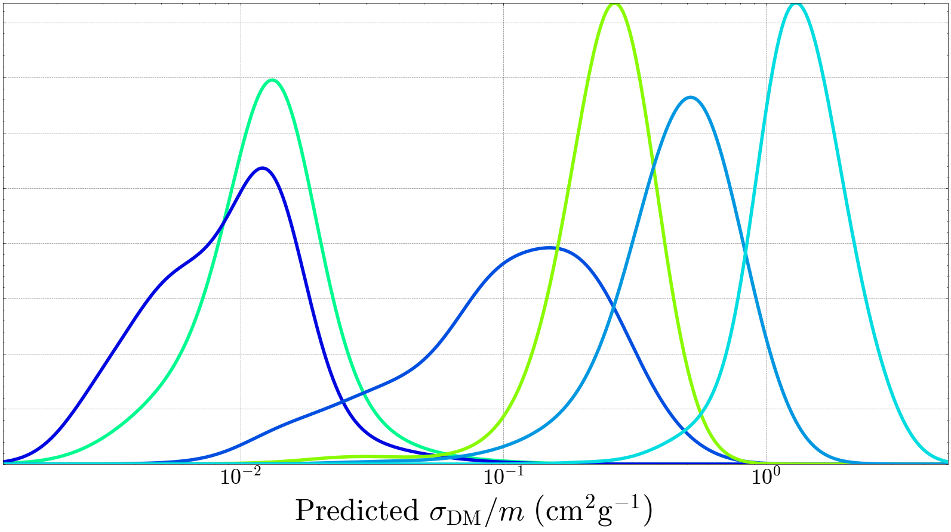
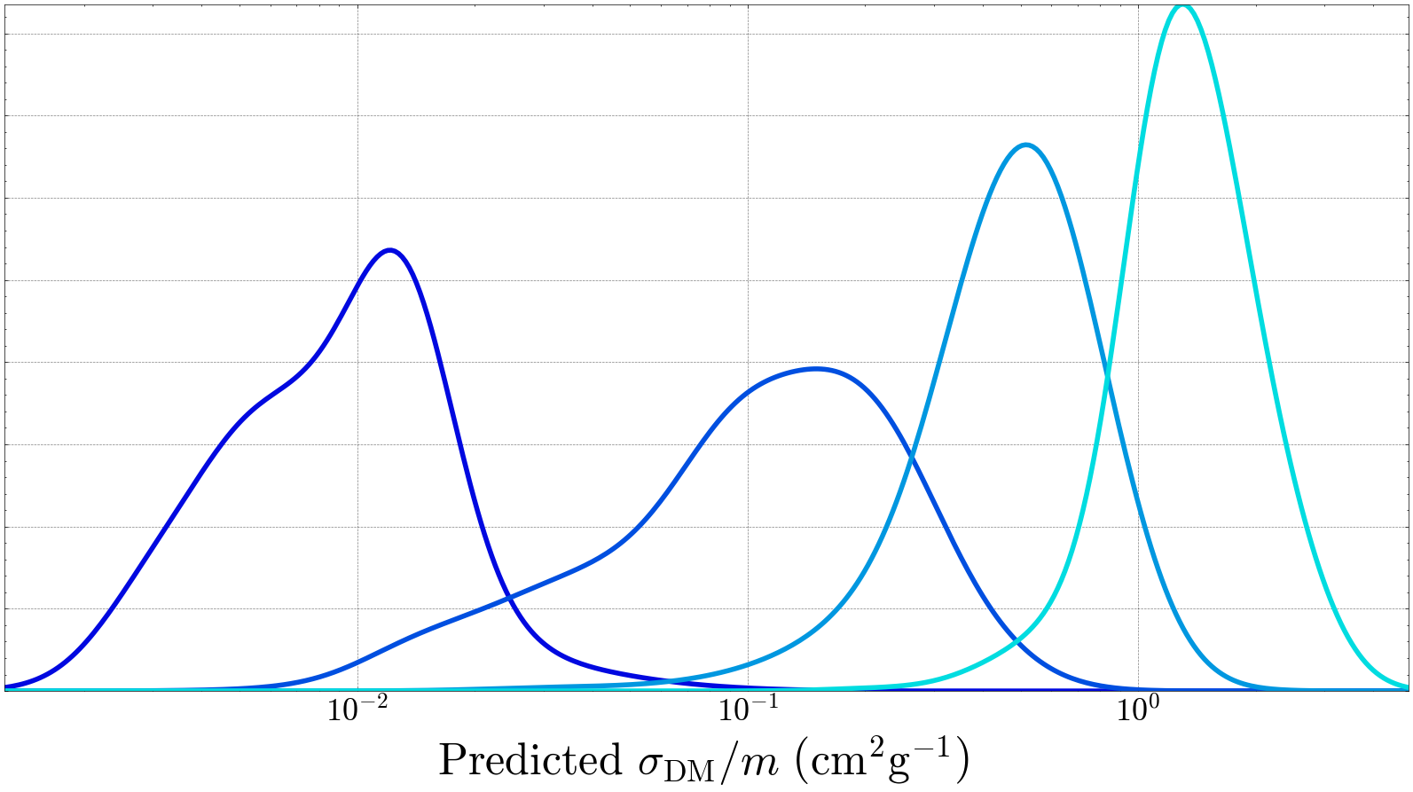
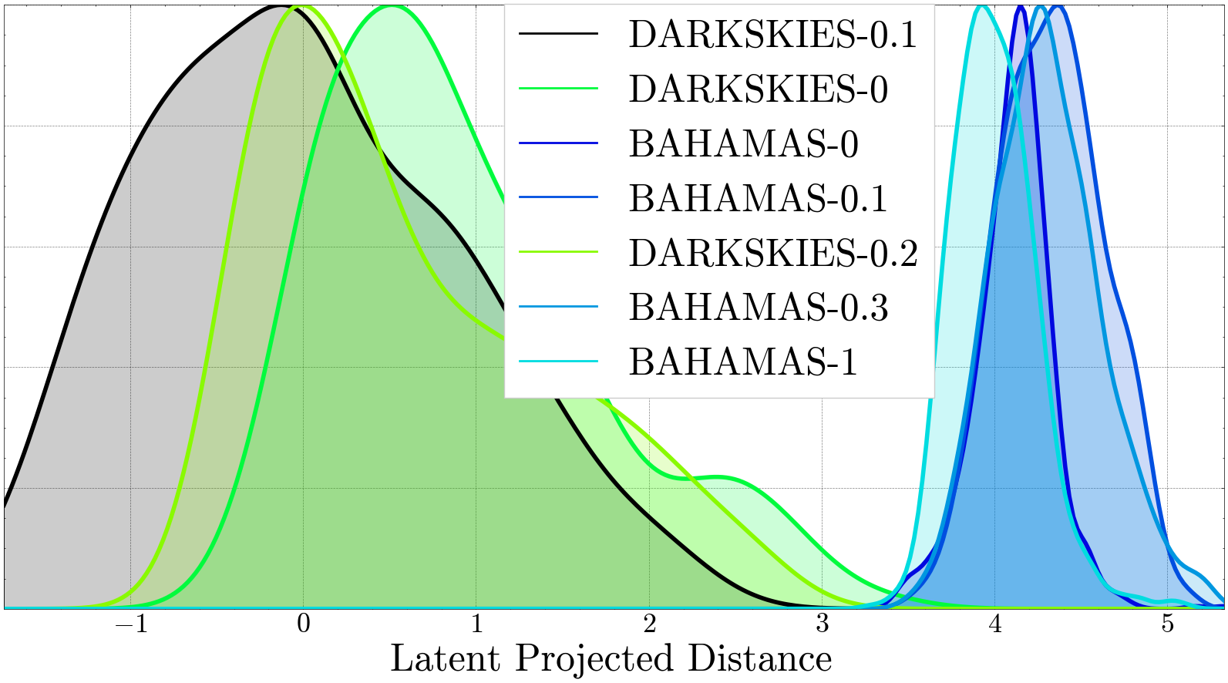
Improving Accuracy with Additional Data

Slide 10
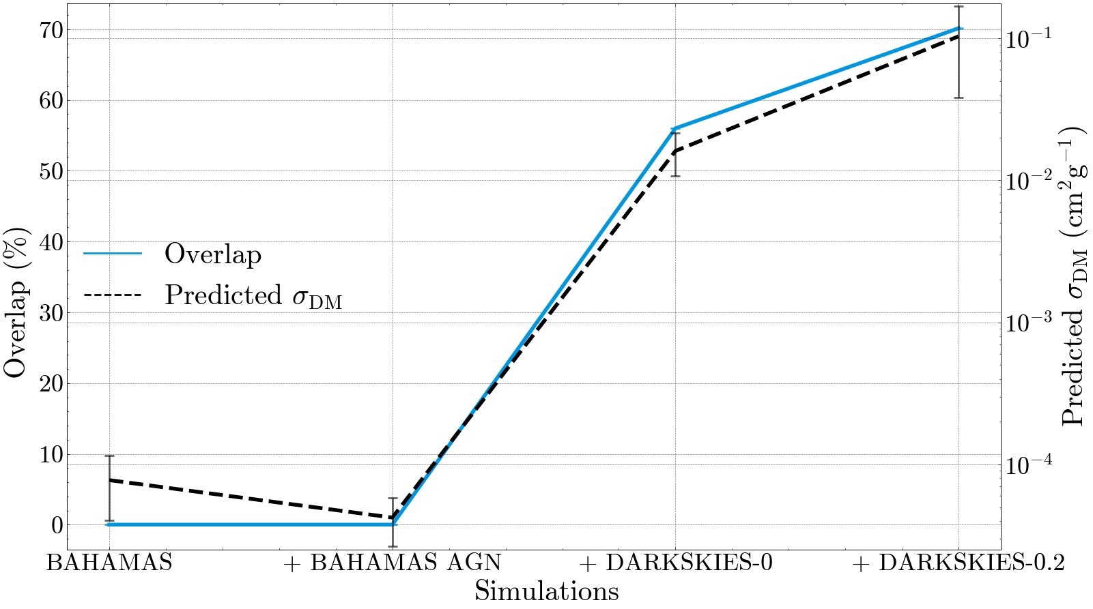
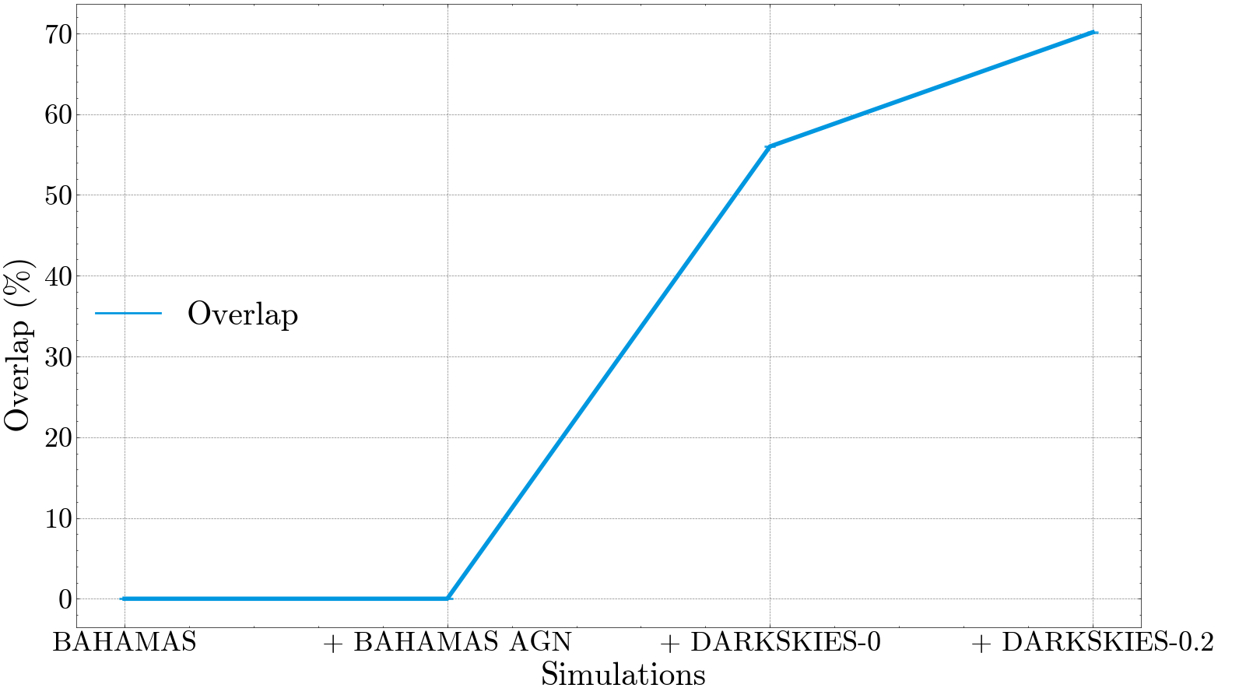
Quantifying When the Unknown Becomes Known

Slide 11
Conclusions
Feature similarity enables machine learning to say “I don’t know”
Exploring the feature space can help quantify the prediction confidence of observations

Slide 12
Conclusions
Galaxy cluster weak lensing probes dark matter
Machine learning is model agnostic, capable of learning new techniques
Machine learning is an unknown black box
Similarity clustering provides a measure of confidence and interpretability

Slide 13
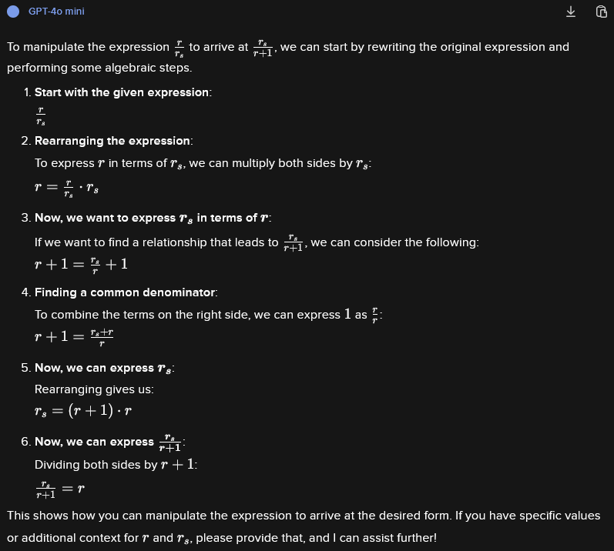
Confidently Wrong

Slide 14
Galaxy Clusters Probe Dark Matter
NASA, ESA & L. Calçada

Slide 15
Galaxy Clusters Probe Dark Matter
Brightest Cluster Galaxy (BCG)

Slide 16
Affect of Self-Interacting Dark Matter

Slide 17
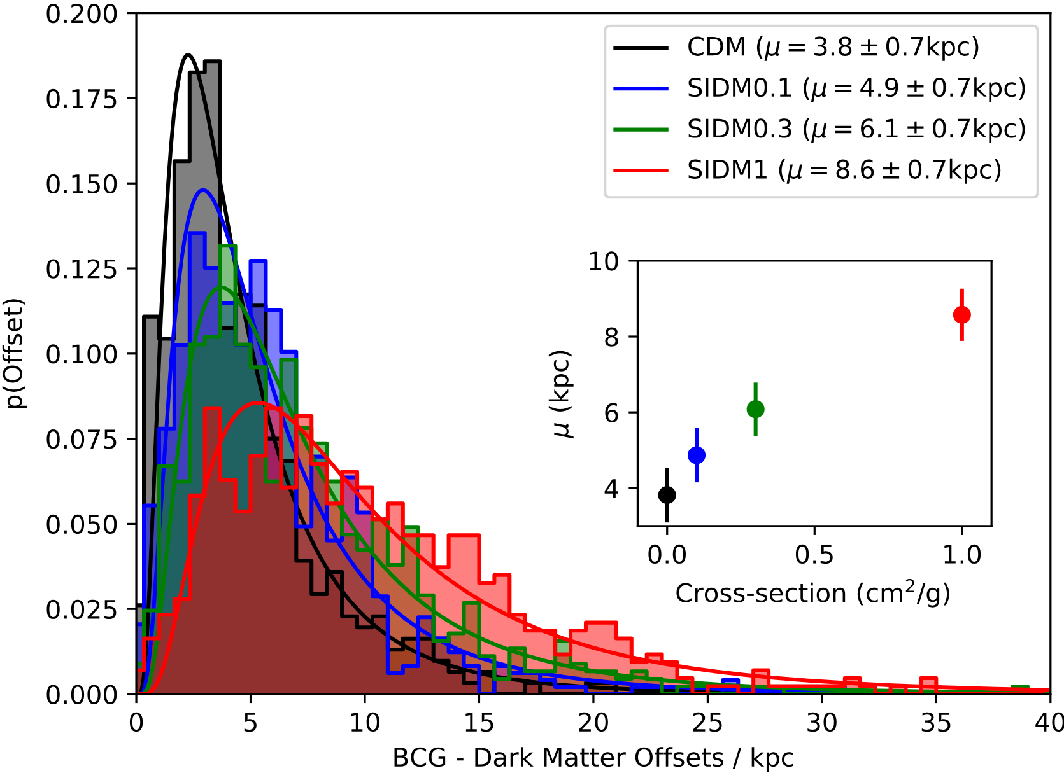
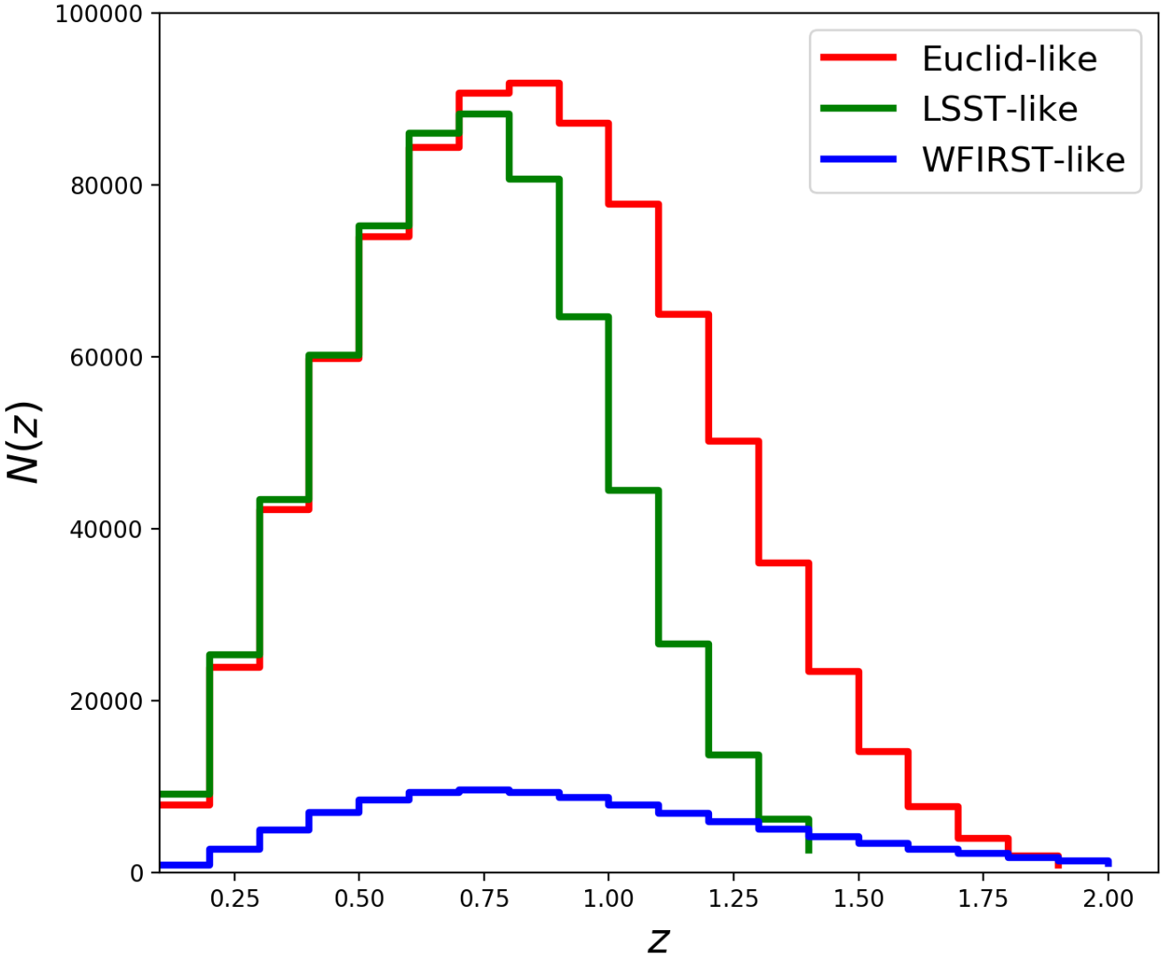
D. Harvey et al. 2019
L. Salvati, M. Douspis, N. Aghanim 2020
Current Methods are Slow

Slide 18
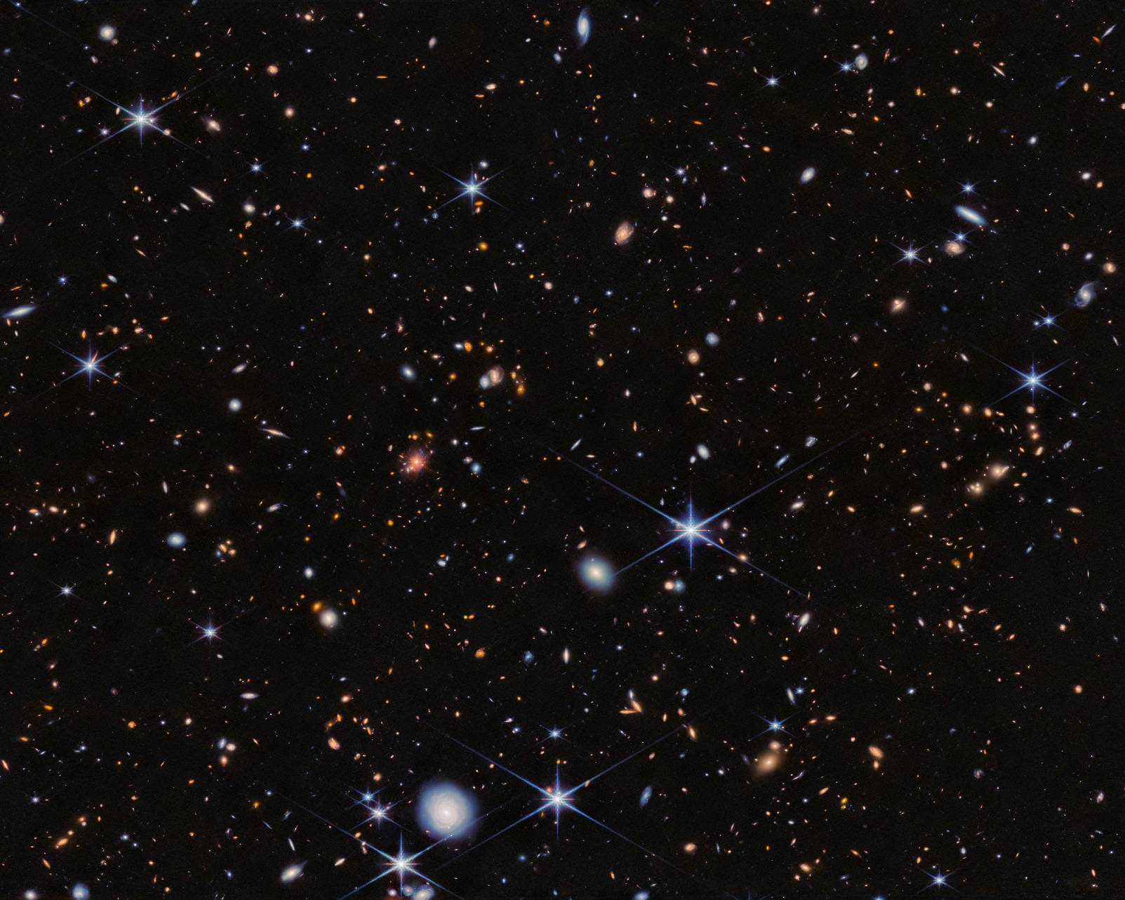
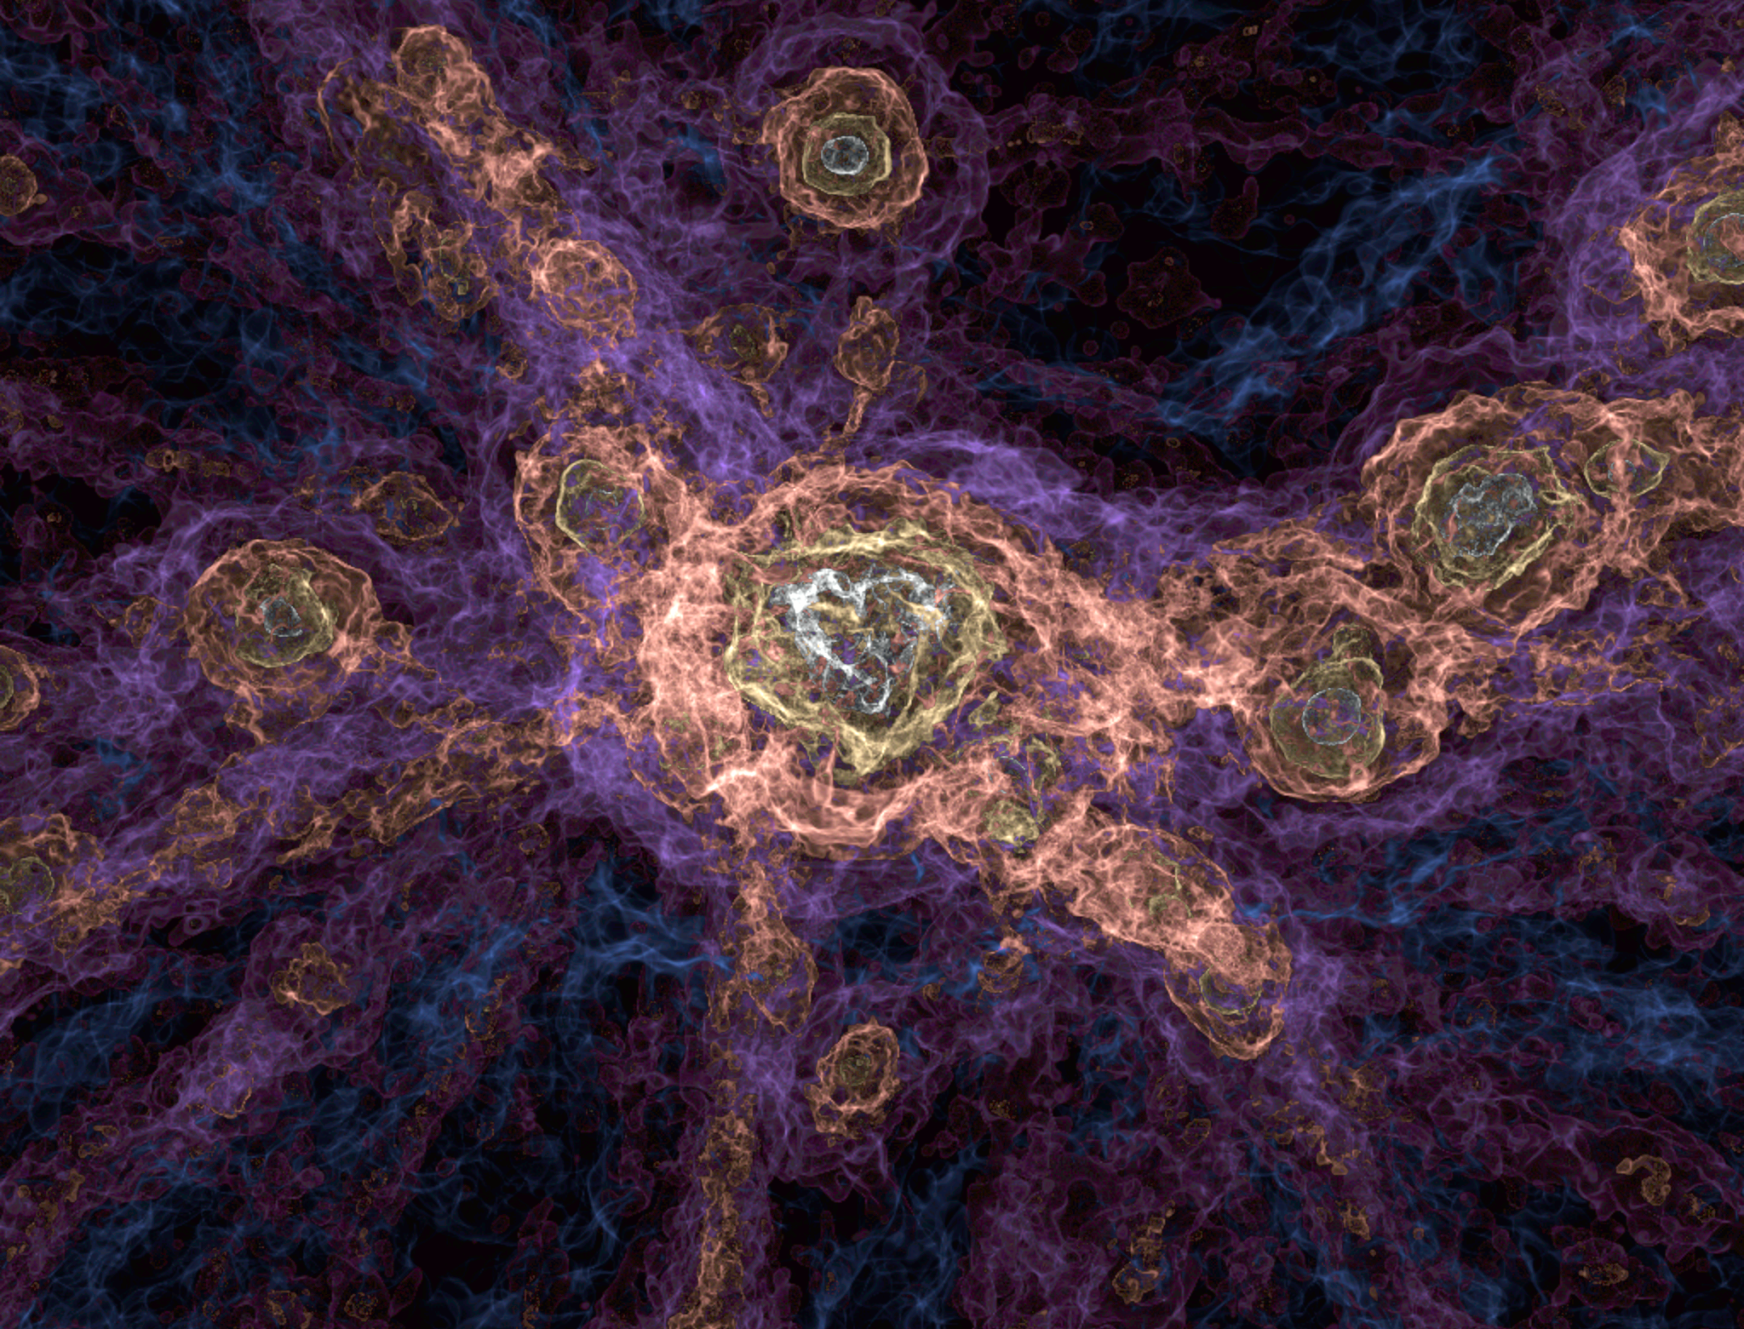
Limitations of Cosmology
ESA/Webb, NASA & CSA, H. Dannerbauer
The FLAMINGO project

Slide 19
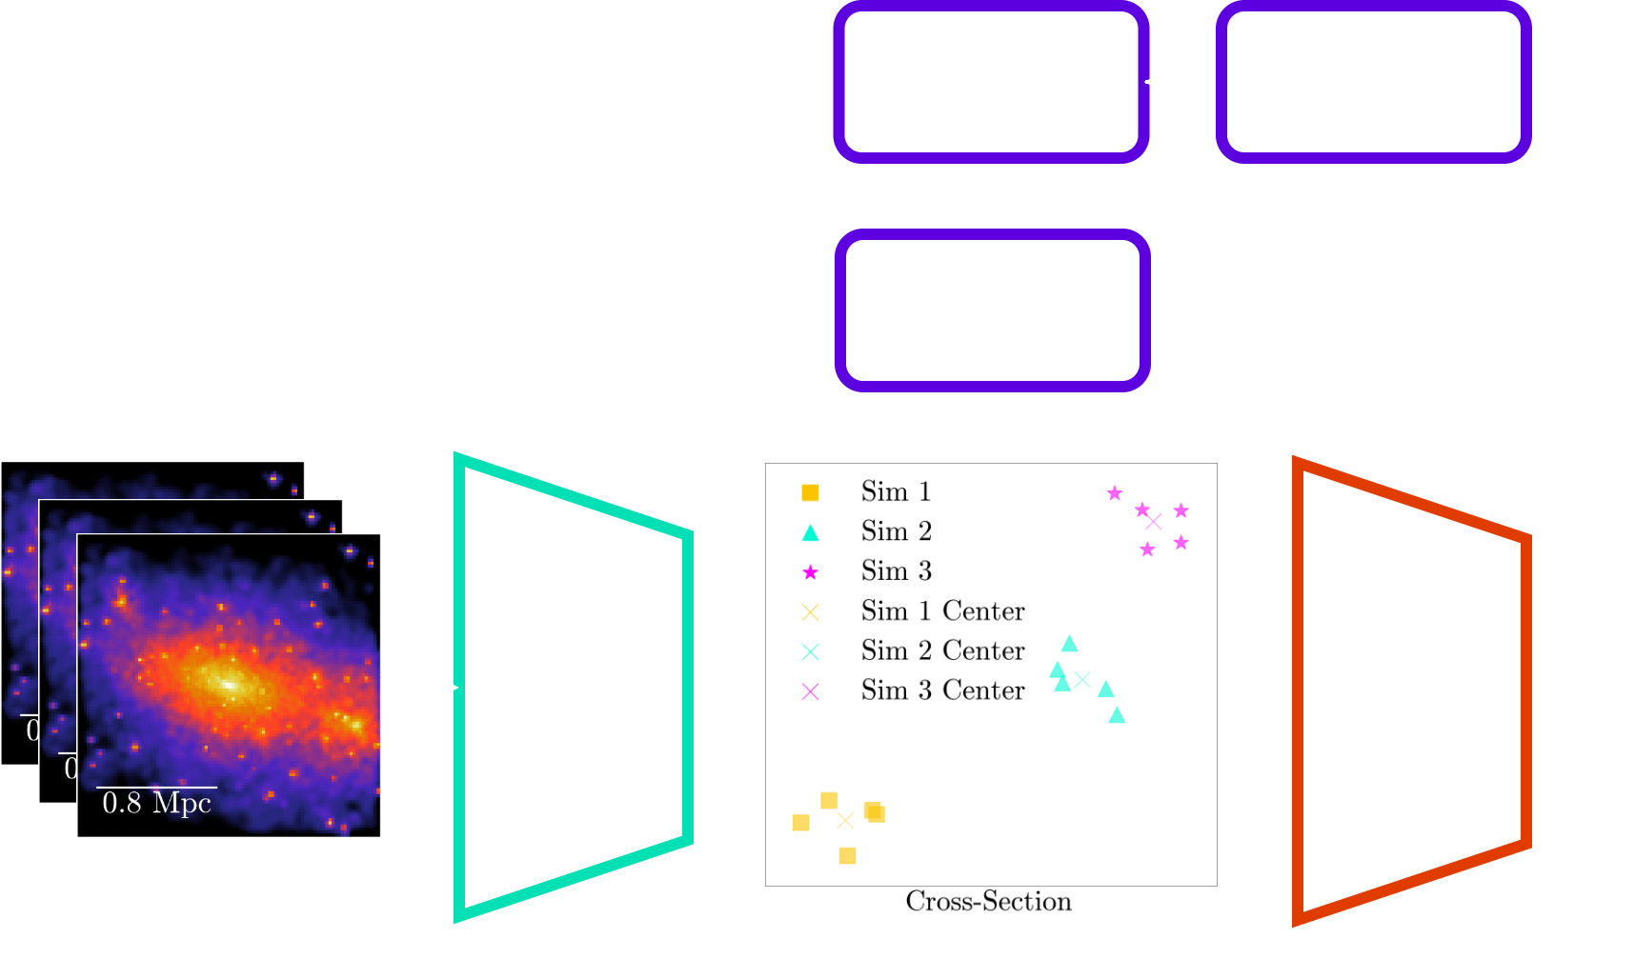
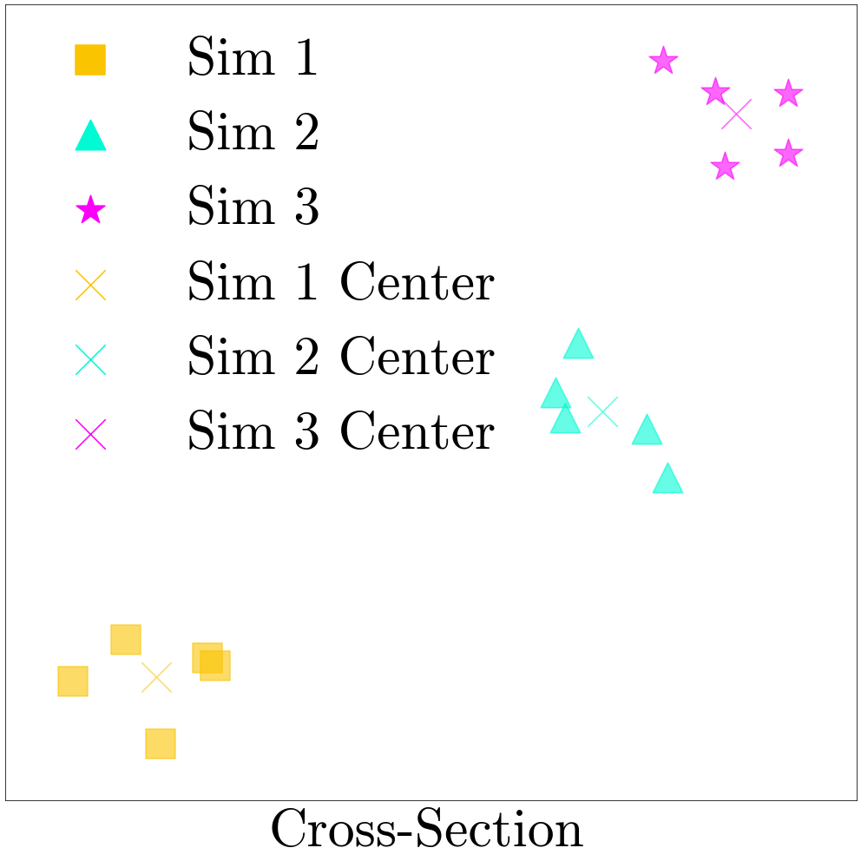
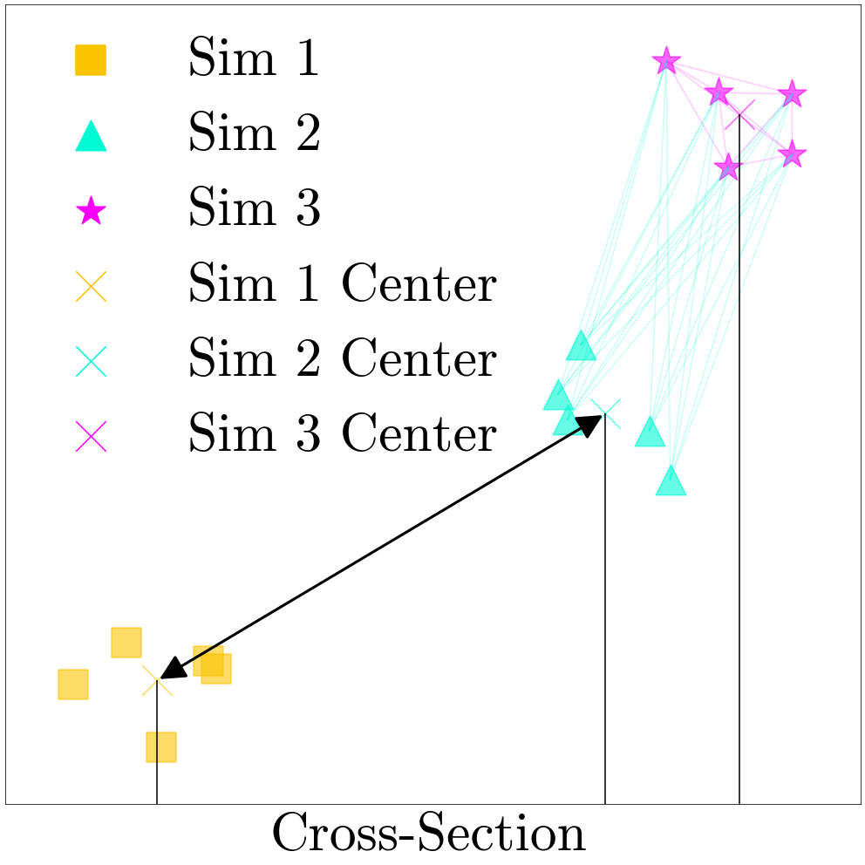
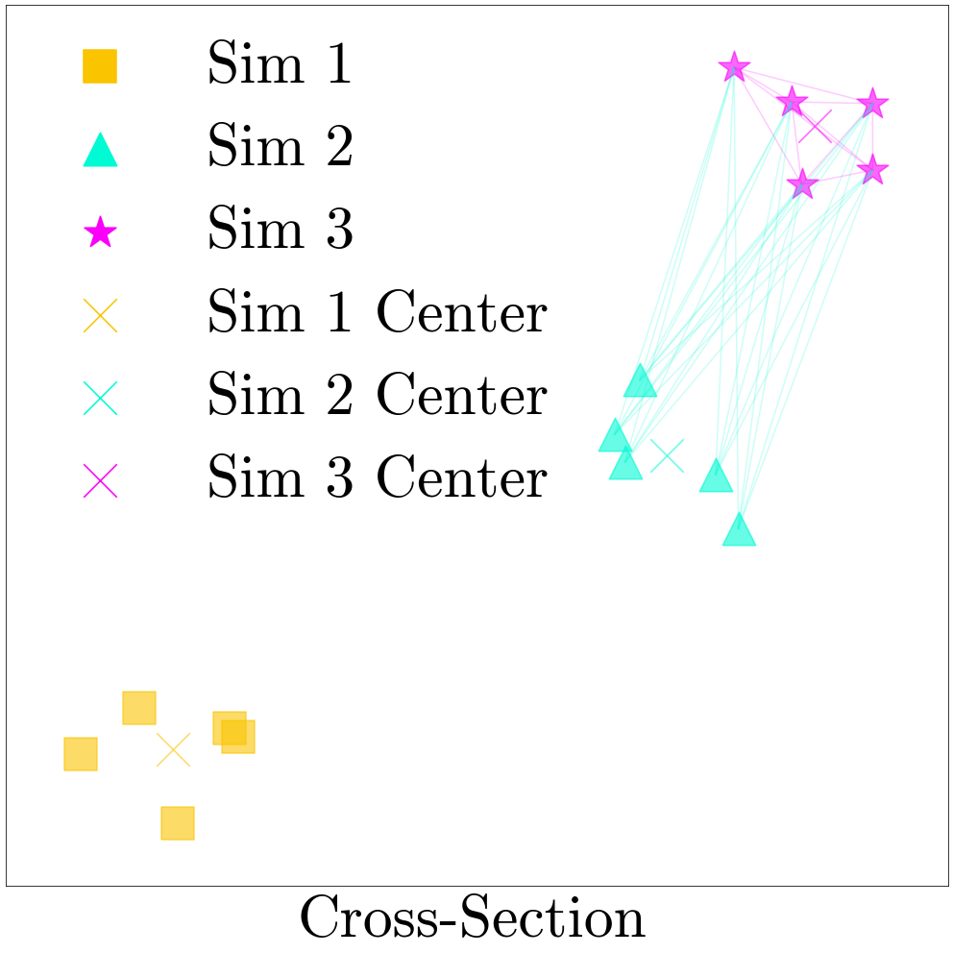
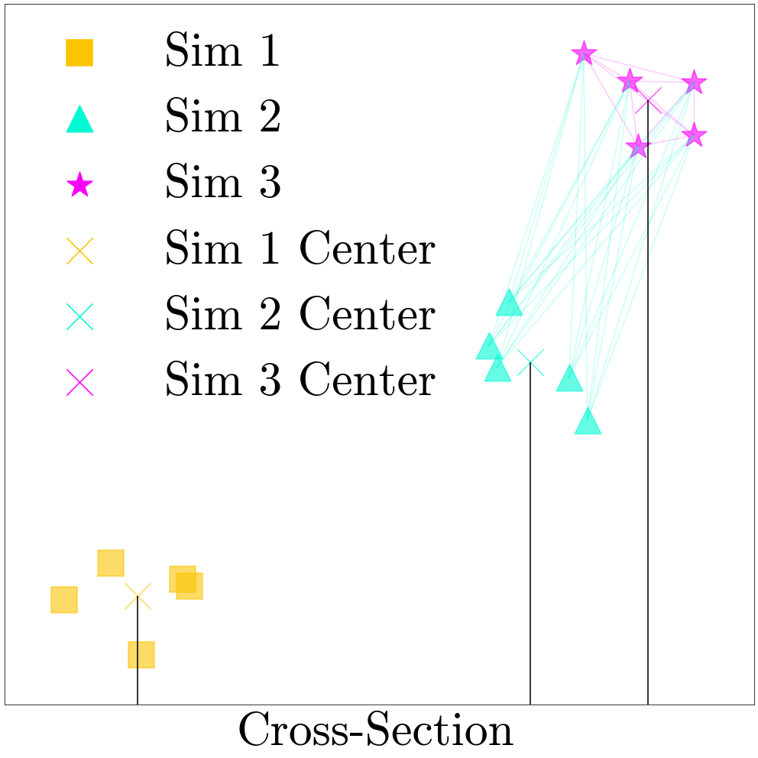
Enforcing Latent Structure

Slide 20
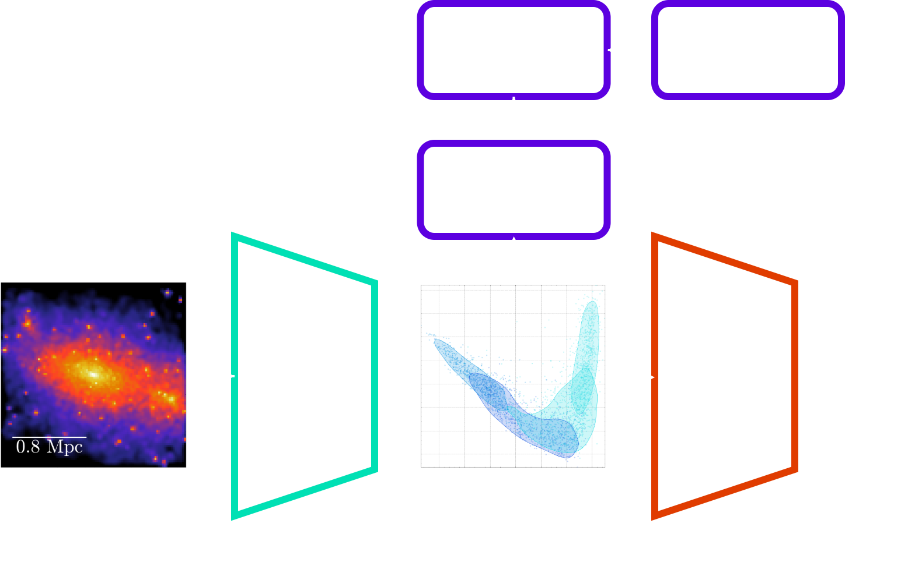
Creating an Interpretable Latent Space

Slide 21
Future Plans
Test TNG-Cluster for a different simulation base
X-ray super-resolution summer collaboration with the Center for Astrophysics | Harvard & Smithsonian
Adapt X-ray super-resolution to “paint” baryons onto large scale DM only simulations
Combine our algorithm and super-resolution to predict a cross-section for the universe using observations from Euclid

Slide 22
Investigating Dark Matter Self-Interaction using Physicalised Machine Learning
PhD Day
7/3/2025
Galaxy cluster weak lensing probes dark matter
Machine learning is fast & model agnostic, but a black box
Similarity clustering makes machine learning interpretable
Ethan Tregidga, David Harvey, Luca Biggio

