Slide 1
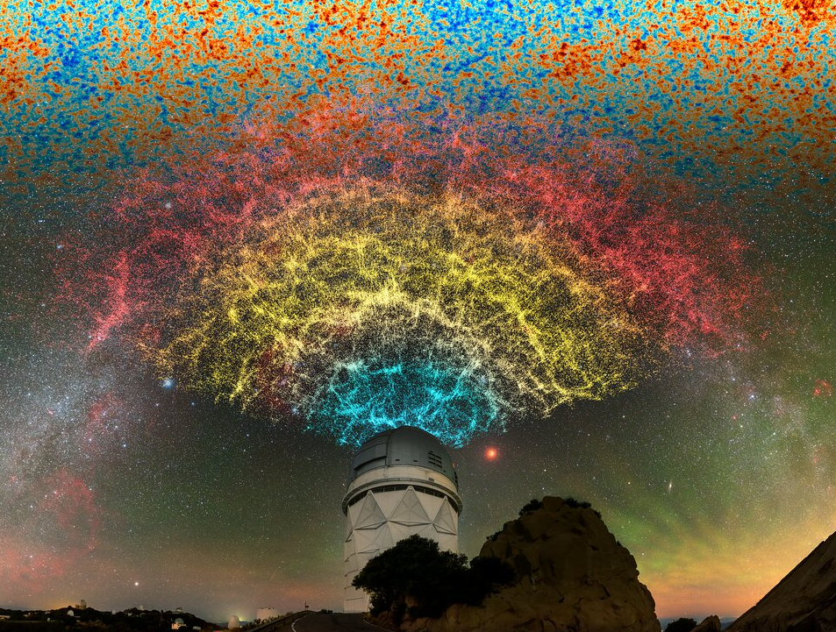
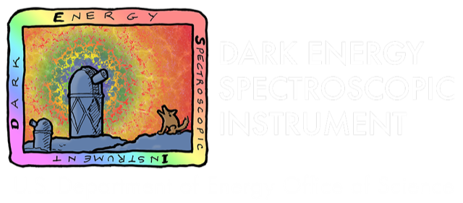
DESI Part 1: Overview of the DESI survey
Antoine Rocher
Postdoc
Ecole Polytechnique Fédérale de Lausanne
On behalf of the DESI collaboration
Swiss Cosmo days – 2025 June 5th - Zurich
Credit : DESI collaboration

Slide 3
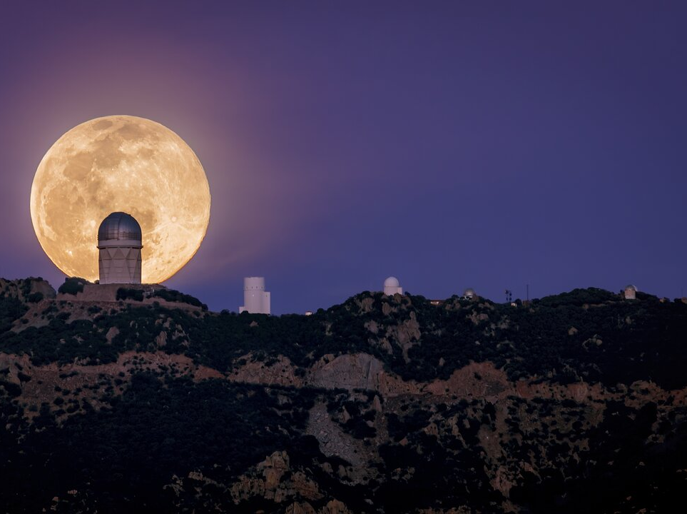
Dark Energy Spectroscopic Instrument
DESI is a state-of-the-art spectroscopic instrument installed at the Mayall 4-meter telescope at Kitt Peak National Observatory.
First Stage-4 spectroscopic survey on sky
measures the 3D distributions of galaxies
1/3 sky 14000 deg²
40M redshifts at the end of the survey (5 years)
x13 previous spectroscopic surveys

Slide 4
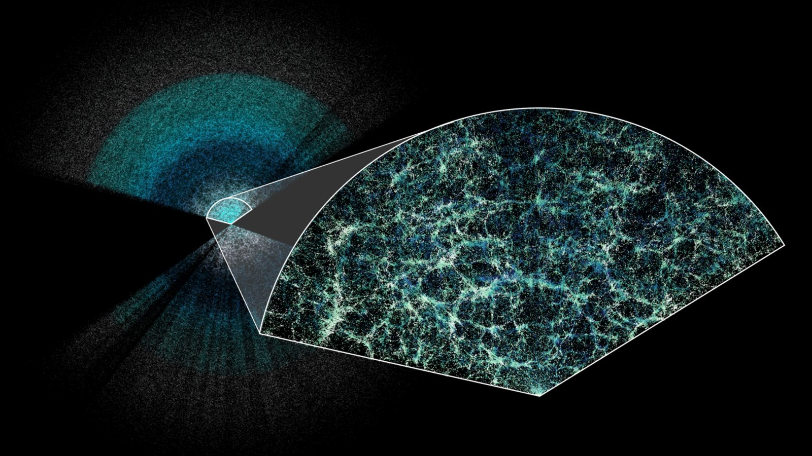
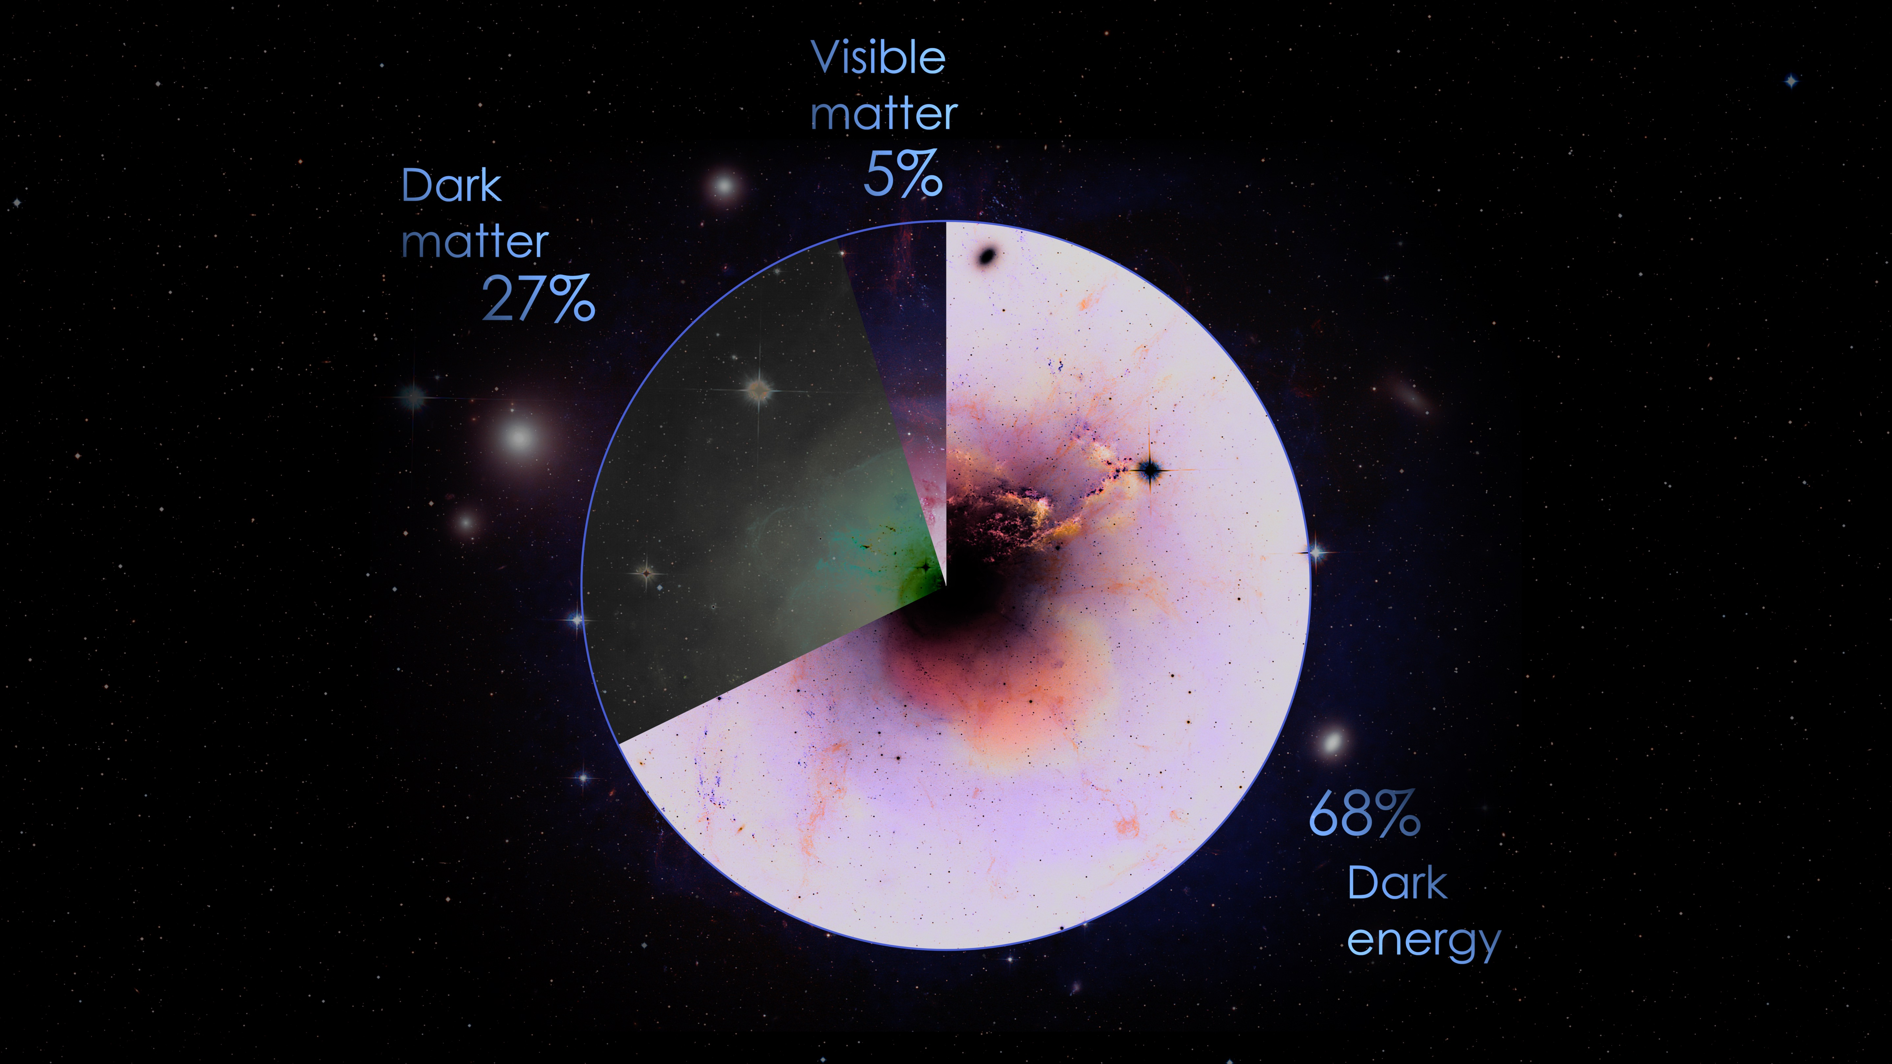
Dark Energy Spectroscopic Instrument
Key questions:
Expansion history of the Universe
=> Constraint Dark Energy with BAO
How does the structure form?
=> Test of gravity (GR)
Primordial physics, inflation (f_{nl})
Neutrino mass, dark matter models...
+ many other science cases
Map the Universe in 3D to constrain the cosmological model
ΛCDM
Credit : DESI collaboration/Claire Lamman

Slide 5
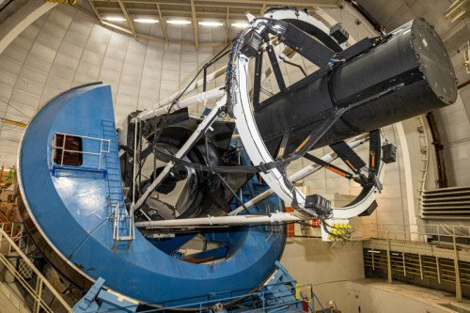
DESI is a state-of-the-art instrument installed at the Mayall 4-meter telescope at Kitt Peak National Observatory.

Slide 6
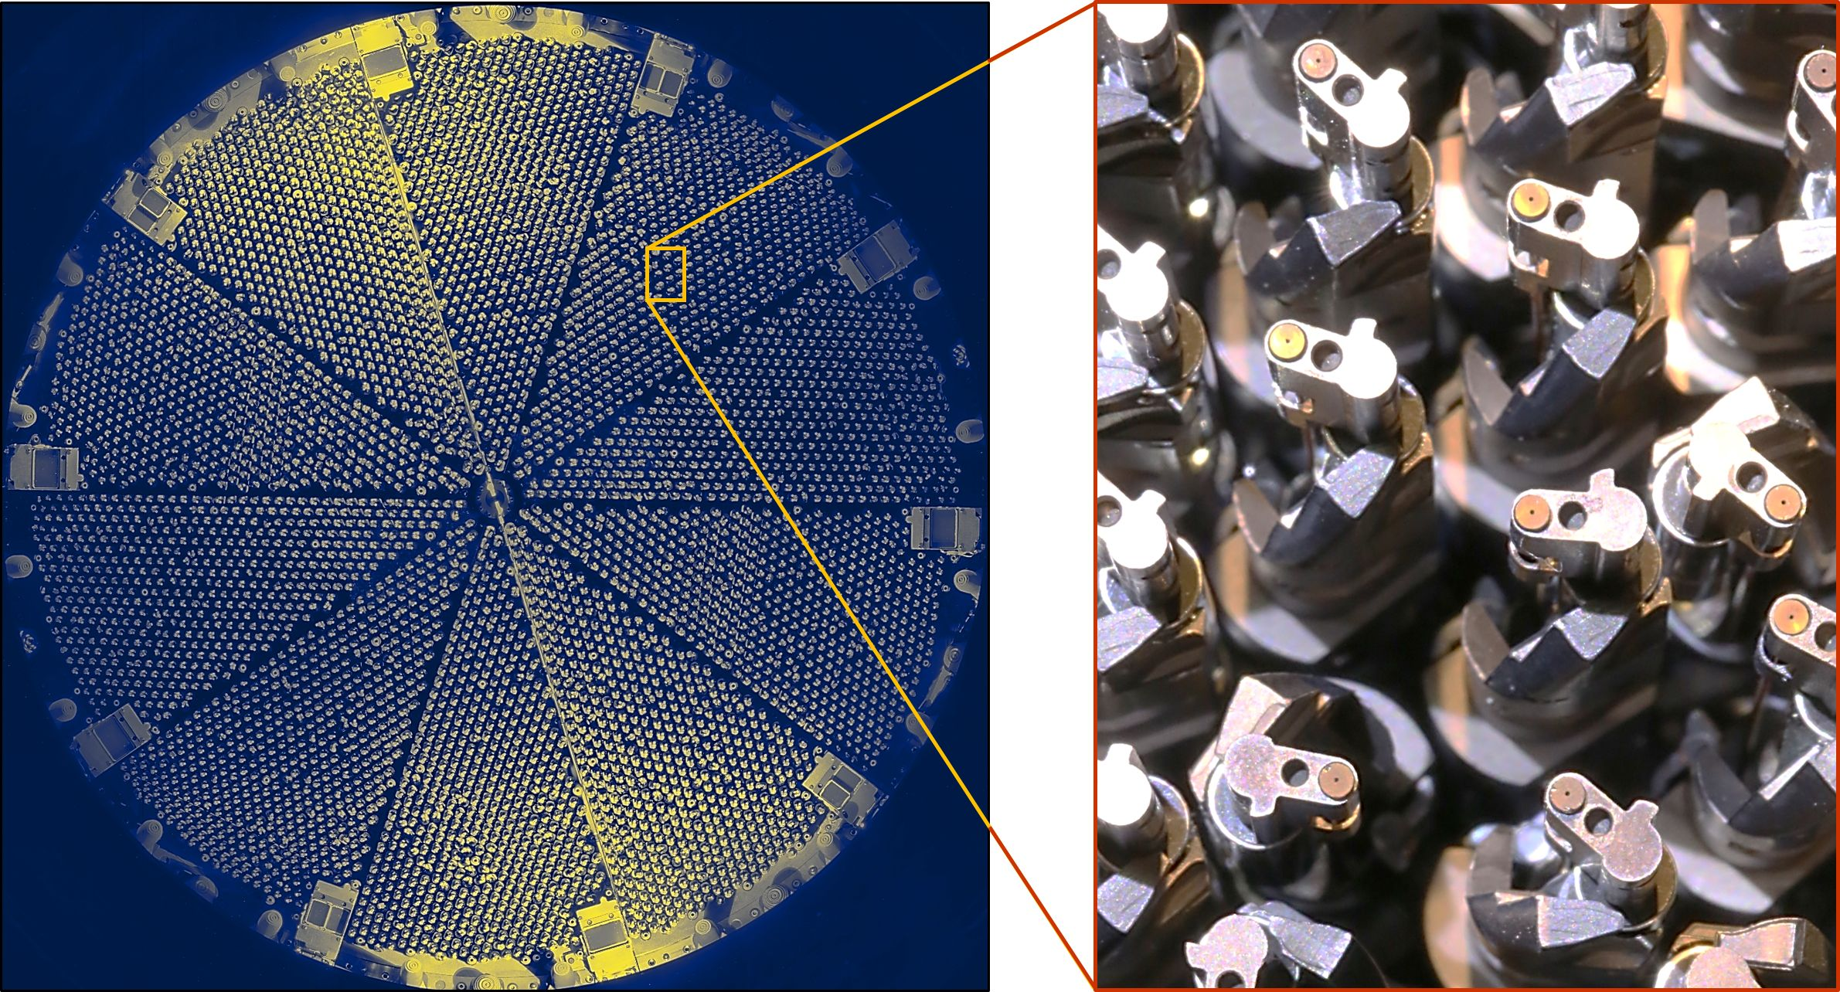
Focal plane is populated with 5000 robotics fibers
DESI is a state-of-the-art instrument installed at the Mayall 4-meter telescope at Kitt Peak National Observatory.

Slide 7
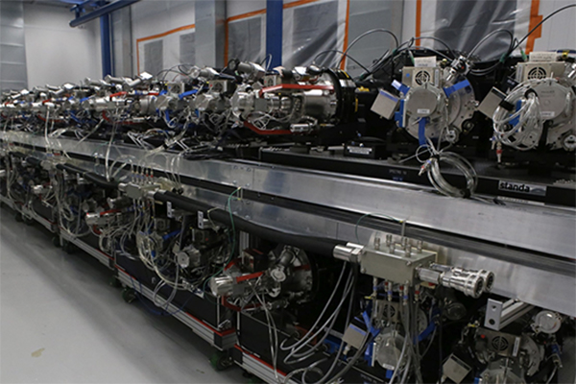
Focal plane is populated with 5000 robotics fibers
That feed
10 spectrographs λ ~ 360-980 nm
DESI is a state-of-the-art instrument installed at the Mayall 4-meter telescope at Kitt Peak National Observatory.

Slide 8
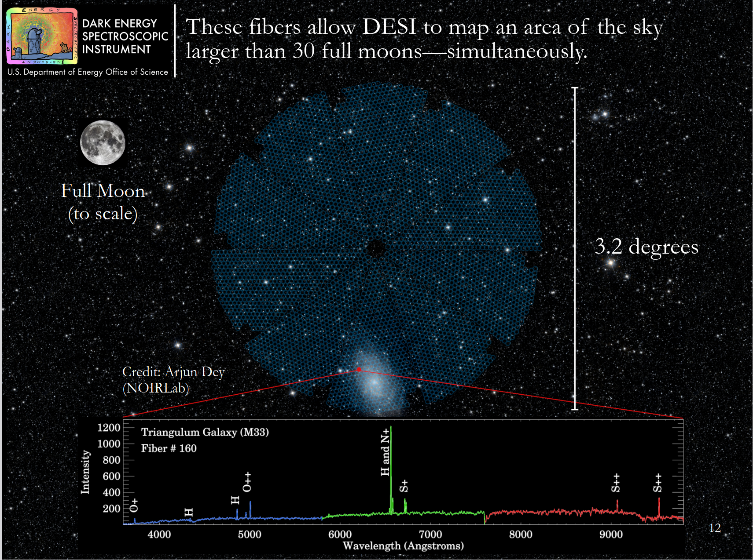

Slide 9
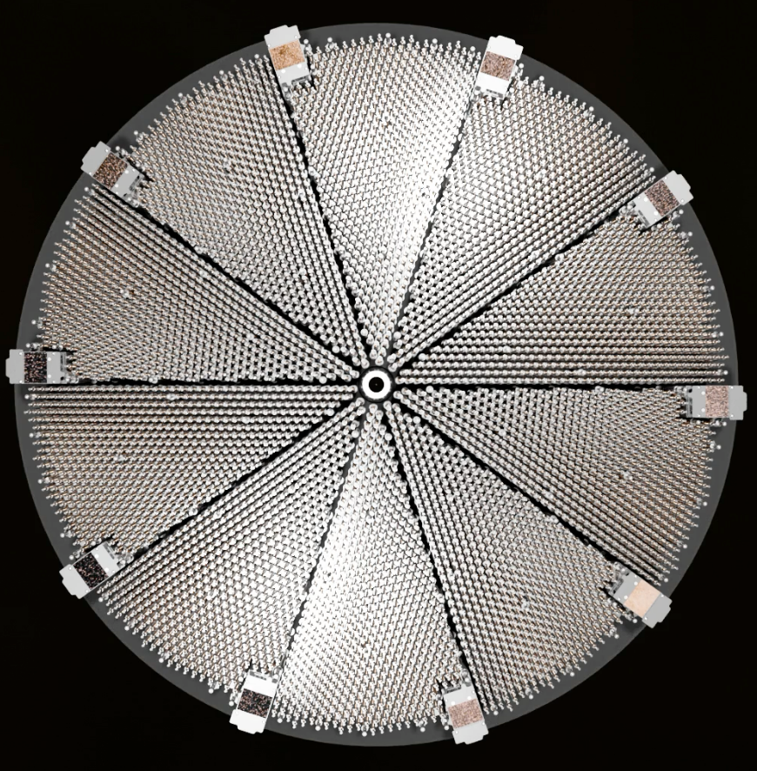
20

Slide 10
20
Reconfiguration time < 2min

Slide 11
20
~20 min between 2 exposures
Reconfiguration time < 2min

Slide 12
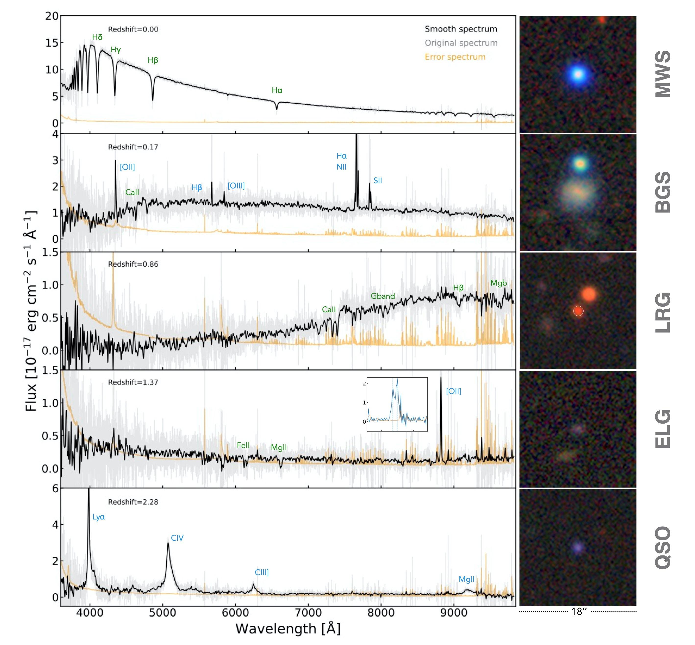
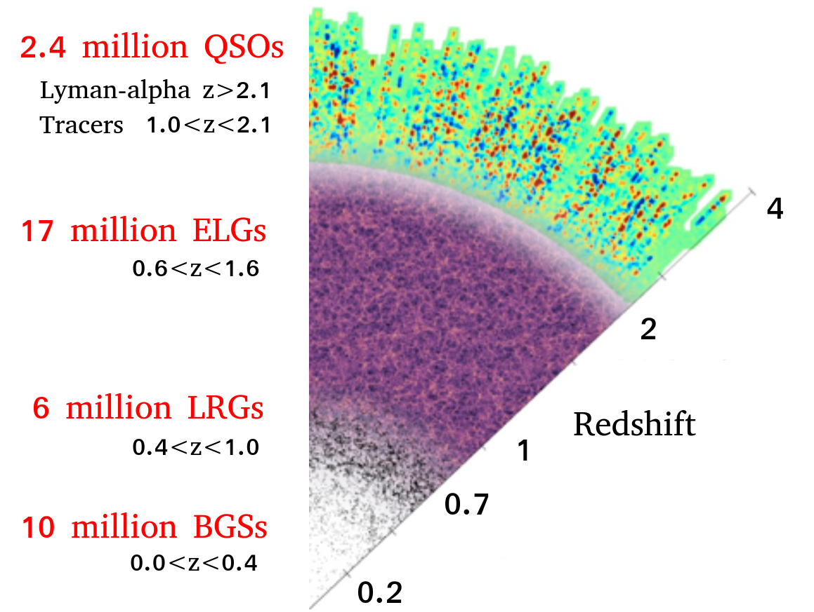
The DESI main survey
4 different tracers to probe the Universe z < 3.5
3M Quasars (QSOs)
0.8<z<2.6
+ Ly-α z > 2.1
17M Emission line galaxies (ELGs)
0.6<z<1.6
8M Luminous red galaxies (LRGs)
0.4<z<1.1
z
13.5M Bright galaxies
0<z<0.5
+ Milky way Stars

Slide 13
The DESI main survey
4 different tracers to probe the Universe z < 3.5
Dark time survey
3M Quasars (QSOs)
0.8<z<2.6
+ Ly-α z > 2.1
17M Emission line galaxies (ELGs)
0.6<z<1.6
8M Luminous red galaxies (LRGs)
0.4<z<1.1
z
13.5M Bright galaxies
0<z<0.5
+ Milky way Stars
Bright time survey

Slide 14
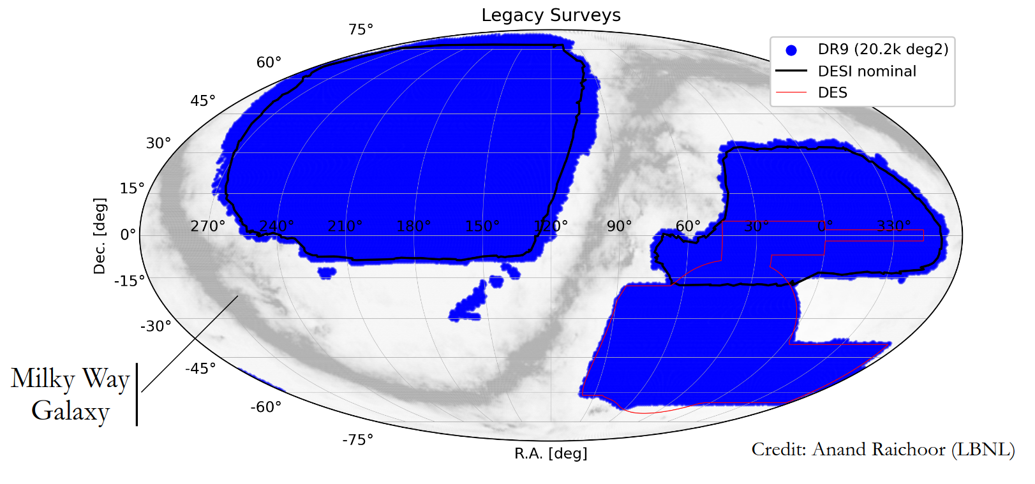
DESI Legacy photometric surveys
DESI Legacy Imaging Surveys: https://legacysurvey.org/dr9
Interactive Sky Viewer: https://legacysurvey.org/viewer

Slide 15
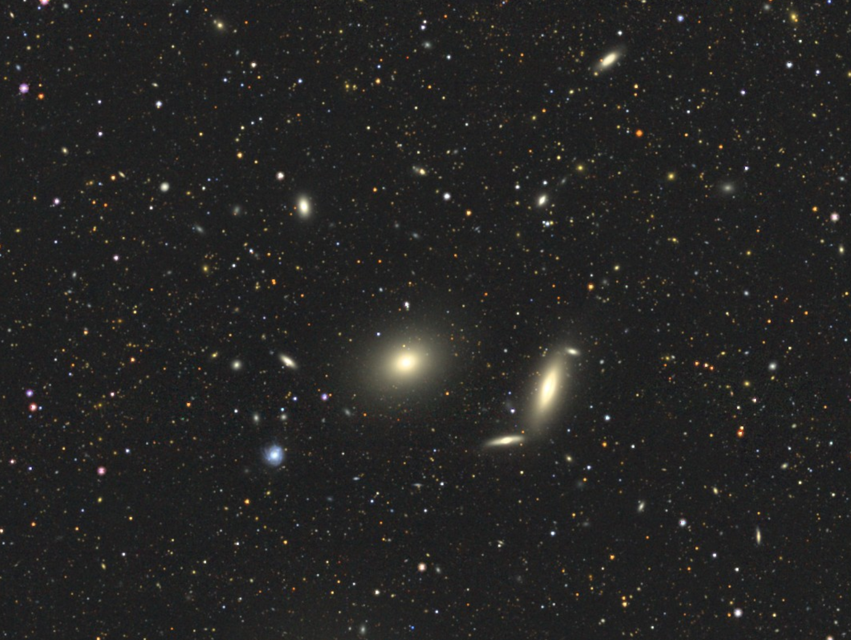
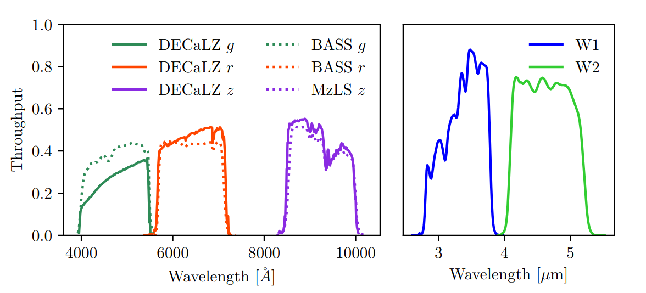
Legacy surveys grz bands:
BASS+MzLS
DECaLS
DES
+ W1/W2 infrared bands from unWISE
Interactive Sky Viewer: https://legacysurvey.org/viewer

Slide 16
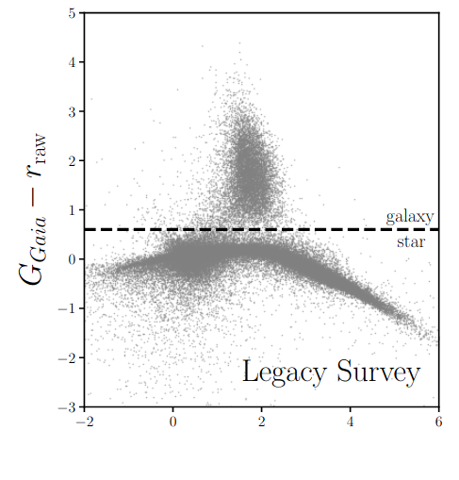
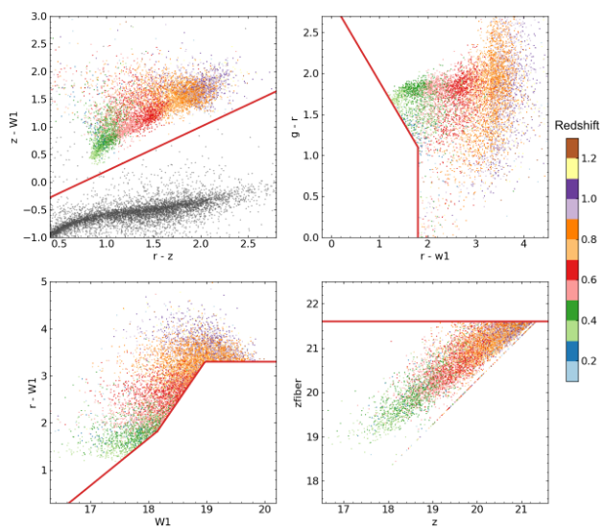
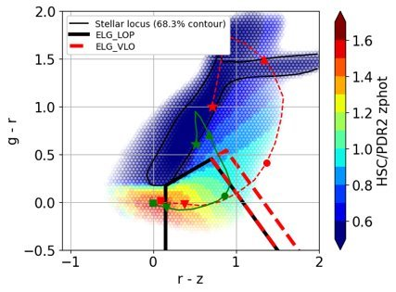
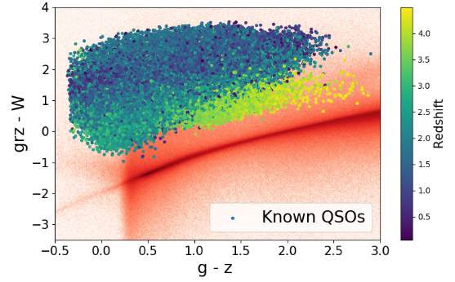
DESI Target Selection
Bright Galaxy Sample
Luminous Red Galaxies
Legacy surveys grz bands:
BASS+MzLS
DECaLS
DES
+ W1/W2 infrared bands from unWISE
Hahn & al. 2022
Zhou & al. 2022
Emission Line Galaxies ​
DESI Quasar
Raichoor & al. 2022
Chaussidon & al. 2022
Interactive Sky Viewer: https://legacysurvey.org/viewer

Slide 17
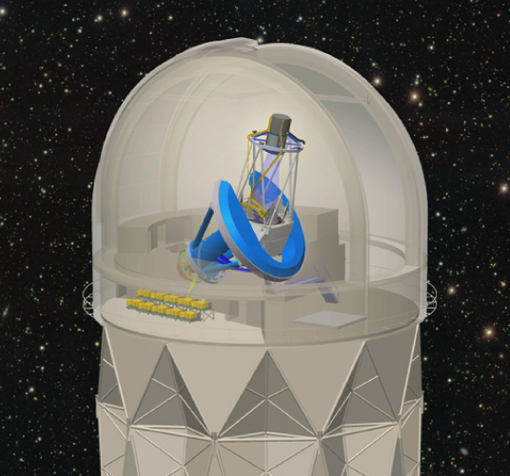

Slide 18
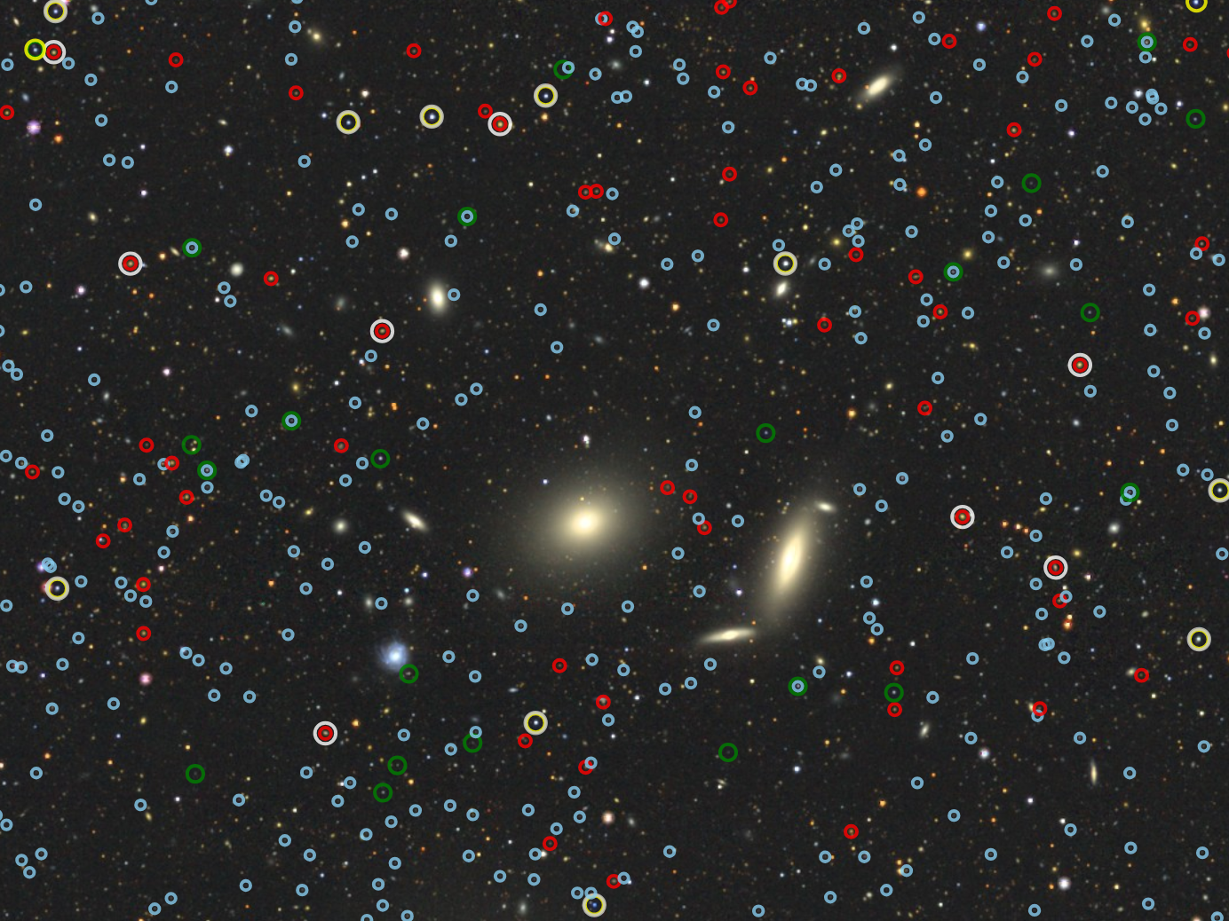
:BGS
:LRGs
:ELGs
:QSOs

Slide 19
:BGS
:LRGs
:ELGs
:QSOs

Slide 20
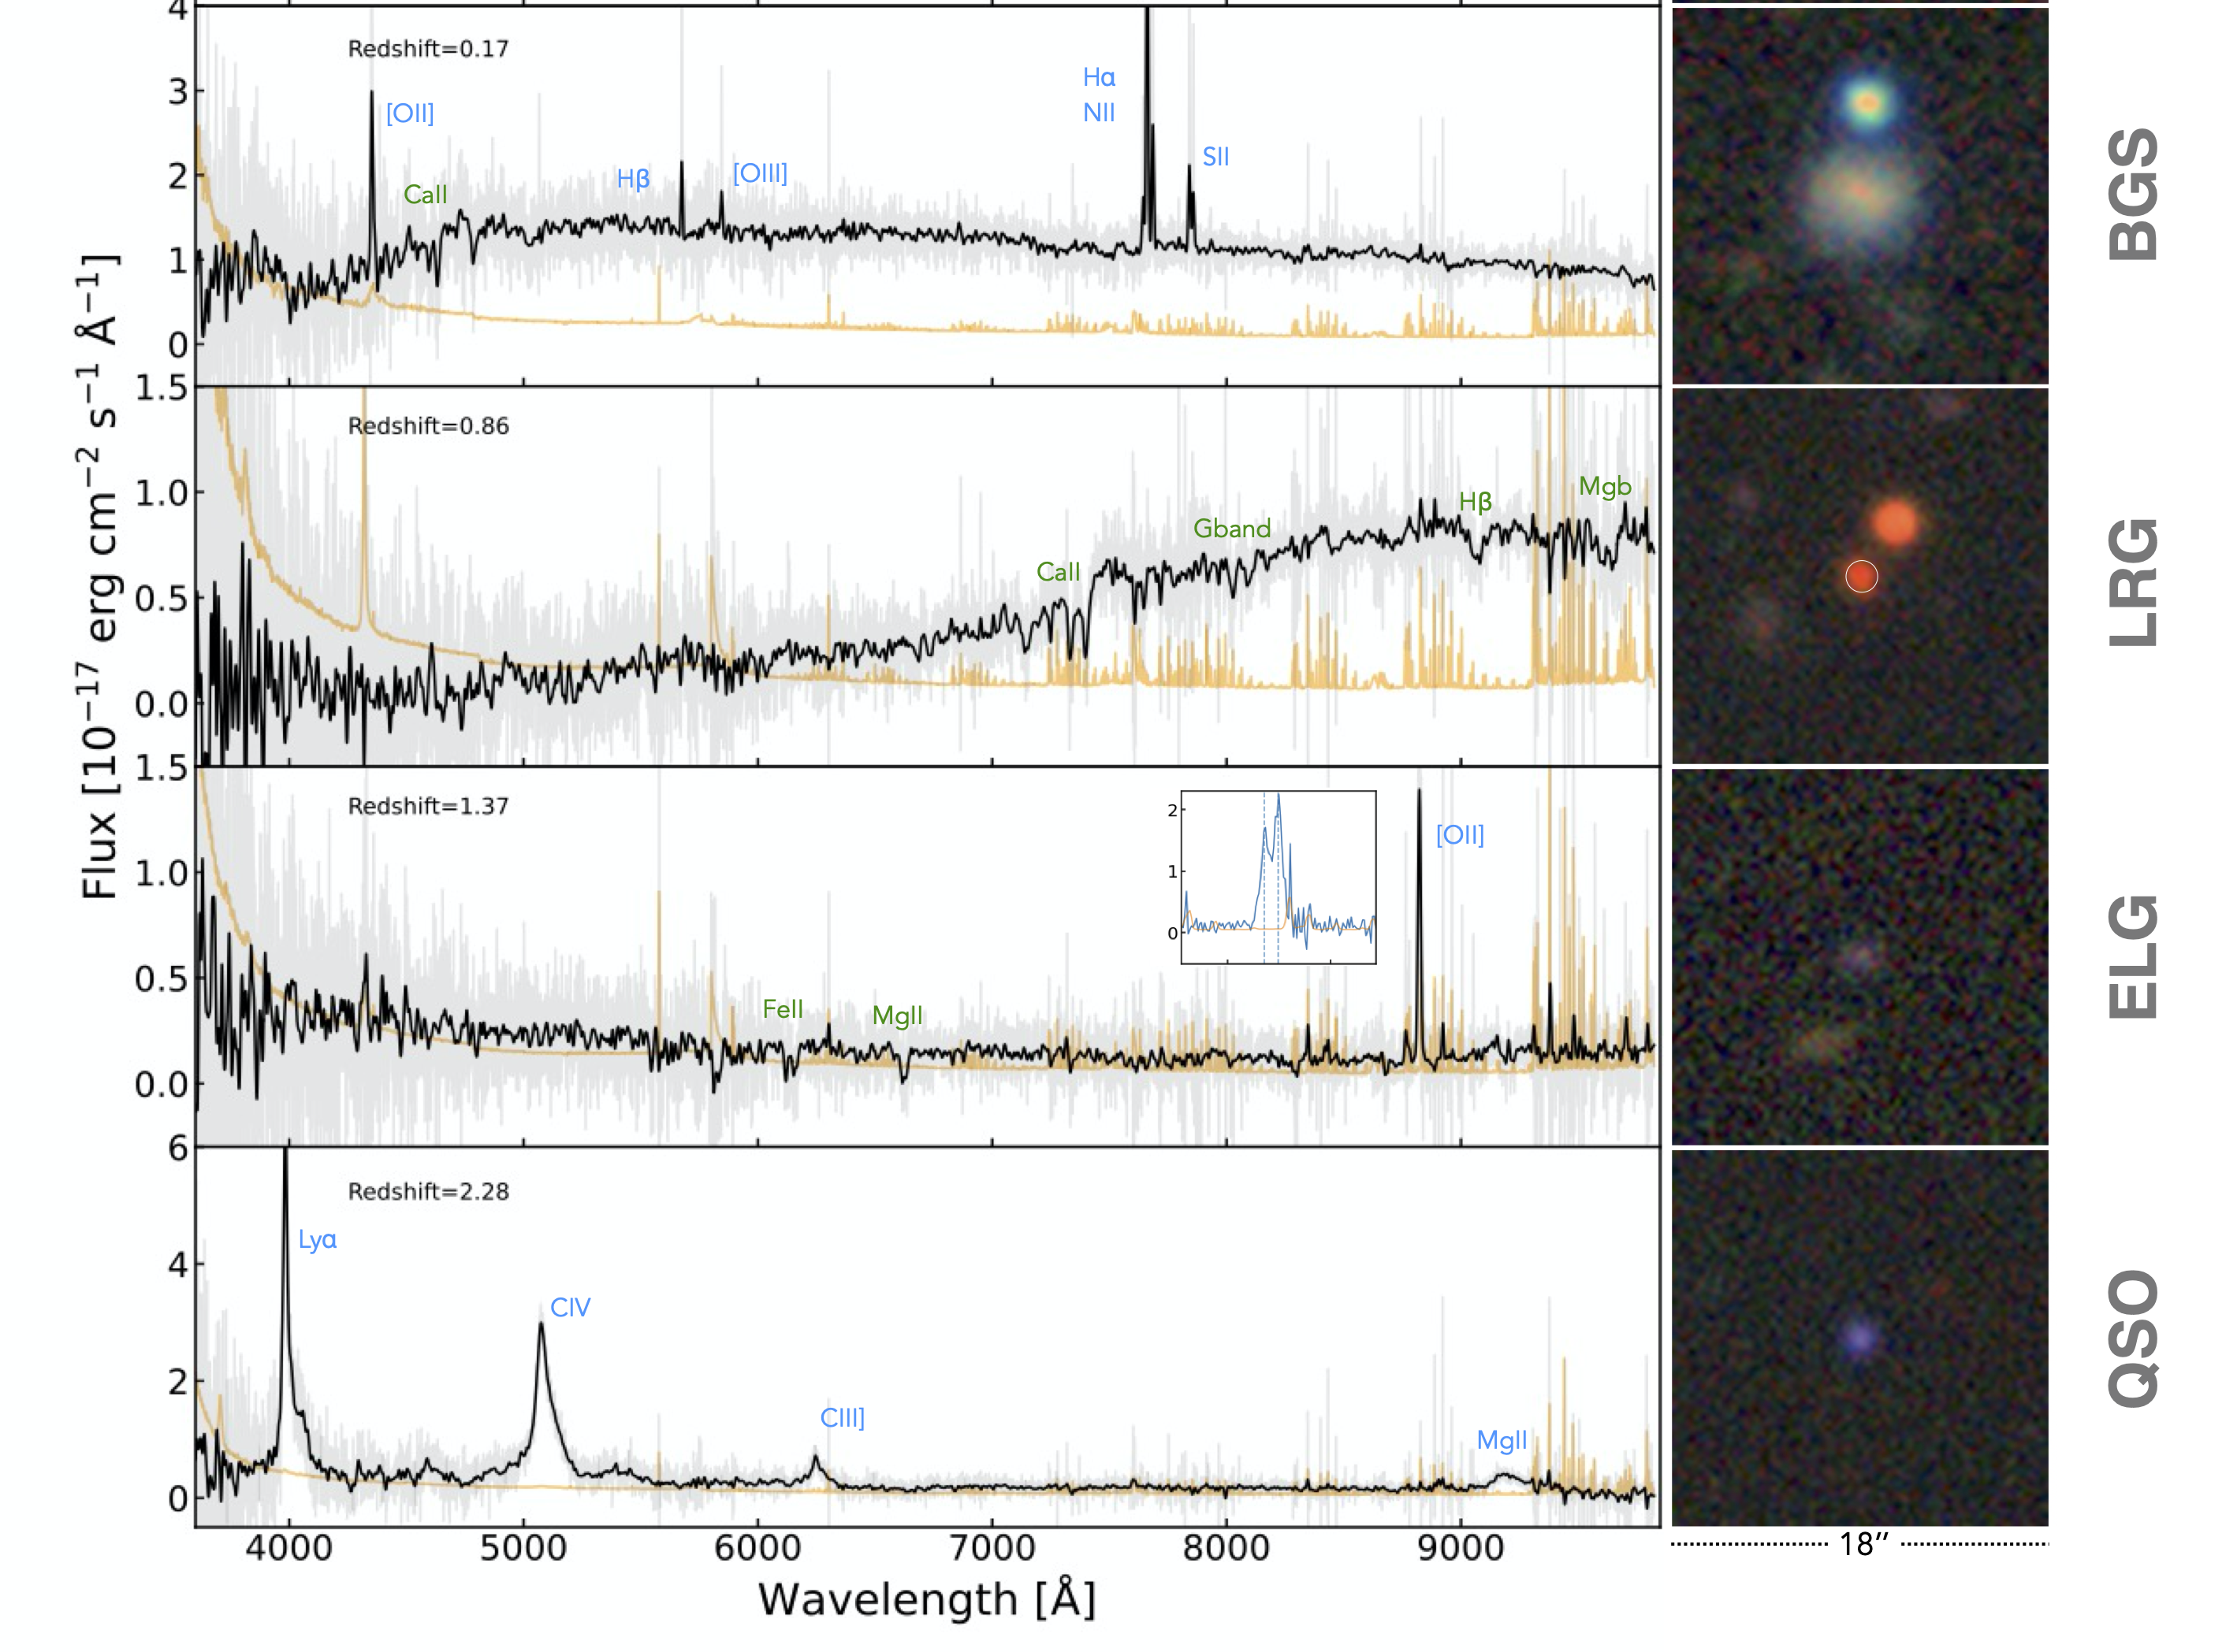
:BGS
:LRGs
:ELGs
:QSOs

Slide 21
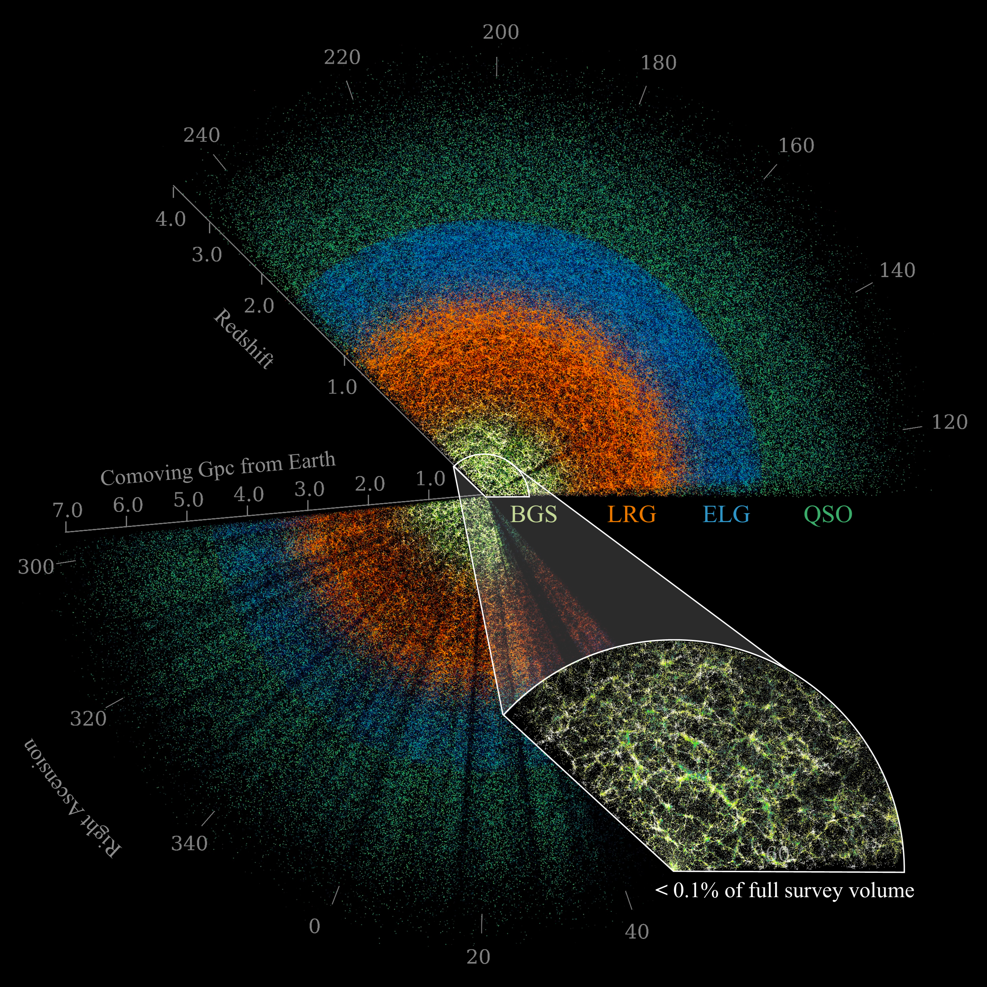
:BGS
:LRGs
:ELGs
:QSOs

Slide 22
:BGS
:LRGs
:ELGs
:QSOs
Credit : DESI collaboration/Claire Lamman

Slide 23
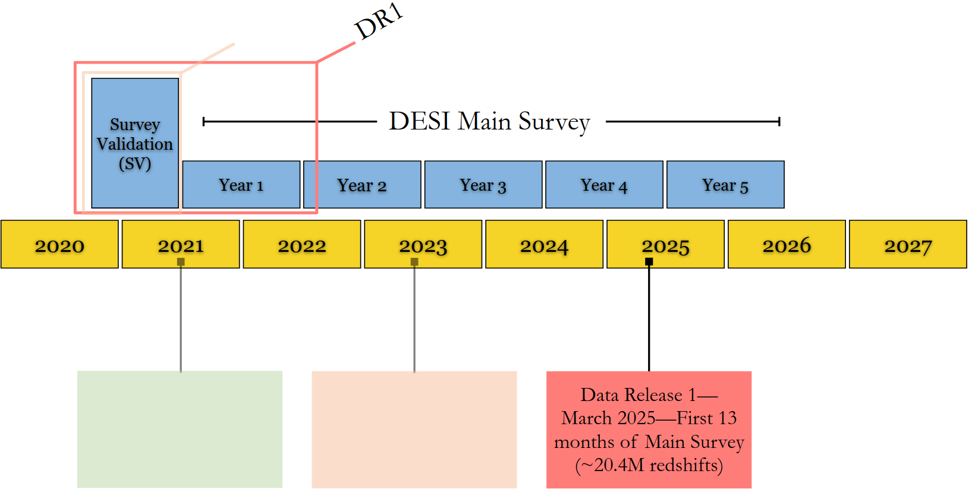
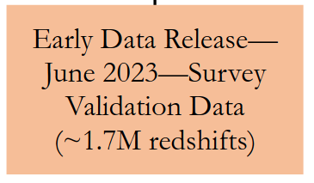
DESI Timeline
DR2
40M extra galactic redshifts
DR1
Full shape results
DR2
BAO results
DR1
BAO results

Slide 24
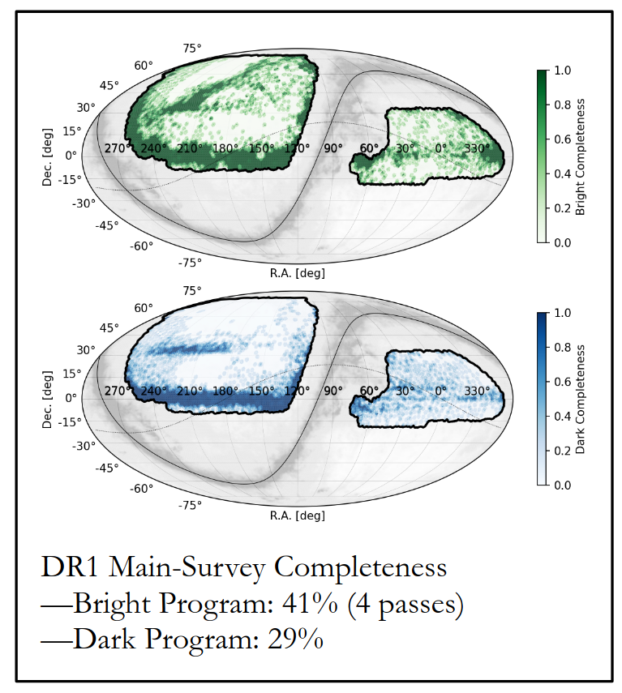
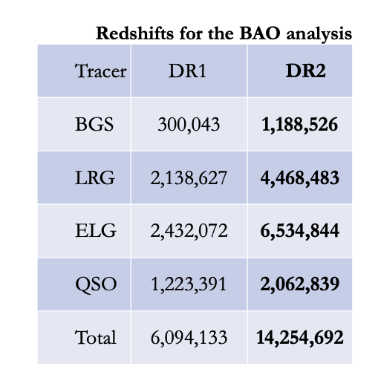
DESI DR1 contains the most detailed 3D map of the universe ever, spanning 12 billion years of cosmic time.
~ 9'700 deg²
Main Survey :
13.1M galaxies
1.6M quasars
4M stars
+ Survey Validation (1.7M objects)
Total: 20.4M redshifts
~ 9'500 deg²
https://data.desi.lbl.gov/doc/releases/dr1

Slide 25
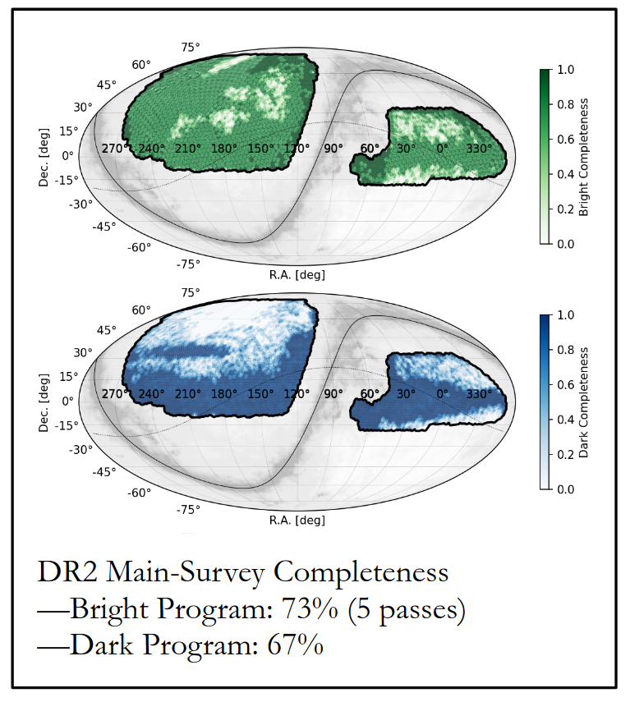
DESI DR2 will contain two-thirds of the 5-year survey data and ~50M redshifts, two times more than DR1!
~ 12'355 deg²
Main Survey (internal release):
31M galaxies
2.8M quasars
12.3M stars
+ Survey Validation (1.7M objects)
Total: 46.1M redshifts
~ 10'500 deg²

Slide 26
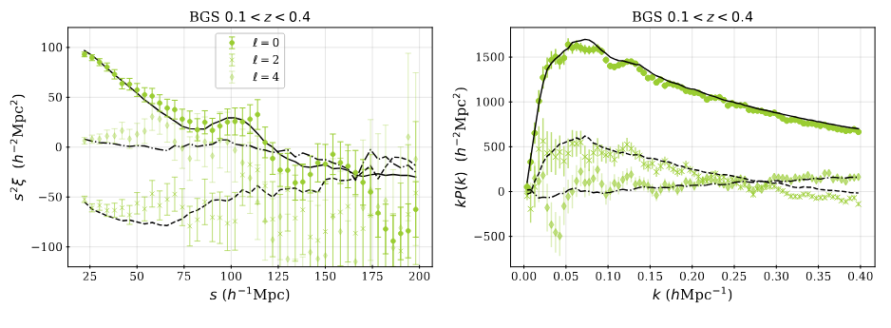
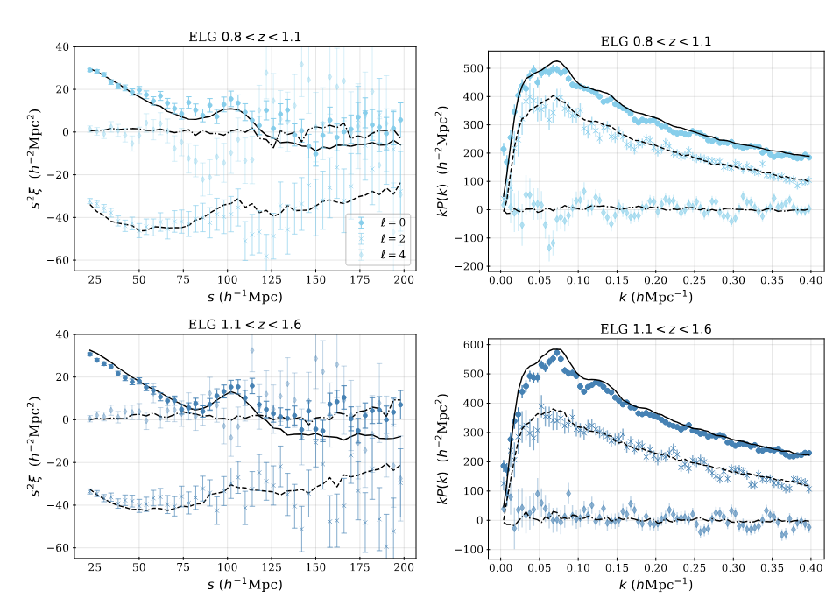
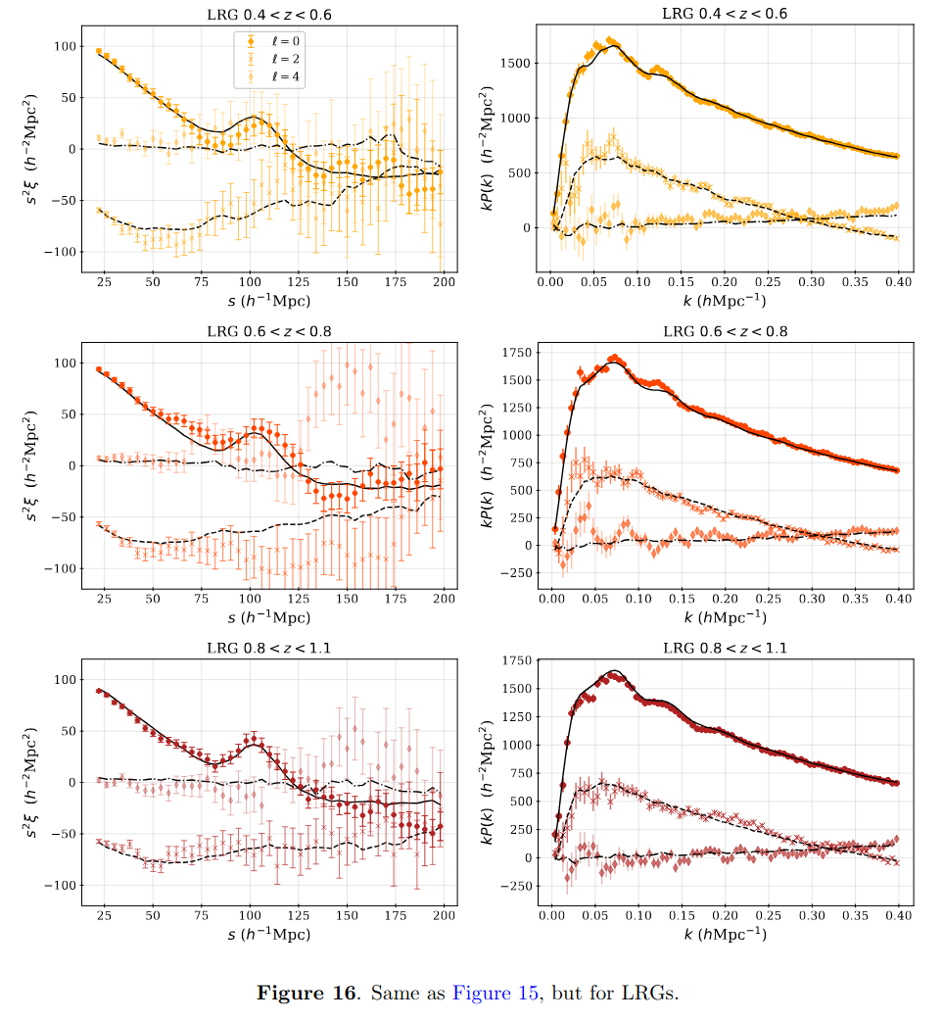
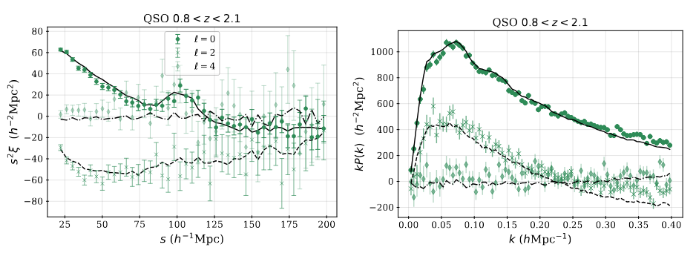
arxiv: 2411.12020v1

Slide 27
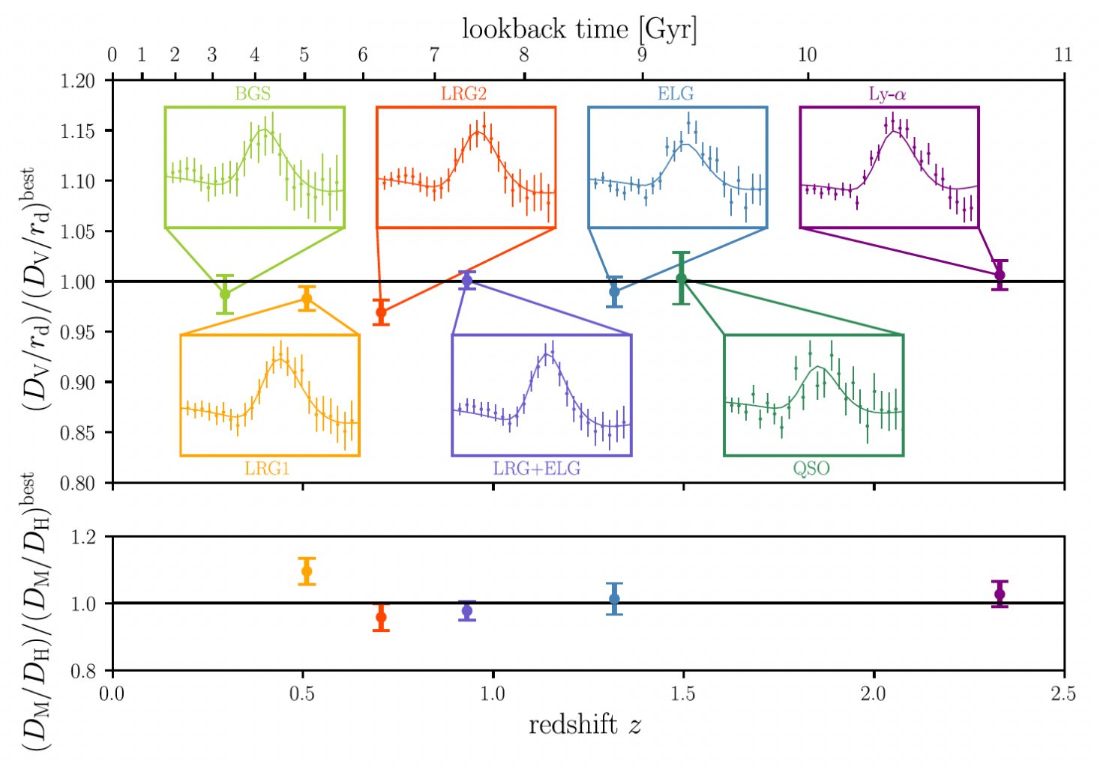
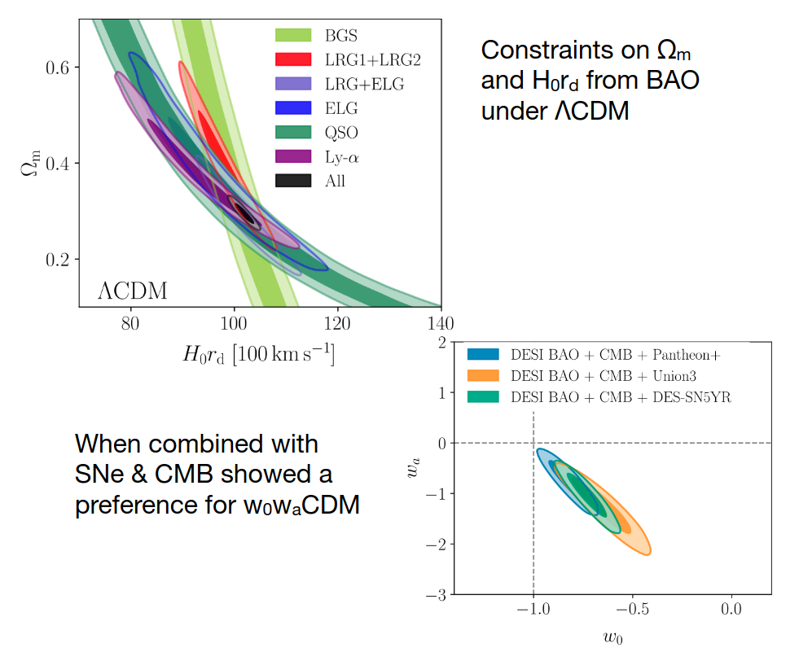
Flash BAO results from DESI DR1
ΛCDM (w=-1)​
Credit : DESI collaboration
Hint for Time dependent dark energy!

Slide 28
Flash BAO results from DESI DR1
ΛCDM (w=-1)​
Rafaela's talk just after for more insights !
Credit : DESI collaboration
Hint for Time dependent dark energy!

Slide 29
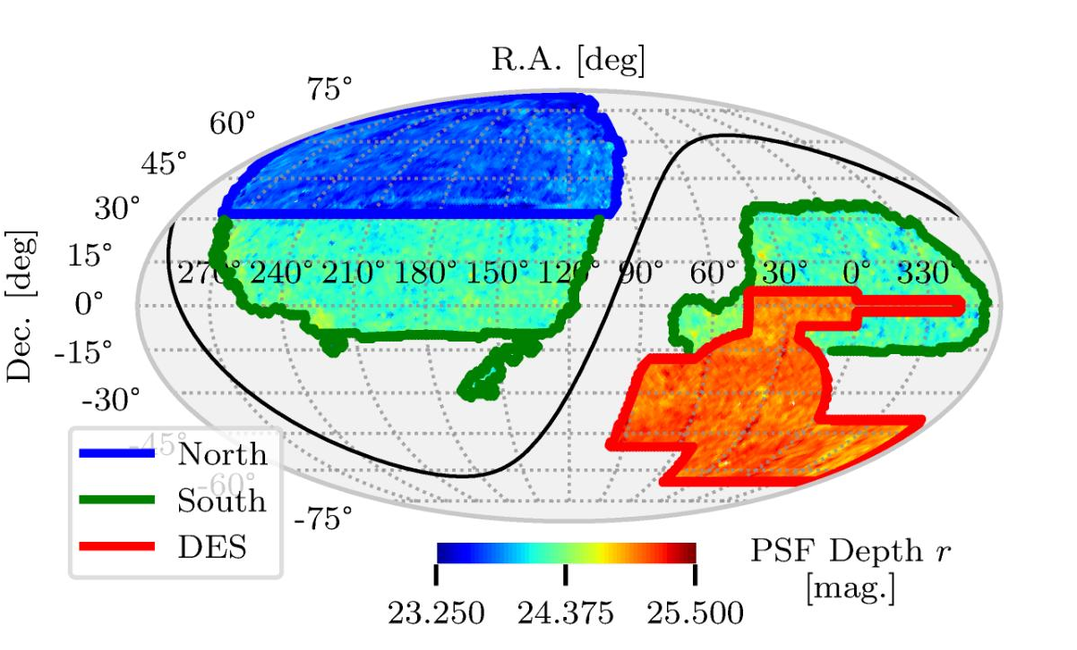
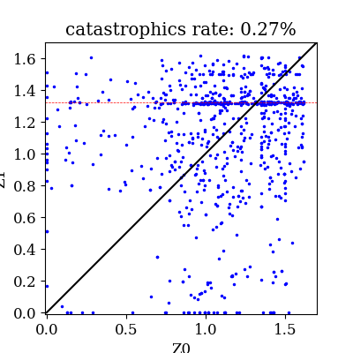
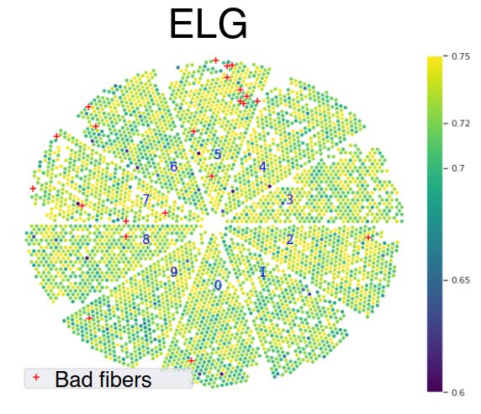
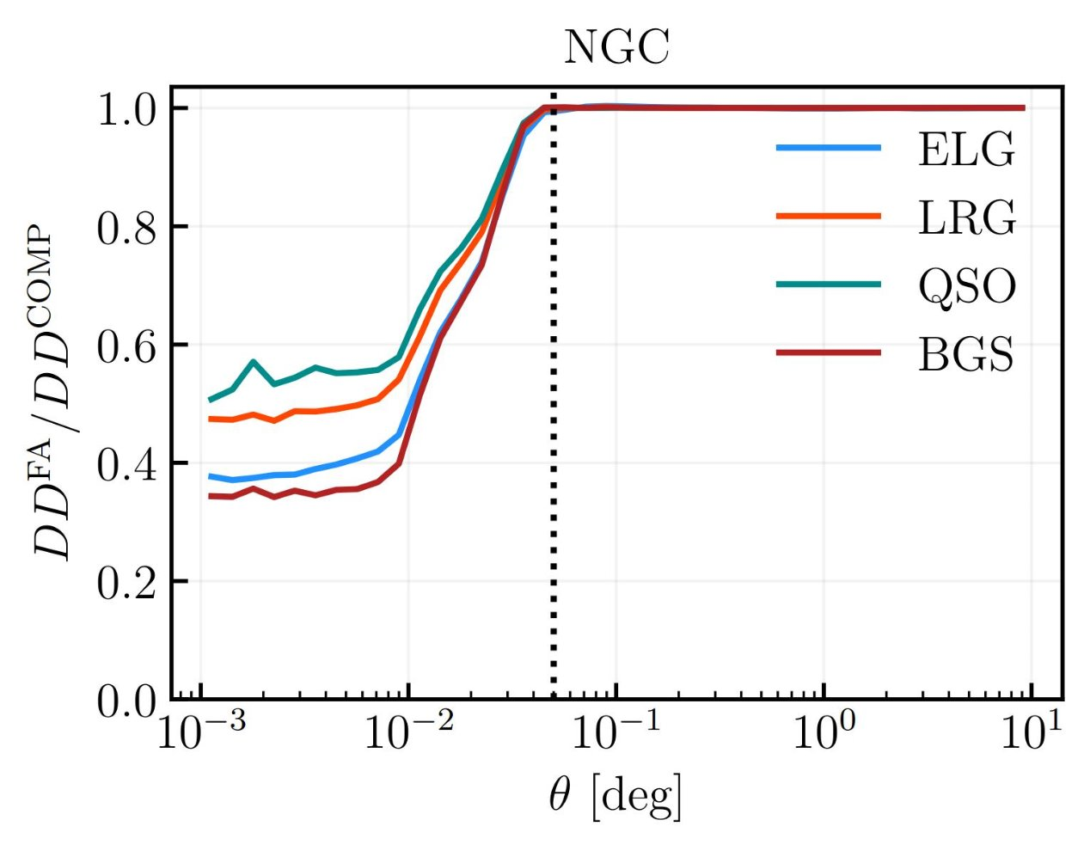
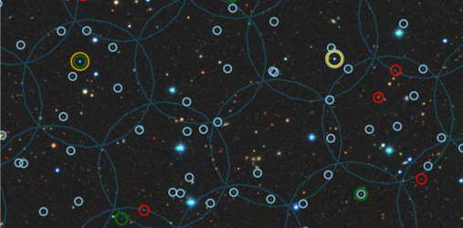
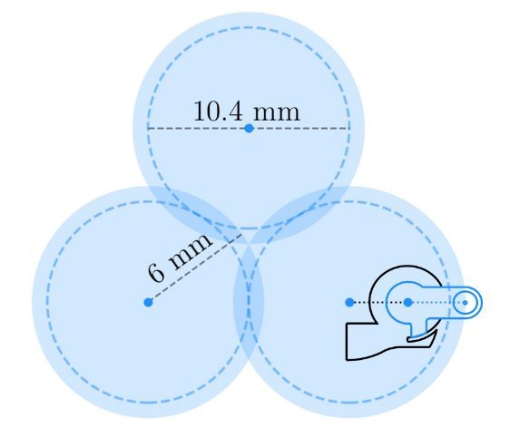
Main observationnal systematic sources
arxiv: 2411.12020v1
Chaussidon et al 2022
Systematic errors from the target selection (imaging systematics):​
Target density variations due to photometric properties
Yu et al. 2024
Krolewski et al. 2024
[OII] line confusion
Systematic errors from spectroscopic operations:
Change in spectroscopic success rate (SSR) due to instrumentation or observing conditions
Fiber assignment effects:
Miss close pairs of objects
z estimated
Spectroscopic succes rate
z true
Fiber patrol radius
:BGS
:LRGs
:ELGs
:QSOs
Y1 FA mocks
Pinon et al 2024

Slide 30
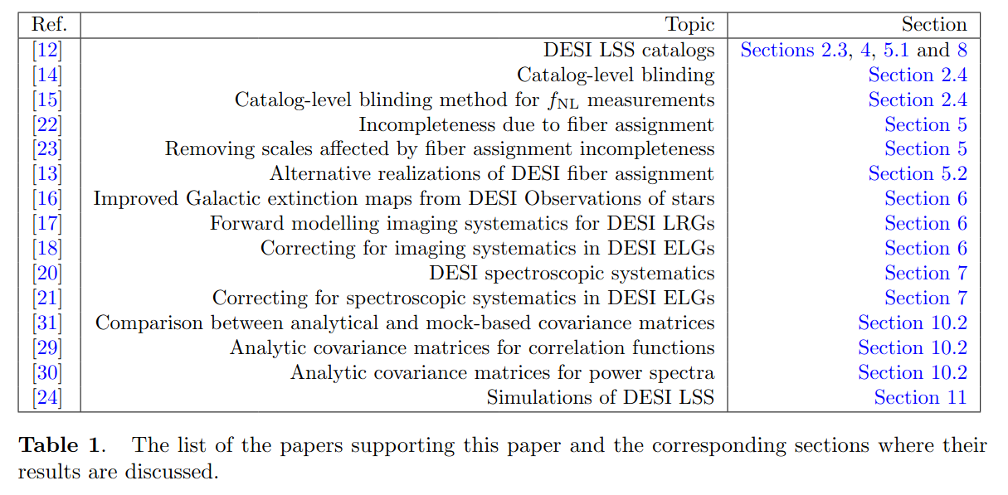
Main observationnal systematic sources
arxiv: 2411.12020v1
Chaussidon et al 2022
Systematic errors from the target selection (imaging systematics):​
Target density variations due to photometric properties
Yu et al. 2024
Krolewski et al. 2024
[OII] line confusion
Systematic errors from spectroscopic operations:
Change in spectroscopic success rate (SSR) due to instrumentation or observing conditions
Fiber assignment effects:
Miss close pairs of objects
z estimated
Spectroscopic succes rate
z true
Fiber patrol radius
:BGS
:LRGs
:ELGs
:QSOs
Y1 FA mocks
Pinon et al 2024

Slide 31
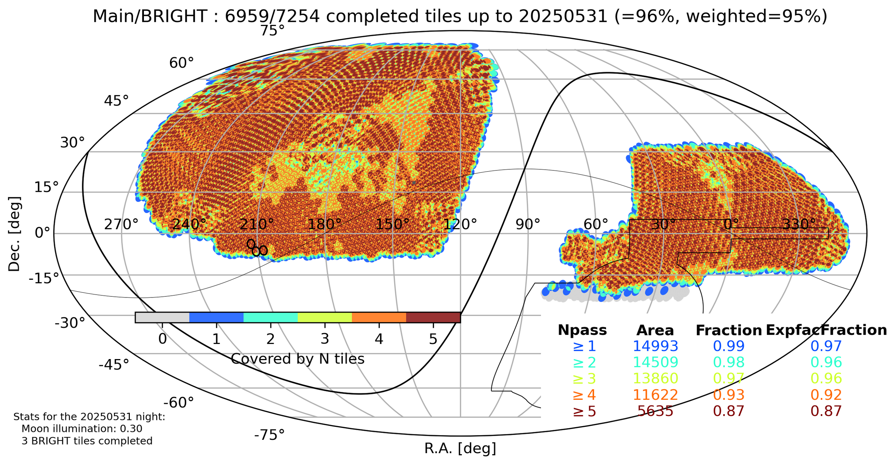
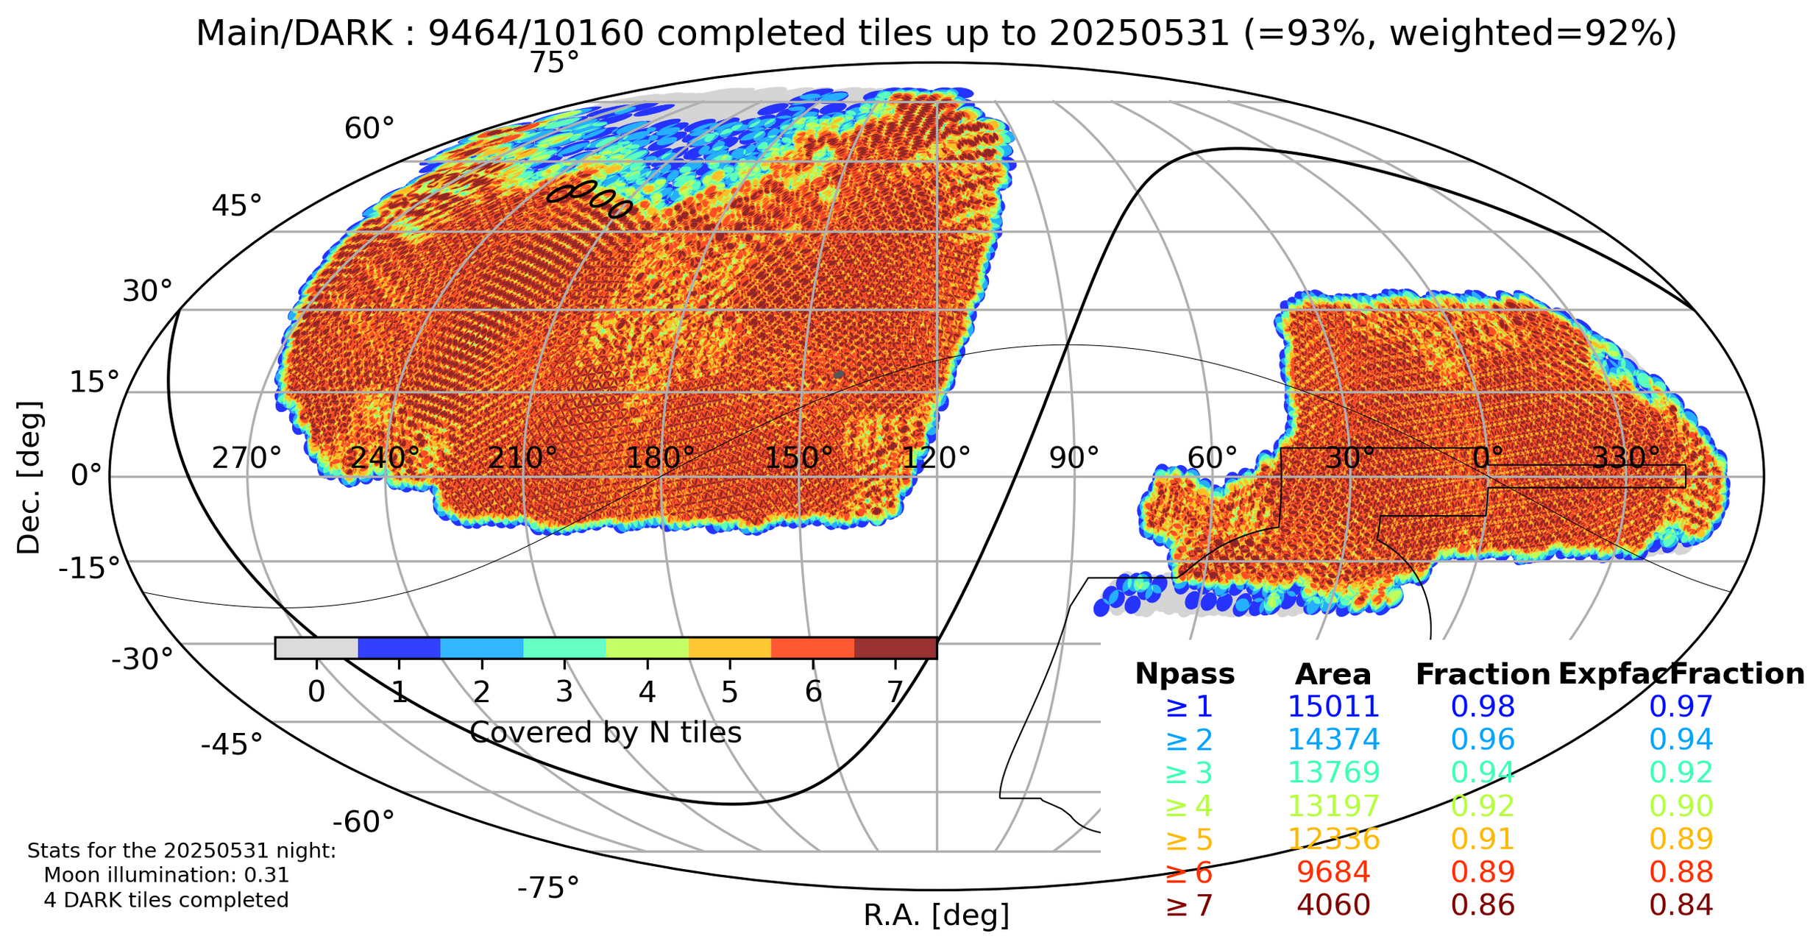
DESI survey status
Main Survey almost finished after 4 years of observations !

Slide 32
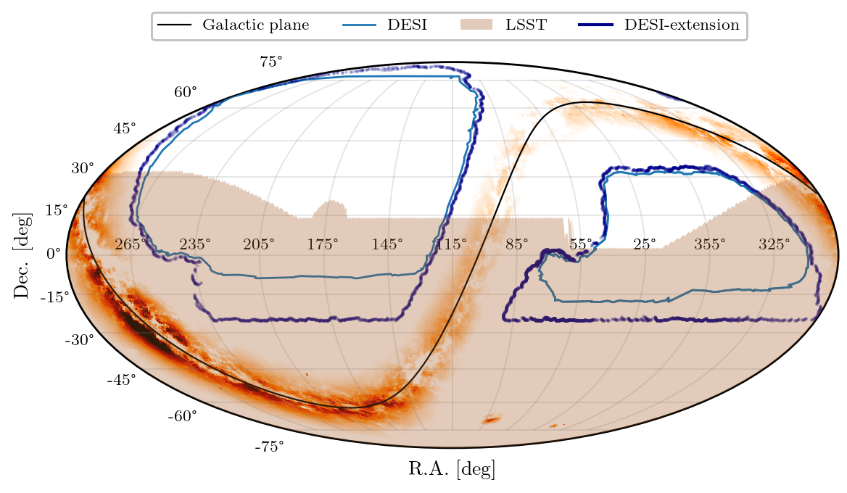
DESI Extension
5 => 8 year survey (until 2029)
3M 3.6M Quasars (QSOs)
0.8<z<2.6
+ Ly-α z > 2.1
17M 21M Emission line galaxies (ELGs)
0.6<z<1.6
8M 10M Luminous red galaxies (LRGs)
0.4<z<1.1
13.5M 16M Bright galaxies
0<z<0.5
+ ~5M New sample of LRGs Luminous Galaxies Extension (LGE)
Increased density (+50%)
0.4<z<1.1
Increase sky area 14'000 => 17'000 deg²
Bigger Overlap with LSST
Expected ~60M extragalactic redshifts

Slide 33
Thank you !
Stay tune for Rafaela presentation on cosmological results from DESI
Credit : DESI collaboration

Slide 34
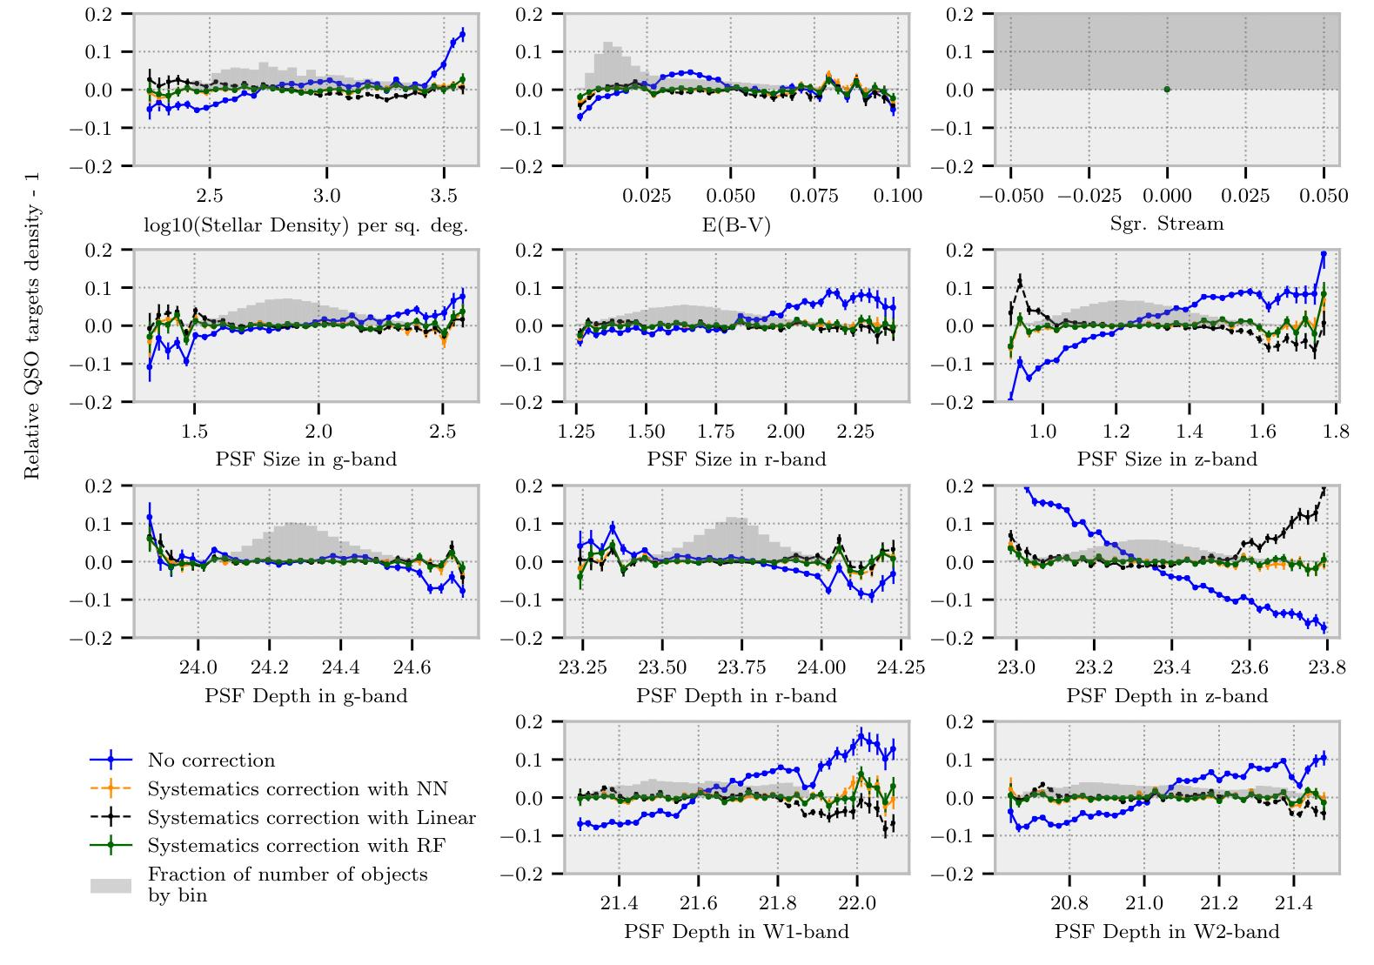
DESI Imaging systematics: QSO case
TS use Legacy survey DR9:
Trends in the number density of QSO vs imaging features (north region)
Relation QSO target density -1
Systematics need to be estimated for each photometric regions
Trends are corrected using different regression techniques:
Linear
Neural network (NN)
Random forets
Chaussidon et al. 2022

Slide 35
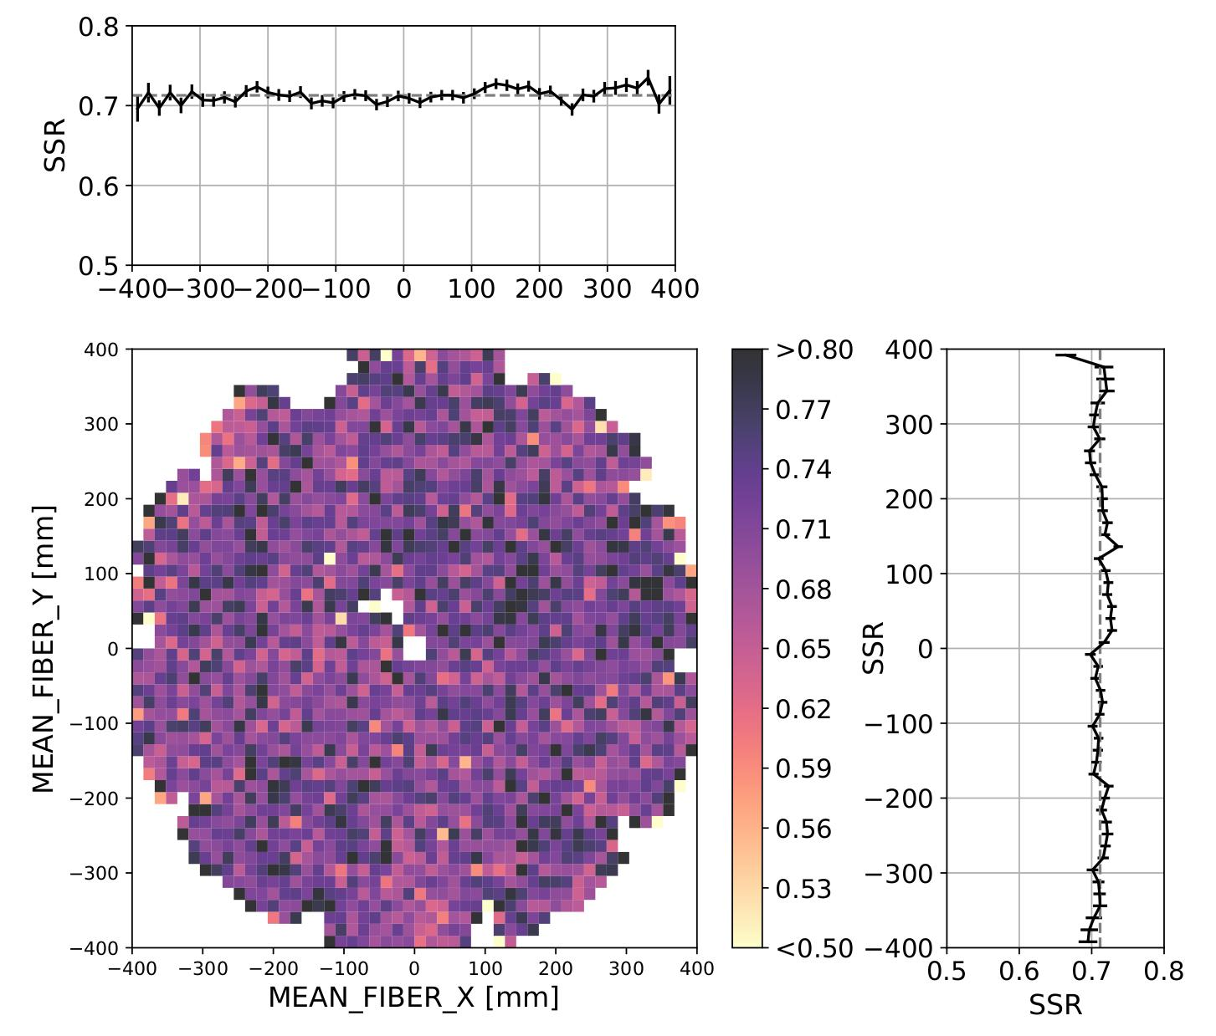
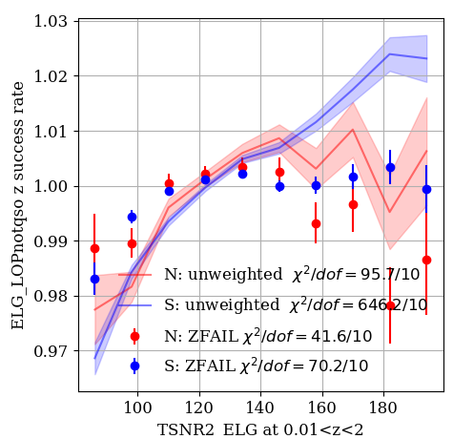
Spectroscopic systematics: ELG case
Trends in the spectroscopic sucess rate vs spectroscopic features
Redshift catastrophics failure with sky-residual lines confusion
[OII] line confusion
z estimated
Across the focal plane
Vs the SNR
z true
+ lots of other features...
Yu et al. 2024
Krolewski et al. 2024
=> We observed only small trends according to spectroscopic features
Trends with spectroscopy are minors and have < 0.2σ impact on clustering measurements

Slide 36
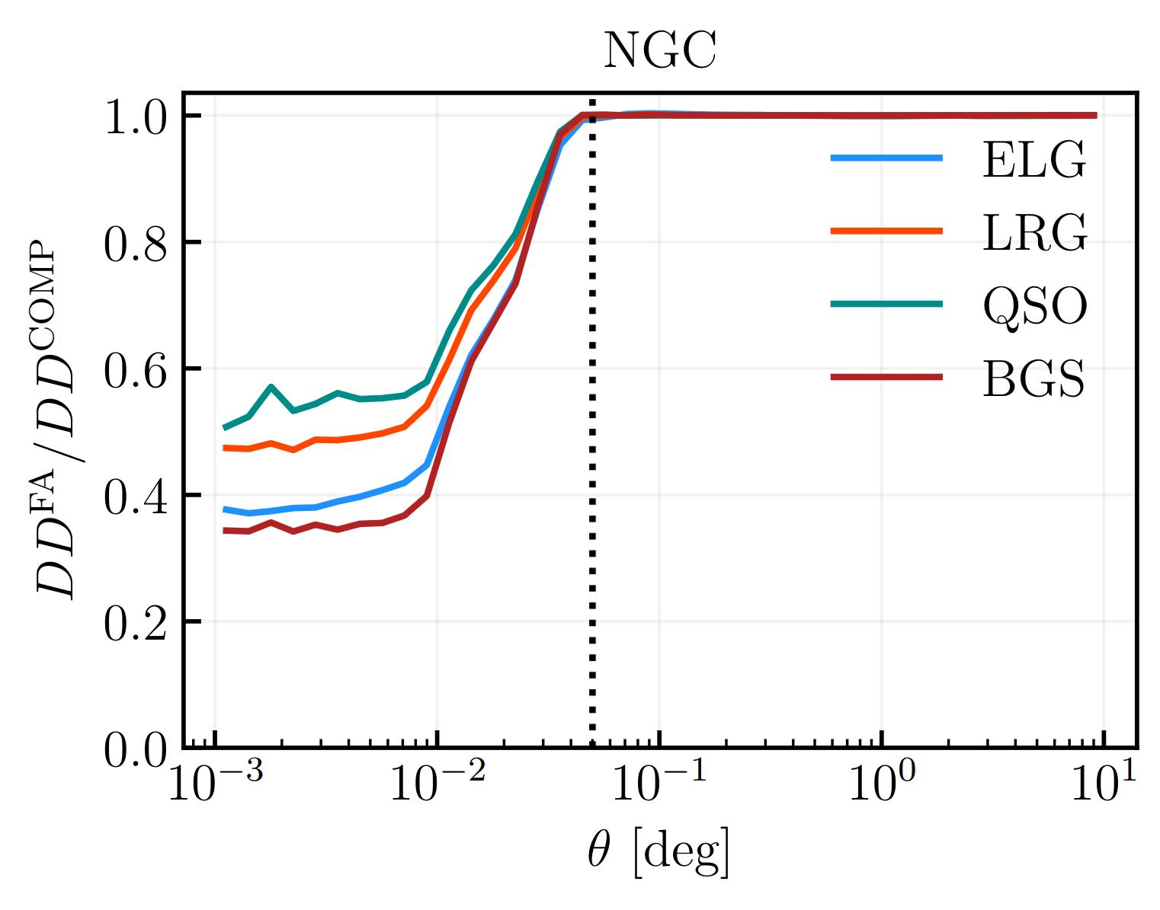
Fiber assignment (FA)
Fiber patrol radius
Y1 FA mocks
Missing pairs at small separations!
Pinon et al. in 2024

Slide 37
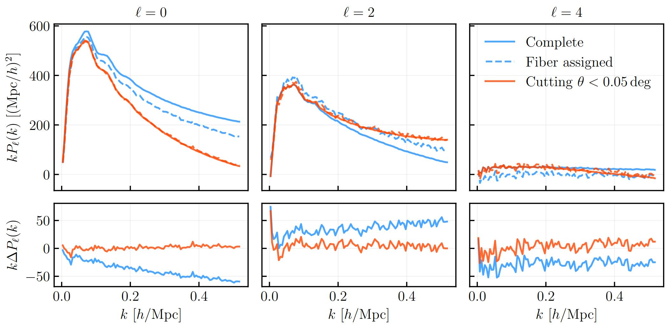
Fiber assignment (FA)
Fiber patrol radius
Y1 FA mocks
Tests on ELG Y1 DESI mocks
Missing pairs at small separations!
Cut pair separation < 0.05 deg (~ size of the patrol radius) leads to unbiased measurement with FA
Pinon et al. in 2024

Slide 38
Fiber assignment: Pairwise-Inverse-Probability (PIP) weighting scheme
Fiber patrol radius
Bianchi & Percival 2017
Mohammad et al. 2020
Statistical estimation to observe a galaxy pair:
Number of FA runs
w_{ij} =
Number of time the galaxy pair has been observed
= 0 for galaxy inside the same patrol radius

Slide 39
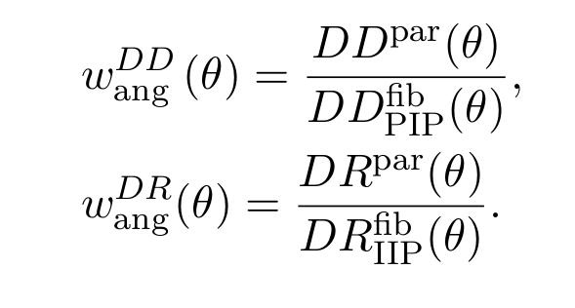
Fiber assignment: Pairwise-Inverse-Probability (PIP) weighting scheme
Fiber patrol radius
Bianchi & Percival 2017
Mohammad et al. 2020
Statistical estimation to observe a galaxy pair:
Angular up-weight (ANG)
Number of FA runs
w_{ij} =
Number of time the galaxy pair has been observed
= 0 for galaxy inside the same patrol radius
The pairs DD and DR at a given separation angle θ are up-weighted

Slide 40
Fiber assignment: Impact on the 1% survey
1 rosettes
ELG projected correlation function
=> Missing targets at the border of the rosettes
PIP weighting scheme lead to 'unbiased' measurement

