Slide 1
Measuring H₀ from supernovae
without anchors
Davide Piras (with Francesco Sorrenti, Ruth Durrer and Martin Kunz)

Slide 2
But first… let me apologise
Notes:
Present you and work. Mention collaborators. Mention that you are open to questions, and that data science includes ML, etc.

Slide 3
But first… let me apologise
First time I present this work

Slide 4
But first… let me apologise
First time I present this work
Material is untested…

Slide 5
But first… let me apologise
First time I present this work
Material is untested…
… including jokes

Slide 6
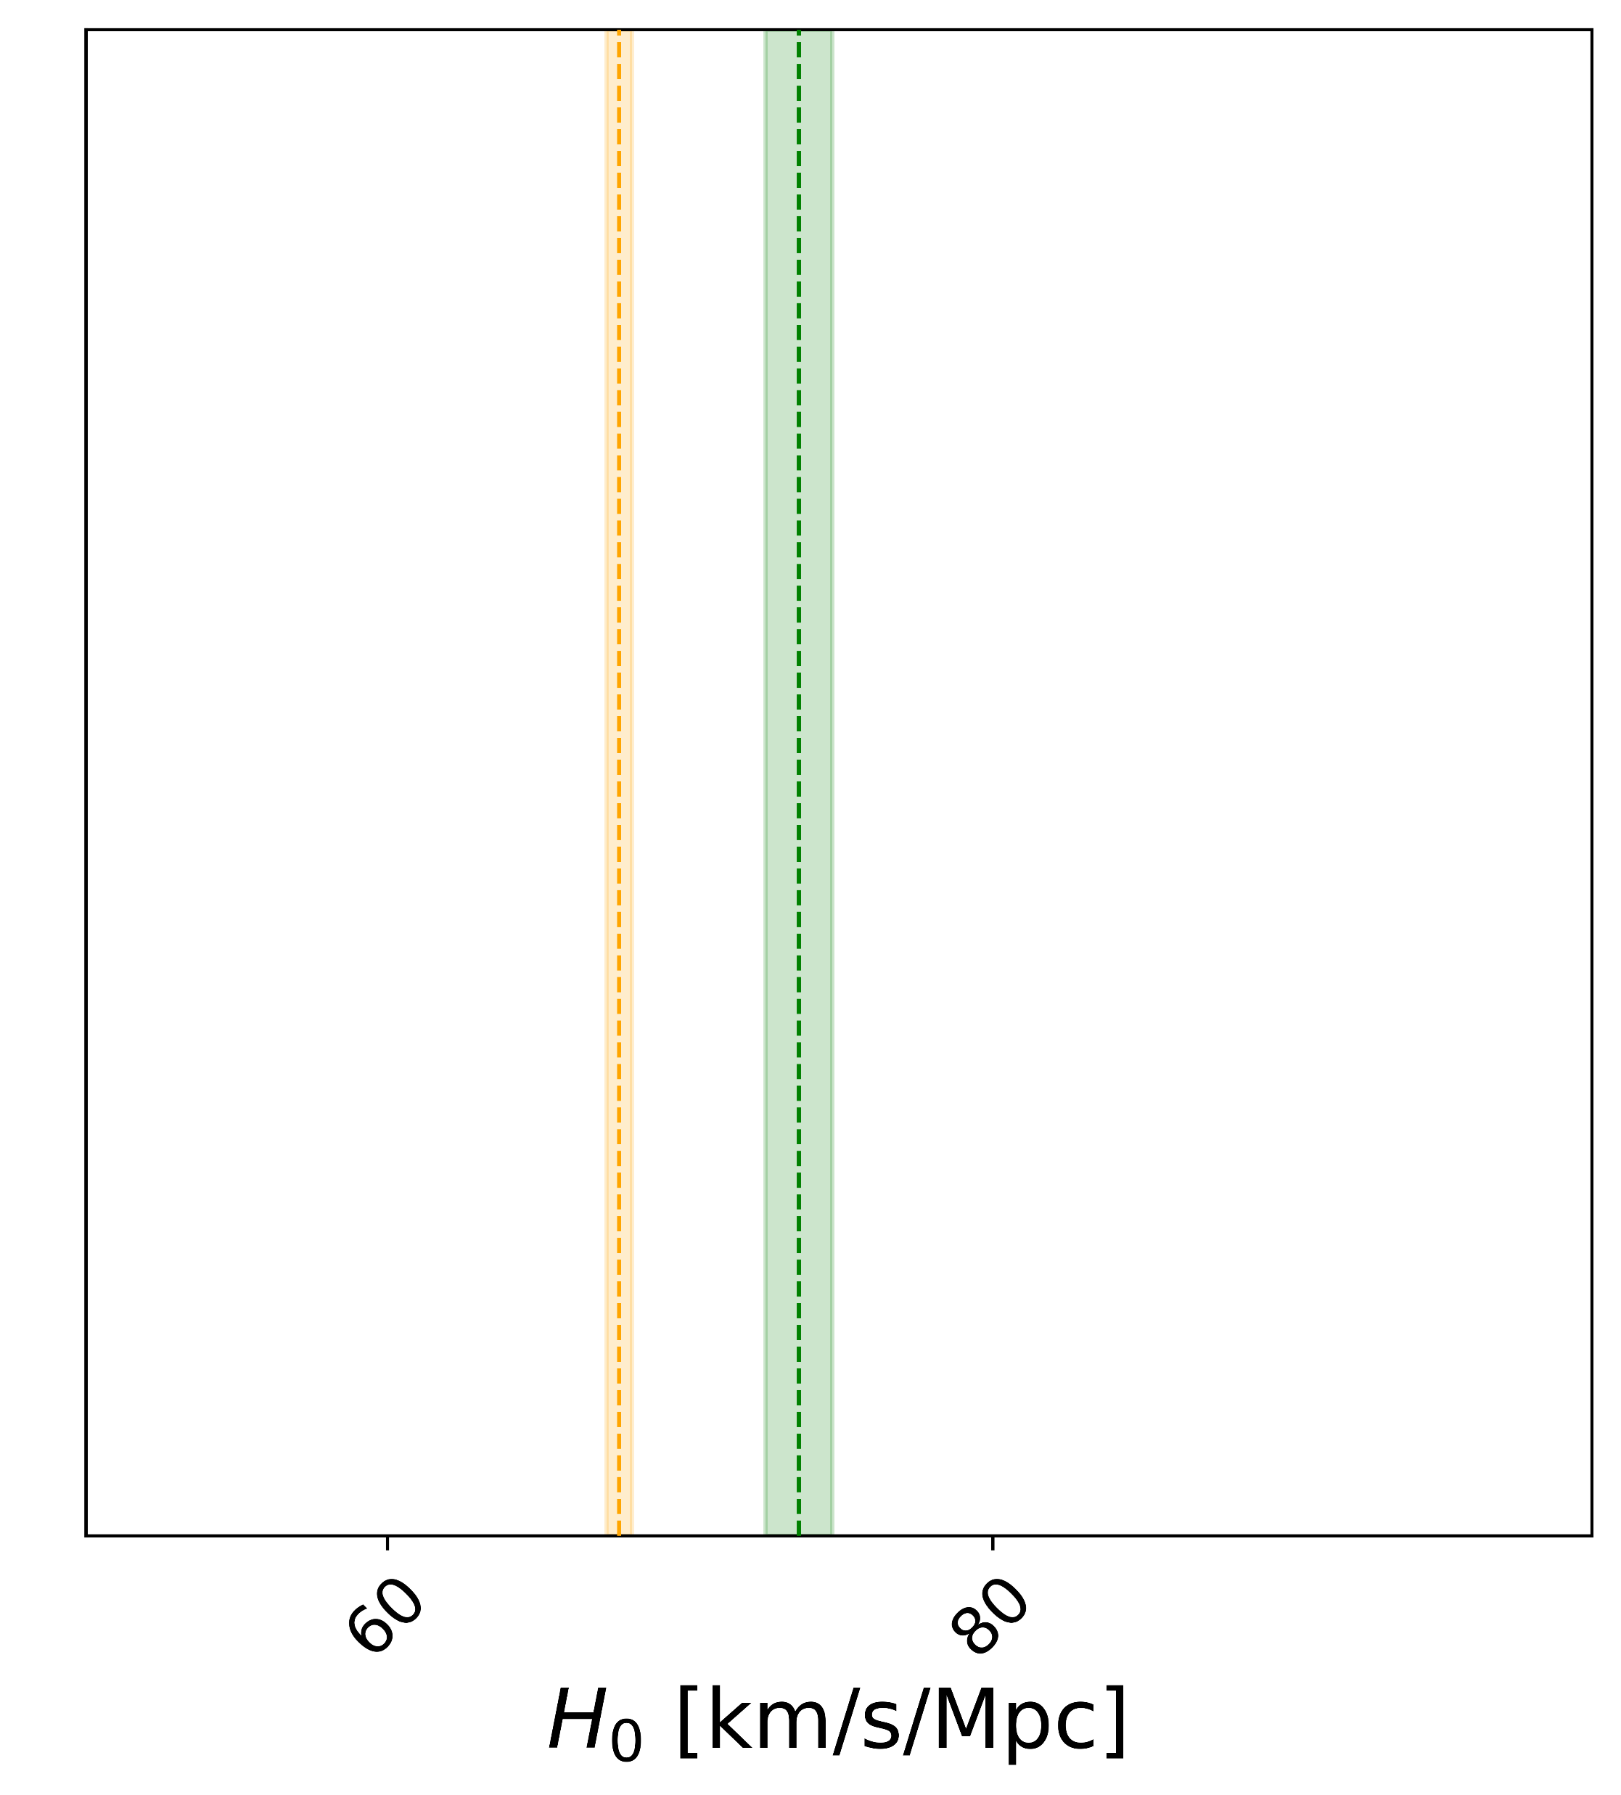
In a nutshell
There is a Hubble tension
Cosmic microwave background
Supernovae (with anchors)

Slide 7
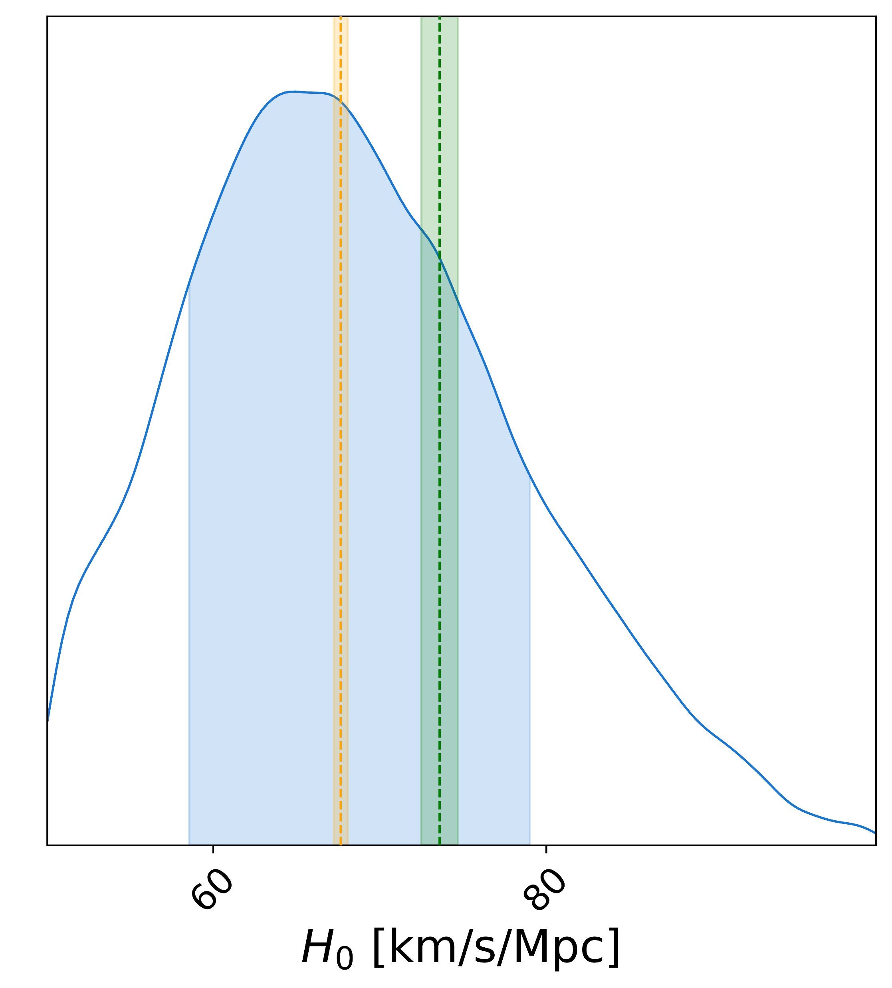
In a nutshell
There is a Hubble tension
We find ~68±10
Cosmic microwave background
Supernovae (with anchors)
Supernovae (without anchors)

Slide 8
Thank you for your attention
Cast
Davide DAVIDE PIRAS
Francesco FRANCESCO SORRENTI
Martin MARTIN KUNZ
Ruth RUTH DURRER
Directed by DAVIDE PIRAS
Produced by DAVIDE PIRAS
Director of Photography DAVIDE PIRAS
No animals were harmed in the making of this presentation

Slide 9
Let’s take a step back

Slide 10
Let’s take a step back
Supernovae are exploding stars with ~stable brightness

Slide 11
Let’s take a step back
Supernovae are exploding stars with ~stable brightness
Distance calibrated using Cepheids (pulsating stars)

Slide 12
Let’s take a step back
Supernovae are exploding stars with ~stable brightness
Distance calibrated using Cepheids (pulsating stars)
Pantheon+

Slide 13
In a nutshell
Pantheon+
There is a Hubble tension
Cosmic microwave background
Supernovae (with anchors)

Slide 14
Two problems
Supernovae might not have all the same brightness
Standard candles?

Slide 15
Two problems
Supernovae might not have all the same brightness
Supernovae have peculiar velocities (PV)

Slide 16
Supernovae might not have all the same brightness
What if we let it be a free parameter?

Slide 17
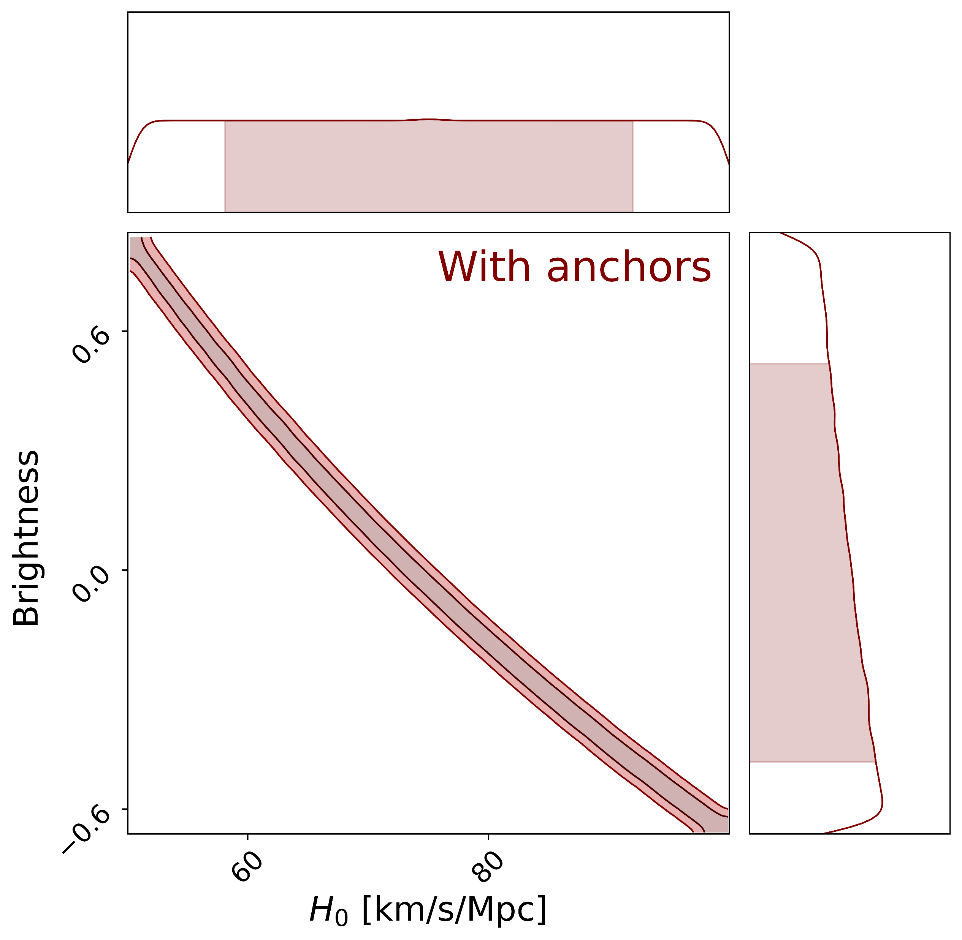
Supernovae might not have all the same brightness
What if we let it be a free parameter?
Brightness is perfectly degenerate with H₀!

Slide 18
Supernovae might not have all the same brightness
What if we let it be a free parameter?
Brightness is perfectly degenerate with H₀!
H₀ information must come from somewhere else…

Slide 19
Supernovae have peculiar velocities (PV)
Typically treated as systematics

Slide 20
Supernovae have peculiar velocities (PV)
Typically treated as systematics
Constant term added to distance covariance matrix

Slide 21
Supernovae have peculiar velocities (PV)
Typically treated as systematics
Constant term added to distance covariance matrix
C = C_{photo} + C_{lensing} + … + C_{PV}
constant

Slide 22
How we model peculiar velocities (PV)
C = C_{photo} + C_{lensing} + … + C_{PV}
constant

Slide 23
How we model peculiar velocities (PV)
C = C_{photo} + C_{lensing} + … + C_{PV}
constant
C_{PV} depends on velocity power spectrum P_{V}

Slide 24
How we model peculiar velocities (PV)
C = C_{photo} + C_{lensing} + … + C_{PV}
constant
C_{PV} depends on velocity power spectrum P_{V}
At linear level, P_{V} ∝ matter power spectrum

Slide 25
How we model peculiar velocities (PV)
C = C_{photo} + C_{lensing} + … + C_{PV}
constant
C_{PV} depends on velocity power spectrum P_{V}
At linear level, P_{V} ∝ matter power spectrum
We also include nonlinear corrections

Slide 26
How we model peculiar velocities (PV)
C = C_{photo} + C_{lensing} + … + C_{PV}
constant

Slide 27
How we model peculiar velocities (PV)
C = C_{photo} + C_{lensing} + … + C_{PV}
constant

Slide 28
Supernovae have peculiar velocities (PV)
C = C_{photo} + C_{lensing} + … + C_{PV}
constant
DEPENDS ON COSMOLOGY

Slide 29
Supernovae have peculiar velocities (PV)
C = C_{photo} + C_{lensing} + … + C_{PV}
constant
DEPENDS ON COSMOLOGY
Supernovae velocities are a cosmological probe!

Slide 30
Did someone say computationally intractable?
Perform Markov chain Monte Carlo (MCMC) sampling

Slide 31
Did someone say computationally intractable?
Perform Markov chain Monte Carlo (MCMC) sampling
Covariance must be recomputed at each step

Slide 32
Did someone say computationally intractable?
Perform Markov chain Monte Carlo (MCMC) sampling
Covariance must be recomputed at each step
Would take 25 years to run…

Slide 33
Did someone say computationally intractable?
We train an emulator based on CosmPower-JAX

Slide 34
Did someone say computationally intractable?
We train an emulator based on CosmPower-JAX
Differentiable likelihood in JAX

Slide 35
Did someone say computationally intractable?
We train an emulator based on CosmPower-JAX
Differentiable likelihood in JAX
From 25 years on CPU to 1 hour on GPU

Slide 36
Did someone say computationally intractable?
We train an emulator based on CosmPower-JAX
Differentiable likelihood in JAX
From 25 years on CPU to 1 hour on GPU

Slide 38
Results
Validation on mocks and N-body simulation
[ask me later if interested]

Slide 39
Results
Results on Pantheon+ data

Slide 40
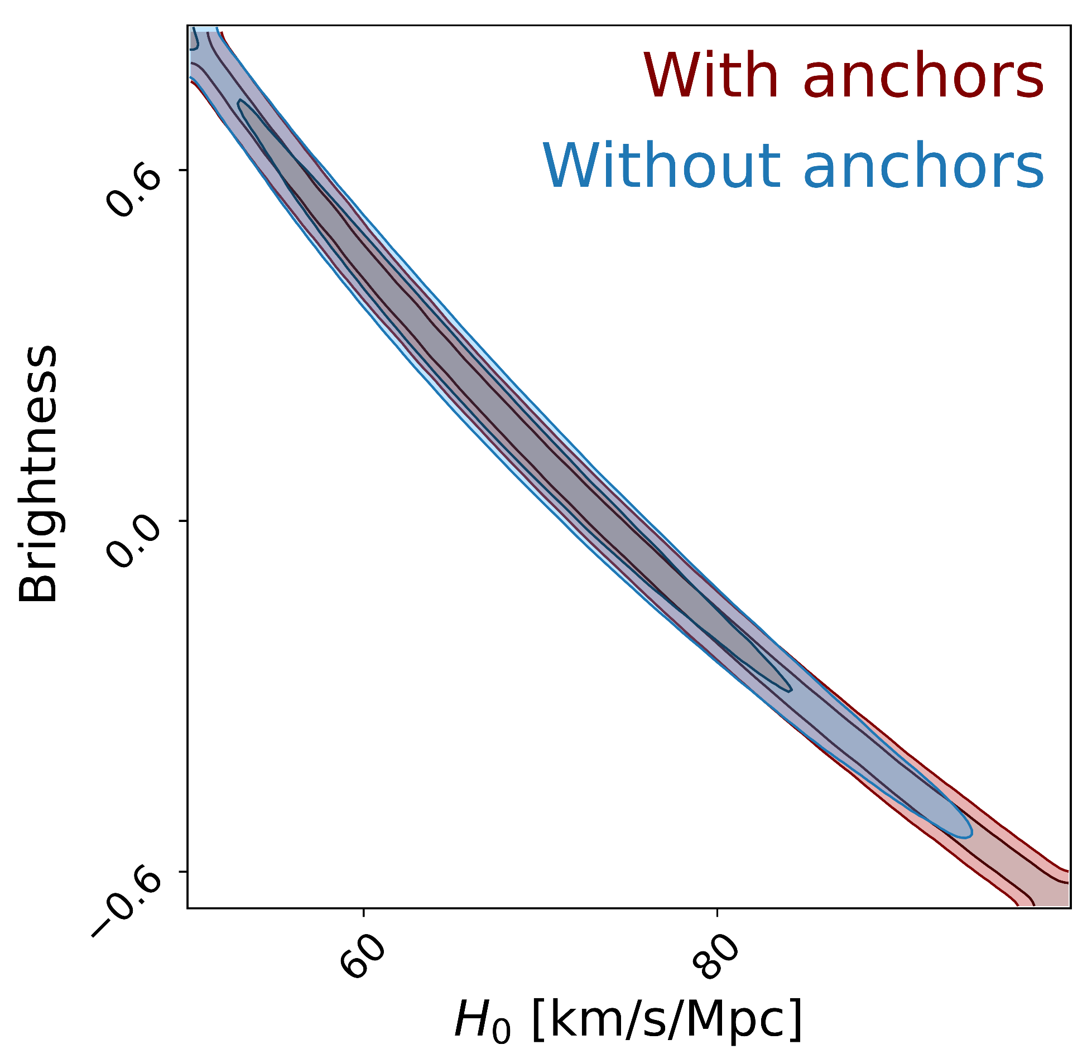
Results
Results on Pantheon+ data: we find ~68±10

Slide 41
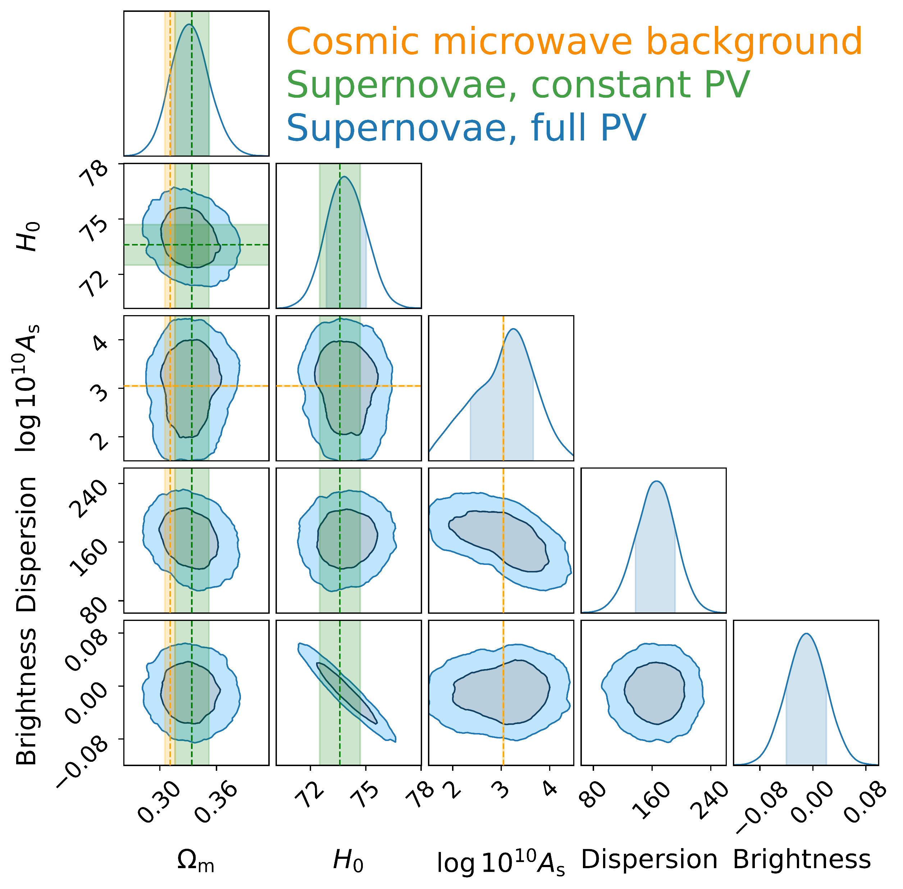
Results
PECULIAR VELOCITIES
OUR RESULT
PVs constrain primordial amplitude A_{s} (with anchors)

Slide 42
Results
PECULIAR VELOCITIES
OUR RESULT
PVs constrain primordial amplitude A_{s} (with anchors)

Slide 43
Conclusions
Supernovae peculiar velocities contain cosmological information

Slide 44
Conclusions
Supernovae peculiar velocities contain cosmological information
They allow for independent measurements of A_{s} and H₀ (without anchors)

Slide 45
Conclusions
Supernovae peculiar velocities contain cosmological information
They allow for independent measurements of A_{s} and H₀ (without anchors)
Working on Zwicky Transient Facility data next

Slide 46
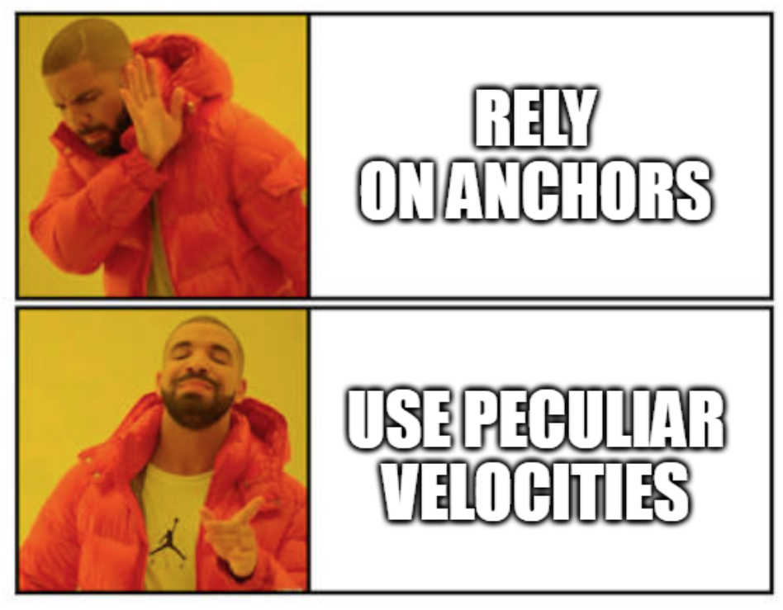
Conclusions

Slide 47
Extra slides

Slide 48
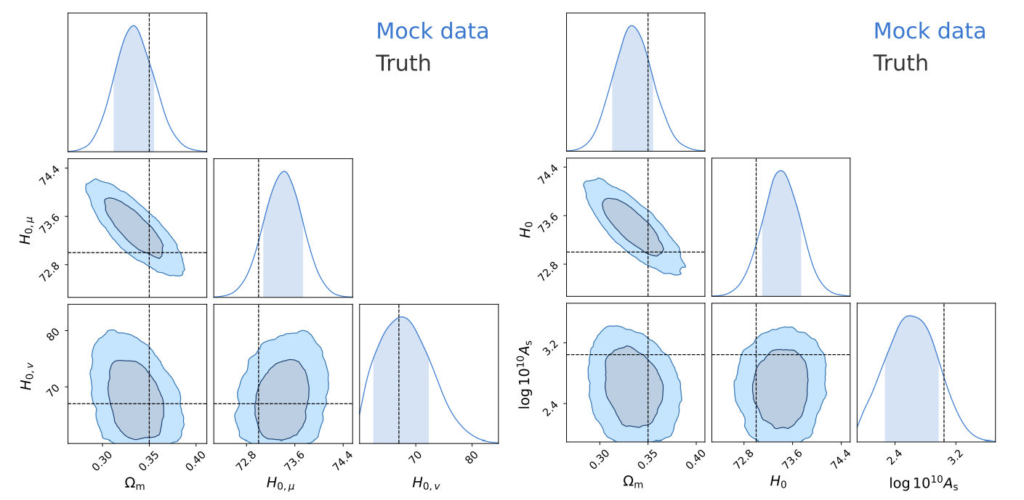
Mock results

Slide 49
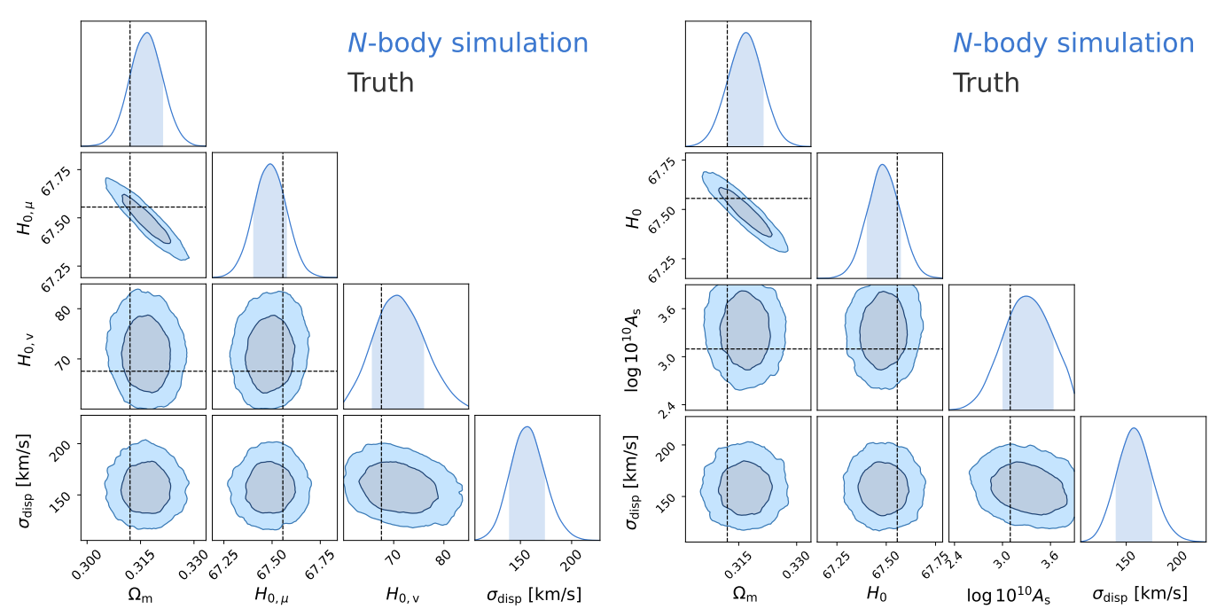
N-body simulation results

Slide 50
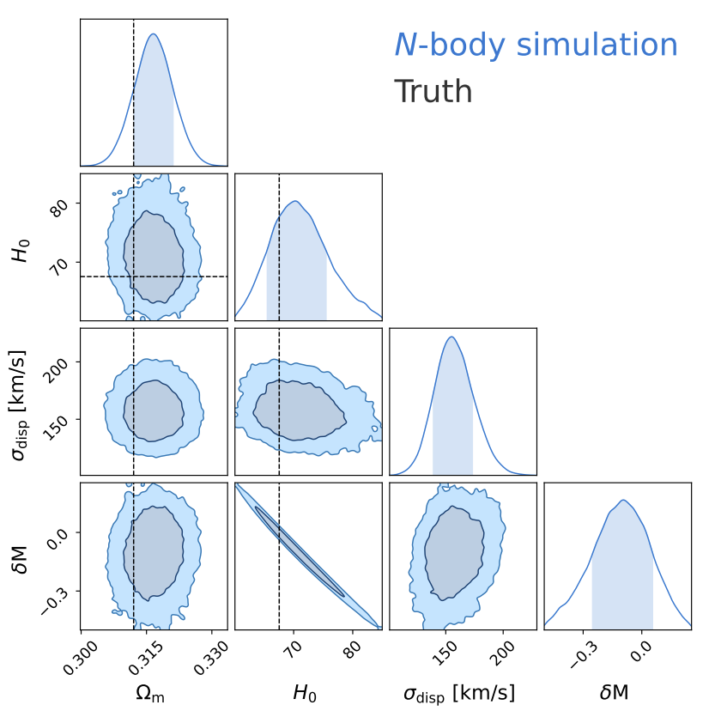
N-body simulation results

